Slide 1

What Makes a Song Popular on Spotify?
Recommendation
To uncover the key factors influencing song popularity on Spotify and provide data-driven recommendations for curating and predicting trending songs.
Introduction
EDA
Source: Spotify Raw Dataset (2 sheets merged using Song_id)
Total Songs: 950 tracks
Artists: 530+ unique artists
Timeline: 1930 – 2023
Data Preparation
Aarti Zikre
How I Prepared the Data
To prepare a clean, structured, and reliable dataset for analyzing the key factors influencing Spotify song popularity.
Loaded both sheets from Google Drive.
Removed 8 and 10 duplicates from each sheet.
Replaced nulls: key → “unknown”, in_shazam_charts → median (2).
Removed outliers and duplicate Song_IDs.
Merged datasets using left join on Song_ID.
Predicted remaining missing values for final analysis.

Slide 2

What Makes a Song Popular on Spotify?
To uncover the key factors influencing song popularity on Spotify and provide data-driven recommendations for curating and predicting trending songs.
Source: Spotify Raw Dataset (2 sheets merged using track_id)
Total Songs: 23,521 tracks
Artists: 5,200+ unique artists across 15 genres
Timeline: 2010 – 2023
Recommendation
How I Prepared the Data
To prepare a clean, structured, and reliable dataset for analyzing the key factors influencing Spotify song popularity.
Introduction
EDA
Loaded both sheets from Google Drive.
Removed 8 and 10 duplicates from each sheet.
Replaced nulls: key → “unknown”, in_shazam_charts → median (2).
Removed outliers and duplicate Song_IDs.
Merged datasets using left join on Song_ID.
Predicted remaining missing values for final analysis.
Data Preparation
EDA & Prediction
For Exploratory Data Analysis (EDA), let’s move to Power BI to visualize key insights and understand factors influencing song popularity.
For prediction, I developed a Stream Count Prediction Website that estimates potential Spotify streams based on song features. Website: https://quarterly-vibrant-orangutan.anvil.app

Slide 3
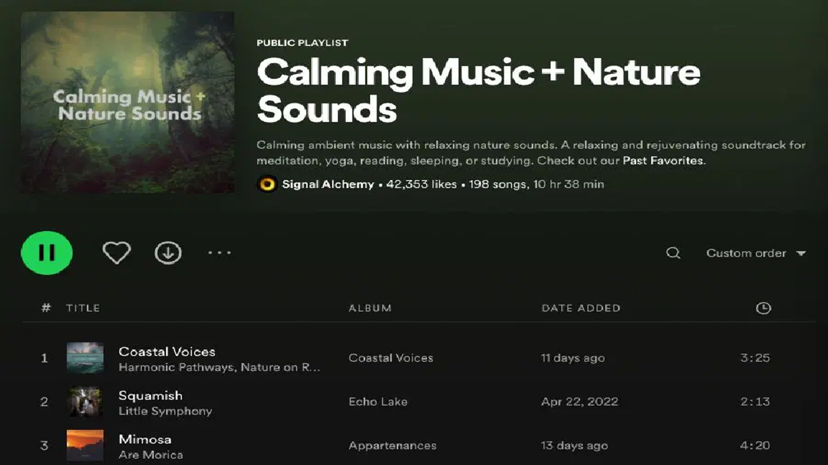
How I Prepared the Data
To prepare a clean, structured, and reliable dataset for analyzing the key factors influencing Spotify song popularity.
Loaded both sheets from Google Drive.
Removed 8 and 10 duplicates from each sheet.
Replaced nulls: key → “unknown”, in_shazam_charts → median (2).
Removed outliers and duplicate Song_IDs.
Merged datasets using left join on Song_ID.
Predicted remaining missing values for final analysis.
Recommendation
EDA & Prediction
For Exploratory Data Analysis (EDA), let’s move to Power BI to visualize key insights and understand factors influencing song popularity.
For prediction, I developed a Stream Count Prediction Website that estimates potential Spotify streams based on song features. Website: https://quarterly-vibrant-orangutan.anvil.app
Introduction
EDA
Data Preparation
Aarti Zikre
Recommendation
Plan releases around September–Friday windows to maximize visibility and listener engagement.
Focus production on C# major compositions for higher resonance with audience preferences.
Collaborate with top-performing artists or similar genres to leverage their proven audience appeal.
Sustain digital campaigns post-release to capitalize on streaming momentum seen in recent years.

Slide 4

EDA & Prediction
For Exploratory Data Analysis (EDA), let’s move to Power BI to visualize key insights and understand factors influencing song popularity.
For prediction, I developed a Stream Count Prediction Website that estimates potential Spotify streams based on song features. Website: https://quarterly-vibrant-orangutan.anvil.app
Recommendation
Recommendation
Plan releases around September–Friday windows to maximize visibility and listener engagement.
Focus production on C# major compositions for higher resonance with audience preferences.
Collaborate with top-performing artists or similar genres to leverage their proven audience appeal.
Sustain digital campaigns post-release to capitalize on streaming momentum seen in recent years.
Introduction
EDA
Data Preparation
Aarti Zikre
What Makes a Song Popular on Spotify?
To uncover the key factors influencing song popularity on Spotify and provide data-driven recommendations for curating and predicting trending songs.
Source: Spotify Raw Dataset (2 sheets merged using track_id)
Total Songs: 23,521 tracks
Artists: 530+ unique artists
Timeline: 2010 – 2023

