Slide 1
WAIT TIMES OF MEDICAL PROCEDURES IN CANADA

Slide 2



TEAM INTRODUCTION
Group Id: 07
Section number: 002
Team members:
Aarti Anil Zikre : Aarti Zikre | LinkedIn
Iqbaldeep Singh Bhullar: Iqbaldeep Singh Bhullar | LinkedIn
Adedeji Adeyemi: Adedeji Adeyemi | LinkedIn

Slide 3
BACKGROUND/MOTIVATION
Many individuals are currently experiencing various illnesses that may necessitate surgery as a treatment option. However, because of the delay in receiving appropriate medical care, the likelihood of these individuals facing increased health risks and complications in their daily lives is rising.
Canada’s health-care wait times reached 27.4 weeks in 2022, the longest ever recorded and 195% higher than the 9.3 weeks Canadians waited in 1993, when the Fraser Institute began tracking medical wait times.
Before this year, the longest recorded wait time was 25.6 weeks in 2021. And also before 2021, 2020 had the longest recorded wait time of an average of 22.6 weeks.

Slide 4
BACKGROUND/MOTIVATION
The goal of this project is to learn more about the causes and implications of excessive wait times for medical procedures in Canada, as well as to provide better insight to enhance access to care for all Canadians. We expect that through the application of data science, we will be able to guide healthcare policy and practice, therefore improving health outcomes and quality of life for people across the country.

Slide 5
PROBLEM STATEMENT
Wait times for medical treatments have been a chronic issue in Canada for many years, with many patients facing significant waits in getting healthcare. This issue has serious ramifications for patient health outcomes and quality of life as well as the healthcare system as a whole.
Public healthcare professionals and policy makers need better insight into how the factors such as seasonal, provincial variations or the even the COVID pandemic can or has cause the delay and delivery of medical procedures.
By accessing the data from various health and government organizations for several types of health issues and the wait times, we intend to figure out distinct factors such as trends, associations or comparisons from the past that has led to the current situation.

Slide 6
PROBLEM STATEMENT
By the application of data science, we can gain insights of the future by performing analysis on the data obtained from research.
This insight derived will potentially guide the medical professionals or make them better understand the situation at hand which is aimed at reducing wait times for medical procedures in order to make key decisions on areas that need great improvement.

Slide 7
PROJECT PROPOSAL
Our project team will deliver a descriptive analysis to examine patterns, trends, associations and/or comparisons of different medical procedures and their wait times.
This will help public health policy makers and key decisions makers gain insights into the factors that can be useful in reducing the extensive wait times and delivering fast, effective and quality healthcare across the nation which will improve the quality of life of its citizens.

Slide 8
ANALYSIS QUESTIONS
Did the COVID pandemic affect or contribute the wait time of medical procedures individually and across different provinces in Canada?
Are some medical procedures common or frequent in some provinces compared to other provinces?
Do some provinces show significant higher wait times when compared to others?
Is there any abnormal trends displayed between these medical procedures and their number of cases?

Slide 9
ANALYSIS QUESTIONS
Is there any relationship between the different types of surgeries and their wait times?
Is there any form of association between the different classes of medical procedures and their wait times?

Slide 10
DATASET DESCRIPTION
The wait time of medical procedures in Canada analysis will be based on “Explore wait times for priority procedures across Canada” dataset from Canadian Institute for Health Information (CIHI).
The wait time dataset provides data on of how long patients wait for a priority procedure between the year 2008 to 2021. The 2022 update would be released in March, 2023.
The dataset collection method was achieved by observing the data, ensuring it provides the relevant data that will make sure this project can be delivered efficiently.
Before we can begin analyzing the data, it is important to first perform data cleaning to eliminate any missing or invalid data. Subsequently, we will need to conduct data normalization to ensure consistent scaling.

Slide 11
DATASET DESCRIPTION
The dataset contains information on the following medical procedures:
- Hip replacement.
- Knee replacement.
- Hip fracture repair.
- Cataract surgery.
- Radiation therapy.
- Coronary artery bypass graft (CABG).
- Magnetic resonance imaging (MRI).
- Computed tomography (CT) scan.
- 5 Cancer surgeries (bladder, breast, colorectal, lung and prostate).
Explore wait times for priority procedures across Canada | CIHI

Slide 12
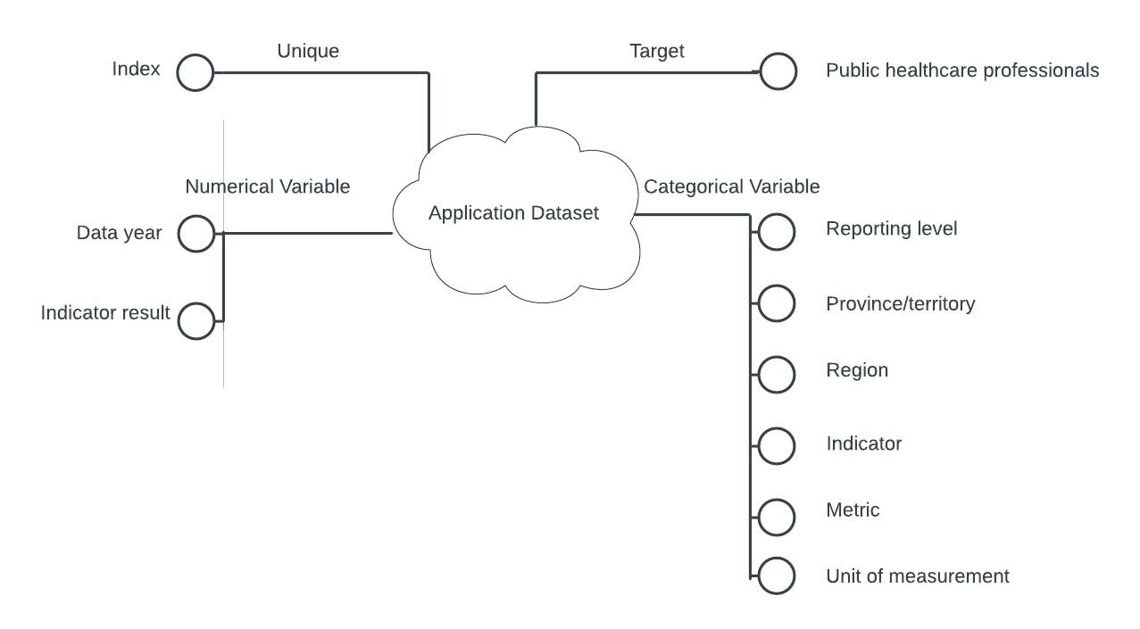
DATASET DESCRIPTION

Slide 13
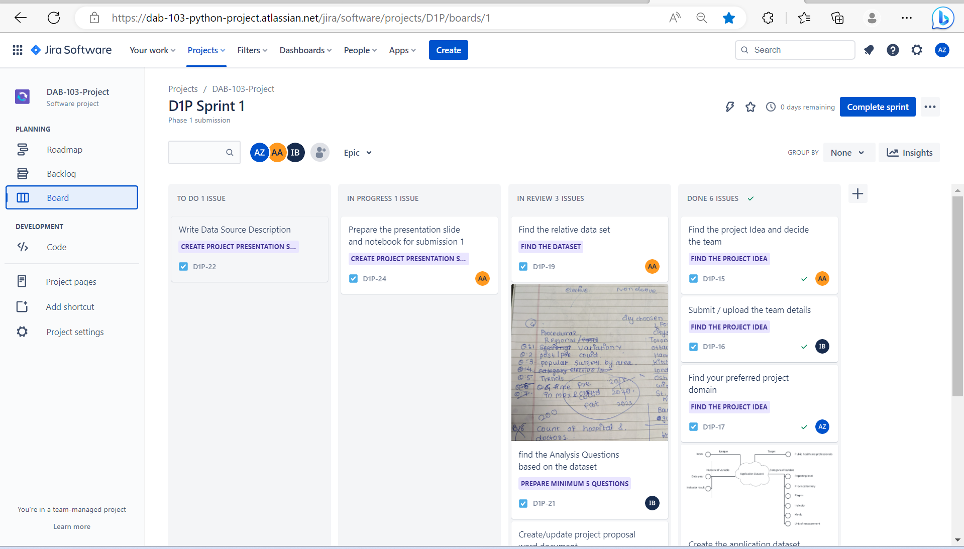
ADDITIONAL INFORMATION
JIRA project showing distribution of work. D1P board - Agile board - Jira (atlassian.net)

Slide 14
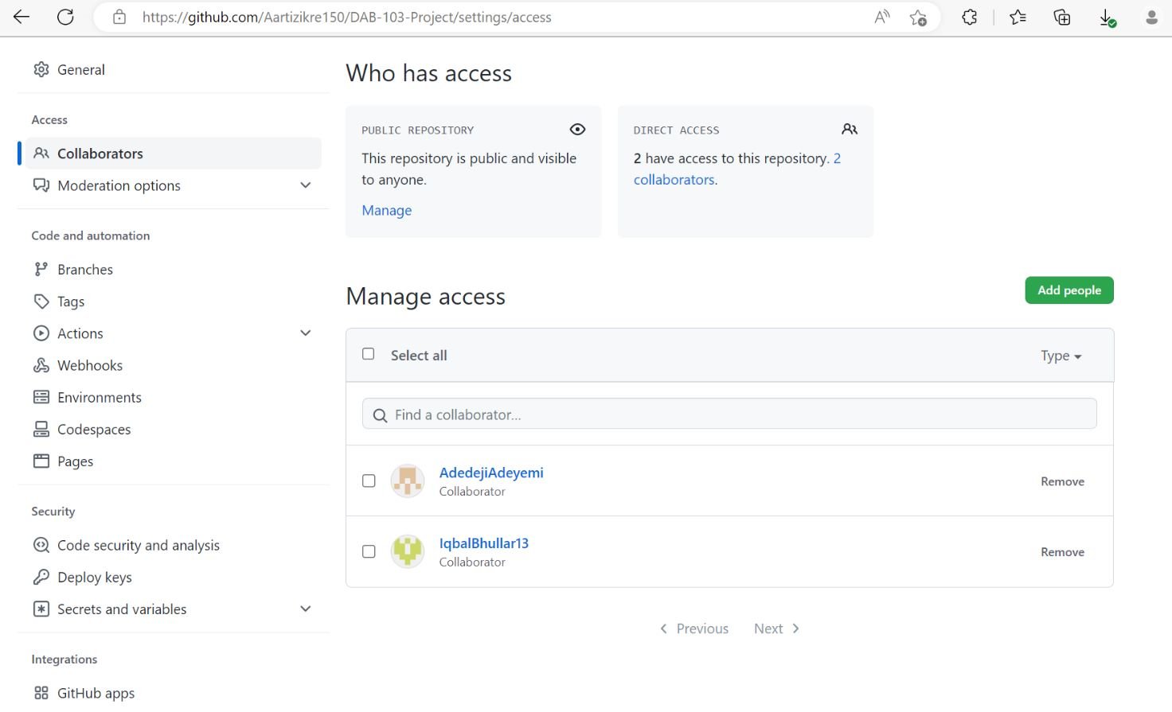
ADDITIONAL INFORMATION
GitHub Repository for your project showing all team members have access. Aartizikre150/DAB-103-Project (github.com)

Slide 15
REFERENCES
Explore wait times for priority procedures across Canada. (n.d.). Canadian Institute for Health Information | CIHI. https://www.cihi.ca/en/explore-wait-times-for-priority-procedures-across-Canada
Waiting your turn: Wait times for health care in Canada, 2022 report. (2022, December 8). Fraser Institute. https://www.fraserinstitute.org/studies/waiting-your-turn-wait-times-for-health-care-in-canada-2022
Waiting your turn: Wait times for health care in Canada, 2021 report. (2021, December 15). Fraser Institute. https://www.fraserinstitute.org/studies/waiting-your-turn-wait-times-for-health-care-in-canada-2021

