Slide 1

The Adaptive Micro-Learning Platform
Future-Proofing Our Learning Technology
A mobile-first, AI-powered solution delivering personalized education through structured bite-sized courses. Our platform transforms how users learn any topic through 5–10 minute adaptive sessions, powered by generative AI for content creation, intelligent difficulty adjustment, and context-aware assistance.

Slide 2
Failures of Traditional Learning Systems
Fundamental technical and user experience flaws are driving the need for innovation in digital education platforms.
Long, Exhausting Content
Static Content
Traditional courses force users through lengthy sessions that lead directly to high abandonment rates and low completion metrics.
One-size-fits-all material cannot adapt to different learning levels, creating a fundamentally non-personalized experience.
No Real-Time Doubt Solving
Not Mobile-First
Absence of immediate support mechanisms is a major factor causing user drop-off and learning frustration.
Legacy platforms lack optimization for the real-world agility and flexibility modern learners require.

Slide 3

Our Vision & Technical Positioning
Vision Statement
To make high-quality learning accessible in micro-sessions, personalized to each user's pace, language, and depth — using the power of Generative AI.
Strategic Positioning
This app positions our organization to lead in the next wave of AI-driven learning technology. We're building the most intuitive and adaptive learning companion in the market.
Strategic Alignment
A critical opportunity to future-proof our learning platform and deliver measurable value through AI-powered adaptive education systems.

Slide 4

The Micro-Learning App: Core Capabilities
A mobile-first application leveraging Generative AI to deliver intelligent, personalized learning experiences.
1
2
Structured Micro-Courses
Dynamic Difficulty Control
AI generates organized, bite-sized content immediately upon search, breaking complex topics into digestible lessons.
Users control content depth in real-time, adapting explanations from basics to advanced concepts on demand.
3
4
Context-Aware AI Chat
Skill Mapping
Intelligent assistant provides immediate doubt resolution with full awareness of current course context.
Post-course analytics deliver personalized insights into strengths, weaknesses, and improvement pathways.

Slide 5
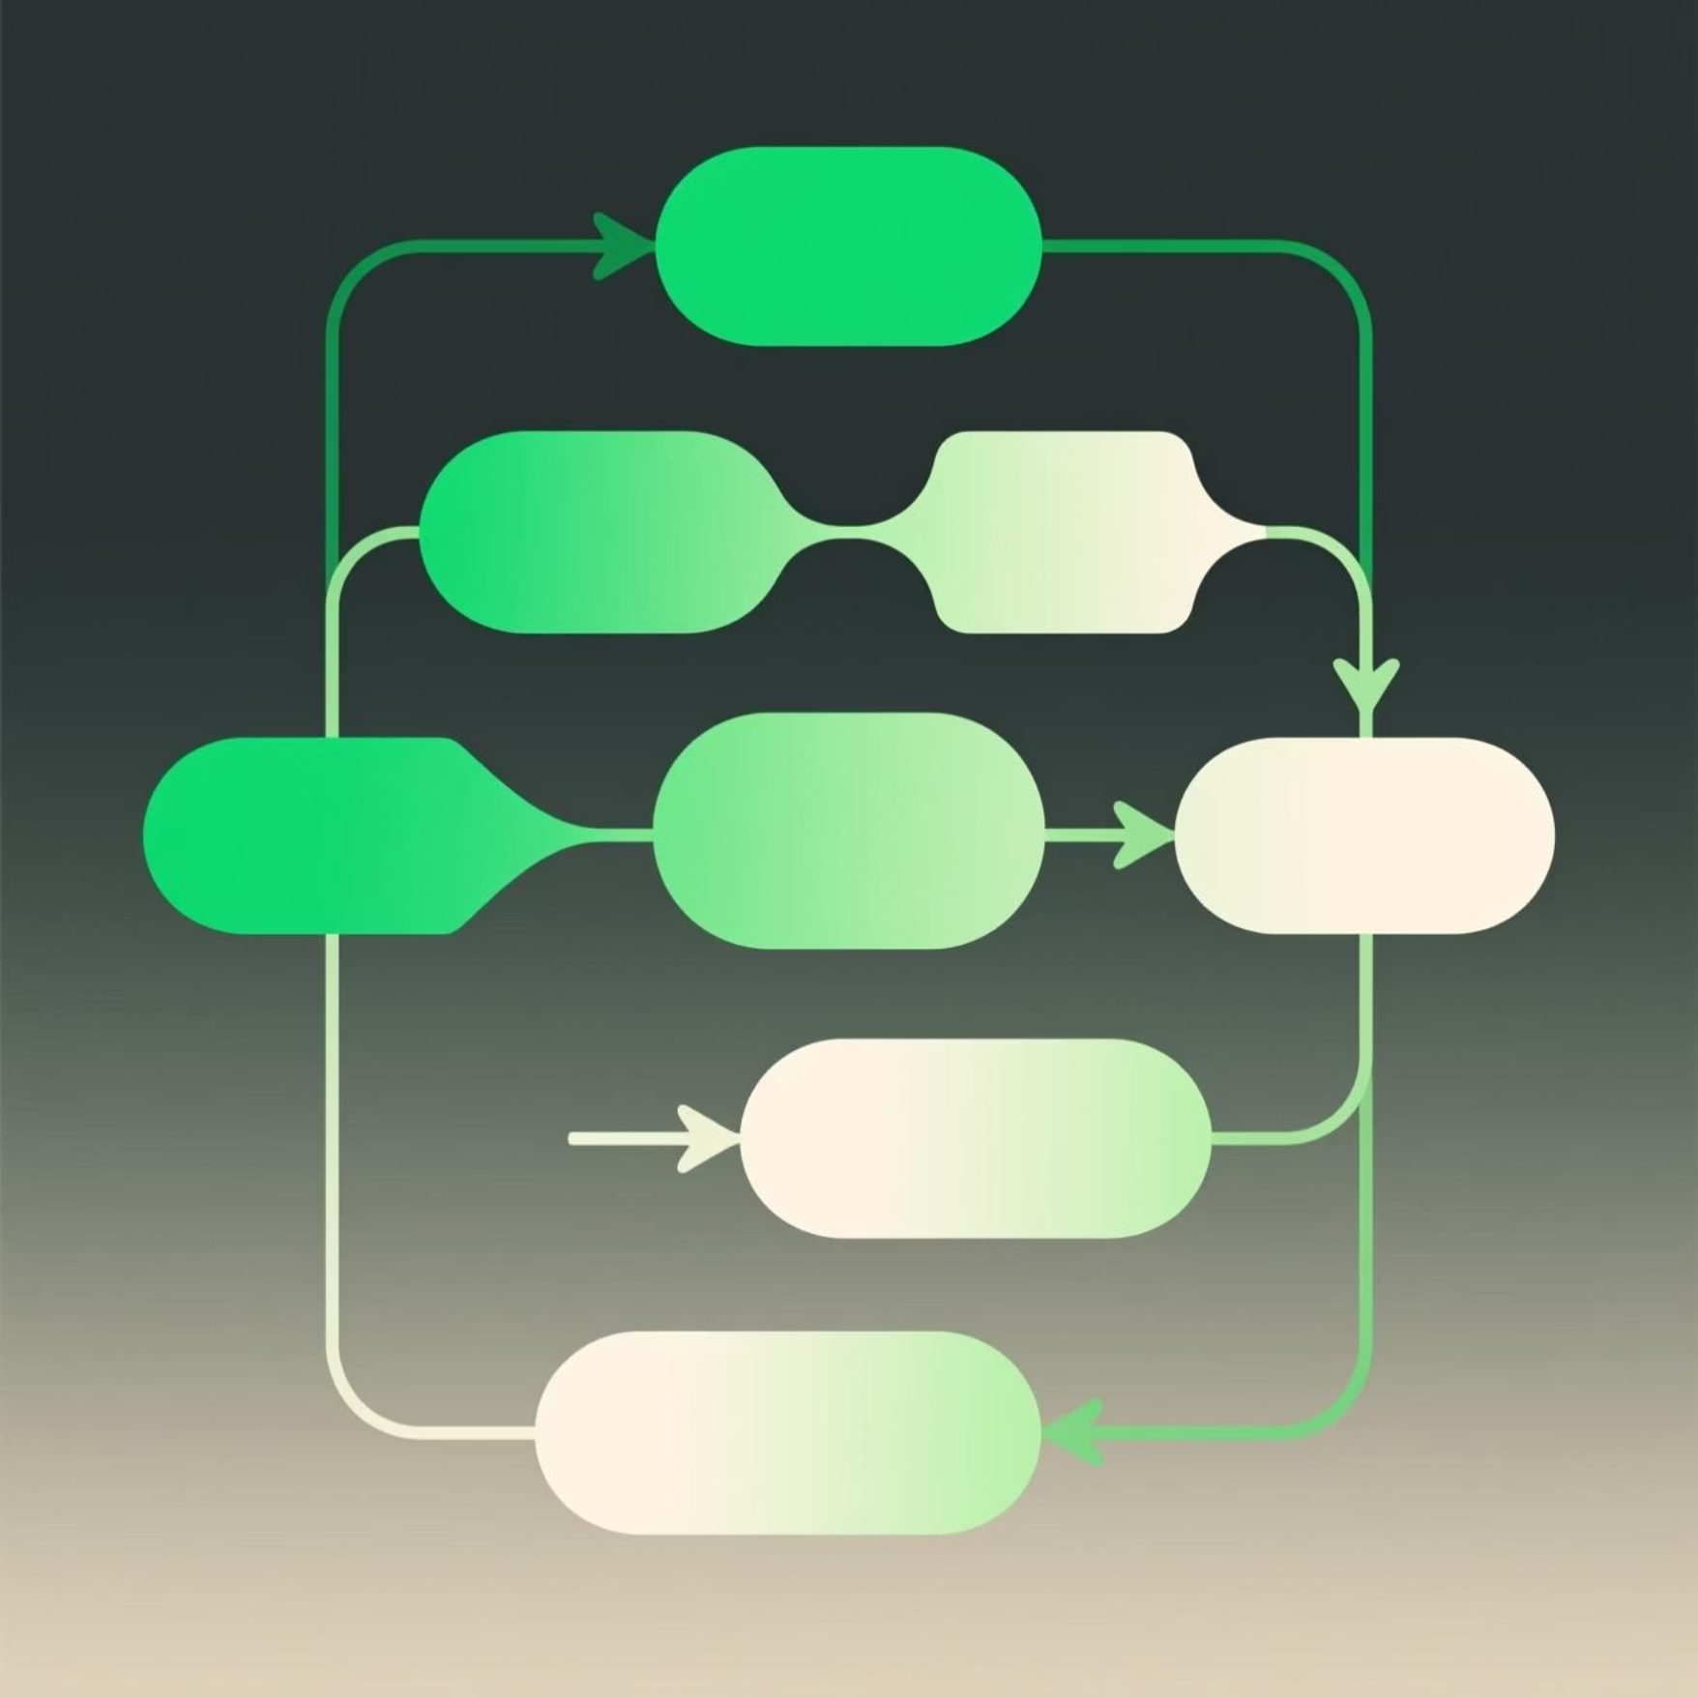
Core Feature 1: Course Structure and Creation
Course Hierarchy
Table of Contents (TOC) Control
Course contains multiple Lessons
Dynamic course organization puts learners in control:
Lesson contains multiple Topic Slides
Visual display of all lessons
Optional quizzes embedded throughout
Drag-and-drop reordering capability
Adaptivity via Attributes
AI-recommended optimal lesson sequences
Four distinct modes determine generated content depth and quiz difficulty:
Real-time progress tracking
Interview — Job-focused practical knowledge
Basics — Foundational concepts
Deep Concepts — Advanced theory
Learning — Comprehensive understanding

Slide 6

Core Feature 2: Adaptive Learning Within Each Slide
Every learner, from beginner to advanced, receives content precisely tailored to their needs and learning style.
Increase Difficulty
Seamlessly transitions to deeper explanations with more complex examples and advanced concepts.
Explain More
Expands into comprehensive long-form content with detailed breakdowns and additional context.
Analogy Mode
Explains topics using simple, relatable real-life analogies for intuitive understanding.
Reverse Learning
Teaches backwards from result to logic to foundation, perfect for problem-solving skills.
Hands-On Mode
Generates small practical exercises for immediate application and skill reinforcement.
Story Mode
Transforms concepts into engaging narratives that enhance retention and engagement.

Slide 7

Core Feature 3: AI Doubt Clarification
Context-Aware Chat Window
Intelligent Support Functions
The built-in AI assistant maintains full awareness of the current course, lesson, and specific slide context, enabling intelligent, relevant responses.
Responds to prompts like "Explain again" or "Explain like I'm 5"
Detects confusion patterns from user behavior
Proactively suggests supplementary micro-lessons
Provides alternative explanations automatically

Slide 8
Assessment, Analytics, and Remediation Loop
Skill Map Analytics
Comprehensive Quizzing
Post-completion analysis identifies strong and weak topic areas, delivering a personalized improvement roadmap with actionable insights.
Speed Quiz for quick recall, Hard Mode with no hints for mastery testing, and Revision Quiz focusing exclusively on previously incorrect answers.
Continuous Learning
Targeted Remediation
Daily Learning Capsules: Automatically generated 3–5 minute sessions based on ongoing topics and weak areas for sustained skill development.
Fix-in-15 Micro Lessons: AI-generated quick explainers with 2–3 practice questions, triggered after assessments to reinforce weak areas immediately.

Slide 9

AI-Powered Background Experience
Purpose
Improve attention, reduce cognitive fatigue, and deliver a premium educational feel through intelligent visual design.
Visual Mechanism
Soft, ambient topic-related illustrations
Animated gradients with low-opacity concept maps
Memory-anchor icons for retention
Dynamic depth signals for complexity levels
Multi-language Support
Progress Tracking
Offline Mode
Comprehensive language options for global accessibility
Integrated analytics across all learning activities
Planned for Phase 3 implementation

Slide 10

High-Level Implementation Roadmap
Strategic phased approach ensuring rapid MVP delivery while building toward comprehensive platform capabilities.
1
Phase 1: MVP
8–10 weeks
Course generation engine
Slide-based learning interface
Difficulty controls
Quiz modes implementation
Context-aware AI chat
Multi-language support
Basic analytics dashboard
2
Phase 2: Enhancement
10–14 weeks
Daily learning capsules
Fix-in-15 micro lessons
Skill map dashboard
Background visualization engine
Advanced personalization
3
Phase 3: Future State
TBD
Offline mode capability
Advanced quiz modes
Enhanced lesson library
Refined personalization
Enterprise features

