Slide 1

HEALTHCARE ANALYTICS
FOR DOCTOR VISITS
Data Analytics Project
Aarush Singh

Slide 2

PROBLEM STATEMENT
Healthcare utilization varies considerably across individuals. Understanding the factors associated with doctor visits can help reveal patterns in healthcare demand.
The Challenge
Healthcare data contains multiple demographic, socioeconomic and health-related variables.
Doctor visits are not evenly distributed across individuals.
Raw healthcare data can be difficult to interpret without systematic analysis.
Important relationships between health conditions and healthcare utilization may remain hidden.
Our Approach
Use Data Analytics to identify patterns and associations between doctor visits and:
Demographics → Health → Socioeconomic factors → Healthcare access → Chronic conditions
Goal: Transform raw healthcare data into meaningful, interpretable insights about doctor-visit patterns.

Slide 3
Project Description
Healthcare Analytics for Doctor Visits is a data analytics project that examines a dataset of 5,190 observations and 13 variables related to doctor visits and individual health characteristics.
What We Analyze
Doctor Visits
Frequency and distribution of visits
Demographics
Gender
Age-related encoded variable
Health
Illness
Health status
Reduced activity
Socioeconomic / Access
Income
Private insurance
Free/reduced healthcare indicators
Chronic Conditions
Chronic-condition indicators
Objective: Identify meaningful patterns and associations in healthcare utilization while avoiding unsupported causal conclusions.

Slide 4

WHO ARE THE END USERS?
🏥 Healthcare Administrators
Analyze healthcare utilization patterns to support service planning.
👨‍⚕️ Hospitals & Clinics
Understand patient-visit patterns and healthcare demand.
📊 Healthcare Analysts
Explore relationships between health, demographics and utilization.
🔬 Researchers
Use healthcare data to investigate population-level patterns and associations.
🏛️ Public Health Organizations
Use analytical insights to understand healthcare utilization across population groups.
The project converts healthcare records into interpretable analytical insights that can support data-driven understanding of healthcare utilization.

Slide 5

Technology Used
🐍 Python
Core programming language for data analysis.
🐼 Pandas
Data loading, cleaning, transformation and analysis.
🔢 NumPy
Numerical operations and data processing.
📊 Matplotlib
Data visualization and statistical charts.
🎨 Seaborn
Advanced statistical visualizations.
📐 SciPy
Statistical hypothesis testing.
📓 Google Colab / Jupyter Notebook
Interactive development and analysis environment.
🐙 GitHub
Project versioning, documentation and sharing.

Slide 6
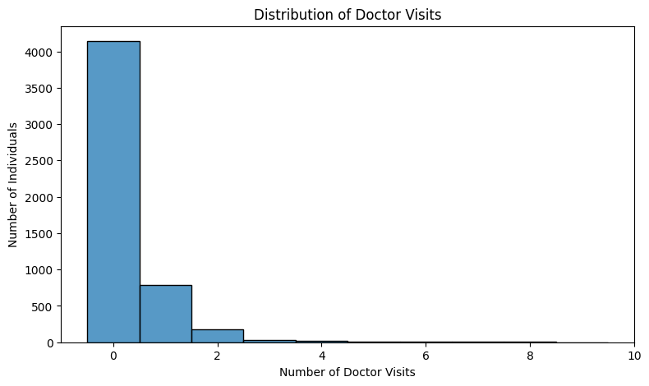
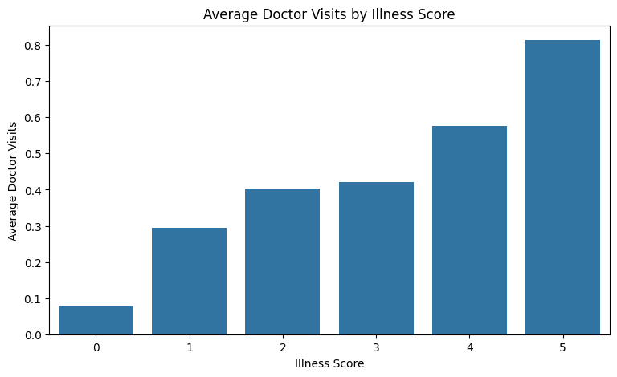
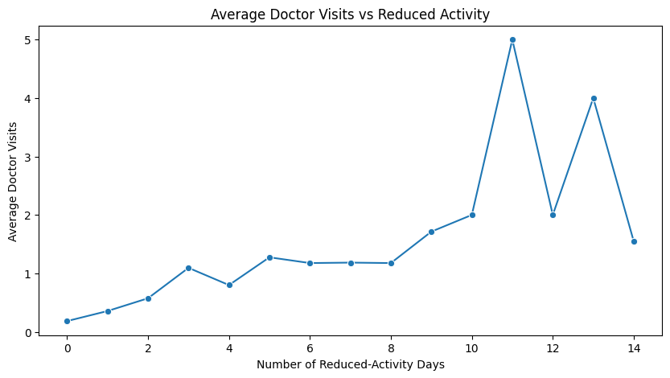
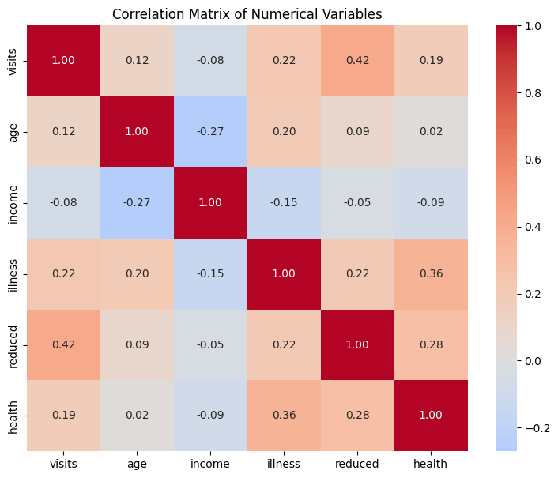
RESULTS
https://github.com/Aarush-Singh01/Healthcare-Analytics-for-Doctor-Visits.git

Slide 7
Thank you
AARUSH SINGH
.
.

