Slide 1
IBM University Engagement Project Submission
“Exploring the Power of Agentic AI with IBM Granite and IBM Bob”

Slide 2

NutriGenie
AI-Powered Personalized Nutrition Agent
Domain: Healthcare / Artificial Intelligence
Student Name | Recent Passport Photo | Email ID | Mobile number [WhatsApp]
Aarush SINGH |  | aarushsingh6204@gmail.com Used for ibm skillsbuild | 8709489929
STUDENT ID : STU6736c7458b0c11731643205

Slide 3
Problem Statement -
Problem Statement : Nutrition Agent
NutriGenie is an AI-powered personalized nutrition assistant designed to help users make informed dietary decisions through personalized meal planning, nutrition analysis, food logging and intelligent feedback.
The system combines Agentic AI, Retrieval-Augmented Generation (RAG), IBM Granite, IBM watsonx.ai and IBM Bob to create a modular and context-aware nutrition solution.
It uses user information such as age, body measurements, activity level, dietary preference, fitness goals and cuisine preferences to generate relevant nutrition guidance.
.
Core Focus
Personalization | Nutrition Knowledge | Meal Planning | Food Tracking | AI Feedback

Slide 4
Problem Overview -
The Challenge
Individuals often struggle with diet planning and portion control.
Nutritional information is scattered across different sources.
Generic diet recommendations do not consider individual goals and preferences.
Users need simple ways to track meals and understand their nutritional intake.
There is a need for personalized and accessible nutrition guidance.
Objective
Develop an AI-powered Nutrition Agent capable of:
Personalized diet plans
Food-data retrieval using RAG
Diet tracking and feedback
Preventive health-oriented guidance
Multi-agent task execution
Nutrition visualization

Slide 5
Proposed Solution -
Proposed Solution: NutriGenie
NutriGenie uses a multi-agent architecture in which specialized AI agents collaborate to solve different nutrition-related tasks.
The system combines user profile information with nutrition knowledge retrieval and AI reasoning to generate personalized recommendations.
Nutrition Knowledge Agent
Retrieves relevant nutritional information.
Diet Recommendation Agent
Generates personalized meal plans.
Health Advisory Agent
Provides preventive nutrition guidance.
Food Log & Feedback Agent
Analyzes logged meals and provides feedback.
User → Orchestrator → Specialized Agents → RAG / Granite → Personalized Output

Slide 6
Technology Used
👤 Personalized Profile
Uses user-specific characteristics and goals.
🍱 Personalized Meal Planning
Generates diet recommendations based on user requirements.
🔎 RAG Nutrition Retrieval
Retrieves relevant nutrition knowledge before generating responses.
📝 Food Logging
Allows users to record meals and quantities.
📊 Nutrition Tracking
Tracks nutritional intake and progress.
🤖 Multi-Agent AI
Uses specialized agents for different nutrition tasks.

Slide 7
TECHNOLOGY STACK
AI Development
IBM Bob
Foundation Model
IBM Granite
AI Platform
IBM watsonx.ai
Cloud
IBM Cloud
Backend
Python
FastAPI
RAG
ChromaDB
Embeddings
Nutrition knowledge base
Frontend
HTML
CSS
JavaScript

Slide 8
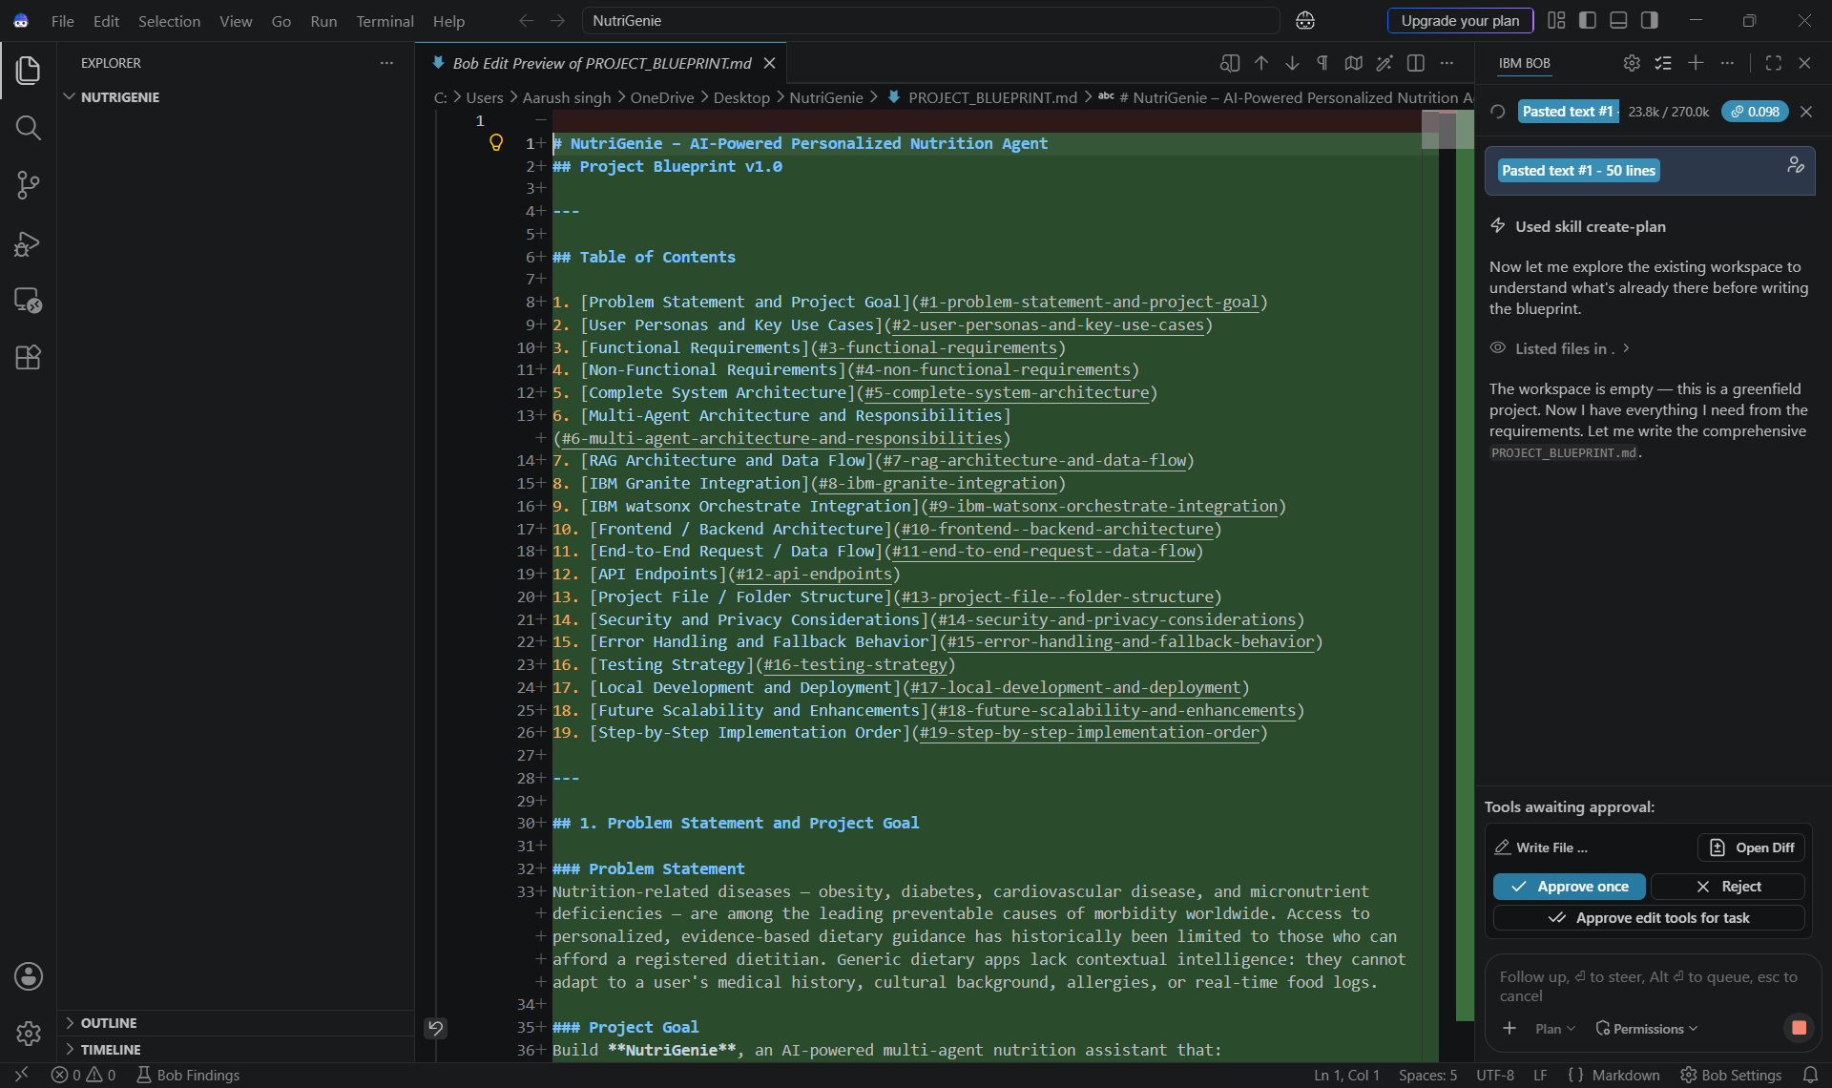
IBM Bob Screenshots:

Slide 9
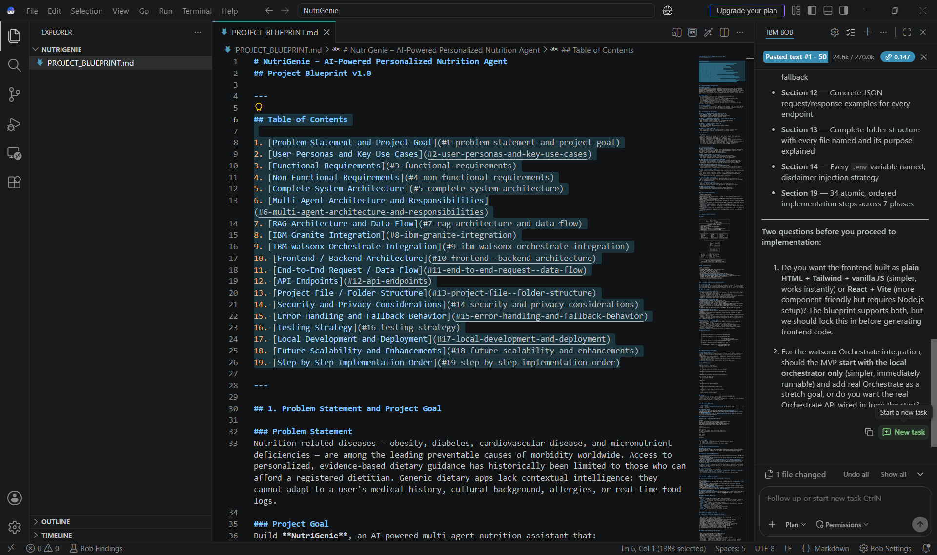
IBM Bob Screenshots:

Slide 10
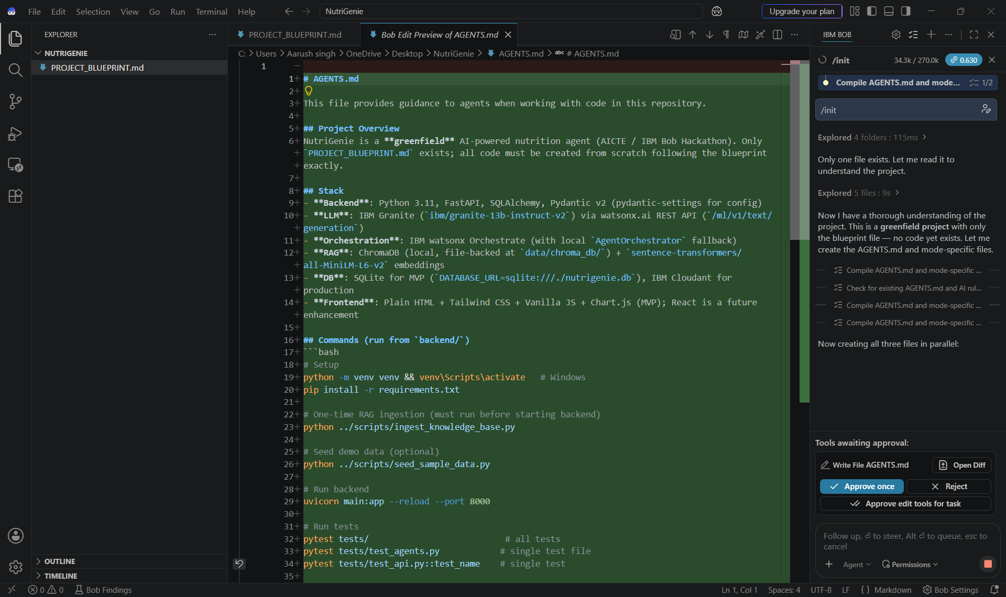
IBM Bob Screenshots:

Slide 11
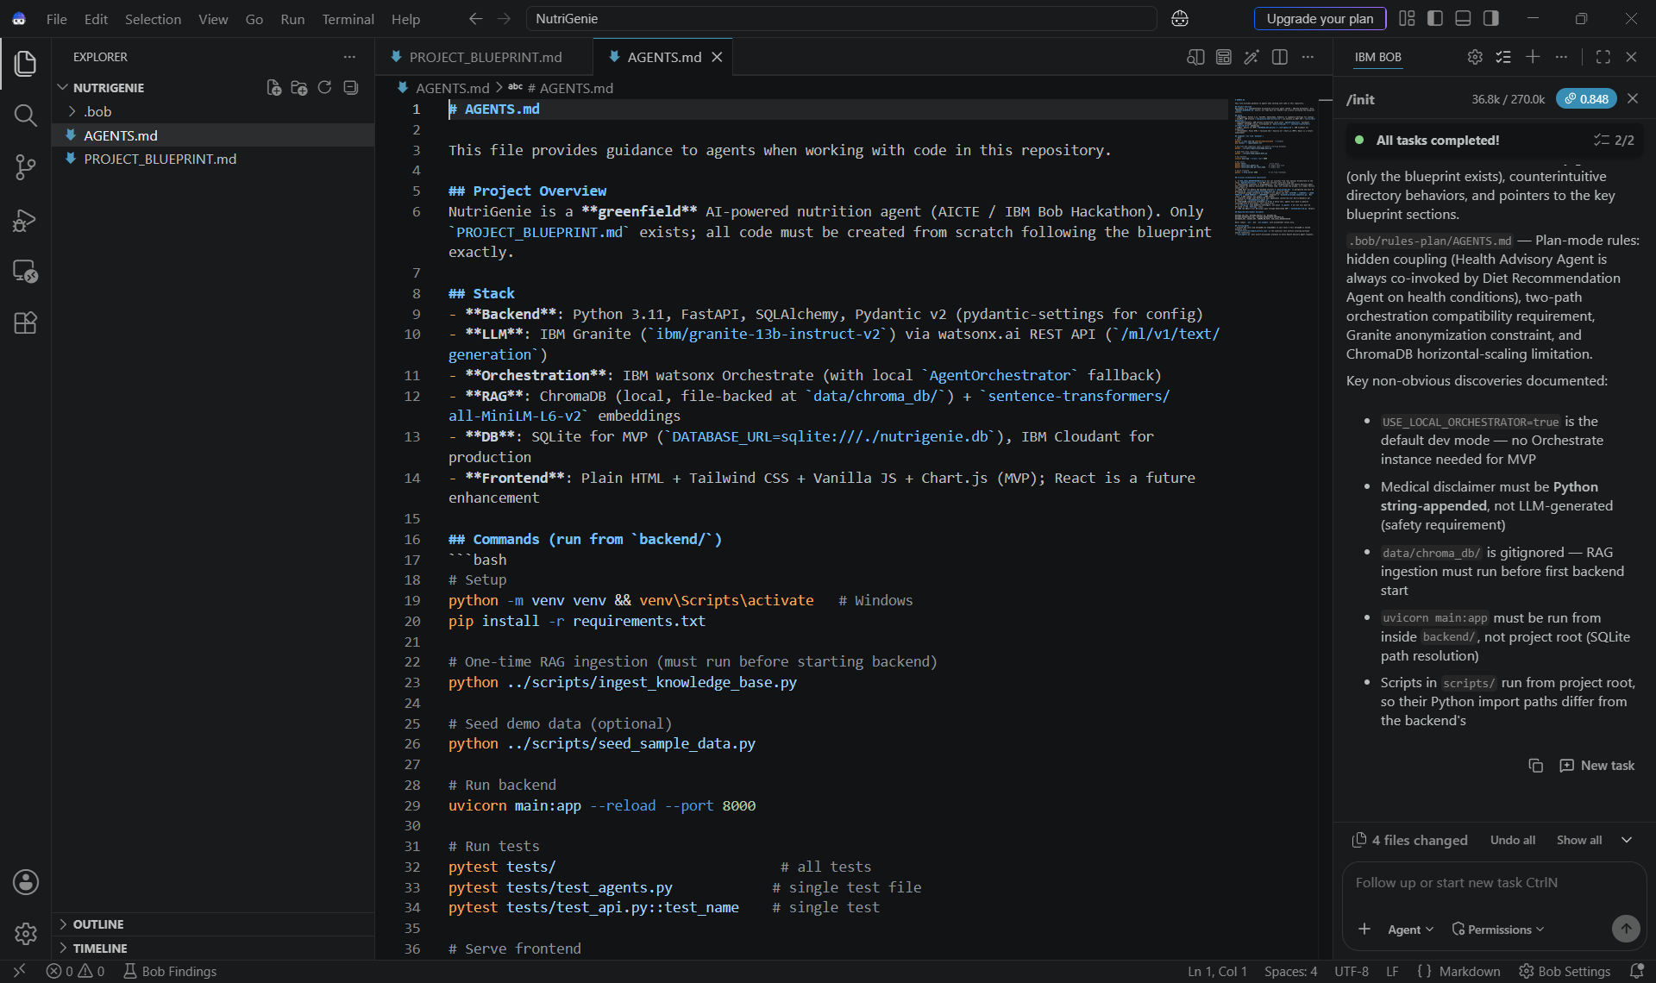
IBM Bob Screenshots:

Slide 12
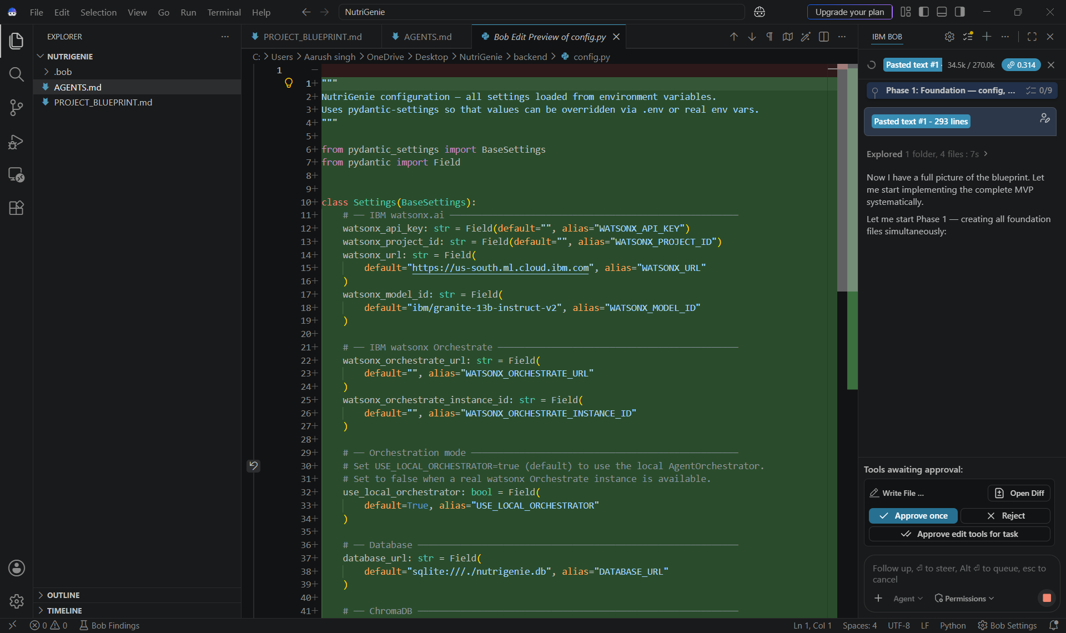
IBM Bob Screenshots:

Slide 13
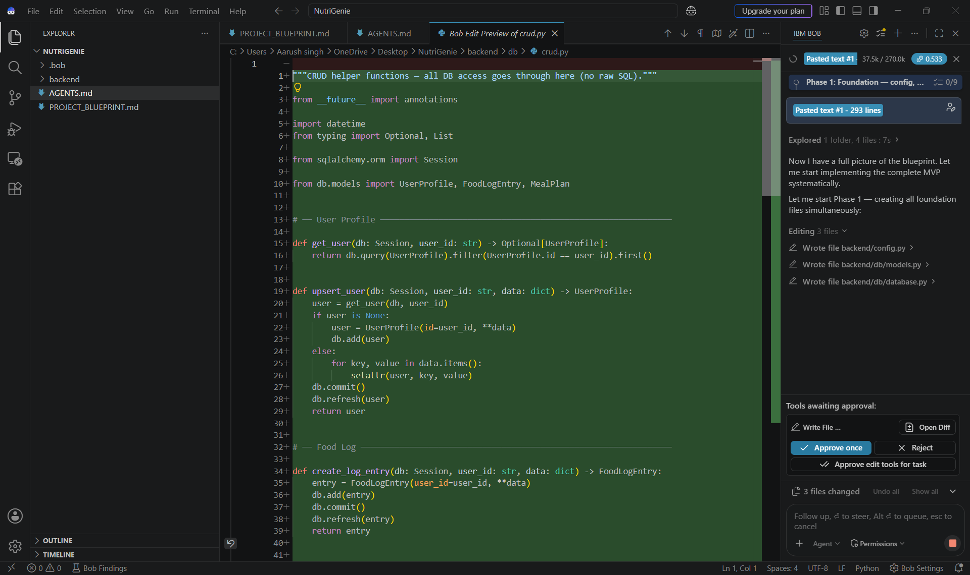
IBM Bob Screenshots:

Slide 14
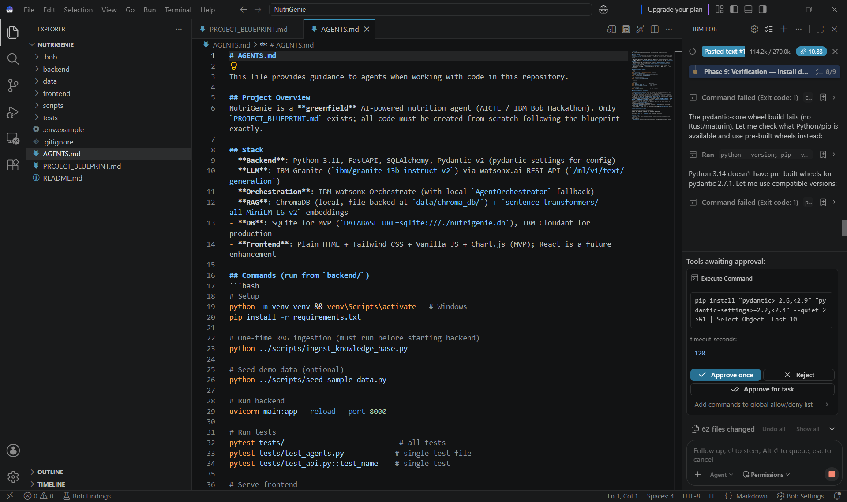
IBM Bob Screenshots:

Slide 15
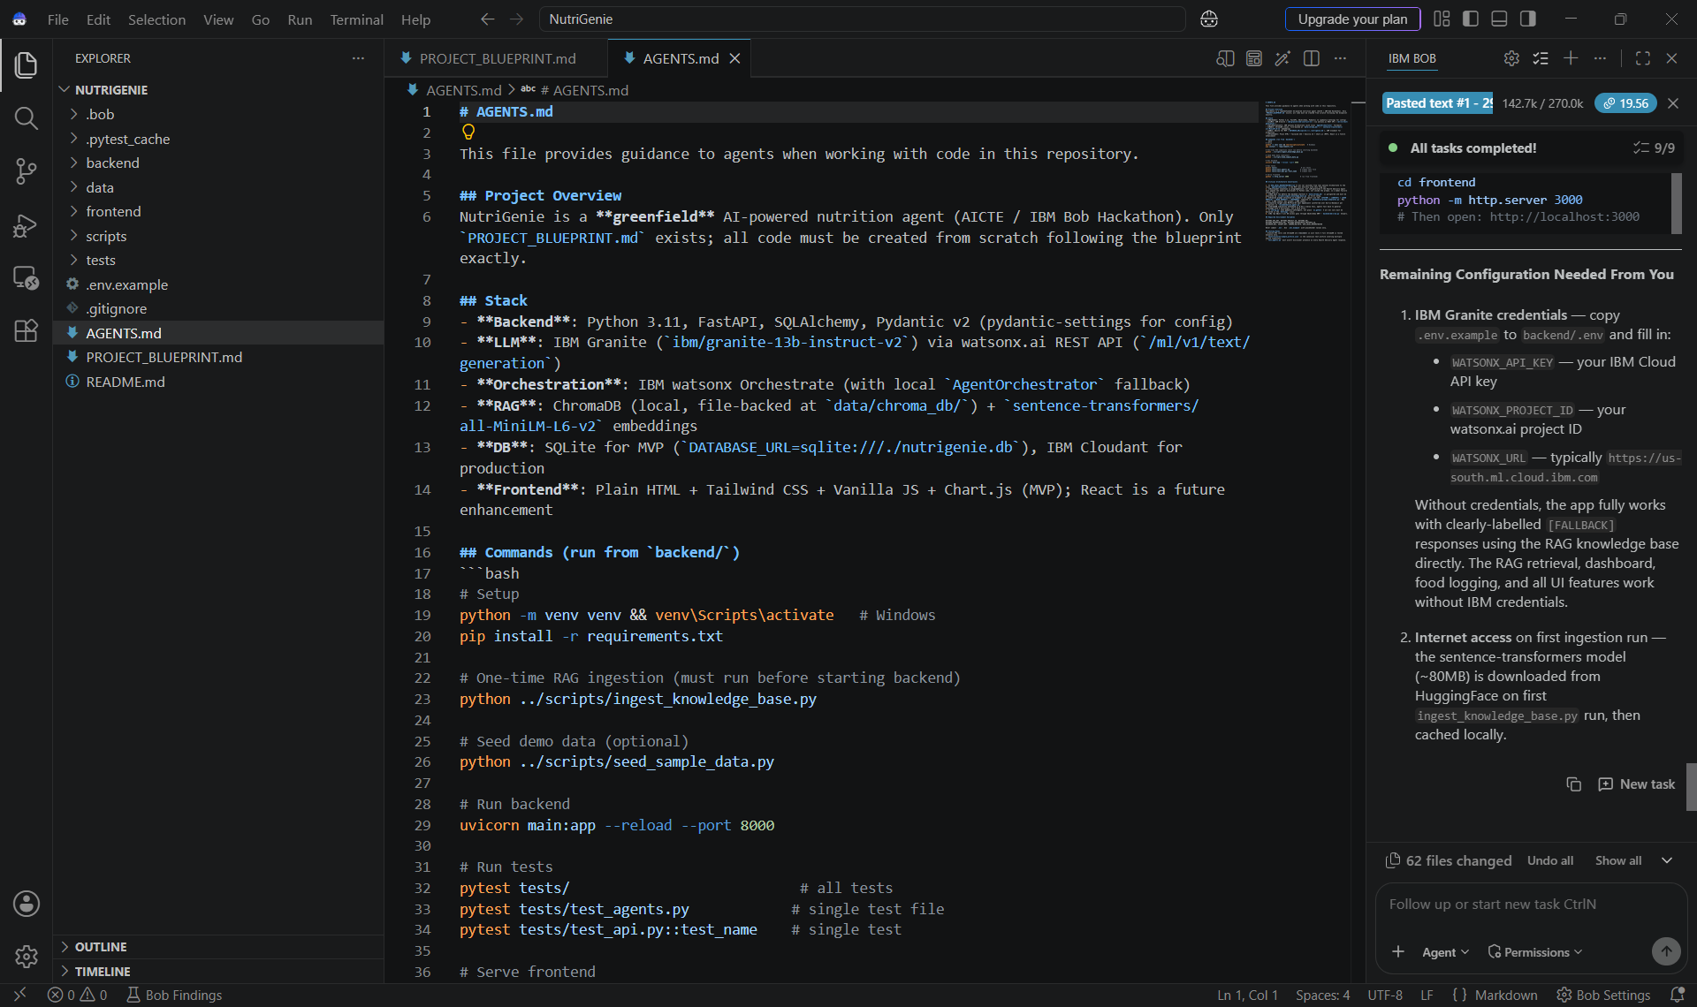
IBM Bob Screenshots:

Slide 16
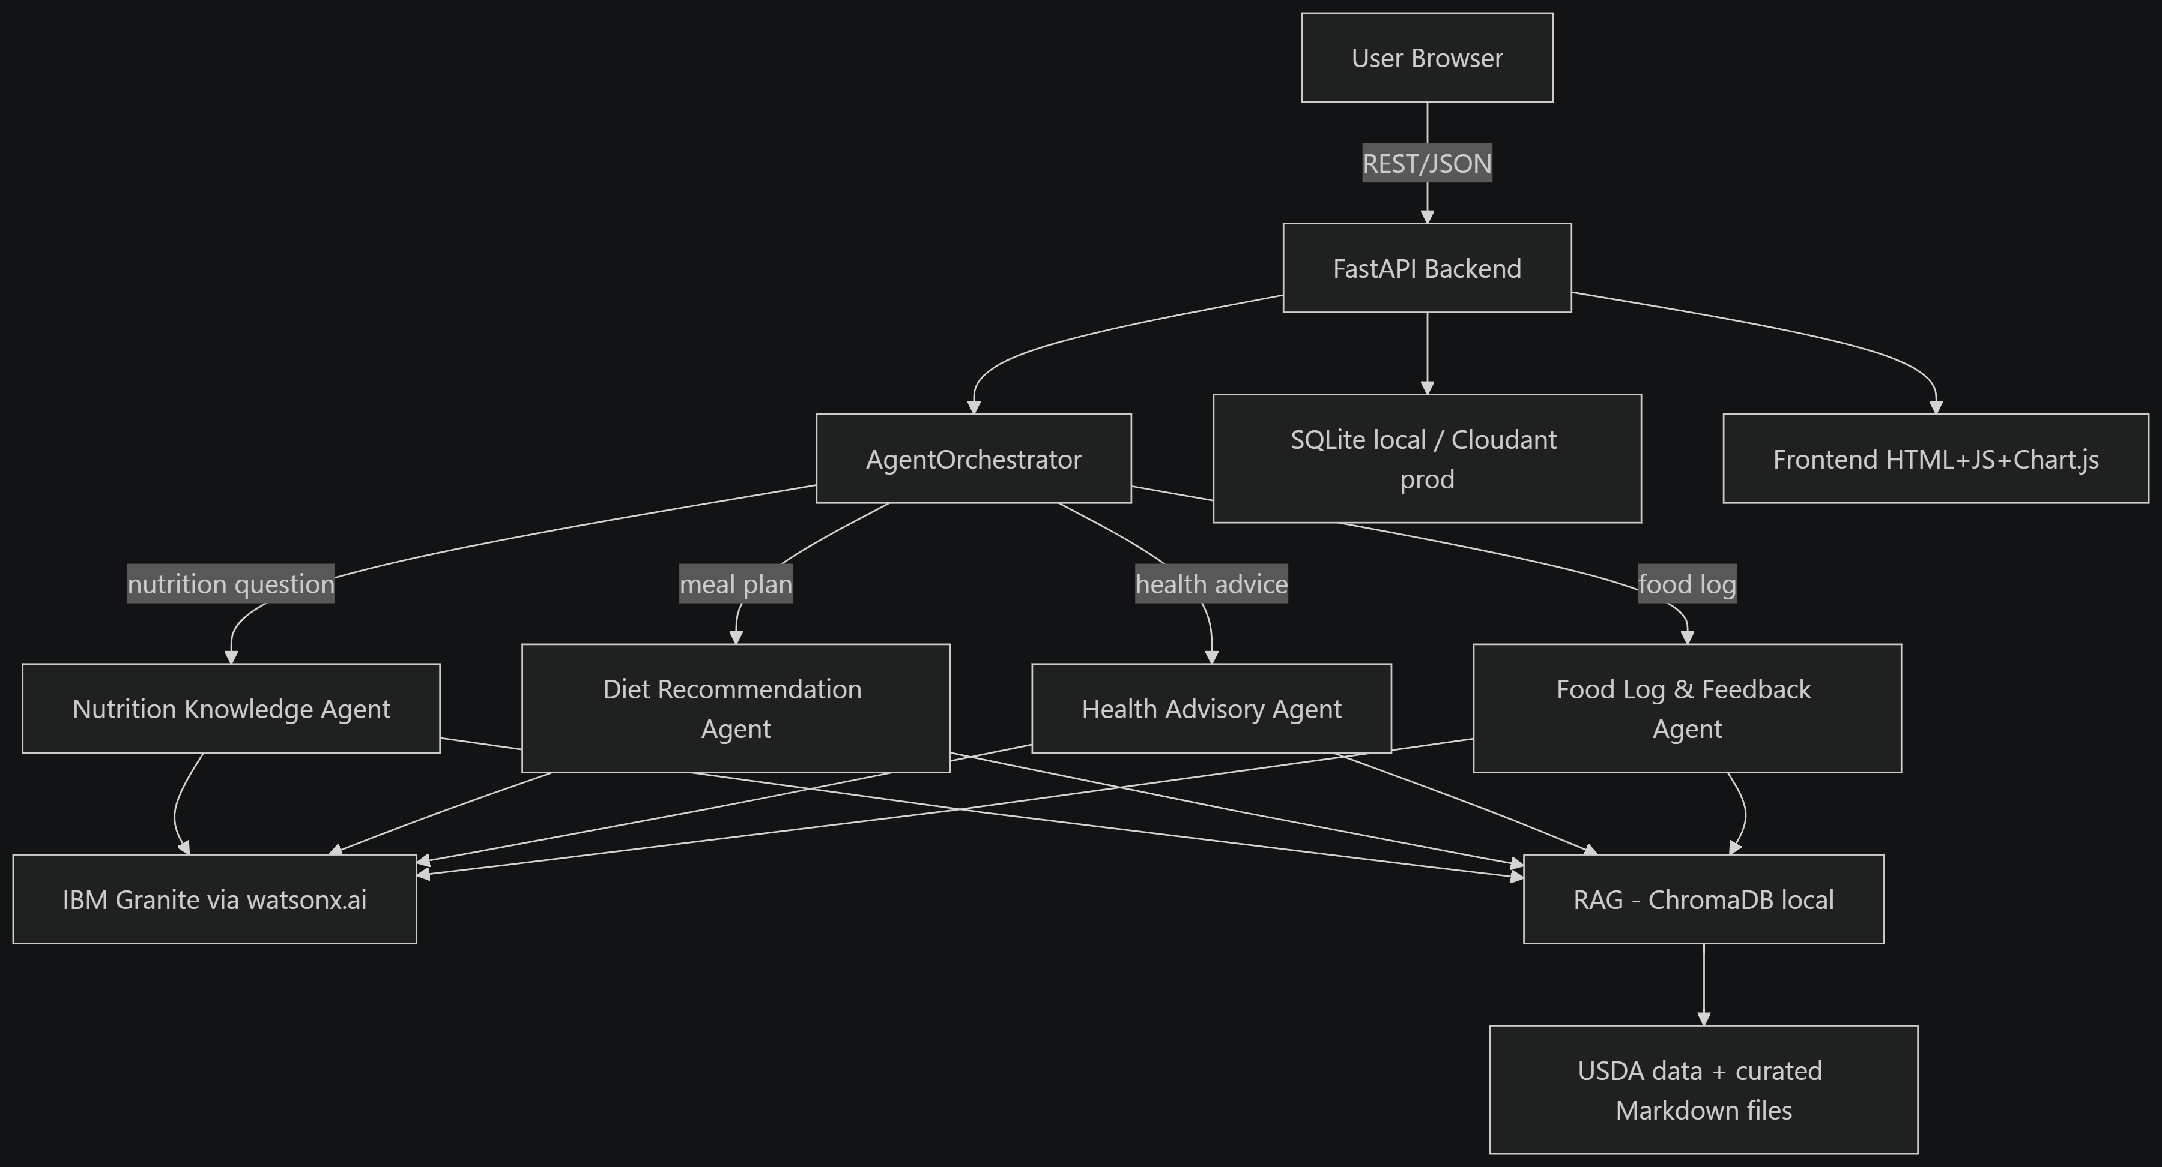
Architecture blueprint for IBM bob:

Slide 17

Role of Agentic AI in the solution
Role of Agentic AI in Nutrition Agent
Task Decomposition
Breaks complex nutrition requests into specialized tasks.
Specialized Agents
Each agent handles a specific responsibility.
Context Awareness
User profile and nutrition goals influence recommendations.
Collaboration
Agents work together to produce a more complete response.
Goal-Oriented Assistance
The system focuses on helping users achieve nutrition goals.
NutriGenie behaves as an intelligent nutrition assistant rather than a simple question-answer chatbot.

Slide 18
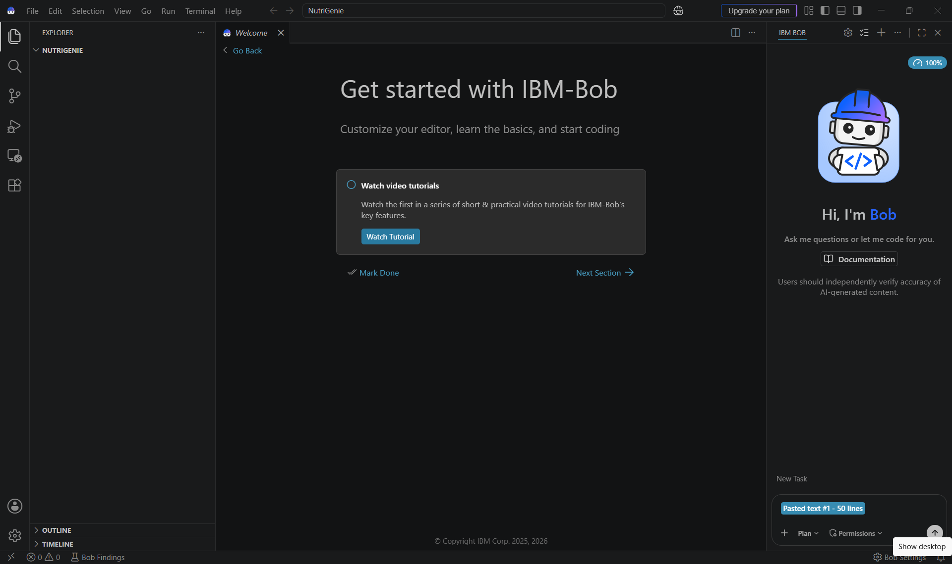
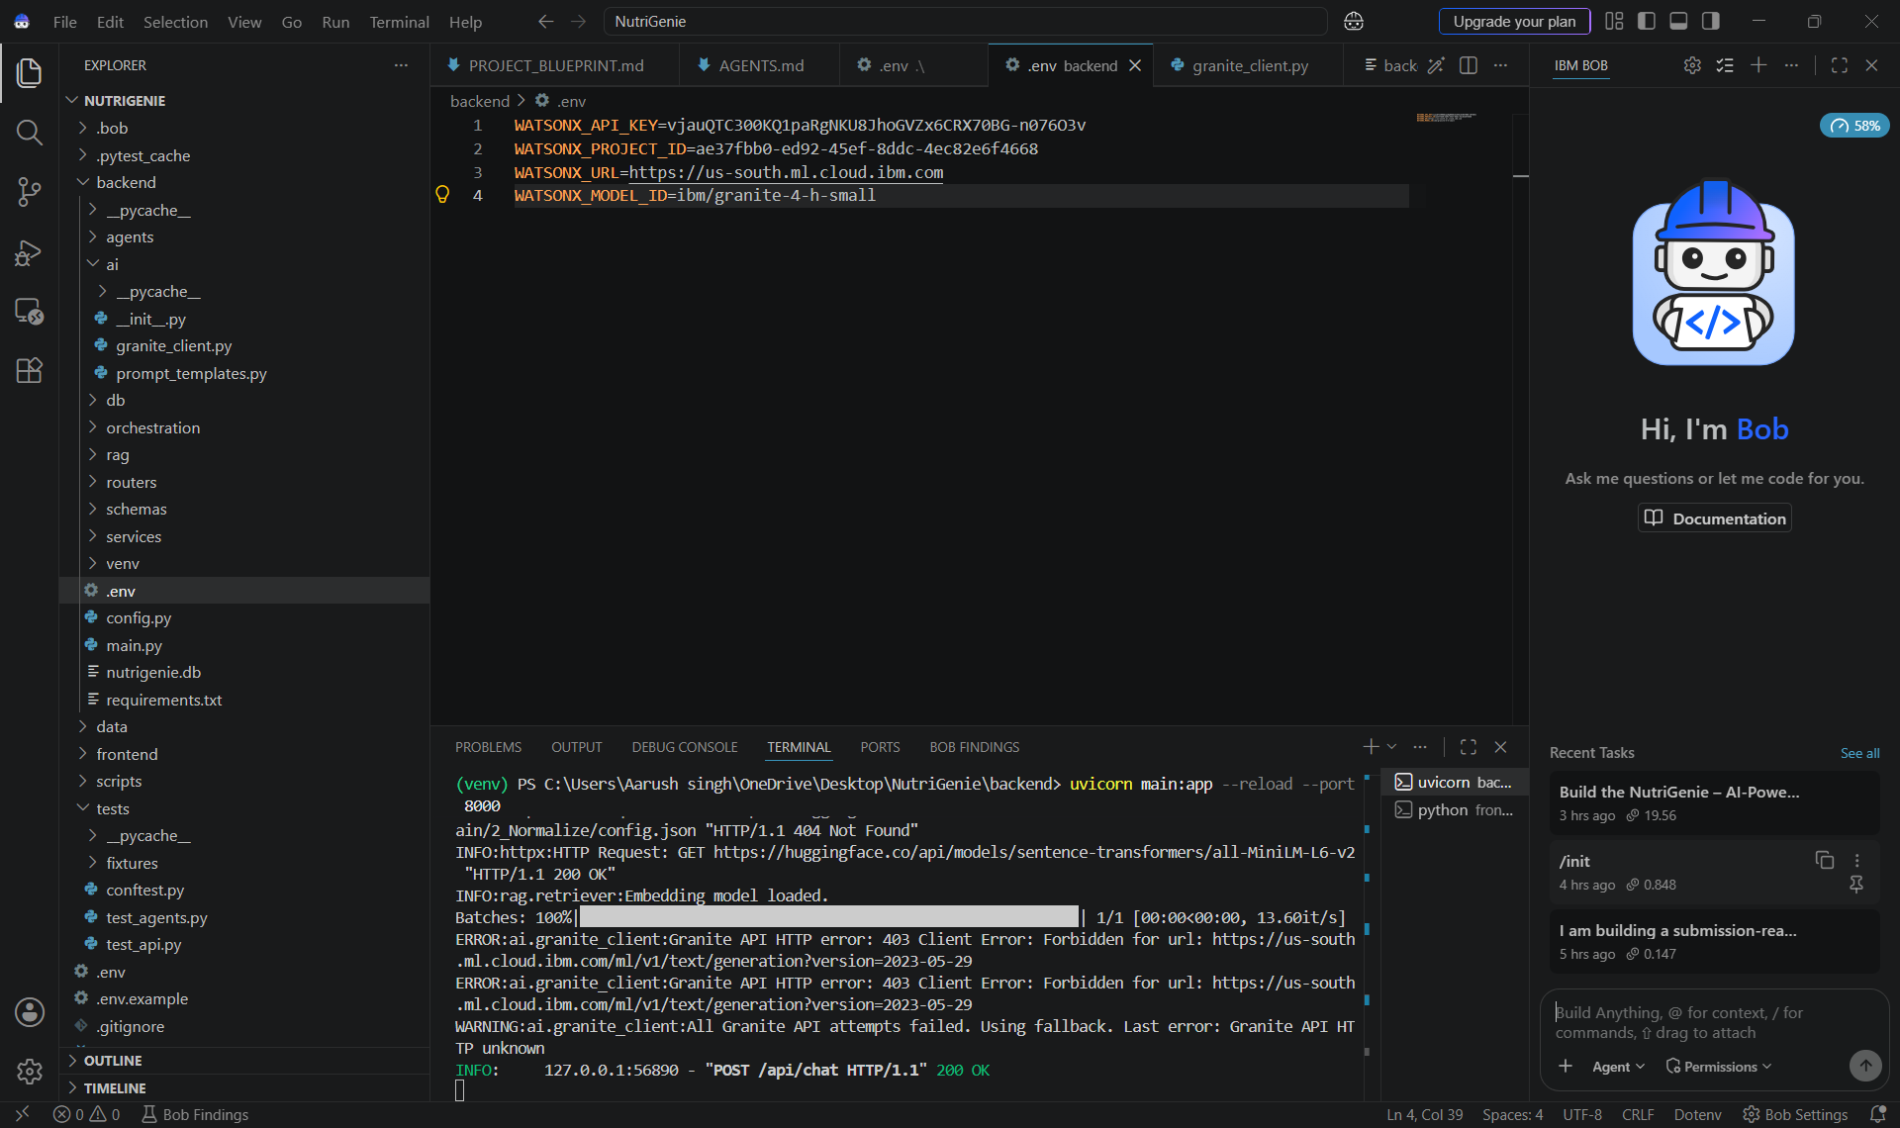
Token Usage
11,761 token are used
Before Prompt
After the Prompt
·
·
·

Slide 19
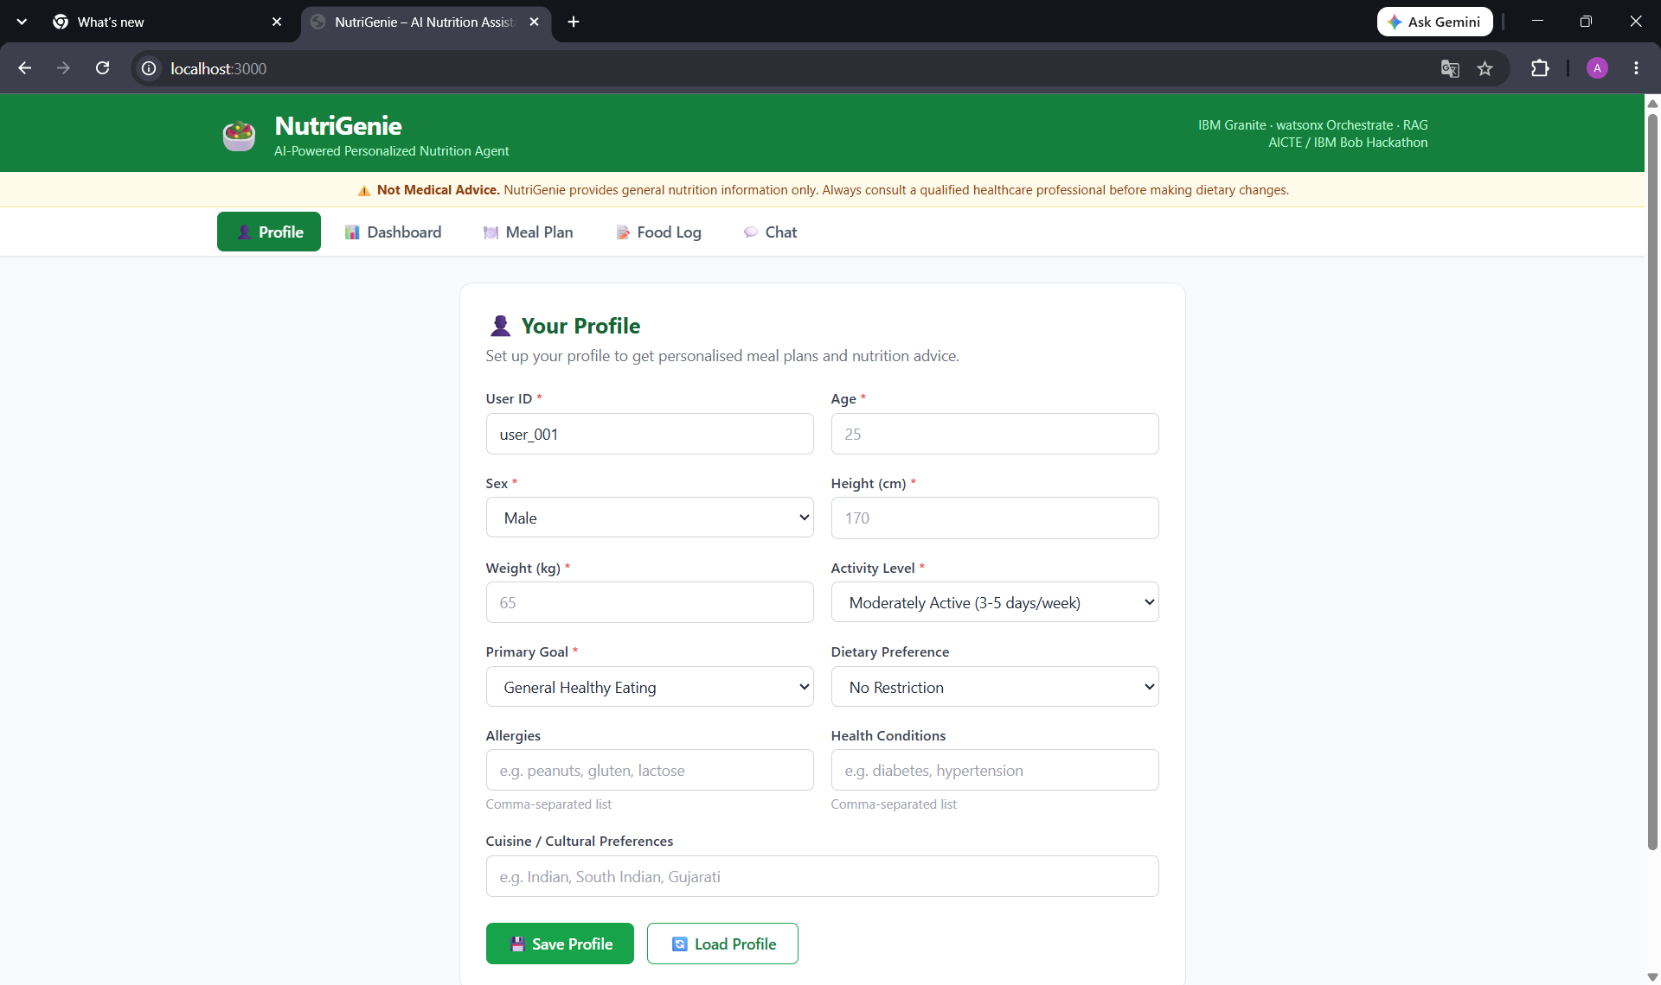
Project Output Screenshot
·
·
·

Slide 20
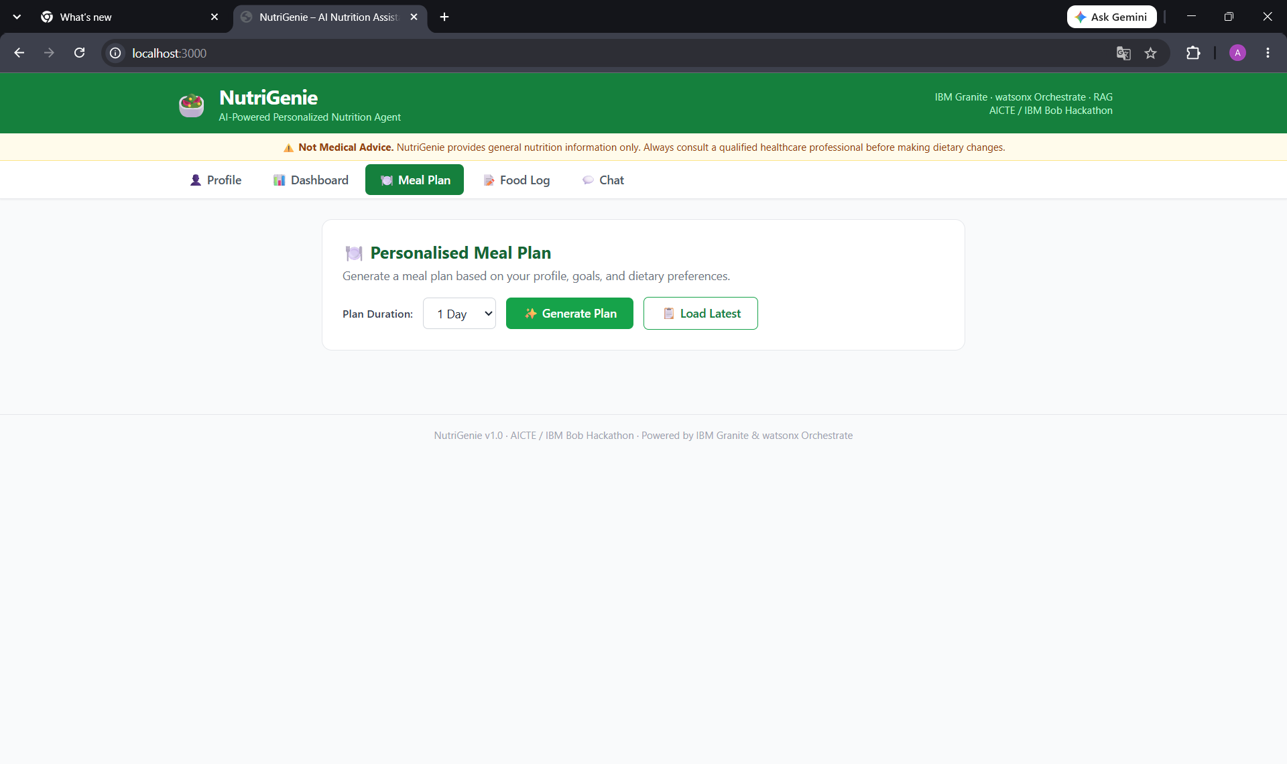
Project Output Screenshot
·
·
·

Slide 21
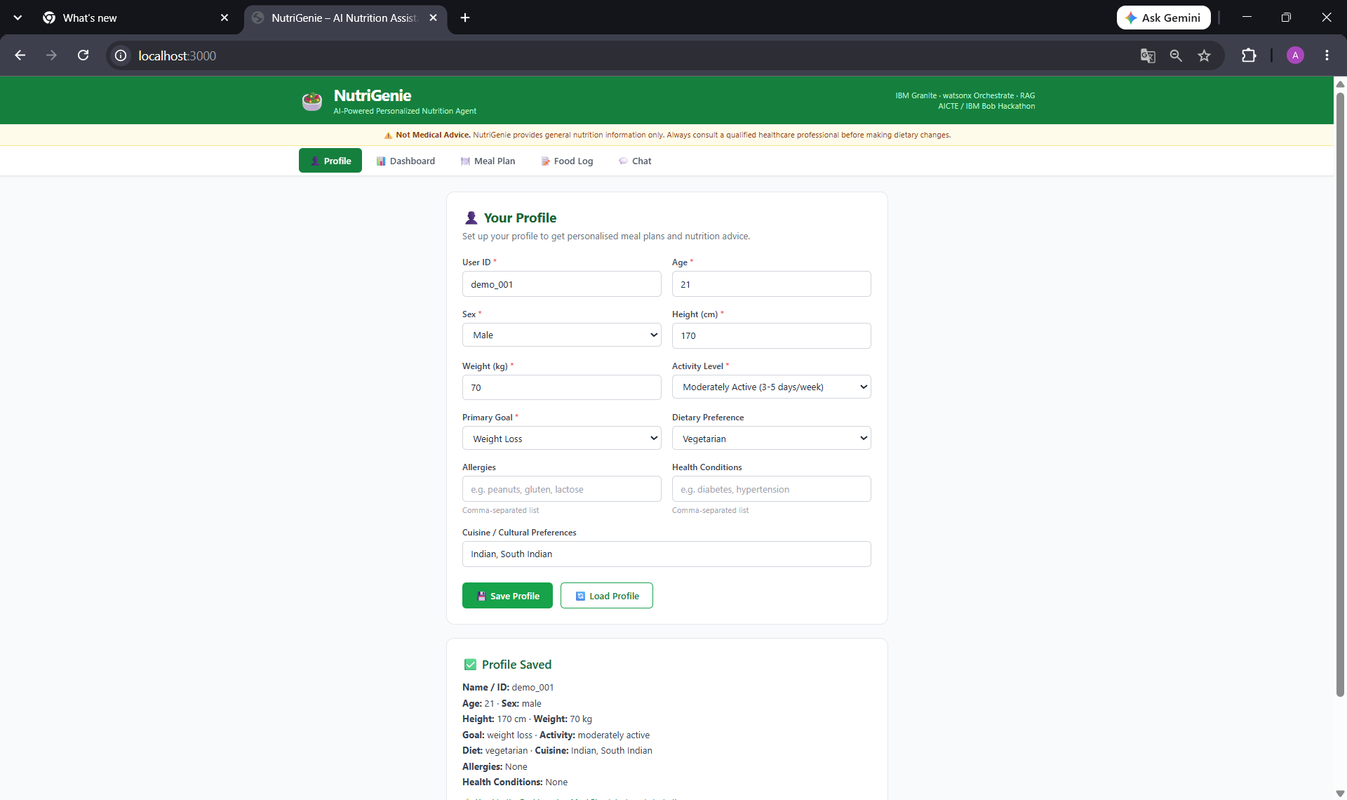
Project Output Screenshot
·
·
·

Slide 22
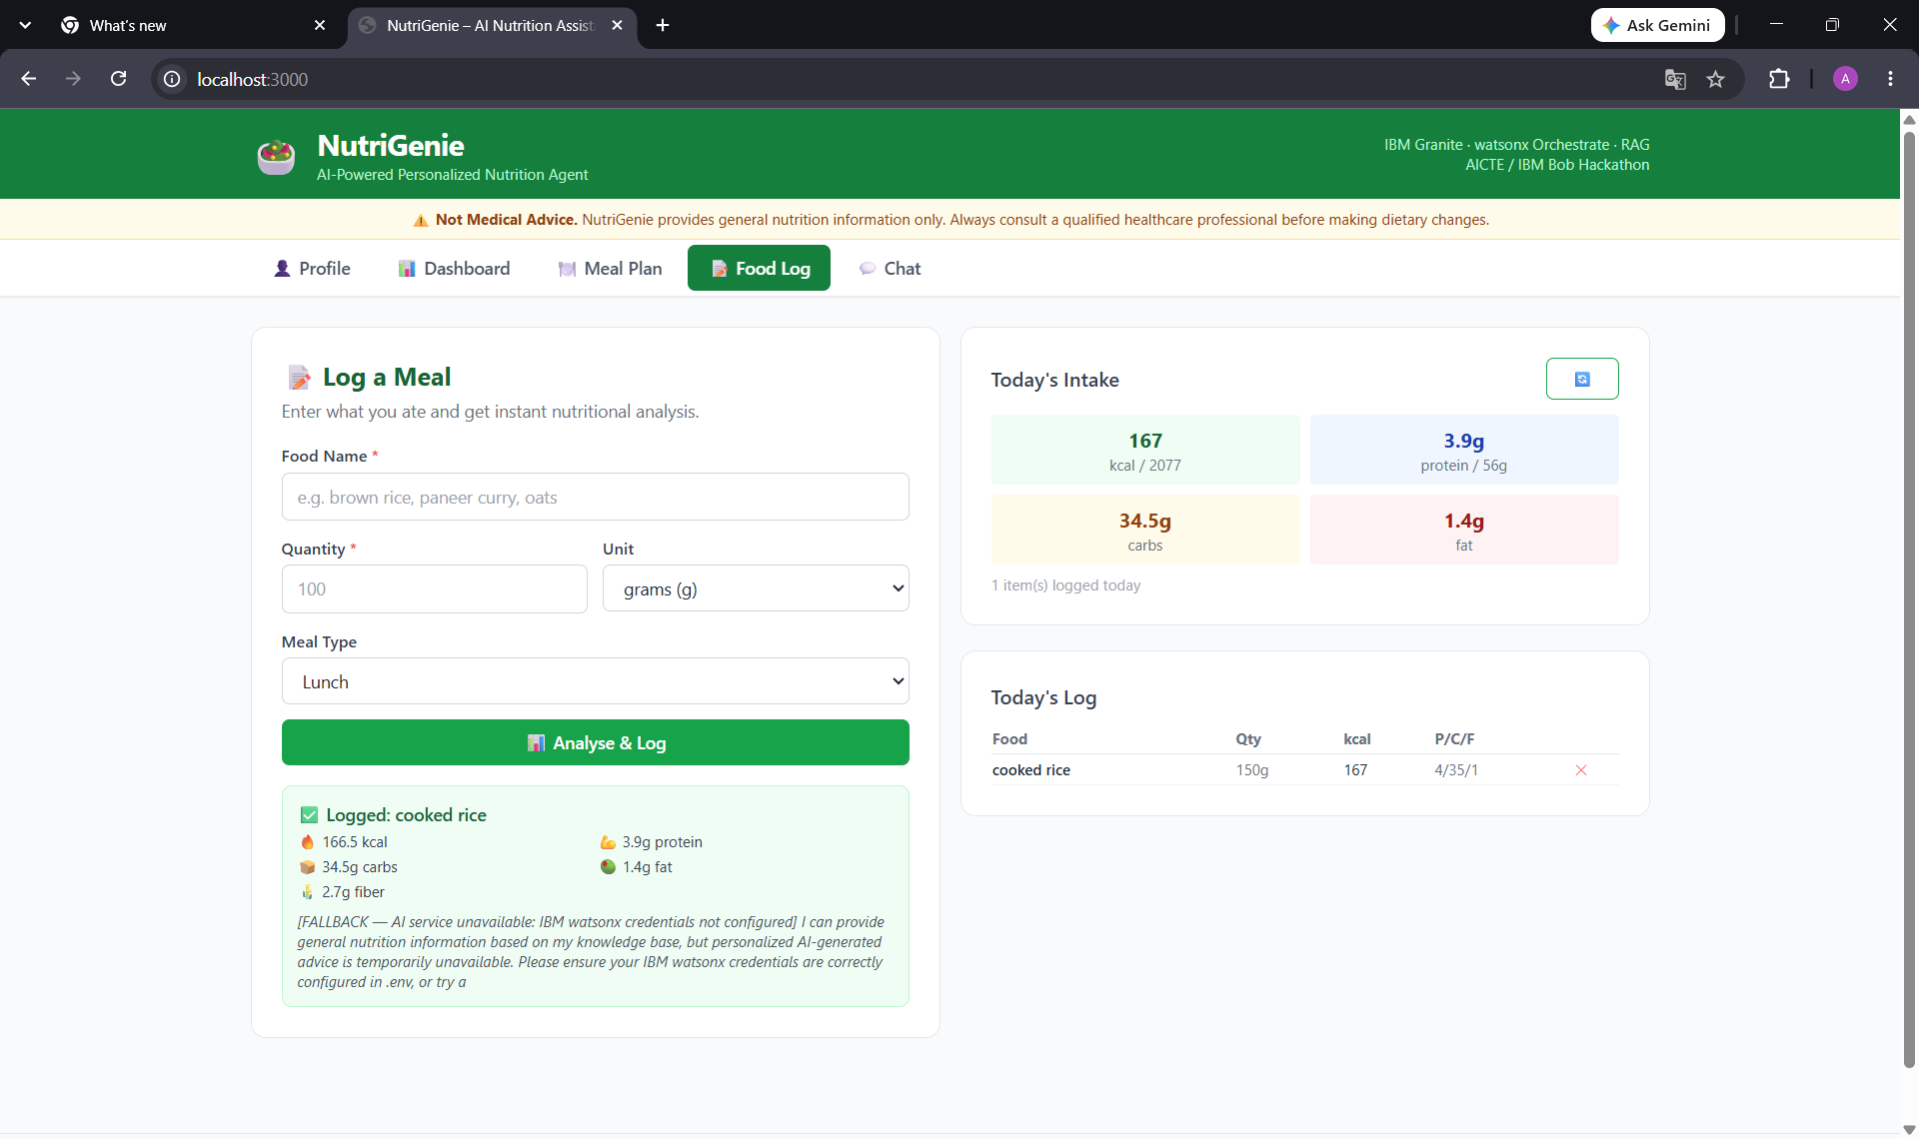
Project Output Screenshot
·
·
·

Slide 23
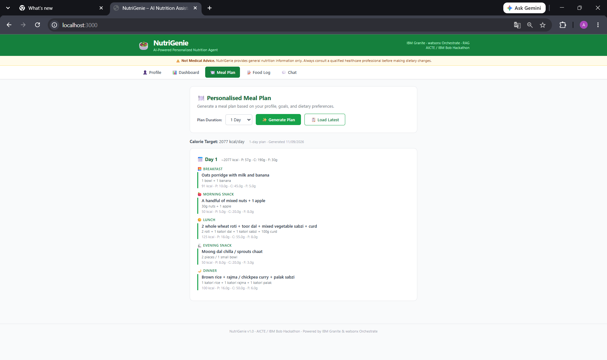
Project Output Screenshot
·
·
·

Slide 24
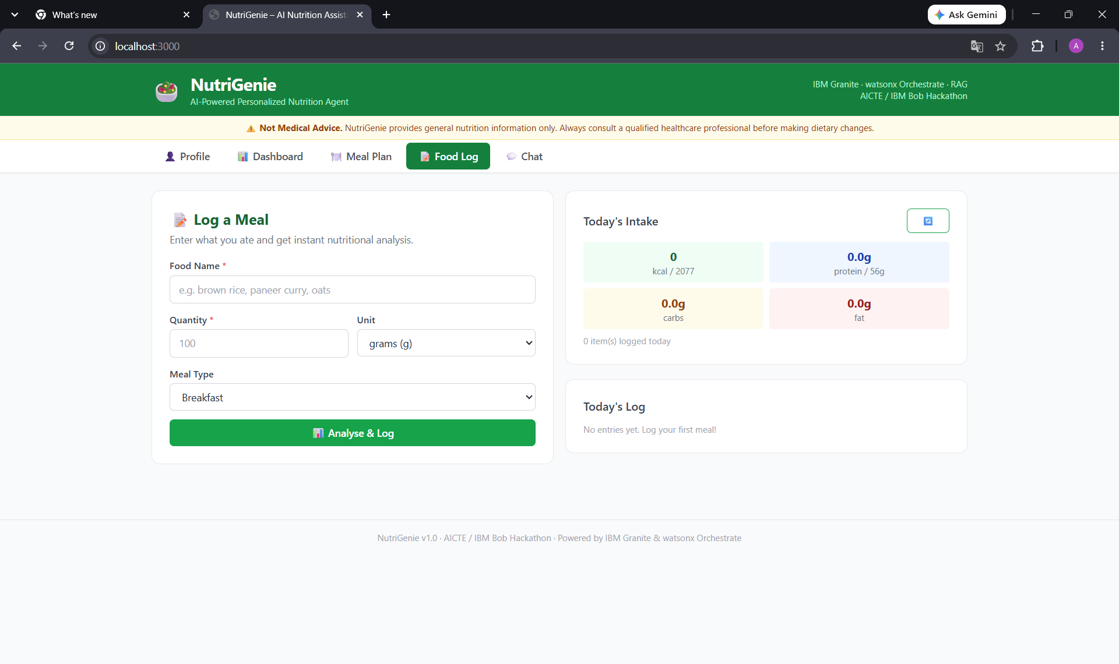
Project Output Screenshot
·
·
·

Slide 25
Novelty and Uniqueness
1. Multi-Agent Intelligence
Specialized agents collaborate.
2. RAG-Based Accuracy
Retrieved knowledge supports generated responses.
3. Hyper-Personalization
Recommendations reflect user context and goals.
4. Real-Time Feedback Loop
Meal logging supports continuous feedback.
5. Multimodal Potential
Architecture can be extended to text, voice and images.
6. Preventive Healthcare Focus
Moves beyond basic meal recommendations.
7. Scalable Architecture
Designed around IBM's AI ecosystem.

Slide 26
Git Hub Link
https://github.com/Aarush-Singh01/NutriGenie.git
·
·
·

Slide 27
Future Scope
1. Wearable Integration
Integrate:
Smartwatches
Fitness trackers
Steps
Calories burned
Heart rate
Sleep patterns
2. Voice & Multilingual AI
Voice-based interaction
Regional languages
Natural conversational assistance
3. Advanced Food Recognition
Future versions can analyze meal images to identify foods and estimate nutritional information.
·
·
·

Slide 28
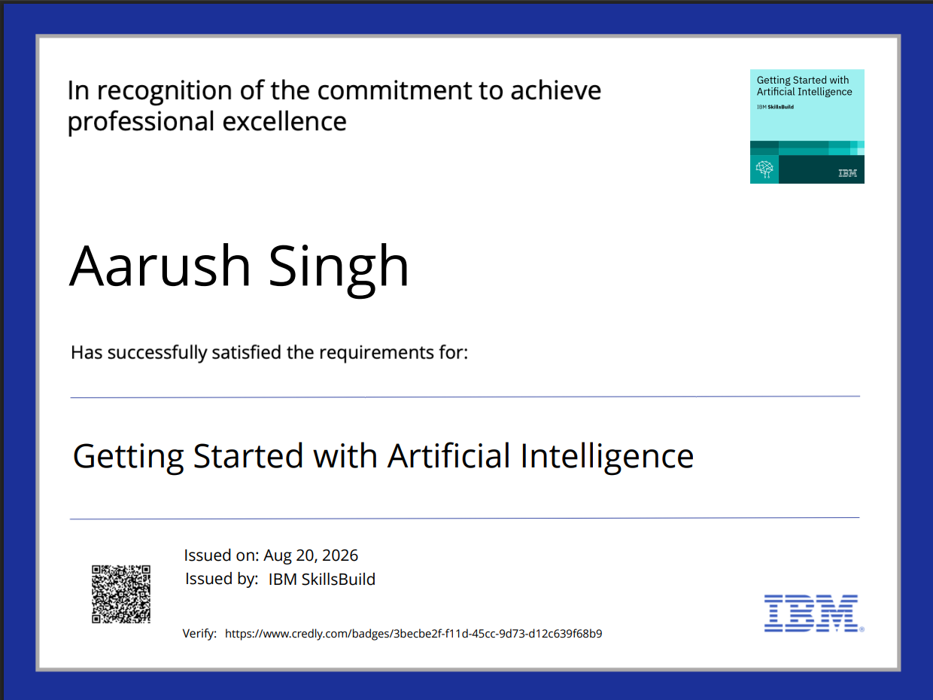
Certificates Earned:
Please add your credly certificate(Getting Started with Artificial Intelligence)

Slide 29
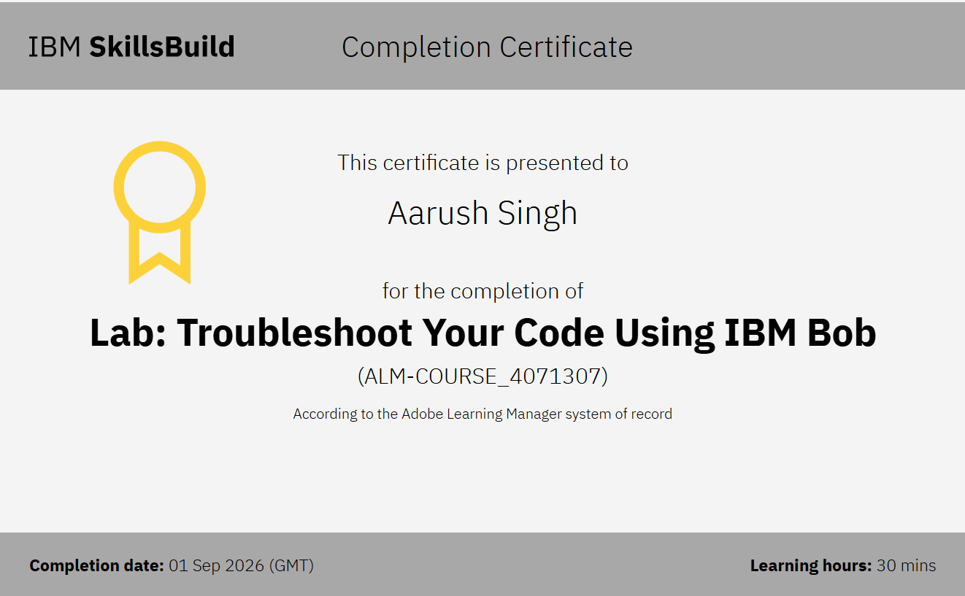
Certificates Earned:​
Add your IBM BOB Certificate

Slide 30
THANK YOU

