Slide 1

Project Title : Seasonal Agriculture Performance Analysis Student : Aarush Singh College : G H Raisoni International Skill Tech University AICTE STU ID : STU6736c7458b0c11731643205

Slide 2

PROBLEM STATEMENT
Agricultural performance is influenced by seasonal variations in environmental conditions, farming practices, resource availability and market conditions. As a result, agricultural performance may differ from one season to another.
However, raw agricultural data does not clearly explain how agricultural performance changes across seasons or what patterns can be observed under different seasonal conditions.
Therefore, this project analyzes agricultural data to identify meaningful patterns, trends, relationships and variations in crop yield, production, profitability, resource utilization and agricultural risk.

Slide 3
Project Description This project performs an exploratory and statistical analysis of agricultural performance using a dataset containing 4,000 records and 28 variables. The analysis examines crops, seasons, locations, environmental conditions, agricultural inputs, irrigation methods, production, yield, revenue, cost, profit, water usage and disease/pest risk. Data cleaning, descriptive statistics, univariate, bivariate and multivariate analysis, outlier detection, correlation analysis and seasonal comparisons are performed to identify important patterns. The project also includes student-designed analyses to evaluate crop performance, irrigation efficiency, profitability and seasonal risk.

Slide 4

WHO ARE THE END USERS?
Farmers
Agricultural planners
Agricultural researchers
Government agricultural departments
Agribusiness organizations
Data analysts
Agricultural consultants
Policy makers
Purpose: To support data-driven agricultural planning and decision-making.

Slide 5

Technology Used
Programming
Python
Libraries
Pandas
NumPy
Matplotlib
Seaborn
Platform
Google Colab
Data Analysis
Exploratory Data Analysis
Statistical Analysis
Correlation Analysis
Data Visualization
Version Control
GitHub

Slide 6
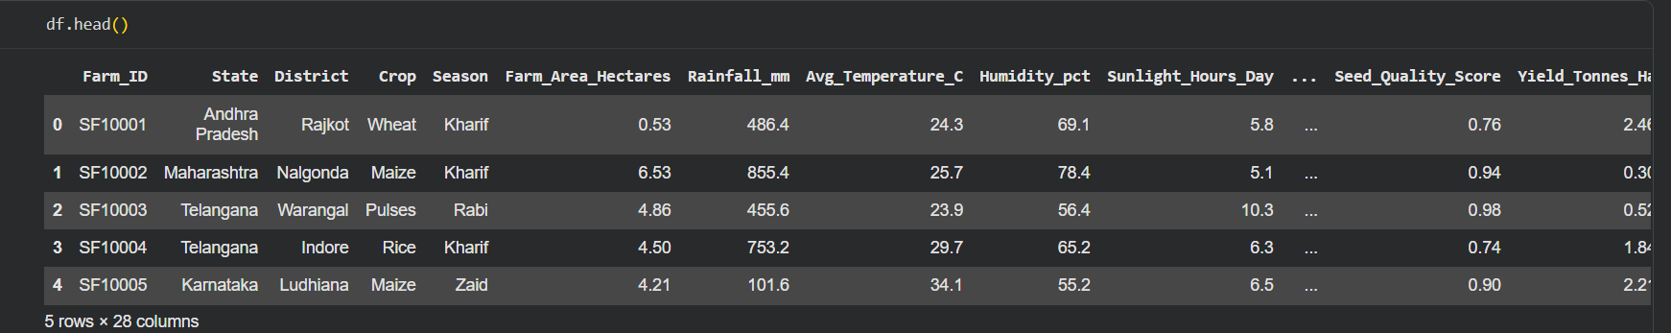
RESULTS
Dataset Overview
Records: 4,000
Variables: 28
Crops: 8
Seasons: 3
States: 8
Districts: 10
Irrigation Methods: 4
Duplicate Records: 0

Slide 7
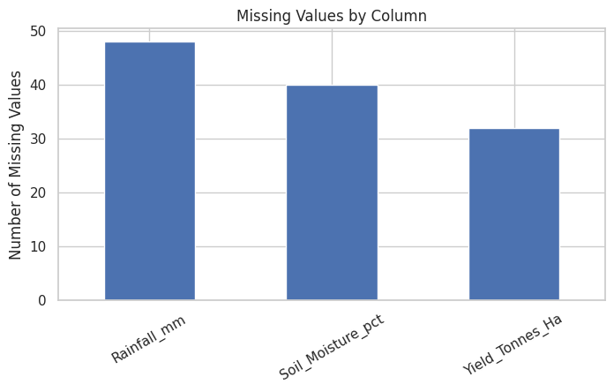
RESULTS
Rainfall missing values: 48
Soil moisture missing values: 40
Yield missing values: 32
Missing values handled using median imputation
Duplicate records: 0

Slide 8
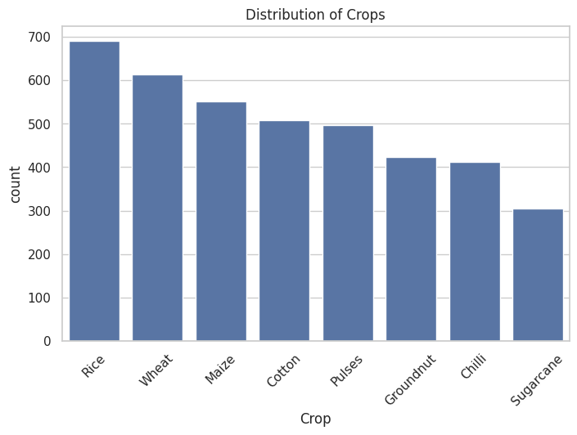
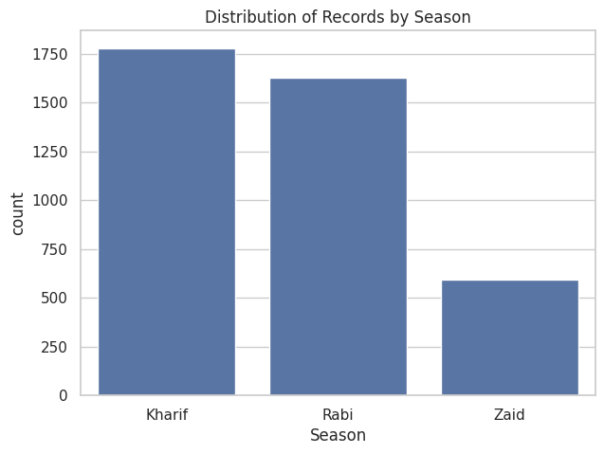
RESULTS
The visualizations show the distribution of agricultural records across crops and seasons.

Slide 9
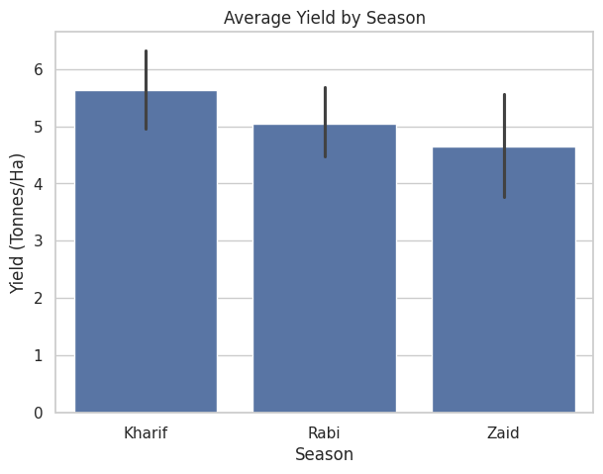
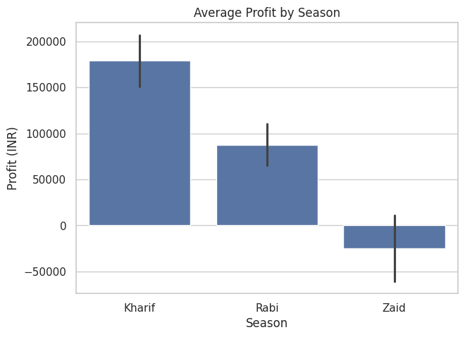
RESULTS
Seasonal comparison reveals meaningful differences in agricultural performance, with Kharif showing the highest average yield in the analyzed dataset.

Slide 10
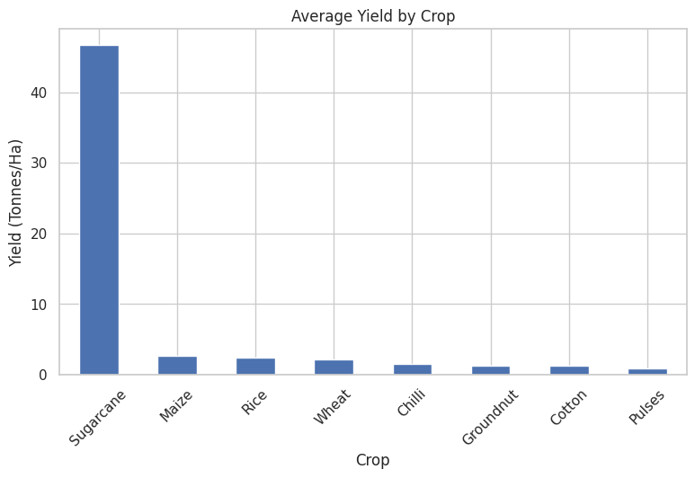
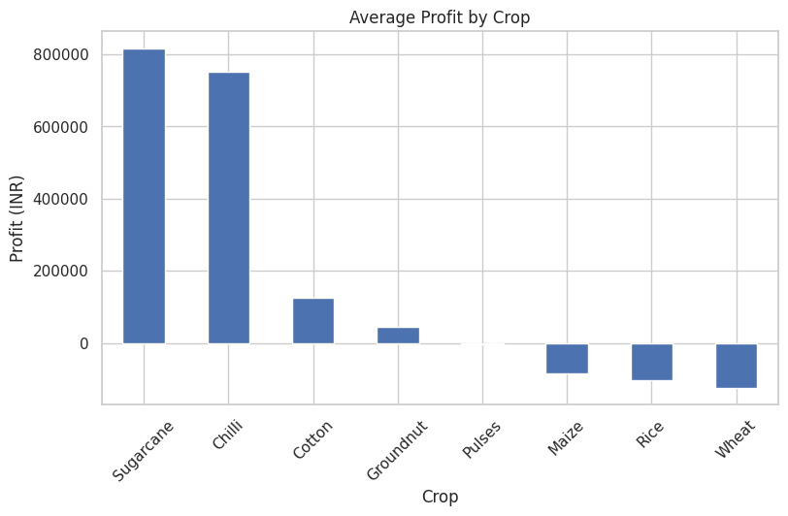
RESULTS
Crop-level analysis shows substantial variation in both productivity and profitability.
Sugarcane records the highest average yield and average profit in the dataset.

Slide 11
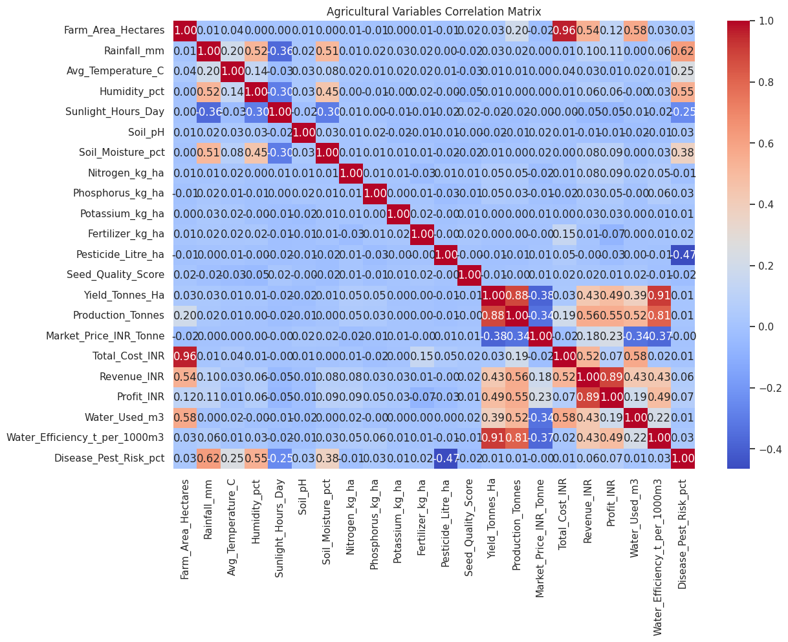
RESULTS
Correlation analysis was performed to understand relationships between environmental conditions, agricultural inputs, yield, production, revenue, profit and resource efficiency.

Slide 12
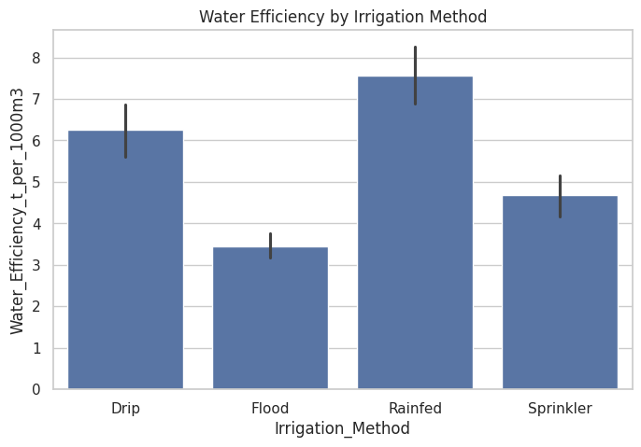
RESULTS
Irrigation methods show differences in yield, profitability and water efficiency, highlighting the importance of resource-management practices.
Drip irrigation shows strong performance in yield and profitability in the analyzed dataset.

Slide 13
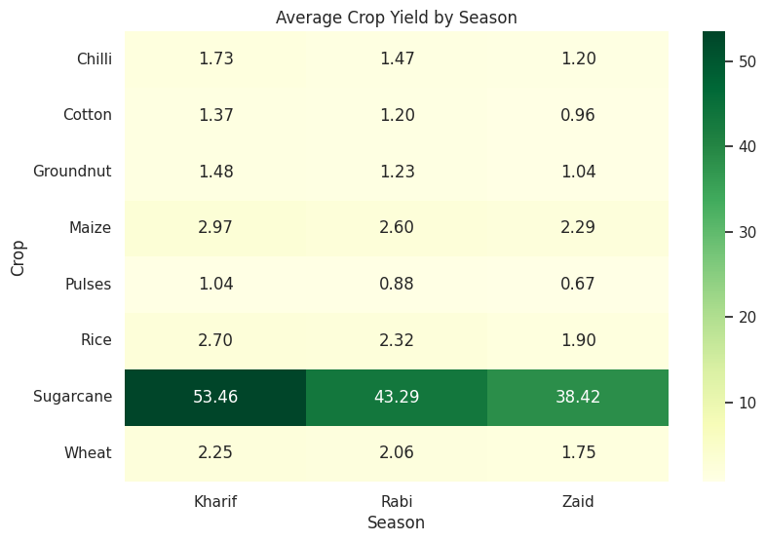
RESULTS
The heatmap highlights how crop performance changes across seasons and helps identify season-specific high-performing crop combinations.

Slide 14
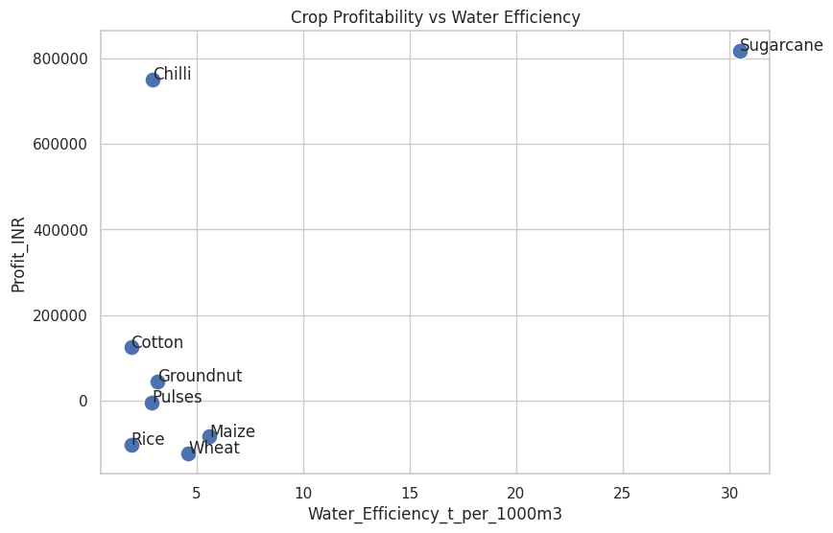
RESULTS
This analysis evaluates crops using two important dimensions: profitability and water-use efficiency. It helps identify crops that combine economic returns with efficient resource utilization.

Slide 15
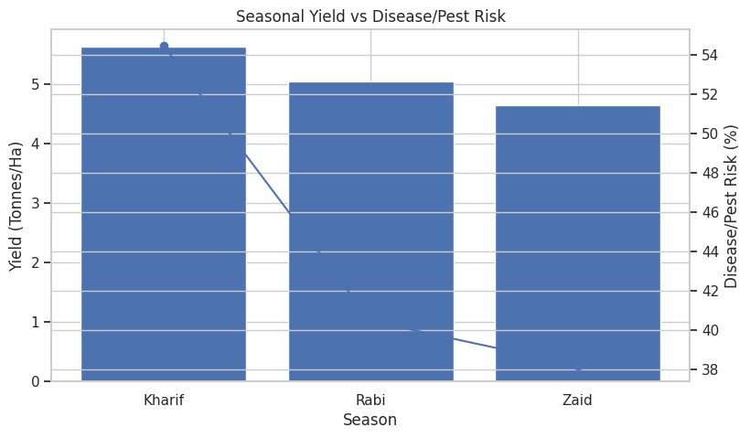
RESULTS
Disease and pest risk varies across seasons. Comparing risk with yield provides additional context for seasonal agricultural planning.

Slide 16
Key Insights 1. Kharif records the highest average yield in the dataset. 2. Agricultural performance varies significantly across seasons. 3. Crop performance differs across seasonal conditions. 4. Sugarcane shows the highest average yield in the analyzed dataset. 5. Crop profitability varies considerably. 6. Irrigation methods show differences in yield and water efficiency. 7. Yield has strong relationships with production and resource-efficiency variables. 8. Disease/pest risk differs across seasons and should be considered during planning.

Slide 17
Future scope
Integrate real-time weather data.
Include multi-year agricultural datasets.
Develop crop yield prediction models.
Build seasonal crop recommendation systems.
Use machine learning for yield and profit prediction.
Develop interactive dashboards using Power BI or Streamlit.
Incorporate satellite and soil sensor data.
Provide region-specific agricultural recommendations.

Slide 18
GitHub Link
https://github.com/Aarush-Singh01/seasonal-agriculture-performance-analysis.git
GitHub

Slide 19

VOIS Course completion certificate - Course name- Data Visualization

Slide 20

VOIS Course completion certificate - Course name- Data Analysis Using NumPy
.
.

Slide 21

VOIS Course completion certificate - Course name- Data Visualization
.
.

Slide 22

VOIS Course completion certificate - Course name- Permission Management
.
.

Slide 23

VOIS Course completion certificate - Course name- Linux Vi Text Editors
.
.

Slide 24

VOIS Course completion certificate - Course name- Linux Administration
.
.

Slide 25

VOIS Course completion certificate - Course name- Getting Started with Class and Objects
.
.

Slide 26

VOIS Course completion certificate - Course name- Getting Started with Sequenced Data Types
.
.

Slide 27

VOIS Course completion certificate - Course name- Getting Started with Operations on Strings
.
.

Slide 28

VOIS Course completion certificate - Course name- Building Blocks Of Python
.
.

Slide 29

VOIS Course completion certificate - Course name- Getting Started with Basics of Python
.
.

Slide 30

VOIS Course completion certificate - Course name- Getting Started with Python Environment Installations
.
.

Slide 31

VOIS Course completion certificate - Course name- Basics of Linux Operating Systems
.
.

Slide 32

VOIS Course completion certificate - Course name- Getting Started with Linux File System
.
.

Slide 33

VOIS Course completion certificate - Course name- Linux System Utilities
.
.

Slide 34
Thank you
.
.

