Slide 1
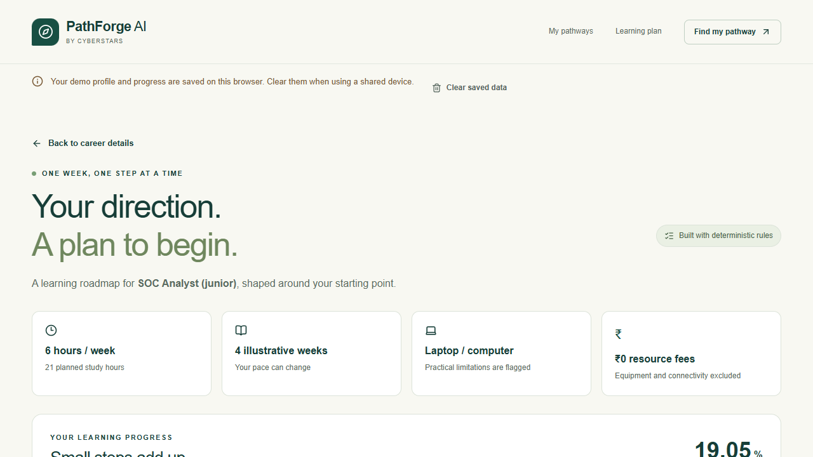
SEVA INNOVATION CHALLENGE 2026 • REFERENCE PITCH DECK
PathForge AI | CYBERSTARS
Working local prototype
12 careers · 36 skills
33 checked learning references
Explained matching and weekly plans
Progress saved on the student's browser
AI, quizzes and translations are planned; they are not implemented.
Career pathways that respect a student's skills, time, device and budget.
General | Education & Employability
Working prototype: Phases 1–2
Aarush Tendulkar | CYBERSTARS
Local demonstration; public deployment pending
Notes:
Scope: deterministic working prototype. No LLM, backend-graded assessment, translation coverage or pilot outcome is claimed.

Slide 2
2
The Problem
Problem hypothesis: career advice should account for practical learning constraints.
What is the problem?
Who is affected, and where?
Students may know a career goal but struggle to connect current skills with realistic next steps. A useful plan needs to reflect time, device access and budget.
Intended users: diploma, ITI, undergraduate and first-generation job seekers in Maharashtra and similar regions. No measured beneficiary count is claimed.
Not measured
Target reach is to be established through a consenting pilot.
Evidence
Current gaps
Why it matters
No student interviews or field pilot yet. Problem and curriculum assumptions require local review. Current evidence is a working prototype and automated checks.
Hypothesis to test: generic plans can overlook device access, prerequisite skills and available study hours. No competitor cost or speed benchmark has been performed.
Aim: make the next learning step understandable and feasible without promising a job.
Seva Innovation Challenge 2026 | Slide 2 of 6
Notes:
Problem is a hypothesis from the project brief. Do not substitute fabricated population/survey/placement statistics.

Slide 3
3
Our Solution & Innovation
Built: guest onboarding → explained matches → career gaps → weekly roadmap → local progress.
Our solution in brief
What makes it new?
A Next.js interface and FastAPI service calculate career matches with transparent rules. The planner schedules prerequisites, free references and activities within weekly hours, with explicit device limitations.
 | Baseline to validate | Current prototype
Cost | Not benchmarked | No paid API calls
Speed / time | Not benchmarked | Weekly hours constrained
Reach / access | Not benchmarked | Guest; phone limits explicit
Ease of use | Not benchmarked | Explained scores; pilot planned
How it works
1
2
3
Input
›
Process
›
Output
Skills, interests, time, budget and device
Weighted matching + prerequisite planning
Three paths, exact gaps and weekly tasks
Key USP
Same SOC goal: 6h/week + laptop gives 4 illustrative weeks; 4h/week + phone gives 6 weeks and theory alternatives. This is a design mechanism, not a validated novelty or patent claim.
Seva Innovation Challenge 2026 | Slide 3 of 6
Notes:
Architecture: Next.js → FastAPI → pure matching/planning; SQLite stores public catalogs; localStorage stores guest progress. Source and scoring disclosures are in docs/architecture.md and docs/data-sources.md.

Slide 4
4
Feasibility & Implementation
Working locally; public hosting and human validation remain pending.
Current stage (mark ✔ where you are today)
Idea
Proof of Concept
✓ Working Prototype
Field Pilot
Ready to Deploy
Technology
Estimated cost
Timeline
Partners
Next.js + TypeScript, FastAPI + Pydantic, SQLite/SQLAlchemy/Alembic. No LLM API. Browser-local progress. Expert administration and a gated public directory are implemented. See the verification record for current test counts.
Current demo: zero paid API calls; free public reading references. Free hosting is conditional on provider limits, not an always-on guarantee. Pilot staffing/device costs are not yet quoted.
Proposed: 3 months—review mappings and a small consenting pilot; 6 months—evaluate usefulness and refine; 12 months—consider expansion if evidence supports it. These are targets, not completed milestones.
No adoption or institutional partner confirmed. Seeking educators/counsellors for curriculum review and access to consenting students for a pilot.
Seva Innovation Challenge 2026 | Slide 4 of 6
Notes:
Costs exclude engineering time, devices, connectivity, supervision and support. Vercel Hobby and Render Free have usage/cold-start limits. Public deployment has not been verified.

Slide 5
5
Impact & Scalability
Intended impact; outcomes have not yet been measured.
Pilot planned
Not measured
Not measured
Beneficiaries reached
Saving in cost / time
Jobs or livelihoods
5–10 consenting students proposed; not recruited
No baseline time/cost comparison yet
No placement or job-creation claim
Social impact
Sustainability
Scale-up plan
Aim: clearer career exploration for students with different devices, study hours and budgets. Phone alternatives support theory; practical work still needs appropriate access.
Current prototype avoids paid AI. Longer-term hosting, maintenance and curriculum review need a sustainable sponsor/institution model; no revenue or funding is claimed.
Start with local curriculum review. Track explanation comprehension, usefulness (1–5), task completion and resource availability, then expand only after reviewing evidence.
Seva Innovation Challenge 2026 | Slide 5 of 6
Notes:
Pilot measures: consent/date/sample size, completion rate, time to roadmap, comprehension, usefulness, task completion and working-link rate. All are planned, not collected.

Slide 6
6
Team/Individual & Support Required
CYBERSTARS | Aarush Tendulkar, Team Lead | Team size: 1. Guidance experts are separate.
No photo supplied
Aarush Tendulkar
Support we are seeking
Team Lead | CYBERSTARS
Requested: mentorship and curriculum review
Qualification: to be confirmed
Requested: access to a consenting local pilot
Funding needs: not quoted; define after pilot design
Project team: Aarush Tendulkar, Team Lead. Team size: 1.
Student guidance experts are managed separately in the application. No experts or institutional partners are confirmed.
Incubation: optional future support
Requested: accessibility and evaluation guidance
Support would help test usefulness and feasibility with students before making impact or readiness claims.
Mentor / institutional partner: none confirmed
Contact: | Public demo URL: pending deployment
Seva Innovation Challenge 2026 | Slide 6 of 6
Notes:
Applicant: Aarush Tendulkar; Team Lead, CYBERSTARS; team size 1. General Category, Education and Employability. Contact remains null; verify mandatory contact and qualification fields directly with the applicant. Guidance experts belong to the database, not the project roster. Organizer page asks PPTX while downloaded template asks PDF ≤10MB; follow the actual portal upload control. Source: https://www.sevainnovationchallenge.in/guidelines.html checked 25 Oct 2026.

