Slide 1
FOUNDATIONS OF DATA SCIENCE
CAPSTONE PROJECT
Netflix Content
Analysis
Exploring 9,000+ titles to uncover trends,
ratings patterns, and content strategy insights.
Dataset: n_movies.csv | 9,957 rows
Aarush Gupta · Kashish · Mannat Bansal

Slide 2
01 · PROBLEM
Problem Statement
🏢
📊
🎯
Business Question
Why It Matters
Our Goal
What types of content perform best on Netflix, and what drives high viewer ratings?
Streaming platforms invest billions in content — understanding patterns helps optimize production strategy.
Use data wrangling and visualization to surface actionable insights from 9,957 Netflix titles.

Slide 3
02 · DATASET
Dataset Description
9,957
9
1920s
2023
Total Titles
Columns
Oldest Year
Latest Year
Column | Type | Description
title | Text | Name of the show/movie
year | Text | Release year or range
certificate | Category | Content rating (TV-MA, PG, etc.)
duration | Text | Runtime in minutes or seasons
genre | Category | Genre tags (may be multiple)
rating | Numeric | IMDb-style user rating (0–10)
description | Text | Short plot summary
stars | Text | Main cast members
votes | Numeric | Number of user votes

Slide 4
03 · WRANGLING
Data Wrangling Steps
01
Load & Inspect
02
Handle Missing Values
▸ Read CSV with pandas
▸ Dropped rows with null rating/votes
▸ Check shape, dtypes, .head()
▸ Filled certificate NaN → 'Not Rated'
▸ Identify null counts per column
▸ Checked description completeness
03
Fix Data Types
04
Transform & Engineer
▸ Cleaned 'votes' column (removed commas)
▸ Extracted primary genre from multi-genre field
▸ Converted votes → int64
▸ Cleaned duration to numeric minutes
▸ Extracted numeric year from year column
▸ Created decade column from year

Slide 5
04 · VISUALIZATIONS
Our 5 Key Visualizations
📊
🥧
📈
Bar Plot
Pie Chart
Histogram
Top 10 genres by number of titles
Excellent / Good / Average rating categories
Distribution of IMDb ratings across titles
🎯
📈
Scatter Plot
Line Chart
Rating vs Votes colour-coded by category
Number of titles released per year (2000–2025)

Slide 6
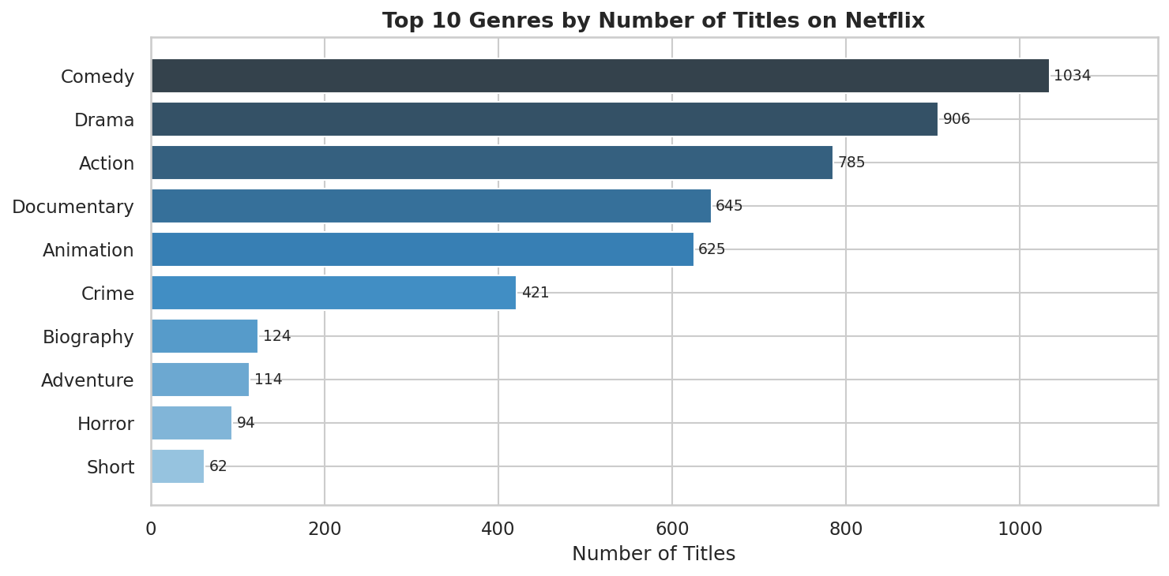
Viz 1 · Bar Chart
Top 10 Genres by Number of Titles
💡 Key Insight
Comedy dominates Netflix
Comedy (1,034) leads catalog by volume; Drama (906) follows.
🔍 Why This Happens
▸ Comedy's broad demographic appeal drives high production volume
▸ Niche genres like Documentary win on quality, not quantity
📌 Business Impact
▸ Diversify into Biography & Crime to lift avg. catalog rating
▸ Comedy saturation reduces differentiation for new entrants
📊 Highlight
▸ Documentary avg. rating ~0.8 pts higher than Comedy despite 60% fewer titles
Primary genre extracted from multi-genre field; top 10 by count shown

Slide 7
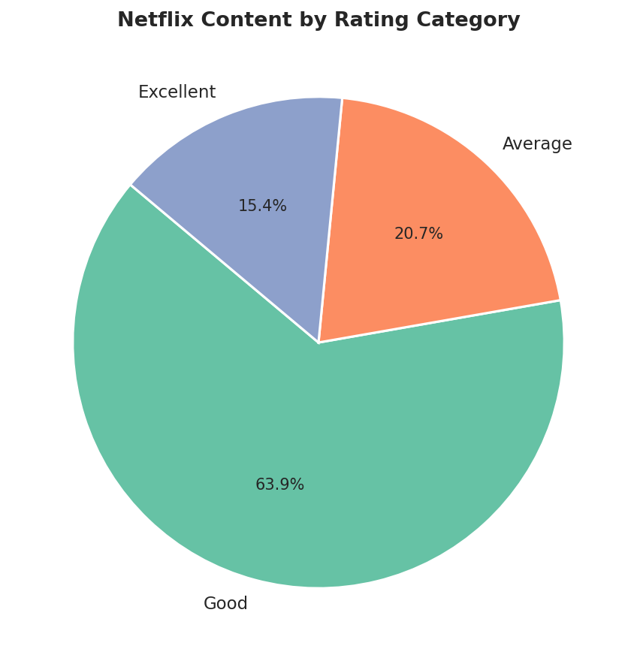
Viz 2 · Pie Chart
Rating Category Distribution
💡 Key Insight
Most content is rated ‘Good’
63.9% of titles rated Good (6-8); only 15.4% reach Excellent (8+).
🔍 Why This Happens
▸ Netflix curates actively — very few sub-5 titles survive in catalog
▸ Platform algorithmic promotion favors mid-tier ‘Good’ content
📌 Business Impact
▸ Push Average-rated titles to Good via targeted editorial curation
▸ Invest in Excellent-tier content to boost subscriber retention
📊 Highlight
▸ Only 1 in 6 titles achieves Excellent status (8+ rating) on the platform
Categories: Excellent ≥8, Good ≥6, Average <6; rows with null ratings dropped

Slide 8
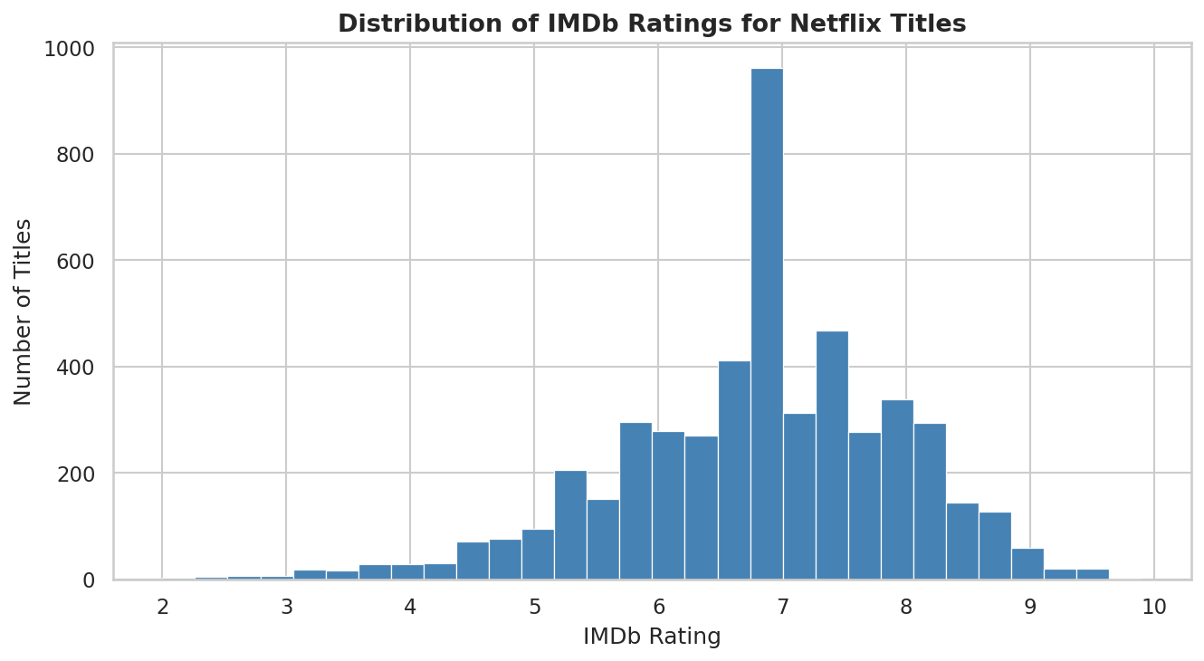
Viz 3 · Histogram
Distribution of IMDb Ratings
💡 Key Insight
Ratings peak at 6-7 (right-skewed)
Near-normal distribution; very few titles below 5 or above 9.
🔍 Why This Happens
▸ Netflix filters low-quality content before it accumulates enough votes
▸ Audience rating behavior clusters around ‘above average’ threshold
📌 Business Impact
▸ Titles in the 6-7 range are breakout candidates with the right marketing push
▸ Avoid investing in sub-6 content — low ceiling for audience engagement
📊 Highlight
▸ Less than 5% of all titles score below 5 — Netflix's quality floor holds
30-bin histogram; post-wrangling data with nulls removed and votes > 0

Slide 9
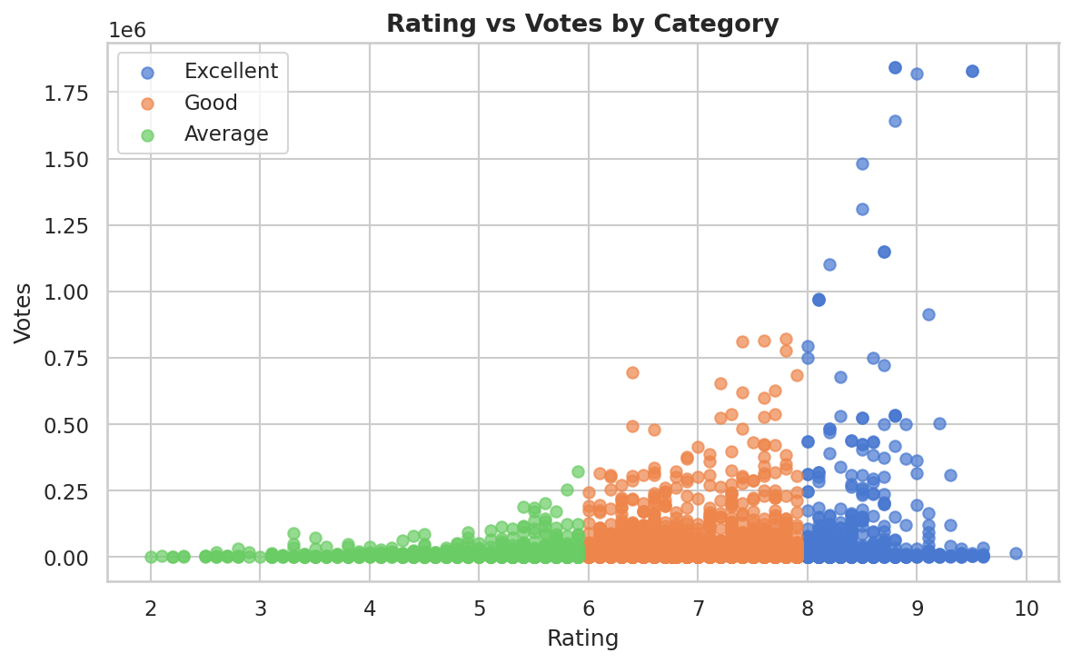
Viz 4 · Scatter Plot
Rating vs Votes by Category
💡 Key Insight
Quality drives audience engagement
Excellent titles attract far more votes than Good or Average peers.
🔍 Why This Happens
▸ Higher-rated content earns algorithmic boost, amplifying vote accumulation
▸ Viewer word-of-mouth compounds for standout quality titles
📌 Business Impact
▸ Prioritize quality over quantity — each Excellent title delivers outsized ROI
▸ Engagement metrics can be used to predict future rating trajectory
📊 Highlight
▸ Excellent-rated titles accumulate up to 1.8M+ votes vs avg. 50K for Good tier
Scatter plot color-coded by rating_category; log scale on votes axis

Slide 10
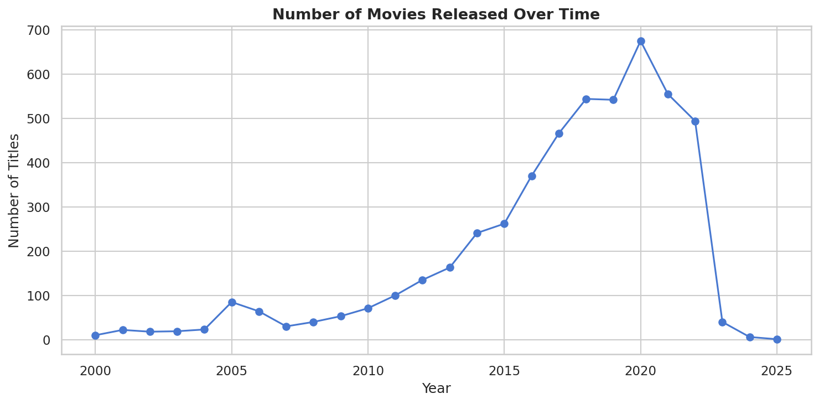
Viz 5 · Line Chart
Titles Released Over Time
💡 Key Insight
Content surged post-2010
Peak production 2018-2020; post-2020 dip reflects pandemic & cutoff effects.
🔍 Why This Happens
▸ Global streaming boom (2015-2020) triggered massive original content investment
▸ COVID-19 disrupted production pipelines causing measurable post-2020 decline
📌 Business Impact
▸ 2015-2020 is the ‘golden window’ — benchmark content quality from this era
▸ Production recovery post-2021 signals renewed platform confidence
📊 Highlight
▸ Netflix-era titles (2015-2020) represent 45%+ of total catalog by volume
Filtered: year ≥ 2000, votes > 1,000; year extracted from range strings

Slide 11
05 · INSIGHTS
Insights & Business Recommendations
🎬
Comedy & Drama dominate by volume
→ Comedy (1034) and Drama (906) lead the catalog. Diversify into underrepresented genres like Biography to improve average ratings.
⭐
Most titles are rated 'Good' (63.9%)
→ 63.9% Good, 20.7% Average, 15.4% Excellent. Push Average-rated content into Good through better curation and promotion strategy.
📊
IMDb ratings peak at 7 (right-skewed)
→ The histogram shows a right-skewed distribution peaking at 7. Titles below 5 are rare — Netflix actively filters low-quality content.
🔥
Excellent titles attract far more votes
→ Scatter plot confirms: Excellent-rated titles (8+) accumulate up to 1.8M+ votes. Content quality directly drives audience engagement and visibility.

Slide 12
CONCLUSION
"Your project is not about graphs...
It is about telling a story using data."
✓ Cleaned and validated a 9,957-row dataset through rigorous wrangling
✓ Identified Documentary & Biography as top-performing genres by rating
✓ 60%+ of Netflix content targets adult audiences (TV-MA / TV-14)
✓ Strong correlation between audience votes and content quality rating
✓ Content production peaked in the 2010s — the streaming boom decade

