Slide 1
CLOUD COMPUTING
- By -
Aarush P. & Akshar D.
8A

Slide 2

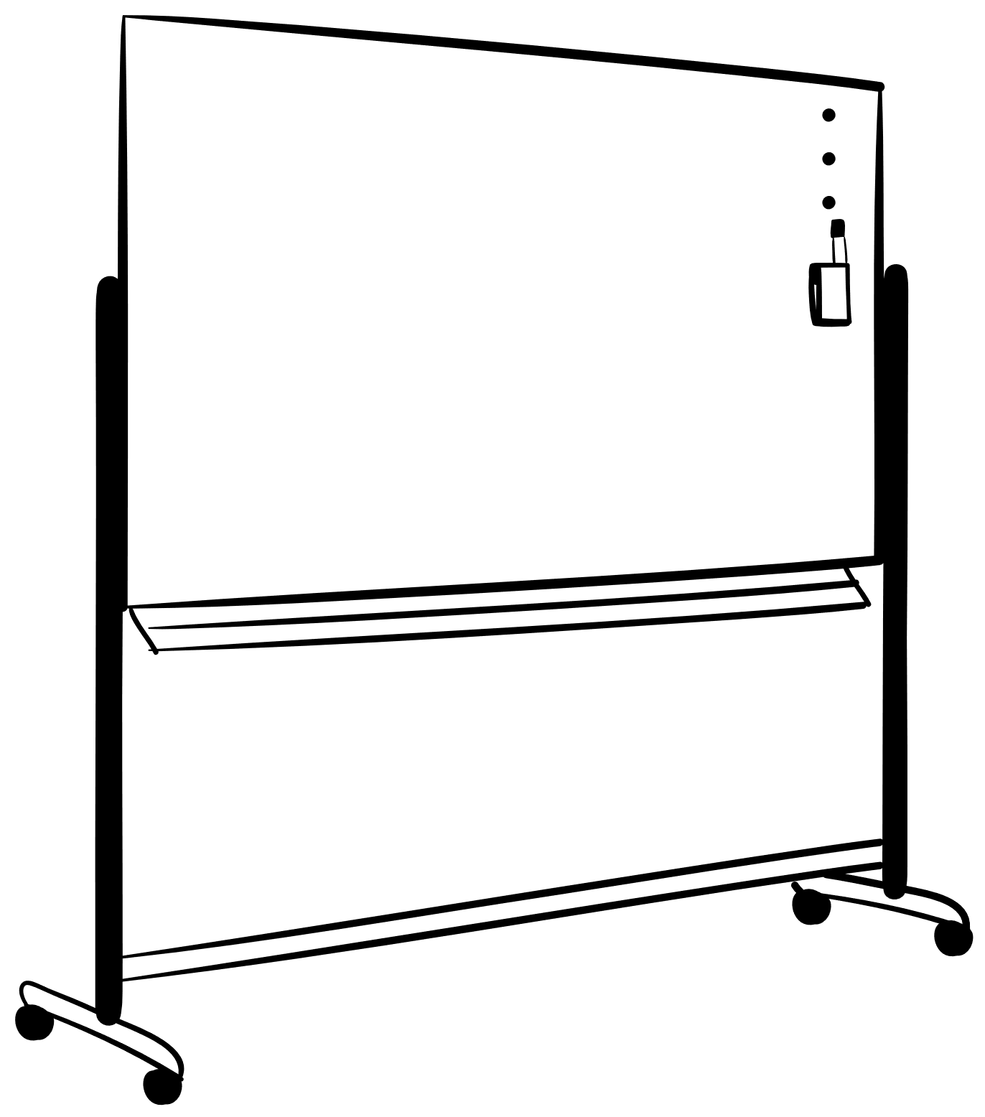










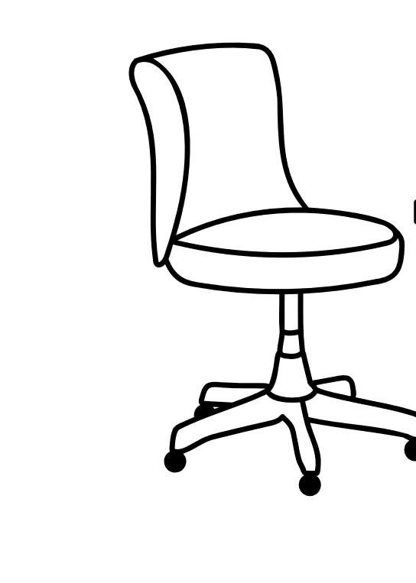


COMIC STRIP
Do you offer
‘Homework-as-a-Service, i.e. HaaS’?
Cloud

Slide 3
TABLE OF CONTENTS
02
01
04
05
TABLE OF CONTENTS
WHAT
IS IT?
AIMS AND GOALS
DEPLOYMENT
MODELS
03
Definition & Origin of Cloud Computing
What does it want to provide?
Private Cloud, Public Cloud & Hybrid Cloud
SERVICE
MODELS
PROS
CONS
&
06
ITS USES
IaaS, SaaS, PaaS, MBaaS, Serverless Computing
How it’s beneficial and at the same time, disadvantageous.
Role of Cloud Computing In Today’s World

Slide 4
01
PREFACE
TO CLOUD COMPUTING

Slide 5
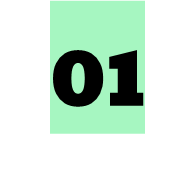

CLOUD COMPUTING
Simply put, cloud computing is described as the delivery of various computing services such as servers, storage, databases, networking, software, analytics, and intelligence, which we already have.
The difference? It’s offered over the Internet (“the cloud”)to offer faster innovation and flexible resources.

Slide 6
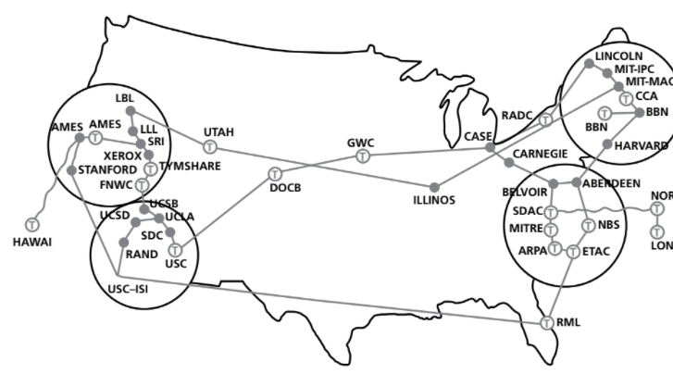
ORIGIN
In 1950s, a problem – How can many people access the same technology? – triggered the existence of Cloud Computing.
J.C.R. Licklider, at Pentagon’s ARPA division, was the first to discuss the idea of the ‘Cloud’.
His ideas materialized when ARPAnet came into existence! →
The proper term given to it was coined by Compaq as – ‘Cloud Computing’.
Now, almost everything is on the cloud!

Slide 7
02
AIMS AND GOALS OF CLOUD COMPUTING

Slide 8
AIMS AND GOALS OF CLOUD COMPUTING
First & Foremost, It’s primary goal is to provide easy, scalable access to computing resources and IT services.
It also aims to globalize the modern workspaces and provide accessibility on demand.
It lets you ‘plug into' infrastructure via the internet, and use computing resources without installing and maintaining them on-premises.
Organizations and companies can deliver their software to all their employees & users, wherever they are.
It helps to minimize the chances of data loss.
Lastly, streaming videos and games, with running programs on powerful PCs and then streaming – it’s cloud computing!

Slide 9
03
DEPLOYMENT MODELS OF CLOUD COMPUTING

Slide 10


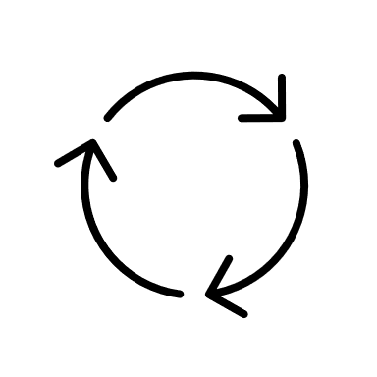
DEPLOYMENT MODELS
03
Private Clouds
Public Clouds
Hybrid Clouds

Slide 11
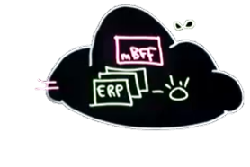
PUBLIC CLOUDS
The public cloud is defined as computing services offered by third-party providers over the Internet.
This is available to anyone who wants to buys it / use it.
Here, a third-party provider would host and manage all the infrastructure.
Public clouds are more elastic and scalable than private clouds.
Several companies offer such services, which will be discussed later.

Slide 12
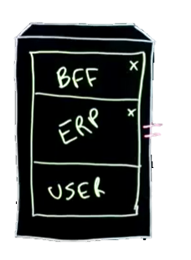
PRIVATE CLOUDS
The private cloud is defined as computing services offered either over the Internet or a private internal network and only to select users instead of the general public.
Here, the server may be located on-premises or be hosted by a third-party provider.
Private clouds offer more security and administrative privileges over public clouds.
Documents are more secure too!
Private clouds deliver 2 service models – IaaS & PaaS.

Slide 13
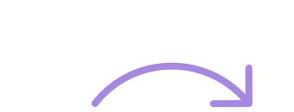
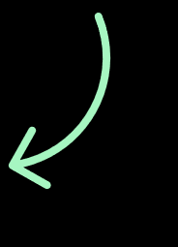
HYBRID CLOUDS
A hybrid cloud is a computing environment, combining a private cloud with a public cloud, allowing data and applications to be shared between them.
It’s also referred to as a multicloud configuration.
Hybrid clouds are the most beneficial of all 3 types.
This is because organizations can easily meet their data storage objectives.
It allows avoiding the time and cost of maintaining new servers, which may not be needed.

Slide 14
04
SERVICE MODELS OF CLOUD COMPUTING

Slide 15
SERVICE MODELS
IaaS
PaaS
SaaS
IaaS stands for Infrastructure as a Service.
PaaS stands for Platform as a Service.
SaaS stands for Software as a Service.

Slide 16
SERVICE MODELS
MBaaS
Serverless computing
MBaaS stands for Mobile Backend as a Service.
“Serverless” is a misnomer here!!

Slide 17
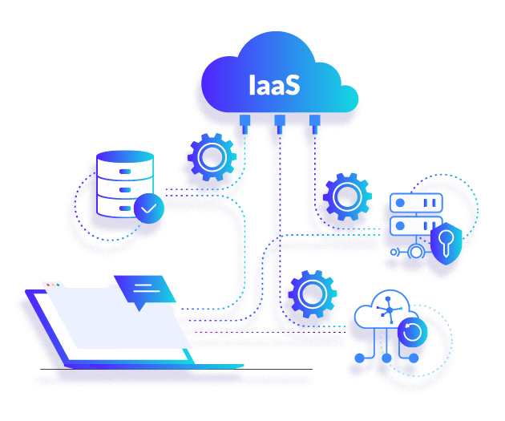
IaaS Infrastructure as a Service
Infrastructure as a service refers to online services that provide network infrastructure.
It also provides access to fundamental computing resources over the internet.
As resources are easily scalable, IaaS helps prevent overbuying of resources.
However, it’s important to note that it offers the lowest-level control of computing resources.
Currently, it’s growth rate has stagnated.
For example, physical computing resources, location, security, etc.

Slide 18
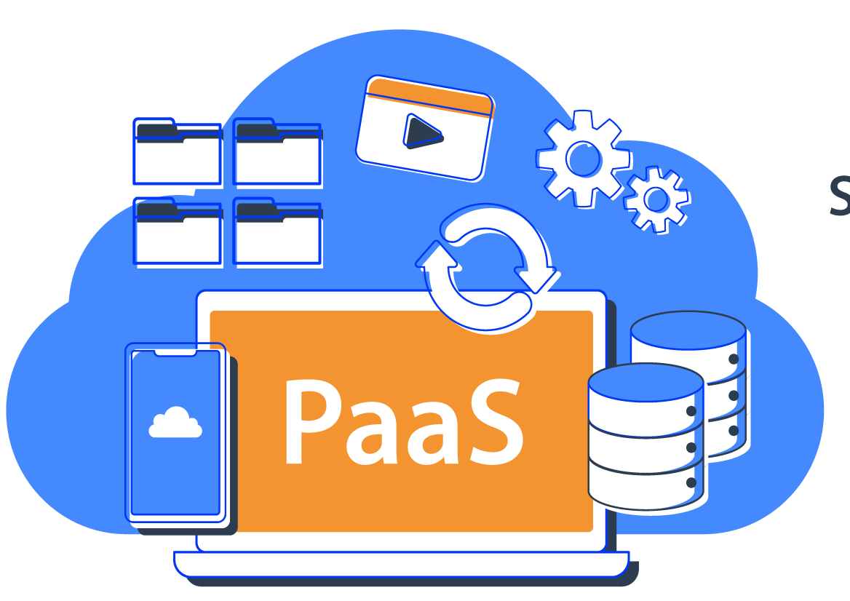
Platform as a Service is a cloud computing model where a third-party provider delivers hardware and software tools to users over the internet.
With PaaS, the cloud provider hosts everything (servers, networks, storage, etc.)at their data center.
Usually, these tools are needed for application development.
Here, virtual machines are the backbone for offering the endless services on demand.
PaaS Platform as a Service

Slide 19
Software as a Service is a software distribution model in which a cloud provider hosts applications and makes them available to users over the internet.
In most cases, SaaS users pay a monthly or annual subscription fee; some may offer ‘pay-as-you-go’ pricing based on your actual usage.
For example, Google Workspace, Dropbox, Cisco WebEx, etc.
SaaS Software as a Service

Slide 20
Mobile Backend as a Service, also known as backend as a service, is a cloud model that provides web app and mobile app developers with a way to link their applications to backend cloud service.
They provide features such as user management, push notifications, etc.
It is mainly used to make mobile apps and web apps.
The most common example is the use of MBaaS by social media networking sites.
MBaaS Mobile Backend as a Service

Slide 21
Serverless computing is a cloud computing model that offloads the backend infrastructure management tasks (like patching, scheduling, etc.) to the cloud provider.
This leaves the developers free to focus on the code and business logic specific to all their applications.
Some examples include AWS Lambda and IBM Openwhisk.
Serverless Computing

Slide 22
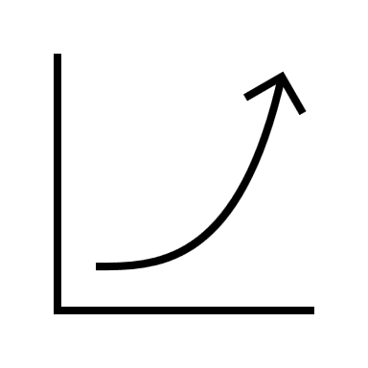
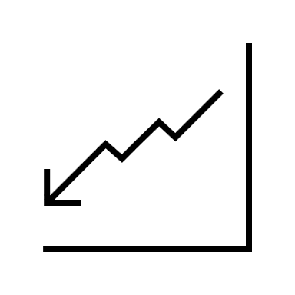
05
PROS & CONS
OF CLOUD COMPUTING

Slide 23

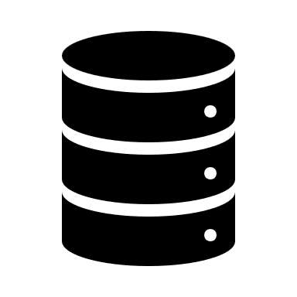
ADVANTAGES OF CLOUD COMPUTING
Back Up and Restore
Excellent accessibility
Once data is stored in the cloud, back up and restore of data is made easy.
Data in the cloud can be accessed from anywhere in the world with a stable internet connection.
Unlimited Storage Capacity
Data Security
The cloud offers a huge amount of storage (almost unlimited) capacity.
There are many features on the cloud used to keep your data safe and secure.

Slide 24

DISADVANTAGES OF CLOUD COMPUTING
Internet Stability
Expensive Storage
If the client has a slow or unstable internet connection, they will have problems accessing data.
Costs can be high if large storage capacity is required.
Risk of Failure
Internet Costs
Potential failure of the cloud is possible, causing a loss of data.
Expensive to pay for high download/upload data transfer limits with the client’s internet service provider (ISP)

Slide 25
MAJOR SECURITY BREACHES
XEN Security Breach
The XEN security threat forced several cloud operators to reboot all their cloud servers.
This was caused by a problem in the XEN hypervisor, which managed all the VMs.
A hypervisor is a piece of computer software, firmware or hardware that creates and runs virtual machines.
Celebrity Photos Cloud Hacking Scandal
The celebrity photos cloud hacking scandal, in which more than 100 private photos of celebrities were leaked.
Hackers had gained access to several cloud accounts, which enabled them to publish the photos on social networks and sell them to publishing companies.

Slide 26
MAJOR SECURITY BREACHES
NEIM Security Breach
In 2016, the National Electoral Institute of Mexico suffered a cloud security breach in which 93 million voter registrations, stored on a central database, were compromised and became publicly available to everyone.
To make matters worse, much of the information on this database was also linked to an Amazon cloud server outside Mexico.
Data Loss Due to Software
A large cloud service provider permanently lost data during a routine back-up procedure.

Slide 27
06
USES
OF CLOUD COMPUTING

Slide 28
USES OF CLOUD COMPUTING
Cloud Storage
Data Backup
Disaster Recovery
The cloud offers large amounts of storage
The cloud automatically backs up data
The cloud provides fast data recovery.
Data Analytics
EARTH
NEPTUNE
The cloud offers many ways to analyse huge amounts of data.
The Earth is a beautiful place
Neptune is far away from the Sun

Slide 29

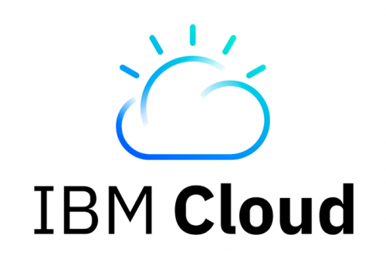

CLOUD SERVICE PROVIDERS
Amazon Web Services
Microsoft Azure
IBM Cloud

Slide 30
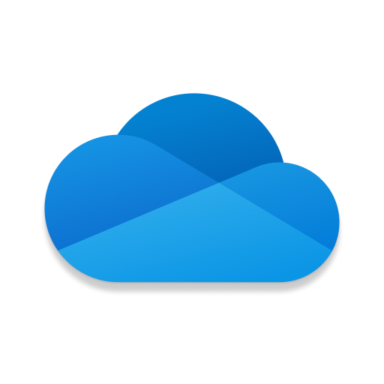
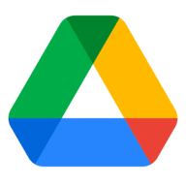
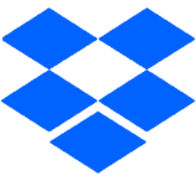
CLOUD STORAGE PROVIDERS
OneDrive
Google Drive
DropBox
Earlier was Skydrive
Hosted By Microsoft
Provides 5GB Free Storage
Hosted by Google
Provides 15GB Free Storage
Hosted By Dropbox Inc.
Provides 2GB Free Storgage

Slide 31
OTHER USES
Netflix uses AWL, a form of cloud computing, for all its computing and storage needs.
Cloud Gaming- Xbox cloud gaming and Google Stadia use servers to run video games.
Hosting Computers Over The Internet – Windows 365

Slide 32








I need to
connect my app with twitter and WhatsApp, such that users can share their work.
Which cloud
model should I
Buy and can it be a web app?
True/False?
SkyDrive By Microsoft is a cloud service, today bundled with MS 365.
The correct answer is:
A company uses a __________, which is being hosted by Microsoft __________
The correct answer is:
The correct answer is:
MBaaS
(Mobile)
Backend as a service
Private Cloud ;
Azure
True!
SkyDrive is OneDrive!

Slide 33
THANK YOU!
DO YOU HAVE ANY QUESTIONS?
- By -
Aarush P. & Akshar D.
8A
Please keep this slide for attribution

