Slide 1
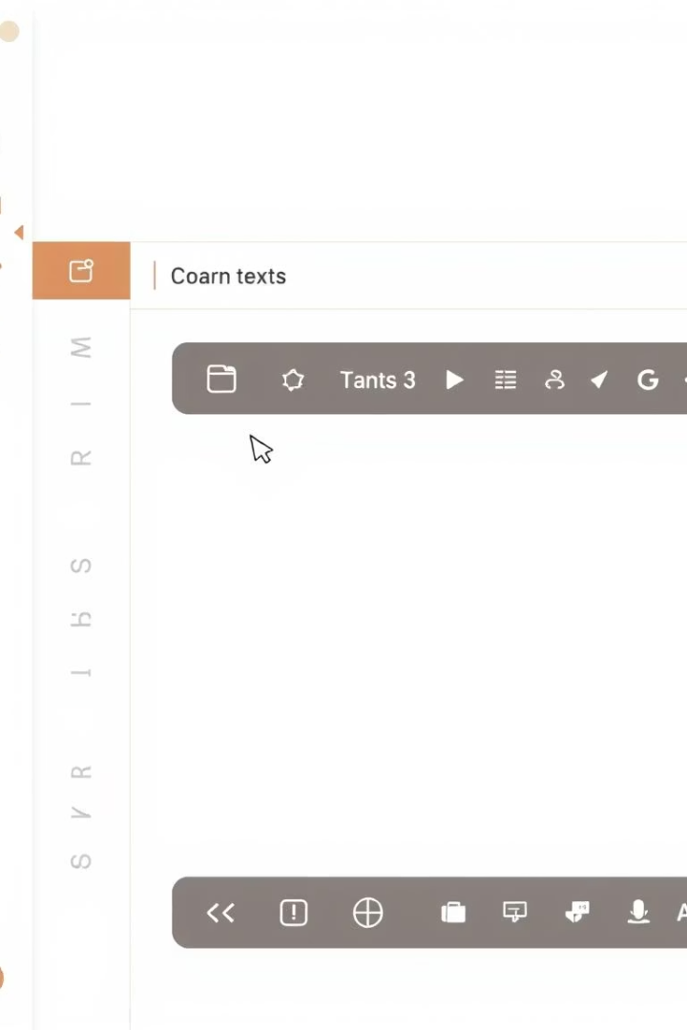
Undo/Redo System Design and Implementation
This presentation explores the design and implementation of a stack-based Undo/Redo system in a text editor, using the Last-In-First-Out (LIFO) principle. The use of stacks makes this feature efficient and easy to implement, with constant time complexity for core operations.
By
Aarush C S, Athul K Koshy, Mohammed Rizwan PP, Moideen Nihal

Slide 2
Problem Statement
Challenge
Solution
Text editors need a reliable way for users to navigate through changes. Traditional implementations may suffer from inefficiencies or memory issues when handling multiple sequential actions, especially when editing large texts.
A robust structure is required that provides quick access to both the last change and the ability to revert or reapply it — making stacks an ideal choice.

Slide 3
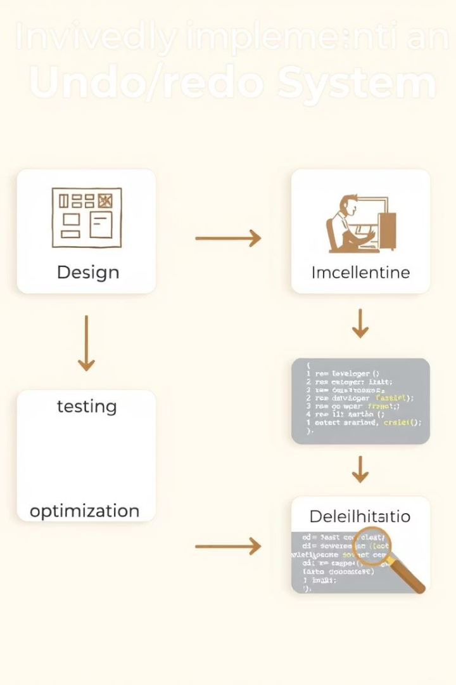
Objectives
1
Implement an Undo/Redo System Using Stacks
Design two stacks: undo_stack and redo_stack to manage text modifications.
2
Optimize for Time Efficiency
Ensure all operations (type, undo, redo) operate in constant time O(1) by utilizing Python’s built-in list operations for stacks.
3
Manage Redo Stack Consistency
Demonstrate core features with different use cases and sequences of actions to highlight correctness.
4
Ensure Error Handling and User Feedback
Automatically clear the redo stack when a new edit is made after an undo operation to maintain the correctness of the redo history.

Slide 4
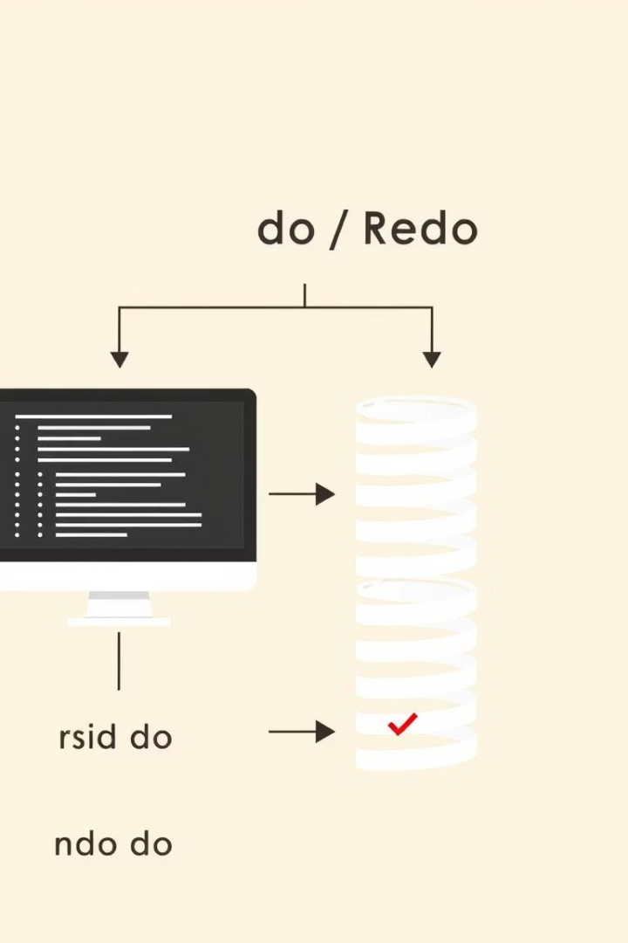
System Design and Architecture
TextEditor Class
Undo Stack
Encapsulates the current state of the text, two internal stacks to manage undo and redo operations, and user-facing methods to interact with the system (type, undo, redo, show).
Stores previous versions of the text before each change.
Redo Stack
Stores undone versions of the text that can be redone.

Slide 5




System Workflow
User Types Text
Save current state in undo_stack, clear redo_stack, append new text to self.text.
User Clicks Undo
Push current state into redo_stack, pop the last state from undo_stack and restore it to self.text.
User Clicks Redo
Push current state into undo_stack, pop the last state from redo_stack and restore it to self.text.

Slide 6
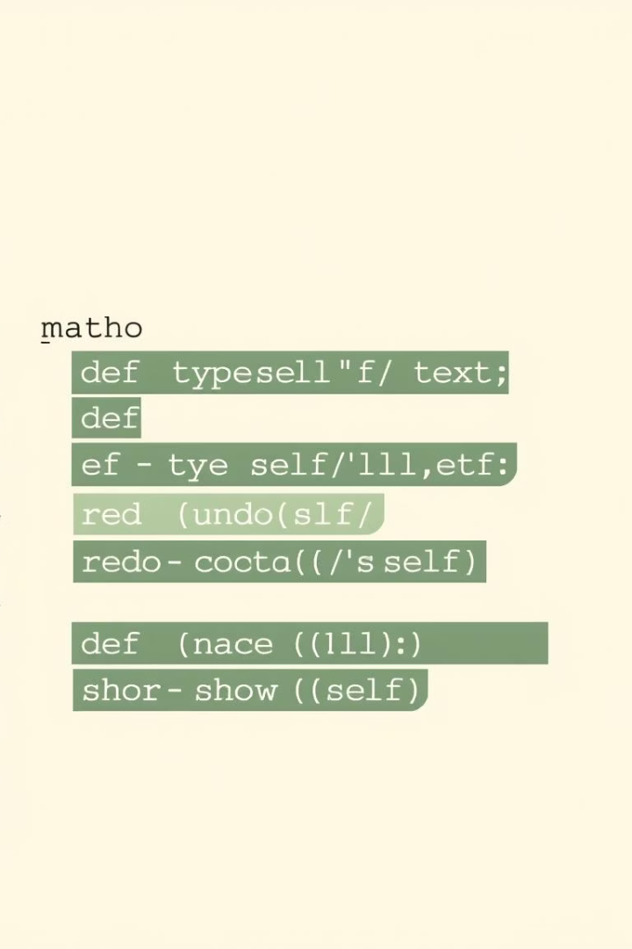
Implementation (with Code)
class TextEditor: def __init__(self): self.text = "" self.undo_stack = [] self.redo_stack = [] def type(self, new_text): self.undo_stack.append(self.text) self.redo_stack.clear() self.text += new_text def undo(self): if not self.undo_stack: print("Nothing to undo.") return self.redo_stack.append(self.text) self.text = self.undo_stack.pop() def redo(self): if not self.redo_stack: print("Nothing to redo.") return self.undo_stack.append(self.text) self.text = self.redo_stack.pop() def show(self): print(f"Current Text: '{self.text}'")

Slide 7
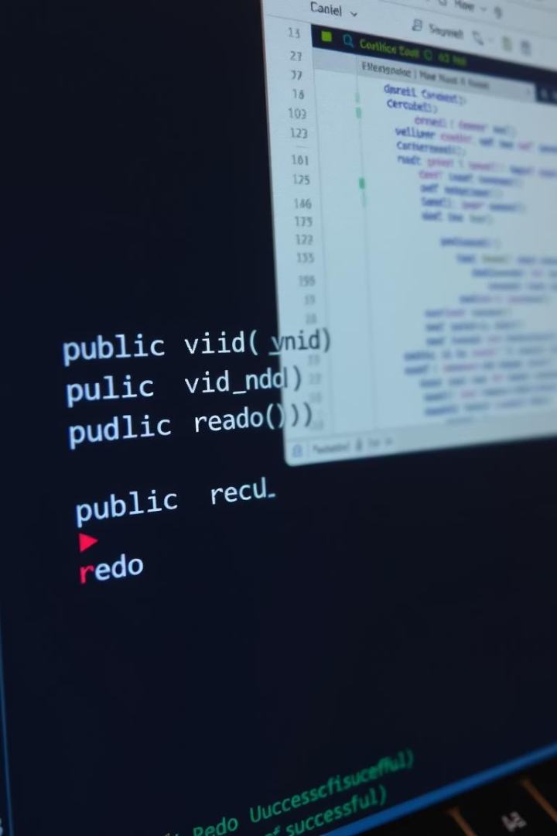
Sample Output
editor = TextEditor() editor.type("Hello ") editor.type("World") editor.show() # Output: Hello World editor.undo() editor.show() # Output: Hello editor.redo() editor.show() # Output: Hello World editor.undo() editor.type("Everyone") editor.show() # Output: Hello Everyone

Slide 8





Real-World Applications
Text Editors
Graphic Design Software
Code Editors and IDEs
CAD Tools
Text editors use the undo/redo stack to allow users to undo or redo typing actions, text formatting, and other modifications.
In CAD software, undo/redo is vital for engineers and designers to reverse drawing or modeling operations such as scaling, rotating, or deleting objects.
In graphic design software, undo/redo is a crucial feature that enables designers to reverse or reapply transformations like resizing, cropping, applying filters, or modifying layers.
Code editors and Integrated Development Environments (IDEs) use undo/redo mechanisms to help developers manage changes in their code.

Slide 9
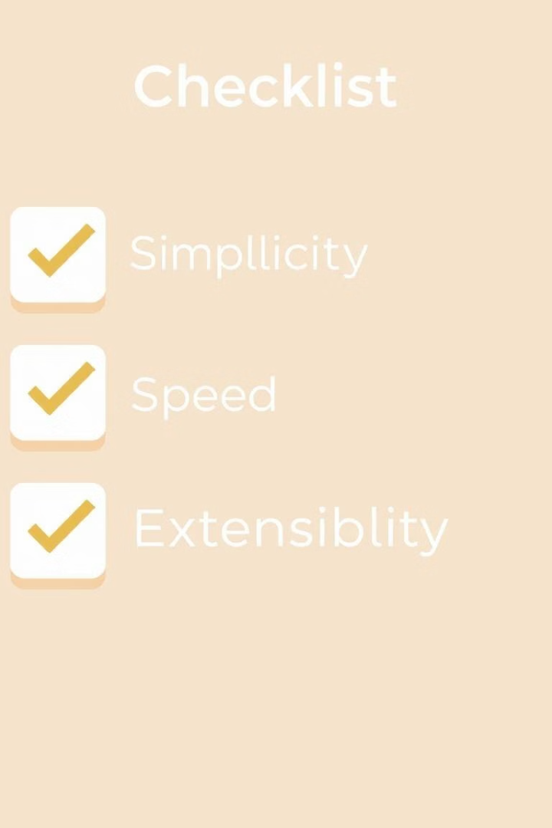



Advantages of Stack-Based Undo/Redo
Simple to Implement and Understand
Fast Performance for Undo/Redo Actions (O(1) Time)
A stack-based undo/redo system is relatively easy to implement because it relies on basic data structures (stacks) and follows straightforward principles (pushing actions onto the stack and popping them to undo or redo).
One of the key advantages of using a stack is the constant time complexity (O(1)) for both undo and redo actions.
Easily Extendable to More Complex Operations
Stack-based systems are flexible and can be expanded to handle more complex use cases.

Slide 10
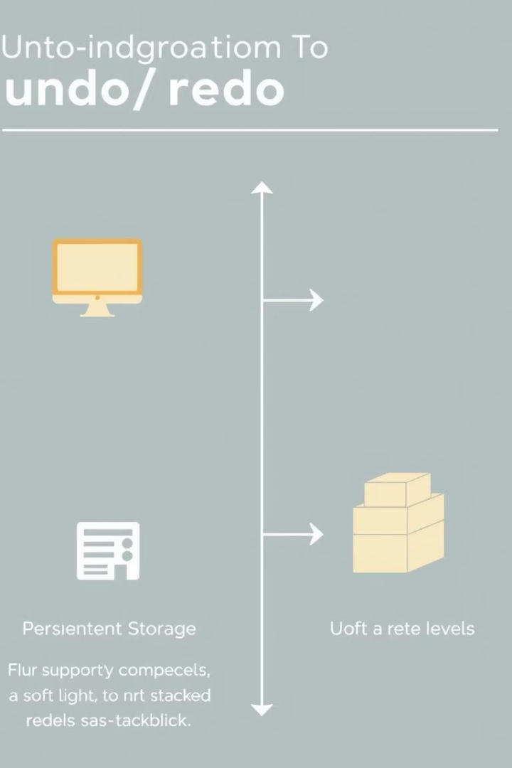
Conclusion and Future Scope
This project demonstrates a practical use of the stack data structure by implementing an Undo/Redo system for a basic text editor. It successfully showcases how theoretical data structures can be used to improve user experience in real software. With minimal memory usage and optimal performance, the stack-based system is highly effective and forms a fundamental part of many applications used daily.
Future work could focus on adding a graphical user interface (GUI), storing changes as operations instead of full text, supporting multiple redo levels, implementing persistent storage, and visualizing the history of changes.

