Slide 1




Slide 2

BFS,DFS

Slide 3
BREADTH-FIRST SEARCH
INTRODUCTION
Breadth First Traversal or Breadth First Search is a recursive algorithm for searching all the vertices of a graph or tree data structure.
A standard BFS implementation puts each vertex of the graph into one of two categories:
Visited
Not Visited
The purpose of the algorithm is to mark each vertex as visited while avoiding cycles.

Slide 4
BREADTH-FIRST SEARCH
ALGORITHM
The algorithm works as follows:
Start by putting any one of the graph's vertices at the back of a queue.
Take the front item of the queue and add it to the visited list.
Create a list of that vertex's adjacent nodes. Add the ones which are not in the visited list to the back of the queue.
Keep repeating steps 2 and 3 until the queue is empty.
The graph might have two different disconnected parts so to make sure that we cover every vertex, we can also run the BFS algorithm on every node

Slide 5
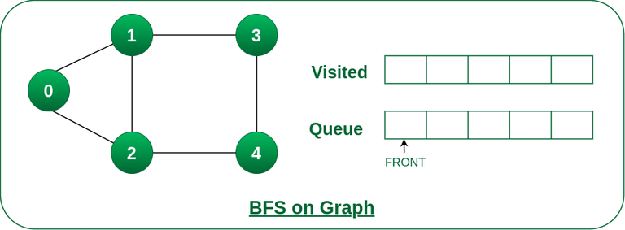
BREADTH-FIRST SEARCH
Example
Step1: Initially queue and visited arrays are empty.

Slide 6
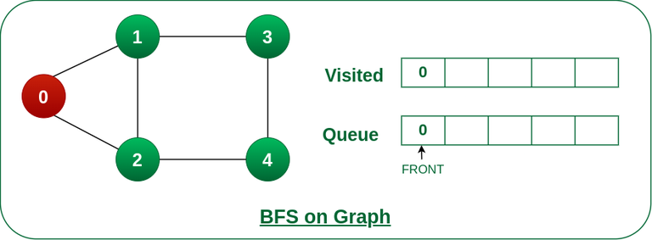
Step2: Push node 0 into queue and mark it visited.
BREADTH-FIRST SEARCH

Slide 7
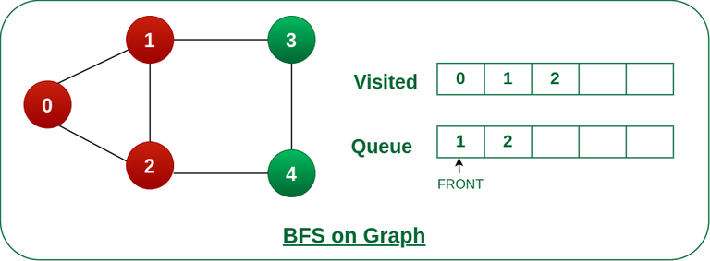
BREADTH-FIRST SEARCH
Step3: Remove node 0 from the front of queue and visit the unvisited neighbours and push them into queue.

Slide 8
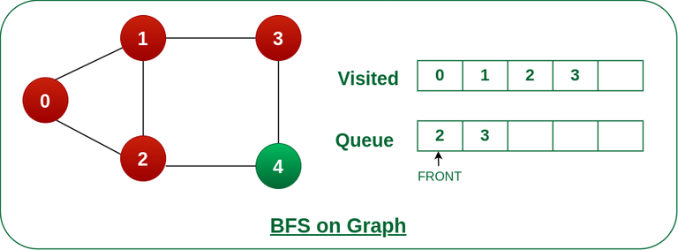
BREADTH-FIRST SEARCH
Step 4: Remove node 1 from the front of queue and visit the unvisited neighbours and push them into queu.

Slide 9
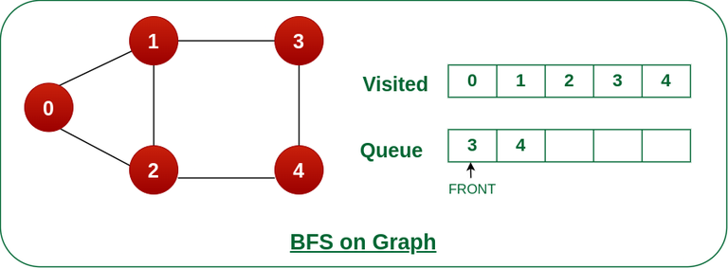
BREADTH-FIRST SEARCH
Step 5: Remove node 2 from the front of queue and visit the unvisited neighbours and push them into queue.

Slide 10

BREADTH-FIRST SEARCH
Step 6: Remove node 3 from the front of queue and visit the unvisited neighbours and push them into queue. As we can see that every neighbours of node 3 is visited, so move to the next node that are in the front of the queue.

Slide 11

BREADTH-FIRST SEARCH
Step 7: Remove node 4 from the front of queue and visit the unvisited neighbours and push them into queue.
As we can see that every neighbours of node 4 are visited, so move to the next node that is in the front of the queue.
Now, Queue becomes empty, So, terminate these process of iteration.

Slide 12
BREADTH-FIRST SEARCH
Pseudocode
create a queue Q
mark v as visited and put v into Q
while Q is non-empty
remove the head u of Q
mark and enqueue all (unvisited) neighbours of u

Slide 13
BREADTH-FIRST SEARCH
Program: BFS Implementation
bfs.java
Time Complexity: O(V + E)
Space Complexity: O(V)
where V is the number of nodes and E is the number of edges

Slide 14
BREADTH-FIRST SEARCH
import java.util.*; public class Graph { private int V; private LinkedList<Integer> adj[]; // Create a graph Graph(int v) { V = v; adj = new LinkedList[v]; for (int i = 0; i < v; ++i) adj[i] = new LinkedList(); } // Add edges to the graph void addEdge(int v, int w) { adj[v].add(w); } // BFS algorithm void BFS(int s) { boolean visited[] = new boolean[V]; | LinkedList<Integer> queue = new LinkedList(); visited[s] = true; queue.add(s); while (queue.size() != 0) { s = queue.poll(); System.out.print(s + " "); Iterator<Integer> i = adj[s].listIterator(); while (i.hasNext()) { int n = i.next(); if (!visited[n]) { visited[n] = true; queue.add(n); } } } }

Slide 15
BREADTH-FIRST SEARCH
public static void main(String args[]) { Graph g = new Graph(4); g.addEdge(0, 1); g.addEdge(0, 2); g.addEdge(1, 2); g.addEdge(2, 0); g.addEdge(2, 3); g.addEdge(3, 3); System.out.println("Following is Breadth First Traversal " + "(starting from vertex 2)"); g.BFS(2); } }

Slide 16
BREADTH-FIRST SEARCH
Applications of BFS
BFS can be used to find the neighboring locations from a given source location.
In a peer-to-peer network, BFS algorithm can be used as a traversal method to find all the neighboring nodes.
BFS can be used in web crawlers to create web page indexes where, every web page is considered as a node in the graph.
BFS is used to determine the shortest path and minimum spanning tree.
BFS is also used in Cheney's technique to duplicate the garbage collection.
It can be used in Ford-Fulkerson method to compute the maximum flow in a flow network.
It can be used in cycle detection in an undirected graph and also in navigation

Slide 17
DEPTH -FIRST SEARCH
Introduction
Depth first Search or Depth first traversal is a recursive algorithm for searching all the vertices of a graph or tree data structure
A standard DFS implementation puts each vertex of the graph into one of two categories:
Visited
Not Visited
The purpose of the algorithm is to mark each vertex as visited while avoiding cycles.

Slide 18
DEPTH -FIRST SEARCH
Algorithm
Start by putting any one of the graph's vertices on top of a stack.
Take the top item of the stack and add it to the visited list.
Create a list of that vertex's adjacent nodes. Add the ones which aren't in the visited list to the top of the stack.
Keep repeating steps 2 and 3 until the stack is empty.

Slide 19
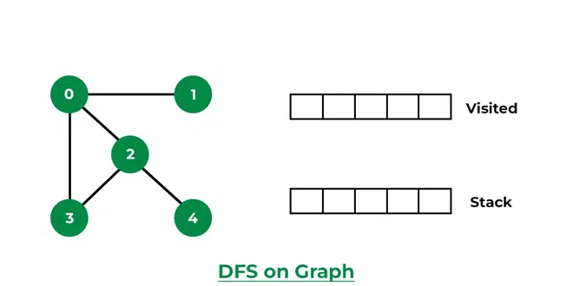
DEPTH -FIRST SEARCH
Step1: Initially stack and visited arrays are empty.

Slide 20
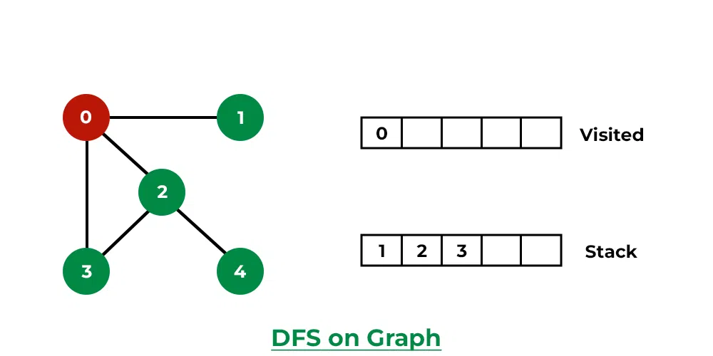
DEPTH -FIRST SEARCH
Step 2: Visit 0 and put its adjacent nodes which are not visited yet into the stack.

Slide 21
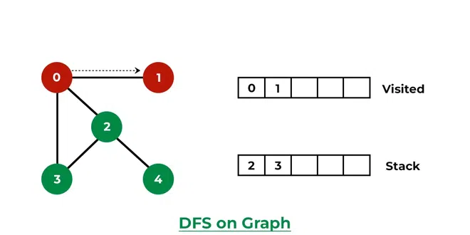
DEPTH -FIRST SEARCH
Step 3: Now, Node 1 at the top of the stack, so visit node 1 and pop it from the stack and put all of its adjacent nodes which are not visited in the stack.

Slide 22
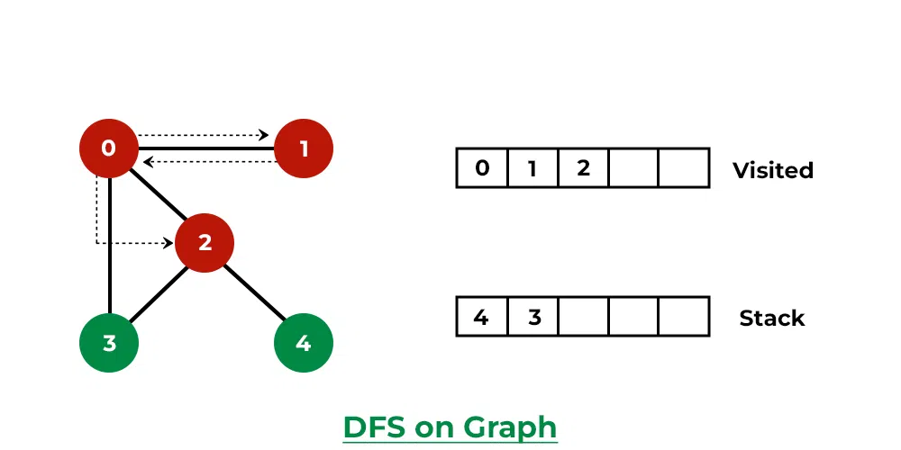
DEPTH -FIRST SEARCH
Step 4: Now, Node 2 at the top of the stack, so visit node 2 and pop it from the stack and put all of its adjacent nodes which are not visited (i.e, 3, 4) in the stack.

Slide 23
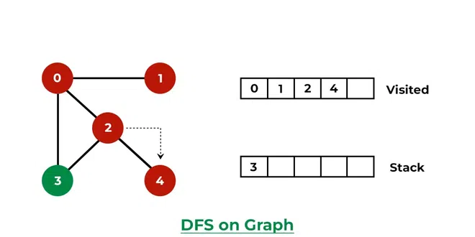
DEPTH -FIRST SEARCH
Step 5: Now, Node 4 at the top of the stack, so visit node 4 and pop it from the stack and put all of its adjacent nodes which are not visited in the stack.

Slide 24
DEPTH -FIRST SEARCH
Step 5: Now, Node 4 at the top of the stack, so visit node 4 and pop it from the stack and put all of its adjacent nodes which are not visited in the stack..

Slide 25
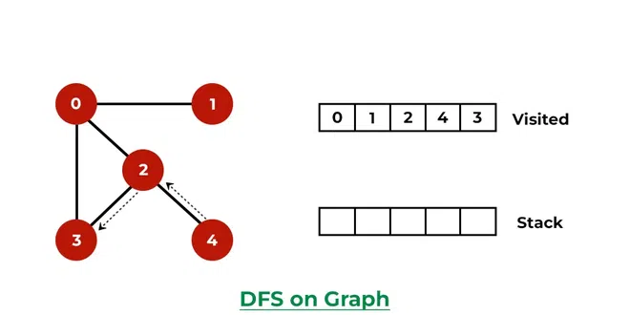
DEPTH -FIRST SEARCH
Step 6: Now, Node 3 at the top of the stack, so visit node 3 and pop it from the stack and put all of its adjacent nodes which are not visited in the stack.
Now, Stack becomes empty, which means we have visited all the nodes and our DFS traversal ends.

Slide 26
DEPTH -FIRST SEARCH
Pseudocode
DFS(G, u)
u.visited = true
for each v ∈ G.Adj[u]
if v.visited == false
DFS(G,v)
init() {
For each u ∈ G
u.visited = false
For each u ∈ G
DFS(G, u)
}

Slide 27
DEPTH -FIRST SEARCH
Program: DFS Implementation
dfs.java
Time Complexity: O(V + E)
Space Complexity: O(V)
where V is the number of nodes and E is the number of edges

Slide 28
DEPTH -FIRST SEARCH
import java.util.*; class Graph { private LinkedList<Integer> adjLists[]; private boolean visited[]; // Graph creation Graph(int vertices) { adjLists = new LinkedList[vertices]; visited = new boolean[vertices]; for (int i = 0; i < vertices; i++) adjLists[i] = new LinkedList<Integer>(); } // Add edges | void addEdge(int src, int dest) { adjLists[src].add(dest); } void DFS(int vertex) { visited[vertex] = true; System.out.print(vertex + " "); Iterator<Integer> ite = adjLists[vertex].listIterator(); while (ite.hasNext()) { int adj = ite.next(); if (!visited[adj]) DFS(adj); } }

Slide 29
DEPTH -FIRST SEARCH
public static void main(String args[]) { Graph g = new Graph(4); g.addEdge(0, 1); g.addEdge(0, 2); g.addEdge(1, 2); g.addEdge(2, 3); System.out.println("Following is Depth First Traversal"); g.DFS(2); } }

Slide 30
DEPTH -FIRST SEARCH
Applications of DFS
For an unweighted graph, DFS traversal of the graph produces the minimum spanning tree.
DFS can be used to detect a cycle in the graph
We can specialize the DFS algorithm to find a path between the two given vertices u and z.
DFS can be used in topological sorting. Topological Sorting is mainly used for scheduling jobs from the given dependencies among jobs
DFS can be used to test if a graph is bipartite
DFS can be used to finding Strongly connected components of a graph
DFS can be used to solving puzzles with only one solution

Slide 31

https://learn.codemithra.com

Slide 32
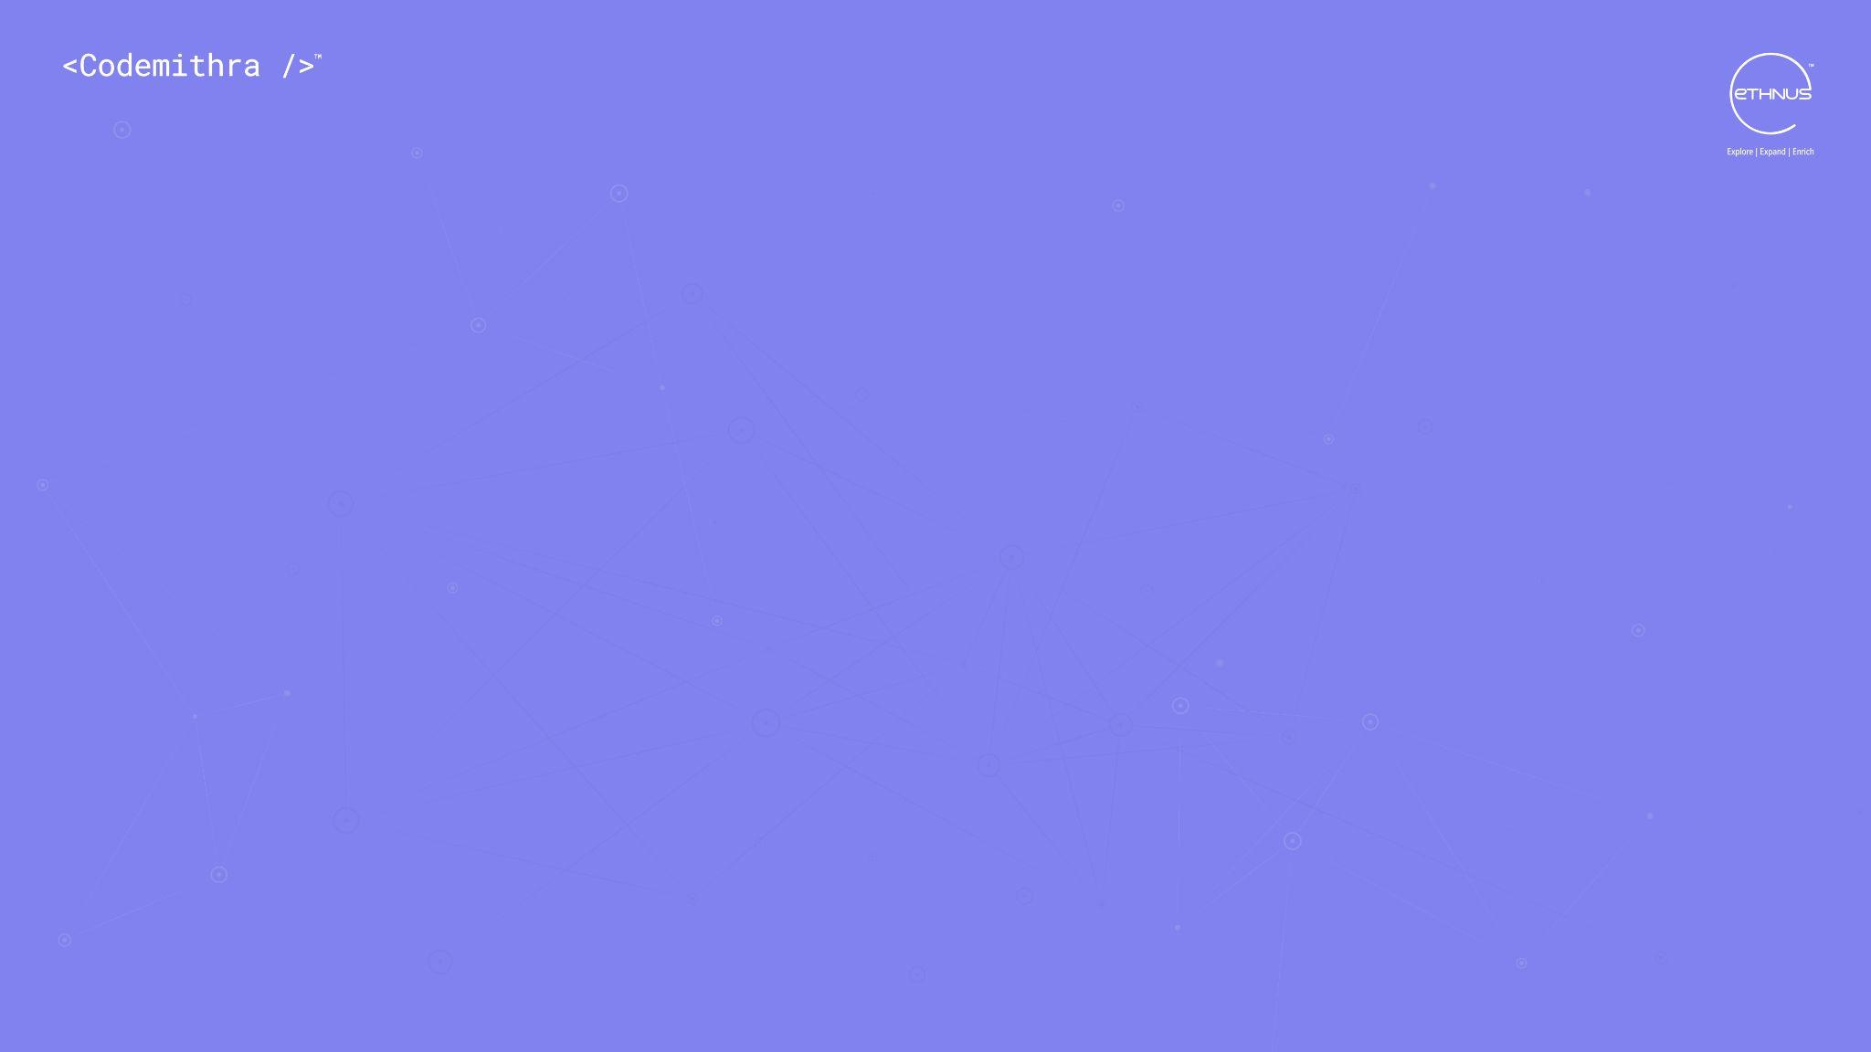



THANK YOU
+91 78150 95095
codemithra@ethnus.com
www.codemithra.com

