Slide 1




Slide 2

BELLMAN FORD ALGORITHM

Slide 3
BELLMAN-FORD ALGORITHM
WHERE IT WORKS
The Bellman-Ford algorithm works for weighted, directed graphs, including those with negative weight edges, and it can detect negative weight cycles.

Slide 4
BELLMAN-FORD ALGORITHM
IMPORTANT TERMINOLOGY
`V`: The number of vertices in the graph.
`E`: The number of edges in the graph.
`dist[]`: An array to store the shortest distances from the source vertex to all other vertices.
`CreateEdge`: A class representing an edge with source, destination, and weight.

Slide 5
BELLMAN-FORD ALGORITHM
ALGORITHM
Initialize the `dist` array, setting the distance to the source vertex as 0 and all other distances as infinity.
Repeat the following V-1 times (V is the number of vertices):
For each edge (u, v) with weight w, if `dist[u] + w` is smaller than `dist[v]`, update `dist[v]` to `dist[u] + w`.
Check for negative weight cycles by iterating through all edges and performing the same relaxation step. If any `dist[u] + w` is smaller than `dist[v`, a negative weight cycle exists.
If no negative weight cycle is found, print the shortest distances from the source vertex to all other vertices.

Slide 6
BELLMAN-FORD ALGORITHM
PSEUDOCODE
BellmanFord(graph, source):
Initialize dist[] with infinity values
Set dist[source] to 0
Repeat V-1 times:
For each edge (u, v) with weight w:
if dist[u] + w < dist[v]:
dist[v] = dist[u] + w
Check for negative weight cycles:
For each edge (u, v) with weight w:
if dist[u] + w < dist[v]:
Print "Graph contains negative weight cycle"
return
Print the shortest distances from the source vertex to all other vertices

Slide 7
BELLMAN-FORD ALGORITHM
public class Main { static class CreateGraph { class CreateEdge { int src, dest, weight; CreateEdge(int src, int dest, int weight) { this.src = src; this.dest = dest; this.weight = weight; } } int V, E; CreateEdge edge[]; CreateGraph(int v, int e) { V = v; E = e; edge = new CreateEdge[e]; } | void BellmanFord(int src) { int dist[] = new int[V]; for (int i = 0; i < V; ++i) dist[i] = Integer.MAX_VALUE; dist[src] = 0; for (int i = 1; i < V; ++i) { for (int j = 0; j < E; ++j) { int u = edge[j].src; int v = edge[j].dest; int w = edge[j].weight; if (dist[u] != Integer.MAX_VALUE && dist[u] + w < dist[v]) dist[v] = dist[u] + w; } } for (int j = 0; j < E; ++j) { int u = edge[j].src; int v = edge[j].dest;

Slide 8
BELLMAN-FORD ALGORITHM
int w = edge[j].weight; if (dist[u] != Integer.MAX_VALUE && dist[u] + w < dist[v]) { System.out.println("Graph contains negative weight cycle"); return; } } printSolution(dist); } void printSolution(int dist[]) { System.out.println("Vertex Distance from Source"); for (int i = 0; i < V; ++i) System.out.println(i + "\t\t" + dist[i]); } } public static void main(String[] args) { int V = 5; int E = 7; | CreateGraph graph = new CreateGraph(V, E); graph.edge[0] = graph.new CreateEdge(0, 1, 5); graph.edge[1] = graph.new CreateEdge(0, 2, 4); graph.edge[2] = graph.new CreateEdge(1, 3, 3); graph.edge[3] = graph.new CreateEdge(2, 1, 6); graph.edge[4] = graph.new CreateEdge(3, 2, 2); graph.edge[5] = graph.new CreateEdge(1, 4, -4); graph.edge[6] = graph.new CreateEdge(4, 2, 2); graph.BellmanFord(0); // 0 is the source vertex }}

Slide 9
BELLMAN-FORD ALGORITHM
TIME AND SPACE COMPLEXITY
Time Complexity: O(VE) where V is the number of vertices and E is the number of edges.
Space Complexity: O(V) for the `dist` array.

Slide 10
BELLMAN-FORD ALGORITHM
DIJKSTRA’S ALGORITHM VS BELLMAN FORD ALGORITHM
Aspect | Dijkstra's Algorithm | Bellman-Ford Algorithm
Edge Weight | Non-negative edge weights | Negative edge weights are allowed
Optimality | Provides shortest paths with non-negative edge weights | Can handle negative edge weights and detect negative weight cycles
Data Structures | Typically uses priority queue with a minimum key | Uses an array to store distances
Suitable For | Suitable for graphs with non-negative edge weights | Suitable for graphs with negative edge weights or cycles
Common Usage | Used for finding shortest paths in non-negative weighted graphs, e.g., road networks | Used when negative weights or cycles may be present, e.g., network routing with possible packet delays

Slide 11
INTERVIEW QUESTION
1. What is the Bellman-Ford algorithm, and in what type of graphs is it typically used?
Answer: The Bellman-Ford algorithm is used to find the shortest paths from a single source vertex to all other vertices in a weighted, directed graph. It can handle graphs with negative edge weights and detect negative weight cycles. It is typically used in scenarios where negative weights or cycles may be present in the graph.

Slide 12
INTERVIEW QUESTION
2. Can you explain the basic idea behind the Bellman-Ford algorithm?
Answer: The Bellman-Ford algorithm uses a dynamic programming approach. It iteratively relaxes the estimated shortest distances to vertices, repeating this process for V-1 times (where V is the number of vertices). In each iteration, it considers all edges in the graph and updates the distance if a shorter path is found. This process continues until no further improvements can be made, or a negative weight cycle is detected.

Slide 13
INTERVIEW QUESTION
3. What is the purpose of the V-1 iterations in the Bellman-Ford algorithm?
Answer: The V-1 iterations in the Bellman-Ford algorithm ensure that the shortest paths are found in the majority of cases, assuming there are no negative weight cycles. In a graph with V vertices, the longest possible path between two vertices is V-1 edges. Therefore, V-1 iterations are sufficient to find the shortest paths.

Slide 14
INTERVIEW QUESTION
4. How does the Bellman-Ford algorithm detect the presence of a negative weight cycle in a graph?
Answer: After the V-1 iterations, the Bellman-Ford algorithm checks all edges one more time. If it finds any further improvements in distances, it indicates the presence of a negative weight cycle. If a vertex's distance can be reduced during this additional iteration, it implies that the graph contains a negative weight cycle..

Slide 15
INTERVIEW QUESTION
5.Can you provide an example scenario where the Bellman-Ford algorithm would be a better choice than Dijkstra's algorithm?
Answer: The Bellman-Ford algorithm is a better choice when working with network routing problems in scenarios where negative delays, costs, or congestion can occur. For example, in a communication network, packet delays can sometimes be negative (indicating faster routing). Bellman-Ford can accurately model such scenarios, while Dijkstra's algorithm cannot handle negative weights.

Slide 16
INTERVIEW QUESTION
6.What distinguishes the Bellman-Ford algorithm from Dijkstra's algorithm?
1. Edge Weights: Bellman-Ford can handle negative edge weights, while Dijkstra's algorithm works with non-negative weights.
2. Negative Cycle Detection: Bellman-Ford can detect negative weight cycles, which Dijkstra's algorithm cannot.
3. Use Cases: Use Bellman-Ford when dealing with negative weights or cycle detection; choose Dijkstra for non-negative weights in the graph.

Slide 17

https://learn.codemithra.com

Slide 18
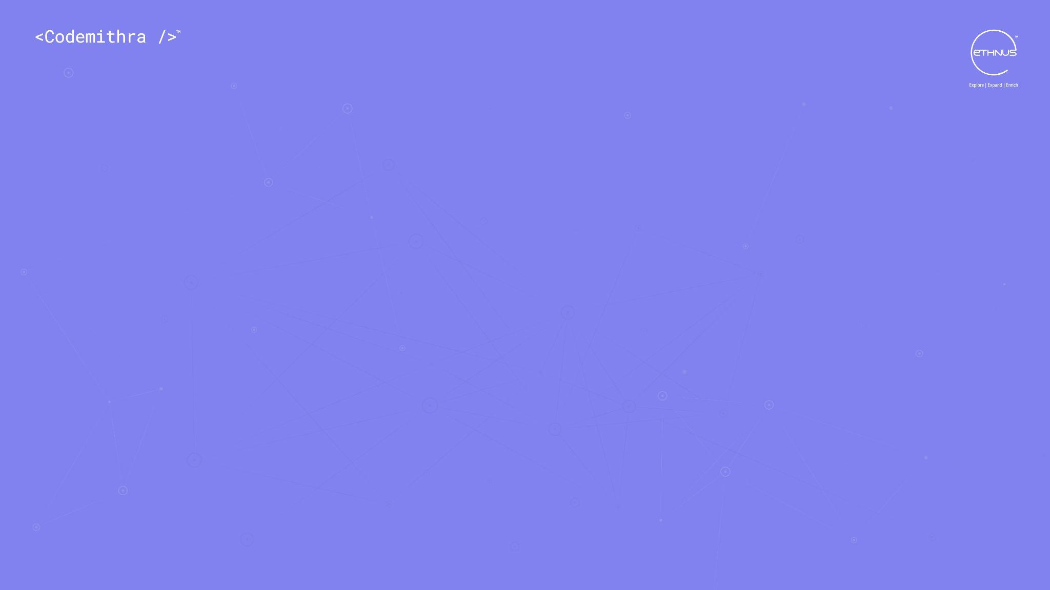



THANK YOU
+91 78150 95095
codemithra@ethnus.com
www.codemithra.com

