Slide 1




Slide 2

TOPOLOGICAL SORT

Slide 3
TOPOLOGICAL SORT
DIRECTED GRAPH
A directed graph is characterized by edges that possess specific directions, often referred to as arcs. Consider two vertices, v and w, within such a directed graph.

Slide 4
TOPOLOGICAL SORT
DIRECTED GRAPH
Inedge: An edge pointing toward or entering a node.
Outedge: An edge pointing away or departing from a node. The nodes at the receiving end of the out edges of v are termed v's neighbors.
Indegree: The count of edges directed into a node.
Outdegree: The count of outages departing from a node.
Dependency: Stating "v depends on w" or "v is dependent on w" signifies a directed path from w to v, where v and w are vertices in a directed graph.

Slide 5
TOPOLOGICAL SORT
TOPOLOGICAL SORT
Topological sorting is a linear ordering of the vertices of a directed acyclic graph (DAG) in such a way that for every directed edge U 🡪 V, Then vertex U comes before V in the ordering. In simpler terms, it's an arrangement of the nodes in a directed graph such that every directed edge goes from left to right.

Slide 6
TOPOLOGICAL SORT
TOPOLOGICAL SORT
1. DAG Requirement: Topological sorting is only applicable to Directed Acyclic Graphs (DAGs). The absence of cycles is crucial because cycles introduce ambiguity in defining a linear ordering.
2. Ordering: The output of a topological sort is a linear ordering of the vertices. This ordering respects the partial order defined by the directed edges.

Slide 7
TOPOLOGICAL SORT
TOPOLOGICAL SORT
3. Dependencies: Topological sorting has significant applications in scheduling tasks that have dependencies. If task B depends on task A, then A comes before B in the topological order.
4. Algorithm: One common algorithm for topological sorting is the Depth-First Search (DFS) algorithm. The idea is to visit a node and mark it as visited before exploring its neighbors. The linear order of visiting nodes gives the topological order.

Slide 8
TOPOLOGICAL SORT
TOPOLOGICAL SORT
5. Multiple Solutions: It's important to note that a DAG may have more than one valid topological ordering. The crucial aspect is the relative order of vertices connected by directed edges.
topological sorting provides a systematic way to order the vertices of a directed acyclic graph, reflecting the dependencies between nodes in a natural and meaningful manner.

Slide 9
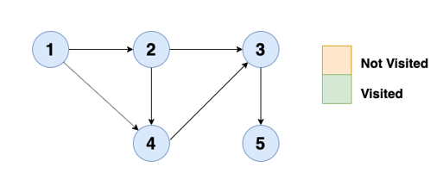
TOPOLOGICAL SORT
EXAMPLE

Slide 10
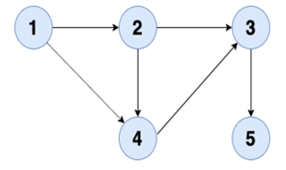
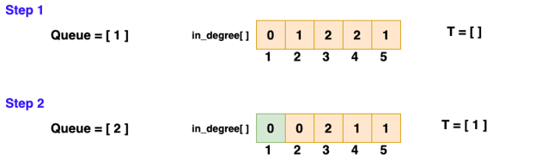
TOPOLOGICAL SORT
EXAMPLE

Slide 11
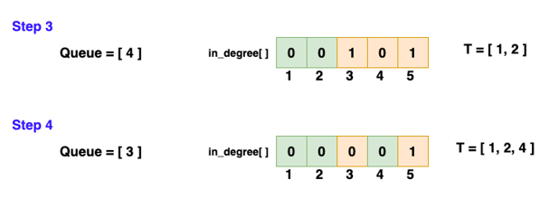
TOPOLOGICAL SORT
EXAMPLE

Slide 12
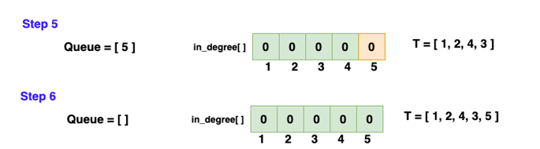
TOPOLOGICAL SORT
EXAMPLE

Slide 13
TOPOLOGICAL SORT
KHAN’S ALGORITHM
The steps below are involved in Kahn’s algorithm:
Auxiliary variables:
An array (“temp”) to hold the result of the preprocessing stage.
A variable (“visited”) to store the number of vertices that have been visited.
A string (“result”) to hold the topological sort order.
A queue.

Slide 14
TOPOLOGICAL SORT
KHAN’S ALGORITHM
Pre-processing:
Calculate the in-degree of each vertex of the graph and store them in the array “temp”.
INDEGREE
A

Slide 15
TOPOLOGICAL SORT
KHAN’S ALGORITHM
Actual steps:
Enqueue the vertices with the in-degree of 0.
While the queue is not empty:
1. Dequeue a vertex.
2. Add this vertex to the result.
3. Increment the “visited” variable by 1.
4. Decrement the in-degree of all its neighboring vertices by 1 in the array “temp”.
5 Enqueue the neighboring vertices with the in-degree of 0.
If the value of the “visited” variable is equal to the number of vertices in the graph, then the graph is indeed directed and acyclic ​and the result will contain the topological sort for the graph.

Slide 16
KHAN’S ALGORITHM
TOPOLOGICAL SORT
import java.util.*; class Graph { private Map<Integer, List<Integer>> adjacencyList; private int vertices; public Graph(int vertices) { this.vertices = vertices; this.adjacencyList = new HashMap<>(); for (int i = 0; i < vertices; i++) { this.adjacencyList.put(i, new ArrayList<>()); } } public void createEdge(int u, int v) { this.adjacencyList.get(u).add(v); } public void topologicalSort() { int[] totalIndegree = new int[vertices]; for (int i = 0; i < vertices; i++) { for (int j : adjacencyList.get(i)) { totalIndegree[j]++; }} | Queue<Integer> queue = new LinkedList<>(); for (int i = 0; i < vertices; i++) { if (totalIndegree[i] == 0) { queue.add(i); } } int visitedNodes = 0; List<Integer> order = new ArrayList<>(); while (!queue.isEmpty()) { int u = queue.poll(); order.add(u); for (int i : adjacencyList.get(u)) { totalIndegree[i]--; if (totalIndegree[i] == 0) { queue.add(i); } } visitedNodes++; }

Slide 17
KHAN’S ALGORITHM
TOPOLOGICAL SORT
if (visitedNodes != vertices) {
System.out.println("There's a cycle present in the Graph.\nGiven graph is not DAG");
} else {
System.out.println(order);
}
}
public static void main(String[] args) {
Graph graph = new Graph(6);
graph.createEdge(0, 1);
graph.createEdge(0, 2);
graph.createEdge(1, 3);
graph.createEdge(1, 5);
graph.createEdge(2, 3);
graph.createEdge(2, 5);
graph.createEdge(3, 4);
graph.createEdge(5, 4);
graph.topologicalSort();
}
}

Slide 18
INTERVIEW QUESTIONS
1. What is Topological Sorting?
Answer: Topological Sorting is a linear ordering of the vertices of a directed acyclic graph (DAG) in such a way that for every directed edge u -> v, vertex u comes before v in the ordering.

Slide 19
INTERVIEW QUESTIONS
3. How is Topological Sorting useful in project scheduling?
Answer: Topological Sorting helps schedule tasks that have dependencies. If task B depends on task A, then A comes before B in the topological order, providing a natural way to schedule dependent tasks.

Slide 20
INTERVIEW QUESTIONS
4. Explain the algorithm for Topological Sorting using Depth-First Search (DFS).
Answer: The DFS-based algorithm involves visiting a node, marking it as visited, and then recursively exploring its neighbors. The linear order of visiting nodes gives the topological order.

Slide 21
INTERVIEW QUESTIONS
4. Explain the algorithm for Topological Sorting using Depth-First Search (DFS).
Answer: The DFS-based algorithm involves visiting a node, marking it as visited, and then recursively exploring its neighbors. The linear order of visiting nodes gives the topological order.

Slide 22
INTERVIEW QUESTIONS
5. Can Topological Sorting be applied to graphs with cycles?
Answer: No, Topological Sorting cannot be applied to graphs with cycles. It is specifically designed for acyclic graphs. Cycles introduce ambiguity in defining a linear order.

Slide 23

https://learn.codemithra.com

Slide 24




THANK YOU
+91 78150 95095
codemithra@ethnus.com
www.codemithra.com

