Slide 1
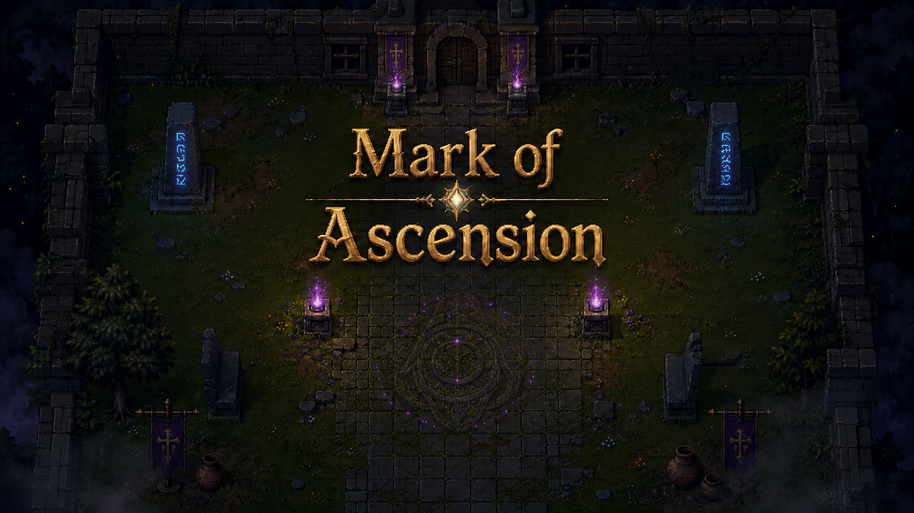
Mark of Ascension
A 2D top-down dark fantasy action game built in Unity
Game Development Project
Aarush Patel
Built from the current Unity project repository
Mark of Ascension
Game Development Presentation

Slide 2
Project Overview
High-level concept and scope based on the current repo.
What The Game Is
A 2D top-down action game with a dark fantasy setting and stage-based progression.
The player clears enemy waves, defeats bosses, and unlocks stronger abilities between stages.
The project includes a full playable loop from main menu to final-stage victory.
Built in Unity with separate scene, gameplay, UI, progression, and audio systems.
Overview
Source: README.md + Assets/Scripts

Slide 3
Visual Direction
The project uses a dark fantasy presentation style consistent with the game theme.
Art Direction
Dark fantasy mood
Readable top-down presentation
Room for bosses, hazards, and progression feedback
School-friendly without losing visual identity
Visual Theme
Project art asset in Assets/

Slide 4
Gameplay Flow
The current progression loop is scene-based and easy to explain to players.
1
2
3
4
5
Main Menu
Lobby
Stage01
Stage02
Stage03
Start game
Prepare and choose stage
Intro combat and boss
Stronger enemies and reward
Final boss and victory
Core loop: clear enemies -> unlock boss path -> defeat boss -> earn reward -> use portal to continue or return.
Flow
MainMenu -> SC_Lobby -> Stage01 -> Stage02 -> Stage03

Slide 5
Stage Progression and Rewards
Each stage adds difficulty and gives a meaningful gameplay upgrade.
Stage01
Stage02
Stage03
Early dungeon introduction
Wave clear unlocks boss path
Reward: Poison Strike
Bonus: Max Health +2
Tougher fortress stage
Stronger mid-game combat
Reward: Flame Strike
Bonus: damage up + faster attacks
Dark fortress finale
Hazards + final boss pressure
Reward: victory state
Outcome: run complete message
Stages & Rewards
Source: README.md + PlayerProgression.cs

Slide 6
Core Gameplay Systems
The project combines player, combat, progression, UI, and feedback systems.
Gameplay Systems
Feedback Systems
Persistent player spawning across scenes
Top-down movement and melee attack
Enemy AI with contact damage
Boss spawning after enemy-wave clear
Hazard zones that punish positioning
Level-up reward notifications between stages
Poison and fire damage-over-time effects
Audio for combat, boss events, portals, and lobby music
Game-over flow with return to main menu
Final victory message after Stage03
Systems
Gameplay + UI + Audio

Slide 7
Technical Structure
The repo is organized around scenes, gameplay scripts, and UI systems.
Important Folders
Key Scripts
Assets/Scenes: MainMenu, SC_Lobby, Stage01, Stage02, Stage03
Assets/Scripts/Gameplay: combat, AI, portals, hazards, progression
Assets/Scripts/UI: menu flow, health bar, reward notifications
Assets/Resources/Audio: reusable sound effects and music clips
PlayerProgression.cs manages rewards and victory states
Stage01FlowController.cs handles enemy waves, boss spawn, and portal unlock
ScenePortal.cs manages scene transitions
GameAudio.cs centralizes audio playback
Structure
Source: Assets/Scenes + Assets/Scripts

Slide 8
How The Progression Loop Works
The gameplay loop is implemented as a clear chain of events inside the project scripts.
Enemy wave
Boss unlock
Boss spawn
Reward
Portal exit
Small enemies are tracked
Path blockers are removed
Boss is instantiated and configured
PlayerProgression grants upgrade
Scene portal or victory message
This structure makes the project easy to extend with additional stages, rewards, and boss encounters later.
Implementation
Stage01FlowController.cs + PlayerProgression.cs

Slide 9
Current Status and Strengths
What is already working in the project right now.
Playable Features
Full flow from main menu to final stage is implemented.
Boss rewards directly change combat by unlocking poison and fire effects.
UI gives feedback through health bars, reward popups, death flow, and final victory messaging.
Audio support now covers combat, boss events, portal actions, and lobby music.
The codebase is organized enough to keep expanding with more stages or polish.
Status
Current repo build

Slide 10
Conclusion
Mark of Ascension already demonstrates a complete gameplay loop and clear progression system.
Key Takeaways
Thank You
The project combines gameplay, progression, UI, and audio into one coherent loop.
Its stage-based structure makes the design easy to explain and easy to expand.
The current repo already supports a strong class presentation because the systems are visible in both scenes and code.
Questions or discussion
Conclusion
Mark of Ascension

