Slide 1

Disaster Tweets Prediction: A Machine Learning
Project
In this presentation, we will explore a machine learning project focused on predicting the severity of disaster-related tweets. By leveraging natural language processing and advanced modeling techniques, we aim to build an effective system that can assist emergency response teams in quickly identifying critical information during times of crisis.

Slide 2
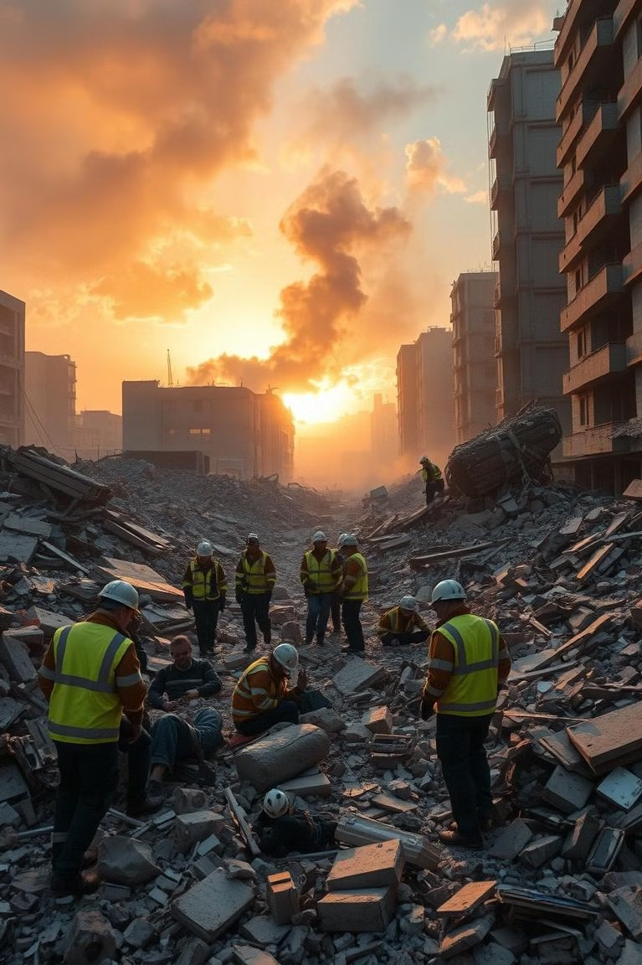
Introduction to the Problem
1
Importance of Social Media in Disasters
During crises, people increasingly turn to social media to share information, seek help, and raise awareness.
2
Challenges in Processing Disaster- Related Tweets
The high volume and unstructured nature of disaster tweets make it difficult for responders to quickly identify the most critical messages.
3
Need for Automated Prediction Models
Leveraging machine learning can enable rapid and accurate prioritization of disaster-related social media data.

Slide 3

Project Objective and Dataset Overview
Project Objective
Develop a machine learning model to predict the severity of disaster- related tweets, enabling emergency responders to quickly identify the most critical information.
Dataset Overview
The dataset includes over 10,000 tweets related to various natural disasters, with annotations on the severity of each tweet.

Slide 4

Data Preprocessing and Feature Extraction with TF-IDF
Data Cleaning
Removed URLs, mentions, and other irrelevant elements from the tweet text to prepare the data for analysis.
Feature Extraction
Utilized TF-IDF (Term Frequency- Inverse Document Frequency) to convert the tweet text into numerical feature vectors.

Slide 5

Modeling Techniques: Logistic Regression, Random Forest, Hyper-Parameter Tuning
Logistic Regression
Employed a logistic regression model to predict the binary classification of tweet severity.
Random Forest
Utilized a random forest classifier to capture nonlinear relationships and handle the multi-class nature of the problem.
Hyperparameter Tuning: Grid Search was applied to tune hyperparameters, such as the number of estimators and maximum depth for Random Forest.

Slide 6
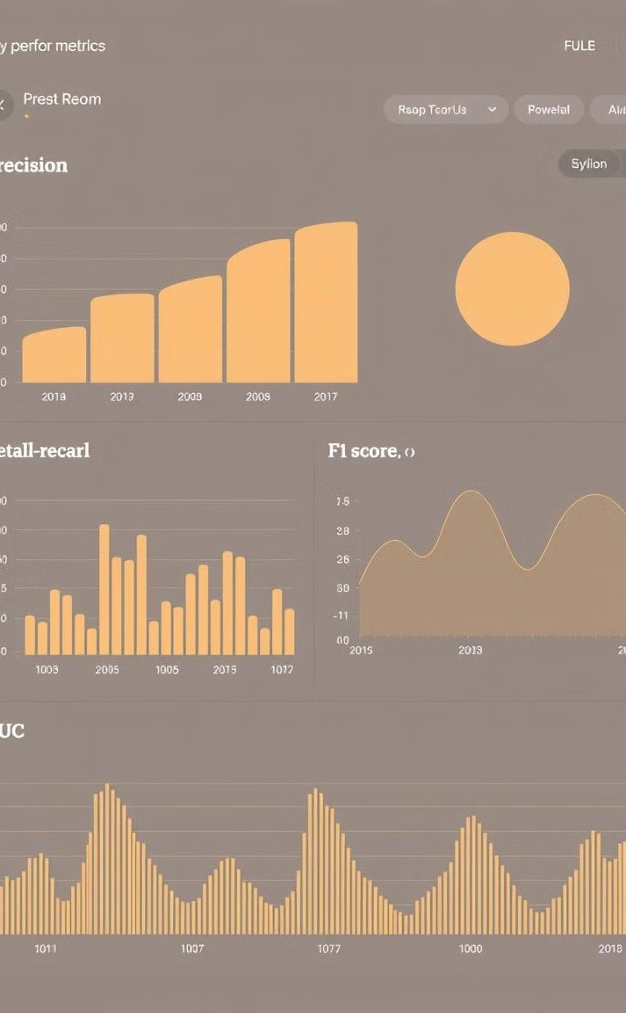
Evaluation Metrics: Accuracy, Precision, Recall, F1-Score
1
Accuracy
Measures the overall correctness of the model's predictions.
2
Precision & recall
Evaluates the model's ability to correctly identify positive instances. Precision: Proportion of true positives among predicted positives. Recall: Proportion of true positives among actual positives.
3
ROC /AUC:
Measure of the model's ability to distinguish between classes.

Slide 7

Comparative Results Analysis
Model Performance Comparison
Logical regression achieved the highest overall accuracy, while random forest showed better precision but lower recall, meaning it missed many disaster-related tweets
Tradeoffs and Considerations
Depending on the specific needs of the emergency response teams, different models may be preferred based on the relative importance of accuracy, precision, and recall.

Slide 8
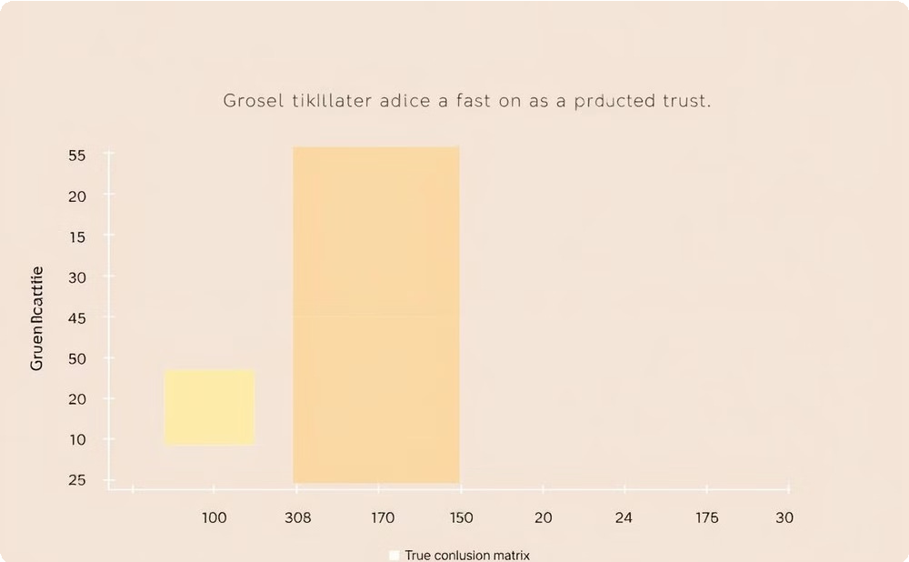
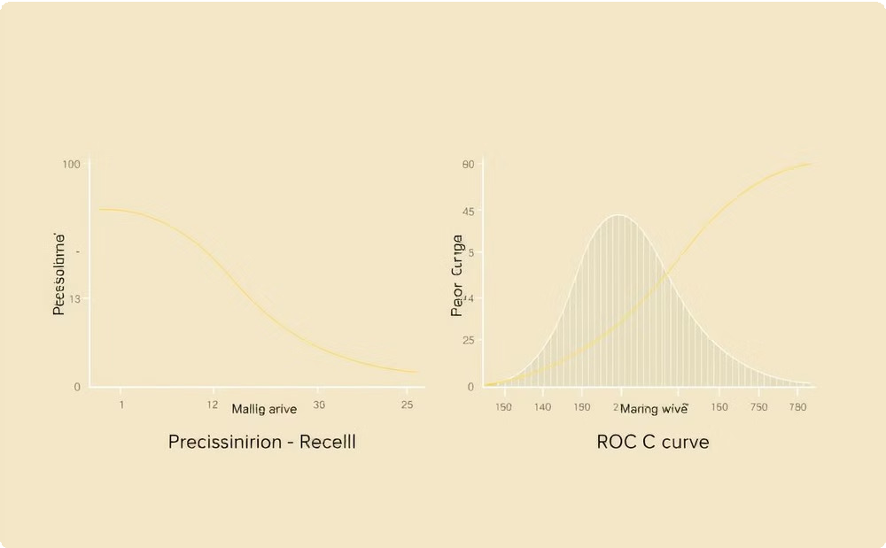
Visualizations: Confusion Matrices and Performance Charts
Confusion Matrix
Provides a detailed breakdown of the model's performance, highlighting the correct and incorrect predictions for each severity class.
Performance Charts
Illustrate the trade-offs between different evaluation metrics, allowing for a comprehensive assessment of the model's capabilities.

Slide 9
Conclusion and Future Directions
Future Enhancements
Explore deep learning techniques, incorporate additional data sources, and further refine the model to enhance its real-world applicability.
Key Takeaways
The disaster tweet prediction model demonstrated promising results, with the potential to significantly improve emergency response efforts during crisis situations.
Collaboration Opportunities
Engage with emergency management agencies and humanitarian organizations to deploy the model and gather feedback for continuous improvement.

Slide 10
Thankyou!
DISASTER TWEETS PREDICTION
Submitted for-Statistical Machine Learning CSET211
Submitted by:
(E23CSEU1102) SOWMYA NEGI
(E23CSEU1097) AARUSHI GOEL
(E23CSEU1083) NANDINI JAISWAL

