Slide 1


FoodZap
Place Your Order in secs !!
Aarush Srivastava
API-Hacks 2021

Slide 2

Why FoodZap ?
What's the Current Solution
What Makes Us Better?
What to Achieve
Website to order food to your location !!
Just one time sign-up using your Email .
No more hassle of remembering passwords .

Slide 3


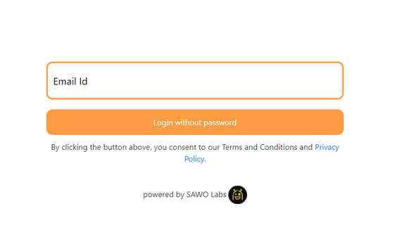
SAWO LABS API
One time Sign-up with any number & Email-ID
APIs are fast, reliable, integrate onto any platform
Passwordless Authentication
Secure user's data & trust

Slide 4
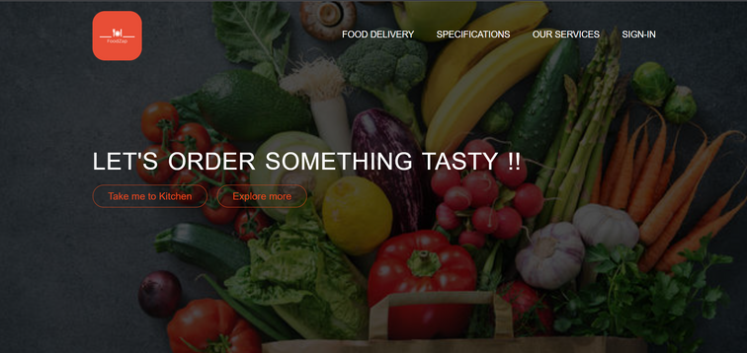
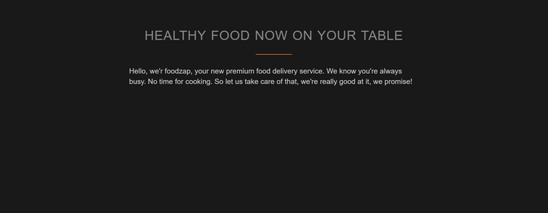
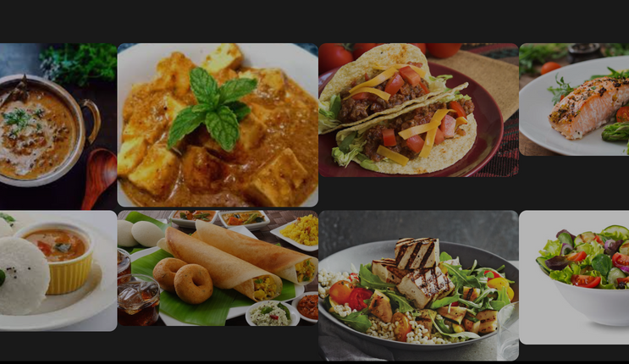
FoodZap
Sign-in to purchase Premium Packages
After login just order whatever you would like to !!
Get food Deliever in Just 30 mins

