Slide 1
Enhancing Scientific Literature Analysis with a RAG System
Jin Huang, Xuteng Luo, Omkar Vodela, Aarya Kulshrestha
University of Michigan
April 18, 2025

Slide 2
Context and motivation
Scientific fields are evolving rapidly, with thousands of new papers published weekly.
Researchers struggle to keep up, analyze, and synthesize this vast literature.
Traditional LLMs help, but their knowledge becomes outdated quickly.
We aim to build a system that retrieves up-to-date, relevant, and contextual scientific insights on demand.

Slide 3
Problem statement
How can we build a scientific literature assistant that dynamically incorporates new information and responds accurately in real time?
Challenges: Most previous works lack real time adaptation to new literatures.

Slide 4
Previous works
Domain-Specific Pretraining (e.g., SciBERT): great for tailored understanding but fixed post-training.
SciLitLLM: adds domain knowledge by continual pre-training and supervised fine-tuning on scientific corpora, but still static and lacks real-time adaptability.
BM25 Retrieval: simple and fast but fails to capture semantic meaning—limited for nuanced queries.
Existing systems lack semantic, real-time adaptability to evolving scientific literature.

Slide 5
Contributions
Dynamic Retrieval: Inject external context into the model at inference time.
Semantic Understanding: Use vector databases and embedding-based similarity.
Key Advantage: No need to retrain model for every update—just update the corpus.

Slide 6
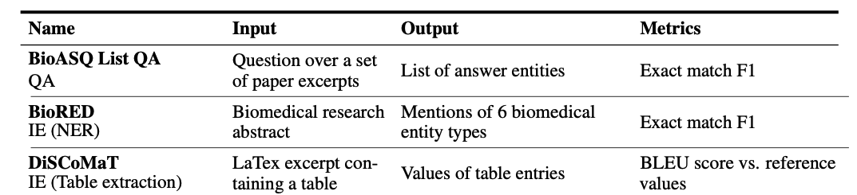
Background
Reference: Table 1, [2406.07835] SciRIFF: A Resource to Enhance Language Model Instruction-Following over Scientific Literature

Slide 7
Background
Reference: Table 1, [2406.07835] SciRIFF: A Resource to Enhance Language Model Instruction-Following over Scientific Literature

Slide 8
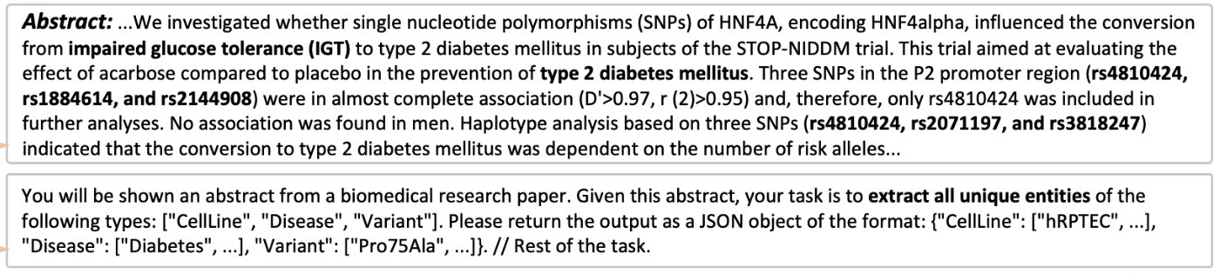
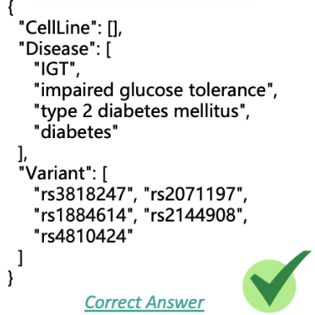
Evaluation (below example: BioRED task)
Input
Expected output

Slide 9
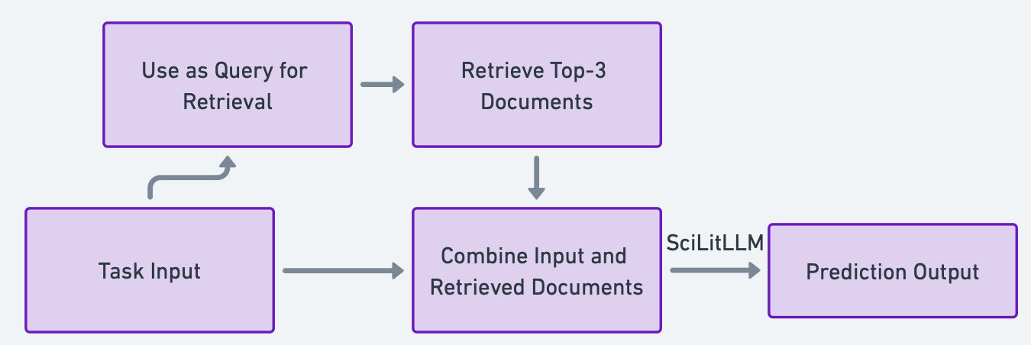
Method
Retrieval Dataset: sampled 1000 papers about bio-medicine from S2ORC (The Semantic Scholar Open Research Corpus)
Retrial query: the whole input
RAG module

Slide 10
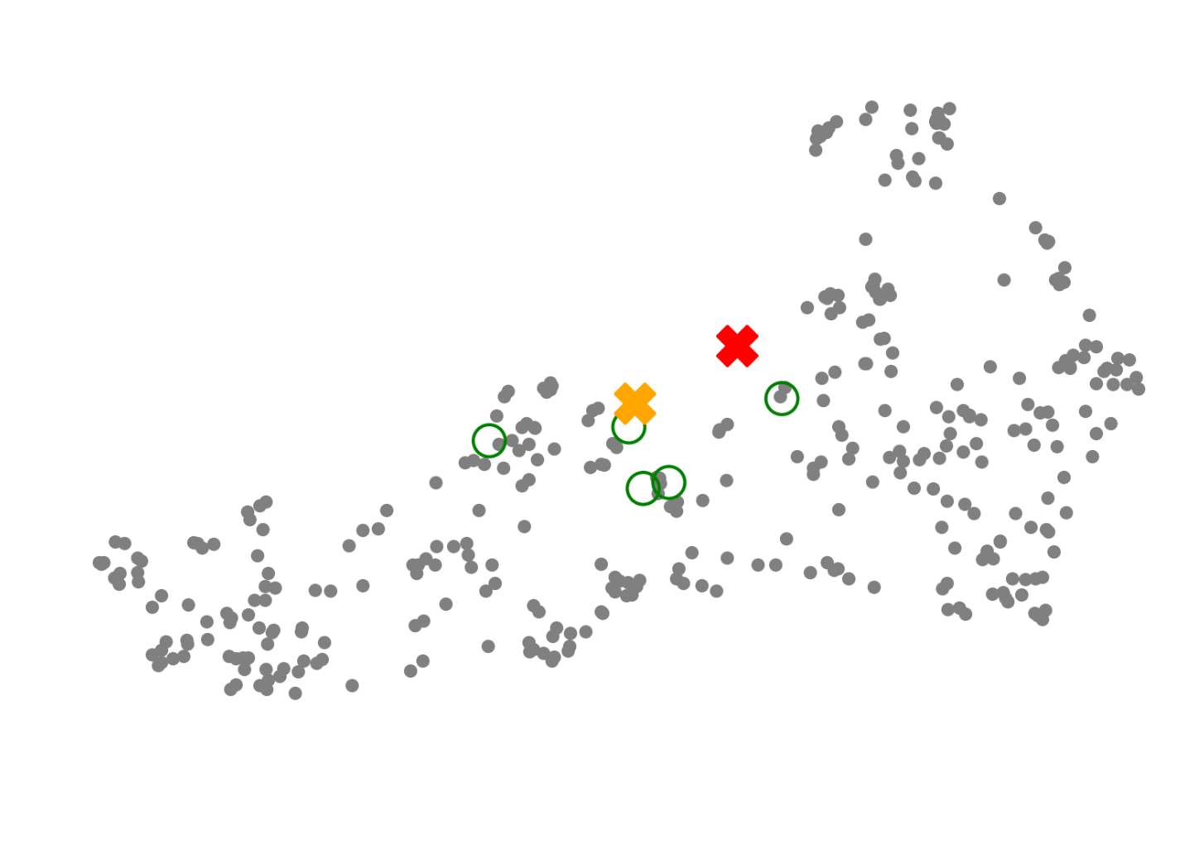
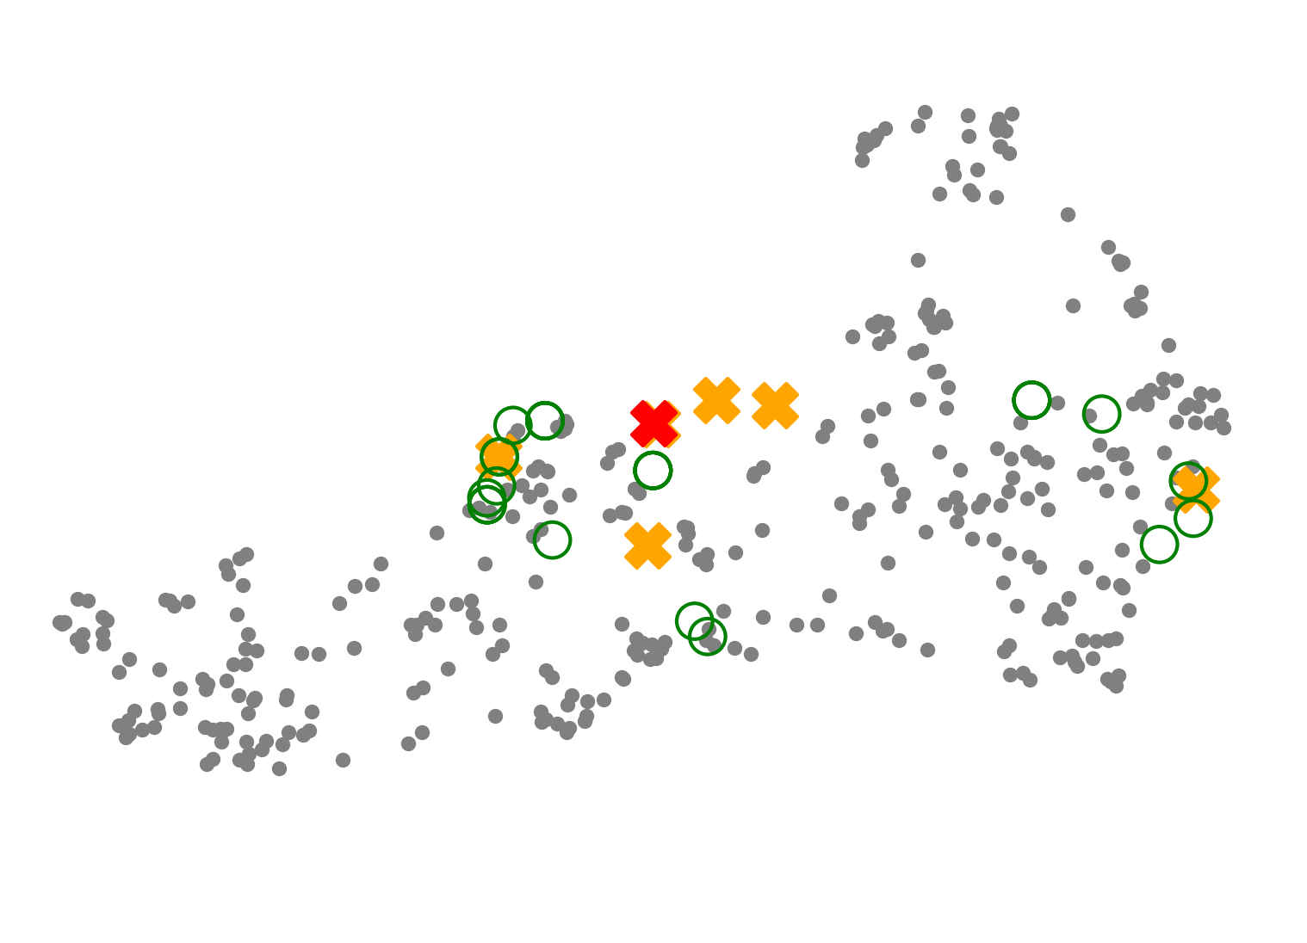
Method: RAG
Evolution
Naive Rag
Expanded Answers
Expanded Queries
Embed data
Document Retrieval
Data Augmentation
LLM Generation

Slide 11
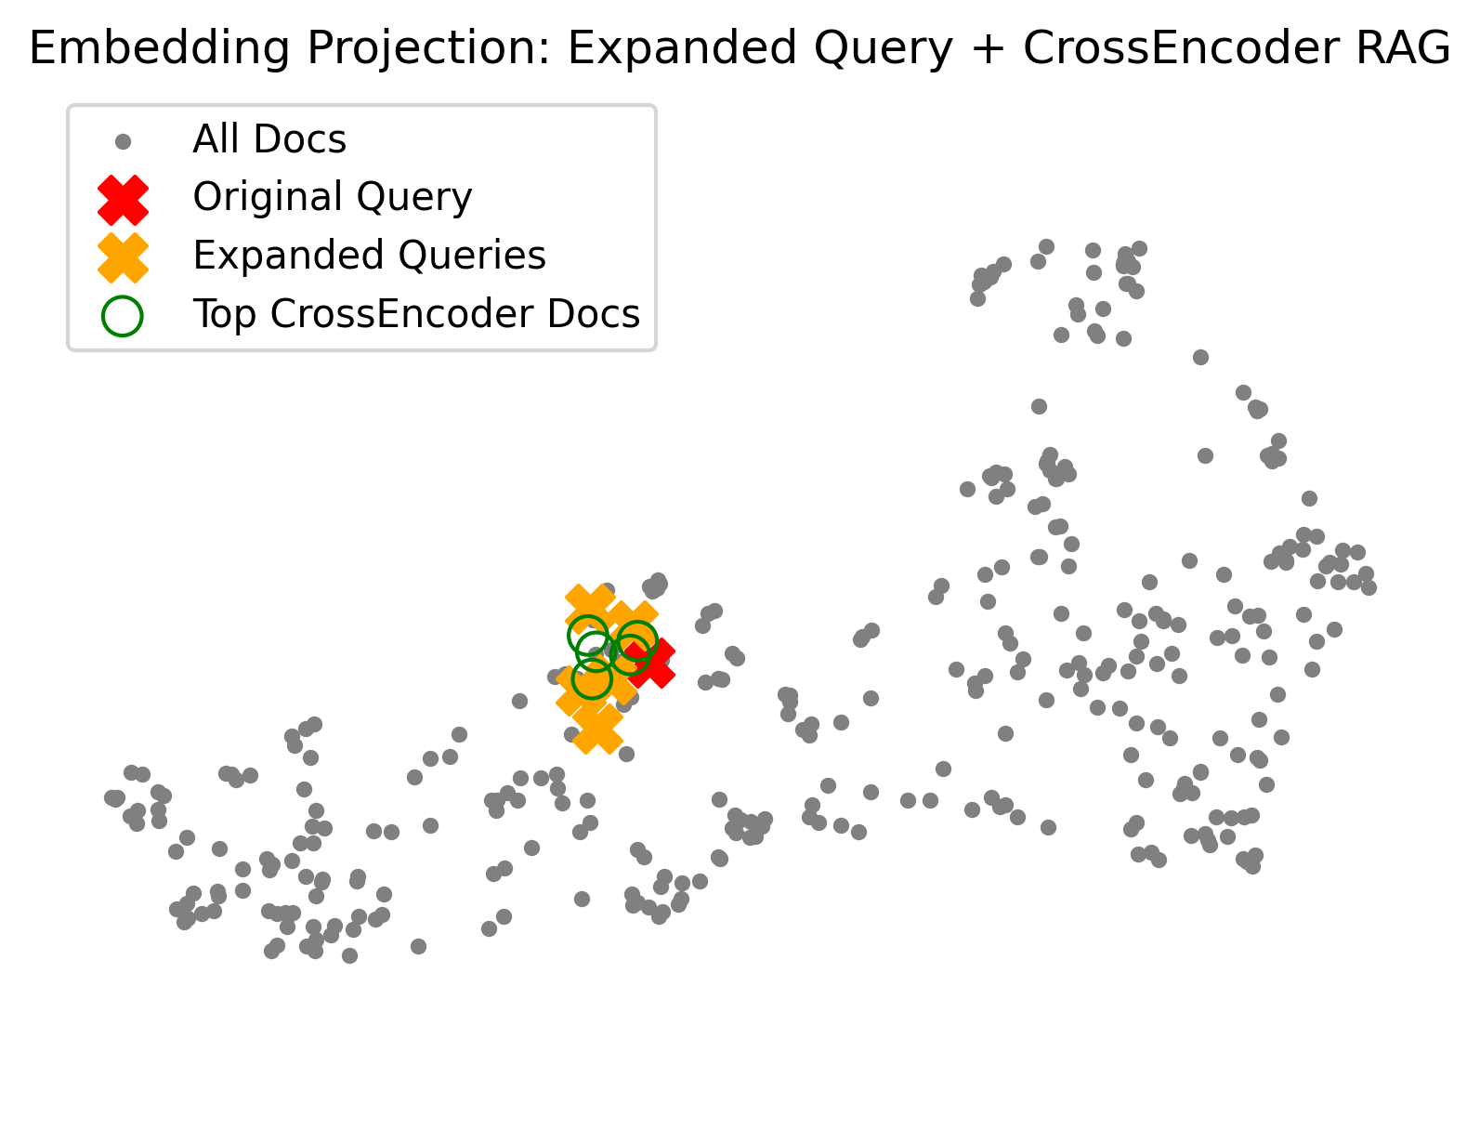
Method: RAG

Slide 12
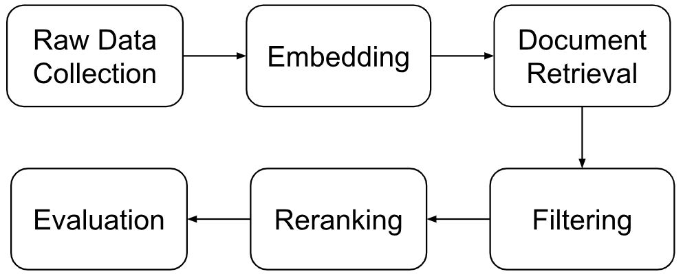
Method: RAG
Embed all documents using a dense retriever (contriever-msmarco).
For each evaluation query, retrieve K top documents
Apply filters for deduplication, decontamination (remove overlap with test data)
Rerank using a cross-encoder for more precise document ranking
Run evaluation tasks to generate fine-grained metrics

Slide 13
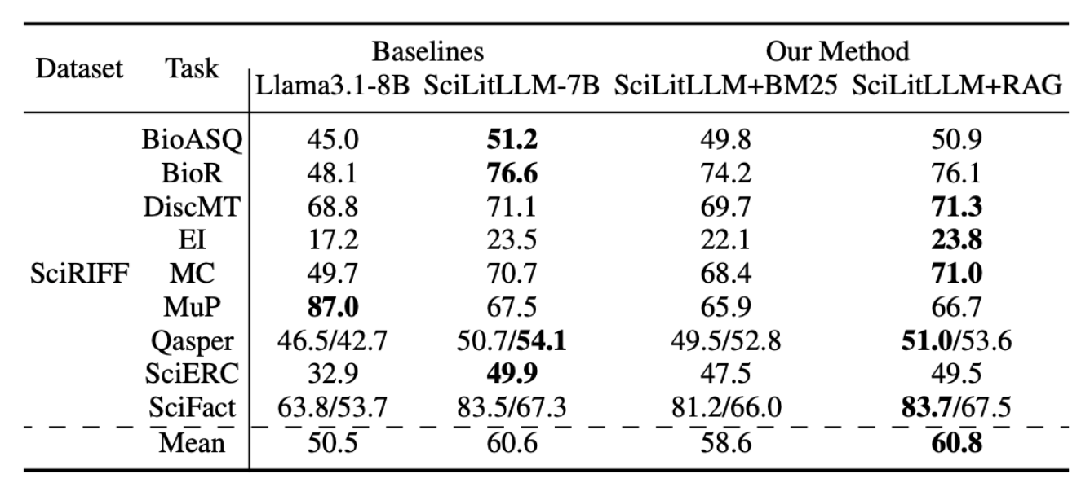
Results and Analysis 1
Notes:
lm-

Slide 14
Results and Analysis 2
Results
BM-25 retrieved documents harm the performance and RAG brings a small performance improvement, indicating the effectiveness of our RAG module.
Analysis
The number of documents in current vector database is small (1k) → limited knowledge coverage
SciRIFF is mostly a in-context benchmark, i.e. not strictly rely on external knowledge → the small improvement from RAG is understandable.

Slide 15
Key Takeaways and Contributions
What We Did
Extended the SciLitLLM pipeline with a Retrieval-Augmented Generation (RAG) module for scientific literature analysis.
Conducted direct comparisons between lexical (BM25) and various semantic (RAG) retrieval methods to find the most appropriate pipeline.
Takeaways
RAG pipelines provide better factual accuracy and reduce hallucinations by grounding responses in verifiable source documents
Preprocessing is everything
Adding rerankers, query expansion, or hybrid retrievers can improve performance — but increase latency
Human evaluation and retrieval precision provided a better picture of real-world performance

Slide 16
Ethical Considerations
Real-World Risks
Hallucinations remain a threat: Poorly tuned RAG can inject unrelated or misleading context if retrieval returns off-topic documents.
Bias in embeddings: Vector-based systems may inherit biases from pre-trained models, leading to skewed context or exclusion of diverse sources.
Mitigations Considered
Used answer-aware augmentation to ground queries in plausible contexts, reducing hallucination risks.
Designed evaluation methodology (e.g., UMAP visualization) to detect retrieval noise and semantic drift early.
Focused on transparent document sources and query interpretability to support reproducibility and auditability.

Slide 17
Reflections and Future Work
What Went Well
Current RAG framework retrieved relevant documents and improve performance on the scientific analysis tasks.
Our RAG module outperform the baseline: BM25.
What We’d Do Differently
We expect the incorporation of larger corpora and more diverse scientific domains would yield better generalization.
We could benefit from more fine-grained RAG tuning (e.g., chunk size, embedding models).
Future Directions
Apply query rewriting and augmentation strategies potentially using reinforcement learning or user feedback loops.
Apply the pipeline to domain-specific evaluations (e.g., biomedicine, materials science) with corresponding RAG datasets.

