Slide 1
CELBC710 · Computational Intelligence Laboratory · Experiments 9 and 10
SymbioForge
Heart-health decision support: eight AI workflows, one orchestrator, one explained overview
The problem
A bare yes/no from a single model is hard to trust and impossible to act on.
People do not know what their own numbers mean.
A health tool that cannot say "I am unsure" is unsafe.
Our answer
Run independent workflows (ML, deep learning, expert rules, SHAP, trust, what-if, test planner) and reconcile them.
Return an explained, uncertainty-aware overview and a next step, not a label.
Reach it through a clinic website: one link, one flow.
0.896
10
ROC-AUC, held-out test (n = 138)
AI workflows run and traced for every patient
56 ms
22
median time for the full pipeline incl. explanation
automated tests passing
What a visitor experiences
Clinic website
Guided chat
Overview + explanation
Next steps + chat
Book a home checkup
Decision support only, not a diagnosis. Research prototype trained on a public dataset; not clinically validated.
1 / 5

Slide 2
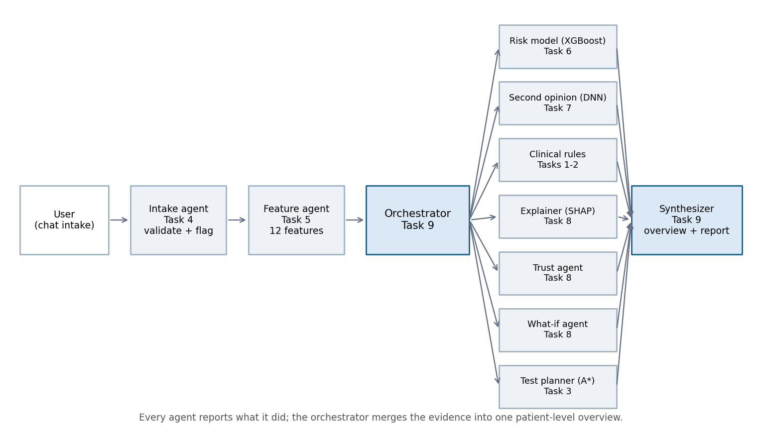
HOW IT WORKS
Eight workflows, one orchestrator
Workflow | From | What it does
Intake agent | T4 | validate; flag and fill missing tests
Feature agent | T5 | 12 features from one formula module
Risk model | T6 | XGBoost probability (the verdict)
Second opinion | T7 | DNN; flags disagreement
Clinical rules | T1-2 | R1-R7: fired / not fired / unknown
Test planner | T3 | A* picks the cheapest decisive test
Explainer | T8 | exact SHAP contributions
Trust + what-if | T8 | bands, conformal set, sensitivity
Synthesizer | T9 | overview, doctor questions, report
Each box is an independent workflow that reports what it did; the orchestrator merges the evidence.
918 patients
4 hospitals, 918 after cleaning, 12 engineered features
Clean evaluation
70/15/15 split (seed 42); imputer, scaler and models fit on train only
No train/serve skew
one feature function; parity test < 1e-9 against the saved matrix
Honest about gaps
missing tests are flagged, confidence is capped, rules never run on guesses
SymbioForge · Decision support only, not a diagnosis. Research prototype, not clinically validated.
2 / 5

Slide 3
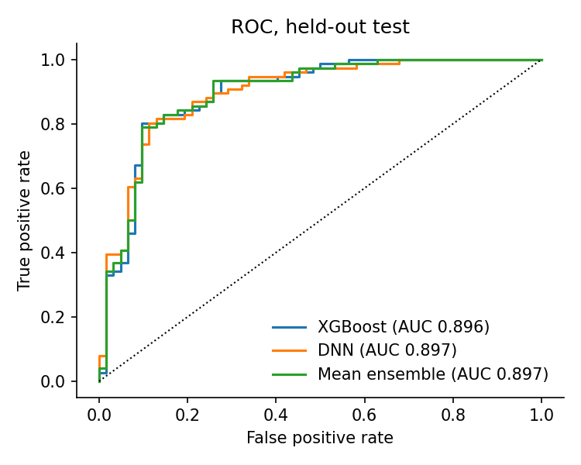
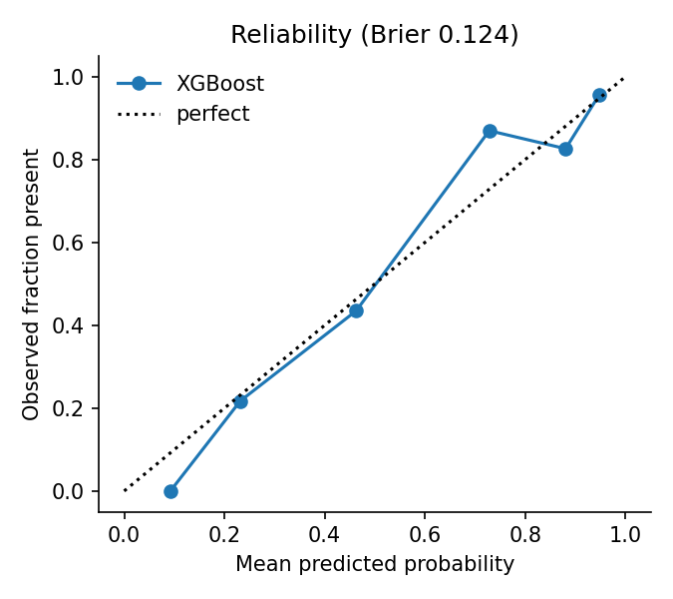
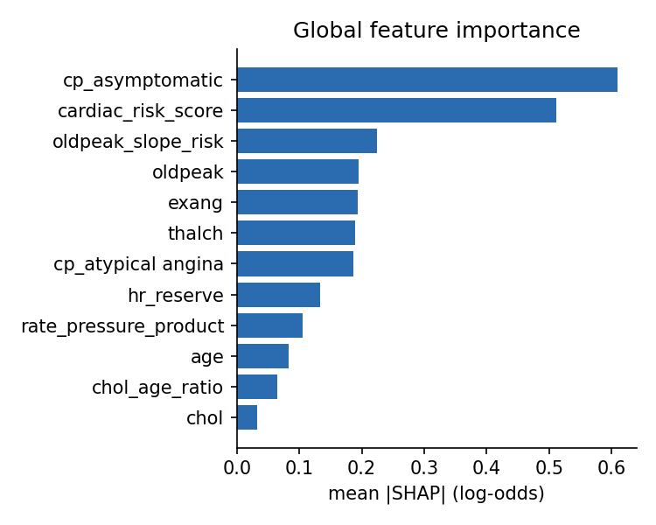
EVIDENCE
Accurate, and honest about uncertainty
ROC curves, held-out test (AUC XGBoost 0.896, DNN 0.897)
Reliability: predicted vs observed (Brier 0.124)
What drives predictions (mean |SHAP|, test set)
Seven models compared (5-fold CV on train, then held-out test)
92%
6%
92%
Model | CV AUC | Test acc. | Test AUC
XGBoost (tuned) | 0.876 | 0.819 | 0.896
LogisticRegression | 0.874 | 0.833 | 0.904
SVM | 0.859 | 0.819 | 0.879
RandomForest | 0.853 | 0.841 | 0.870
GradientBoosting | 0.853 | 0.833 | 0.893
XGBoost (task 6) | 0.844 | 0.833 | 0.878
DecisionTree | 0.811 | 0.819 | 0.855
ML accuracy when expert rules agree (53% when they disagree)
XGBoost and DNN disagree; confidence is lowered
conformal coverage (target 90%); 21% flagged 'uncertain'
What we conclude
AUC 95% interval 0.84-0.95: XGBoost and the DNN cannot be separated at n = 138, and averaging gave no gain. So XGBoost gives the verdict, the DNN is a second opinion, and every disagreement is shown to the user.
SymbioForge · Decision support only, not a diagnosis. Research prototype, not clinically validated.
3 / 5

Slide 4
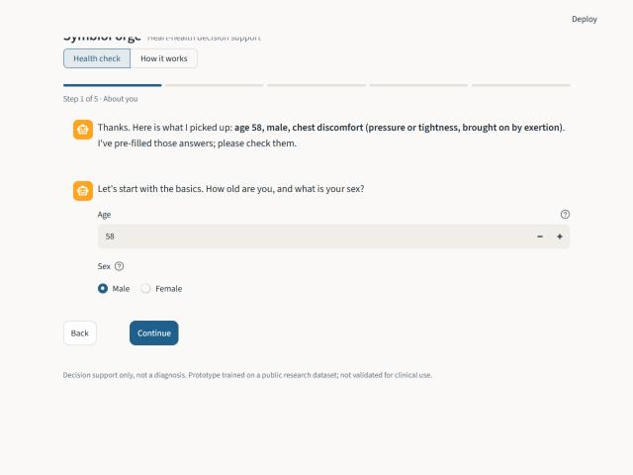
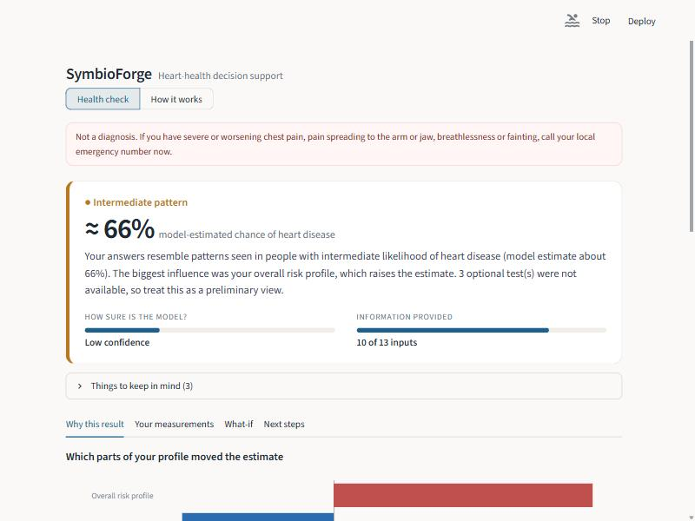
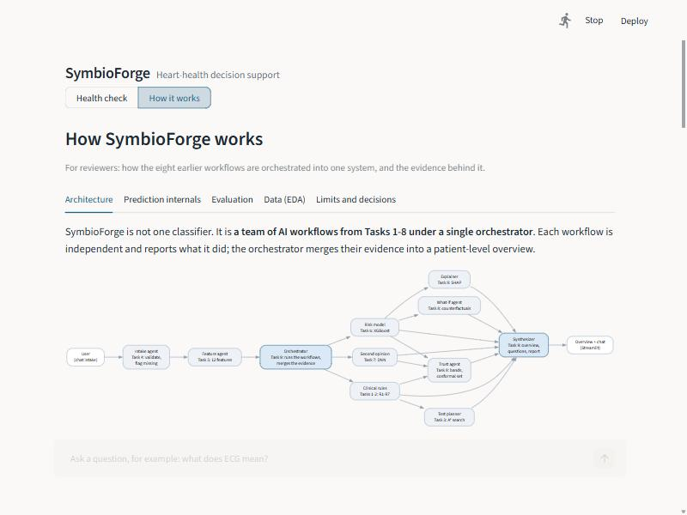
THE PRODUCT
From a clinic website to a plain-language overview
Guided chat: plain-language questions, a tooltip on every field, free-text pre-fill
Overview: risk pattern, estimate, confidence and how much information was given
How it works view for reviewers: live trace of the workflows
What the user gets
Plain-language questions; chest pain classified from three yes/no questions.
Four tabs: why this result, their measurements vs reference ranges, what-if curves, next steps.
Three independent opinions (ML, deep learning, expert rules).
Ranked next tests, questions for the doctor, a downloadable report.
A chat that answers only from the computed analysis: no external AI service, no invented facts.
One public link, free to run
Clinic website (GitHub Pages) is the front door; its button redirects into the Streamlit Cloud app, which links back and offers booking.
Stateless: nothing stored, no API keys, no data leaves the page.
Local demo with one command: python run_demo.py
Live app: symbioforge.streamlit.app
SymbioForge · Decision support only, not a diagnosis. Research prototype, not clinically validated.
4 / 5

Slide 5
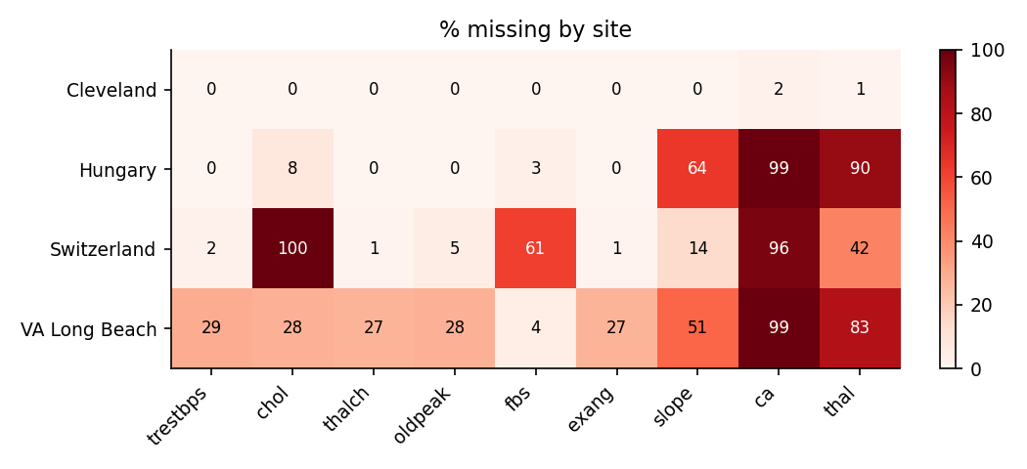
RESPONSIBLE BY DESIGN
What we guard against, what we learned, where it goes next
Area | How it is handled
Not a diagnosis | Notice on every screen and report; emergency wording always available
Missing tests | Flagged, never silent; 2+ missing blocks 'high' confidence; rules never run on guesses
Disagreement | ML vs DNN vs rules shown; any conflict lowers confidence
Explainable | Exact SHAP per patient; DNN limits stated in the UI
Uncertainty | Validation-based bands and a 90% conformal set; 'uncertain' is allowed
Counterfactuals | Labelled model sensitivity, never treatment advice
Privacy | Stateless; no patient data stored or sent anywhere
What independent review caught
Two review passes found defects that tests had missed. The most telling: a constant used to fill missing cholesterol acted as a hidden hospital marker, and the model learned it. Removing it lowered test AUC slightly (0.899 to 0.896), which is the honest number.
Why we are careful
Missingness and disease rate both depend on the hospital, so the data hide a confounder.
Fairness check (test set; groups are small, so weak evidence)
Group | n | AUC | Recall
Sex: male | 113 | 0.881 | 0.843
Sex: female | 25 | 0.895 | 0.833
Site: Cleveland | 46 | 0.898 | 0.783
Site: Hungary | 53 | 0.897 | 0.800
Site: Switzerland | 18 | 0.941 | 0.882
Site: VA Long Beach | 21 | 0.825 | 0.938
Conclusion
SymbioForge turns a classifier into an explained, uncertainty-aware overview by reconciling eight workflows, and it is reached through a clinic front door with a single public link.
Honest limits: small test set (138), historical single-source data, no clinical validation.
Next: clinician and user study, site-held-out validation, calibrated probabilities, an optional language-model layer limited to computed evidence.
SymbioForge · Decision support only, not a diagnosis. Research prototype, not clinically validated.
5 / 5

