Slide 1
Online Shopping Mall using Python
B.Tech F.Y.
L-B3
Data Structures Using Python Course Project
Department of Engineering, Sciences and Humanities (DESH)
Vishwakarma Institute of Technology, Pune
A.Y.(2021-2022) Term II
Roll No. | PRN No. | Member
58 | 12110699 | Aarya Nirgude
59 | 12110007 | Tejashri Nirmal
60 | 12110824 | Nitesh Rahangdale
61 | 12110102 | Nitin Choudhary
62 | 12110700 | Pratik Ohol
63 | 12111073 | Ojas Khade

Slide 2
OUTLINE
Introduction
problem statement
objectives
background
Implementation
Results and discussion
Conclusion and Future Scope
References

Slide 3
Introduction
The popularity of online shopping is due to a variety of factors which includes external factors such as the increasing cost of fuel and the difficulty of reaching far away shops. This has led to a rise in interest in online shopping.
People prefer online shopping because they can find a variety of products and it is easy.
There are a lot of products available online and you can easily search for products you want.

Slide 4
problem statement
Online sellers face the challenge of identifying the customer's wants and needs because customers are in great numbers. So, it is necessary for the researcher to identify the factors influencing customers to shopping online.

Slide 5
objectives
1. Creating a virtual shop environment for users, which will be available to them through the internet.
2. Easy navigation of products which are needed by the customers.
3. To increase the number of customers and enhance relationship between sellers and customers.

Slide 6
background
The current shopping system requires people to visit shops manually to buy products and to pay for the same item in cash mode. This kind of system is not very user-friendly as people will have to visit shops physically and it is unknown if their desired product is available.
Many times, these shops are not accessible to certain people So, through the Online Shopping System people can buy products and the shop owner can be the admin of the system.

Slide 7
Implementation
Category of the project
- Online Shopping Mall Platform
Tools / Platform
- Visual Studio Code, MySQL, Matplotlib,
Text-to-speech

Slide 8
Implementation (Cont.)
Features
It will provide different graphs of products along with the quantity sold.
Customers will have the facility of text-to-speech where they will be able to hear details.
It will be easy for users to navigate for products.

Slide 9
Implementation (Cont.)
Algorithm
Step 1: Start
Step 2: Firstly main() function will be executed, in this quiz will ask about player’s name, then menu() function will be called.
Step 3: In menu() function instructions are displayed as well as player can start the quiz, then question() function will be called.
Step 4: question() function is executed and the questions will be displayed sequentially as the player proceeds further and result() function will be called everytime as player gives answer. Then calculateScore() will be called.
Step 5: calculateScore() function will display the score as well as number of questions attempted, the number of correct answers also.
Step 6: The above whole process will be repeated for every new attempt.
Step 7: Stop.

Slide 10
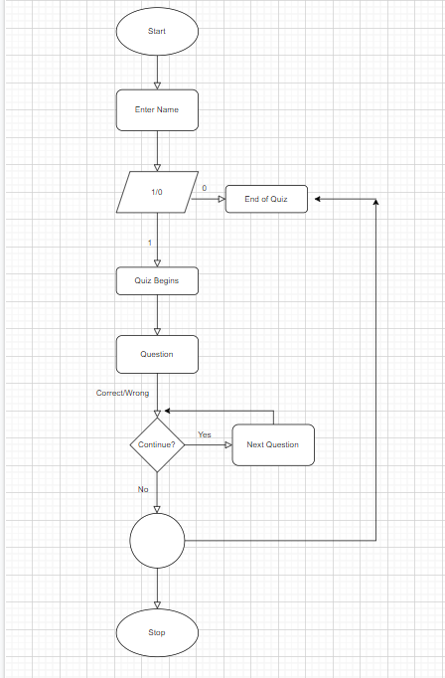
Flowchart

Slide 11
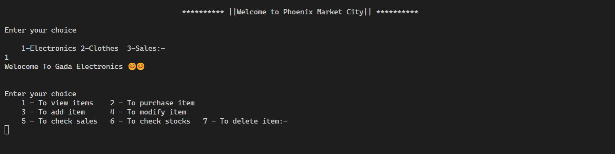
Results and discussion
Fig1. All Menu for Electronics Shop

Slide 12
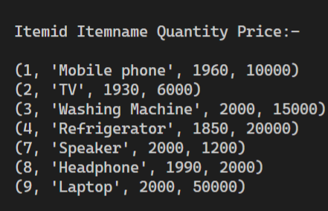
Results and discussion
Fig2. Variety of items in Elec. Shop

Slide 13
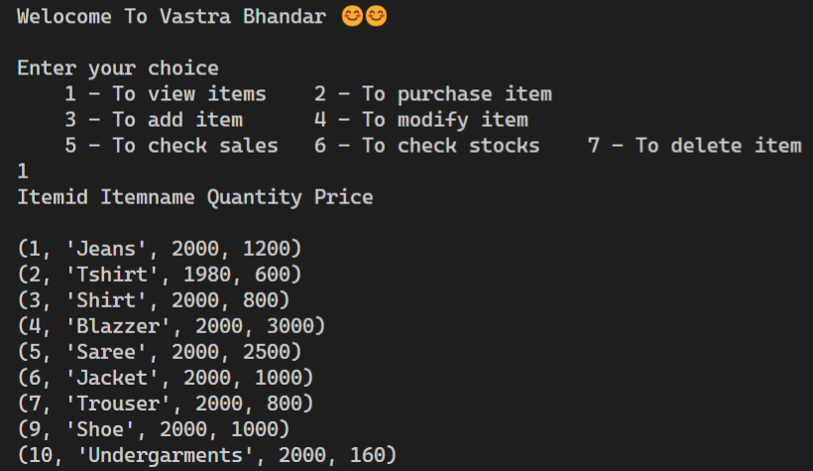
Results and discussion
Fig3. Variety of items in Clothes Shop

Slide 14
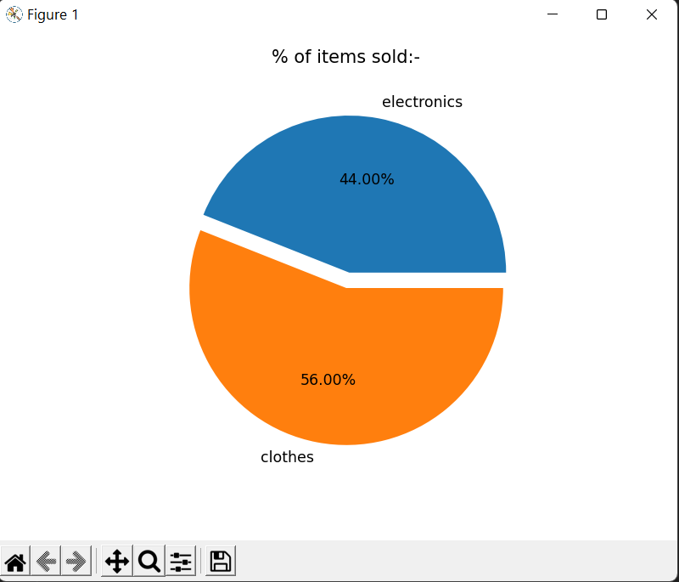
Results and discussion
Fig4. Sales(Electronics vs Clothes)

Slide 15
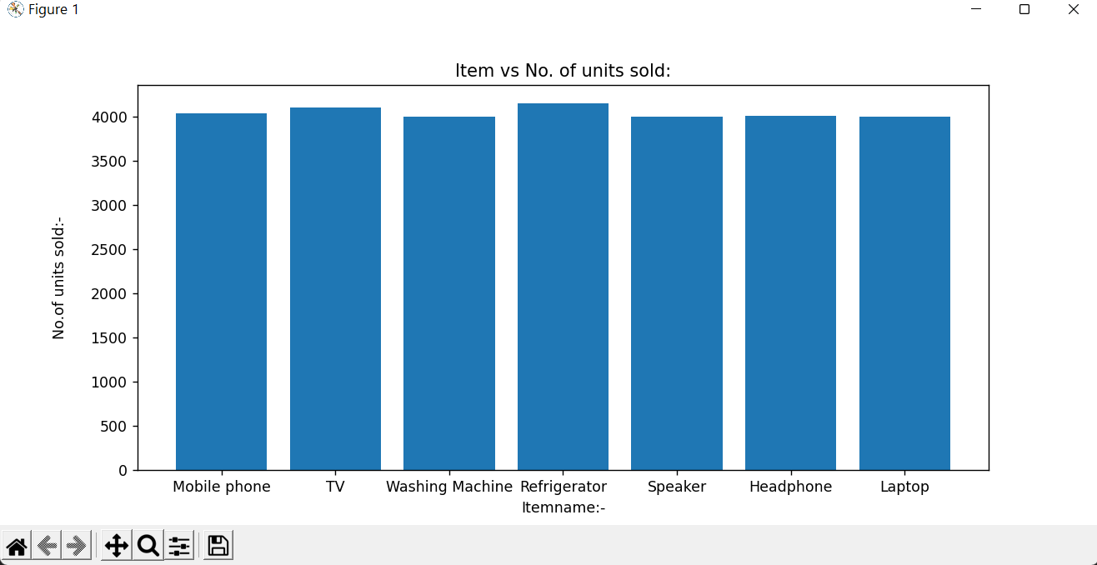
Results and discussion
Fig5. Sales of Elec. items in form of Bar Graph

Slide 16
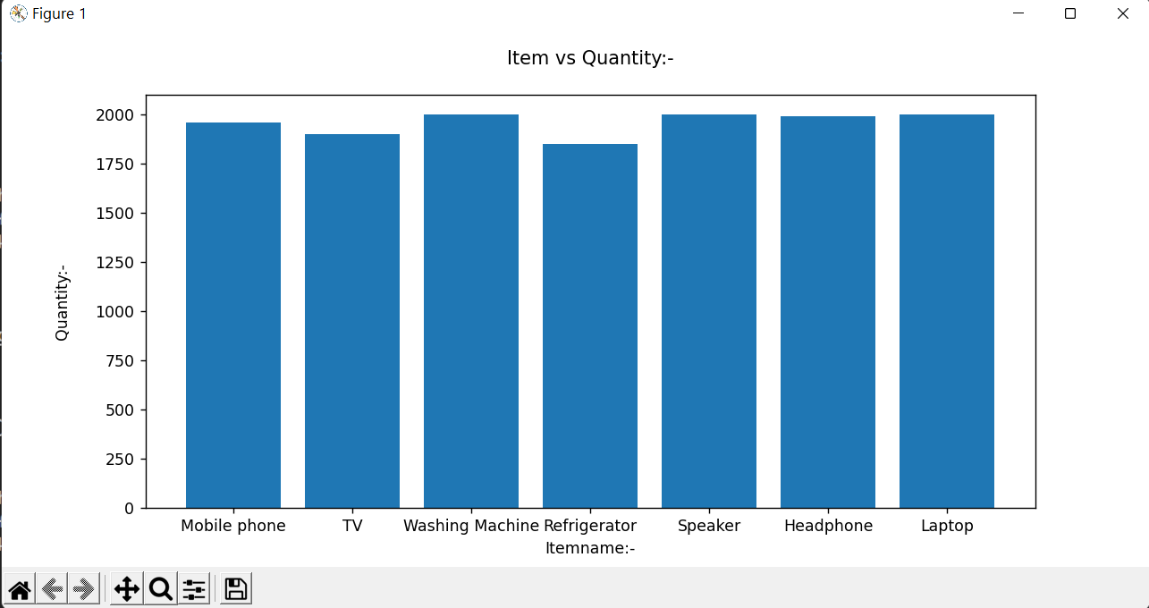
Results and discussion
Fig6. Stocks available in Electronics store

Slide 17
Conclusion and Future Scope
Conclusion
Based on a thorough analysis of the study of customer preference towards online shopping with respect to various online shopping platforms, it is concluded that although there are a large number of products available in the market, a large proportion of respondents prefers to purchase products through online shopping. So, we have made a try to bring the offline market on the online platform.
Hence, the system has been developed with much care and free of errors and at the same time it is efficient and less time consuming.
Future Scope
Many other shops can be added.
GUI can be introduced to give customers a visual experience.

Slide 18
Contribution
Div L Batch B3
Roll No 58-PRNNo-12110699-Aarya
Coding, Objectives
Roll No 59-PRNNo-12110007-Tejashri
Coding, UI Design idea
Roll No 60-PRNNo-12110824-Nitesh
Algorithm and Coding
Roll No 61-PRNNo-12110102-Nitin
Problem Statement, Coding and Debugging
Roll No 62-PRNNo-12110700-Pratik
Project Testing and Coding
Roll No 63-PRNNo-12111073-Ojas
Model Design and Coding

Slide 19
References
[1]https://www.researchgate.net/publication/264556861_Online_Shopping_-_An_Overview
[2]https://pythonclassroomdiary.files.wordpress.com/2020/01/project-report-the-mall-of-emirates
[3]https://www.academia.edu/38999169/THE_STUDY_OF_IMPACT_OF_ONLINE_SHOPPING_ON_CONVENTIONAL_SHOPPING_METHODS_BY_TODAYS_YOUTH_WITH_RESPECT_TO_CLOTHING_AND_ACCESSORIES
[4] http://www.ijarset.com/upload/2021/may/01-busari-30

Slide 20
Thank You

