Slide 1
Chess AI with Minimax and Alpha-Beta Pruning
Algorithms Implemented:
Minimax
Alpha-Beta Pruning
Key Features:
Self-playing AI using classic game tree search
Custom evaluation function
Visualization and video generation using pygame and OpenCV

Slide 2
Evaluation Strategy
Scoring Mechanism
Material Evaluation: Each piece has a static value (e.g., Queen = 900).
Positional Evaluation:
Uses Piece-Square Tables (e.g., central control is rewarded). Separate tables for middle and endgame for the king. Game State Handling:
Checkmate → ±10000
Stalemate/Draws → 0
Loops through all 64 squares:
Checks piece type and color.
Applies appropriate piece-square table and material score.

Slide 3
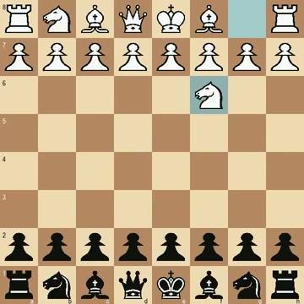
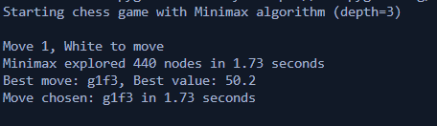
Minimax Algorithm
Key Points:
Objective: Explore all possible move sequences up to a fixed depth to find the best move based on evaluation.
Approach:
Recursively simulate moves to a specified depth.
Alternate between maximizing (White) and minimizing (Black) player.
Use a static evaluation function at leaf nodes.

Slide 4

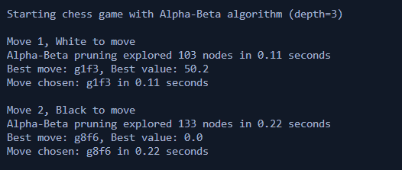
Alphabeta Algorithm
Alpha-Beta Pruning: Efficient Minimax Search
Key Points:
Improvement over Minimax
Prunes branches that don't affect the final decision
Same results as Minimax, but much faster.
How it works:
Maintains two values
α (Alpha): Best value for maximizer so far
β (Beta): Best value for minimizer so far
Stops evaluating a branch when α ≥ β.
Enhancement: Move ordering heuristic (captures & checks first) improves pruning efficiency.

