Slide 1

Project Title – Seasonal Agriculture Performance Analysis
AARYA RAMCHANDRA TARPHE
KONKAN GYANPEETH COLLEGE OF ENGINEERING
AICTE STU ID : STU66595b86dc18b1717132166

Slide 2

PROBLEM STATEMENT
Agricultural performance changes with different seasons.
Factors like rainfall, temperature, irrigation and resources can affect crop performance.
The project aims to find seasonal patterns and compare agricultural performance.

Slide 3
Project Description
Analyzed agricultural data from different seasons, crops and regions.
Cleaned and prepared the dataset for analysis.
Compared yield, production, cost, revenue and profit.
Studied the relationship between environmental conditions and crop performance.
Used graphs and statistical analysis to find useful patterns.

Slide 4

WHO ARE THE END USERS?
Farmers - for better seasonal planning.
Agricultural departments – for planning and resource management.
Researchers – for studying agricultural trends.
Agribusinesses – for understanding production and market performance.

Slide 5

Technology Used
  Python
  Google Colab
  Pandas
  NumPy
  Matplotlib
  Seaborn
  SciPy
  CSV Dataset

Slide 6
RESULTS
Found differences in agricultural performance across seasons.
Compared yield, production and profit between seasons.
Identified relationships between environmental factors and yield.
Observed differences between crops and regions.
Found some unusual patterns that need further study.

Slide 7
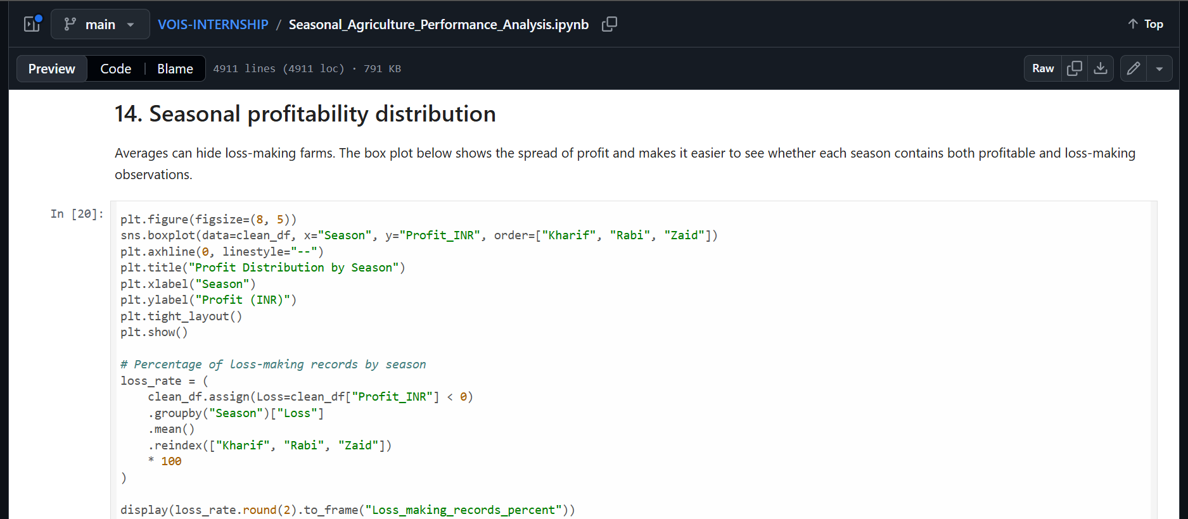
RESULTS

Slide 8
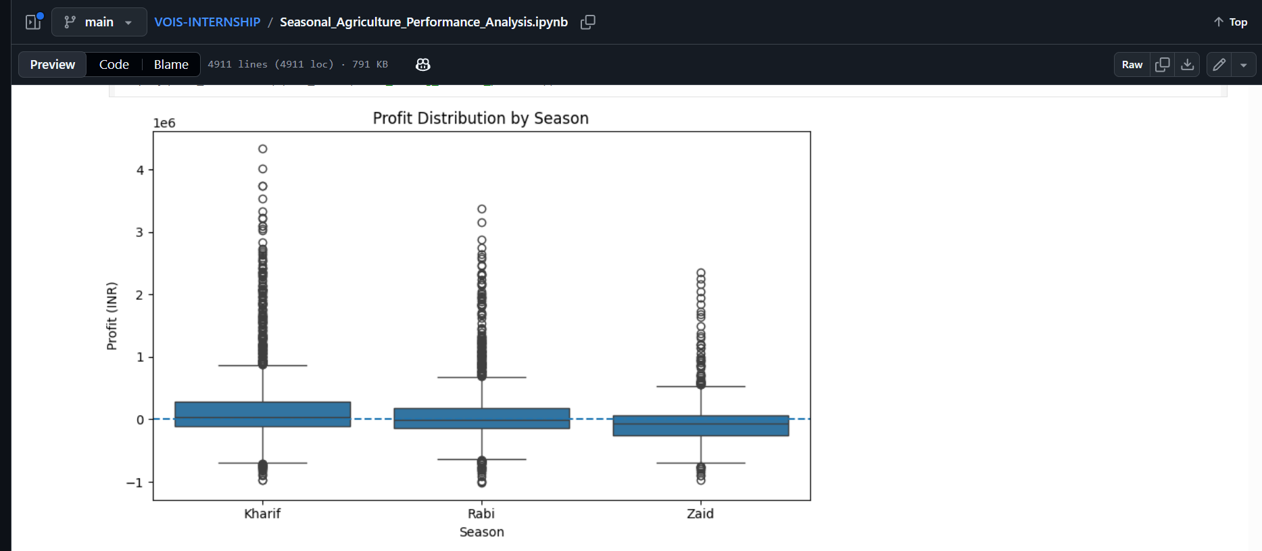
RESULTS

Slide 9
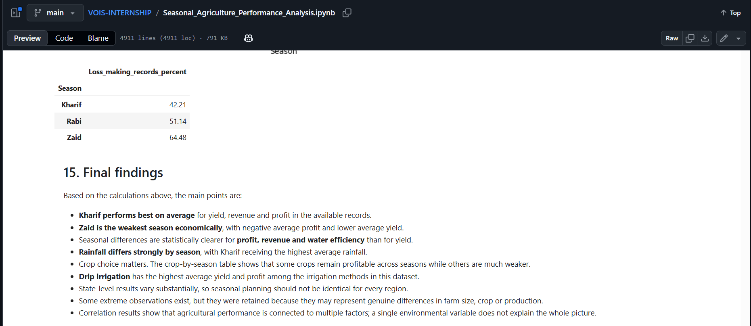
RESULTS

Slide 10
RESULTS
The analysis shows clear differences in agricultural performance between seasons, particularly in economic outcomes and water efficiency.
Kharif has the strongest overall performance in this dataset, while Zaid faces weaker profitability.
At the same time, crop, irrigation method and state also create important differences.
Therefore, the main conclusion is that seasonal agricultural performance should be studied together with crop choice, resource use, environmental conditions and regional factors.
The dataset supports useful comparisons and planning insights, but the results describe associations in the available records and should not be interpreted as proof that one factor alone causes the observed outcomes.

Slide 11
Future scope
Predict crop yield using Machine Learning.
Add real-time weather data.
Build an interactive dashboard.
Develop crop recommendation based on season and conditions.
Expand the analysis to more regions and datasets.

Slide 12
GitHub Link
https://github.com/Aarya718/VOIS-INTERNSHIP/blob/main/Seasonal_Agriculture_Performance_Analysis.ipynb

Slide 13

VOIS Course completion certificate -
Course name- Data Visualization

Slide 14
Thank you
.
.

