Slide 1
Procedures & Functions

Slide 2
Procedures & Functions
"A procedures or function is a group or set of SQL and PL/SQL statements that perform a specific task.“
A function and procedure is a named PL/SQL Block which is similar .
The major difference between a procedure and a function is, a function must always return a value, but a procedure may or may not return a value.

Slide 3
Procedures
A procedure is a named PL/SQL block which performs one or more specific task.
This is similar to a procedure in other programming languages.
A procedure has a header and a body.
The header consists of the name of the procedure and the parameters or variables passed to the procedure.

Slide 4
Procedures
The body consists or declaration section, execution section and exception section similar to a general PL/SQL Block.
A procedure is similar to an anonymous PL/SQL Block but it is named for repeated usage.
We can pass parameters to procedures in three ways.

Slide 5
Procedures
Parameters | Description
IN type | These types of parameters are used to send values to stored procedures.
OUT type | These types of parameters are used to get values from stored procedures. This is similar to a return type in functions.
IN OUT type | These types of parameters are used to send values and get values from stored procedures.

Slide 6
Procedures
CREATE [OR REPLACE] PROCEDURE procedure_name (<Argument> {IN, OUT, IN OUT}
<Datatype>,…)
IS
Declaration section<variable, constant> ;
BEGIN
Execution section
END

Slide 7
Procedures
IS - marks the beginning of the procedure body similar to DECLARE in anonymous PL/SQL Blocks.
The code between IS and BEGIN forms the Declaration section.
The syntax within the brackets [ ] indicate they are optional.
By using CREATE OR REPLACE together the procedure is created if no other procedure with the same name exists or the existing procedure is replaced with the current code.

Slide 8
How to execute a Procedure?
There are two ways to execute a procedure
1. From the SQL prompt :
EXECUTE [or EXEC] procedure_name;
2. Within another procedure simply use the
procedure name :
procedure_name;

Slide 9
How to execute a Procedure?
create table named emp with two column id and salary with number datatype. CREATE OR REPLACE PROCEDURE p1(id IN NUMBER, sal IN NUMBER) AS
BEGIN
INSERT INTO emp VALUES(id, sal);
DBMS_OUTPUT.PUT_LINE('VALUE
INSERTED.');
END;

Slide 10
Functions

Slide 11
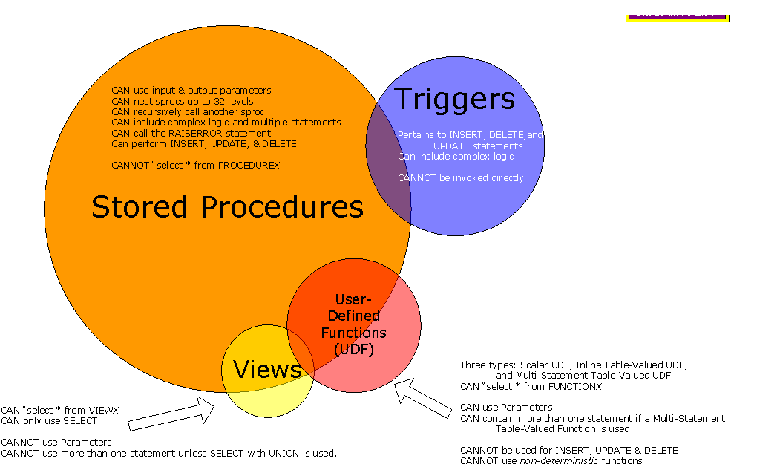

Slide 12
Functions
A function is a named PL/SQL Block which is similar to a procedure.
The major difference between a procedure and a function is, a function must always return a value, but a procedure may or may not return a value.

Slide 13
Functions
Syntax:
CREATE [OR REPLACE] FUNCTION function_name [parameters]
RETURN return_datatype; {IS, AS}
Declaration_section <variable,constant> ;
BEGIN Execution_section
Return return_variable;
EXCEPTION exception section
Return return_variable;
END;

Slide 14
Functions
RETURN TYPE:
The header section defines the return type of the function.
The return datatype can be any of the oracle datatype like varchar, number etc.
The execution and exception section both should return a value which is of the datatype defined in the header section.

Slide 15
How to execute a Function?
A function can be executed in the following ways.
As a part of a SELECT statement :
SELECT emp_details_func FROM dual;
In a PL/SQL Statement :
dbms_output.put_line(emp_details_func);

Slide 16
Function
create or replace function getsal (no IN number)
return number
is
sal number(5);
begin
select salary into sal from emp where id=no;
return sal;
end;

Slide 17
Destroying procedure and function
Syntax:
DROP PROCEDURE/FUNCTION

Slide 18
Procedures VS Functions
A function MUST return a value
A procedure cannot return a value
Procedures and functions can both return data in OUT and IN OUT parameters

Slide 19
Procedures VS Functions
The return statement in a function returns control to the calling program and returns the results of the function
The return statement of a procedure returns control to the calling program and cannot return a value
Functions can be called from SQL, procedure cannot
Functions are considered expressions, procedure are not

