Slide 1
CURSORS

Slide 2
CURSOR
A cursor is a temporary work area created in the system memory when a SQL statement is executed.
A cursor is a handle, or pointer, to the context area.
A cursor contains information on a select statement and the rows of data accessed by it.
This temporary work area is used to store the data retrieved from the database, and perform intermediate operations before output is displayed to the client.
A cursor can hold more than one row, but can process only one row at a time

Slide 3
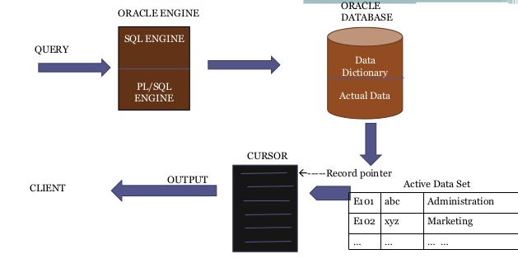
Bordoloi and Bock

Slide 4
Why to use Cursor?
Cursor is a mechanism that provides a way to select multiple rows of data from the database and then process each row individually inside a PL/SQL program.
The cursor first points at row1 and once it is processed it then advances to row2 and so on.
Bordoloi and Bock

Slide 5
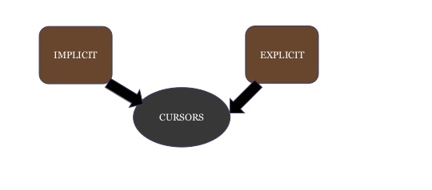
Types Of Cursors
There are two types of cursors

Slide 6
Implicit cursors
These are created by default when DML statements like, INSERT, UPDATE, and DELETE statements are executed.
The user is not aware of this happening & will not be able to control or process the information.
When an implicit cursor is working, DBMS performs the open, fetches and close automatically.

Slide 7
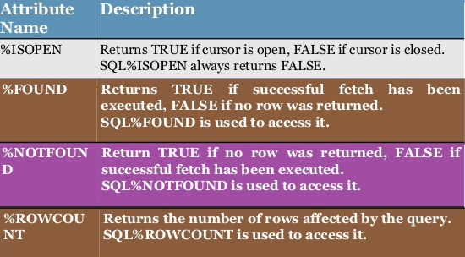
Implicit cursors

Slide 8
Implicit cursors
Write a pl/sql program to update the salary of customers by Rs 5000.

Slide 9
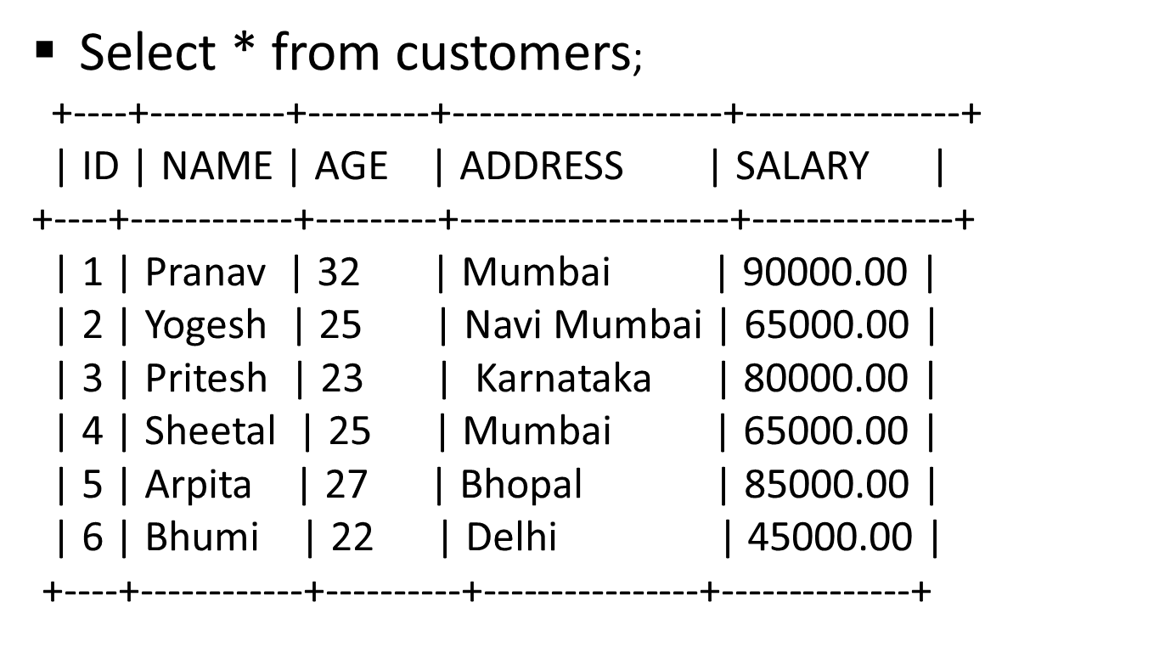
Implicit cursors

Slide 10
Implicit cursors
DECLARE total_rows number(2);
BEGIN
UPDATE customers
SET salary = salary + 5000;
IF sql%notfound
THEN dbms_output.put_line('no customers selected');
ELSIF sql%found
THEN total_rows := sql%rowcount;
dbms_output.put_line( total_rows || ‘customers
selected ');
END IF;
END;

Slide 11
Implicit cursors
Result: 6 customers selected
PL/SQL procedure successfully completed.
Select * from customers;

Slide 12
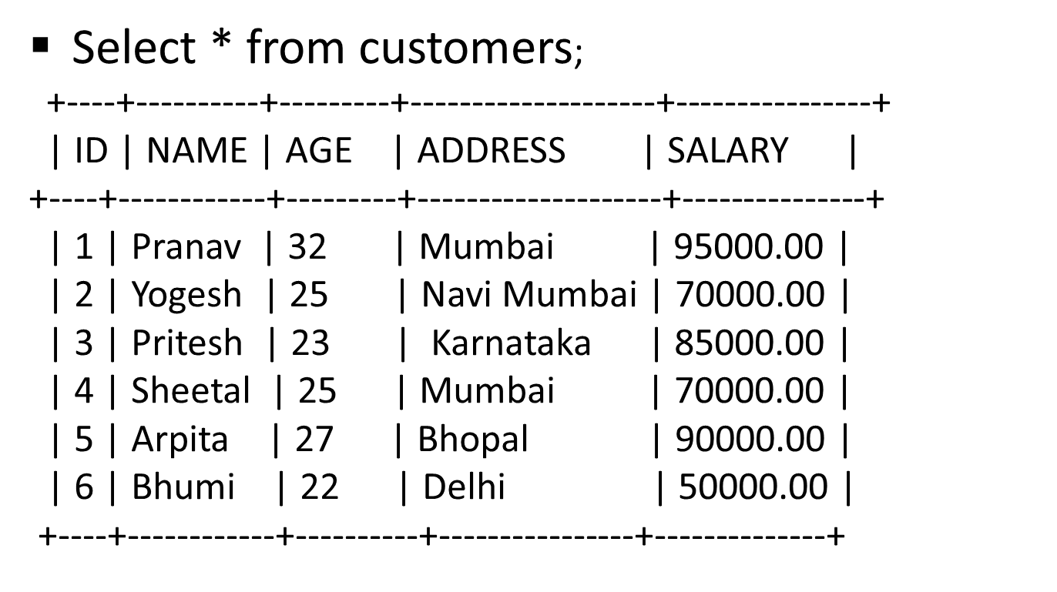
Implicit cursors

Slide 13
Explicit cursors
Explicit cursors are programmer defined cursors for gaining more control over the context area.
An explicit cursor should be defined in the declaration section of the PL/SQL Block.
It is created on a SELECT Statement which returns more than one row.

Slide 14
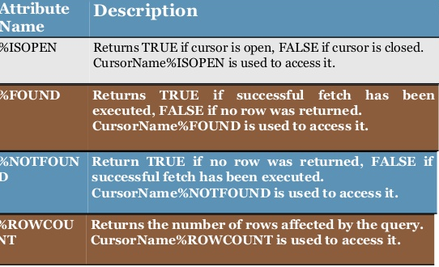
Explicit cursors
Bordoloi and Bock

Slide 15
Explicit cursor involves four steps
DECLARING the cursor. This initializes the cursor into memory.
OPENING the cursor. The declared cursor can now be opened and memory is allotted.
FETCHING the cursor. The opened cursor can now retrieve data; this is called fetching cursor.
CLOSING the cursor. The fetched cursor must now be closed to release memory allocation.

Slide 16
DECLARING A CURSOR
Declaring a cursor defines the name of the cursor and associates it with a SELECT statement.
The first step is to Declare the Cursor with the syntax:
CURSOR c_cursor_name IS select statement
Any valid select statement can be used to define a cursor.

Slide 17
DECLARING A CURSOR
Cursor Declaration:
  Declared as a variable in the same way as standard variables
  E.g. CURSOR cur_emp IS
  SELECT emp_id, name, grade
  FROM employee;
Bordoloi and Bock

Slide 18
Declaring the Cursor Syntax:
  CURSOR cursor_name IS
  select_statement;
For example:
  CURSOR c_customers IS
  SELECT id, name, address
  FROM customers;
Bordoloi and Bock

Slide 19
Opening the Cursor
Syntax: OPEN cursor_name;
Example: OPEN c_customers;

Slide 20
Fetching the cursor
Fetching the cursor involves accessing one row at a time.
Syntax: FETCH cursor_name INTO record_name;
Example:
FETCH c_customers INTO c_id, c_name, c_addr;

Slide 21
Closing the cursor
Closing the cursor means releasing the allocated memory.
Syntax: CLOSE cursor_name;
Example: CLOSE c_customers;
Bordoloi and Bock

Slide 22
DECLARE c_id customers.id%type;
c_name customers.name%type;
c_addr customers.address%type;
CURSOR c_customers IS
SELECT id, name, address FROM customers;
BEGIN
OPEN c_customers;
LOOP
FETCH c_customers into c_id, c_name, c_addr;
EXIT WHEN c_customers%notfound;
dbms_output.put_line(c_id || ' ' || c_name || ' ' || c_addr);
END LOOP;
CLOSE c_customers;
END;

Slide 23
PL/SQL procedure successfully completed
Output will have three columns and respected rows
Bordoloi and Bock

