Slide 1
View in SQL

Slide 2
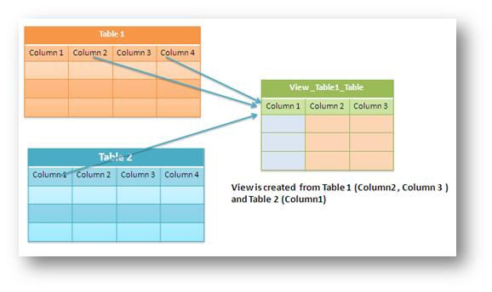
Views (Virtual Tables) in SQL
Concept of a view in SQL
Single table derived from other tables
Considered to be a virtual table

Slide 3

VIEW Definition
View is Virtual relation that does not necessarily actually exist in the database but is produced upon request, at time of request.

Slide 4
Views (Virtual Tables) in SQL
A view is a virtual table based on the result-set of an SQL statement.
A view contains rows and columns, just like a real table.
The fields in a view are fields from one or more tables in the database.
User can add SQL functions, WHERE, and JOIN statements to a view and present the data .

Slide 5
CREATE VIEW command
Give Table (View) name,
List of attribute names for the View (table),
and a Query to specify the contents of the View

Slide 6
CREATE VIEW Syntax
CREATE VIEW view_name AS SELECT column1, column2, ... FROM table_name WHERE condition;

Slide 7
Consider the EMPLOYEE table having the following records:
Emp_id | Emp_name | Dept | Salary
1 | Adams | Sales | 40000
2 | Neel | HR | 70000
3 | Johnson | Sales | 50000
4 | Smith | Research | 90000
5 | Willams | HR | 80000

Slide 8
SQL > CREATE VIEW EMPLOYEE_VIEW AS SELECT Emp_id, Emp_name
FROM EMPLOYEE;
Then, can query the view as follows:
SQL > SELECT * FROM EMPLOYEE_VIEW;

Slide 9
Consider the EMPLOYEE table having the following records:
Emp_id | Emp_name
1 | Adams
2 | Neel
3 | Johnson
4 | Smith
5 | Willams

Slide 10
The WITH CHECK OPTION
The purpose of the WITH CHECK OPTION is to ensure that all UPDATE and INSERTs satisfy the condition(s) in the view definition.
If they do not satisfy the condition(s), the UPDATE or INSERT returns an error.

Slide 11
The WITH CHECK OPTION
EMPLOYEE_VIEW with the WITH CHECK OPTION
CREATE VIEW EMPLOYEE_VIEW AS
SELECT Emp_id,Emp_name
FROM EMPLOYEE
WHERE Emp_id IS NOT NULL WITH CHECK OPTION;
The WITH CHECK OPTION in this case should deny the entry of any NULL values in the view's Emp_id column, because the view is defined by data that does not have a NULL value in the Emp_id column.;

Slide 12
SQL Updating a View
A view can be updated under certain conditions:
The SELECT clause may not contain the keyword DISTINCT.
The SELECT clause may not contain summary functions.
The SELECT clause may not contain set functions. • The SELECT clause may not contain set operators. • The SELECT clause may not contain an ORDER BY clause.

Slide 13
SQL Updating a View
The FROM clause may not contain multiple tables.
The WHERE clause may not contain subqueries.
The query may not contain GROUP BY or HAVING.
Calculated columns may not be updated.
All NOT NULL columns from the base table must be included in the view in order for the INSERT query to function. So if a view satisfies all the abovementioned rules then you can update a view.

Slide 14
SQL Drop a View
To delete a view with the DROP VIEW command.
SQL DROP VIEW Syntax
DROP VIEW view_name

Slide 15
SQL Updating a View
Following is an example to update the Emp_id of Neel
SQL > UPDATE EMPLOYEE_VIEW
SET Emp_id = 35 WHERE name=‘Neel';
This would ultimately update the base table EMPLOYEE and same would reflect in the view itself.
Now, try to query base table, and SELECT statement would produce the following result:

