Slide 1
HMAC and CMAC

Slide 2
Limitation of Using Hash Functions for Authentication
Require an authentic channel to transmit the hash of a message
  anyone can compute the hash value of a message, as the hash function is public
  not always possible
How to address this?
  use more than one hash functions
  use a key to select which one to use

Slide 3
HMAC: Hash-based Message Authentication Code Functions
  Constructing MAC from Cryptographic Hash:
  HMAC_{K}[M] = Hash[(K⁺ ⊕ opad) || Hash[(K⁺ ⊕ ipad)||M)]]
K⁺ is the key padded (with 0) until the key length equals the block size B(in bytes) of the hash function
ipad = the byte 0x36 repeated B times
opad = the byte 0x5C repeated B times.

Slide 4
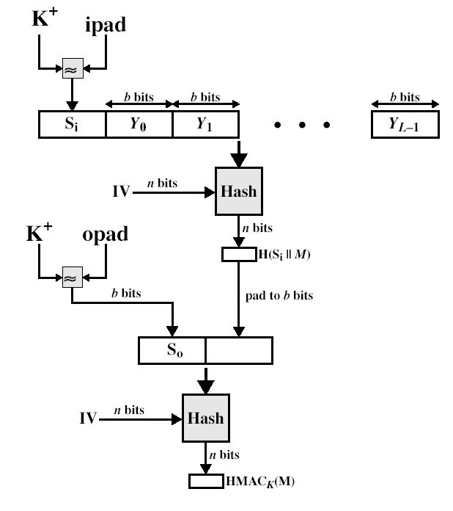
HMAC Overview

Slide 5
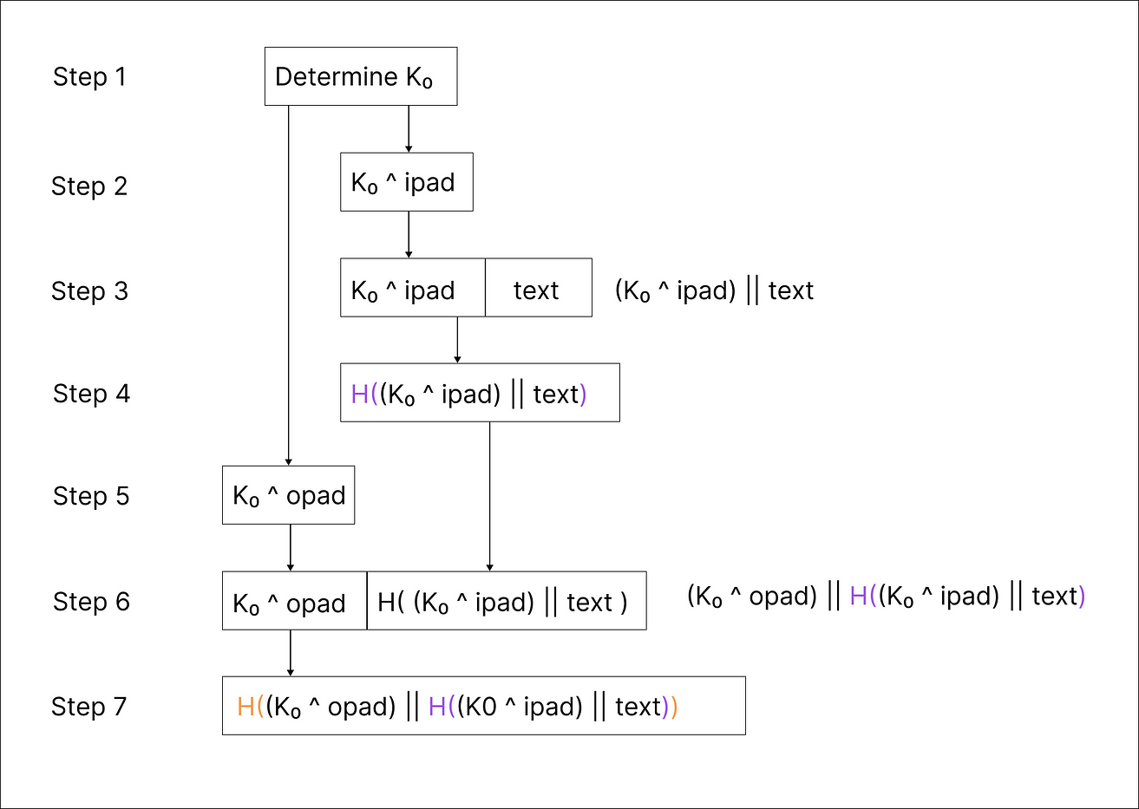

HMAC
CS426
Fall 2010/Lecture 6

Slide 6
HMAC
K0 — key wich length = block size.
ipad — Inner pad; The constant which equals x36 repeated as many times as block size in bytes (for SHA1 64 bytes).
opad — Outer pad; The constant which equals x5C repeated as many times as block size in bytes (for SHA1 64 bytes).
H — A hashing function that takes a string of any size as an argument and returns a hashed string of a fixed size.
^ — symbol of XOR operation.
|| — append/concatination. Concatenation of two strings.

Slide 7
HMAC example
Input data:
Message: “Hello” → x48656C6C 6F
Secret Key: “Key” → x4B6579
Constants for our case hash algorithm (SHA1) with block size 64 bytes:
ipad (in HEX): x36363636 36363636 36363636 36363636 36363636 36363636 36363636 36363636 36363636 36363636 36363636 36363636 36363636 36363636 36363636 36363636 (x36 repeated 64 time)
opad (in HEX): x5C5C5C5C 5C5C5C5C 5C5C5C5C 5C5C5C5C 5C5C5C5C 5C5C5C5C 5C5C5C5C 5C5C5C5C 5C5C5C5C 5C5C5C5C 5C5C5C5C 5C5C5C5C 5C5C5C5C 5C5C5C5C 5C5C5C5C 5C5C5C5C (x5C repeated 64 time)

Slide 8
HMAC example
Step1: If the key length < block size, we must add 0s until the key length equals the block size. In our case, the key length is 3 bytes, and the block length is 64 bytes. So new key is K0 = 4B657900 00000000 00000000 00000000 00000000 00000000 00000000 00000000 00000000 00000000 00000000 00000000 00000000 00000000 00000000 00000000

Slide 9
HMAC example
Step2: We need to perform the operation K0 XOR ipad
K0 XOR ipad = 7D534F36 36363636 36363636 36363636 36363636 36363636 36363636 36363636 36363636 36363636 36363636 36363636 36363636 36363636 36363636 36363636

Slide 10
HMAC example
Step 3: Now, we append the message to K0 XOR ipad
(K0 XOR ipad) || message = 7D534F36 36363636 36363636 36363636 36363636 36363636 36363636 36363636 36363636 36363636 36363636 36363636 36363636 36363636 36363636 36363636 48656C6C 6F
Step 4: We put the result of the previous operation into the SHA-1 hash.
7D534F3636363636363636363636363636363636363636363636363636363636363636363636363636363636363636363636363636363636363636363636363648656C6C6F
sha1(K0 XOR ipad || message) = 8e32567d57353a91515458d65b4cc7802450172c

Slide 11
HMAC example
Step 5: We need to perform the operation K0 XOR opad.
K0 XOR opad = 1739255C 5C5C5C5C 5C5C5C5C 5C5C5C5C 5C5C5C5C 5C5C5C5C 5C5C5C5C 5C5C5C5C 5C5C5C5C 5C5C5C5C 5C5C5C5C 5C5C5C5C 5C5C5C5C 5C5C5C5C 5C5C5C5C 5C5C5C5C

Slide 12
HMAC example
Step 6: Append to the result of the previous operation the wich hash obtained in step 4.
(K0 XOR opad) || (sha1(K0 XOR ipad || message)) =
1739255C 5C5C5C5C 5C5C5C5C 5C5C5C5C 5C5C5C5C 5C5C5C5C 5C5C5C5C 5C5C5C5C 5C5C5C5C 5C5C5C5C 5C5C5C5C 5C5C5C5C 5C5C5C5C 5C5C5C5C 5C5C5C5C 5C5C5C5C 8E32567D 57353A91 515458D6 5B4CC780 2450172C
Step 7: Put the result of step 6 into the SHA-1 hash.
HMAC = 173ac40fb6ac57cc7524594c523bea1bdd54836a

Slide 13
HMAC Security
If used with a secure hash functions (e.g., SHA-256) and according to the specification (key size, and use correct output), no known practical attacks against HMAC

Slide 14
CMAC (Cipher-Based Message Authentication Code)
The Cipher-Based Message Authentication Code (CMAC) is a cryptographic technique used for message authentication. It is designed to provide strong security against various types of attacks, including message forgery and replay attacks. CMAC is a block cipher-based algorithm that generates a fixed-length message authentication code (MAC) for a given message.

Slide 15
CMAC
CMAC is a block cipher-based algorithm that uses a secret key to generate a message authentication code (MAC) for a given message.
The algorithm works by dividing the input message into fixed-length blocks, each of which is processed by the block cipher in a special way.
The CMAC algorithm uses the block cipher in CBC mode to generate a MAC for a given message with some modifications to the CBC-MAC technique to overcome its limitations.

Slide 16
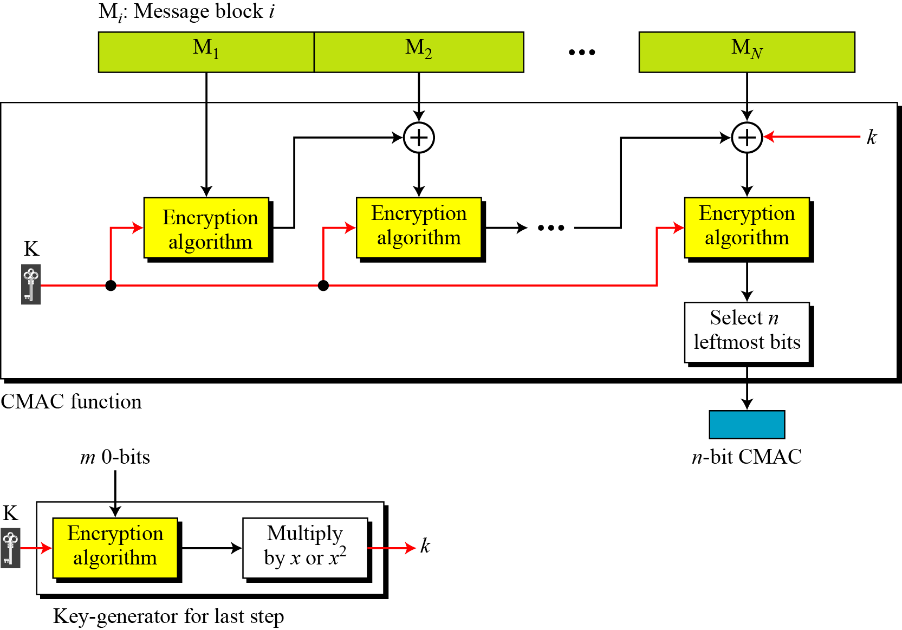
CMAC: Cipher-Based Message Authentication Code

Slide 17
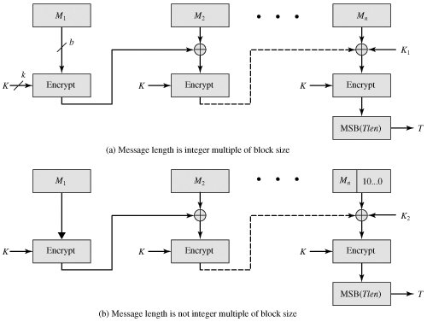
CMAC: Cipher-Based Message Authentication Code

Slide 18
CMAC Algorithm
Key Generation: A secret key is generated by the user, which is used to generate the MAC.
Padding: The input message is padded with zeros to ensure that its length is a multiple of the block size.
Message blocks: The algorithm divides the message into blocks of equal size(block size).
First Block Processing: The first block of the message is encrypted with the key K using the block cipher(AES/DES…). The resulting ciphertext is then XORed with the next message block while processing next block.

Slide 19
CMAC Algorithm
5. Intermediate Block Processing: The remaining blocks of the message are processed similarly. Each block is XORed with the previous ciphertext, and encrypted using the key K using the block cipher.
6. Final Block Processing: After all the blocks have been processed, the resulting ciphertext is XORed with the last message block and the newly generated key k and then encrypted once more using the block cipher,
7. Output: From the final ciphertext, n leftmost bits are taken as MAC value which is the output of the CMAC algorithm.

Slide 20
Features of CMAC
Strong Security: CMAC provides strong security against various types of attacks, including message forgery, replay attacks, and substitution attacks.
Fixed-Length Output: The output of the CMAC algorithm is a fixed-length MAC, which makes it easy to compare and verify.
Efficient: CMAC is an efficient algorithm that can generate a MAC for a given message in a short amount of time.
Key Reuse: The same key can be reused for multiple messages without compromising the security of the MAC.
Easy Implementation: CMAC is easy to implement in software and hardware, making it a popular choice for many applications.

Slide 21
Advantages of CMAC:
Resistance to Attack: CMAC is resistant to various types of attacks, including message forgery, replay attacks, and substitution attacks. This makes it a secure choice for applications where data integrity is critical.
Fixed-Length Output: The fixed-length output of CMAC makes it easy to compare and verify MAC values, which simplifies the implementation of security protocols.
Efficient: CMAC is an efficient algorithm that can generate MAC values for large amounts of data in a short amount of time. This makes it a good choice for applications that require fast authentication of data.
Key Reuse: CMAC allows for key reuse, which simplifies the implementation of security protocols and reduces the risk of key management errors.
Easy Implementation: CMAC is easy to implement in software and hardware, making it a popular choice for many applications.

Slide 22
Limitations of CMAC:
Limited Key Size: The security of CMAC depends on the key size used. If the key size is too small, it can be easily brute-forced, compromising the security of the MAC. Therefore, it is recommended to use a key size of at least 128 bits.
Vulnerability to Side-Channel Attacks: Like any cryptographic algorithm, CMAC is vulnerable to side-channel attacks. Side-channel attacks are attacks that exploit weaknesses in the implementation of the algorithm rather than weaknesses in the algorithm itself. Therefore, it is important to implement CMAC correctly to prevent side-channel attacks.
Limited Block Size: CMAC has a limited block size, which means that it can only generate MAC values for messages that are smaller than the block size. If a message is larger than the block size, it must be divided into smaller blocks and processed separately, which can be inefficient.
Key Management: The security of CMAC depends on the security of the key used. Therefore, it is important to manage the keys properly to prevent unauthorized access to the key.

Slide 23
Applications of CMAC:
CMAC is widely used in various applications that require message authentication, including:
Secure Communication: CMAC is used to authenticate messages in secure communication protocols such as SSL/TLS, IPSec, and SSH.
File Integrity: CMAC is used to verify the integrity of files and ensure that they have not been tampered with.
Digital Signatures: CMAC is used to generate digital signatures, which are used to verify the authenticity of documents and messages.
Payment Systems: CMAC is used in payment systems such as credit cards and electronic wallets to authenticate transactions and prevent fraud

