Slide 1
E-mail Security (S/MIME)

Slide 2
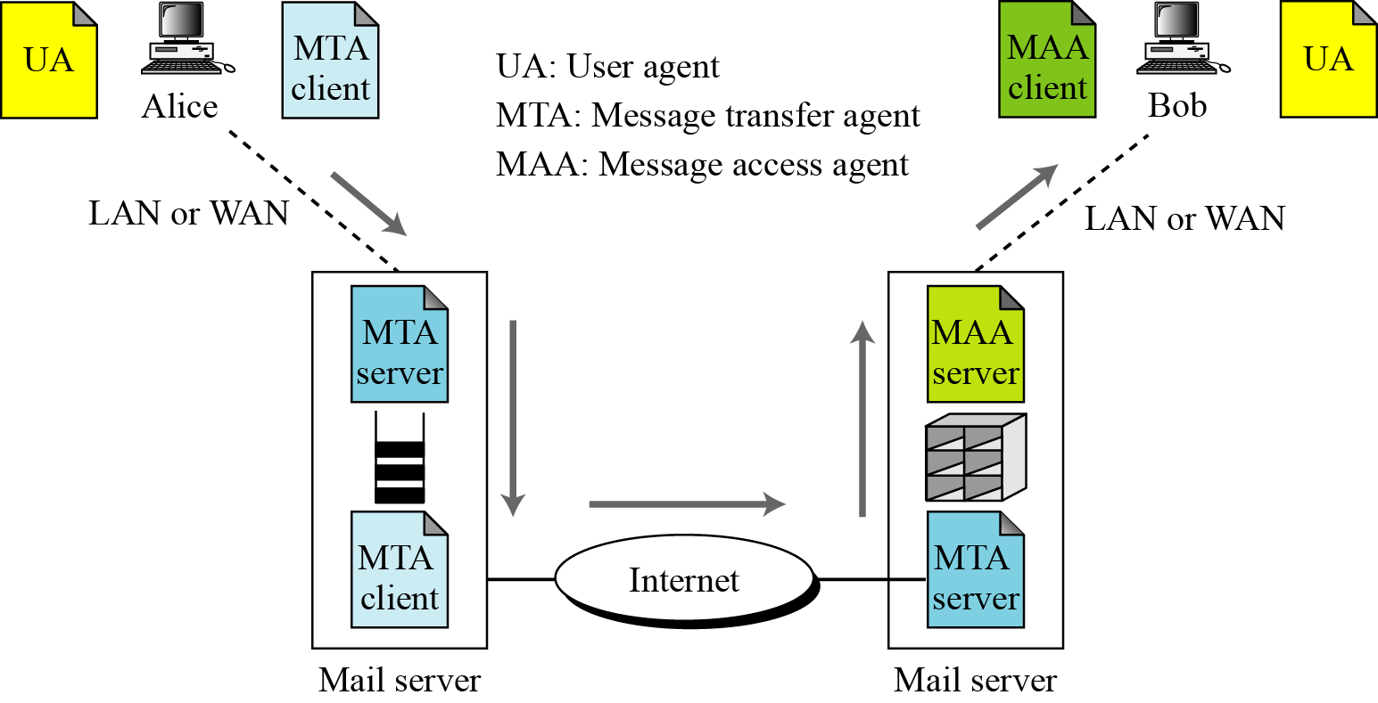
E-mail Architecture

Slide 3
E-mail Security
E-mail is one of the most widely used network services
killer application of the Internet
Normally message contents not secured
Can be read/modified either in transit or at destination by the attacker
E-mail service is like postcard service
just pick it and read it

Slide 4
Email Security Enhancements
confidentiality
protection from disclosure
authentication
of sender of message
message integrity
protection from modification
non-repudiation of origin
protection from denial by sender

Slide 5
S/MIME
Secure/Multipurpose Internet Mail Extensions
A standard way for email encryption and signing
IETF effort (RFCs 2632, 2633 – for version 3.0; RFCs 3850, 3851 for version 3.1; 5750, 5751 for version 3.2)
Industry support
Not a standalone software, a system that is to be supported by email clients
such as MS Outlook and Thunderbird
S/MIME handles digital signatures
Also provides encryption

Slide 6
Quick E-mail History
SMTP and RFC 822
only ASCII messages (7-bit)
MIME (Multipurpose Internet Mail Extensions)
content type
Almost any type of information can appear in an email message
transfer encoding
specifies how the message body is encoded into textual form (radix64 is common)
S/MIME: Secure MIME
new content types, like signature, encrypted data

Slide 7
S/MIME Cryptographic Algorithms
hash functions: SHA-1 & MD5
digital signatures: DSS & RSA
session key encryption: ElGamal & RSA
message encryption: Triple-DES, AES and others
sender should know the capabilities of the receiving entity (public announcement or previously received messages from receiver)
otherwise sender takes a risk

Slide 8
Scope of S/MIME Security
S/MIME secures a MIME entity
a MIME entity is entire message except the headers
so the header is not secured
First MIME message is prepared
This message and other security related data (algorithm identifiers, certificates, etc.) are processed by S/MIME
and packed as one of the S/MIME content type

Slide 9
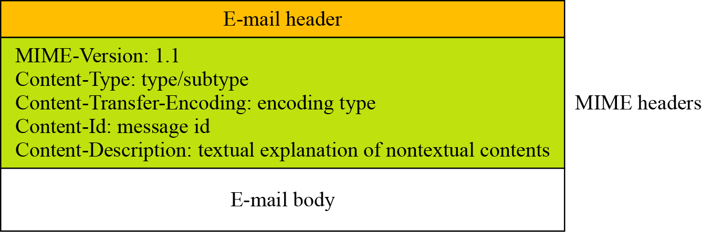
E-mail Format

Slide 10
MIME - New header fields
MIME-Version
Content-Type
describes the data contained in the body
receiving agent can pick an appropriate method to represent the content
Content-Transfer-Encoding
indicates the type of the transformation that has been used to represent the body of the message
Content-ID
Content-Description
description of the object in the body of the message
useful when content is not readable (e.g., audio data)
S/MIME / introduction

Slide 11
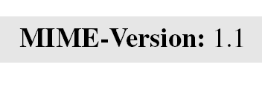
MIME-Version
This header defines the version of MIME used. The current version is 1.1.
Content-Type
The content type and the content subtype are separated by a slash. Depending on the subtype, the header may contain other parameters.

Slide 13
MIME – Transfer encodings
7bit
short lines of ASCII characters
8bit
short lines of non-ASCII characters
binary
non-ASCII characters
lines are not necessarily short
quoted-printable
non-ASCII characters are converted into hexa numbers
base64 (radix 64)
3 8-bit blocks into 4 6-bit blocks
S/MIME / introduction

Slide 14
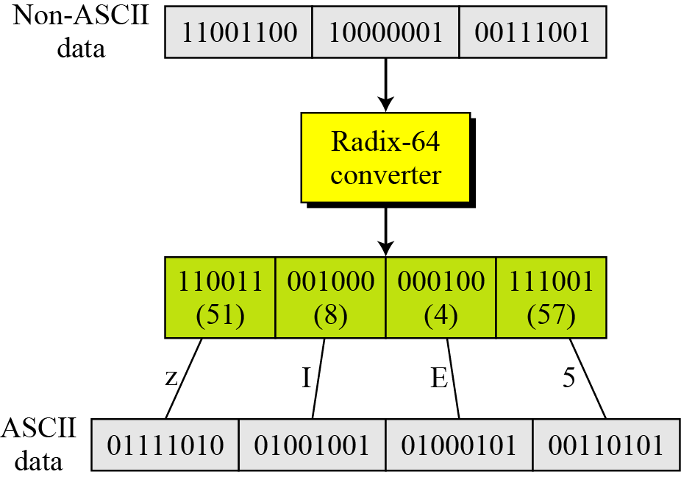
Radix-64 conversion

Slide 16
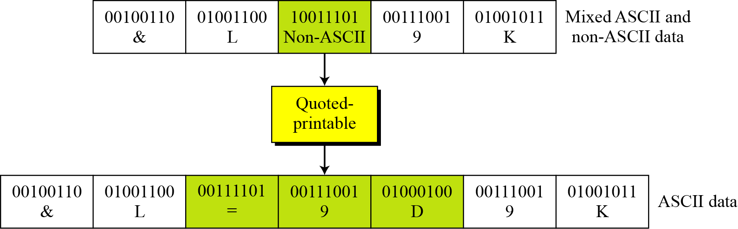
Quoted-printable

Slide 17
S/MIME
S/MIME adds some new content types to include security services to the MIME. All of these new types include the parameter “application/pkcs7-mime,” in which “pkcs” defines “Public Key Cryptography Specification.”
Cryptographic Message Syntax (CMS)
To define how security services, such as confidentiality or integrity, can be added to MIME content types, S/MIME has defined Cryptographic Message Syntax (CMS). The syntax in each case defines the exact encoding scheme for each content type. For details, the reader is referred to RFC 3369 and 3370.

Slide 18
S/MIME Functions
enveloped data
encrypted content and associated keys
signed data
encoded message + encoded signed message digest
clear-signed data
cleartext message + encoded signed message digest
authenticated data
encoded message + encoded signed message digest which is encrypted

Slide 19
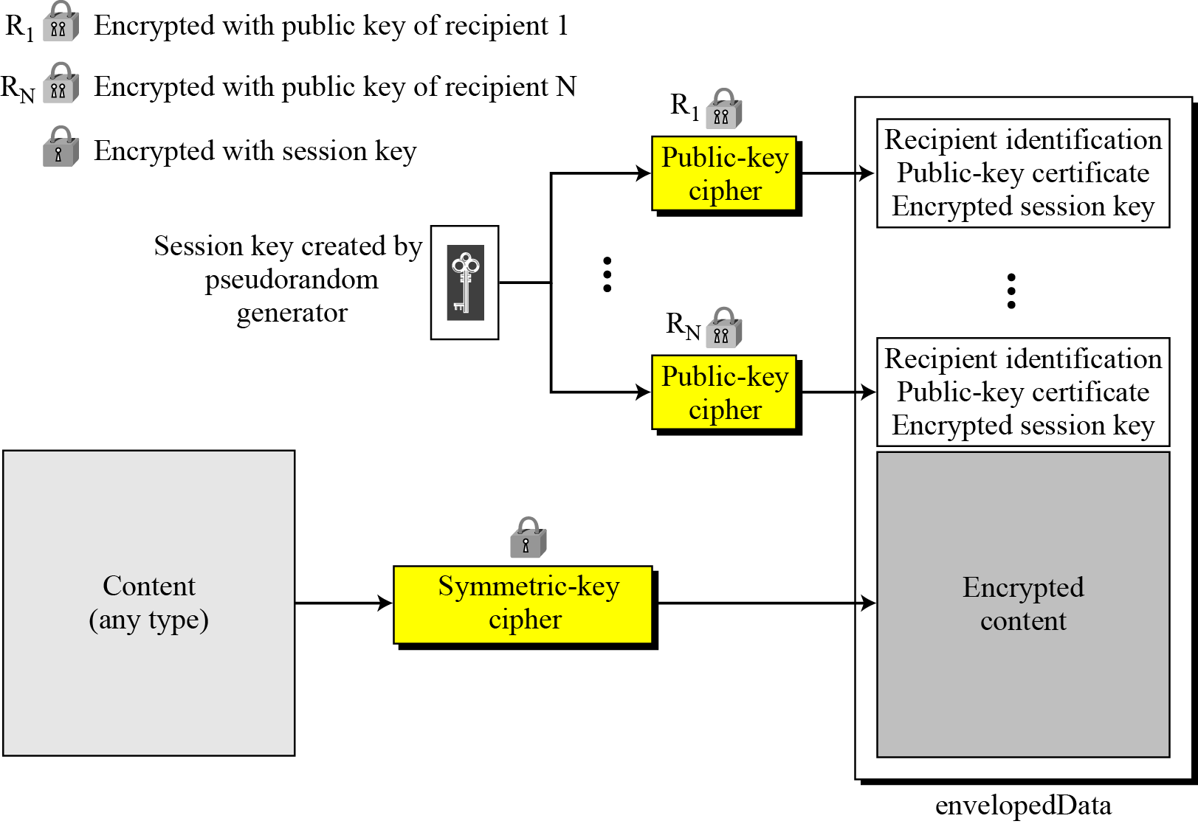
Enveloped-data content type

Slide 20
EnvelopedData
For message encryption
create a random session key, encrypt the message with that key and a conventional crypto, encrypt the session key with recipient’s public key
recipient’s public key comes from an X.509 certificate

Slide 21
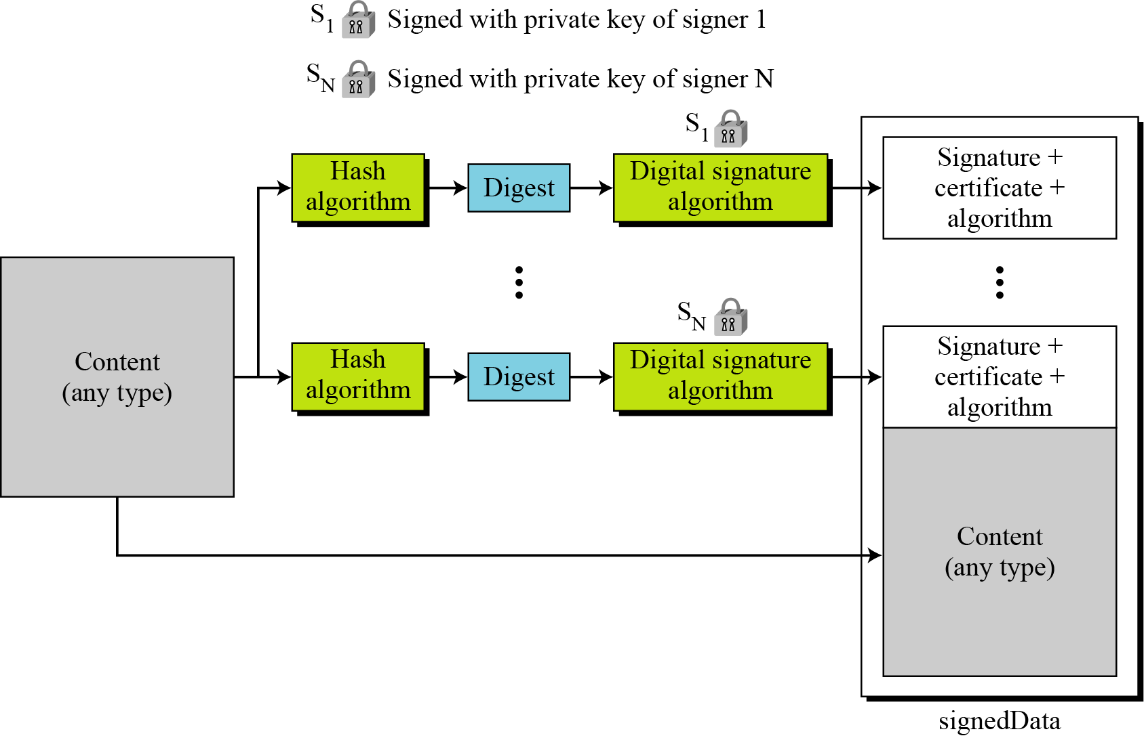
Signed-data content type

Slide 22
SignedData
For signed message
both message and signature are encoded so that the recipient only sees some ASCII characters if he does not use an email client with S/MIME support
Similar to PGP
first message is hashed, then the hash is encrypted using sender’s private key
Message, signature, identifiers of algorithms and the sender’s certificate are packed together
again difference between S/MIME and PGP in trust management

Slide 23
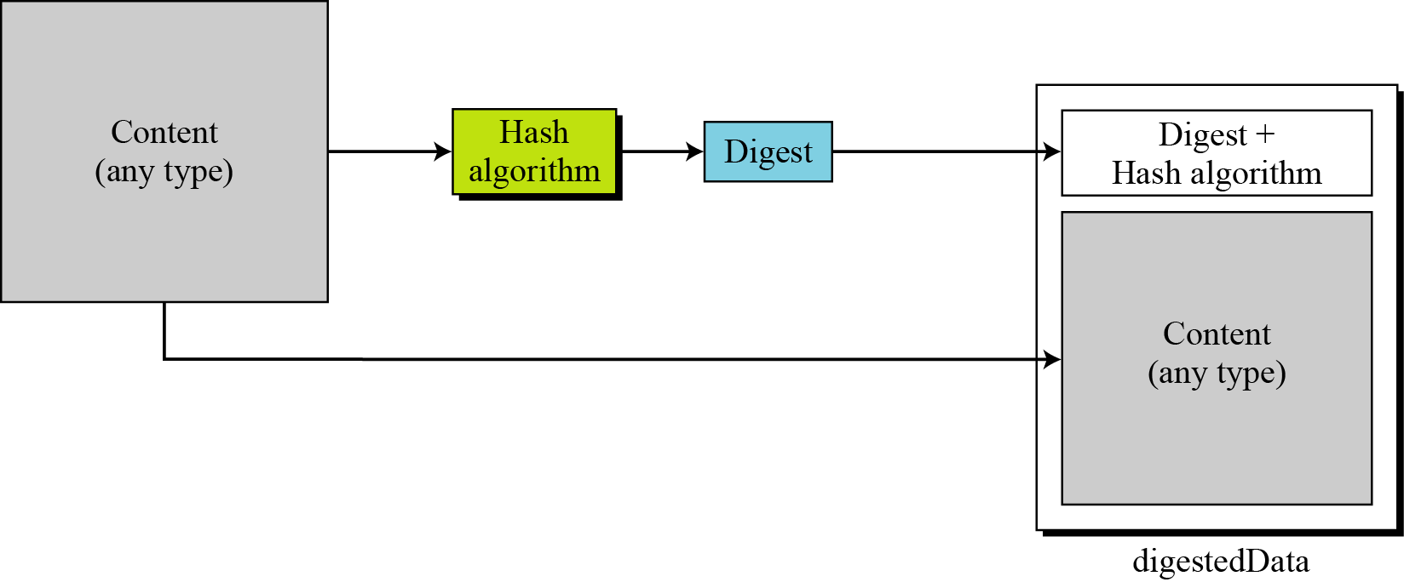
clear-signed data content type

Slide 24
Clear Signing
Another mechanism for signature
but the message is not encoded, so an email client with no S/MIME support could also view the message
of course the signature will not be verified and will be seen as a meaningless attachment
multipart/signed content type
2 parts
Clear text message
Signature

Slide 25
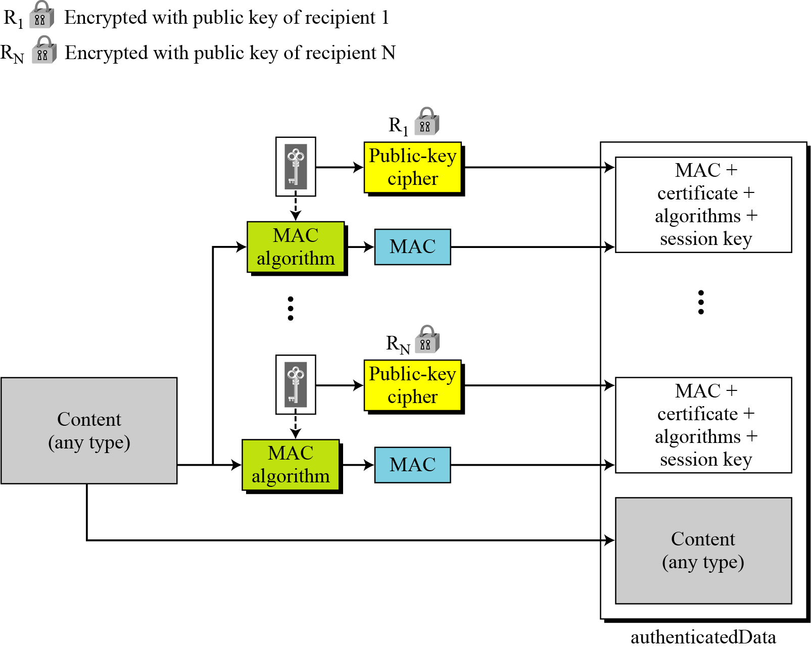
Authenticated-data content type

Slide 26
Cryptographic Algorithms
S/MIME defines several cryptographic algorithms. The term “must” means an absolute requirement; the term “should” means a recommendation.

Slide 27
Enveloped data – Example
Example 16.3
The following shows an example of an enveloped-data in which a small message is encrypted using triple DES.

Slide 28
Clear-signed data – Example
Content-Type: multipart/signed; protocol="application/pkcs7-signature";
micalg=sha1; boundary=boundary42
--boundary42
Content-Type: text/plain
This is a clear-signed message.
--boundary42
Content-Type: application/pkcs7-signature; name=smime.p7s
Content-Transfer-Encoding: base64
Content-Disposition: attachment; filename=smime.p7s
ghyHhHUujhJhjH77n8HHGTrfvbnj756tbB9HG4VQpfyF467GhIGfHfYT6
4VQpfyF467GhIGfHfYT6jH77n8HHGghyHhHUujhJh756tbB9HGTrfvbnj
n8HHGTrfvhJhjH776tbB9HG4VQbnj7567GhIGfHfYT6ghyHhHUujpfyF4
7GhIGfHfYT64VQbnj756
--boundary42--
S/MIME / message formats

Slide 29
S/MIME Certificate Processing
S/MIME uses X.509 v3 certificates
Certification Authorities (CAs) issue certificates
unlike PGP, a user cannot be a CA
each client has a list of trusted CA certificates
actually that list comes with e-mail client software or OS and own public/private key pairs and certs

