Slide 1
UML Interaction Diagrams

Slide 2
Interaction Diagrams
Interaction: is a behavior that comprises a set of messages exchanged among a set of objects within a context to accomplish a purpose.
Message: is a specification of a communication between objects that conveys information.
Used to model the dynamic behavior of the system.
Sequence and Collaboration Diagrams are two types.

Slide 3
Use Case Realization
The use case diagram is an external view of the system
A use case is realized in a collaboration
A collaboration shows an internal implementation- dependent solution of a use case in terms of:
  classes/objects
  their relationships
  their interaction

Slide 4
Use Cases and Scenarios
A Use Case actually describes a set of sequences [of actions].
Each sequence represents one possible flow of actions in using the system.
Each sequence is called a Scenario.
A Scenario is basically one instance of a use case.
  a Scenario is to a Use Case, what an Object is to a Class.
  Graphical view of scenario is interaction diagrams

Slide 5

Use case Realization Notation
Use Case Realization
Realization
Relationship
Use Case
Use Case Realization

Slide 6
UML sequence diagrams
sequence diagram: an "interaction diagram" that models a single scenario executing in the system
  perhaps 2nd most used UML diagram (behind class diagram)
relation of UML diagrams to other exercises:
  use cases -> sequence diagrams

Slide 7
Key parts of a sequence diag.
participant: an object or entity that acts in the sequence diagram
  sequence diagram starts with an unattached "found message" arrow
message: communication between participant objects
the axes in a sequence diagram:
  horizontal: which object/participant is acting
  vertical: time (down -> forward in time)

Slide 8
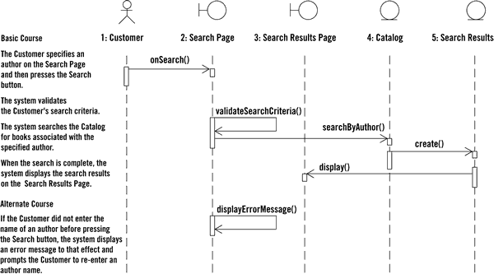
Sequence diag. from use case

Slide 9
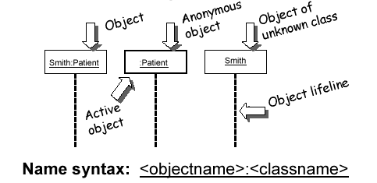
Representing objects
squares with object type, optionally preceded by object name and colon
  write object's name if it clarifies the diagram
  object's "life line" represented by dashed vert. line

Slide 10
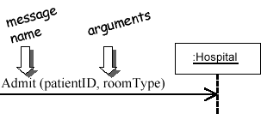
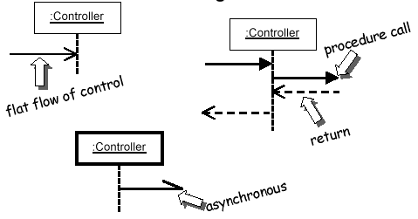
Messages between objects
message (method call) indicated by horizontal arrow to other object
  write message name and arguments above arrow
  dashed arrow back indicates return
  different arrowheads for normal / concurrent (asynchronous) methods

Slide 11
Various message types
Arrow | Message Type | Description
 | Synchronous | Sender waits
 | Simple | Sending message to passive object
 | Asynchronous | Sender continues with next messg
 | Return | Return message
 | Delayed message | Will take time

Slide 12
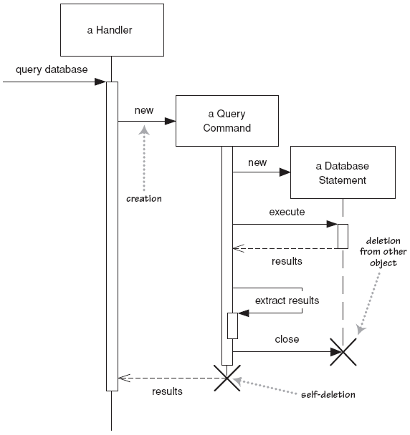
Lifetime of objects
creation: arrow with 'new' or ‘create’ written above it
  notice that an object created after the start of the scenario appears lower than the others
deletion: an X at bottom of object's lifeline
  Java doesn't explicitly delete objects; they fall out of scope and are garbage-collected

Slide 13
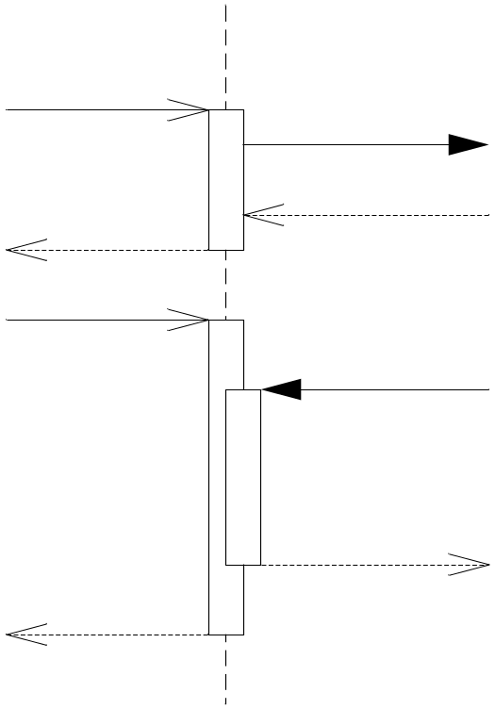
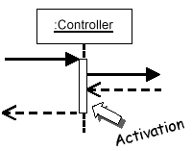
Indicating method calls
activation: thick box over object's life line; drawn when object's method is on the stack
  either that object is running its code, or it is on the stack waiting for another object's method to finish
  nest to indicate recursion
Activation
Nesting

Slide 14
Indicating selection and loops
frame: box around part of a sequence diagram to indicate selection or loop
  if -> (opt) [condition]
  if/else -> (alt) [condition], separated by horiz. dashed line
  loop -> (loop) [condition or items to loop over]
opt
[
balance
<>
0
]
alt
[
balance
<
100
.
00
]
[
balance
>
=
100
.
00
]
loop
[
balance
<
0
]

Slide 15
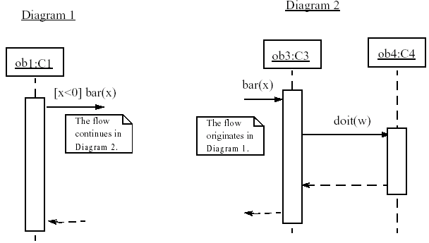
linking sequence diagrams
if one sequence diagram is too large or refers to another diagram, indicate it with either:
  an unfinished arrow and comment

Slide 16
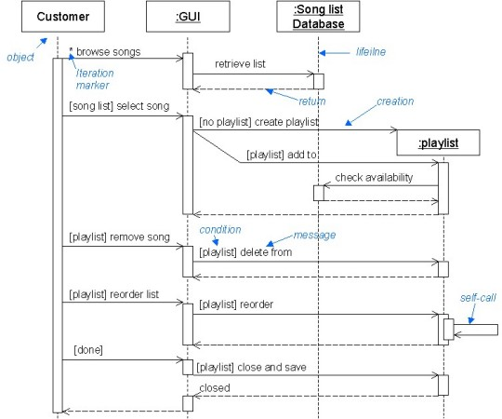
Example 1
Conditional branching

Slide 17
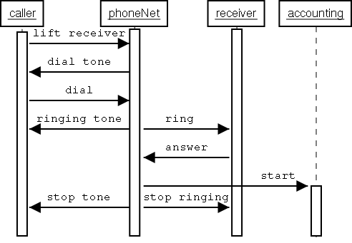
Example 2 : A phone line
Concurrent
branching

Slide 18
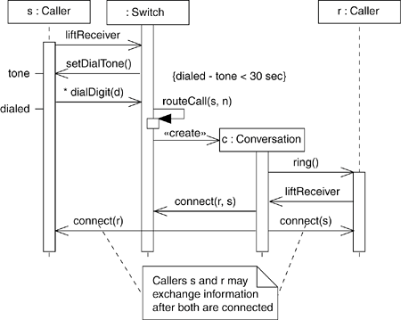
Example 3:

Slide 19
Why not just code it?
Sequence diagrams can be somewhat close to the code level. So why not just code up that algorithm rather than drawing it as a sequence diagram?
  a good sequence diagram is still a bit above the level of the real code (not EVERY line of code is drawn on diagram)
  sequence diagrams are language-agnostic (can be implemented in many different languages
  non-coders can do sequence diagrams
  easier to do sequence diagrams as a team
  can see many objects/classes at a time on same page (visual bandwidth)

Slide 20
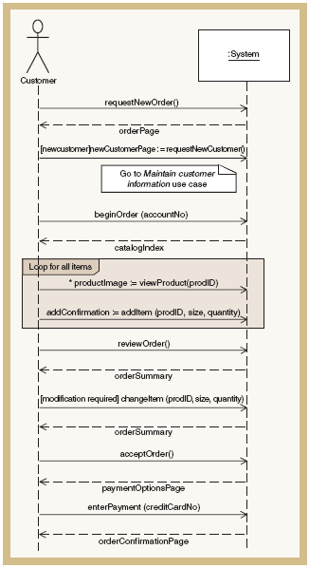

Sequence Diagram for Create new order use case

Slide 21
Exercise 1
Draw sequence diagram for invalid pin use case in an Bank ATM system.
Objects:
User ,ATM card, ATM machine, customer record/database, bank.
Messages:
insert ATM card, read account no., enter pin no., send pin no., verify, wrong pin no., eject card, display main screen, etc..

Slide 22
Sequence diagram exercise 2
Let's do a sequence diagram for the following casual use case, Add Calendar Appointment :
  The scenario begins when the user chooses to add a new appointment in the UI. The UI notices which part of the calendar is active and pops up an Add Appointment window for that date and time.
  The user enters the necessary information about the appointment's name, location, start and end times. The UI will prevent the user from entering an appointment that has invalid information, such as an empty name or negative duration. The calendar records the new appointment in the user's list of appointments. Any reminder selected by the user is added to the list of reminders.
  If the user already has an appointment at that time, the user is shown a warning message and asked to choose an available time or replace the previous appointment. If the user enters an appointment with the same name and duration as an existing group meeting, the calendar asks the user whether he/she intended to join that group meeting instead. If so, the user is added to that group meeting's list of participants.

Slide 23
Collaboration Diagram

Slide 24
Collaboration Diagrams
Is an interaction diagram that emphasizes on structural organization of objects that send and receive messages.
Graphically, is a collection of vertices and arcs.
Describes a specific scenario.
Shows association among objects along with interaction.
Same as sequence, but shown in a different way.

Slide 25
Elements
Object: Shown as rectangle with the name, preceded by colon and underlined.
Relation/Association: A link connecting the associated objects. Multiplicity can be shown
Messages: An arrow pointing from source object to destination.
Also show numbering which represents order/sequence of interaction.

Slide 26
Notations:
Objectname:classname
object
1: function()
1
*
Message
link

Slide 27
Creating collaboration diagrams
First place the objects that participate in interaction as vertices.
Then add links that connect these objects as arcs.
Finally adorn links with messages along with sequence numbers.
Also add constraints if required.

Slide 28
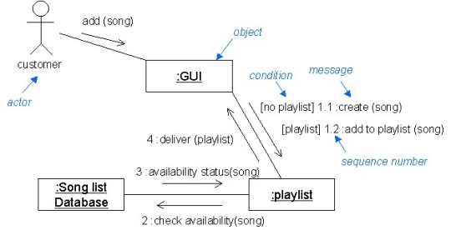
Example 1:

Slide 29
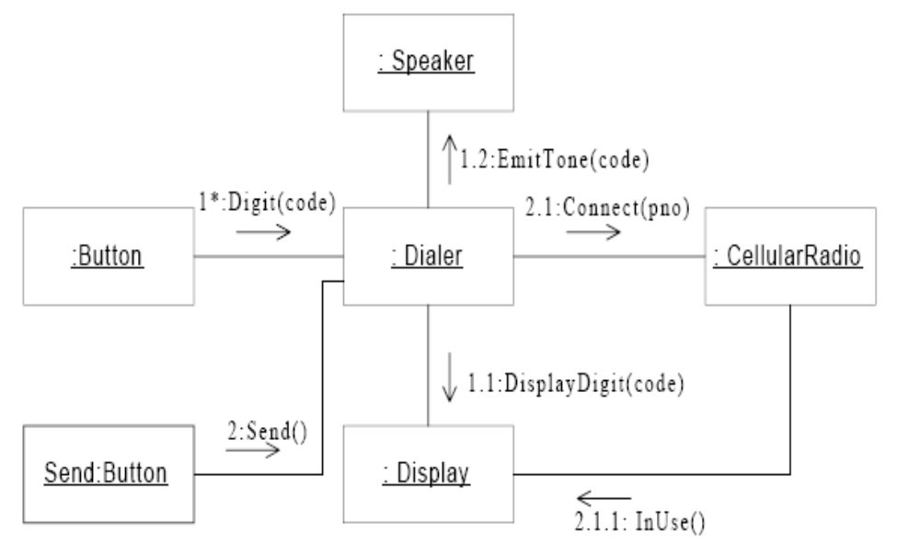
Example 2:Make phone call use case

Slide 30
Examples of Collaboration Diagram Messages
1:display()
[mode=display] 1.2.1:redraw()
[balance >0] 5:debit(amount)
2*[n:=1..m]curr:=nextSeq(n)
2.3[x<0]:doodle()
3.1[y=>1]:write()
1.1a,1.1b: playSong(songname:String)
2.2a,2.2b/3:playback()

Slide 31
Distinguishing sequence and collaboration
First, there is path to indicate how one object is linked to another.
Can attach a stereotype.
e.g. <<global>> (link role) --Instance is available as a name known throughout the system.
<<local>> (link role) Instance is available as a local variable in an operation.
Sequence number can be shown to indicate time ordering.

Slide 32
Which is better??
Sequence diagrams are better choice in 3 situations:
1. ordering of messages.
2. to be build form use cases
3. to show details of messages.
Collaboration diagrams are better choice :
If you want to build interaction model form class diagram.

Slide 33
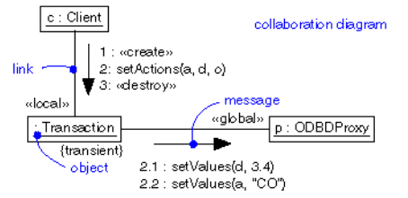
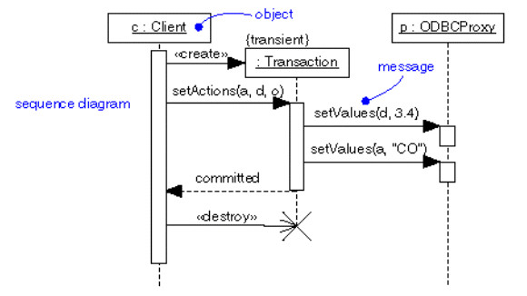
Relationship Between Both Notations
Notes:
For the sequence diagram, explain about the “activation rectangle”. These indicate along an object’s time line that it is involved in a computation, perhaps having called methods in other objects.
Explain that sometimes we don’t draw these. Some tools make it easy to draw them, and some don’t.
The arrow indicating a method is called always points to the top of the activation rectangle.
Point out that these rectangles do make it easy to see the returns of functions where we don’t use the dashed line. So on the object “p” the call to setValue() returns back to Transaction.setAction(), and then that calls p.setValue(). When that returns, other things may happen in Transaction.setAction() but then it returns to its caller, returning the value “committed”. (It appears that the two “setter” methods called on object p don’t return a value.)

Slide 34
Exercise 1
Create a sequence diagram and collaboration diagram for cooking food in an microwave oven
Objects:
Oven,
Light,
Emission tube,
Timer

Slide 35
Exercise 2
Draw sequence and collaboration diagrams for following scenarios identified in vending machine:
1. The drink is available and coins deposited are equal to product price.
2. The drink is available and coins deposited are not equal to product price.
Objects are: customer, selection panel, controller, coin collector, product dispenser, product.

Slide 36
Questions??
Define interaction diagram. Explain any one in detail with notations.
Draw the sequence diagram for login procedure to a system. Include all scenarios. [D-14]
Construct the sequence diagram and corresponding collaboration diagram for use case “Determine Total Bank Assets” in a Bank Management System. [D-15,M-16]

