Slide 1
EDGE Technology

Slide 2
Introduction
EDGE – Enhanced Data rates for Global Evolution
Objective:
– to increase data transmission rates and spectral efficiency
- to facilitate new applications and increased capacity for mobile use

Slide 3
EDGE better than GPRS ,
how?
GPRS – allows 115 kbps
theoretically up to 160 kbps
EDGE – allows 384 kbps
theoretically up to 473.6 kbps
new modulation technique
error tolerant tx methods
improved link adaptation mechanisms

Slide 4
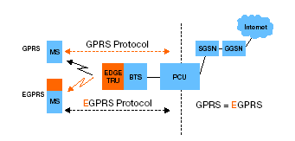


Slide 5
Base Station Subsystem
(BSS)
● Composed of
Base Station Transceiver
(BTS) and Base station controller (BSC)
● BTS – radio transmission
and reception
equipment. It provides coverage to a particular geographic area and is controlled by the BSC
● BSC -- handles the medium access and radio resource scheduling

Slide 6
Serving GPRS Support
Node (SGSN)
Controls GPRS service in a particular geographical coverage area
provides a point of attachment for the GPRS
mobiles. A logical link is established between the mobile station and the SGSN, via the base station
responsible for the transport and delivery of packets to and from the user
is responsible for validating the mobile stations,
before they are allowed access to the GPRS
system, and also performing security functions such as authentication and ciphering

Slide 7
Gateway GPRS Support
Node(GGSN)
provides connectivity to the external packet data networks
primary role is to route data to the mobile stations at their current points of attachment
Once the mobile station activates its packet data address, the mobile station is registered with the corresponding GGSN. The GGSN maintains a routing table associating the active GPRS mobiles in the system with a particular SGSN.

Slide 8
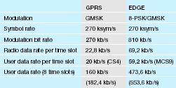
EDGE vs GPRS – a
comparison of technical data

Slide 9
Channel Coding
● Both the networks support adaptive channel coding—
●
for good channel conditions maximum throughput is aimed at
for poorer channel conditions error control bits are used to reduce errors and hence reduce the number of re transmissions
●

Slide 10
Coding Schemes
GPRS – 4 coding schemes – CS1 to CS4
Each has different amounts of error correcting coding that is optimized for different radio environments.
EDGE – 9 coding schemes – MCS1 to MCS9
MCS1 to MCS4 – use GMSK
MCS5 to MCS9 – use 8PSK

Slide 11
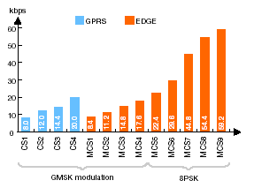

Slide 12
Interleaving
Blocks are broken up and interleaved between bursts. To receive the whole data all the bursts need to be received.
For GPRS – 1 in 4 bursts.
For EDGE – 1 in 2 bursts.

Slide 13
Incremental Redundancy
Initially uses MCS9 and if noise level increases then coding scheme is changed(adaptive coding) to sustain the noise level
If Information received incorrectly then Retransmission takes place and combined in the receiver with the previously received information.
Procedure is repeated until information is successfully decoded.

Slide 14
Modulation technique
Modulation technique in GPRS – Gaussian Minimum Shift Keying

Slide 15
Modulation technique
Modulation standard for EDGE – 8-Phase shift Keying (8PSK).
8PSK – linear modulation technique – three consecutive bits are mapped onto one symbol.
The symbol rate remains the same but each symbol represents 3 bits instead of one.
Total data rate increases by a factor of three.

Slide 16
Modulation Technique
( cont. )
Distance between different symbols is shorter using 8PSK.
Increases misinterpretation.
Under poor radio conditions extra bits will be added for error correcting.
Only under very poor conditions GMSK is more efficient.

Slide 17
RLC
Error correction is done by selective retransmission of only the erroneous frames
The correctly received frames are buffered until the erroneous frames are correctly received

Slide 18
Packet Handling
EDGE – Has the ability to retransmit an erroneous packet with a more robust coding scheme
GPRS -- Once packets have been sent, they must be retransmitted using the original coding scheme even if the radio environment has changed.

Slide 19
EDGE benefits
Short-term benefits –
EDGE triples the capacity of GPRS.
Boosts performance of existing application and enables services such as multimedia…..
Enables transceiver to carry more voice/data traffic.

Slide 20
EDGE benefits
With EDGE, operators can offer more wireless data applications, including wireless multimedia, e-mail, web infotainment and positioning services, for both consumer and business users.
Subscribers will be able to browse the Internet on their mobile phones, personal digital assistants or laptops at the speed as on stationary personal computers

