Slide 1
AIPI 510 · MODULE PROJECT 1
Where should a founder look
before building?
A public-data screen of 12 U.S. local-service industries
Aarya Deshpande · Tanya Sharma
Working draft for team review
Notes:
0:45. The audience is a founder choosing where to conduct customer discovery. Anecdotes can suggest a niche, but we can first check market structure with public evidence. This analysis narrows where to interview; it does not identify a product or prove demand. Sources: https://www.census.gov/data/datasets/2023/econ/cbp/2023-cbp.html and https://www.bls.gov/oes/tables.htm

Slide 2
AIPI 510 · MODULE PROJECT 1
Two datasets, one comparison
Census CBP · 2023
BLS OEWS · May 2025
Employer locations, employees, and size bands
Office/admin employment and annual mean wage
Our screen uses three visible dimensions:
Small-location share Admin-payroll proxy per location Number of small locations
Proxy = average employees/location × admin employment share × admin mean wage
We checked the 2017-to-2022 NAICS concordance before joining industry estimates.
Sources: U.S. Census Bureau 2023 CBP; BLS May 2025 OEWS; Census NAICS concordance.
2 / 7
Notes:
0:55. CBP counts employer establishments, which are physical locations, not distinct firms. OEWS reports national occupational estimates, not firm-level operations. We selected 12 local-service industries with usable industry definitions in both sources. CBP uses 2017 NAICS and OEWS 2022 NAICS; the official concordance confirmed these particular matches at four- or six-digit scope. Sources: https://www.census.gov/data/datasets/2023/econ/cbp/2023-cbp.html; https://www.bls.gov/oes/tables.htm; https://www.census.gov/naics/concordances/2022_to_2017_NAICS.xlsx

Slide 3
AIPI 510 · MODULE PROJECT 1
Small locations are common, but not equally so
2023 CBP employer establishments. Fewer than 20 employees describes a location, not necessarily an independent firm.
3 / 7
Notes:
1:05. Most of these selected industries have a high share of locations with fewer than 20 employees. Chiropractors reach 99.2%. Dental offices have 129,008 of 135,665 locations below 20 employees, about 95.1%. Home health is different at 62.3%. Small locations can be part of multi-location firms, and CBP excludes nonemployers. Source: https://www.census.gov/data/datasets/2023/econ/cbp/2023-cbp.html

Slide 4
AIPI 510 · MODULE PROJECT 1
Office work varies much more than location size
Selected industries shown; full 12-industry chart is in the article.
BLS May 2025 OEWS. Share = SOC 43-0000 employment ÷ all-occupation employment in the same industry.
4 / 7
Notes:
1:05. Location fragmentation alone does not tell us what work occurs inside a business. OEWS estimates 40.3% of chiropractor employment in office/admin occupations, versus 28.2% in dental, 26.8% in accounting, 25.0% in legal, 6.5% in landscaping and 5.4% in home health. Annual mean wages range from $42,280 to $57,710 across the 12 selected industries. This is a broad occupational group and does not say which tasks are painful or automatable. Source: https://www.bls.gov/oes/tables.htm; methods: https://www.bls.gov/oes/2025/may/oes_tec.htm

Slide 5
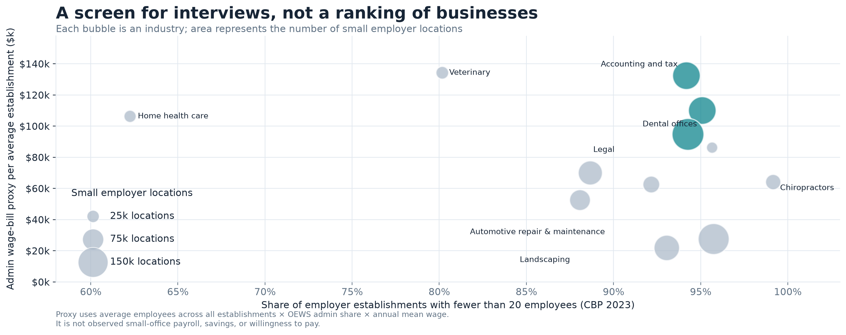
AIPI 510 · MODULE PROJECT 1
Three large markets combine depth and office work
Bubble area = number of small employer locations. Payroll proxy is directional and is not observed spending or savings.
5 / 7
Notes:
2:00. The hero chart puts three dimensions together without collapsing them into a subjective opportunity score. Dental offices have about 129,008 small employer locations, a 28.2% office/admin share, and a $110,000 proxy per average establishment. Accounting has 129,097 small locations and a $132,000 proxy. Legal has 170,721 small locations and a $95,000 proxy. Veterinary has the highest proxy at about $134,000 but only 27,497 small locations; chiropractors have a 40.3% admin share but much less depth than legal. The proxy multiplies CBP average employees across all establishments by OEWS admin employment share and mean annual wage. It is not an estimate of payroll for a small location. OEWS annual wages generally use a full-time-year convention. These sources refer to different years and populations, so the number is directional, not observed payroll or an automatable budget. Sources: https://www.census.gov/data/datasets/2023/econ/cbp/2023-cbp.html; https://www.bls.gov/oes/tables.htm; https://www.bls.gov/oes/2025/may/oes_tec.htm

Slide 6
AIPI 510 · MODULE PROJECT 1
What this screen cannot answer
01
A small location may belong to a large firm
02
2023 CBP counts and 2025 OEWS estimates differ in year and method
03
Administrative work is not a measure of waste or automation potential
04
Public data cannot reveal pain, trust, workflow, or willingness to pay
CBP measures employer locations; OEWS is a modeled occupational estimate. Sources in speaker notes and README.
6 / 7
Notes:
0:55. We should make these limits explicit. CBP excludes nonemployers and counts locations rather than distinct firms. OEWS May 2025 combines six sample panels over three years and estimates wage/salary workers; it excludes some owners and self-employed workers. Our industry definitions were matched with the official NAICS concordance, but the data years differ. The payroll proxy is not measured firm payroll. Admin work includes valuable human service and care; it would be unethical to label these jobs as waste or imply they should be replaced. Sources: https://www.census.gov/data/datasets/2023/econ/cbp/2023-cbp.html; https://www.bls.gov/oes/2025/may/oes_tec.htm; https://www.census.gov/naics/concordances/2022_to_2017_NAICS.xlsx

Slide 7
AIPI 510 · MODULE PROJECT 1
Four markets to interview next
Accounting and tax
Dental offices
129k small locations; strong admin share
129k small locations; 28% admin share
Legal services
Chiropractors
Largest small-location count in this screen
Highest admin share; smaller market depth
Next step: ask operators which administrative tasks are painful, costly, and safe to improve.
This is an interview shortlist, not a ranking of product opportunities or proof of demand.
7 / 7
Notes:
1:00. We would interview four markets first for different reasons, without deciding a winner. Accounting, dental and legal combine considerable market depth with meaningful office/admin shares. Chiropractors are a contrast case with the highest admin share but fewer small locations. Interviews should test actual workflow pain, purchasing authority, existing tools, privacy and safety constraints, and willingness to pay. Public data can guide where to ask better questions; customers determine whether anything is worth building. Sources: https://www.census.gov/data/datasets/2023/econ/cbp/2023-cbp.html; https://www.bls.gov/oes/tables.htm

