Slide 1
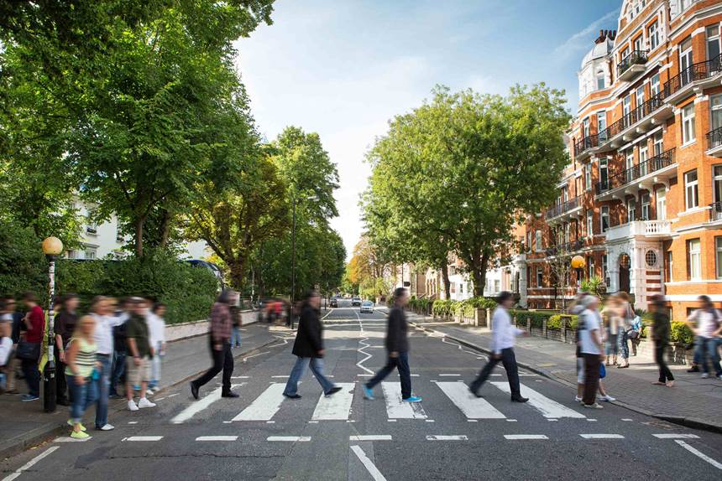
AIPI 510 / MODULE PROJECT 2
Can one minute
represent five?
Continuous vs distributed
observation at Abbey Road
Abbey Road crossing, context photograph
Source: Abbey Road Studios (2019)
Aarya Deshpande • Tanya Sharma
Notes:
Aarya | target 50 seconds
Picture the zebra crossing outside Abbey Road Studios. A group of tourists walks across together, and then the crossing stays empty for a while. Now imagine you have only one minute to count pedestrians, but your goal is to estimate the full five minutes. Do you watch one continuous minute, or spread your attention across several short moments? We tested that choice using recorded crossing footage. Our question was simple: does dividing the same one-minute observation budget change how accurate the estimate is?
Sources: data/raw/experiment_protocol.json; data/raw/crossing_events.csv; data/processed/analysis_summary.json; data/review/observer_confirmation.json. Official footage viewed only at https://www.abbeyroad.com/crossing. Statistical assumptions: https://docs.scipy.org/doc/scipy/reference/generated/scipy.stats.permutation_test.html . Speaker assignments are proposed; rehearse before recording.
Title photograph: user-supplied image from Abbey Road Studios, Celebrating 50 Years of the Iconic Crossing, June 18, 2019. https://www.abbeyroad.com/news/celebrating-50-years-of-the-iconic-crossing-2567 . Historical location context only, not footage from the November 3, 2026 experiment. This title image is a real source photograph.

Slide 2

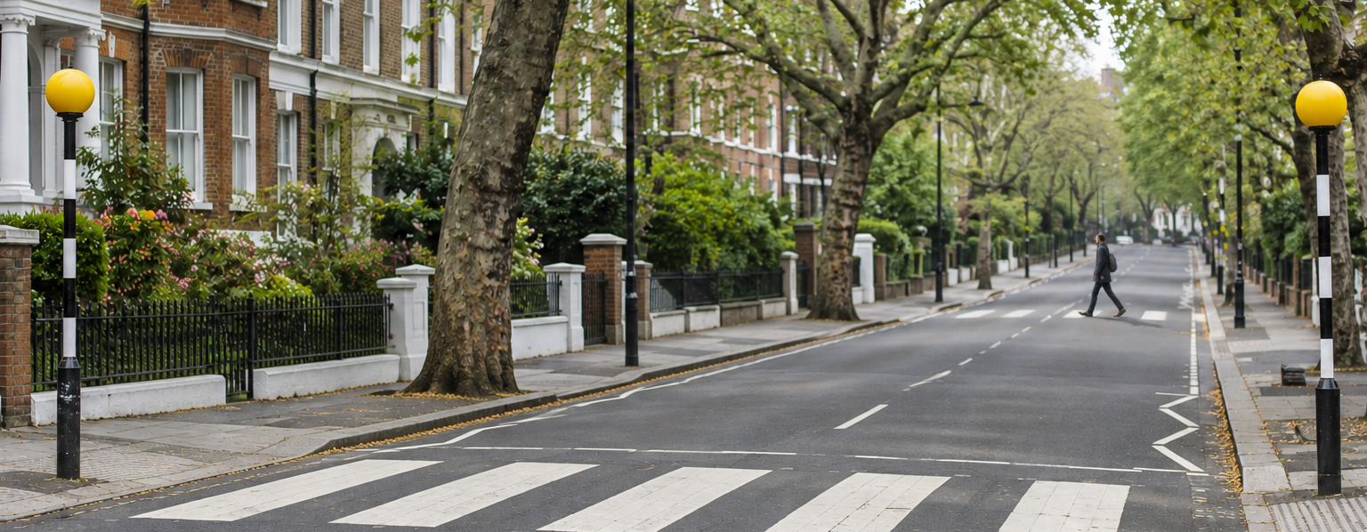
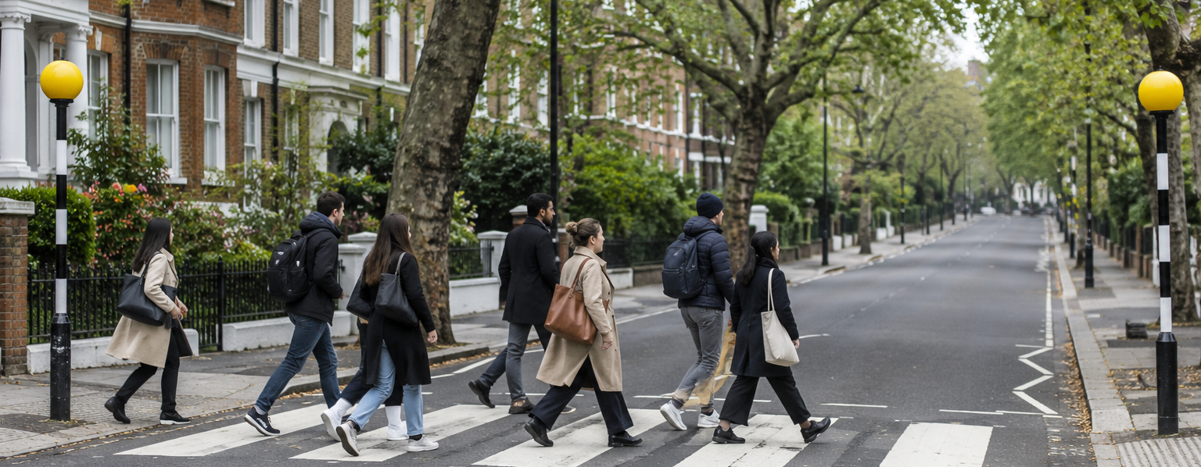
Same window, different moments
Full count
5 minutes
43
10:25–10:30 GMT, November 3
A One continuous 60-second block
B Six distributed 10-second blocks
Actual crossings in 10-second blocks
Actual crossings in 10-second blocks
Color = sampled
Color = sampled
0:00
1:00
2:00
3:00
4:00
5:00
0:00
1:00
2:00
3:00
4:00
5:00
7 observed × 5
35
19 observed × 5
95
Absolute error: 8
Absolute error: 52
estimate
estimate
The sampling intervals can land on very different moments.
Street scenes: AI illustrations. Timelines and counts: actual logged events from recording 13.
2 / 8
Notes:
Aarya | target 52 seconds
The practical reason is that counting every second of every camera recording takes time. A short sample is appealing, especially when the camera shows hours of activity. But pedestrians do not arrive like a metronome. In one of our actual five-minute windows, we counted forty-three crossings. A continuous sample estimated thirty-five, while the spread-out sample estimated ninety-five. That example shows what can happen when a sample catches a particularly busy moment. We needed all thirty-six windows to understand whether that was a pattern or one unusual case.
Sources: data/raw/experiment_protocol.json; data/raw/crossing_events.csv; data/processed/analysis_summary.json; data/review/observer_confirmation.json. Official footage viewed only at https://www.abbeyroad.com/crossing. Statistical assumptions: https://docs.scipy.org/doc/scipy/reference/generated/scipy.stats.permutation_test.html . Speaker assignments are proposed; rehearse before recording.
Background: AI-generated fictional London-inspired illustration, selected by the presenters. It is not footage of the actual study, its conditions, or exact Abbey Road geography. Asset and prompt provenance: slides/assets/ai/prompts.json and SHA256.json.
Slide 2 evidence: clip 13, November 3, 2026, 10:25–10:30 GMT. Full count 43. A samples relative [120,180), counts 7, estimates 35, absolute error 8. B samples [30,40), [50,60), [120,130), [170,180), [220,230), [290,300), counts 19, estimates 95, absolute error 52. Every bar shows the true event total in a consecutive ten-second bin. Gray bars are outside the sample, colored bars are inside. Each colored time track totals 60 seconds. The two AI street scenes are conceptual quiet/busy illustrations; they are not the actual sample frames and do not encode the observed counts. Source reconstruction: scripts/build_slide2_evidence.py and slides/assets/slide02_actual_timeline.json.

Slide 3

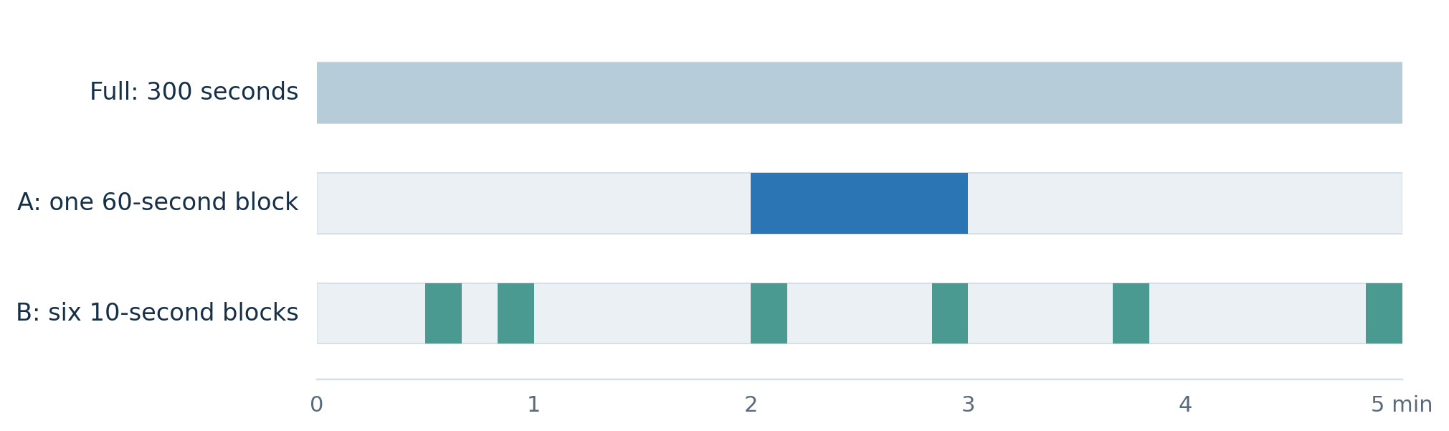
Two sampling methods
Both methods use 60 seconds out of a five-minute window.
Estimated total = sample count × 5 • Error = |estimate − full count|
3 / 8
AI-generated background illustration
Notes:
Aarya | target 56 seconds
Here's the comparison. Each of our windows lasts five minutes. For Method A, we randomly pick one complete minute. For Method B, we divide those five minutes into six fifty-second sections and randomly pick ten seconds from each section. That gives us sixty seconds for both methods. We multiply each sampled count by five to estimate the full window. We also counted all five minutes as our reference. The outcome we compare is the absolute difference between the estimate and that full count. The random choices were fixed before counting anyone.
Sources: data/raw/experiment_protocol.json; data/raw/crossing_events.csv; data/processed/analysis_summary.json; data/review/observer_confirmation.json. Official footage viewed only at https://www.abbeyroad.com/crossing. Statistical assumptions: https://docs.scipy.org/doc/scipy/reference/generated/scipy.stats.permutation_test.html . Speaker assignments are proposed; rehearse before recording.
Background: AI-generated fictional London-inspired illustration, selected by the presenters. It is not footage of the actual study, its conditions, or exact Abbey Road geography. Asset and prompt provenance: slides/assets/ai/prompts.json and SHA256.json.

Slide 4

36 windows, sampled before we counted
One camera · one London day · eight hourly strata
36
828
60 s
five-minute windows
recorded crossings
observed by each method
Randomized 5-minute slots and interval positions
Seed 20261103 · assumed d_z = 0.5 · nominal independent-pair power ≈ 83%
H₀: μ_D = 0 H₁: μ_D ≠ 0 D = absolute error A − absolute error B
4 / 8
AI-generated background illustration
Notes:
Aarya | target 60 seconds
We selected thirty-six nonoverlapping five-minute windows across eight daytime hours on November third, using the frozen random seed. The five-minute window is our paired unit. Our null hypothesis is equal mean absolute error; the two-sided alternative is a difference. Aarya counted eight hundred twenty-eight active crossings using the nearer crossing midpoint rule. As a sample-size calibration, an assumed moderate paired effect of zero point five gives about eighty-three percent power at alpha zero point zero five, if the windows are independent. That assumption may be optimistic because nearby windows share hourly conditions. This calculation is not evidence that the original sample size was chosen through a prospective power analysis.
Sources: data/raw/experiment_protocol.json; data/raw/crossing_events.csv; data/processed/analysis_summary.json; data/review/observer_confirmation.json. Official footage viewed only at https://www.abbeyroad.com/crossing. Statistical assumptions: https://docs.scipy.org/doc/scipy/reference/generated/scipy.stats.permutation_test.html . Speaker assignments are proposed; rehearse before recording.
Background: AI-generated fictional London-inspired illustration, selected by the presenters. It is not footage of the actual study, its conditions, or exact Abbey Road geography. Asset and prompt provenance: slides/assets/ai/prompts.json and SHA256.json.

Slide 5

The average errors were almost identical
Absolute estimation error in pedestrians per five-minute window
10.53
10.50
A: one continuous minute
B: six short intervals
15 windows favor A • 15 favor B • 6 ties
5 / 8
AI-generated background illustration
Notes:
Tanya | target 61 seconds
Here are the main results. Method A had a mean absolute error of ten point five three pedestrians. Method B was ten point five zero. Those values are almost identical. The individual comparisons tell the same story: A was closer in fifteen windows, B was closer in fifteen, and six were ties. The spread matters. There were some windows where the distributed sample made a large error, and others where the continuous sample missed a busy stretch. Across this recorded set, neither method was consistently better. So we looked at how uncertain that tiny average difference is.
Sources: data/raw/experiment_protocol.json; data/raw/crossing_events.csv; data/processed/analysis_summary.json; data/review/observer_confirmation.json. Official footage viewed only at https://www.abbeyroad.com/crossing. Statistical assumptions: https://docs.scipy.org/doc/scipy/reference/generated/scipy.stats.permutation_test.html . Speaker assignments are proposed; rehearse before recording.
Background: AI-generated fictional London-inspired illustration, selected by the presenters. It is not footage of the actual study, its conditions, or exact Abbey Road geography. Asset and prompt provenance: slides/assets/ai/prompts.json and SHA256.json.

Slide 6

The mean difference remains uncertain
Paired mean difference (A absolute error − B absolute error)
95% confidence interval: −4.46 to +4.51 pedestrians
-5
-2.5
0
2.5
5
+0.03
0.990
36
mean difference
paired t-test p-value
paired windows
Cohen’s d_z = 0.002 · paired and hour-cluster sign-flip p = 1.000
6 / 8
AI-generated background illustration
Notes:
Tanya | target 59 seconds
We compared the absolute errors within each window as A minus B. The observed mean difference was positive zero point zero three pedestrians. Its nominal ninety-five percent confidence interval ran from negative four point four six to positive four point five one. The paired t-test gave a p-value of zero point nine nine zero, and the paired standardized effect was about zero point zero zero two. These results do not show a mean-accuracy advantage. They also do not establish equivalence, because differences of several pedestrians remain inside the interval. Hourly summaries and sign-flip sensitivity checks did not reveal a stable direction, but eight hourly groups give limited information about dependence.
Sources: data/raw/experiment_protocol.json; data/raw/crossing_events.csv; data/processed/analysis_summary.json; data/review/observer_confirmation.json. Official footage viewed only at https://www.abbeyroad.com/crossing. Statistical assumptions: https://docs.scipy.org/doc/scipy/reference/generated/scipy.stats.permutation_test.html . Speaker assignments are proposed; rehearse before recording.
Background: AI-generated fictional London-inspired illustration, selected by the presenters. It is not footage of the actual study, its conditions, or exact Abbey Road geography. Asset and prompt provenance: slides/assets/ai/prompts.json and SHA256.json.

Slide 7

Limitations
All 36 retained after the observer confirmed visibility during counting.
01
One camera and one day
02
Nearby windows may correlate
We sampled eight hours on one Tuesday.
There are 36 windows within eight hourly groups.
03
Varying playback speeds
04
One observer and one event log
Groups and reaction delay can affect timed counts.
No independent recount; reference and samples share annotations.
7 / 8
AI-generated background illustration
Notes:
Tanya | target 59 seconds
The main limitations concern generalization and measurement. This was one camera on one day, with several windows in each hour. Nearby windows may be correlated. Aarya used varying playback speeds and reported clear visibility, but large groups, reaction delay and people turning back can cause counting mistakes. Full and sampled counts use the same manual event log, so their exact reconciliation validates the software calculation, not the accuracy of every human judgment. Aarya confirmed all thirty-six windows were usable, and we retained them all. There was no independent recount or second annotator, so we do not claim a measured annotation-accuracy percentage.
Sources: data/raw/experiment_protocol.json; data/raw/crossing_events.csv; data/processed/analysis_summary.json; data/review/observer_confirmation.json. Official footage viewed only at https://www.abbeyroad.com/crossing. Statistical assumptions: https://docs.scipy.org/doc/scipy/reference/generated/scipy.stats.permutation_test.html . Speaker assignments are proposed; rehearse before recording.
Background: AI-generated fictional London-inspired illustration, selected by the presenters. It is not footage of the actual study, its conditions, or exact Abbey Road geography. Asset and prompt provenance: slides/assets/ai/prompts.json and SHA256.json.

Slide 8
THE TAKEAWAY
Neither method showed
a clear accuracy advantage
Similar averages do not establish equivalent accuracy.
Next: more days, more sites, independent counting checks.
Source: abbeyroad.com/crossing | 36 observer-confirmed windows, Nov 3, 2026
Notes:
Tanya | target 48 seconds
What would we recommend? With these data, we cannot justify choosing one sampling method on accuracy alone. The broader lesson is that the way observation time is spread can change the outcome for an individual window, even when the average errors look alike. A follow-up should include more days, more locations, and a second person checking some of the crossings. We would also define in advance how large an accuracy improvement would matter in practice. The main takeaway is that a short observation budget needs a tested sampling plan, and the uncertainty belongs in the decision.
Sources: data/raw/experiment_protocol.json; data/raw/crossing_events.csv; data/processed/analysis_summary.json; data/review/observer_confirmation.json. Official footage viewed only at https://www.abbeyroad.com/crossing. Statistical assumptions: https://docs.scipy.org/doc/scipy/reference/generated/scipy.stats.permutation_test.html . Speaker assignments are proposed; rehearse before recording.

