Slide 1
AIPI 510 / MODULE PROJECT 2
Can one minute
represent five?
Continuous vs distributed observation at Abbey Road
Aarya Deshpande • Tanya Sharma
Notes:
Aarya | Target 50 seconds
Picture the zebra crossing outside Abbey Road Studios. A group of tourists walks across together, and then the crossing stays empty for a while. Now imagine you have only one minute to count pedestrians, but your goal is to estimate the full five minutes. Do you watch one continuous minute, or spread your attention across several short moments? We tested that choice using recorded crossing footage. Our question was simple: does dividing the same one-minute observation budget change how accurate the estimate is?
Presenter: pause for the visual and speak conversationally.

Slide 2
A brief burst can reshape an estimate
One observed five-minute window: 10:25–10:30 AM, November 3
43
35
95
crossings during the full 5 minutes
A estimate
B estimate
The sampling intervals can land on very different moments.
2 / 8
Notes:
Aarya | Target 52 seconds
The practical reason is that counting every second of every camera recording takes time. A short sample is appealing, especially when the camera shows hours of activity. But pedestrians do not arrive like a metronome. In one of our actual five-minute windows, we counted forty-three crossings. A continuous sample estimated thirty-five, while the spread-out sample estimated ninety-five. That example shows what can happen when a sample catches a particularly busy moment. We needed all thirty-six windows to understand whether that was a pattern or one unusual case.
Presenter: pause for the visual and speak conversationally.

Slide 3
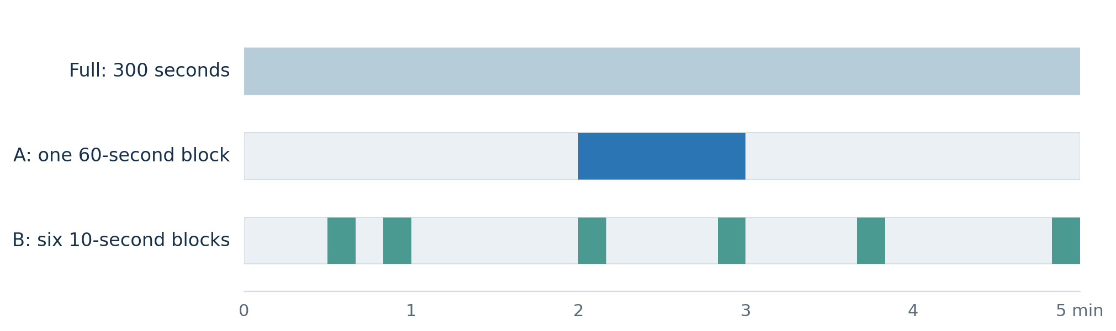
Same observing budget. Different allocation.
Both methods use 60 seconds out of a five-minute window.
Estimated total = sample count × 5 • Error = |estimate − full count|
3 / 8
Notes:
Aarya | Target 56 seconds
Here's the comparison. Each of our windows lasts five minutes. For Method A, we randomly pick one complete minute. For Method B, we divide those five minutes into six fifty-second sections and randomly pick ten seconds from each section. That gives us sixty seconds for both methods. We multiply each sampled count by five to estimate the full window. We also counted all five minutes as our reference. The outcome we compare is the absolute difference between the estimate and that full count. The random choices were fixed before counting anyone.
Presenter: pause for the visual and speak conversationally.

Slide 4
36 windows, sampled before we counted
One camera · one London day · eight hourly strata
36
828
60 s
five-minute windows
recorded crossings
observed by each method
Randomized 5-minute slots and interval positions
seed = 20261103 • planned power ≈ 83% for assumed d = 0.5
All three counts derive from the same timestamped crossing events; the 36 windows are the paired units.
4 / 8
Notes:
Aarya | Target 60 seconds
We sampled thirty-six nonoverlapping windows from one day of the Abbey Road archive, spread from eight in the morning to just before four in the afternoon London time. The schedule was generated with a saved random seed, and we used the same crossing rule for every clip: one person counted when they reached the midpoint of the nearer zebra crossing. All together, the raw log contains eight hundred twenty-eight active crossings. The five-minute window is our unit of analysis, so there are thirty-six paired observations. Our planning calculation suggested eighty-three percent power to detect a moderate standardized difference if the windows were independent. That's an assumption we'll return to.
Presenter: pause for the visual and speak conversationally.

Slide 5
The average errors were almost identical
Absolute estimation error in pedestrians per five-minute window
10.53
10.50
A: one continuous minute
B: six short intervals
15 windows favor A • 15 favor B • 6 ties
5 / 8
Notes:
Tanya | Target 61 seconds
Here are the main results. Method A had a mean absolute error of ten point five three pedestrians. Method B was ten point five zero. Those values are almost identical. The individual comparisons tell the same story: A was closer in fifteen windows, B was closer in fifteen, and six were ties. The spread matters. There were some windows where the distributed sample made a large error, and others where the continuous sample missed a busy stretch. Across this recorded set, neither method was consistently better. So we looked at how uncertain that tiny average difference is.
Presenter: pause for the visual and speak conversationally.

Slide 6
A tiny average gap, with substantial uncertainty
Paired mean difference (A absolute error − B absolute error)
95% confidence interval: −4.46 to +4.51 pedestrians
-5
-2.5
0
2.5
5
+0.03
0.990
36
mean difference
paired t-test p-value
paired windows
The interval allows advantages of several pedestrians for either method.
6 / 8
Notes:
Tanya | Target 59 seconds
We calculated the paired difference in absolute error as A minus B. Its observed mean was about positive zero point zero three pedestrians. The ninety-five percent confidence interval ran from negative four point four six to positive four point five one. The paired t-test gave a p-value of zero point nine nine zero. The result does not provide evidence of a mean difference. It also does not establish that the methods are equivalent: the confidence interval includes differences that could matter for a real counting task. When we summarized differences within each of the eight hours, the direction still changed from hour to hour.
Presenter: pause for the visual and speak conversationally.

Slide 7
What could change the answer?
These data describe the completed recordings, pending manual validity review.
01
One camera and one day
02
Nearby windows may correlate
We sampled eight hours on one Tuesday.
There are 36 windows within eight hourly groups.
03
Human clicks have uncertainty
04
Manual signoff is pending
Timing, visibility and missed crossings can matter.
Clocks verified; 36 validity flags left blank.
7 / 8
Notes:
Tanya | Target 59 seconds
There are four limits worth keeping in mind. This was one camera on one day, and several windows came from the same hour. Those windows may be correlated, reducing the effective information in our sample. One observer clicked a button for each crossing, so timing and missed events can affect counts. The full-window reference was built from that same click stream, and we do not have an independent second annotator. Finally, the extension verified playback coverage and the archived clock, but the manual validity-review fields were left blank in the export. Our statistical results are therefore provisional until that visual review is signed off.
Presenter: pause for the visual and speak conversationally.

Slide 8
THE TAKEAWAY
One minute gave us
two uncertain answers.
We could not identify a consistent accuracy advantage in this sample.
Next: more days, more sites, independent counting checks.
Source: abbeyroad.com/crossing | 36 provisional clock-verified windows, Nov 3, 2026
Notes:
Tanya | Target 48 seconds
What would we recommend? With these data, we cannot justify choosing one sampling method on accuracy alone. The broader lesson is that the way observation time is spread can change the outcome for an individual window, even when the average errors look alike. A follow-up should include more days, more locations, and a second person checking some of the crossings. We would also define in advance how large an accuracy improvement would matter in practice. The main takeaway is that a short observation budget needs a tested sampling plan, and the uncertainty belongs in the decision.
Presenter: pause for the visual and speak conversationally.

