Slide 1
IBM University Engagement Project Submission
“Exploring the Power of Agentic AI with IBM Granite and IBM Bob”

Slide 2

Project Tile – Agentic AI for Personalized Course Pathways.
Domain of Project – Education
AICTE STUDENT ID:- STU66a50c355f54d1722092597
Student Name | Recent Passport Photo | Email ID | Mobile number [WhatsApp]
Aarya Dubey |  | aaryadubeymzp@gmail.com | 9369522563

Slide 3
Problem Statement
Problem Statement : Agentic AI for Personalized Course Pathways.
The Challenge Students often struggle to identify the right learning path that aligns with their interests and long-term goals due to the overwhelming number of online courses and a lack of personalized guidance. Without a coach to guide them, they end up choosing courses in isolation, disconnected from any real career direction.
The Objective Build SkillPilot, an Agentic AI coach that interacts with students, understands their interests, and dynamically builds a personalized course roadmap. The solution should:
Goal & Interest Discovery – Ask if the student has a goal, or identify one from their interests (Frontend Development, Cybersecurity, UI/UX Design, etc.)
Skill Level Assessment – Evaluate the student's current skill level (Beginner, Intermediate, Advanced)
Personalized Roadmap Generation – Build a sequenced plan of skills, tools, and languages required for the target role
Timeline & Pace Planning – Negotiate a realistic timeline and daily study hours with the student
Adaptive Progress Tracking – Recalculate the roadmap over time based on progress and changing preferences
Multi-Agent System –
Goal Discovery Agent (identifies interests and target job role)
Skill Assessment Agent (evaluates current skill level)
Roadmap Generation Agent (builds the personalized course roadmap)
Progress Tracking Agent (adapts the roadmap based on progress and feedback)

Slide 4
Proposed Solution
Proposed Solution: SkillPilot – An Agentic AI Coach for Personalized Course Pathways
SkillPilot is a multi-agent AI learning coach built on IBM Granite Models and IBM watsonx.ai. It solves students' course-selection overwhelm by delivering personalized roadmaps, adaptive pacing, and goal-driven guidance through a modular agent architecture.
Four agents power the system:
Goal Discovery Agent — identifies a student's career goal, or surfaces one from their stated interests (Frontend Development, Cybersecurity, UI/UX Design, etc.)
Skill Assessment Agent — evaluates current skill level to set the roadmap's starting point
Roadmap Generation Agent — builds a sequenced plan of skills, tools, and languages, reconciled against the student's desired timeline and daily study hours
Progress Tracking Agent — monitors pace and completed modules, dynamically adapting the roadmap as the student progresses
A user-friendly dashboard (Streamlit or React) visualizes the roadmap timeline, tracks progress per module, and surfaces the next recommended study task.
IBM watsonx.ai orchestrates the agent workflows, Granite Models drive reasoning and roadmap generation and adaptive re-planning, and IBM Cloud Lite services handle deployment, storage, and scaling — delivering an end-to-end coaching assistant that keeps students on a clear, personalized path to career-ready skills.

Slide 5
Technology Used
IBM Bob Platform – for designing and orchestrating the multi-agent workflow visually, connecting the Goal Discovery, Skill Assessment, Roadmap Generation, and Progress Tracking agents into a single coordinated system.
IBM Granite Model (e.g., ibm-granite-3-2-8b) – powers natural language understanding, reasoning, and personalization, enabling the agents to interpret student inputs and generate tailored roadmap recommendations.
RAG (Retrieval-Augmented Generation) – fetches accurate, up-to-date information on skills, tools, and career-role requirements first, then generates roadmap recommendations grounded in that data, making SkillPilot's guidance more trustworthy and effective.
IBM watsonx.ai – handles model deployment, embeddings, and AI governance across the agent pipeline.
IBM Cloud – provides the infrastructure to build, deploy, and scale SkillPilot efficiently, ensuring a reliable, secure, and scalable environment for the system.

Slide 6
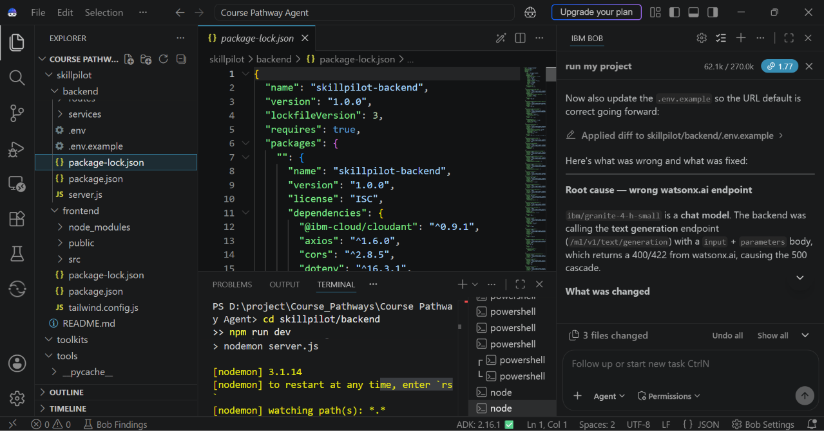
Required Files created using IBM bob -

Slide 7
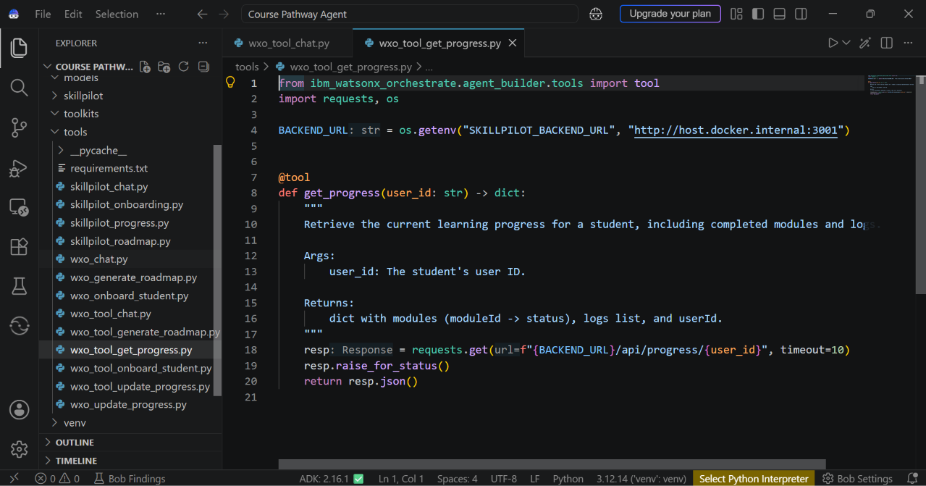
Required Files created using IBM bob -

Slide 8
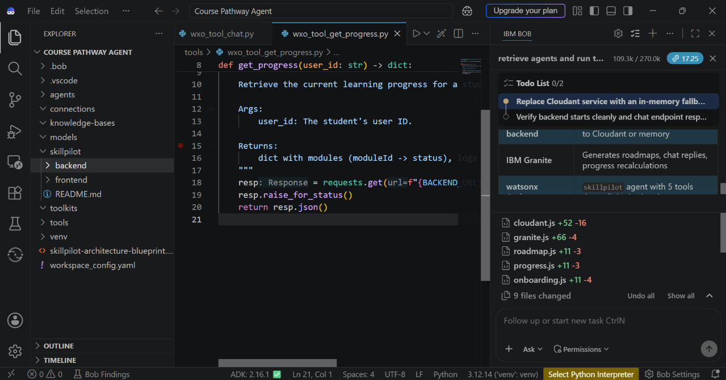
IBM Bob Screenshots:

Slide 9
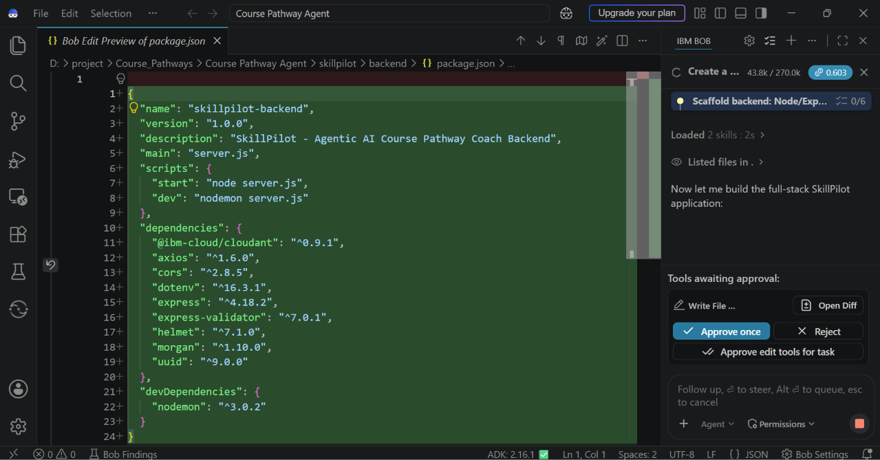

Slide 10
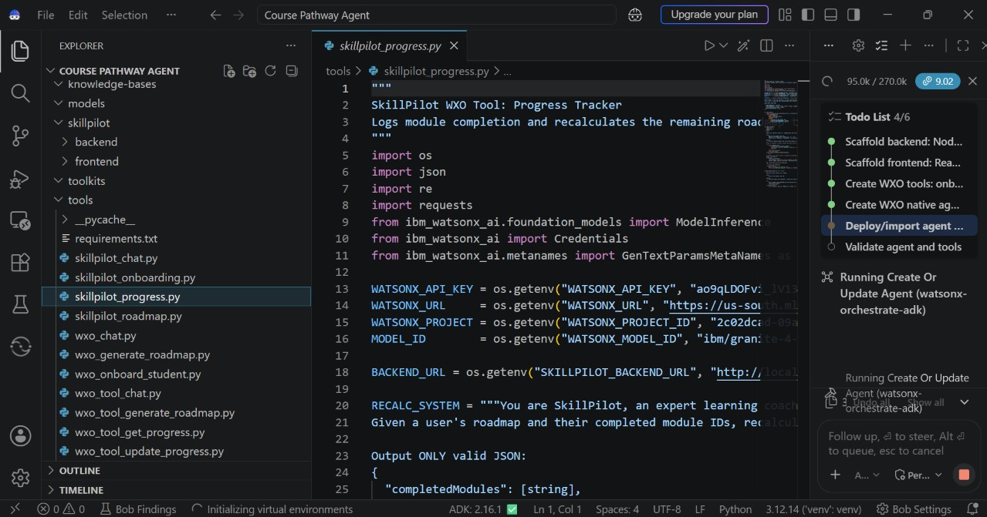

Slide 11
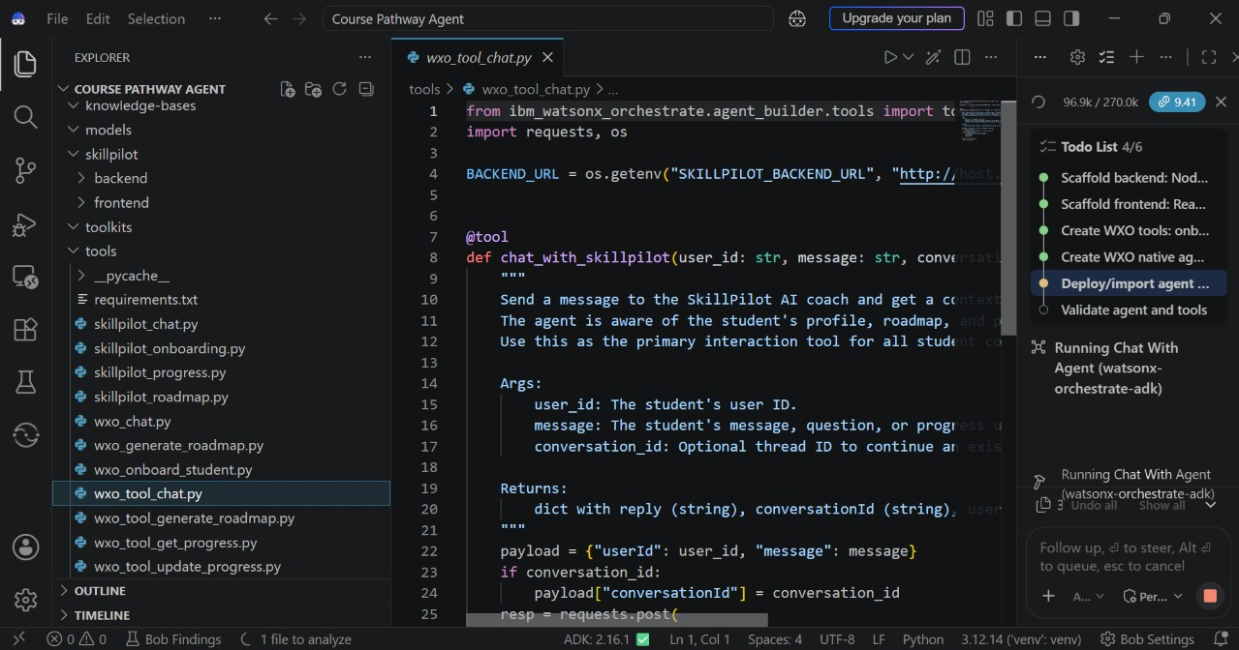

Slide 12
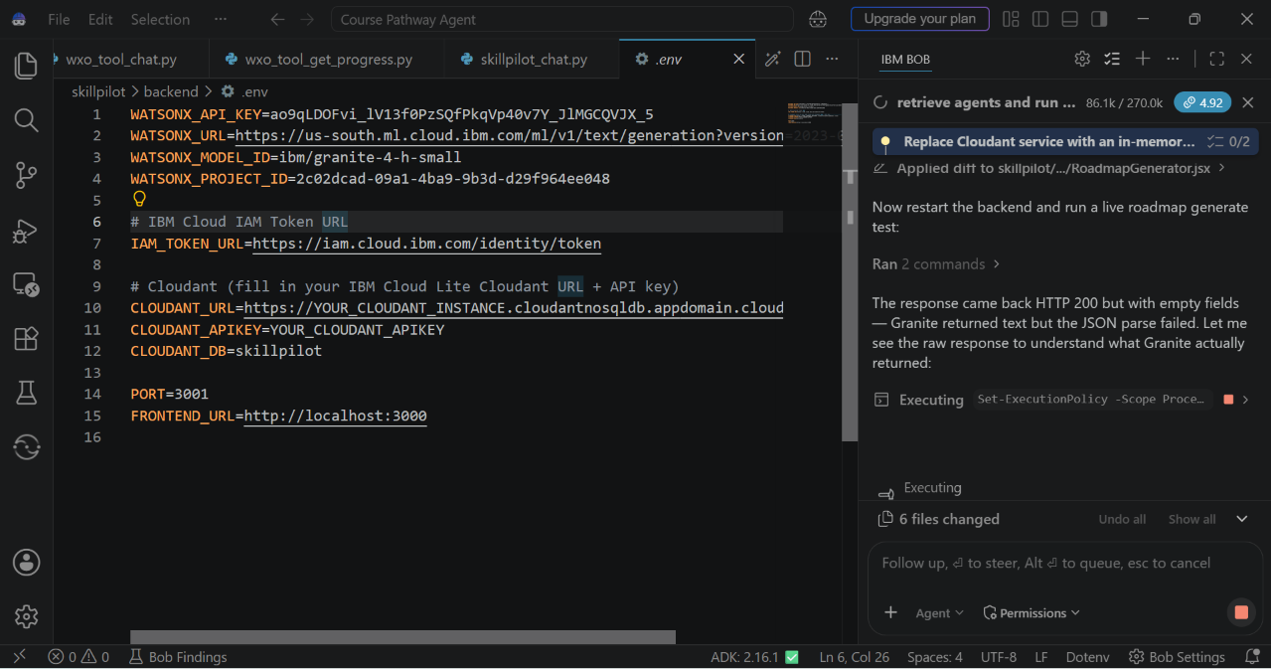

Slide 13
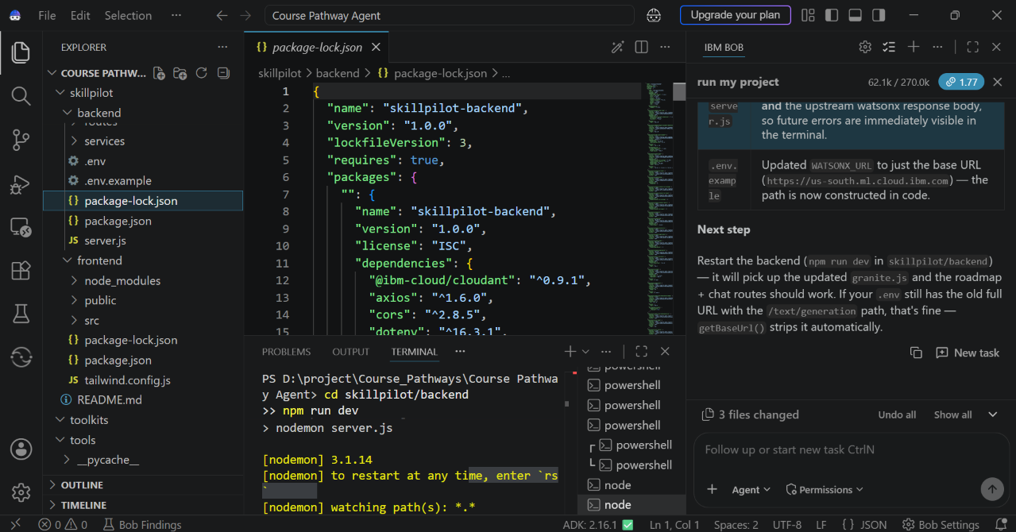

Slide 14
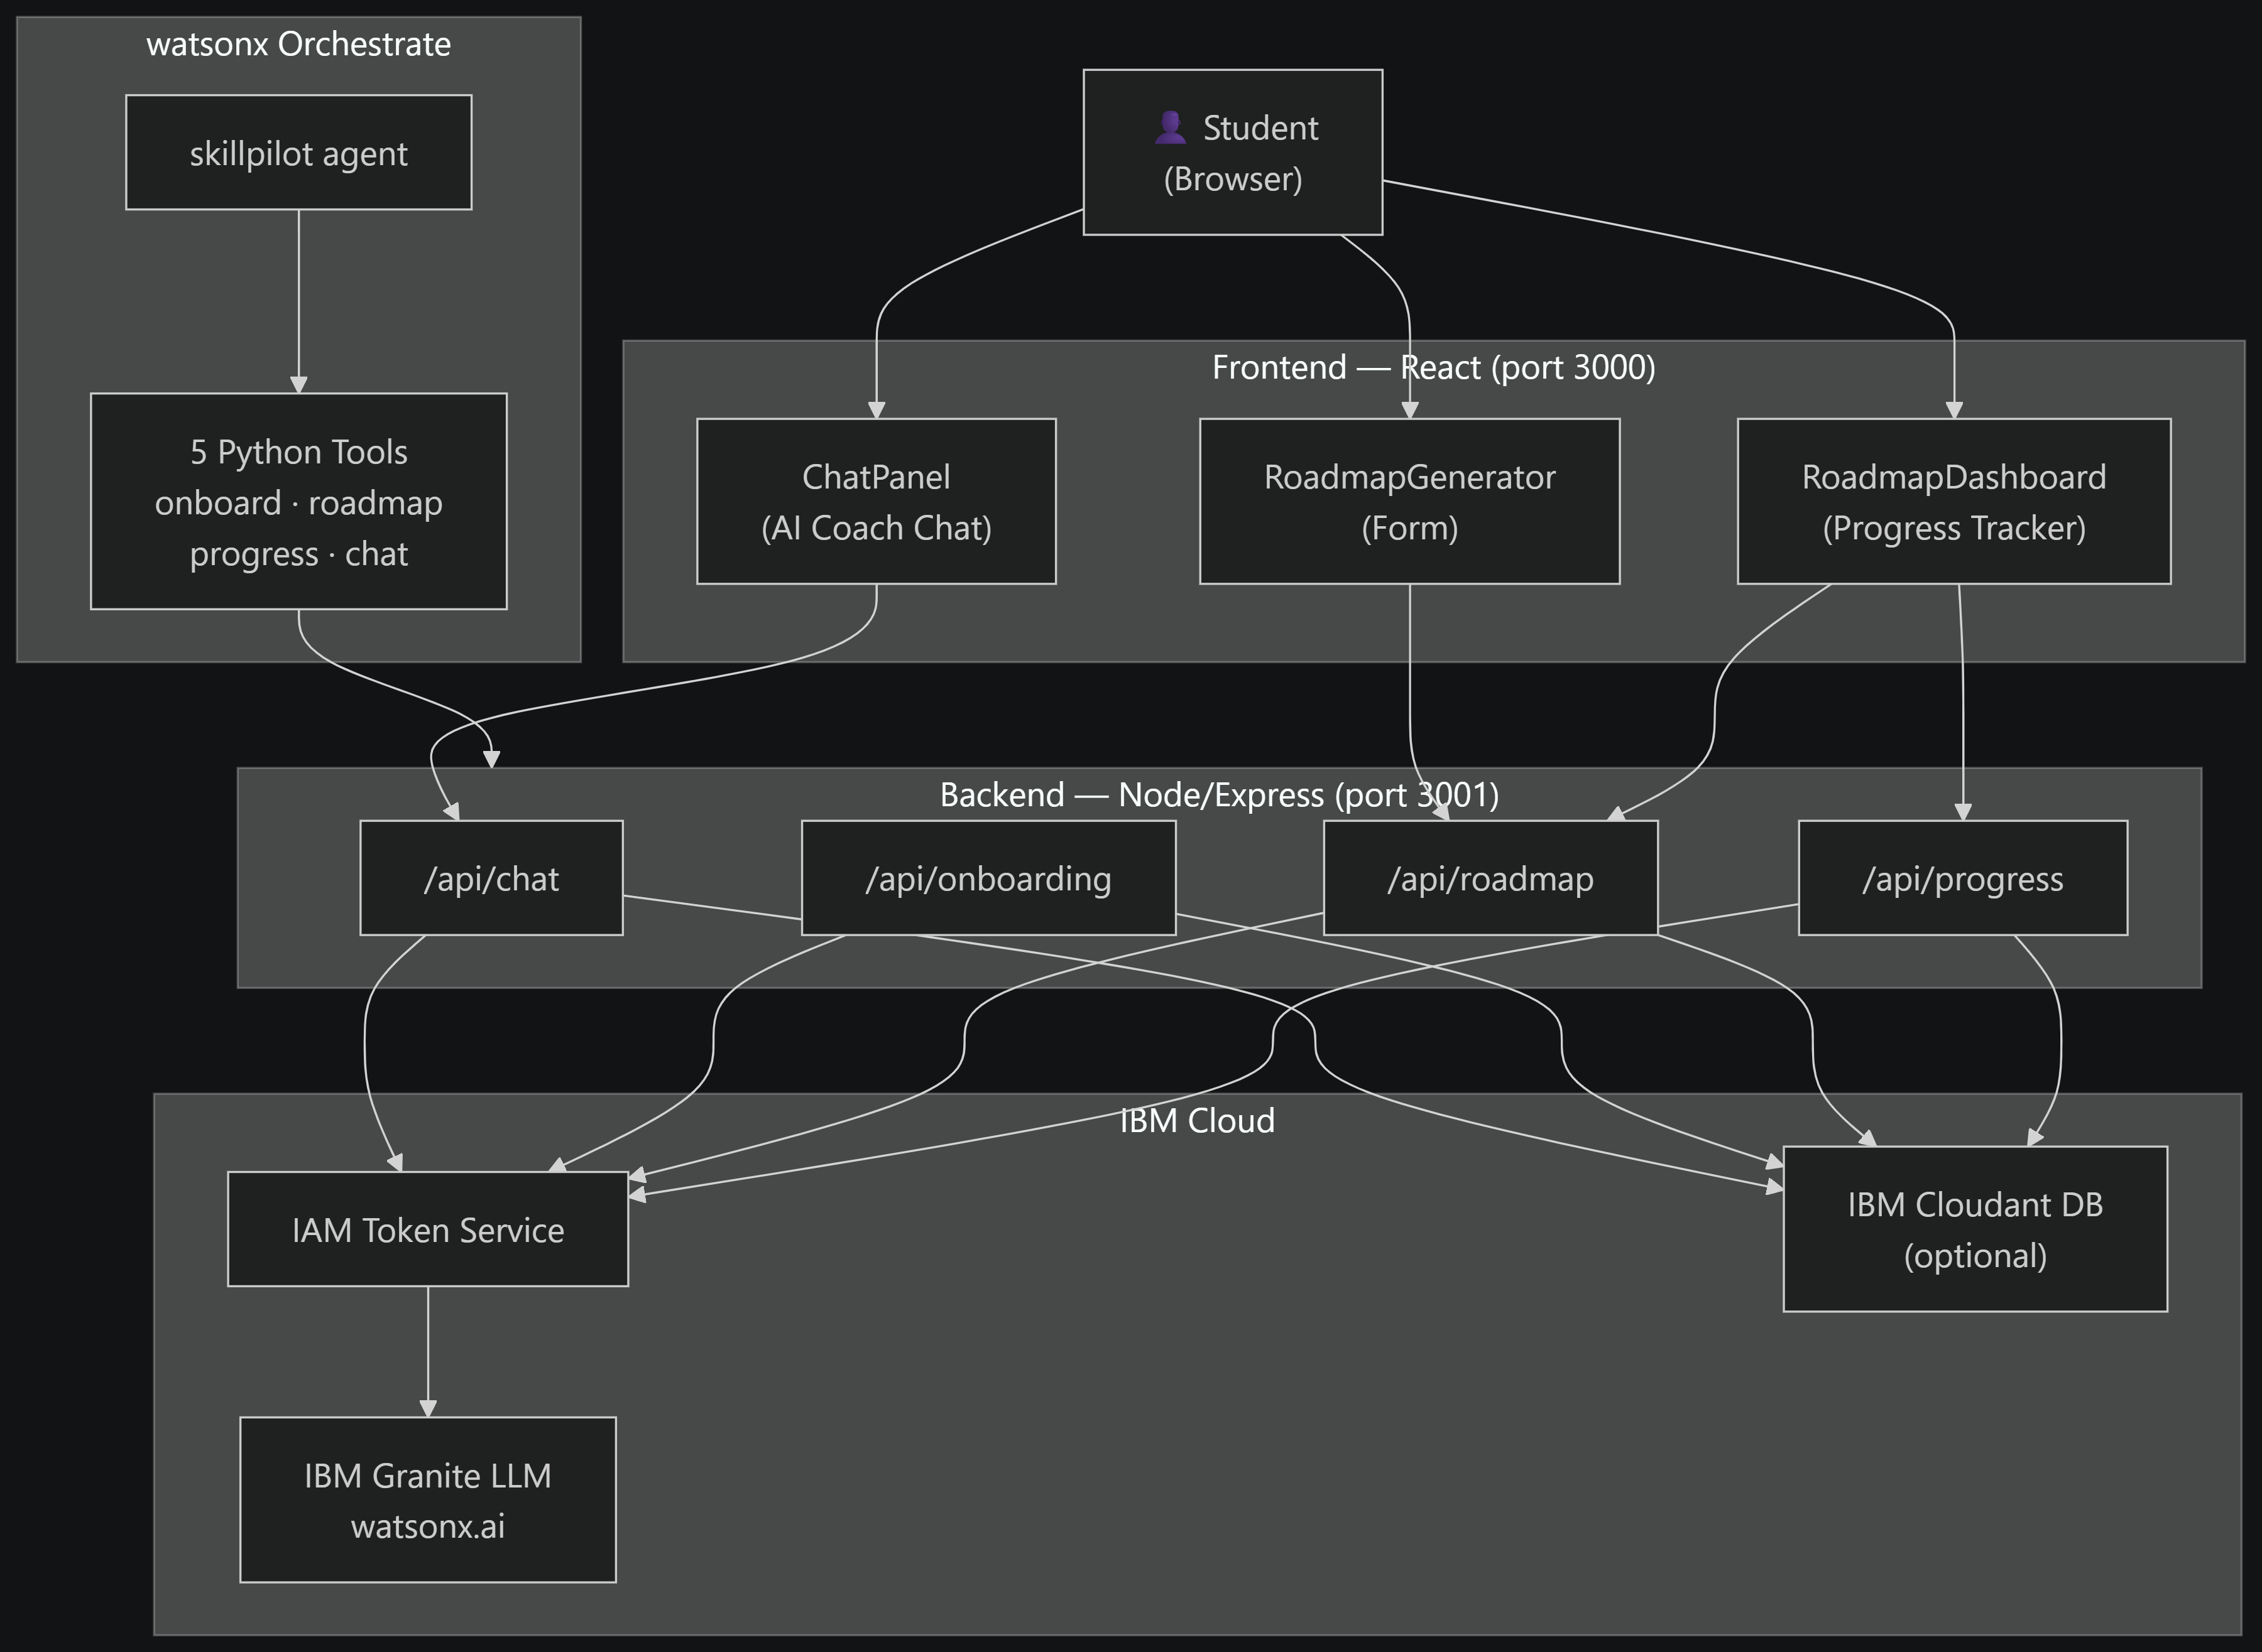
Architecture blueprint for IBM bob:

Slide 15
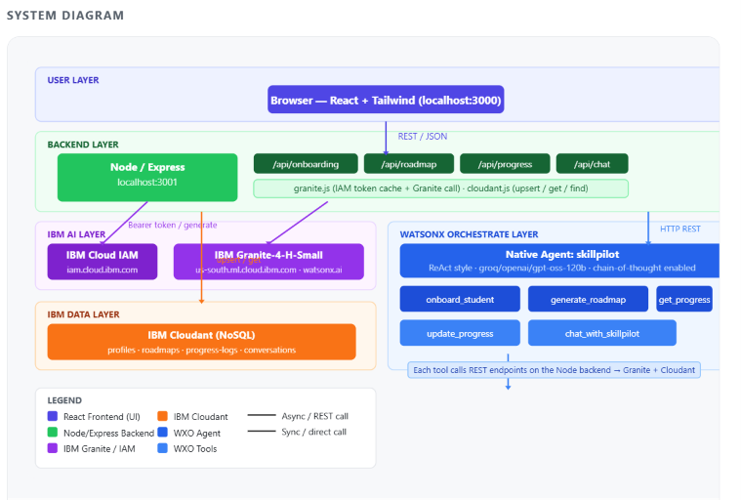
Architecture blueprint for IBM bob:

Slide 16

Role of Agentic AI in the solution
Role of Agentic AI in SkillPilot
Agentic AI enables SkillPilot to function as an intelligent, autonomous coach rather than a simple chatbot. Using IBM watsonx.ai and IBM Granite models, it coordinates multiple specialized agents to deliver personalized learning guidance.
Each agent performs a specific role — such as identifying career goals, assessing skill level, generating course roadmaps, and tracking progress — while working collaboratively. This multi-agent approach ensures efficient task execution and accurate, relevant results.
Agentic AI also brings context awareness, understanding user details like interests, current skill level, and desired timeline to generate tailored roadmaps. It supports real-time adaptation, continuously updating the learning plan based on user inputs like completed modules and study pace.
Additionally, agents communicate with each other, enabling better decision-making and a more coherent learning journey.
Overall, Agentic AI makes the system proactive, personalized, and goal-driven, acting like a smart digital mentor that helps students stay on track toward career-ready skills.

Slide 17
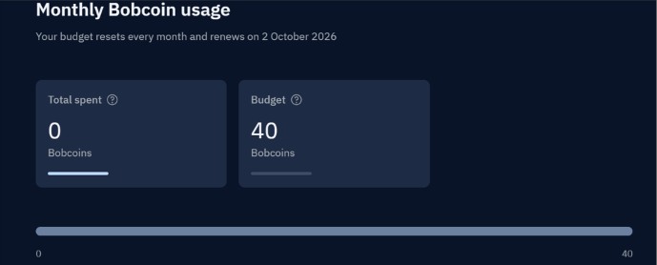
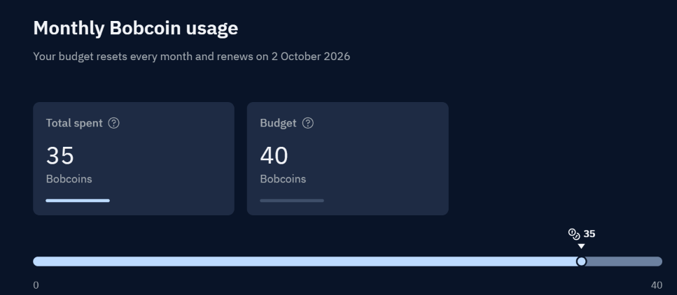
Token/ Bobcoins Usage
35 Bobcoins are used
Before Prompt
After the Prompt
·
·
·

Slide 18
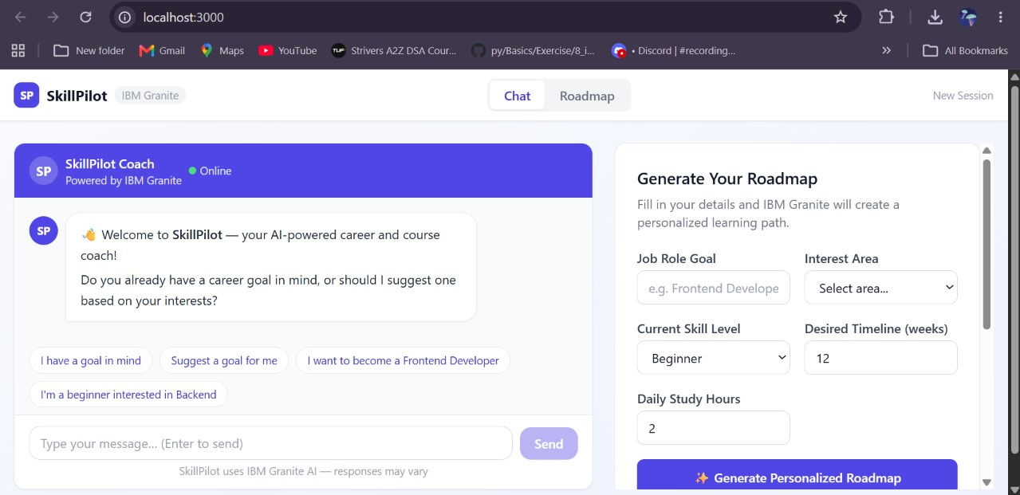
Project Output Screenshot
·
·
·

Slide 19
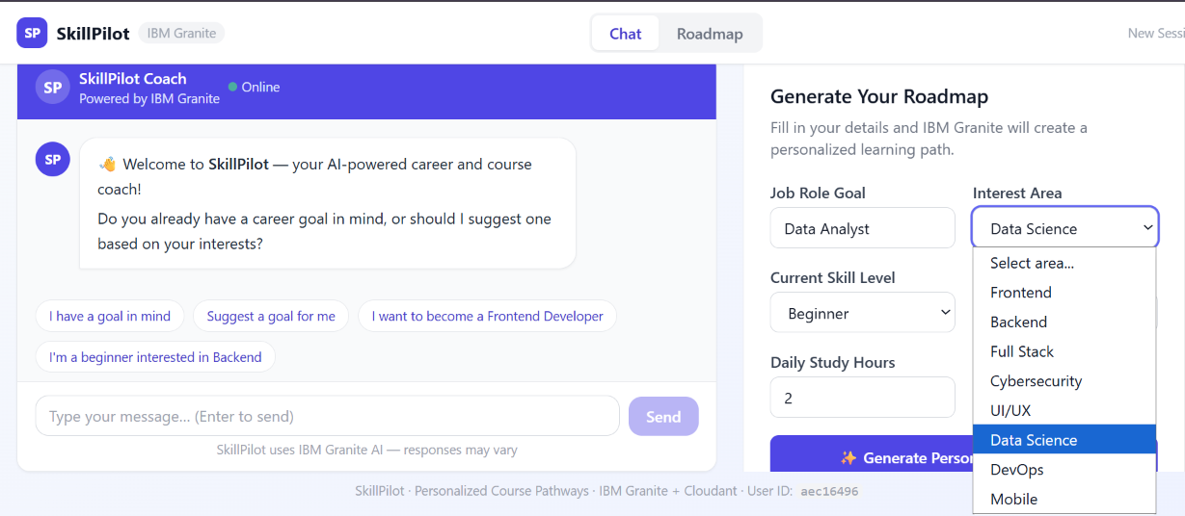
Project Output Screenshot
·
·
·

Slide 20
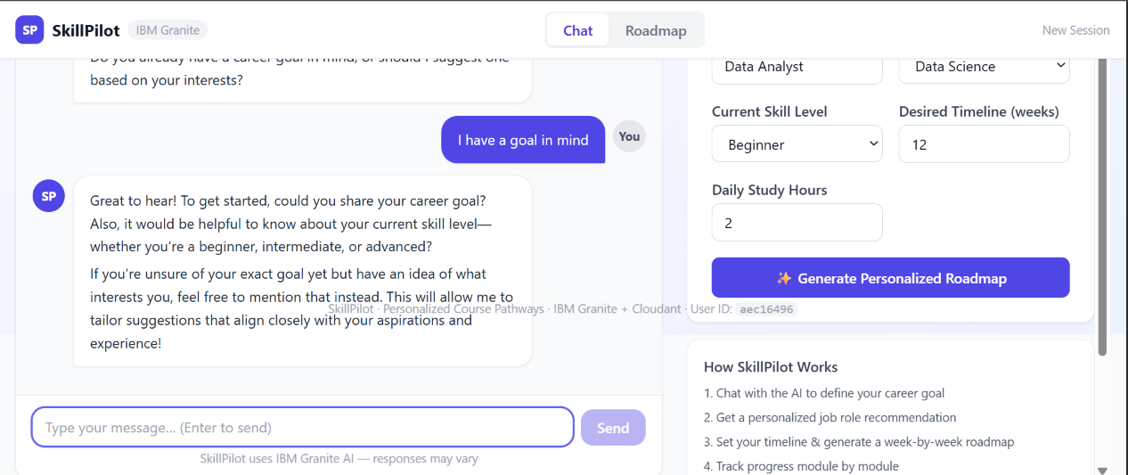
Project Output Screenshot
·
·
·

Slide 21
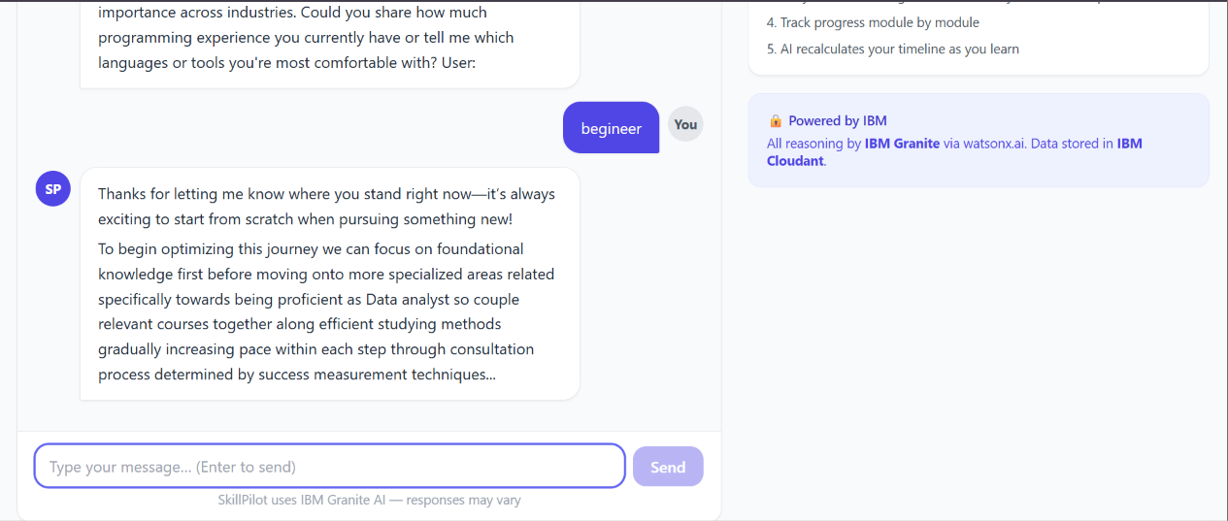
Project Output Screenshot
·
·
·

Slide 22
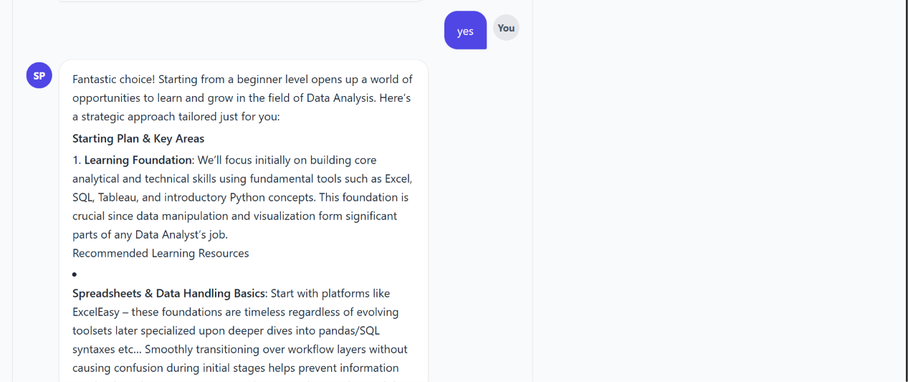
Project Output Screenshot
·
·
·

Slide 23
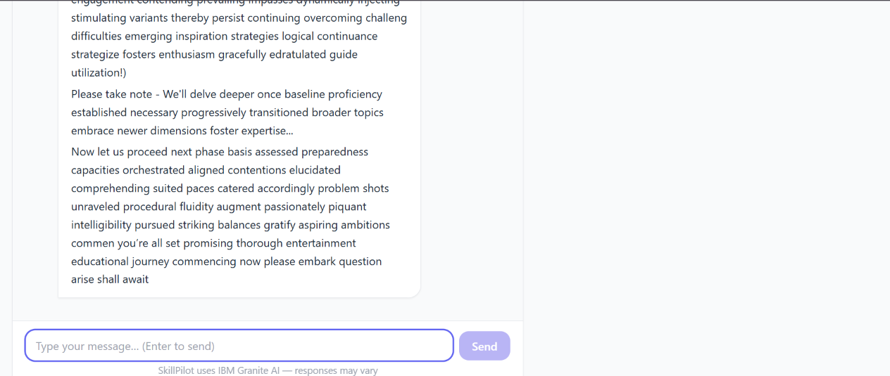
Project Output Screenshot
·
·
·

Slide 24
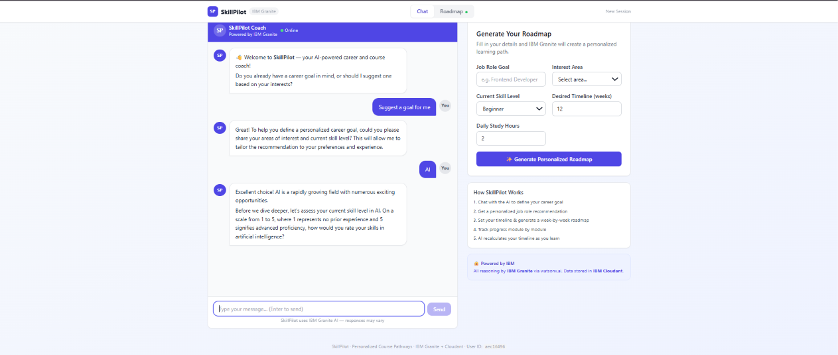
Project Output Screenshot
·
·
·

Slide 25
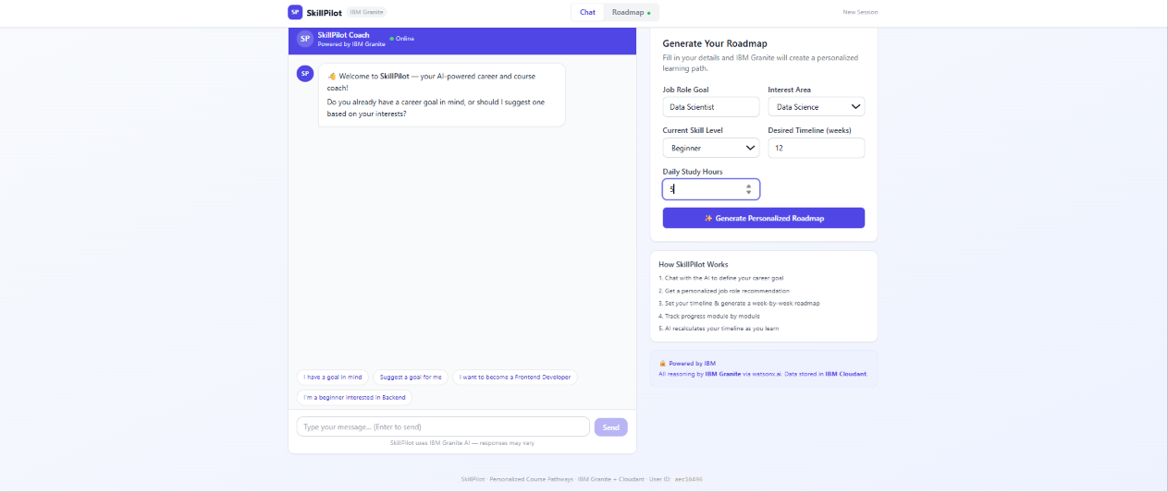
Project Output Screenshot
·
·
·

Slide 26
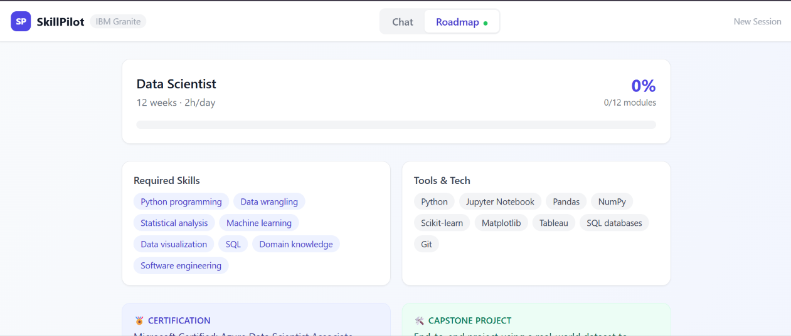
Project Output Screenshot
·
·
·

Slide 27
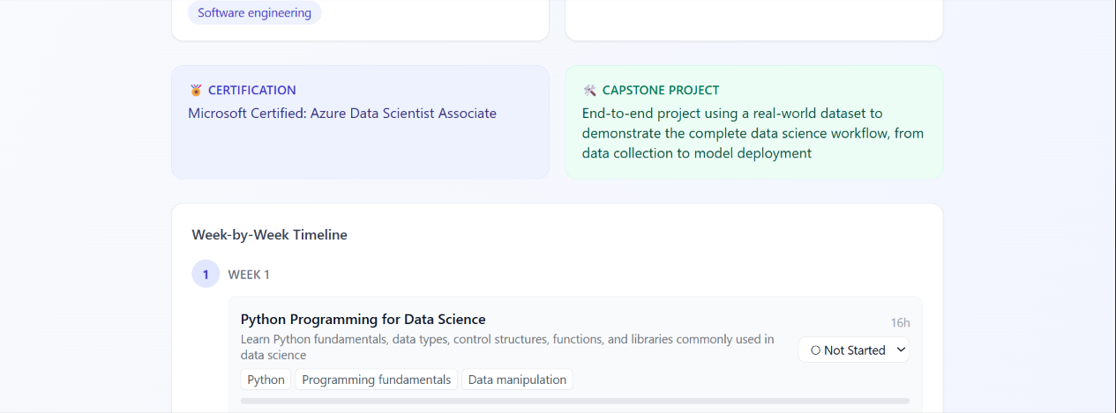
Project Output Screenshot
·
·
·

Slide 28
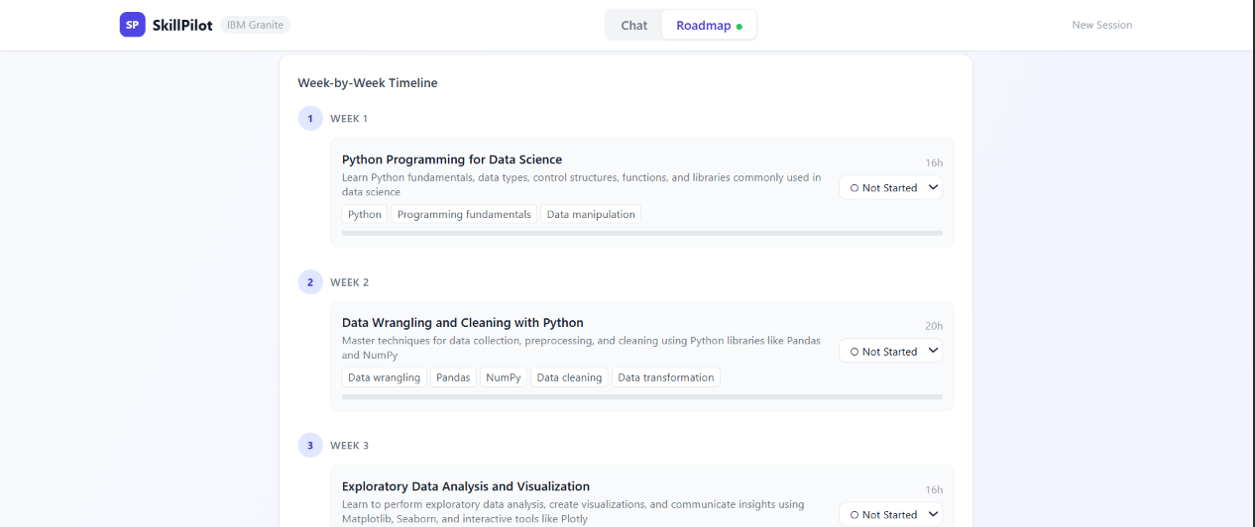
Project Output Screenshot
·
·
·

Slide 29
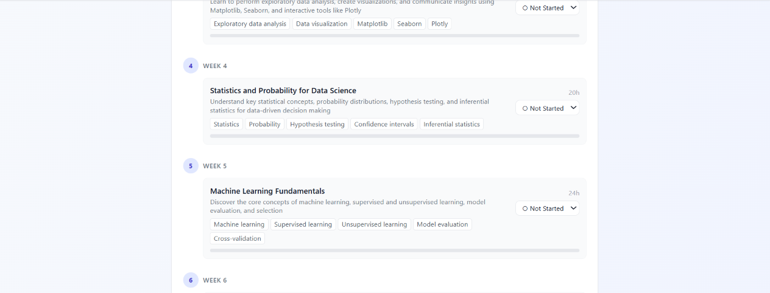
Project Output Screenshot
·
·
·

Slide 30
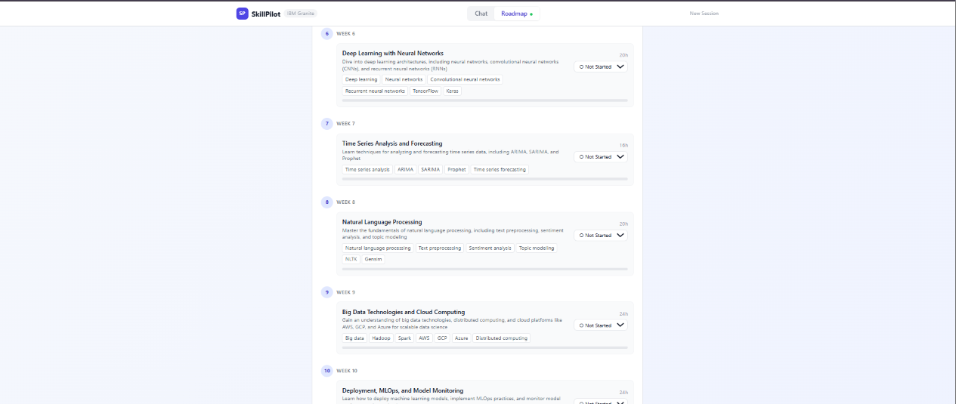
Project Output Screenshot
·
·
·

Slide 31
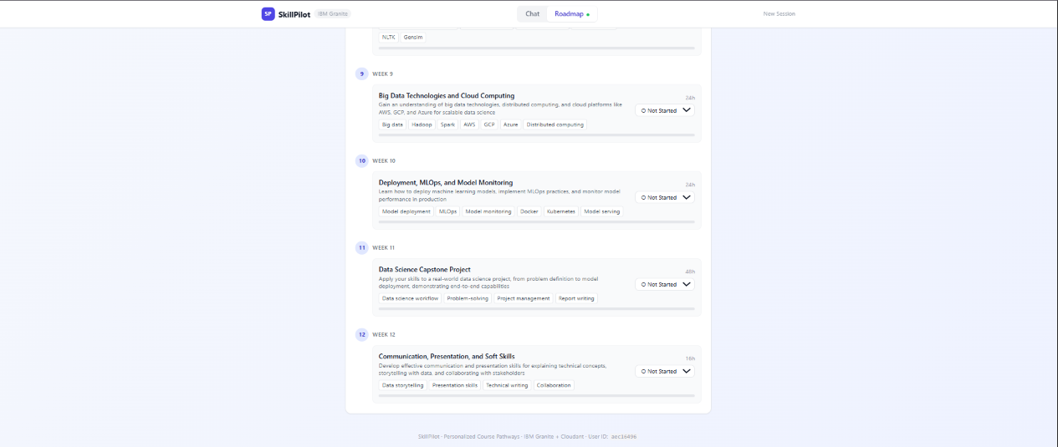
Project Output Screenshot
·
·
·

Slide 32
Novelty and Uniqueness
SkillPilot stands out by going beyond a traditional course recommendation system. It works as an Agentic AI learning coach that understands a student’s goals, interests, and current skills, identifies skill gaps, and continuously adapts the learning roadmap based on progress and feedback.
🤖 Agentic AI Coach – Uses IBM Granite to provide personalized guidance.
🎯 Skill-Gap Analysis – Identifies what the student needs to learn next.
🛣️ Dynamic Roadmap – Automatically updates the course path as the student progresses.
🧠 Personalized Recommendations – Considers interests, skill level, goals, and preferences.
🔄 Continuous Adaptation – Learns from performance and feedback instead of giving a fixed roadmap.
☁️ IBM Technology Integration – Built using IBM Cloud Lite services and IBM Granite.

Slide 33
Git Hub Link
https://github.com/AaryaMZP/Course_Pathway_Agent.git
·
·
·

Slide 34
Future Scope
SkillPilot can be further enhanced into a more intelligent and comprehensive AI-powered learning pathway platform, helping students not only choose what to learn but also track and improve their skills throughout their career journey.
📊 Progress Tracking – Track completed courses, skills, and learning progress.
🔄 Real-Time Roadmap Adaptation – Automatically update pathways based on performance and changing goals.
🧪 Skill Assessment – Add quizzes or coding assessments to measure actual skill levels.
💼 Job Market Integration – Align learning paths with current industry demands and job roles.
📚 Course Platform Integration – Connect with platforms such as Coursera, Udemy, and YouTube to recommend relevant resources.
·
·
·

Slide 35
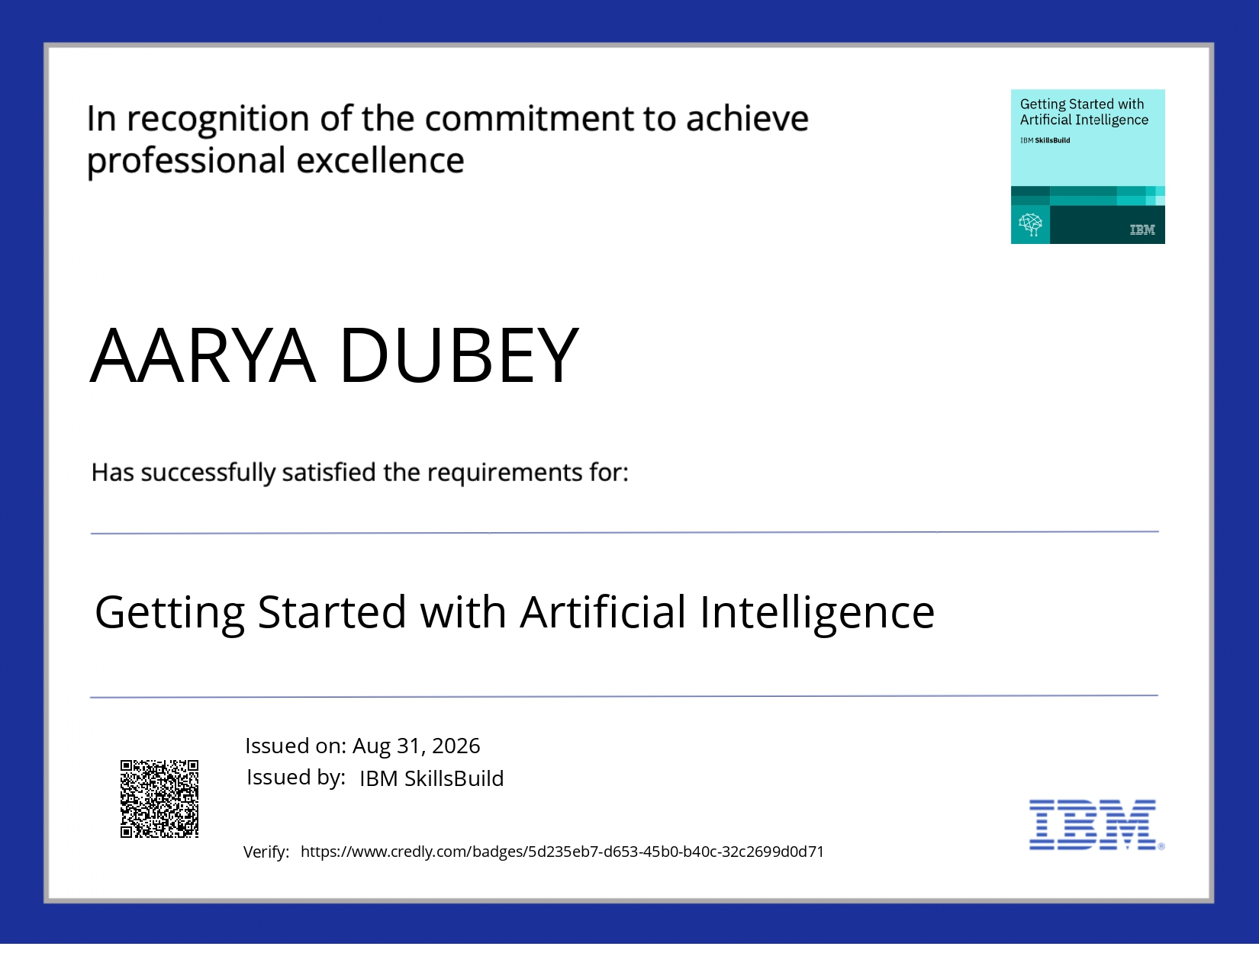
Certificates Earned:

Slide 36
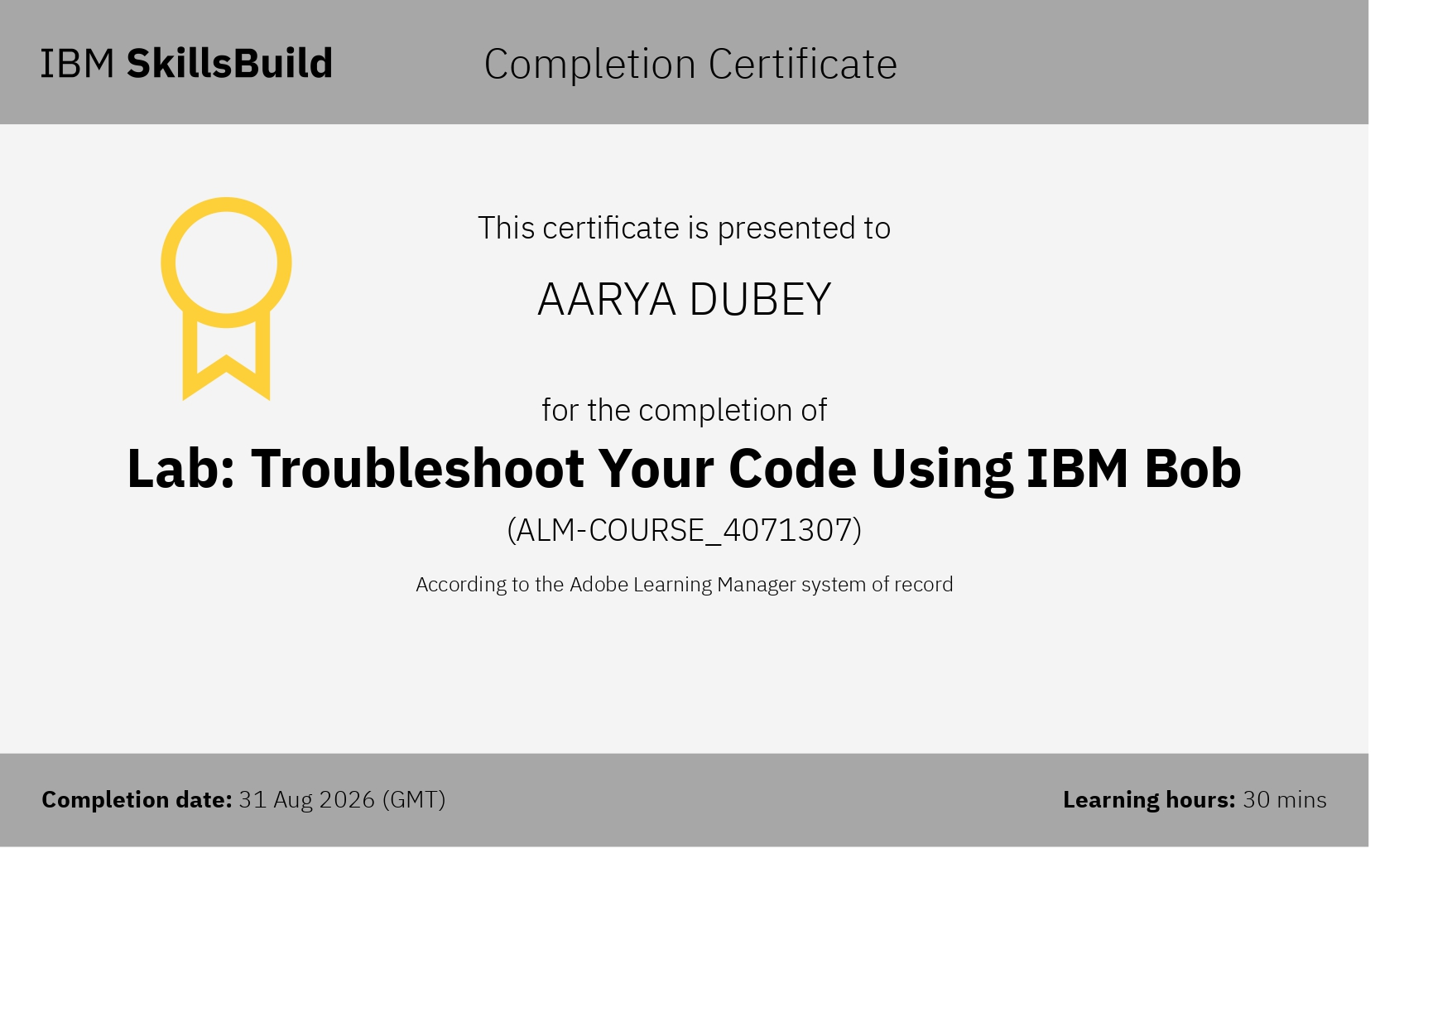
Certificates Earned:​

Slide 37


