Slide 1

EDUNET VOIS FOR TECH-TIRTC AICTE DATA ANALYTICS INTERNSHIP
Healthcare Analytics for Doctor Visits
DIY Project
AICTE STU ID : STU66a50c355f54d1722092597
Submitted by: Aarya Dubey

Slide 2

Problem Statement
Healthcare systems often struggle to understand what truly drives patient demand for medical consultations, making it difficult to allocate resources efficiently or identify at-risk populations before they become high-cost, high-utilization patients.
This project analyzes a healthcare survey dataset of 5,190 individuals to uncover the key demographic, socioeconomic, and health-related factors — such as chronic illness, self-rated health, income, and insurance coverage — that influence how frequently people visit a doctor.
With doctor visits heavily skewed toward zero (the majority of individuals report no visits in the reference period), traditional analysis approaches fail to capture the true patterns of healthcare utilization, leaving policymakers, insurers, and healthcare administrators without clear, data-driven insight into who needs care most and why.
This analysis aims to close that gap by identifying the strongest predictors of healthcare utilization and translating them into actionable recommendations for better resource planning, targeted care management, and more equitable healthcare access.

Slide 3
Project Description
This project is an end-to-end exploratory data analysis and predictive modeling study built on a healthcare survey dataset of 5,190 individuals. It examines the relationship between doctor visit frequency and a range of demographic, socioeconomic, and health-related variables, including age, gender, income, chronic illness status, self-rated health, and insurance/subsidy coverage.
The analysis follows a structured pipeline — starting with data cleaning and preprocessing (including deduplication and feature engineering), moving through in-depth exploratory analysis with statistical significance testing, and culminating in predictive modeling using Logistic Regression, Poisson Regression, and Random Forest classifiers to identify the strongest drivers of healthcare utilization. These findings reveal that most individuals visit a doctor rarely or not at all, while a small, identifiable subgroup — typically those with limiting chronic conditions or poor self-rated health — accounts for a disproportionate share of consultations.
Beyond the technical analysis, these insights are translated into actionable recommendations for healthcare providers, insurers, and policymakers. The deliverables include a fully documented Jupyter notebook, an executed version with all visualizations and outputs, and a standalone HTML report for easy sharing — making the project accessible to both technical and non-technical stakeholders.

Slide 4

WHO ARE THE END USERS?
🏛️ Healthcare Policy Makers — plan resource allocation based on utilization patterns
🏥 Hospital / Clinic Administrators — identify high-need patients for proactive care programs
💳 Health Insurance Providers — understand how coverage type affects visit frequency & cost
🔬 Public Health Researchers — study healthcare access and utilization drivers
🏢 Government Health Departments — design subsidy programs (e.g., free treatment schemes)
📊 Data Analysts / Data Scientists — reference case study for utilization/count-data modeling

Slide 5

Technology Used
Category | Tool / Technology | Purpose
Language | Python | Core programming language
Notebook Environment | Jupyter Notebook (.ipynb) | Interactive development & EDA
Data Handling | pandas, numpy | Data cleaning, transformation, computations
Visualization | matplotlib, seaborn | Charts, plots, dashboards
Statistics | scipy.stats | Significance tests (Mann-Whitney U, Kruskal-Wallis, Spearman)
Data Format | CSV | Raw source dataset
Output Format | HTML | Shareable report export

Slide 6
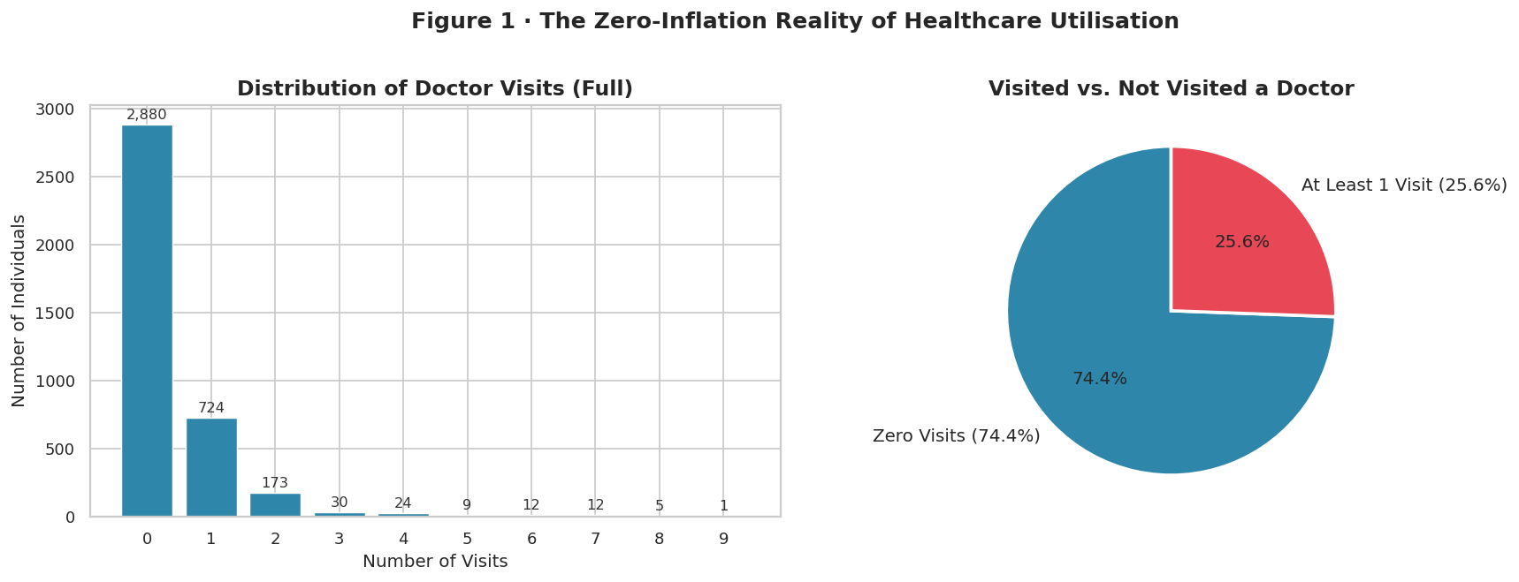
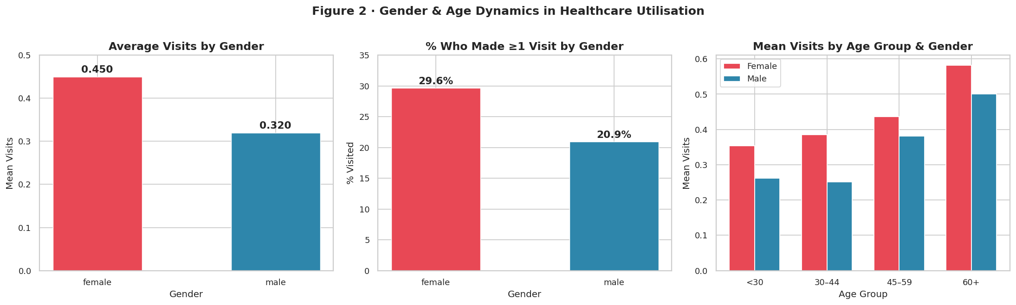
RESULTS
https://github.com/AaryaMZP/Healthcare_Analytics_Doctor_Visits.git

Slide 7
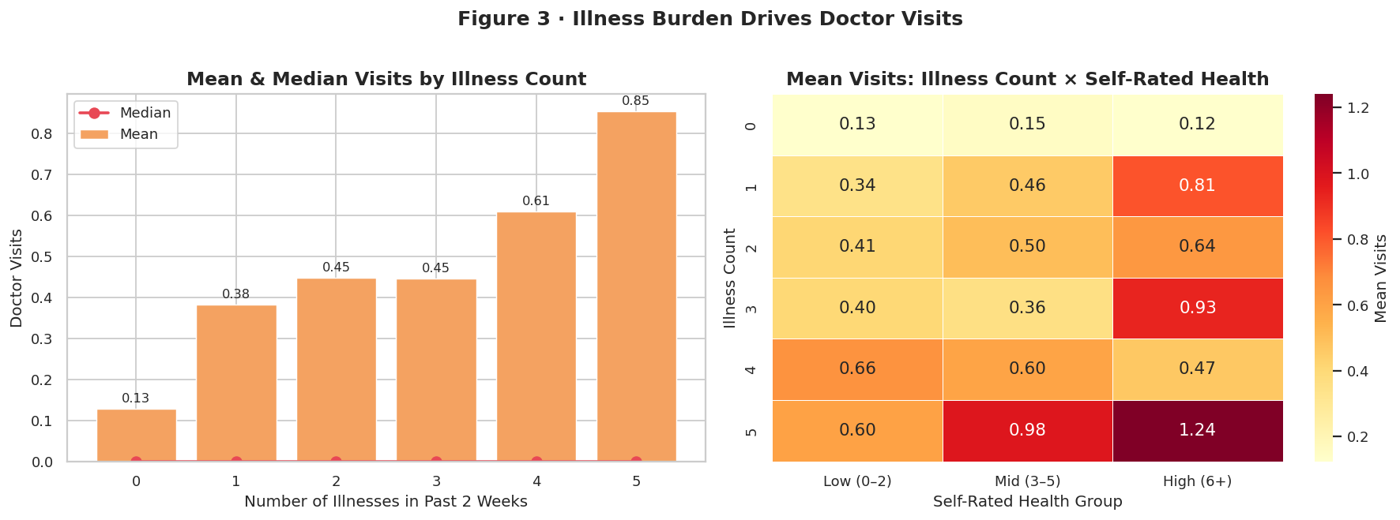
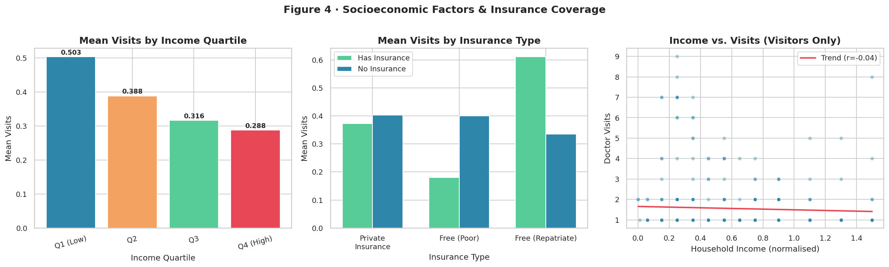
RESULTS
https://github.com/AaryaMZP/Healthcare_Analytics_Doctor_Visits.git

Slide 8
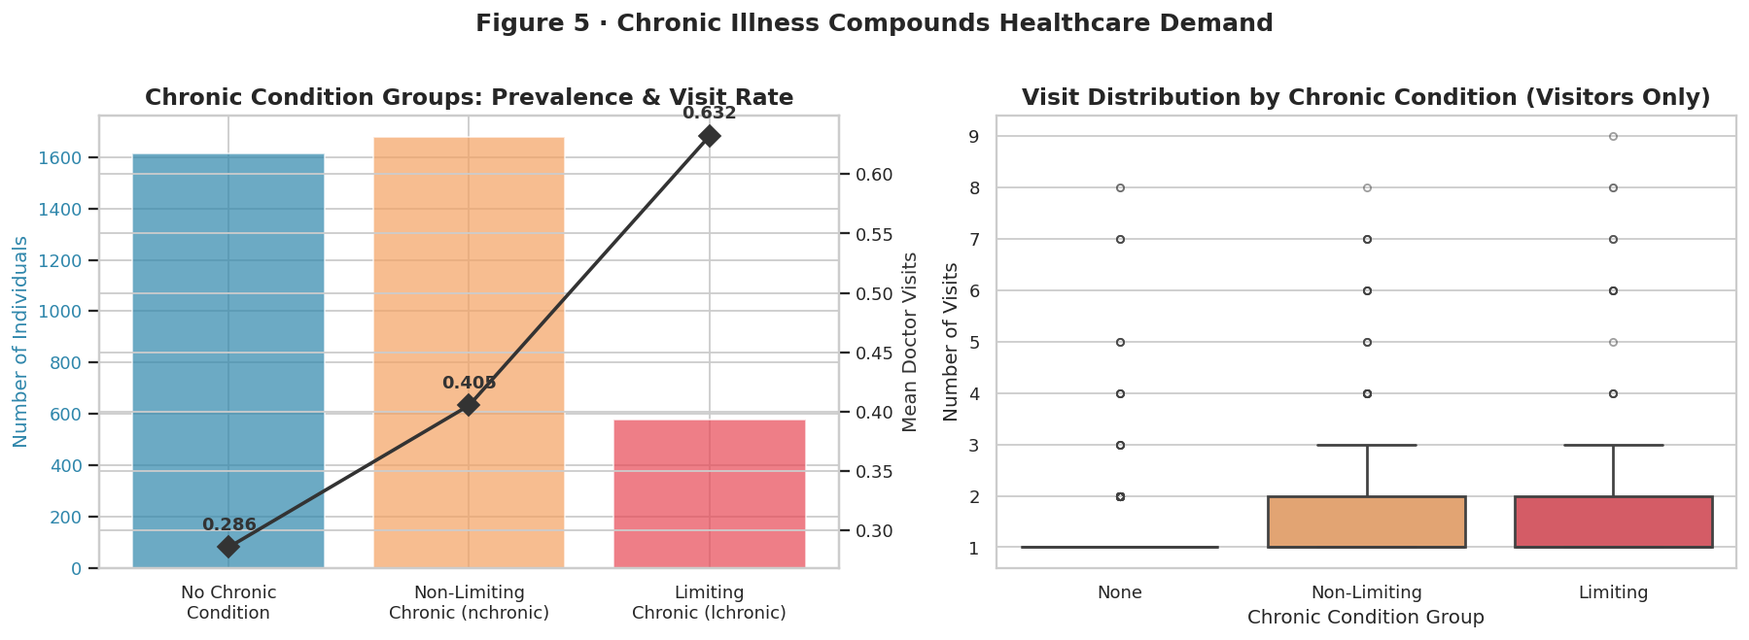
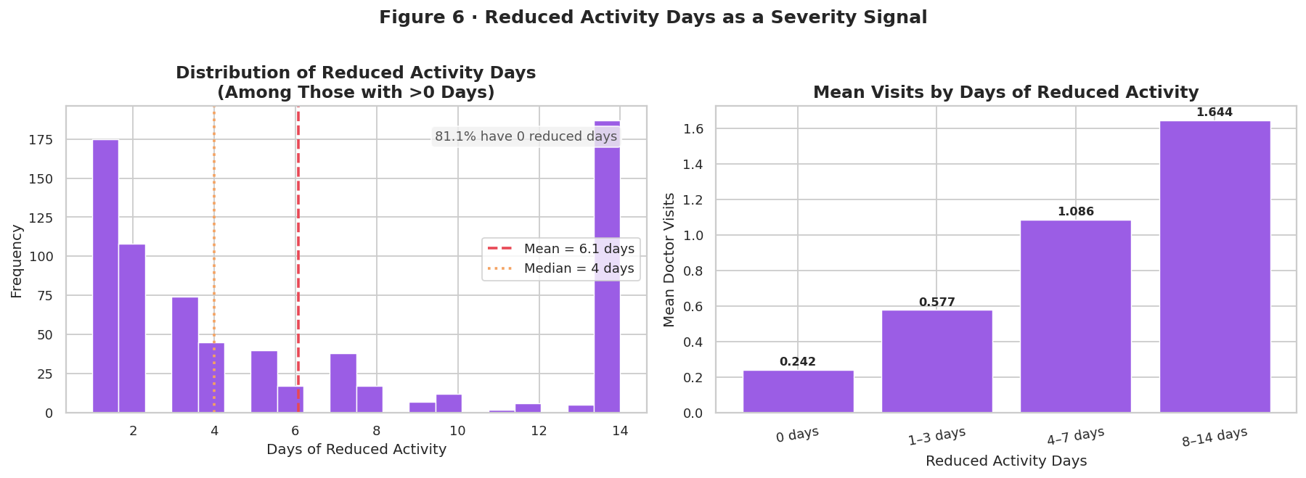
RESULTS
https://github.com/AaryaMZP/Healthcare_Analytics_Doctor_Visits.git

Slide 9
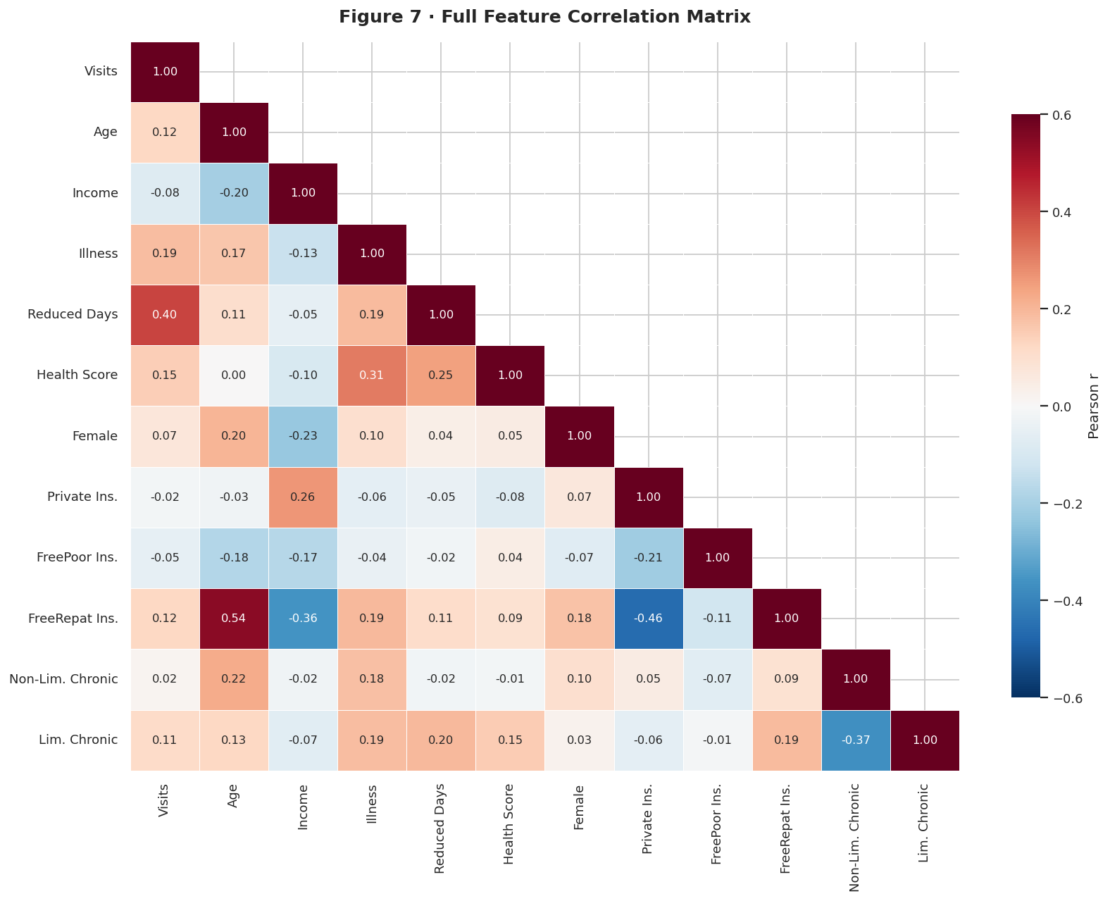
RESULTS
https://github.com/AaryaMZP/Healthcare_Analytics_Doctor_Visits.git

Slide 10
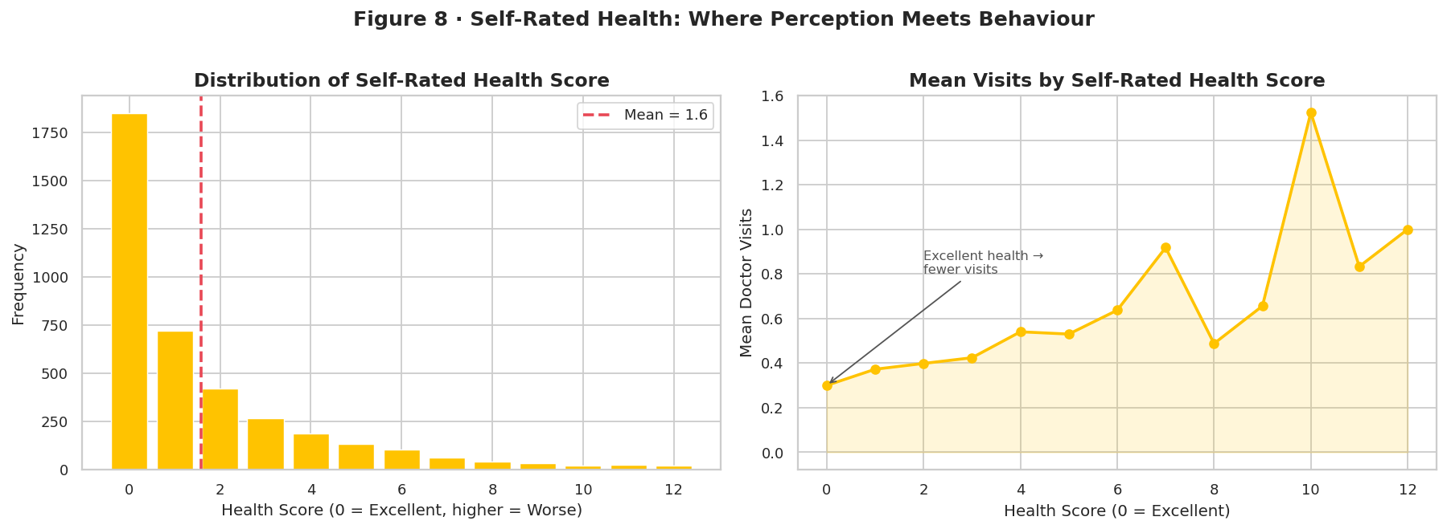
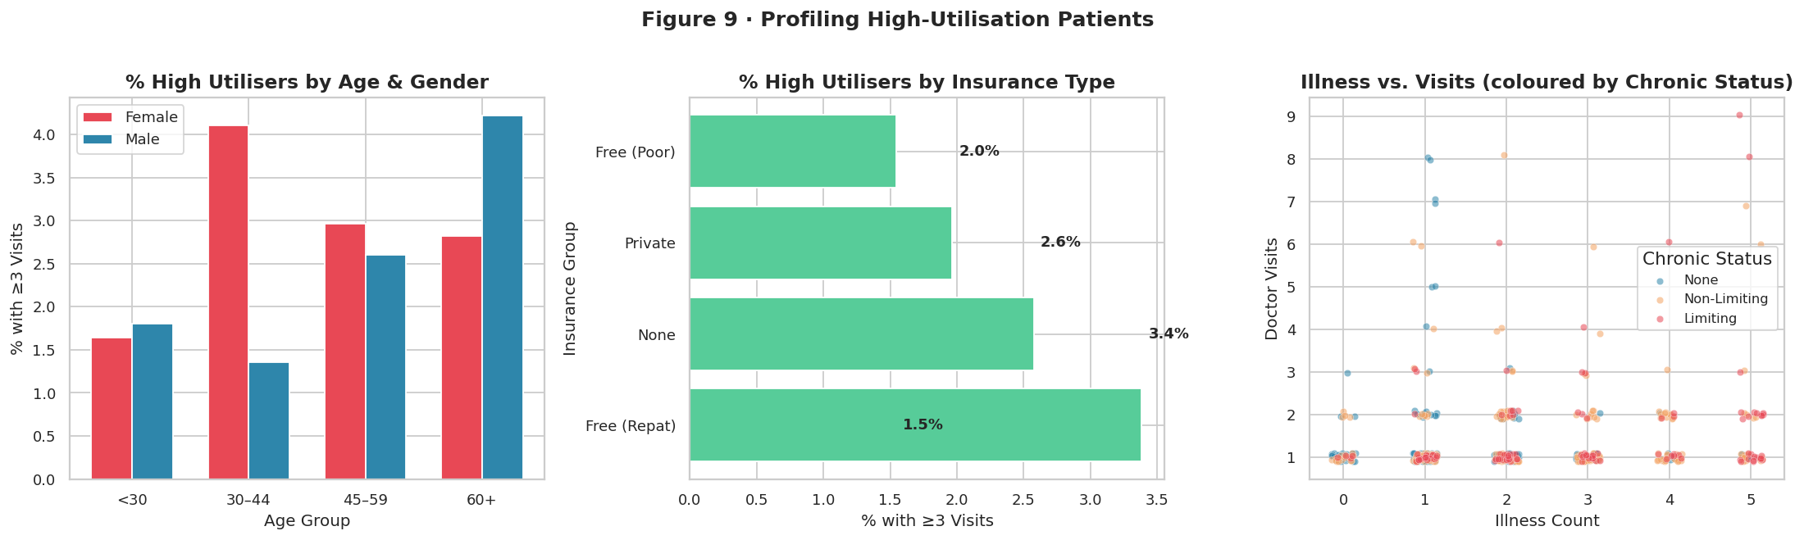
RESULTS
https://github.com/AaryaMZP/Healthcare_Analytics_Doctor_Visits.git

Slide 11
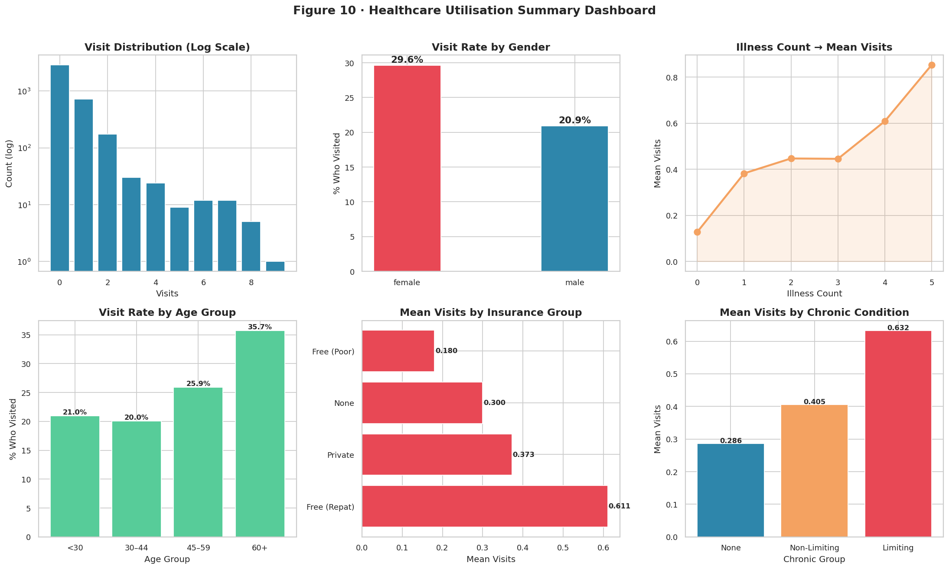
RESULTS
https://github.com/AaryaMZP/Healthcare_Analytics_Doctor_Visits.git

Slide 12
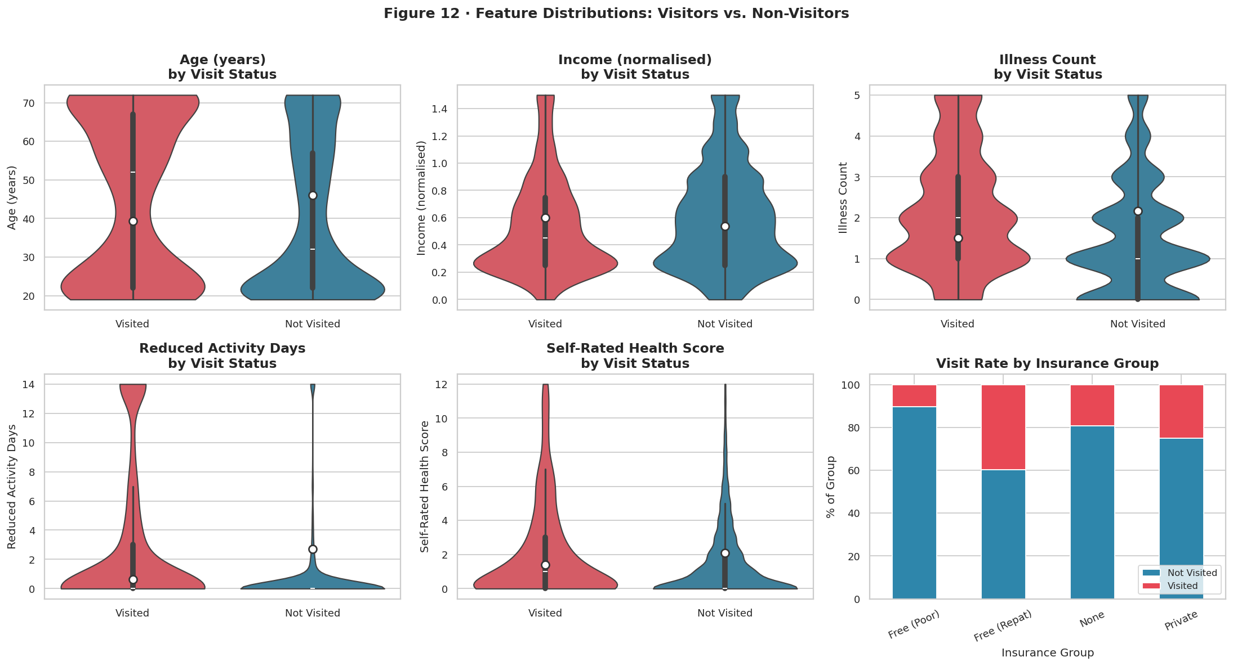
RESULTS
https://github.com/AaryaMZP/Healthcare_Analytics_Doctor_Visits.git

Slide 13
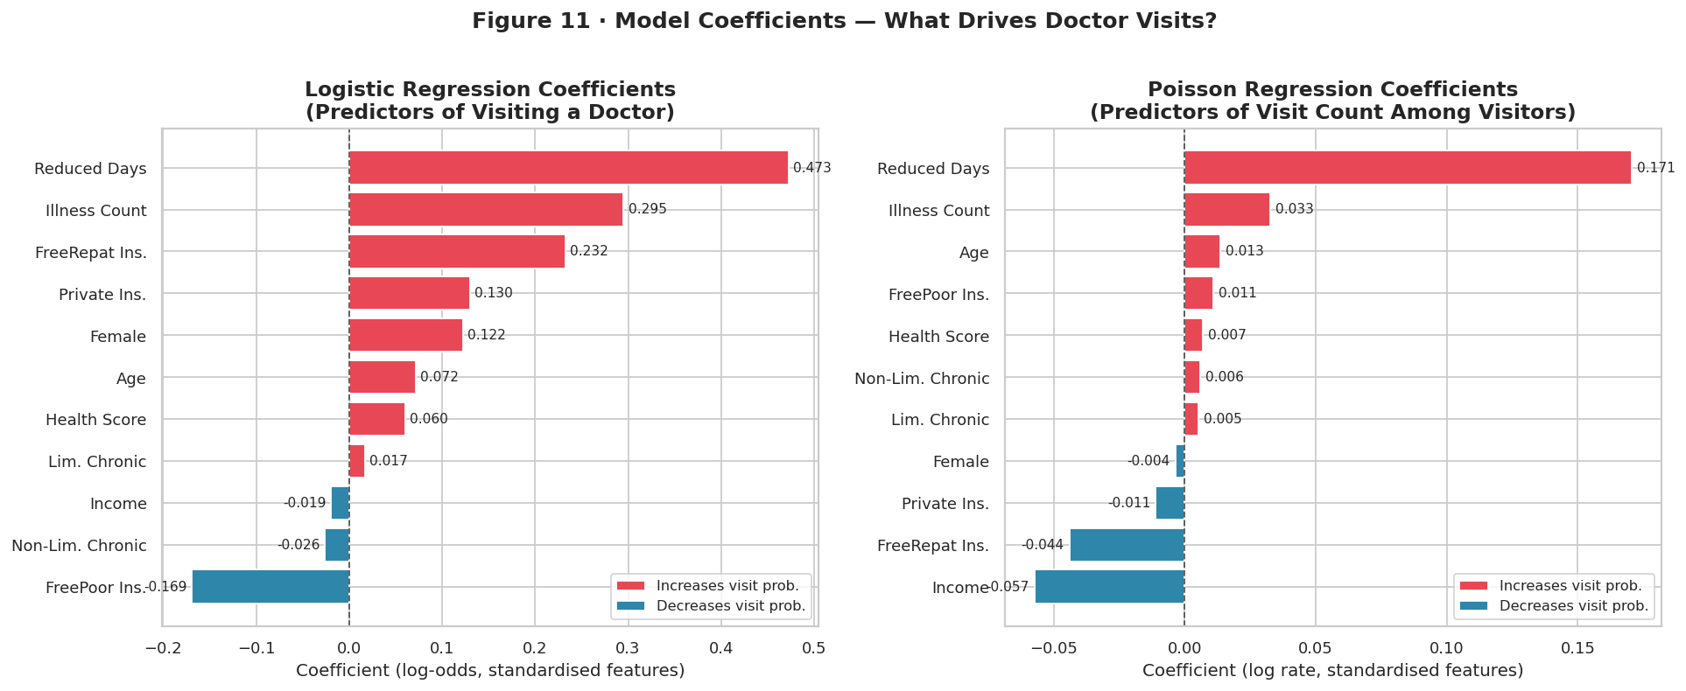
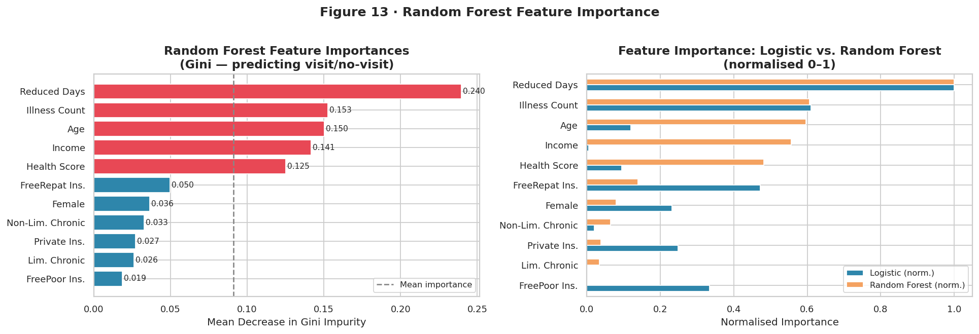
RESULTS
https://github.com/AaryaMZP/Healthcare_Analytics_Doctor_Visits.git

Slide 14
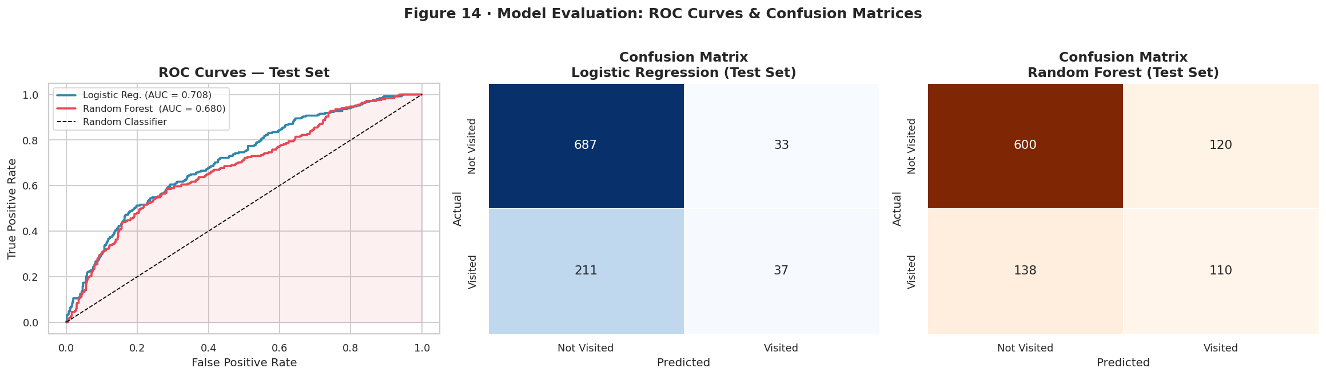
RESULTS
https://github.com/AaryaMZP/Healthcare_Analytics_Doctor_Visits.git

Slide 15
Thank you
.
.

