Slide 1

Internship Project Report VOIS for Tech Program — Data Analytics Seasonal Agriculture Performance Analysis
Student Name:-Aarya Dubey
College Name- Dr. Hari Singh Gour Vishwavidyalaya
AICTE STU ID : STU66a50c355f54d1722092597

Slide 2

Problem Statement
Agricultural performance shifts across seasons — driven by changing rainfall, temperature, resource availability, and market conditions — but raw farm data alone doesn't reveal how or why. This project analyzes seasonal agricultural data across Kharif, Rabi, and Zaid to uncover meaningful patterns, trends, and relationships in farm performance, turning scattered records into actionable, season-wise insight.
Why it matters:
Understand how performance and environmental conditions vary by season
Compare yield, cost, revenue & resource usage across periods
Identify unusual patterns needing further investigation
Support evidence-based, season-aware agricultural planning

Slide 3
Project Description
This project analyzes a seasonal agriculture dataset of 4,000 farm records spanning three cropping seasons — Kharif, Rabi, and Zaid — across 8 Indian states and 8 crop types (Wheat, Rice, Maize, Cotton, Pulses, Chilli, Groundnut, Sugarcane).
The analysis follows a structured Data Analytics workflow:
Data cleaning — handled missing values (Rainfall, Soil Moisture, Yield) using median imputation, checked for duplicates
Exploratory Data Analysis — univariate, bivariate, and multivariate visualizations of yield, profit, environmental, and resource-usage variables
Comparative analysis — across Season, Crop, State, and Irrigation Method to identify which combinations perform best and worst
The goal was to move beyond raw numbers and uncover evidence-based seasonal patterns that can support agricultural planning decisions.

Slide 4

Who Are The End Users?
🌾 Farmers & Agricultural Planners
Decide which crops and irrigation methods suit each season.
Reduce guesswork and plan sowing/harvesting around known seasonal risk.
🏛️ Policy Makers & Government Bodies
Plan resource allocation and subsidies using evidence, not assumption.
Target support toward seasons and regions that need it most.
📦 Agri-Business & Supply Chain Companies
Forecast production and procurement volumes ahead of each season.
Align sourcing and storage capacity with expected seasonal output.
📊 Researchers & Data Analysts
Use seasonal patterns as a benchmark for further agricultural studies.
Build on these findings to explore causal or predictive models.
🏦 Banks & Crop Insurers
Assess and price seasonal risk more accurately, especially in Zaid.
Design loan and insurance terms that reflect real seasonal loss patterns.

Slide 5

🛠️ Technology Used
Technology | Purpose
Python | Primary programming language for data analysis
Pandas | Data loading, cleaning, manipulation, and statistical analysis
NumPy | Numerical operations and data calculations
Matplotlib | Creating charts and visualizing data
Seaborn | Statistical visualization, relationship, and distribution analysis
💻 Tools & Environment
Google Colab — Cloud-based environment used for developing and executing the analysis.
Jupyter Notebook (.ipynb) — Notebook format used to organize and present the analysis, code, and visualizations.

Slide 6
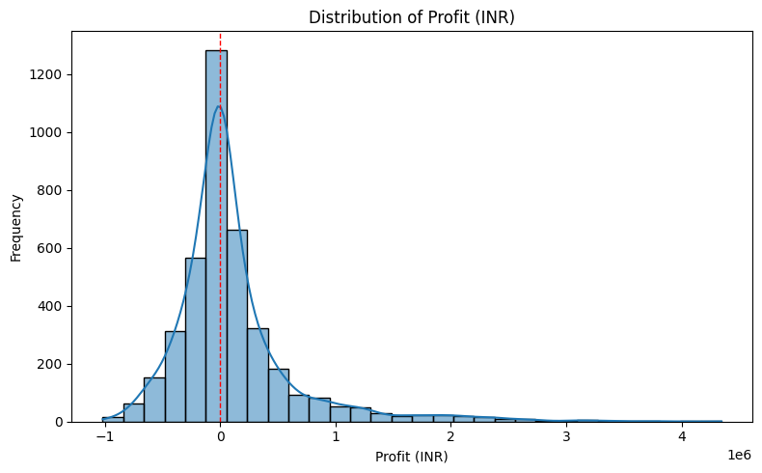
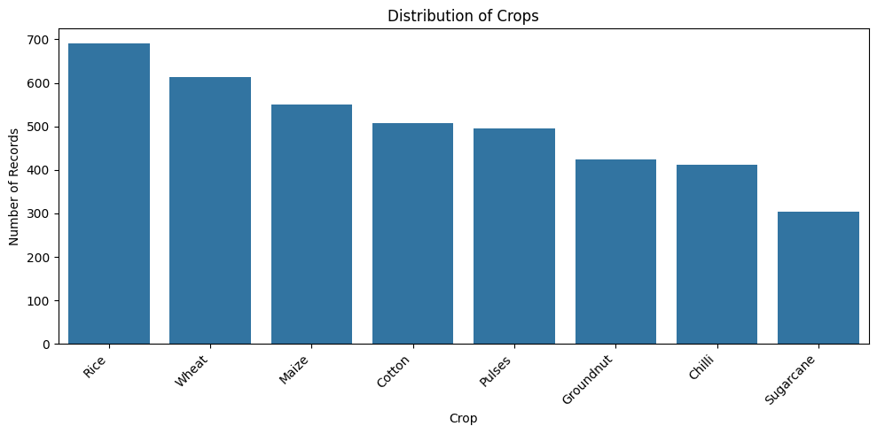
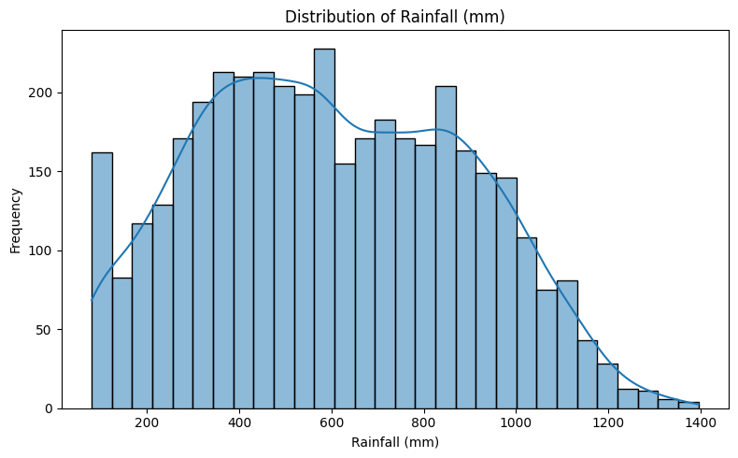
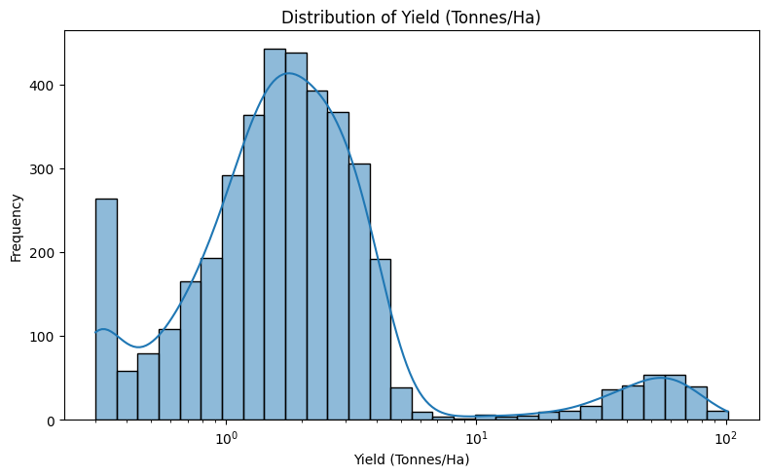
RESULTS

Slide 7
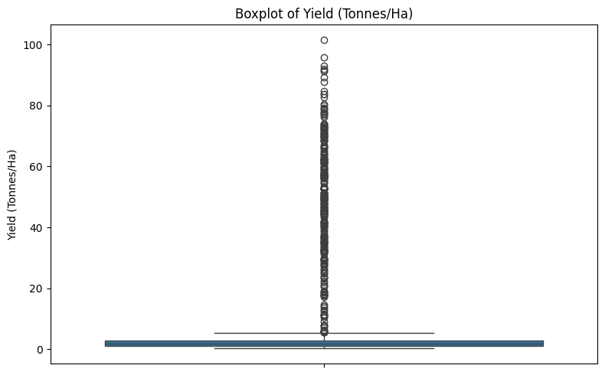
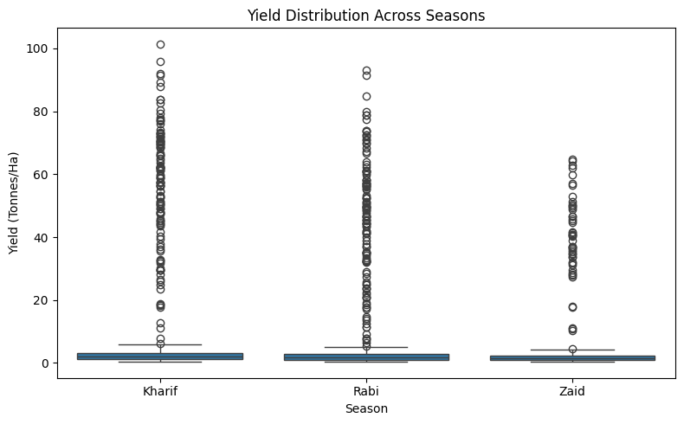
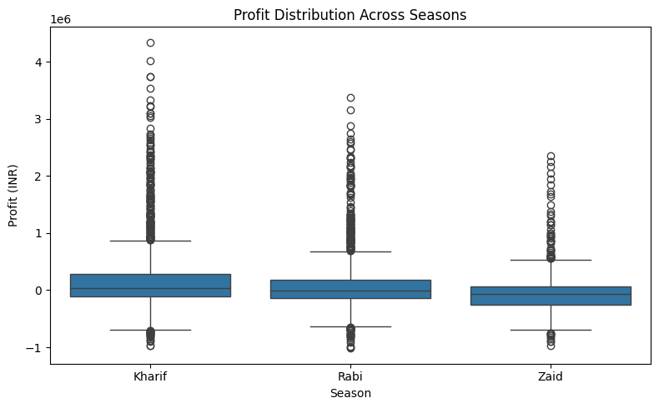
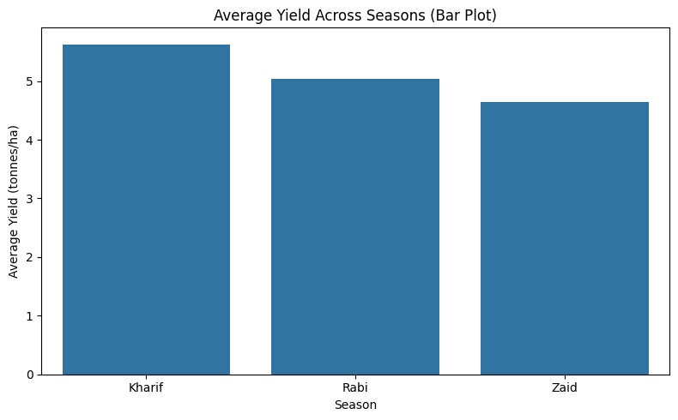
RESULTS

Slide 8
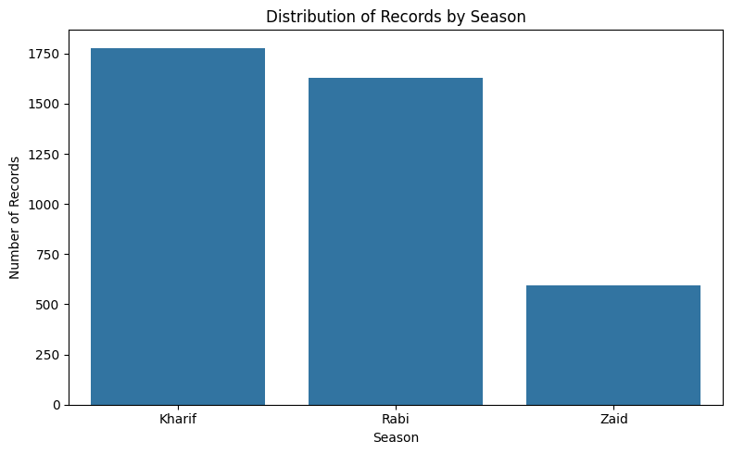
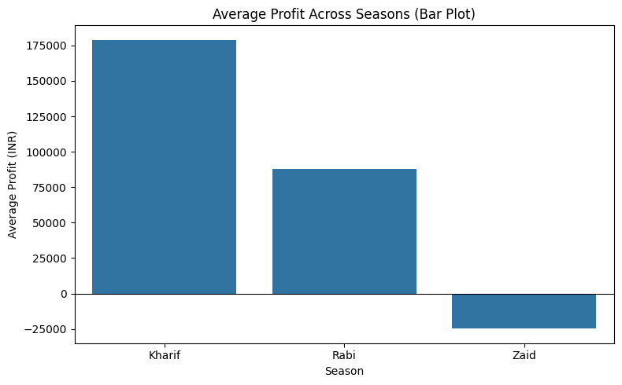
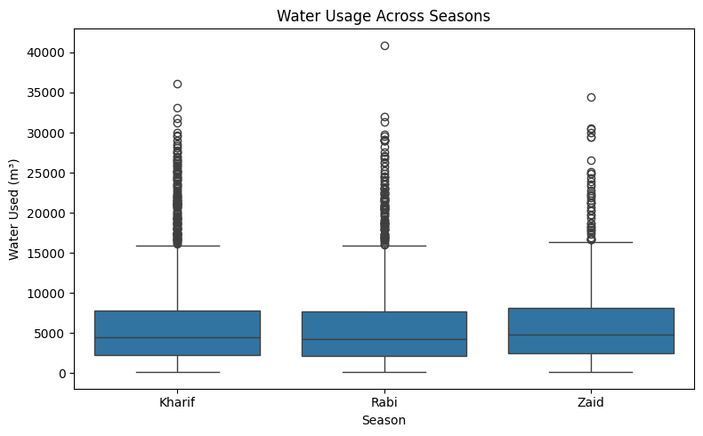
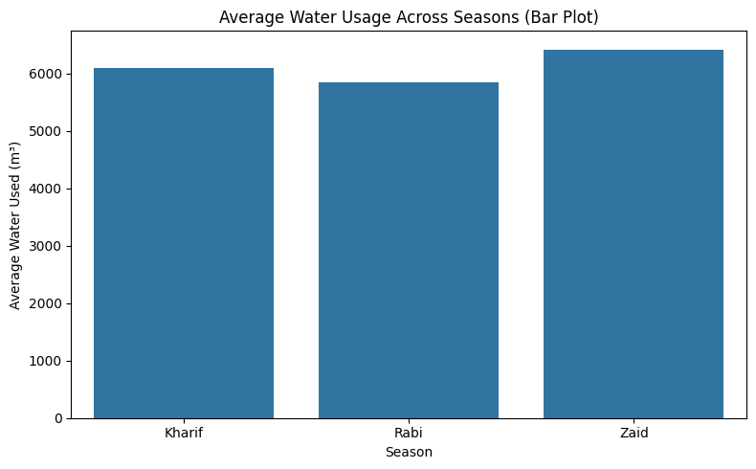
RESULTS

Slide 9
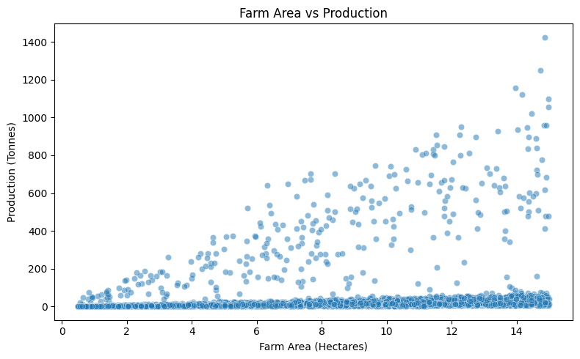
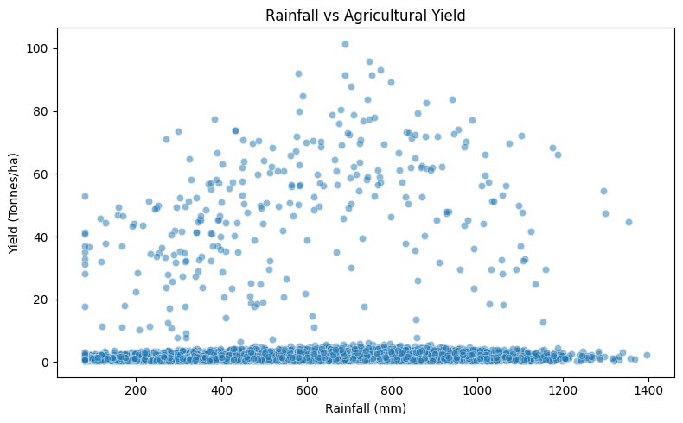
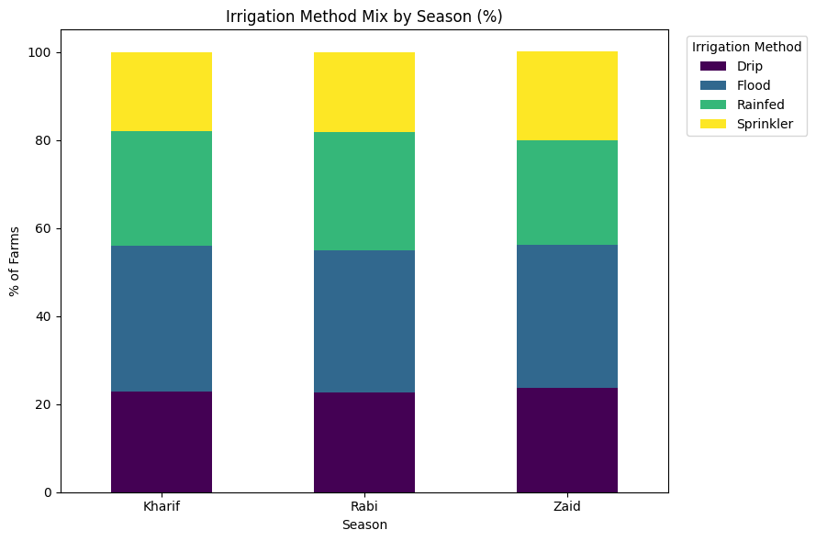
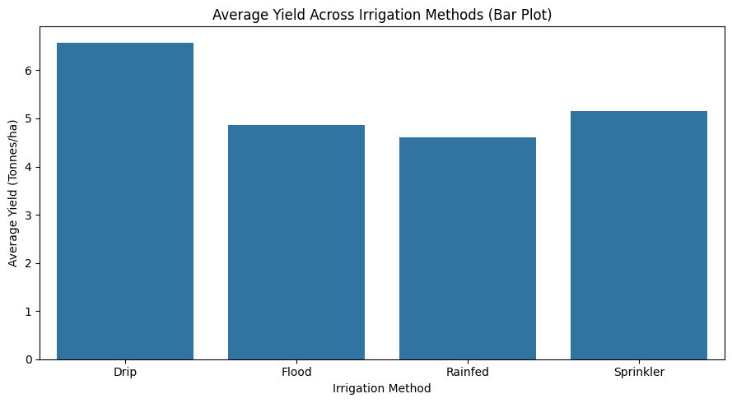
RESULTS

Slide 10
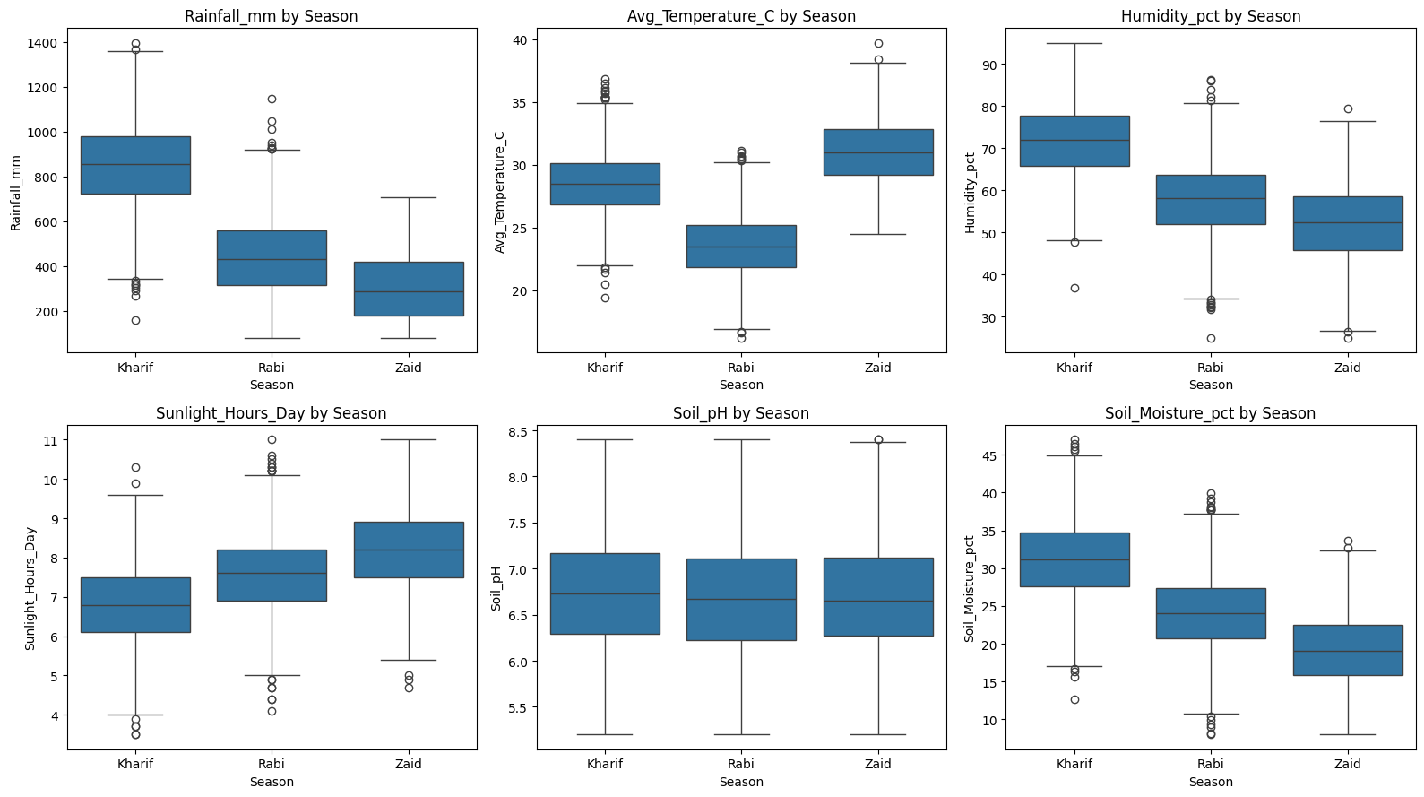
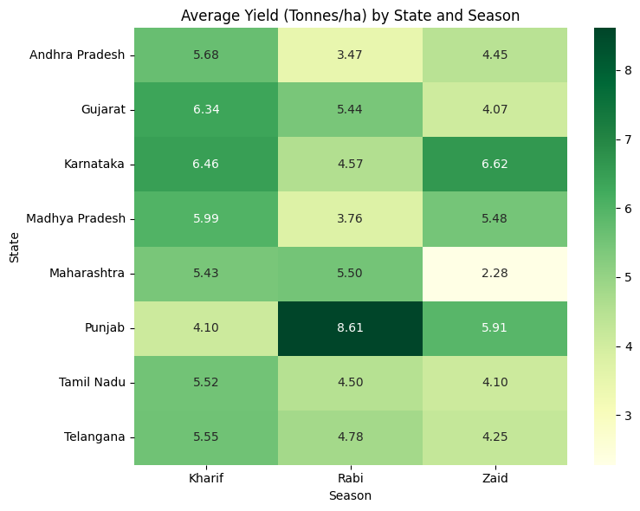
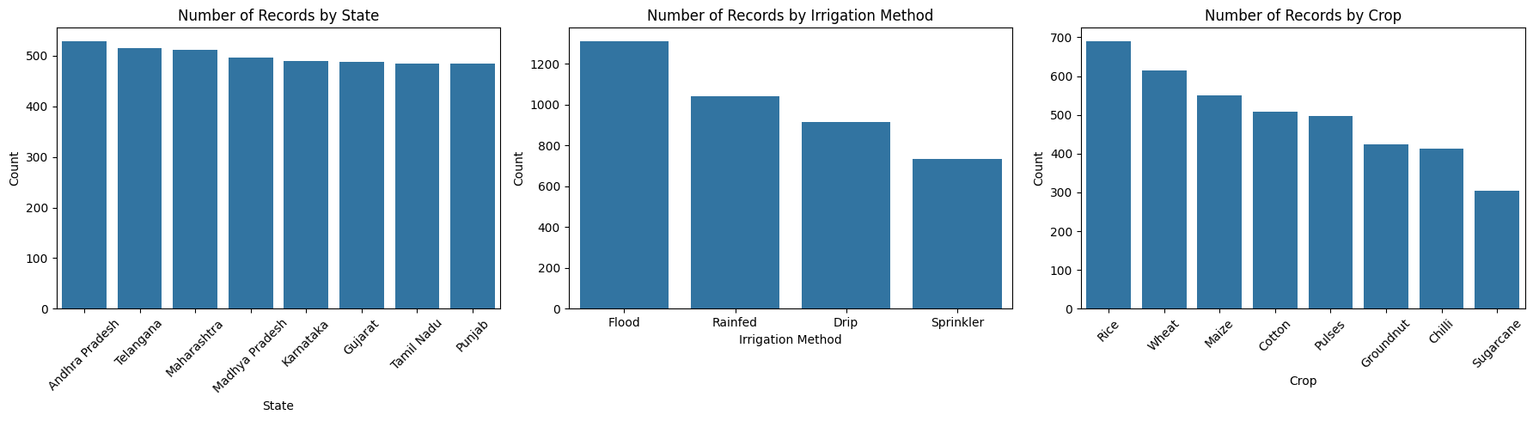
RESULTS

Slide 11
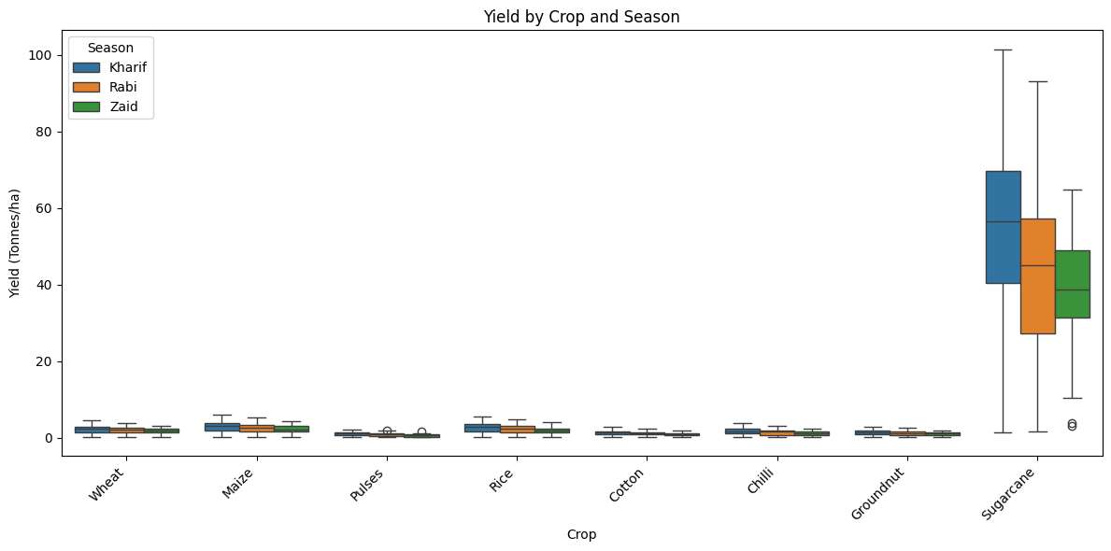
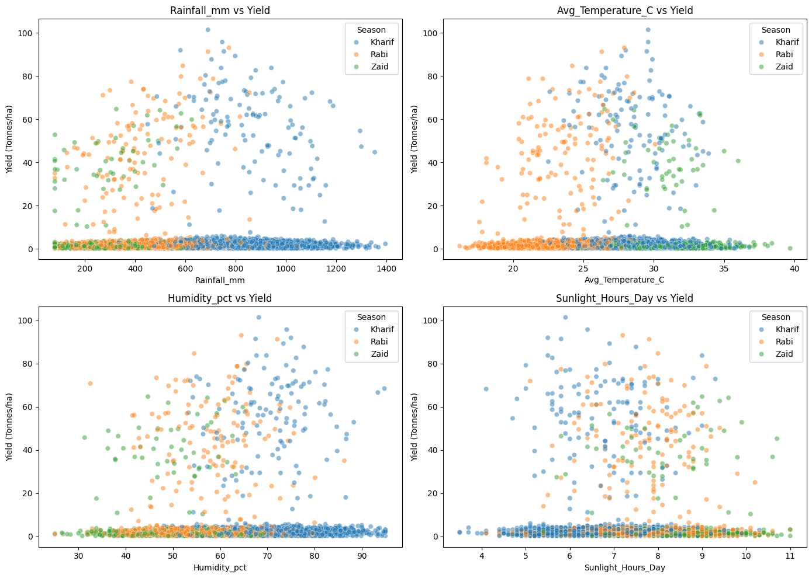
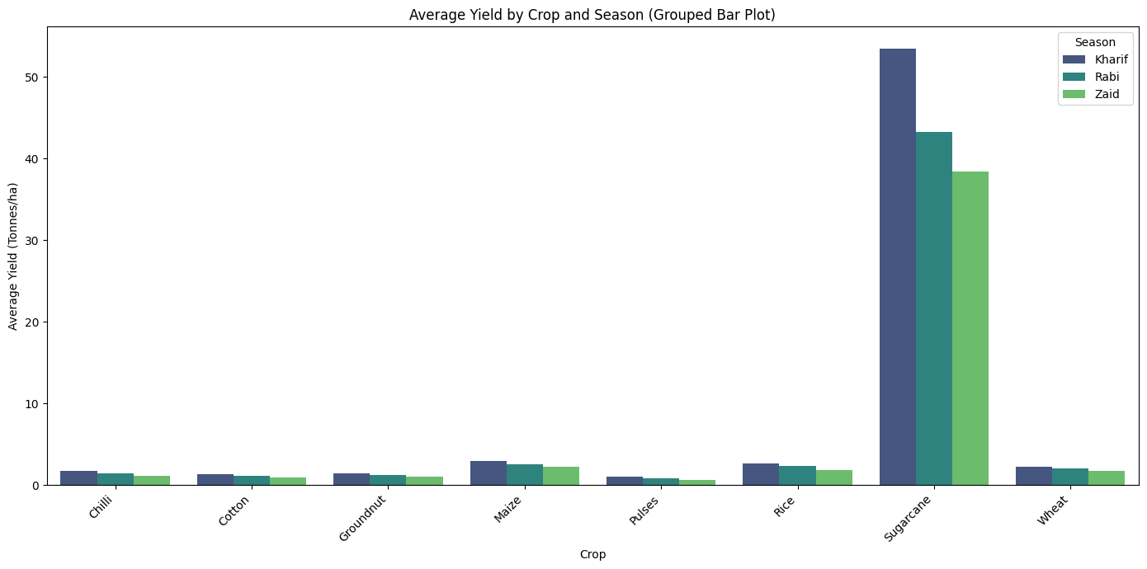
RESULTS

Slide 12
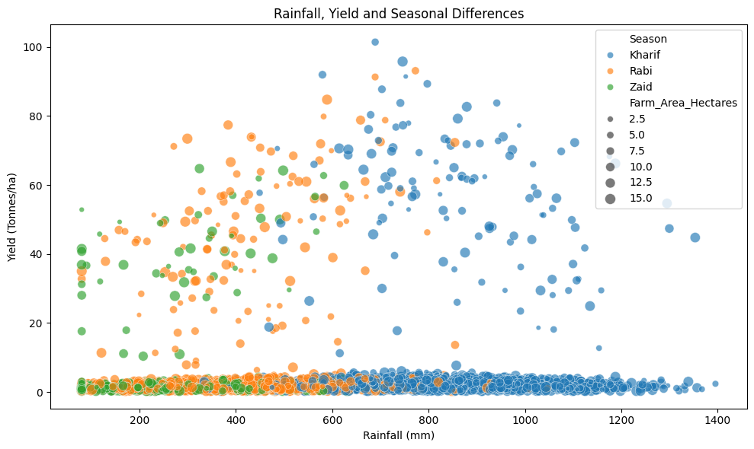
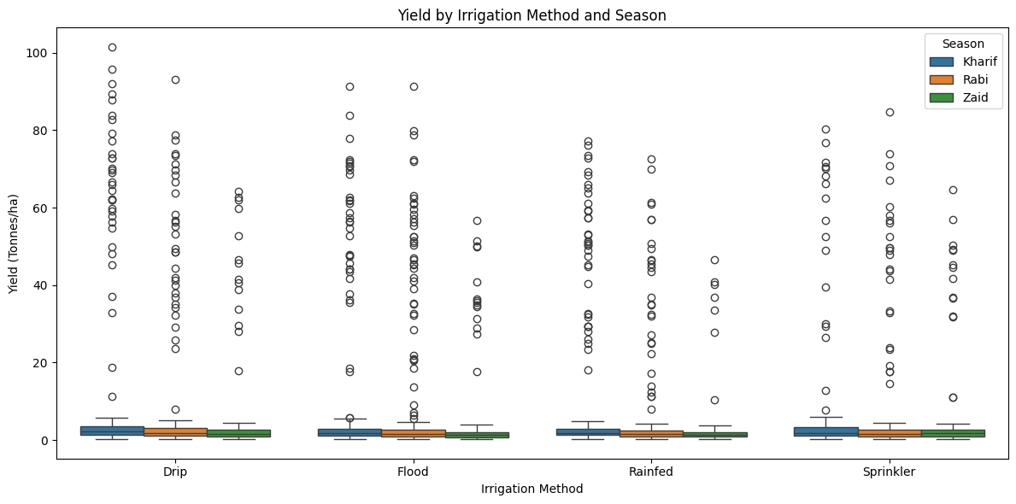
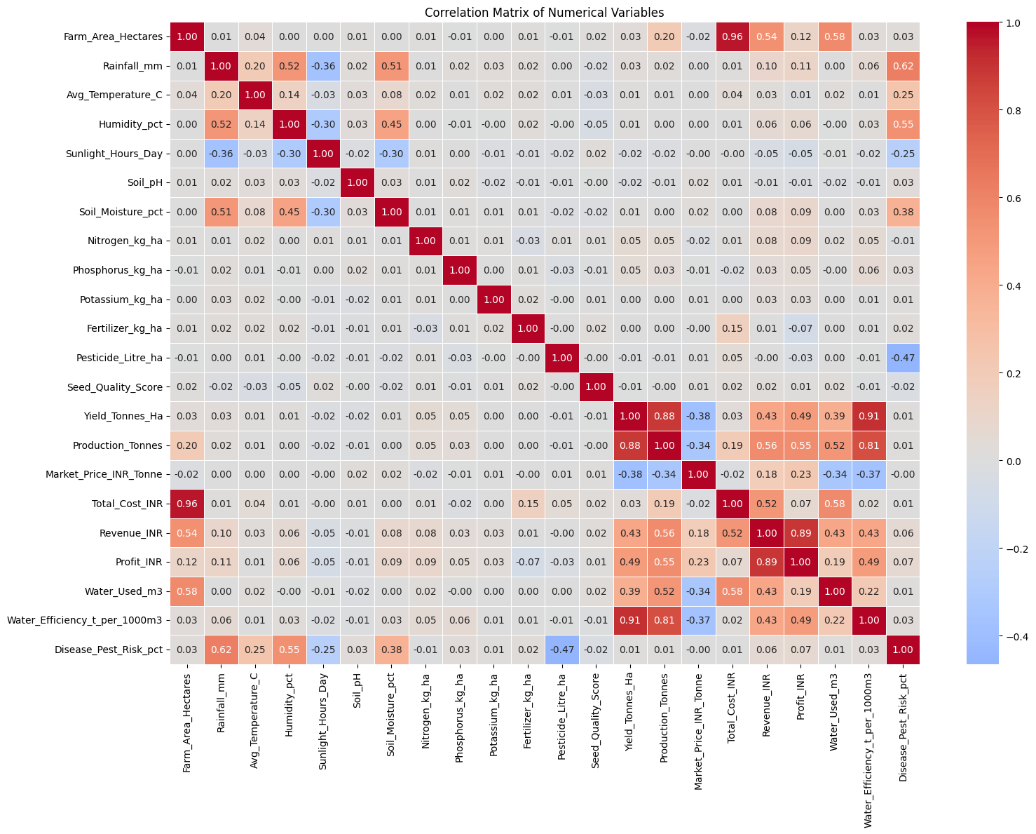
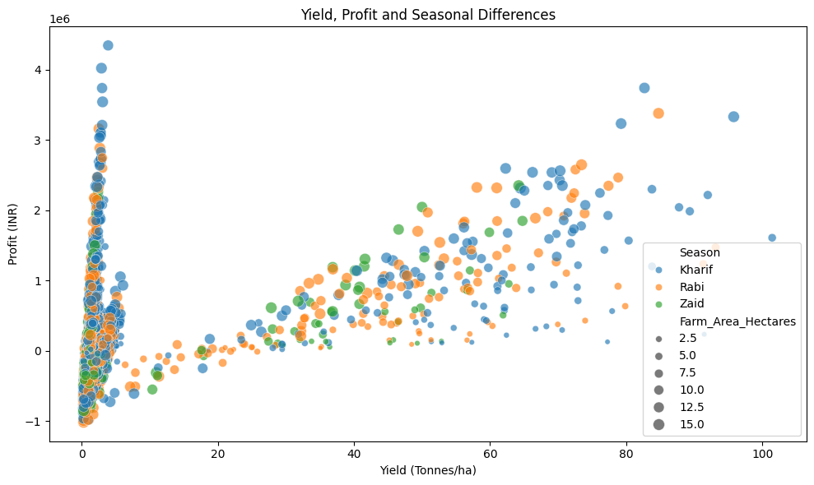
RESULTS

Slide 13
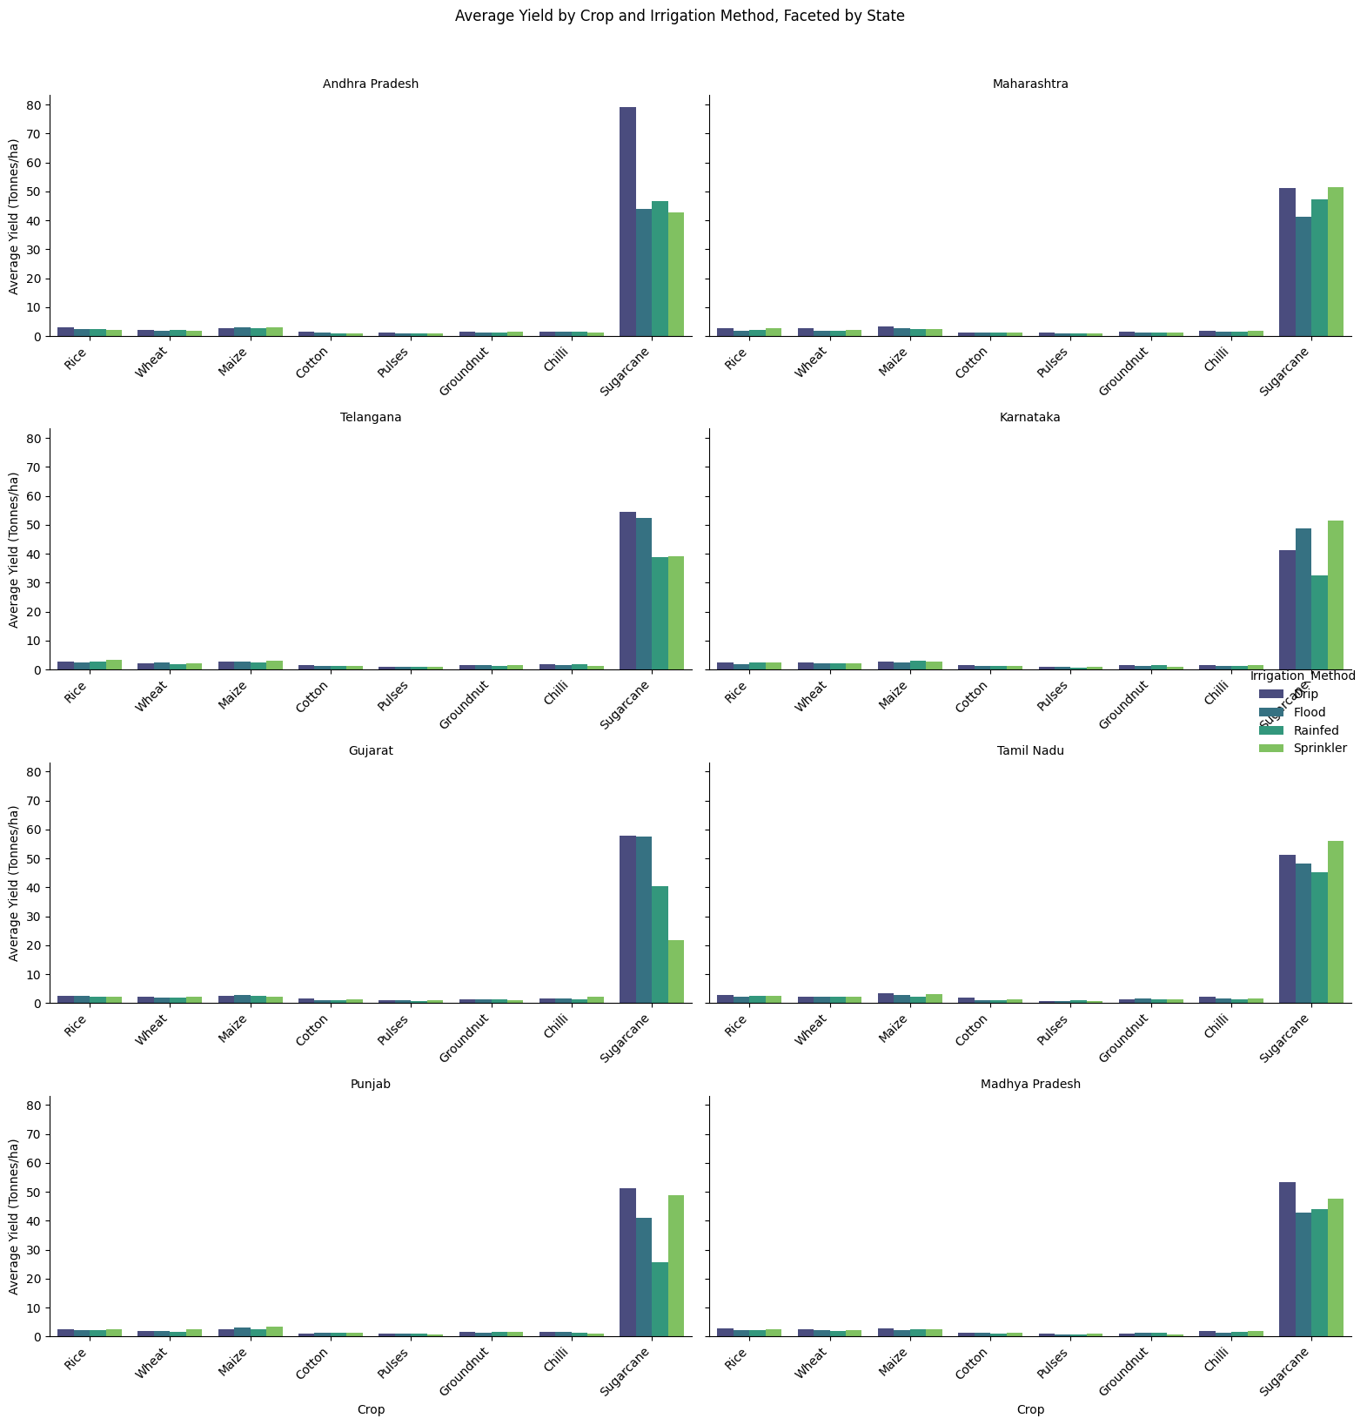
RESULTS

Slide 14
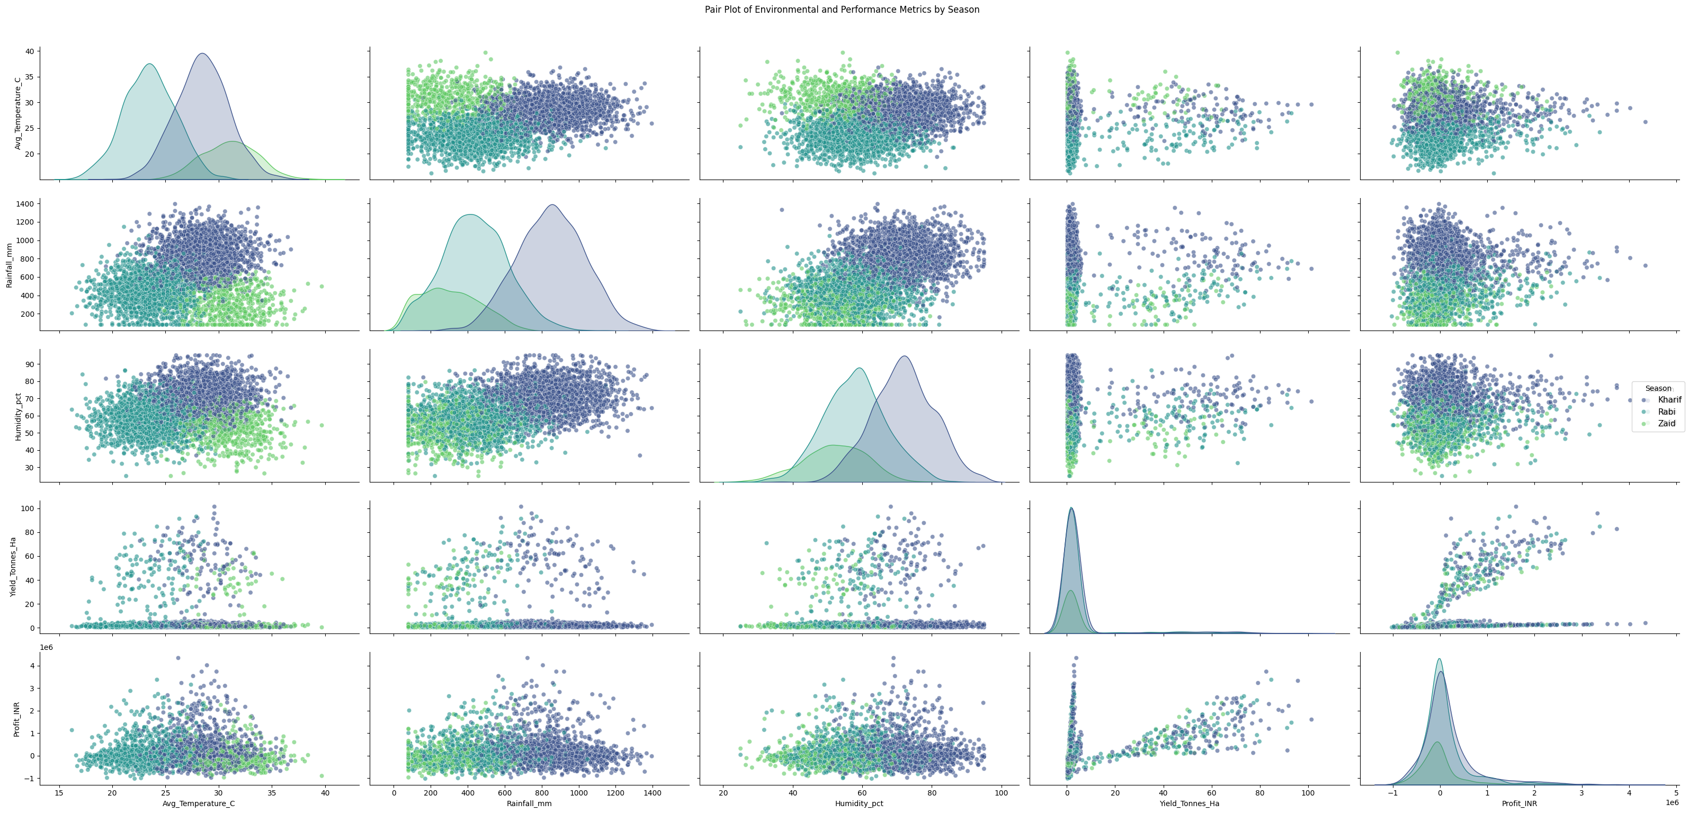
RESULTS

Slide 15
Future Scope
🤖 Predictive Modeling Build a model (e.g., Random Forest/XGBoost) to estimate yield or profit from environmental and resource-usage inputs. This would move the project from descriptive analysis to forward-looking prediction.
📅 Multi-Year Data Extension Extend the dataset across multiple years to separate true seasonal effects from single-year weather anomalies. This confirms whether the patterns found here hold consistently over time.
💰 Cost-Optimization Module Add a module recommending the best irrigation method and crop choice per state and season. This turns the analysis into a practical planning tool, not just a report.
📈 Interactive Dashboard Deploy a live dashboard (e.g., Power BI/Streamlit) for real-time seasonal performance monitoring. This makes the insights accessible to non-technical stakeholders on demand.
🌾 Market Price Forecasting Incorporate price forecasting to address the "high yield, low profit" cases found in Zaid. This targets the root cause of loss-making farms despite strong production.

Slide 16
GitHub Link
https://github.com/AaryaMZP/Seasonal_Agriculture_Performance_Analysis.git

Slide 17

VOIS Course Completion Certificate - Course Name- Data Visualization

Slide 18
Thank you
.
.

