Slide 1

TerraTeach
Helping students master map work for their geography exams

Slide 2
Map work is where students get stuck
Map questions carry easy marks in geography exams, but students struggled to practise them well.
1
2
3
Hard to reach the teacher
In online classes, students couldn't easily show their map to a teacher or ask if it was right.
No clear right answer
Atlases and textbooks draw rivers differently, so students never knew exactly what the examiner expects.
Practising alone
Students had no way to check their own map, so mistakes only showed up in the exam.

Slide 3
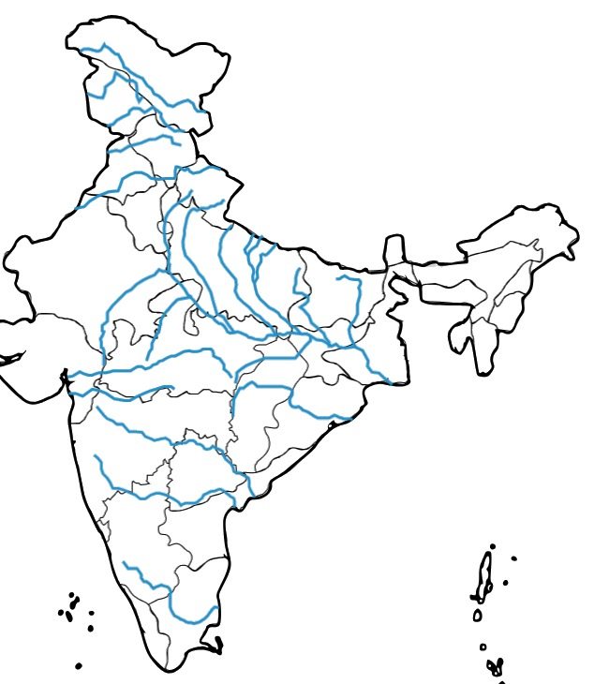
One place to learn, practise and get feedback
TerraTeach turns a blank map of India into a classroom that students can use from home.
1
Learn from answer maps
Every river is traced exactly as the exam expects it
2
Practise and check
Draw on a blank map, then compare with the right answer
3
Ask the teacher
Send your map in and get feedback, even online

Slide 4
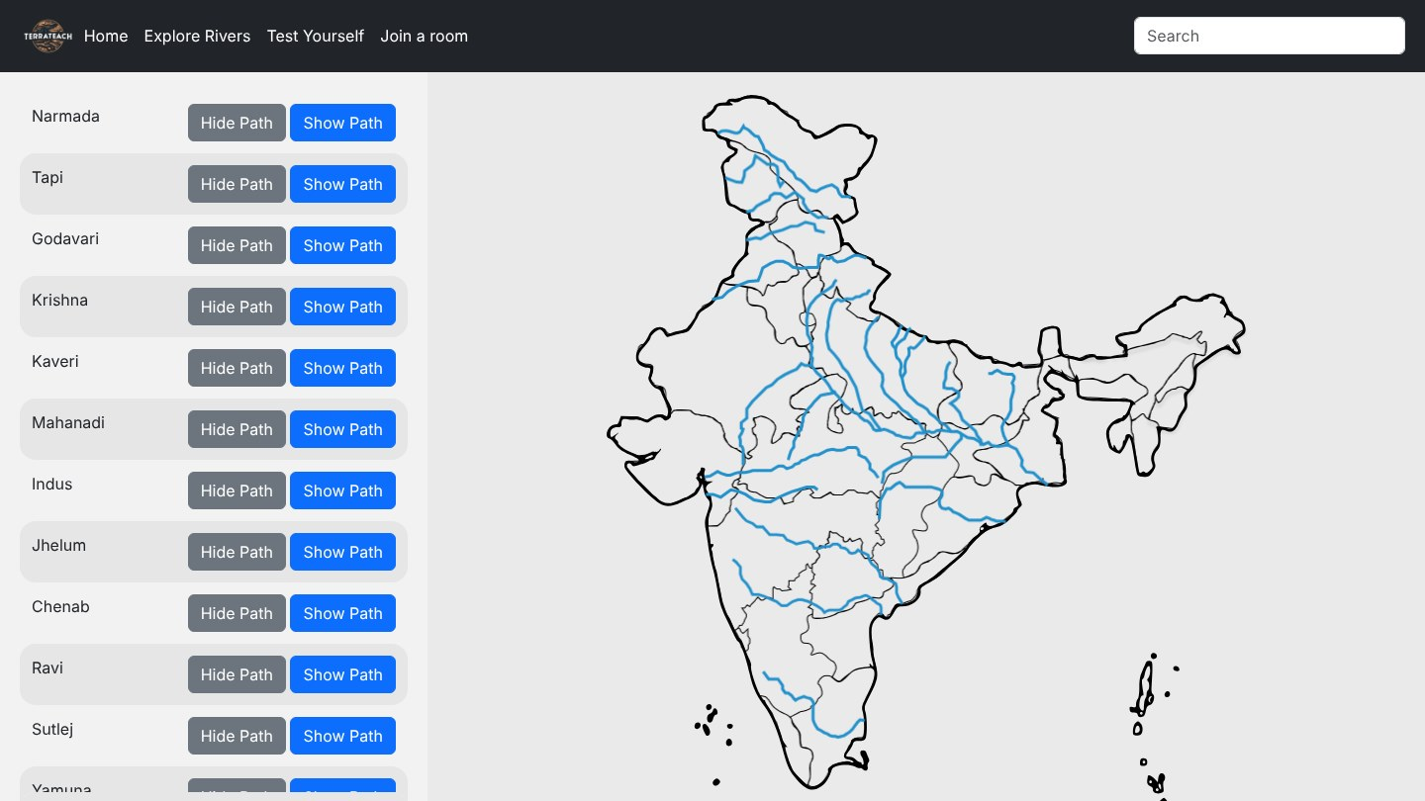
Every river, traced the way the exam expects
20
major rivers, from the Indus to the Kaveri
We carefully traced each river to match the answer students are expected to draw in the exam.
Show one river at a time, or all of them together.
Add the state boundaries to see which states each river flows through.

Slide 5
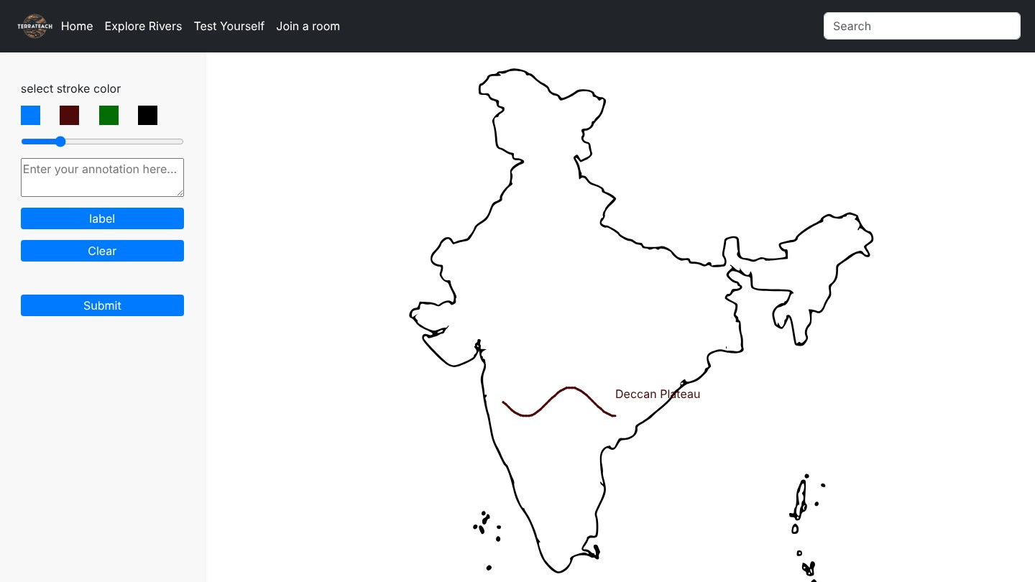
Practise on a blank map, just like the exam
1
Draw the rivers
Pick a colour, such as blue for water, and trace the river onto the map
2
Name what you draw
Add labels, just as the exam asks
3
Start again any time
Clear the map and try once more

Slide 6
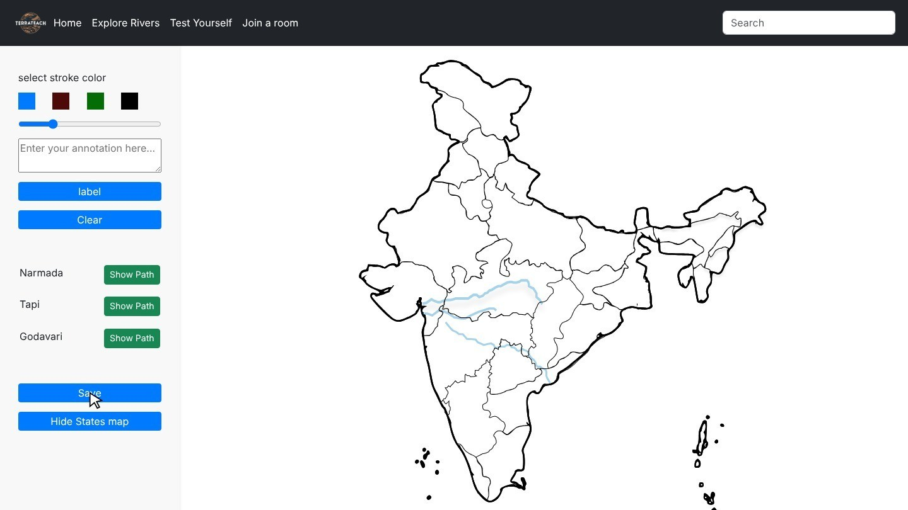
Students check their own answer straight away
1
Follow the guide
Faint outlines of the correct river path to trace over
2
See the states
State boundaries show which states each river flows through
3
Save for revision
Keep the finished map to revise before the exam

Slide 7
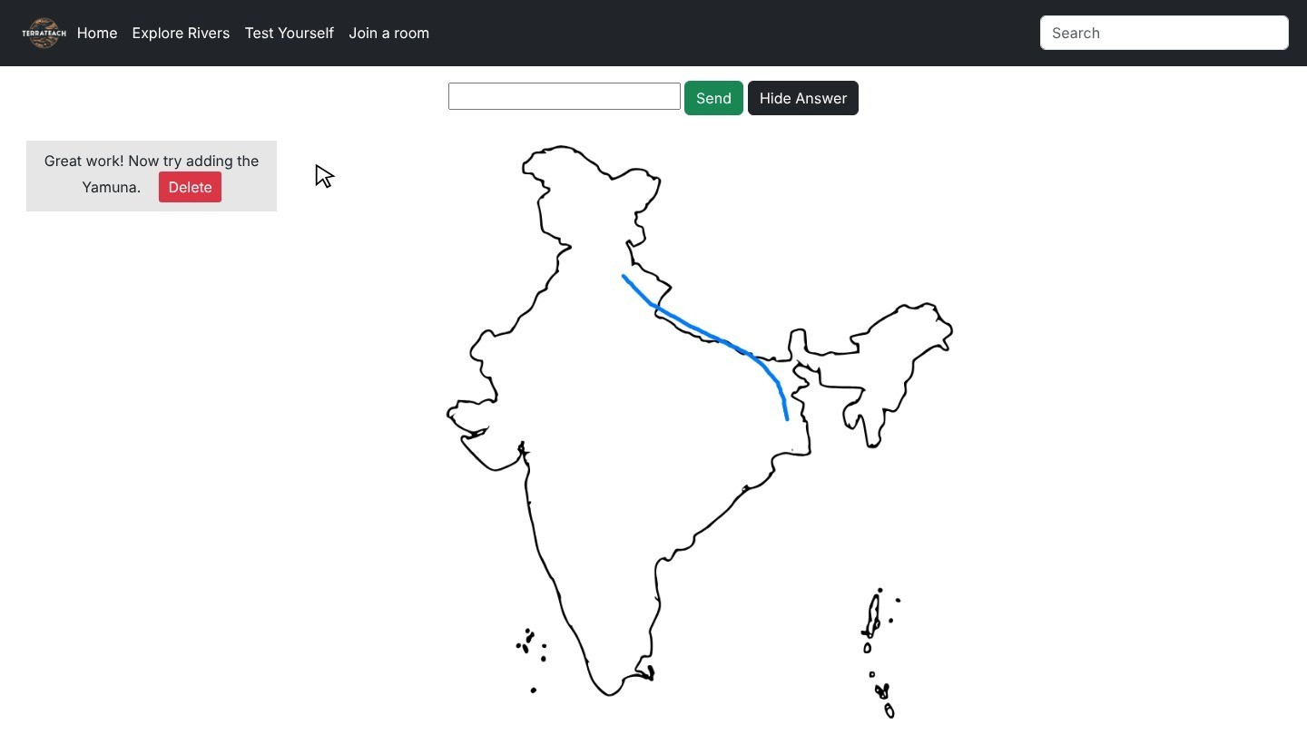
Students and teachers stay connected, even online
1
Student sends the map
One click shares the finished map
2
Teacher sees it at once
No waiting for the next class
3
Teacher replies
Short notes, like “Now add the Yamuna”
4
Student reads the feedback
It appears on their screen within seconds
What the teacher sees: the student's map and the feedback they sent

Slide 8
What changes for students
Before
With TerraTeach
Unsure whether their map was right
Waited for the next class to ask a question
Learned from maps that differ from the exam
A correct answer map for every river
Quick feedback from the teacher, even online
Practice that matches the exam paper

Slide 9
What comes next
Virtual classrooms
A room for each class, so teachers can follow every student
More exam maps
Mountains, soils, states and every river in practice mode
Any device
Use TerraTeach on tablets and phones, not just computers
Progress tracking
Show teachers which maps each student finds hardest

