Slide 1
Linear & Non-Linear Units

Slide 2
Linearity refers to the property of a system or model where the output is directly proportional to the input
while nonlinearity implies that the relationship between input and output is more complex and cannot be expressed as a simple linear function
A Rectified Linear Unit (ReLU) is a form of activation function used commonly in deep learning models.
The function returns 0 if it receives a negative input, and if it receives a positive value, the function will return back the same positive value.

Slide 3
Linear Classification refers to categorizing a set of data points into a discrete class based on a linear combination of its explanatory variables.
Non-Linear Classification refers to categorizing those instances that are not linearly separable. It is possible to classify data with a straight line.
The linear transfer function calculates the neuron's output by simply returning the value passed to it.
This neuron can be trained to learn an affine function of its inputs, or to find a linear approximation to a nonlinear function.
A linear network cannot, be made to perform a nonlinear computation.

Slide 4
Elements of a Neural Network
Input Layer: This layer accepts input features. It provides information from the outside world to the network, no computation is performed at this layer, nodes here just pass on the information(features) to the hidden layer.
Hidden Layer: Nodes of this layer are not exposed to the outer world, they are part of the abstraction provided by any neural network. The hidden layer performs all sorts of computation on the features entered through the input layer and transfers the result to the output layer.
Output Layer: This layer bring up the information learned by the network to the outer world.

Slide 5
What is an activation function and why use them?
The activation function decides whether a neuron should be activated or not by calculating the weighted sum and further adding bias to it. The purpose of the activation function is to introduce non-linearity into the output of a neuron.
We know, the neural network has neurons that work in correspondence with weight, bias, and their respective activation function.
In a neural network, we would update the weights and biases of the neurons on the basis of the error at the output. This process is known as back propagation.
Activation functions make the back-propagation possible since the gradients are supplied along with the error to update the weights and biases

Slide 6
Why do we need Non-linear activation function?
A neural network without an activation function is essentially just a linear regression model.
The activation function does the non-linear transformation to the input making it capable to learn and perform more complex tasks.

Slide 7
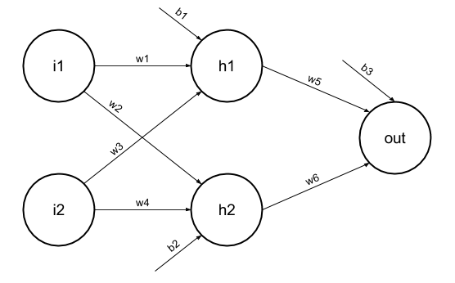
Mathematical proof
Elements of the diagram are as follows:
Hidden layer i.e. layer 1:
z(1) = W(1)X + b(1) a(1)
Here,
z(1) is the vectorized output of layer 1
W(1) be the vectorized weights assigned to neurons of hidden layer i.e. w1, w2, w3 and w4
X be the vectorized input features i.e. i1 and i2
b is the vectorized bias assigned to neurons in hidden layer i.e. b1 and b2
a(1) is the vectorized form of any linear function.
(Note: We are not considering activation function here)
Layer 2 i.e. output layer :-
Note : Input for layer 2 is output from layer 1
z(2) = W(2)a(1) + b(2)
a(2) = z(2)

Slide 8
Calculation at Output layer
z(2) = (W(2) * [W(1)X + b(1)]) + b(2)
z(2) = [W(2) * W(1)] * X + [W(2)*b(1) + b(2)]
Let,
[W(2) * W(1)] = W
[W(2)*b(1) + b(2)] = b
Final output : z(2) = W*X + b
which is again a linear function
This observation results again in a linear function even after applying a hidden layer, hence we can conclude that, doesn’t matter how many hidden layer we attach in neural net, all layers will behave same way because the composition of two linear functions is a linear function itself.
Neuron can not learn with just a linear function attached to it. A non-linear activation function will let it learn as per the difference w.r.t error. Hence we need an activation function.

Slide 9
Variants of Activation Function
Linear Function
Equation : Linear function has the equation similar to as of a straight line i.e. y = x
No matter how many layers we have, if all are linear in nature, the final activation function of last layer is nothing but just a linear function of the input of first layer.
Range : -inf to +inf
Uses : Linear activation function is used at just one place i.e. output layer.
For example : Calculation of price of a house is a regression problem. House price may have any big/small value, so we can apply linear activation at output layer. Even in this case neural net must have any non-linear function at hidden layers.

Slide 10
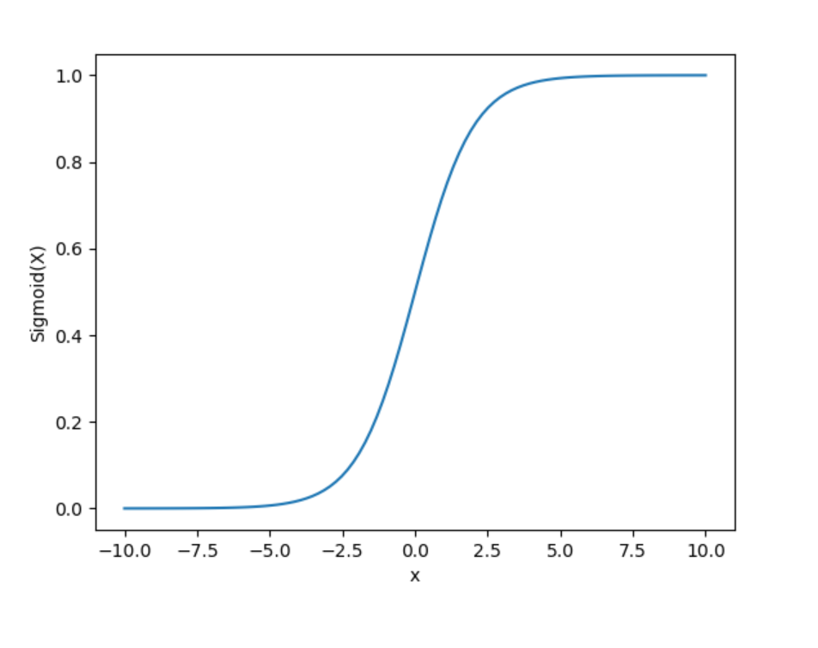
Sigmoid Function
It is a function which is plotted as ‘S’ shaped graph.
Equation : A = 1/(1 + e^{-x})
Nature : Non-linear. Notice that X values lies between -2 to 2, Y values are very steep. This means, small changes in x would also bring about large changes in the value of Y.
Value Range : 0 to 1
Uses : Usually used in output layer of a binary classification, where result is either 0 or 1, as value for sigmoid function lies between 0 and 1 only so, result can be predicted easily to be 1 if value is greater than 0.5 and 0 otherwise.

Slide 11
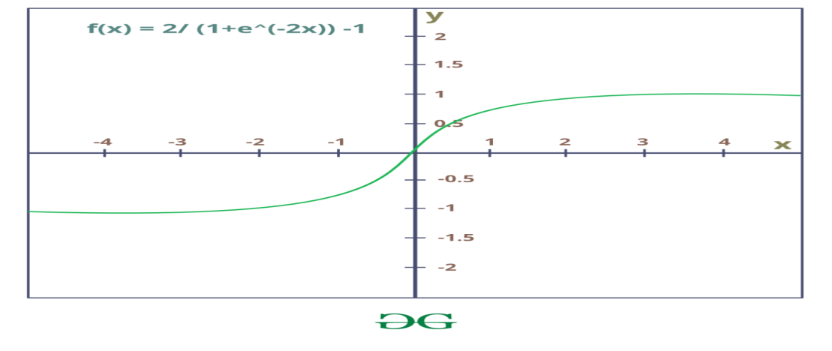

Tanh Function
The activation that works almost always better than sigmoid function is Tanh function also known as Tangent Hyperbolic function. It’s actually mathematically shifted version of the sigmoid function. Both are similar and can be derived from each other.
Value Range :- -1 to +1
Nature :- non-linear
Uses :- Usually used in hidden layers of a neural network as it’s values lies between
-1 to 1 hence the mean for the hidden layer comes out be 0 or very close to it, hence helps in centering the data by bringing mean close to 0. This makes learning for the next layer much easier.

Slide 12
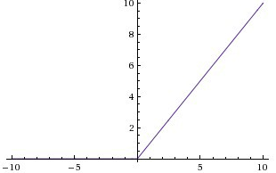
RELU Function
It Stands for Rectified linear unit. It is the most widely used activation function. Mainly implemented in hidden layers of Neural network.
Equation :- A(x) = max(0,x). It gives an output x if x is positive and 0 otherwise.
Value Range :- [0, inf)
Nature :- non-linear, which means we can easily backpropagate the errors and have multiple layers of neurons being activated by the ReLU function.
Uses :- ReLu is less computationally expensive than tanh and sigmoid because it involves simpler mathematical operations. At a time only a few neurons are activated making the network sparse making it efficient and easy for computation.
In simple words, RELU learns much faster than sigmoid and Tanh function.
A rectified linear unit (ReLU) is an activation function that introduces the property of non-linearity to a deep learning model and solves the vanishing gradients issue. "It interprets the positive part of its argument. It is one of the most popular activation functions in deep learning.

Slide 13
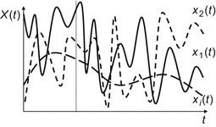
Stochastic (random) function
A stochastic (random) function X(t) is a many-valued numerical function of an independent argument t, whose value for any fixed value t ∈ T (where T is the domain of the argument) is a random variable, called a cut set .
In stochastic neural networks, the algorithm instead of providing deterministic values to each neurons it assigns probabilities to each neuron.
If each neuron passes the threshold values then only the neurons will fire.
It is built by introducing random variation into the network and by giving stochastic weights.

Slide 14
Stochastic modeling forecasts the probability of various outcomes under different conditions, using random variables.
Stochastic modeling presents data and predicts outcomes that account for certain levels of unpredictability or randomness.
With fixed input the output of stochastic neural net is likely to be different (stochastic, or random to certain extent) for multiple evaluations
In contrast to deterministic neural networks, where for fixed input the output is also unique (deterministic).

Slide 15
What is the capacity of a perceptron?
From an information theory point of view, a single perceptron with K inputs has a capacity of 2K bits of information.
What is the capacity of a neural network?
Neural networks are defined at various levels of abstraction, and thus it models different aspects of neural networks. Therefore the network capacity is nothing but the levels of abstraction or the number of fundamental memories or the number of patterns that can be stored and recalled in a network.
What is the perceptron convergence procedure?
Perceptron Convergence Theorem: For any finite set of linearly separable labeled examples, the Perceptron Learning Algorithm will halt after a finite number of iterations. In other words, after a finite number of iterations, the algorithm yields a vector w that classifies perfectly all the examples

