Slide 1
Learning Rules

Slide 2
Classification of learning
Supervised learning
Unsupervised learning
Reinforcement learning

Slide 3
Supervised Learning
Child learns from a teacher
Each input vector requires a corresponding target vector.
Training pair=[input vector, target vector]
Neural
Network
W
X
Y
(Input)
(Actual output)
Error
(D-Y) signals
Error
Signal
Generator
(Desired Output)

Slide 4
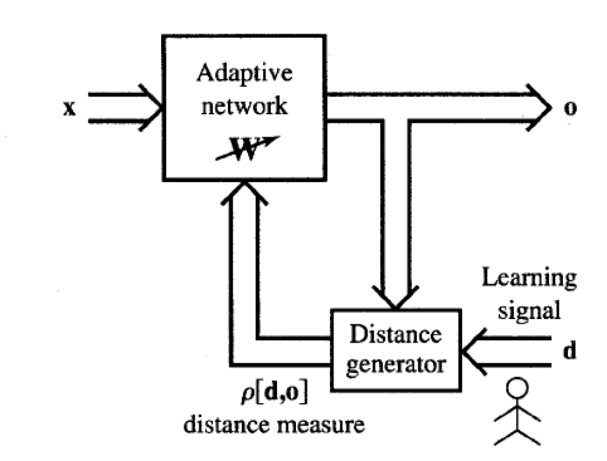
Supervised learning contd.
Supervised learning does minimization of error

Slide 5
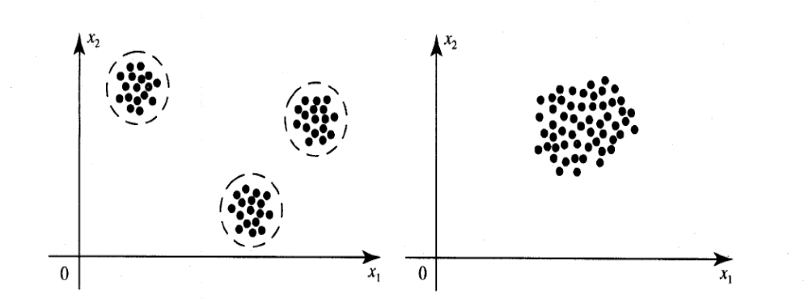
Unsupervised Learning
How a fish or tadpole learns
All similar input patterns are grouped together as clusters.
If a matching input pattern is not found a new cluster is formed

Slide 6
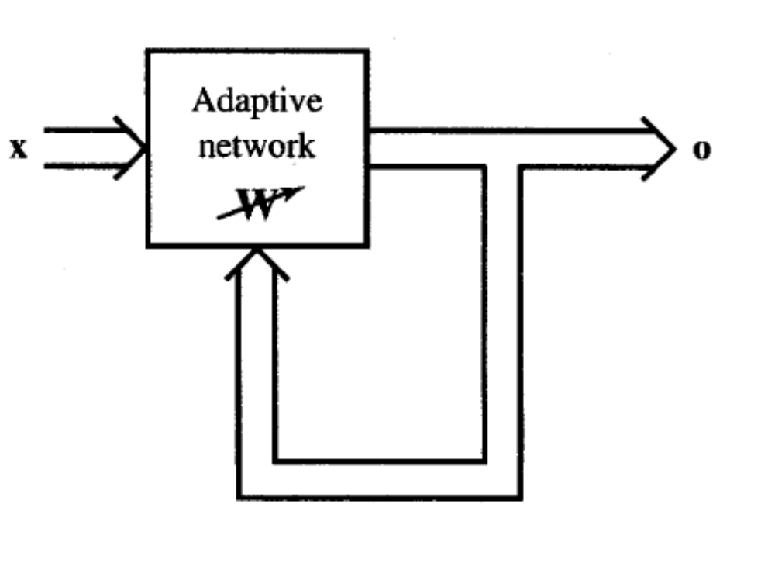
Unsupervised learning

Slide 7
In unsupervised learning there is no feedback
Network must discover patterns, regularities, features for the input data over the output
While doing so the network might change in parameters
This process is called self-organizing

Slide 8
Reinforcement Learning
X
NN
W
Y
(Input)
(Actual output)
Error
signals
Error
Signal
Generator
R
Reinforcement signal

Slide 9
When Reinforcement learning is used?
If less information is available about the target output values (critic information)
Learning based on this critic information is called reinforcement learning and the feedback sent is called reinforcement signal
Feedback in this case is only evaluative and not instructive

Slide 10
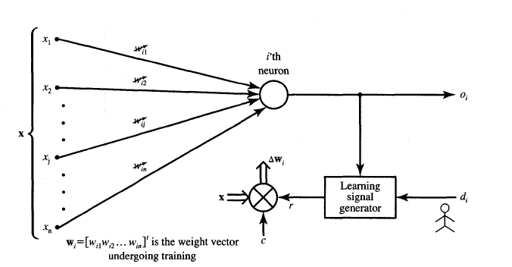



Neural Network Learning rules
c – learning constant

Slide 11
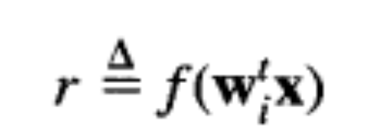
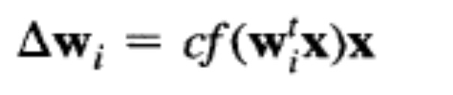
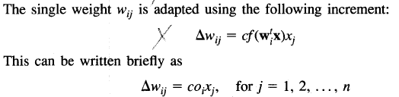
Hebbian Learning Rule
FEED FORWARD UNSUPERVISED LEARNING
The learning signal is equal to the neuron’s output

Slide 12
Features of Hebbian Learning
Feed forward unsupervised learning
“When an axon of a cell A is near enough to excite a cell B and repeatedly and persistently takes place in firing it, some growth process or change takes place in one or both cells increasing the efficiency”
If o_{i}x_{j} is positive the results is increase in weight else vice versa

Slide 13
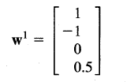
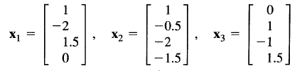
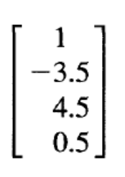
Final answer:

Slide 14
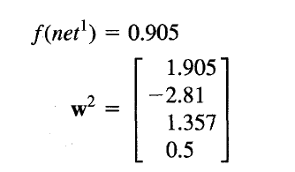
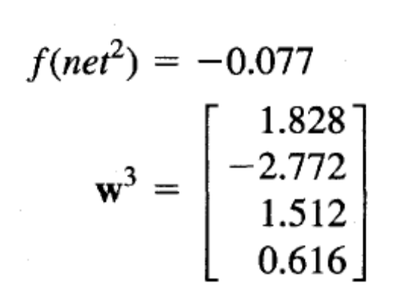
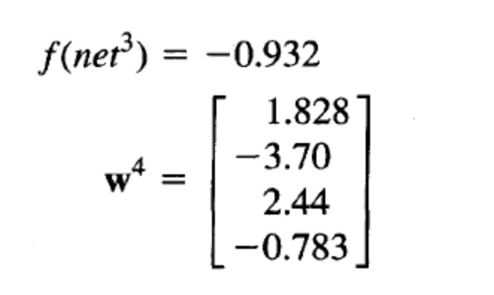
For the same inputs for bipolar continuous activation function the final updated weight is given by

Slide 15
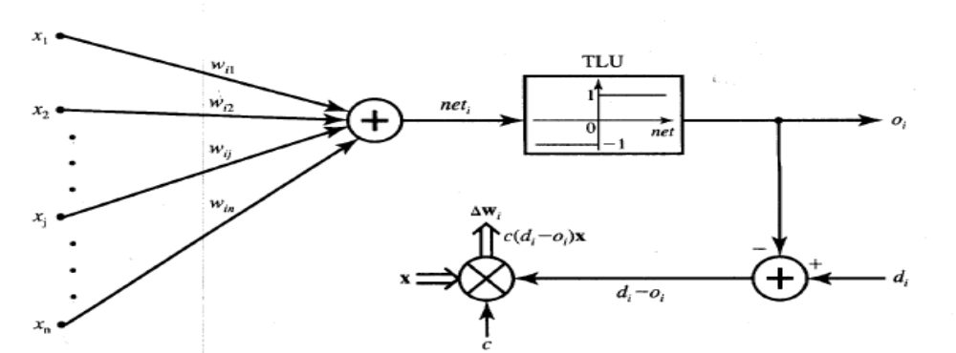
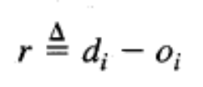

Perceptron Learning rule
Learning signal is the difference between the desired and actual neuron’s response
Learning is supervised

Slide 16
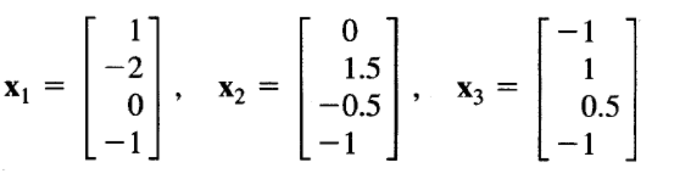
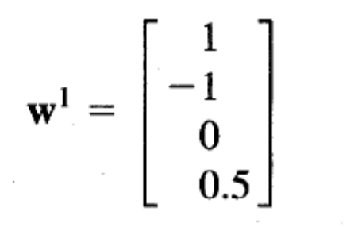

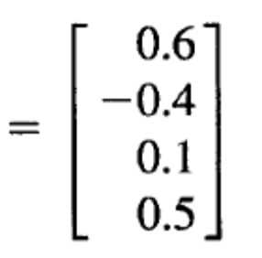
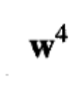

Slide 17
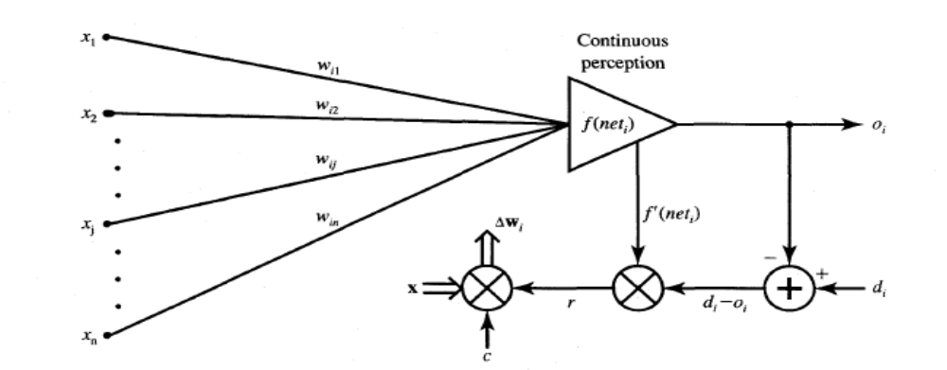
Delta Learning Rule
Only valid for continuous activation function
Used in supervised training mode
Learning signal for this rule is called delta
The aim of the delta rule is to minimize the error over all training patterns

Slide 18
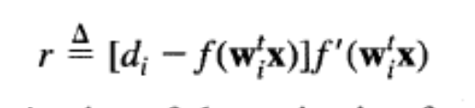





Delta Learning Rule Contd.
Learning rule is derived from the condition of least squared error.
Calculating the gradient vector with respect to wi
Minimization of error requires the weight changes to be in the negative gradient direction

Slide 19
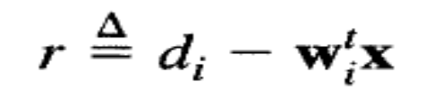
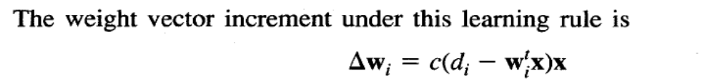
Widrow-Hoff learning Rule
Also called as least mean square learning rule
Introduced by Widrow(1962), used in supervised learning
Independent of the activation function
Special case of delta learning rule wherein activation function is an identity function ie f(net)=net
Minimizes the squared error between the desired output value d_{i} and net_{i}

Slide 20
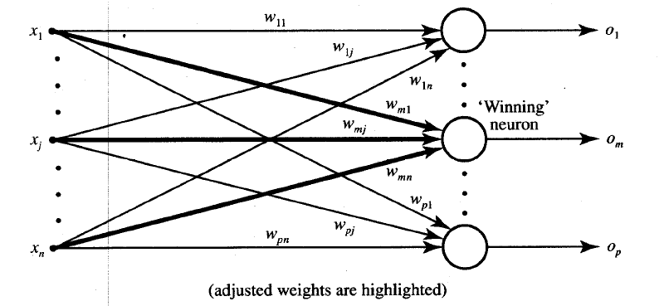
Winner-Take-All learning rules

Slide 21
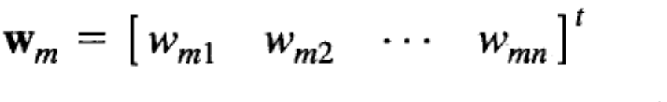
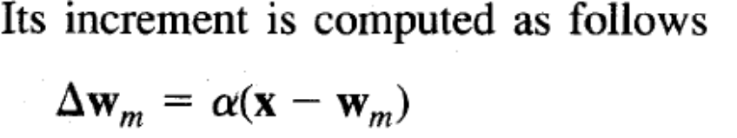
Winner-Take-All Learning rule
Can be explained for a layer of neurons
Example of competitive learning and used for unsupervised network training
Learning is based on the premise that one of the neurons in the layer has a maximum response due to the input x
This neuron is declared the winner with a weight

Slide 22
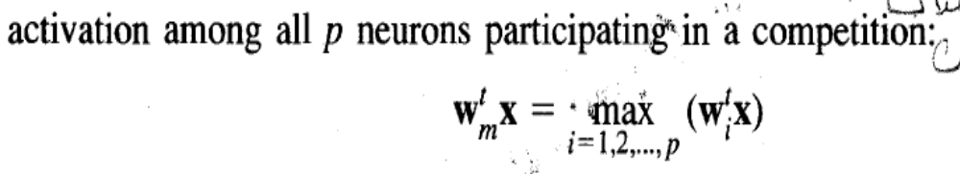

Slide 23
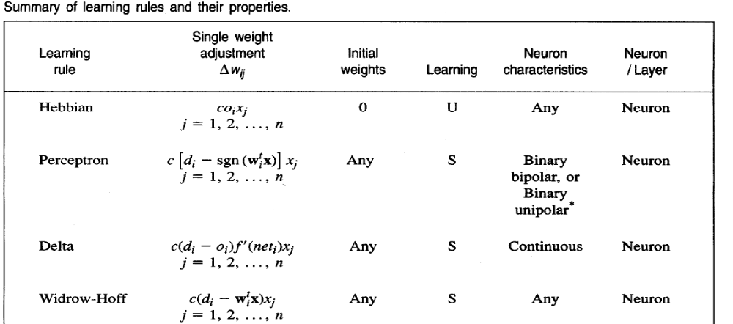
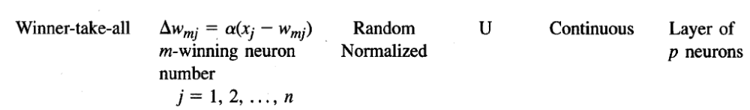
Summary of learning rules

Slide 24
Linear Separability
Separation of the input space into regions is based on whether the network response is positive or negative
Line of separation is called linear-separable line.
Example:-
  AND function & OR function are linear separable
  EXOR function Linearly inseparable.

Slide 25
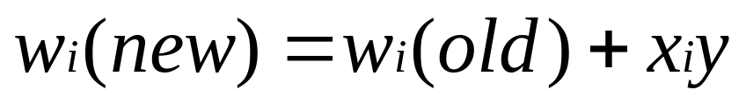
Hebb Network
Hebb learning rule is the simpliest one
The learning in the brain is performed by the change in the synaptic gap
When an axon of cell A is near enough to excite cell B and repeatedly keep firing it, some growth process takes place in one or both cells
According to Hebb rule, weight vector is found to increase proportionately to the product of the input and learning signal.

Slide 26
Flow chart of Hebb training algorithm
Start
1
Initialize Weights
Activate output
y=t
For
Each
s:t
Weight update
n
Bias update
b(new)=b(old) + y
y
Activate input
xi=si
Stop
1

Slide 27
Hebb rule can be used for pattern association, pattern categorization, pattern classification and over a range of other areas

Slide 28
How to solve
X1 | X2 | B | y
1 | 1 | 1 | 1
1 | -1 | 1 | 1
-1 | 1 | 1 | 1
-1 | -1 | 1 | -1
Use bipolar data in the place of binary data
Initially the weights and bias are set to zero
w1=w2=b=0

Slide 29
Inputs |  |  | y | Weight changes |  |  | weights
X1 | X2 | b | Y | W1 | W2 | B | W1(0) | W2(0) | (0)b
1 | 1 | 1 | 1 | 1 | 1 | 1 | 1 | 1 | 1
1 | -1 | 1 | 1 | 1 | -1 | 1 | 2 | 0 | 2
-1 | 1 | 1 | 1 | -1 | 1 | 1 | 1 | 1 | 3
-1 | -1 | 1 | -1 | 1 | 1 | -1 | 2 | 2 | 2

