Slide 1
McCulloch Pitts Model

Slide 2
Artificial Neural Networks
x₁
X₁
w₁
Y
y
x₂
w₂
X₂

Slide 3
Neural net of pure linear eqn.
Input
X
m
Y
mx

Slide 4
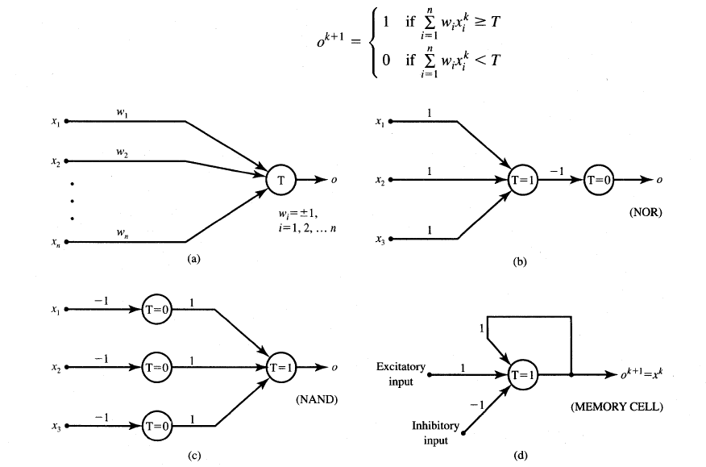
McCulloch-Pitts Neuron Model

Slide 5
Features of McCulloch-Pitts model
Allows binary 0,1 states only
Operates under a discrete-time assumption
Weights and the neurons’ thresholds are fixed in the model and no interaction among network neurons

Slide 6
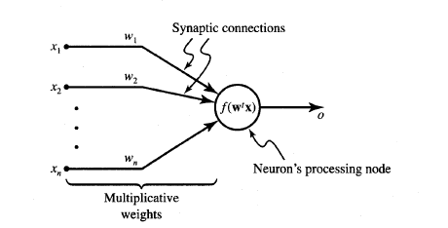
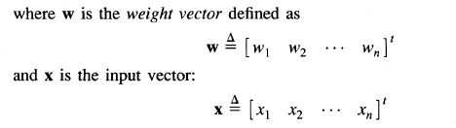
General symbol of neuron consisting of processing node and synaptic connections

Slide 7
Neuron Modeling for ANN
Is referred to activation function.
Domain is set of activation values net.
Scalar product of weight and input vector
Neuron as a processing node performs the operation of summation of its weighted input.

Slide 8
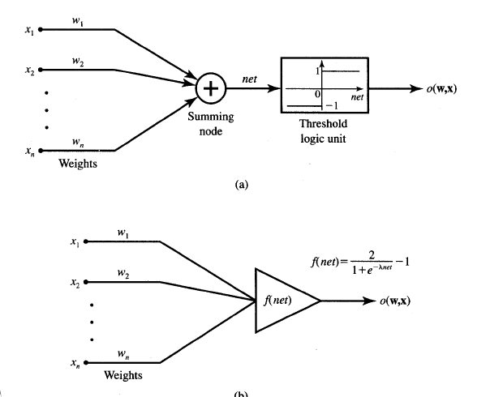
Common models of neurons
Binary perceptrons
Continuous perceptrons

Slide 9
Basic models of ANN
Basic Models of ANN
Interconnections
Learning rules
Activation function

Slide 10
Classification based on interconnections
Interconnections
Feed forward
Feed Back
Recurrent
Single layer
Multilayer
Single layer
Multilayer

Slide 11
Single layer Feedforward Network

Slide 12


Feedforward Network
Its output and input vectors are respectively
Weight w_{ij} connects the i’th neuron with j’th input. Activation rule of ith neuron is
where

Slide 13
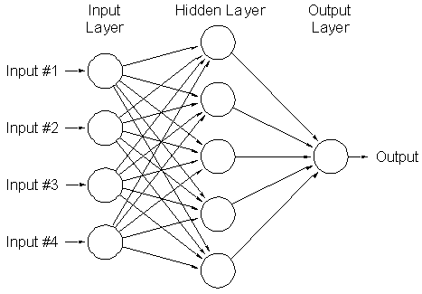
Multilayer feed forward network
Can be used to solve complicated problems

Slide 14
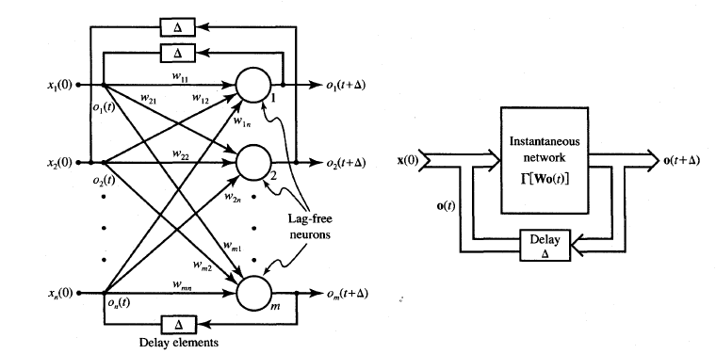
Feedback network
When outputs are directed back as inputs to same or preceding layer nodes it results in the formation of feedback networks

Slide 15
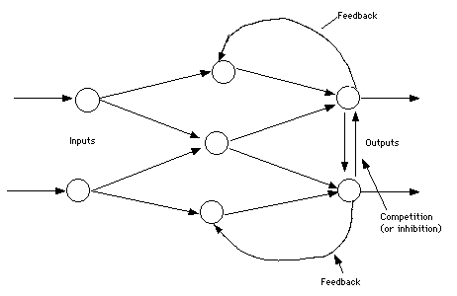
Lateral feedback
If the feedback of the output of the processing elements is directed back as input to the processing elements in the same layer then it is called lateral feedback

Slide 16
Recurrent n/ws
Feedback networks with closed loop are called Recurrent Networks. The response at the k+1’th instant depends on the entire history of the network starting at k=0.
Single node with own feedback
Competitive nets
Single-layer recurrent nets
Multilayer recurrent networks

Slide 17
Single node with own feedback

Slide 18
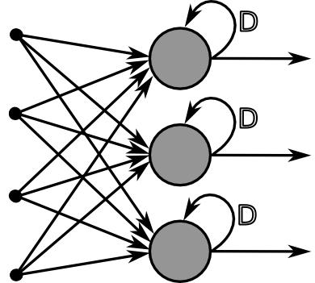
Single layer Recurrent Networks

Slide 19
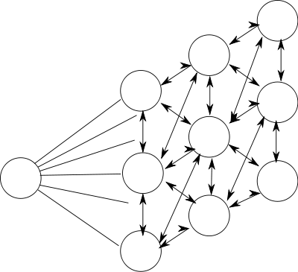
Competitive networks

Slide 20
Basic models of ANN
Basic Models of ANN
Interconnections
Learning rules
Activation function

Slide 21
Learning
It’s a process by which a NN adapts itself to a stimulus by making proper parameter adjustments, resulting in the production of desired response
Two kinds of learning
Parameter learning:- connection weights are updated
Structure Learning:- change in network structure

Slide 22
Training
The process of modifying the weights in the connections between network layers with the objective of achieving the expected output is called training a network.
This is achieved through
Supervised learning
Unsupervised learning
Reinforcement learning

Slide 23
Classification of learning
Supervised learning
Unsupervised learning
Reinforcement learning

Slide 24
Supervised Learning
Child learns from a teacher
Each input vector requires a corresponding target vector.
Training pair=[input vector, target vector]
Neural
Network
W
X
Y
(Input)
(Actual output)
Error
(D-Y) signals
Error
Signal
Generator
(Desired Output)

Slide 25
Supervised learning contd.
Supervised learning does minimization of error

Slide 26
Unsupervised Learning
How a fish or tadpole learns
All similar input patterns are grouped together as clusters.
If a matching input pattern is not found a new cluster is formed

Slide 27
Unsupervised learning

Slide 28
Self-organizing
In unsupervised learning there is no feedback
Network must discover patterns, regularities, features for the input data over the output
While doing so the network might change in parameters
This process is called self-organizing

Slide 29
Reinforcement Learning
X
NN
W
Y
(Input)
(Actual output)
Error
signals
Error
Signal
Generator
R
Reinforcement signal

Slide 30
When Reinforcement learning is used?
If less information is available about the target output values (critic information)
Learning based on this critic information is called reinforcement learning and the feedback sent is called reinforcement signal
Feedback in this case is only evaluative and not instructive

Slide 31
Basic models of ANN
Basic Models of ANN
Interconnections
Learning rules
Activation function

Slide 32
Activation Function
Identity Function
f(x)=x for all x
Binary Step function
Bipolar Step function
Sigmoidal Functions:- Continuous functions
5. Ramp functions:-

Slide 33
Learning algorithms
Supervised:
Adaline, Madaline
Perceptron
Back Propagation
multilayer perceptrons
Radial Basis Function Networks
Unsupervised
Competitive Learning
Kohenen self organizing map
Learning vector quantization
Hebbian learning

Slide 34
Neural processing
Processing phase for a NN and its objective is to retrieve the information. The process of computing o for a given x
Basic forms of neural information processing
Auto association
Hetero association
Classification

Slide 35
Neural processing-Autoassociation
Set of patterns can be stored in the network
If a pattern similar to a member of the stored set is presented, an association with the input of closest stored pattern is made

Slide 36
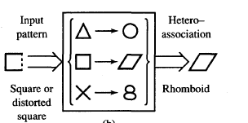
Neural Processing- Heteroassociation
Associations between pairs of patterns are stored
Distorted input pattern may cause correct heteroassociation at the output

Slide 37
Neural processing-Classification
Set of input patterns is divided into a number of classes or categories
In response to an input pattern from the set, the classifier is supposed to recall the information regarding class membership of the input pattern.

Slide 38
Important terminologies of ANNs
Weights
Bias
Threshold
Learning rate
Momentum factor
Vigilance parameter
Notations used in ANN

Slide 39
Weights
Each neuron is connected to every other neuron by means of directed links
Links are associated with weights
Weights contain information about the input signal and is represented as a matrix
Weight matrix also called connection matrix

Slide 40
Weight matrix
W=
=

Slide 41
Weights contd…
w_{ij –}is the weight from processing element ”i” (source node) to processing element “j” (destination node)
1
X₁
b_{j}
w_{1j}
X_{i}
Y_{j}
w_{ij}
X_{n}
w_{nj}

Slide 42
Activation Functions
Used to calculate the output response of a neuron.
Sum of the weighted input signal is applied with an activation to obtain the response.
Activation functions can be linear or non linear
Identity function
Single/binary step function
Discrete/continuous sigmoidal function.

Slide 43
Bias
Bias is like another weight. Its included by adding a component x₀=1 to the input vector X.
X=(1,X₁,X₂…X_{i},…X_{n})
Bias is of two types
Positive bias: increase the net input
Negative bias: decrease the net input

Slide 44
Why Bias is required?
The relationship between input and output given by the equation of straight line y=mx+c
C(bias)
Input
X
Y
y=mx+C

Slide 45
Threshold
Set value based upon which the final output of the network may be calculated
Used in activation function
The activation function using threshold can be defined as

Slide 46
Learning rate
Denoted by α.
Used to control the amount of weight adjustment at each step of training
Learning rate ranging from 0 to 1 determines the rate of learning in each time step

Slide 47
Momentum factor:
used for convergence when momentum factor is added to weight updation process.
Vigilance parameter:
Denoted by ρ
Used to control the degree of similarity required for patterns to be assigned to the same cluster

Slide 48
Basic models of ANN
Basic Models of ANN
Interconnections
Learning rules
Activation function

Slide 49
Learning Rules
Perceptron Learning Rule
Delta Learning Rule
Widrow Hoff Learning Rule
Hebbian Learning Rule

Slide 50
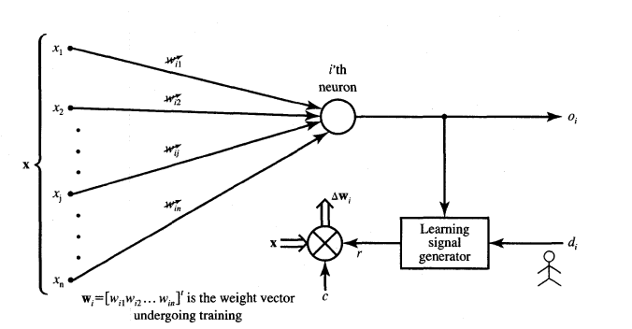
Neural Network Learning rules
c – learning constant

