Slide 1
Perceptron Learning Model

Slide 2
Basic Concepts
A Neural Network maps a set of inputs to a set of outputs
Number of inputs/outputs is variable
The Network itself is composed of an
arbitrary number of nodes or units, connected
by links, with an arbitrary topology.
A link from unit i to unit j serves to propagate the activation a_{j} to a_{j}, and it has a weight W_{ij}.
What can a neural network do?
Compute a known function / Approximate an unknown function
Pattern Recognition / Signal Processing

Slide 3
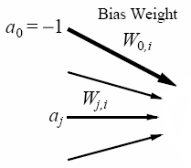
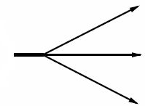


An Artificial Neuron Node or Unit:
Artificial Neuron,
Node or unit ,
Processing Unit i
Input
function(in_{i}):
weighted sum
of its inputs,
including
fixed input a₀.
Output
Input edges,
each with weights
(positive, negative, and
change over time,
learning)
Activation
function (g)
applied to
input function
(typically
non-linear).
Output edges,
each with weights
(positive, negative, and
change over time,
learning)
→ a processing element producing an output based on a function of its inputs
Notes:
A Node is a processing element which produces an output based on a function of it’s inputs:
Winston, p. 445
Simulated neuron is viewed as a…Node connected to other nodes.
Links are the axons and dendrites.
Link associated with a weight. Like a synapse, that weight determines the nature and strength of one node’s influence on another.
Weights are the primary means for long-term storage (plasticity).
One node’s influence on another is the output value of the first times the weight on the connecting link. Large/small, +/- weight corresponds to strong/weak excitation/inhibition. (Models combining influences of set of dendrites).
Output of each node is determined by an activation function. Usually a threshold function. Combines the influences from input links. Sum of weighted inputs. Output is either 0 or 1. (Models the cell body.)
Note: Many facets of real neurons are NOT modeled.

Slide 4
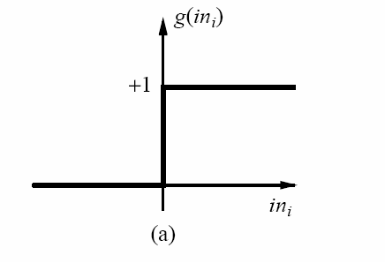
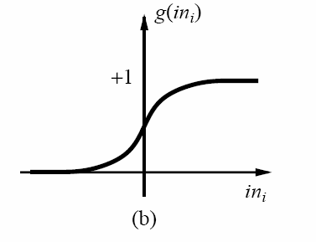
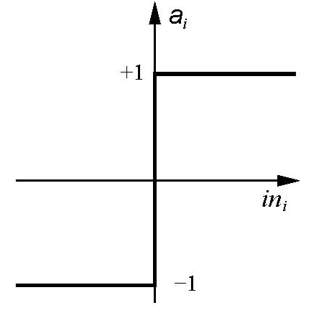

Activation Functions
Threshold activation function → a step function or threshold function
(outputs 1 when the input is positive; 0 otherwise).
(b) Sigmoid (or logistics function) activation function (key advantage: differentiable)
(c) Sign function, +1 if input is positive, otherwise -1.
These functions have a threshold (either hard or soft) at zero.
→ Changing the bias weight W_{0,i} moves the threshold location.

Slide 5

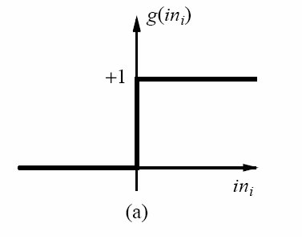
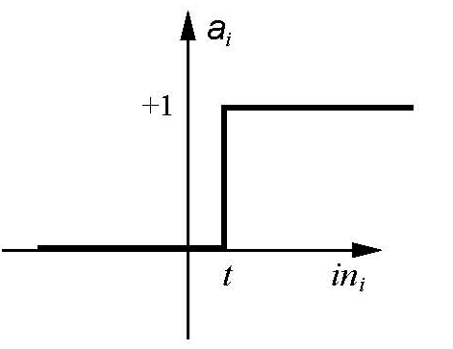

Threshold Activation Function
Input edges,
each with weights
(positive, negative, and
change over time,
learning)
θ_{i} threshold value associated with unit i
θ_{i}=0
θ_{i}=t

Slide 6
Implementing Boolean Functions
Units with a threshold activation function
can act as logic gates; we can use these units
to compute Boolean function of its inputs.

Slide 7
Boolean AND
input x1 | input x2 | ouput
0 | 0 | 0
0 | 1 | 0
1 | 0 | 0
1 | 1 | 1
W₀= 1.5
-1
w₁=1
w₂=1
x₁
x₂
Activation of
threshold units when:

Slide 8
Boolean OR
input x1 | input x2 | ouput
0 | 0 | 0
0 | 1 | 1
1 | 0 | 1
1 | 1 | 1
w₀= 0.5
-1
w₁=1
w₂=1
x₁
x₂
Activation of
threshold units when:

Slide 9
Inverter
input x1 | output
0 | 1
1 | 0
w₀= -0.5
-1
w₁= −1
x₁
Activation of
threshold units when:
So, units with a threshold activation function
can act as logic gates given the appropriate input and
bias weights.

Slide 10
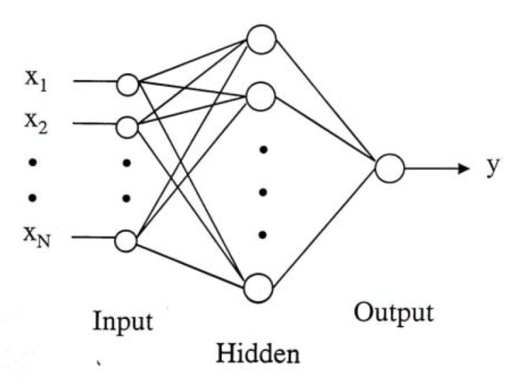
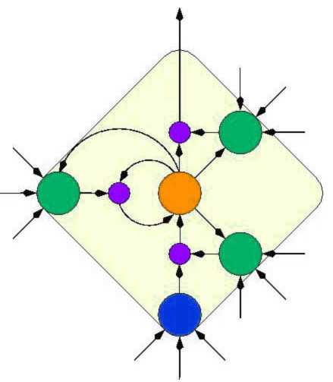
Network Structures
Acyclic or Feed-forward networks
Activation flows from input layer to
output layer
single-layer perceptrons
multi-layer perceptrons
Recurrent networks
Feed the outputs back into own inputs
Network is a dynamical system
(stable state, oscillations, chaotic behavior)
Response of the network depends on initial state
Can support short-term memory
Feed-forward networks implement functions,
have no internal state (only weights).
Notes:
There are two major network structures using these units.
The first one is a feed-forward network.
It’s just an arbitrary function of its current inputs.
And there is no internal state other than weights.
The second one is a recurrent network.
This kind of network feeds its outputs back into its own inputs.
This structure can support a short-term memory.

Slide 11
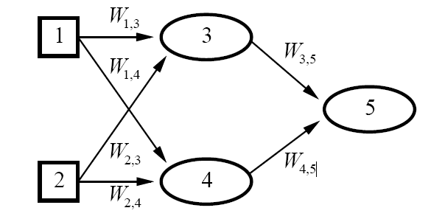

Feed-forward Network: Represents a function of Its Input
Two input units
Two hidden units
One Output
Each unit receives input only
from units in the immediately
preceding layer.
Given an input vector x = (x₁,x₂), the activations of the input units are set to values of the
input vector, i.e., (a₁,a₂)=(x₁,x₂), and the network computes:
Weights are the parameters of the function
Feed-forward network computes a parameterized family of functions h_{W}(x)
By adjusting the weights we get different functions:
that is how learning is done in neural networks!
Notes:
We can represent the output of each unit as a function of its input → the network as a whole is a function of its input
The weights act as parameters
The network as a whole is a function of its input:
the weights correspond to parameters.
A neural network can be used for classification or regression. For Boolean classification
with continuous outputs (e.g., with sigmoid units), it is traditional to have a single output unit,
with a value over 0.5 interpreted as one class and a value below 0.5 as the other. For k-way
classification, one could divide the single output unit’s range into k portions, but it is more
common to have k separate output units, with the value of each one representing the relative
likelihood of that class given the current inp

Slide 12
Feed-forward Network
A neural network can be used for classification or regression.
For Boolean classification with continuous outputs (e.g., with sigmoid
units) → typically a single output unit (value> 0.5 → one class)
For k-way classification, one could divide the single output unit’s range
into k portions → typically, k separate output units, with the value of each
one representing the relative likelihood of that class given the current input

Slide 13
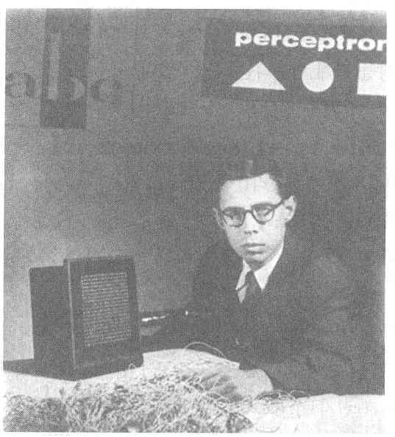
Perceptron
Cornell Aeronautical Laboratory
Perceptron
Invented by Frank Rosenblatt in 1957 in an attempt to understand human memory, learning, and cognitive processes.
The first neural network model by computation, with a remarkable learning algorithm:
If function can be represented by perceptron, the learning algorithm quickly converge to the hidden function
Became the foundation of pattern recognition research
Rosenblatt &
Mark I Perceptron:
the first machine that could "learn" to recognize and identify optical patterns.
Notes:
Perceptron invented by Frank Rosenblatt in 1957.
When perceptron was first introduced, this issue created considerable sensation.
Perceptron was the first neural network modeled by correct computation and affected many fields.
Perceptron also became the foundation of pattern recognition research.
<사진>
This guy is Frank Rosenblatt inventor of perceptron.
And this one is Mark ⅠPerceptron image sensor that is the first neural network equipment.

Slide 14
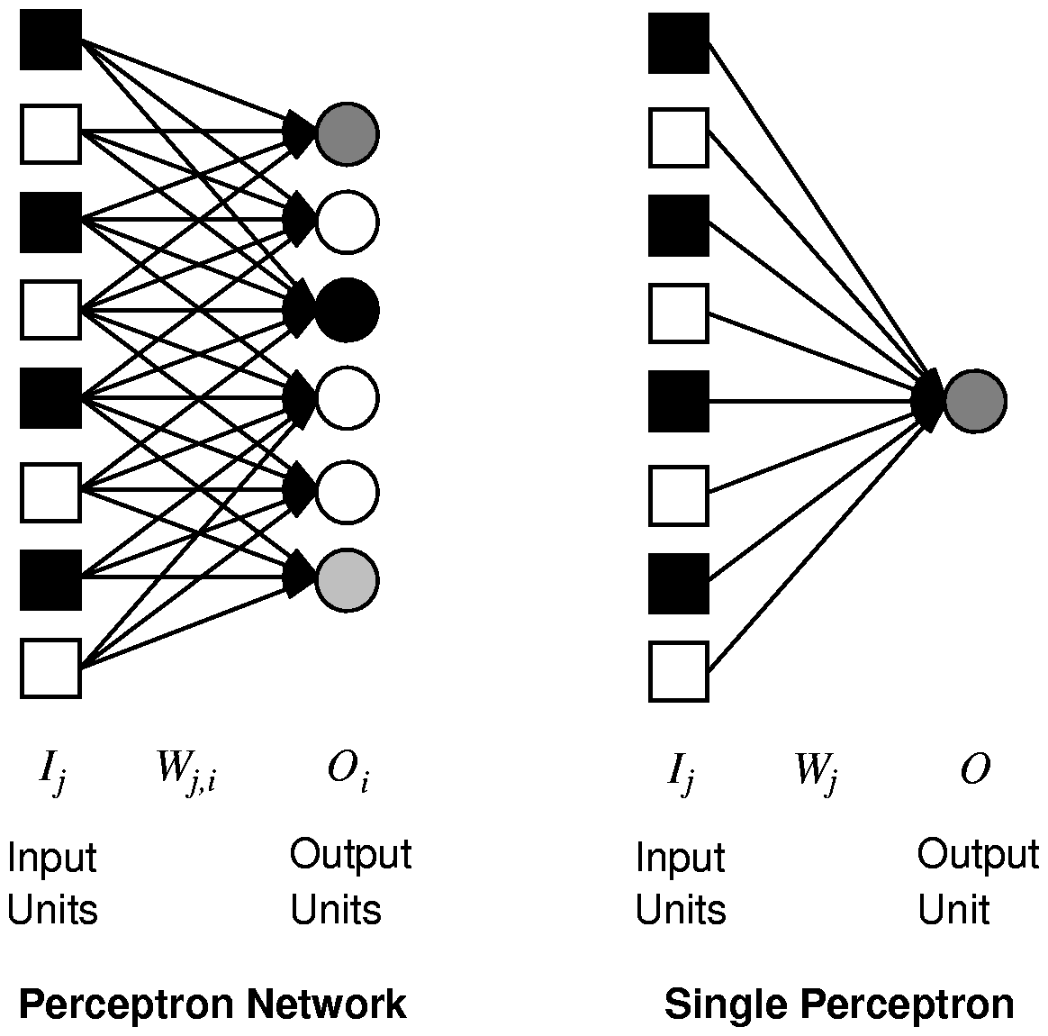
Single Layer Feed-forward Neural Networks Perceptrons
Single-layer neural network (perceptron network)
A network with all the inputs connected directly to the outputs
Output units all operate separately: no shared weights
each output unit is
independent of the others
Notes:
Single layer neural network also called perceptron network is a network with all the inputs connected directly to the outputs.
<그림 a>
This is a perceptron network consisting of three perceptron output units that share five inputs. Each output unit is independent of the others.
So we can limit our study to perceptrons with a single output unit.
<그림 b> --삭제해도 무관함
This is a graph of the output of a two-input perceptron unit using a sigmoid activation function.

Slide 15

Perceptron to Learn to Identify Digits (From Pat. Winston, MIT)
Digit | x₀ | x₁ | x₂ | x₃ | x₄ | x₅ | x₆
0 | 0 | 1 | 1 | 1 | 1 | 1 | 1
9 | 1 | 1 | 1 | 1 | 1 | 1 | 0
8 | 1 | 1 | 1 | 1 | 1 | 1 | 1
7 | 0 | 0 | 1 | 1 | 1 | 0 | 0
6 | 1 | 1 | 1 | 0 | 1 | 1 | 1
5 | 1 | 1 | 1 | 0 | 1 | 1 | 0
4 | 1 | 1 | 0 | 1 | 1 | 0 | 0
3 | 1 | 0 | 1 | 1 | 1 | 1 | 0
2 | 1 | 0 | 1 | 1 | 0 | 1 | 1
1 | 0 | 0 | 0 | 1 | 1 | 0 | 0
Seven line segments
are enough to produce
all 10 digits
2
1
3
0
6
4
5

Slide 16
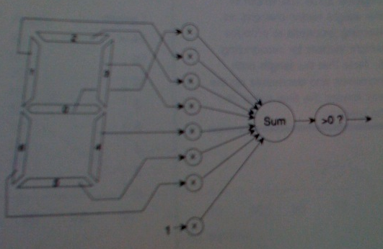
Perceptron to Learn to Identify Digits (From Pat. Winston, MIT)
Seven line segments
are enough to produce
all 10 digits
2
1
3
0
6
4
A vision system reports which of the seven segments
in the display are on, therefore producing the inputs
for the perceptron.
5

Slide 17
Perceptron to Learn to Identify Digit 0
Digit | x₀ | x₁ | x₂ | x₃ | x₄ | x₅ | x₆ | X₇ _{(fixed input)}
0 | 0 | 1 | 1 | 1 | 1 | 1 | 1 | 1
When the input digit is 0,
what’s the value of
sum?
-1
Seven line segments
are enough to produce
all 10 digits
0
0
0
0
0
2
1
1
3
0
Sum>0 → output=1
Else output=0
0
6
4
A vision system reports which of the seven segments
in the display are on, therefore producing the inputs for the perceptron.
5

Slide 18
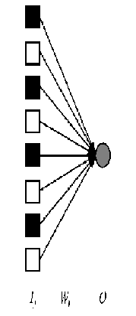
Perceptron Learning:
Weight Update
→ Input I_{j} (j=1,2,…,n)
→ Single output O: target output, T.
Consider some initial weights
Define example error: Err = T – O
Now just move weights in right direction!
If the error is positive, then we need to increase O.
Err >0 → need to increase O;
Err <0 → need to decrease O;
Each input unit j, contributes W_{j} I_{j} to total input:
if I_{j} is positive, increasing W_{j} tends to increase O;
if I_{j} is negative, decreasing W_{j} tends to increase O;
So, use:
W_{j} ← W_{j} + α × I_{j} × Err
Perceptron Learning Rule (Rosenblatt 1960)
α is the learning rate.
Notes:
×

Slide 19
Perceptron Learning: Simple Example
Let’s consider an example (adapted from Patrick Wintson book, MIT)
Framework and notation:
0/1 signals
Input vector:
Weight vector:
x₀ = 1 and θ₀=-w₀, simulate the threshold.
O is output (0 or 1) (single output).
Threshold function:
Learning rate = 1.

Slide 20
Perceptron Learning: Simple Example
Set of examples, each example is a pair
i.e., an input vector and a label y (0 or 1).
Learning procedure, called the “error correcting method”
Start with all zero weight vector.
Cycle (repeatedly) through examples and for each example do:
If perceptron is 0 while it should be 1,
add the input vector to the weight vector
If perceptron is 1 while it should be 0,
subtract the input vector to the weight vector
Otherwise do nothing.
Intuitively correct,
(e.g., if output is 0
but it should be 1,
the weights are
increased) !
Err = T – O
W_{j} ← W_{j} + α × I_{j} × Err

Slide 21
Perceptron Learning: Simple Example
Consider learning the logical OR function.
Sample x0 x1 x2 label
1 1 0 0 0
2 1 0 1 1
3 1 1 0 1
4 1 1 1 1
Activation Function

Slide 22
Perceptron Learning: Simple Example
Error correcting method
If perceptron is 0 while it should be 1,
add the input vector to the weight vector
If perceptron is 1 while it should be 0,
subtract the input vector to the weight vector
Otherwise do nothing.
I₀
w₀
We’ll use a single perceptron with three inputs.
We’ll start with all weights 0 W= <0,0,0>
Example 1 I= < 1 0 0> label=0 W= <0,0,0>
Perceptron (1×0+ 0×0+ 0×0 =0, S=0) output → 0
→it classifies it as 0, so correct, do nothing
Example 2 I=<1 0 1> label=1 W= <0,0,0>
Perceptron (1×0+ 0×0+ 1×0 = 0) output →0
→it classifies it as 0, while it should be 1, so we add input to weights
W = <0,0,0> + <1,0,1>= <1,0,1>
I₁
w₁
O
I₂
w₂

Slide 23
Example 3 I=<1 1 0> label=1 W= <1,0,1>
Perceptron (1×1+ 1×0+ 0×0 > 0) output = 1
→it classifies it as 1, correct, do nothing
W = <1,0,1>
Example 4 I=<1 1 1> label=1 W= <1,0,1>
Perceptron (1×1+ 1×0+ 1×1 > 0) output = 1
→it classifies it as 1, correct, do nothing
W = <1,0,1>
I₀
w₀
I₁
w₁
O
I₂
w₂

Slide 24
Perceptron Learning: Simple Example
Error correcting method
If perceptron is 0 while it should be 1,
add the input vector to the weight vector
If perceptron is 1 while it should be 0,
subtract the input vector from the weight vector
Otherwise do nothing.
I₀
w₀
1
I₁
w₁
O
Epoch 2, through the examples, W = <1,0,1> .
Example 1 I = <1,0,0> label=0 W = <1,0,1>
Perceptron (1×1+ 0×0+ 0×1 >0) output → 1
→it classifies it as 1, while it should be 0, so subtract input from weights
W = <1,0,1> - <1,0,0> = <0, 0, 1>
Example 2 I=<1 0 1> label=1 W= <0,0,1>
Perceptron (1×0+ 0×0+ 1×1 > 0) output →1
→it classifies it as 1, so correct, do nothing
I₂
w₂

Slide 25
Example 3
I=<1 1 0> label=1 W= <0,0,1>
Perceptron (1×0+ 1×0+ 0×1 > 0) output = 0
→it classifies it as 0, while it should be 1, so add input to weights
W = <0,0,1> + W = <1,1,0> = <1, 1, 1>
Example 4
I=<1 1 1> label=1 W= <1,1,1>
Perceptron (1×1+ 1×1+ 1×1 > 0) output = 1
→it classifies it as 1, correct, do nothing
W = <1,1,1>

Slide 26
Perceptron Learning: Simple Example
Epoch 3, through the examples, W = <1,1,1> .
Example 1 I=<1,0,0> label=0 W = <1,1,1>
Perceptron (1×1+ 0×1+ 0×1 >0) output → 1
→it classifies it as 1, while it should be 0, so
subtract input from weights
W = <1,1,1> - W = <1,0,0> = <0, 1, 1>
Example 2 I=<1 0 1> label=1 W= <0, 1, 1>
Perceptron (1×0+ 0×1+ 1×1 > 0) output →1
→it classifies it as 1, so correct, do nothing
1
I₀
w₀
I₁
w₁
O
I₂
w₂

Slide 27
Example 3
I=<1 1 0> label=1 W= <0, 1, 1>
Perceptron (1×0+ 1×1+ 0×1 > 0) output = 1
→it classifies it as 1, correct, do nothing
Example 4
I=<1 1 1> label=1 W= <0, 1, 1>
Perceptron (1×0+ 1×1+ 1×1 > 0) output = 1
→it classifies it as 1, correct, do nothing
W = <1,1,1>

Slide 28
Perceptron Learning: Simple Example
Epoch 4, through the examples, W= <0, 1, 1>.
Example 1 I= <1,0,0> label=0 W = <0,1,1>
Perceptron (1×0+ 0×1+ 0×1 = 0) output → 0
→it classifies it as 0, so correct, do nothing
1
I₀
W₀ =0
I₁
W₁=1
O
I₂
W₂=1
So the final weight vector W= <0, 1, 1> classifies all
examples correctly, and the perceptron has learned the function
OR

Slide 29
Epoch | x0 | x1 | x2 | Desired Target | w0 | w1 | w2 | Output | Error | New w0 | New w1 | New w2
1 example 1 | 1 | 0 | 0 | 0 | 0 | 0 | 0 | 0 | 0 | 0 | 0 | 0
 | 1 | 0 | 1 | 1 | 0 | 0 | 0 | 0 | 1 | 1 | 0 | 1
 | 1 | 1 | 0 | 1 | 1 | 0 | 1 | 1 | 0 | 1 | 0 | 1
 | 1 | 1 | 1 | 1 | 1 | 0 | 1 | 1 | 0 | 1 | 0 | 1
2 | 1 | 0 | 0 | 0 | 1 | 0 | 1 | 1 | -1 | 0 | 0 | 1
 | 1 | 0 | 1 | 1 | 0 | 0 | 1 | 1 | 0 | 0 | 0 | 1
 | 1 | 1 | 0 | 1 | 0 | 0 | 1 | 0 | 1 | 1 | 1 | 1
 | 1 | 1 | 1 | 1 | 1 | 1 | 1 | 1 | 0 | 1 | 1 | 1
3 | 1 | 0 | 0 | 0 | 1 | 1 | 1 | 1 | -1 | 0 | 1 | 1
 | 1 | 0 | 1 | 1 | 0 | 1 | 1 | 1 | 0 | 0 | 1 | 1
 | 1 | 1 | 0 | 1 | 0 | 1 | 1 | 1 | 0 | 0 | 1 | 1
 | 1 | 1 | 1 | 1 | 0 | 1 | 1 | 1 | 0 | 0 | 1 | 1
4 | 1 | 0 | 0 | 0 | 0 | 1 | 1 | 0 | 0 | 0 | 1 | 1

Slide 30
Epoch | x0 | x1 | x2 | Desired Target | w0 | w1 | w2 | Output | Error | New w0 | New w1 | New w2
1 example 1 | 1 | 0 | 0 | 0 | 0 | 0 | 0 | 0 | 0 | 0 | 0 | 0
example 2 | 1 | 0 | 1 | 1 | 0 | 0 | 0 | 0 | 1 | 1 | 0 | 1
 | 1 | 1 | 0 | 1 | 1 | 0 | 1 | 1 | 0 | 1 | 0 | 1
 | 1 | 1 | 1 | 1 | 1 | 0 | 1 | 1 | 0 | 1 | 0 | 1
2 | 1 | 0 | 0 | 0 | 1 | 0 | 1 | 1 | -1 | 0 | 0 | 1
 | 1 | 0 | 1 | 1 | 0 | 0 | 1 | 1 | 0 | 0 | 0 | 1
 | 1 | 1 | 0 | 1 | 0 | 0 | 1 | 0 | 1 | 1 | 1 | 1
 | 1 | 1 | 1 | 1 | 1 | 1 | 1 | 1 | 0 | 1 | 1 | 1
3 | 1 | 0 | 0 | 0 | 1 | 1 | 1 | 1 | -1 | 0 | 1 | 1
 | 1 | 0 | 1 | 1 | 0 | 1 | 1 | 1 | 0 | 0 | 1 | 1
 | 1 | 1 | 0 | 1 | 0 | 1 | 1 | 1 | 0 | 0 | 1 | 1
 | 1 | 1 | 1 | 1 | 0 | 1 | 1 | 1 | 0 | 0 | 1 | 1
4 | 1 | 0 | 0 | 0 | 0 | 1 | 1 | 0 | 0 | 0 | 1 | 1

Slide 31
Epoch | x0 | x1 | x2 | Desired Target | w0 | w1 | w2 | Output | Error | New w0 | New w1 | New w2
1 example 1 | 1 | 0 | 0 | 0 | 0 | 0 | 0 | 0 | 0 | 0 | 0 | 0
example 2 | 1 | 0 | 1 | 1 | 0 | 0 | 0 | 0 | 1 | 1 | 0 | 1
example 3 | 1 | 1 | 0 | 1 | 1 | 0 | 1 | 1 | 0 | 1 | 0 | 1
 | 1 | 1 | 1 | 1 | 1 | 0 | 1 | 1 | 0 | 1 | 0 | 1
2 | 1 | 0 | 0 | 0 | 1 | 0 | 1 | 1 | -1 | 0 | 0 | 1
 | 1 | 0 | 1 | 1 | 0 | 0 | 1 | 1 | 0 | 0 | 0 | 1
 | 1 | 1 | 0 | 1 | 0 | 0 | 1 | 0 | 1 | 1 | 1 | 1
 | 1 | 1 | 1 | 1 | 1 | 1 | 1 | 1 | 0 | 1 | 1 | 1
3 | 1 | 0 | 0 | 0 | 1 | 1 | 1 | 1 | -1 | 0 | 1 | 1
 | 1 | 0 | 1 | 1 | 0 | 1 | 1 | 1 | 0 | 0 | 1 | 1
 | 1 | 1 | 0 | 1 | 0 | 1 | 1 | 1 | 0 | 0 | 1 | 1
 | 1 | 1 | 1 | 1 | 0 | 1 | 1 | 1 | 0 | 0 | 1 | 1
4 | 1 | 0 | 0 | 0 | 0 | 1 | 1 | 0 | 0 | 0 | 1 | 1

Slide 32
Epoch | x0 | x1 | x2 | Desired Target | w0 | w1 | w2 | Output | Error | New w0 | New w1 | New w2
1 example 1 | 1 | 0 | 0 | 0 | 0 | 0 | 0 | 0 | 0 | 0 | 0 | 0
example 2 | 1 | 0 | 1 | 1 | 0 | 0 | 0 | 0 | 1 | 1 | 0 | 1
example 3 | 1 | 1 | 0 | 1 | 1 | 0 | 1 | 1 | 0 | 1 | 0 | 1
example 4 | 1 | 1 | 1 | 1 | 1 | 0 | 1 | 1 | 0 | 1 | 0 | 1
2 | 1 | 0 | 0 | 0 | 1 | 0 | 1 | 1 | -1 | 0 | 0 | 1
 | 1 | 0 | 1 | 1 | 0 | 0 | 1 | 1 | 0 | 0 | 0 | 1
 | 1 | 1 | 0 | 1 | 0 | 0 | 1 | 0 | 1 | 1 | 1 | 1
 | 1 | 1 | 1 | 1 | 1 | 1 | 1 | 1 | 0 | 1 | 1 | 1
3 | 1 | 0 | 0 | 0 | 1 | 1 | 1 | 1 | -1 | 0 | 1 | 1
 | 1 | 0 | 1 | 1 | 0 | 1 | 1 | 1 | 0 | 0 | 1 | 1
 | 1 | 1 | 0 | 1 | 0 | 1 | 1 | 1 | 0 | 0 | 1 | 1
 | 1 | 1 | 1 | 1 | 0 | 1 | 1 | 1 | 0 | 0 | 1 | 1
4 | 1 | 0 | 0 | 0 | 0 | 1 | 1 | 0 | 0 | 0 | 1 | 1

Slide 33
Epoch | x0 | x1 | x2 | Desired Target | w0 | w1 | w2 | Output | Error | New w0 | New w1 | New w2
1 example 1 | 1 | 0 | 0 | 0 | 0 | 0 | 0 | 0 | 0 | 0 | 0 | 0
example 2 | 1 | 0 | 1 | 1 | 0 | 0 | 0 | 0 | 1 | 1 | 0 | 1
example 3 | 1 | 1 | 0 | 1 | 1 | 0 | 1 | 1 | 0 | 1 | 0 | 1
example 4 | 1 | 1 | 1 | 1 | 1 | 0 | 1 | 1 | 0 | 1 | 0 | 1
2 example 1 | 1 | 0 | 0 | 0 | 1 | 0 | 1 | 1 | -1 | 0 | 0 | 1
 | 1 | 0 | 1 | 1 | 0 | 0 | 1 | 1 | 0 | 0 | 0 | 1
 | 1 | 1 | 0 | 1 | 0 | 0 | 1 | 0 | 1 | 1 | 1 | 1
 | 1 | 1 | 1 | 1 | 1 | 1 | 1 | 1 | 0 | 1 | 1 | 1
3 | 1 | 0 | 0 | 0 | 1 | 1 | 1 | 1 | -1 | 0 | 1 | 1
 | 1 | 0 | 1 | 1 | 0 | 1 | 1 | 1 | 0 | 0 | 1 | 1
 | 1 | 1 | 0 | 1 | 0 | 1 | 1 | 1 | 0 | 0 | 1 | 1
 | 1 | 1 | 1 | 1 | 0 | 1 | 1 | 1 | 0 | 0 | 1 | 1
4 | 1 | 0 | 0 | 0 | 0 | 1 | 1 | 0 | 0 | 0 | 1 | 1

Slide 34
Epoch | x0 | x1 | x2 | Desired Target | w0 | w1 | w2 | Output | Error | New w0 | New w1 | New w2
1 example 1 | 1 | 0 | 0 | 0 | 0 | 0 | 0 | 0 | 0 | 0 | 0 | 0
example 2 | 1 | 0 | 1 | 1 | 0 | 0 | 0 | 0 | 1 | 1 | 0 | 1
example 3 | 1 | 1 | 0 | 1 | 1 | 0 | 1 | 1 | 0 | 1 | 0 | 1
example 4 | 1 | 1 | 1 | 1 | 1 | 0 | 1 | 1 | 0 | 1 | 0 | 1
2 example 1 | 1 | 0 | 0 | 0 | 1 | 0 | 1 | 1 | -1 | 0 | 0 | 1
example 2 | 1 | 0 | 1 | 1 | 0 | 0 | 1 | 1 | 0 | 0 | 0 | 1
 | 1 | 1 | 0 | 1 | 0 | 0 | 1 | 0 | 1 | 1 | 1 | 1
 | 1 | 1 | 1 | 1 | 1 | 1 | 1 | 1 | 0 | 1 | 1 | 1
3 | 1 | 0 | 0 | 0 | 1 | 1 | 1 | 1 | -1 | 0 | 1 | 1
 | 1 | 0 | 1 | 1 | 0 | 1 | 1 | 1 | 0 | 0 | 1 | 1
 | 1 | 1 | 0 | 1 | 0 | 1 | 1 | 1 | 0 | 0 | 1 | 1
 | 1 | 1 | 1 | 1 | 0 | 1 | 1 | 1 | 0 | 0 | 1 | 1
4 | 1 | 0 | 0 | 0 | 0 | 1 | 1 | 0 | 0 | 0 | 1 | 1

Slide 35
Epoch | x0 | x1 | x2 | Desired Target | w0 | w1 | w2 | Output | Error | New w0 | New w1 | New w2
1 example 1 | 1 | 0 | 0 | 0 | 0 | 0 | 0 | 0 | 0 | 0 | 0 | 0
example 2 | 1 | 0 | 1 | 1 | 0 | 0 | 0 | 0 | 1 | 1 | 0 | 1
example 3 | 1 | 1 | 0 | 1 | 1 | 0 | 1 | 1 | 0 | 1 | 0 | 1
example 4 | 1 | 1 | 1 | 1 | 1 | 0 | 1 | 1 | 0 | 1 | 0 | 1
2 example 1 | 1 | 0 | 0 | 0 | 1 | 0 | 1 | 1 | -1 | 0 | 0 | 1
example 2 | 1 | 0 | 1 | 1 | 0 | 0 | 1 | 1 | 0 | 0 | 0 | 1
example 3 | 1 | 1 | 0 | 1 | 0 | 0 | 1 | 0 | 1 | 1 | 1 | 1
 | 1 | 1 | 1 | 1 | 1 | 1 | 1 | 1 | 0 | 1 | 1 | 1
3 | 1 | 0 | 0 | 0 | 1 | 1 | 1 | 1 | -1 | 0 | 1 | 1
 | 1 | 0 | 1 | 1 | 0 | 1 | 1 | 1 | 0 | 0 | 1 | 1
 | 1 | 1 | 0 | 1 | 0 | 1 | 1 | 1 | 0 | 0 | 1 | 1
 | 1 | 1 | 1 | 1 | 0 | 1 | 1 | 1 | 0 | 0 | 1 | 1
4 | 1 | 0 | 0 | 0 | 0 | 1 | 1 | 0 | 0 | 0 | 1 | 1

Slide 36
Epoch | x0 | x1 | x2 | Desired Target | w0 | w1 | w2 | Output | Error | New w0 | New w1 | New w2
1 example 1 | 1 | 0 | 0 | 0 | 0 | 0 | 0 | 0 | 0 | 0 | 0 | 0
example 2 | 1 | 0 | 1 | 1 | 0 | 0 | 0 | 0 | 1 | 1 | 0 | 1
example 3 | 1 | 1 | 0 | 1 | 1 | 0 | 1 | 1 | 0 | 1 | 0 | 1
example 4 | 1 | 1 | 1 | 1 | 1 | 0 | 1 | 1 | 0 | 1 | 0 | 1
2 example 1 | 1 | 0 | 0 | 0 | 1 | 0 | 1 | 1 | -1 | 0 | 0 | 1
example 2 | 1 | 0 | 1 | 1 | 0 | 0 | 1 | 1 | 0 | 0 | 0 | 1
example 3 | 1 | 1 | 0 | 1 | 0 | 0 | 1 | 0 | 1 | 1 | 1 | 1
example 4 | 1 | 1 | 1 | 1 | 1 | 1 | 1 | 1 | 0 | 1 | 1 | 1
3 | 1 | 0 | 0 | 0 | 1 | 1 | 1 | 1 | -1 | 0 | 1 | 1
 | 1 | 0 | 1 | 1 | 0 | 1 | 1 | 1 | 0 | 0 | 1 | 1
 | 1 | 1 | 0 | 1 | 0 | 1 | 1 | 1 | 0 | 0 | 1 | 1
 | 1 | 1 | 1 | 1 | 0 | 1 | 1 | 1 | 0 | 0 | 1 | 1
4 | 1 | 0 | 0 | 0 | 0 | 1 | 1 | 0 | 0 | 0 | 1 | 1

Slide 37
Epoch | x0 | x1 | x2 | Desired Target | w0 | w1 | w2 | Output | Error | New w0 | New w1 | New w2
1 example 1 | 1 | 0 | 0 | 0 | 0 | 0 | 0 | 0 | 0 | 0 | 0 | 0
example 2 | 1 | 0 | 1 | 1 | 0 | 0 | 0 | 0 | 1 | 1 | 0 | 1
example 3 | 1 | 1 | 0 | 1 | 1 | 0 | 1 | 1 | 0 | 1 | 0 | 1
example 4 | 1 | 1 | 1 | 1 | 1 | 0 | 1 | 1 | 0 | 1 | 0 | 1
2 example 1 | 1 | 0 | 0 | 0 | 1 | 0 | 1 | 1 | -1 | 0 | 0 | 1
example 2 | 1 | 0 | 1 | 1 | 0 | 0 | 1 | 1 | 0 | 0 | 0 | 1
example 3 | 1 | 1 | 0 | 1 | 0 | 0 | 1 | 0 | 1 | 1 | 1 | 1
example 4 | 1 | 1 | 1 | 1 | 1 | 1 | 1 | 1 | 0 | 1 | 1 | 1
3 example 1 | 1 | 0 | 0 | 0 | 1 | 1 | 1 | 1 | -1 | 0 | 1 | 1
 | 1 | 0 | 1 | 1 | 0 | 1 | 1 | 1 | 0 | 0 | 1 | 1
 | 1 | 1 | 0 | 1 | 0 | 1 | 1 | 1 | 0 | 0 | 1 | 1
 | 1 | 1 | 1 | 1 | 0 | 1 | 1 | 1 | 0 | 0 | 1 | 1
4 | 1 | 0 | 0 | 0 | 0 | 1 | 1 | 0 | 0 | 0 | 1 | 1

Slide 38
Epoch | x0 | x1 | x2 | Desired Target | w0 | w1 | w2 | Output | Error | New w0 | New w1 | New w2
1 example 1 | 1 | 0 | 0 | 0 | 0 | 0 | 0 | 0 | 0 | 0 | 0 | 0
example 2 | 1 | 0 | 1 | 1 | 0 | 0 | 0 | 0 | 1 | 1 | 0 | 1
example 3 | 1 | 1 | 0 | 1 | 1 | 0 | 1 | 1 | 0 | 1 | 0 | 1
example 4 | 1 | 1 | 1 | 1 | 1 | 0 | 1 | 1 | 0 | 1 | 0 | 1
2 example 1 | 1 | 0 | 0 | 0 | 1 | 0 | 1 | 1 | -1 | 0 | 0 | 1
example 2 | 1 | 0 | 1 | 1 | 0 | 0 | 1 | 1 | 0 | 0 | 0 | 1
example 3 | 1 | 1 | 0 | 1 | 0 | 0 | 1 | 0 | 1 | 1 | 1 | 1
example 4 | 1 | 1 | 1 | 1 | 1 | 1 | 1 | 1 | 0 | 1 | 1 | 1
3 example 1 | 1 | 0 | 0 | 0 | 1 | 1 | 1 | 1 | -1 | 0 | 1 | 1
example 2 | 1 | 0 | 1 | 1 | 0 | 1 | 1 | 1 | 0 | 0 | 1 | 1
 | 1 | 1 | 0 | 1 | 0 | 1 | 1 | 1 | 0 | 0 | 1 | 1
 | 1 | 1 | 1 | 1 | 0 | 1 | 1 | 1 | 0 | 0 | 1 | 1
4 | 1 | 0 | 0 | 0 | 0 | 1 | 1 | 0 | 0 | 0 | 1 | 1

Slide 39
Epoch | x0 | x1 | x2 | Desired Target | w0 | w1 | w2 | Output | Error | New w0 | New w1 | New w2
1 example 1 | 1 | 0 | 0 | 0 | 0 | 0 | 0 | 0 | 0 | 0 | 0 | 0
example 2 | 1 | 0 | 1 | 1 | 0 | 0 | 0 | 0 | 1 | 1 | 0 | 1
example 3 | 1 | 1 | 0 | 1 | 1 | 0 | 1 | 1 | 0 | 1 | 0 | 1
example 4 | 1 | 1 | 1 | 1 | 1 | 0 | 1 | 1 | 0 | 1 | 0 | 1
2 example 1 | 1 | 0 | 0 | 0 | 1 | 0 | 1 | 1 | -1 | 0 | 0 | 1
example 2 | 1 | 0 | 1 | 1 | 0 | 0 | 1 | 1 | 0 | 0 | 0 | 1
example 3 | 1 | 1 | 0 | 1 | 0 | 0 | 1 | 0 | 1 | 1 | 1 | 1
example 4 | 1 | 1 | 1 | 1 | 1 | 1 | 1 | 1 | 0 | 1 | 1 | 1
3 example 1 | 1 | 0 | 0 | 0 | 1 | 1 | 1 | 1 | -1 | 0 | 1 | 1
example 2 | 1 | 0 | 1 | 1 | 0 | 1 | 1 | 1 | 0 | 0 | 1 | 1
example 3 | 1 | 1 | 0 | 1 | 0 | 1 | 1 | 1 | 0 | 0 | 1 | 1
 | 1 | 1 | 1 | 1 | 0 | 1 | 1 | 1 | 0 | 0 | 1 | 1
4 | 1 | 0 | 0 | 0 | 0 | 1 | 1 | 0 | 0 | 0 | 1 | 1

Slide 40
Epoch | x0 | x1 | x2 | Desired Target | w0 | w1 | w2 | Output | Error | New w0 | New w1 | New w2
1 example 1 | 1 | 0 | 0 | 0 | 0 | 0 | 0 | 0 | 0 | 0 | 0 | 0
example 2 | 1 | 0 | 1 | 1 | 0 | 0 | 0 | 0 | 1 | 1 | 0 | 1
example 3 | 1 | 1 | 0 | 1 | 1 | 0 | 1 | 1 | 0 | 1 | 0 | 1
example 4 | 1 | 1 | 1 | 1 | 1 | 0 | 1 | 1 | 0 | 1 | 0 | 1
2 example 1 | 1 | 0 | 0 | 0 | 1 | 0 | 1 | 1 | -1 | 0 | 0 | 1
example 2 | 1 | 0 | 1 | 1 | 0 | 0 | 1 | 1 | 0 | 0 | 0 | 1
example 3 | 1 | 1 | 0 | 1 | 0 | 0 | 1 | 0 | 1 | 1 | 1 | 1
example 4 | 1 | 1 | 1 | 1 | 1 | 1 | 1 | 1 | 0 | 1 | 1 | 1
3 example 1 | 1 | 0 | 0 | 0 | 1 | 1 | 1 | 1 | -1 | 0 | 1 | 1
example 2 | 1 | 0 | 1 | 1 | 0 | 1 | 1 | 1 | 0 | 0 | 1 | 1
example 3 | 1 | 1 | 0 | 1 | 0 | 1 | 1 | 1 | 0 | 0 | 1 | 1
example 4 | 1 | 1 | 1 | 1 | 0 | 1 | 1 | 1 | 0 | 0 | 1 | 1
4 | 1 | 0 | 0 | 0 | 0 | 1 | 1 | 0 | 0 | 0 | 1 | 1

Slide 41
Epoch | x0 | x1 | x2 | Desired Target | w0 | w1 | w2 | Output | Error | New w0 | New w1 | New w2
1 example 1 | 1 | 0 | 0 | 0 | 0 | 0 | 0 | 0 | 0 | 0 | 0 | 0
example 2 | 1 | 0 | 1 | 1 | 0 | 0 | 0 | 0 | 1 | 1 | 0 | 1
example 3 | 1 | 1 | 0 | 1 | 1 | 0 | 1 | 1 | 0 | 1 | 0 | 1
example 4 | 1 | 1 | 1 | 1 | 1 | 0 | 1 | 1 | 0 | 1 | 0 | 1
2 example 1 | 1 | 0 | 0 | 0 | 1 | 0 | 1 | 1 | -1 | 0 | 0 | 1
example 2 | 1 | 0 | 1 | 1 | 0 | 0 | 1 | 1 | 0 | 0 | 0 | 1
example 3 | 1 | 1 | 0 | 1 | 0 | 0 | 1 | 0 | 1 | 1 | 1 | 1
example 4 | 1 | 1 | 1 | 1 | 1 | 1 | 1 | 1 | 0 | 1 | 1 | 1
3 example 1 | 1 | 0 | 0 | 0 | 1 | 1 | 1 | 1 | -1 | 0 | 1 | 1
example 2 | 1 | 0 | 1 | 1 | 0 | 1 | 1 | 1 | 0 | 0 | 1 | 1
example 3 | 1 | 1 | 0 | 1 | 0 | 1 | 1 | 1 | 0 | 0 | 1 | 1
example 4 | 1 | 1 | 1 | 1 | 0 | 1 | 1 | 1 | 0 | 0 | 1 | 1
4 example 1 | 1 | 0 | 0 | 0 | 0 | 1 | 1 | 0 | 0 | 0 | 1 | 1

Slide 42
Derivation of a learning rule for Perceptrons Minimizing Squared Errors
Threshold perceptrons have some advantages , in particular
→ Simple learning algorithm that fits a threshold perceptron to any
linearly separable training set.
Key idea: Learn by adjusting weights to reduce error on training set.
→ update weights repeatedly (epochs) for each example.
→Sum of squared errors (e.g., used in linear regression), classical error measure
→Learning is an optimization search problem in weight space.

Slide 43
Derivation of a learning rule for Perceptrons Minimizing Squared Errors
Let S = {(x_{i}, y_{i}): i = 1, 2, ..., m} be a training set. (Note, x is a vector of inputs, and y is the vector of the true outputs.)
Let h_{w} be the perceptron classifier represented by the weight vector w.
Definition:

Slide 44

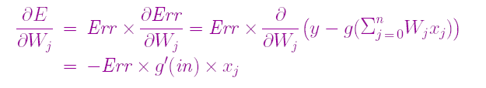
Derivation of a learning rule for Perceptrons Minimizing Squared Errors
The squared error for a single training example with input x and true output y is:
Where h_{w} (x) is the output of the perceptron on the example and y is the true output value.
We can use the gradient descent to reduce the squared error by calculating the partial derivatives of E with respect to each weight.
Note: g’(in) derivative of the activation function. For sigmoid g’=g(1-g). For threshold perceptrons,
Where g’(n) is undefined, the original perceptron rule simply omitted it.

Slide 45



Gradient descent algorithm → we want to reduce E, for each weight w_{i} , change weight in direction of steepest descent:
Intuitively:
Err = y – h_{W}(x) is positive
output is too small → weights are increased for positive inputs and decreased for negative inputs.
Err = y – h_{W}(x) is negative
→ output is large → weights are decreased for positive inputs and increased for negative inputs.
α learning rate
W_{j} ← W_{j} + α × I_{j} × Err

Slide 46
W_{j} ← W_{j} + α × I_{j} × Err
Perceptron learning rule:
Start with random weights, w = (w₁, w₂, ... , w_{n}).
Select a training example (x,y) ∈ S.
Run the perceptron with input x and weights w to obtain g
Let α be the training rate (a user-set parameter).
Go to 2.
Epoch → cycle through the examples
Epochs are repeated until some stopping criterion is reached—
typically, that the weight changes have become very small.
The stochastic gradient method selects examples randomly from the training set rather than cycling through them.

Slide 47
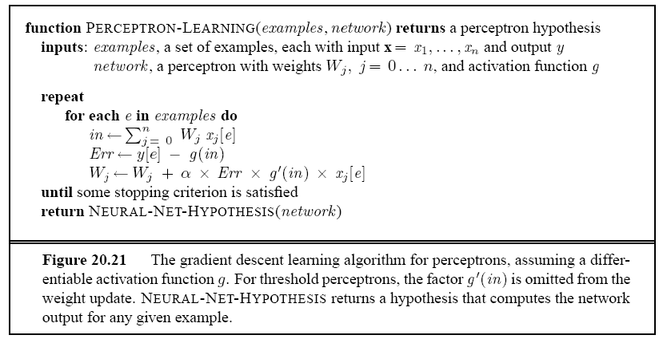
Perceptron Learning: Gradient Descent Learning Algorithm

Slide 48
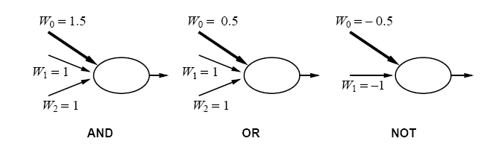
Expressiveness of Perceptrons
What hypothesis space can a perceptron represent?
Even more complex Booelan functions such as majority function .
But can it represent any arbitrary Boolean function?

Slide 49

Expressiveness of Perceptrons
A threshold perceptron returns 1 iff the weighted sum of its inputs (including the bias) is positive, i.e.,:
I.e., iff the input is on one side of the hyperplane it defines.
Perceptron → Linear Separator
Linear discriminant function or linear decision surface.
Weights determine slope and bias determines offset.

Slide 50
Linear Separability
Consider example with two inputs, x1, x2:
x₂
+
+
+
Can view trained network
as defining a “separation line”.
+
+
+
+
What is its equation?
x₁
Percepton used for classification

Slide 51
Linear Separability
x₂
+
+
?
OR
x₁
−
+

Slide 52
Linear Separability
x₂
−
?
+
AND
x₁
−
−

Slide 53
Linear Separability
x₂
+
?
−
XOR
x₁
−
+

Slide 54
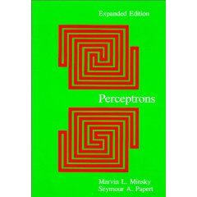
Linear Separability
x₂
Not linearly separable
+
−
XOR
x₁
−
+
Minsky & Papert (1969)
Bad News: Perceptrons can only represent linearly separable functions.

Slide 55
Linear Separability: XOR
Consider a threshold perceptron for the logical XOR function (two inputs):
Our examples are:
x1 x2 label
1 0 0 0
2 1 0 1
3 0 1 1
4 1 1 0
Given our examples, we have the following inequalities
for the perceptron:
From (1) 0 + 0 ≤ T → T≥0
From (2) w₁+ 0 > T → w₁ > T
From (3) 0 + w2 > T → w₂ > T
From (4) w1 + w2 ≤ T
w1 + w2 > 2T
contradiction
So, XOR is not linearly separable

Slide 56
Convergence of Perceptron Learning Algorithm
Perceptron converges to a consistent function, if…
… training data linearly separable
… step size α sufficiently small
… no “hidden” units

Slide 57
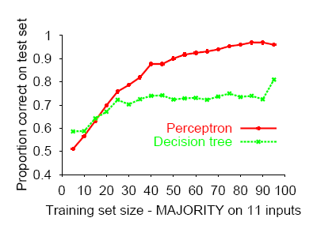
Perceptron learns majority function easily,
DTL is hopeless

Slide 58
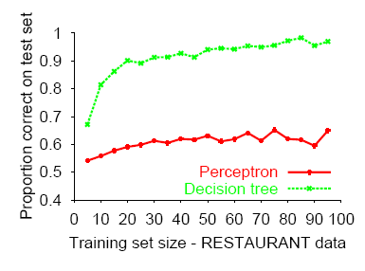
DTL learns restaurant function easily,
perceptron cannot represent it

Slide 59
Good news: Adding hidden layer allows more target functions to be represented.
Minsky & Papert (1969)

