Slide 1
Chapter 4: Indexing

Slide 2
Outline
Basic Concepts
Ordered Indices
B⁺-Tree Index Files
B-Tree Index Files
Hashing
Write-optimized indices
Spatio-Temporal Indexing

Slide 3
Basic Concepts
Indexing mechanisms used to speed up access to desired data.
E.g., author catalog in library
Search Key - attribute to set of attributes used to look up records in a file.
An index file consists of records (called index entries) of the form
Index files are typically much smaller than the original file
Two basic kinds of indices:
Ordered indices: search keys are stored in sorted order
Hash indices: search keys are distributed uniformly across “buckets” using a “hash function”.
search-key
pointer

Slide 4
Index Evaluation Metrics or Attributes of Indexing
Access types: This refers to the type of access such as value-based search, range access, etc.
Records with a specified value in the attribute
Records with an attribute value falling in a specified range of values.
Access time: refers type of access such as range access or value based access
Insertion time: It refers to the time taken to find the appropriate space and insert new data.
Deletion time: Time taken to find an item and delete it as well as update the index structure.
Space overhead: It refers to the additional space required by the index.

Slide 5
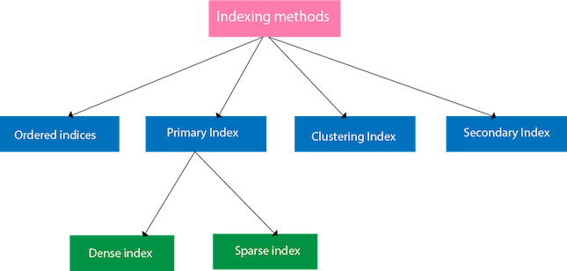
Indexing Methods

Slide 6
Ordered Indices
In an ordered index, index entries are stored sorted on the search key value.
Clustering index: in a sequentially ordered file, the index whose search key specifies the sequential order of the file.
Also called primary index
The search key of a primary index is usually but not necessarily the primary key.
Secondary index: an index whose search key specifies an order different from the sequential order of the file. Also called nonclustering index.
Index-sequential file: sequential file ordered on a search key, with a clustering index on the search key.

Slide 7
Dense Index Files
Dense index — The dense index contains an index record for every search key value in the data file. It makes searching faster.
In this, the number of records in the index table is same as the number of records in the main table.
It needs more space to store index record itself. The index records have the search key and a pointer to the actual record on the disk.
E.g. index on ID attribute of instructor relation

Slide 8
Dense Index Files (Cont.)
Dense index on dept_name, with instructor file sorted on dept_name

Slide 9
Sparse Index Files
Sparse Index: The index record appears only for a few items in the data file. Each item points to a block as shown.
To locate a record, we find the index record with the largest search key value less than or equal to the search key value we are looking for.
We start at that record pointed to by the index record, and proceed along with the pointers in the file (that is, sequentially) until we find the desired record.
Number of Accesses required=log₂(n)+1,
here n=number of blocks acquired by index file
Contains index records for only some search-key values.
Applicable when records are sequentially ordered on search-key
To locate a record with search-key value K we:
Find index record with largest search-key value < K
Search file sequentially starting at the record to which the index record points

Slide 10
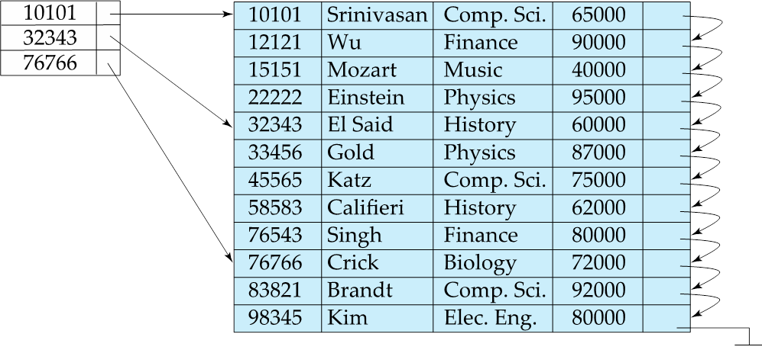

Slide 11
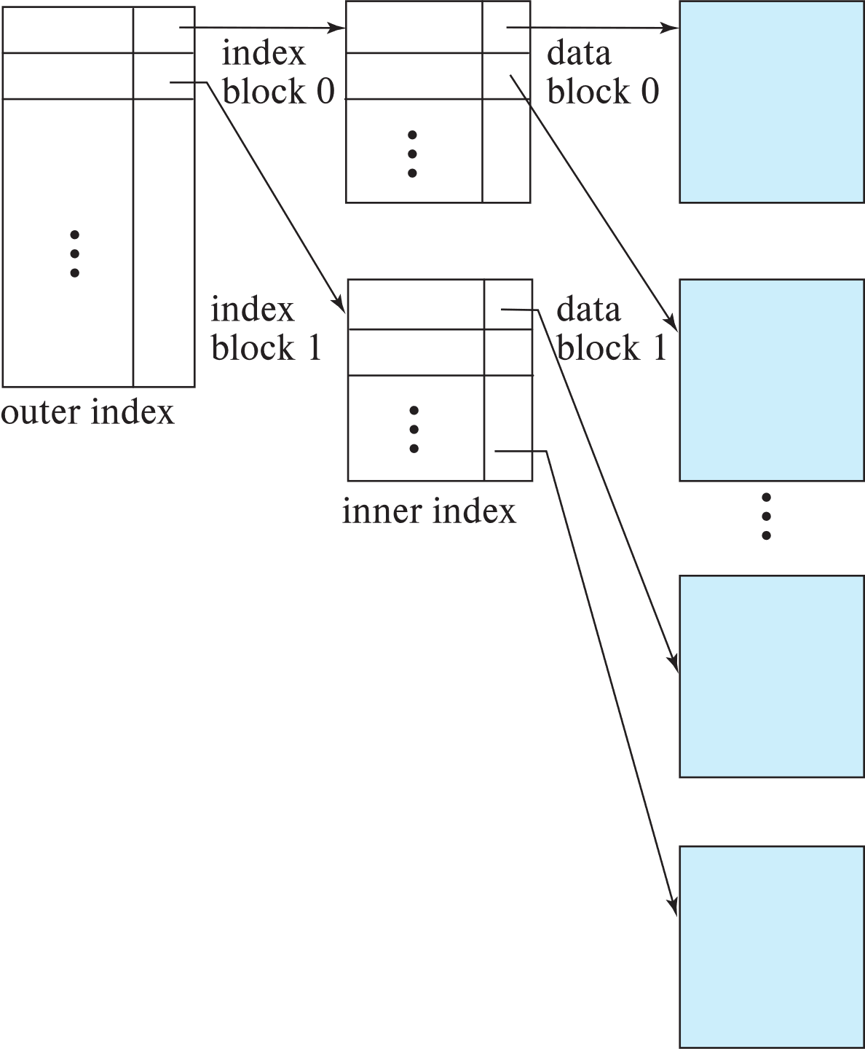
Sparse Index Files (Cont.)
Compared to dense indices:
Less space and less maintenance overhead for insertions and deletions.
Generally slower than dense index for locating records.
Good tradeoff:
for clustered index: sparse index with an index entry for every block in file, corresponding to least search-key value in the block. For unclustered index: sparse index on top of dense index (multilevel index)

Slide 12
Indexing in database
Creating Index Index can increase the speed on search records. In creating the index, index key fields are specified based on fields that are often accessed by clauses : Where, Join, Order By, Group By.
Syntax: Create Index index_name on table_name (key_field)
Example : Query : Find the name of employee ‘Smith’ Sql : Select Ename from emp wh
Creating the index with key field is ename :
Create index idx_ename on emp (ename);
Furthermore, the above sql is accessed again.
Sql : Select Ename from emp where ename=‘smith’;

Slide 13
Create INDEX
create a table named Employees consisting of the following records:
Employee_ID
Name
Age
Gender
Create table employees with Employee_ID as the primary key.
CREATE TABLE Employee (
Employee_ID int PRIMARY KEY,
Name varchar(25) NOT NULL,
Age int NOT NULL,
Gender varchar(6) NOT NULL

Slide 14
Create and drop single column Index.
;
The command for creating an index is as follows:
CREATE INDEX index_name ON table_name (column_Name);
1) Create an Index on Single Column:
Create an index on the Employee_ID field (primary indexing).
CREATE INDEX index_id ON Employee (Employee_ID);
2) To view Index :
You can check the different indexes present in a particular table given by the user or the server itself and their uniqueness.
Syntax:
SELECT * from USER_INDEXES; or
SHOW INDEXES FROM table_name;

Slide 15
3) Index with where Clause
Show indexes From tablename where column_name= value;
4) dropping an index in mysql is as follows:
ALTER TABLE table_name
DROP INDEX index_name

Slide 16
Create and drop multi column Index.
CREATE INDEX index_name ON table_name (column1,column2,…columnn);
CREATE INDEX index_id
On Employee (Employee_ID,Age);

Slide 17
Unique index
Worked as unique constraint .
CREATE UNIQUE INDEX index_idA ON TABLE (COLUMN_NAME);
CREATE UNIQUE INDEX index_uni
On Employee (Employee_id);

Slide 18
Secondary Index
It is a two-level indexing technique used to reduce the mapping size of the primary index.
The secondary index points to a certain location where the data is to be found but the actual data is not sorted like in the primary indexing.
Secondary Indexing is also known as non-clustered Indexing.
Secondary indexing is used to improve the search performance of frequently queried non-key attributes/columns in a database table.
Unlike primary indexing, which is based on the primary key, secondary indexing focuses on non-key columns.
It creates an index structure that maps the values of the indexed column to the corresponding disk block addresses or pointers where the records are stored.
Secondary indexes enable faster access to records based on the values in the indexed column, reducing the need for full table scans.

Slide 19
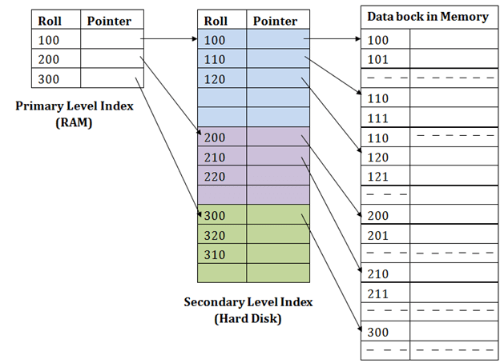
Secondary Index

Slide 20
Secondary Indices Example
Secondary index on salary field of instructor
Index record points to a bucket that contains pointers to all the actual records with that particular search-key value.

Slide 21
Index Update: Deletion
If deleted record was the only record in the file with its particular search-key value, the search-key is deleted from the index also.
Single-level index entry deletion:
Dense indices – deletion of search-key is similar to file record deletion.
Sparse indices –
if an entry for the search key exists in the index, it is deleted by replacing the entry in the index with the next search-key value in the file (in search-key order).
If the next search-key value already has an index entry, the entry is deleted instead of being replaced.

Slide 22
Index Update: Insertion
Single-level index insertion:
Perform a lookup using the search-key value of the record to be inserted.
Dense indices – if the search-key value does not appear in the index, insert it
Indices are maintained as sequential files
Need to create space for new entry, overflow blocks may be required
Sparse indices – if index stores an entry for each block of the file, no change needs to be made to the index unless a new block is created.
If a new block is created, the first search-key value appearing in the new block is inserted into the index.
Multilevel insertion and deletion: algorithms are simple extensions of the single-level algorithms

Slide 23
Indexing Use Cases
Online Transaction Processing (OLTP) Systems: Indexing is well-suited for OLTP systems, where rapid data retrieval is essential for handling numerous concurrent user requests.
Range Queries: When dealing with queries involving a range of values, ordered indexing can significantly speed up search times.
Primary and Secondary Key Lookups: Indexing primary and secondary keys provide a direct path to essential data records.
Best Practices:
Limit the Number of Indexes: Too many indexes can lead to increased storage requirements and performance overhead. Identify critical fields and create indexes accordingly.
Regular Maintenance: Periodically analyze and rebuild indexes to ensure optimal performance as data changes over time

Slide 24
B⁺-Tree
The B+ tree is a balanced binary search tree. It follows a multi-level index format.
In the B+ tree, leaf nodes denote actual data pointers. B+ tree ensures that all leaf nodes remain at the same height.
B+ trees store records in leaf nodes and keys in internal nodes
In the B+ tree, the leaf nodes are linked using a link list. Therefore, a B+ tree can support random access as well as sequential access.
The properties of B+ trees are similar to the properties of B trees, except that the B trees can store keys and records in all internal nodes and leaf nodes
One profound property of the B+ tree is that all the leaf nodes are connected to each other in a single linked list format and a data pointer is available to point to the data present in disk file. This helps fetch the records in equal numbers of disk access.

Slide 25
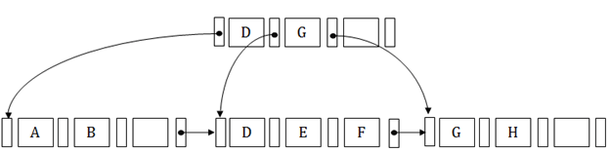
Structure of B+ Tree
In the B+ tree, every leaf node is at equal distance from the root node. The B+ tree is of the order n where n is fixed for every B+ tree.
It contains an internal node and leaf node.
Internal node
An internal node of the B+ tree can contain at least n/2 record pointers except the root node.
At most, an internal node of the tree contains n pointers.
Leaf node
The leaf node of the B+ tree can contain at least n/2 record pointers and n/2 key values.
At most, a leaf node contains n record pointer and n key values.
Every leaf node of the B+ tree contains one block pointer P to point to next leaf node.

Slide 26
Properties of B+ trees
Every node in a B+ Tree, except root, will hold a maximum of m children and (m-1) keys, and a minimum of ⌈m/2⌉ children and ⌈m−1/2⌉ keys, since the order of the tree is m.
The root node must have no less than two children and at least one search key.
All the paths in a B tree must end at the same level, i.e. the leaf nodes must be at the same level.
A B+ tree always maintains sorted data.

Slide 27
Example of B⁺-Tree

Slide 28
B⁺-Tree Index Files (Cont.)
A B⁺-tree is a rooted tree satisfying the following properties:
All paths from root to leaf are of the same length
Each node that is not a root or a leaf has between ⎡n/2⎤ and n children.
A leaf node has between ⎡(n–1)/2⎤ and n–1 values
Special cases:
If the root is not a leaf, it has at least 2 children.
If the root is a leaf (that is, there are no other nodes in the tree), it can have between 0 and (n–1) values.

Slide 29
B⁺-Tree Node Structure
Typical node
K_{i} are the search-key values
P_{i} are pointers to children (for non-leaf nodes) or pointers to records or buckets of records (for leaf nodes).
The search-keys in a node are ordered
K₁ < K₂ < K₃ < . . . < K_{n–1}
(Initially assume no duplicate keys, address duplicates later)

Slide 30
Leaf Nodes in B⁺-Trees
Properties of a leaf node:
For i = 1, 2, . . ., n–1, pointer P_{i} points to a file record with search-key value K_{i},
If L_{i}, L_{j} are leaf nodes and i < j, L_{i}’s search-key values are less than or equal to L_{j}’s search-key values
P_{n} points to next leaf node in search-key order

Slide 31
Non-Leaf Nodes in B⁺-Trees
Non leaf nodes form a multi-level sparse index on the leaf nodes. For a non-leaf node with m pointers:
All the search-keys in the subtree to which P₁ points are less than K₁
For 2 ≤ i ≤ n – 1, all the search-keys in the subtree to which P_{i} points have values greater than or equal to K_{i–1} and less than K_{i}
All the search-keys in the subtree to which P_{n} points have values greater than or equal to K_{n–1}
General structure

Slide 32
Example of B⁺-tree
B⁺-tree for instructor file (n = 6)
Leaf nodes must have between 3 and 5 values (⎡(n–1)/2⎤ and n –1, with n = 6).
Non-leaf nodes other than root must have between 3 and 6 children (⎡(n/2⎤ and n with n =6).
Root must have at least 2 children.

Slide 33
Observations about B⁺-trees
Since the inter-node connections are done by pointers, “logically” close blocks need not be “physically” close.
The non-leaf levels of the B⁺-tree form a hierarchy of sparse indices.
The B⁺-tree contains a relatively small number of levels
Level below root has at least 2* ⎡n/2⎤ values
Next level has at least 2* ⎡n/2⎤ * ⎡n/2⎤ values
.. etc.
If there are K search-key values in the file, the tree height is no more than ⎡ log_{⎡n/2⎤}(K)⎤
thus searches can be conducted efficiently.
Insertions and deletions to the main file can be handled efficiently, as the index can be restructured in logarithmic time (as we shall see).

Slide 34
Queries on B⁺-Trees
function find(v)
1. C=root
2. while (C is not a leaf node)
Let i be least number s.t. V ≤ K_{i}.
if there is no such number i then
Set C = last non-null pointer in C
else if (v = C.K_{i} ) Set C = P_{i +1}
else set C = C.P_{i}
3. if for some i, K_{i} = V then return C.P_{i}
4. else return null /* no record with search-key value v exists. */

Slide 35
Queries on B⁺-Trees (Cont.)
Range queries find all records with search key values in a given range
See book for details of function findRange(lb, ub) which returns set of all such records
Real implementations usually provide an iterator interface to fetch matching records one at a time, using a next() function

Slide 36
Queries on B⁺⁻Trees (Cont.)
If there are K search-key values in the file, the height of the tree is no more than ⎡log_{⎡n/2⎤}(K)⎤.
A node is generally the same size as a disk block, typically 4 kilobytes
and n is typically around 100 (40 bytes per index entry).
With 1 million search key values and n = 100
at most log₅₀(1,000,000) = 4 nodes are accessed in a lookup traversal from root to leaf.
Contrast this with a balanced binary tree with 1 million search key values — around 20 nodes are accessed in a lookup
above difference is significant since every node access may need a disk I/O, costing around 20 milliseconds

Slide 37
Non-Unique Keys
If a search key a_{i} is not unique, create instead an index on a composite key (a_{i} , A_{p}), which is unique
A_{p} could be a primary key, record ID, or any other attribute that guarantees uniqueness
Search for a_{i} = v can be implemented by a range search on composite key, with range (v, - ∞) to (v, + ∞)
But more I/O operations are needed to fetch the actual records
If the index is clustering, all accesses are sequential
If the index is non-clustering, each record access may need an I/O operation

Slide 38
Updates on B⁺-Trees: Insertion
Assume record already added to the file. Let
pr be pointer to the record, and let
v be the search key value of the record
Find the leaf node in which the search-key value would appear
If there is room in the leaf node, insert (v, pr) pair in the leaf node
Otherwise, split the node (along with the new (v, pr) entry) as discussed in the next slide, and propagate updates to parent nodes.

Slide 39
Updates on B⁺-Trees: Insertion (Cont.)
Splitting a leaf node:
take the n (search-key value, pointer) pairs (including the one being inserted) in sorted order. Place the first ⎡n/2⎤ in the original node, and the rest in a new node.
let the new node be p, and let k be the least key value in p. Insert (k,p) in the parent of the node being split.
If the parent is full, split it and propagate the split further up.
Splitting of nodes proceeds upwards till a node that is not full is found.
In the worst case the root node may be split increasing the height of the tree by 1.
Result of splitting node containing Brandt, Califieri and Crick on inserting Adams
Next step: insert entry with (Califieri, pointer-to-new-node) into parent

Slide 40
B⁺-Tree Insertion
Affected nodes
B⁺-Tree before and after insertion of “Adams”

Slide 41
B⁺-Tree Insertion
B⁺-Tree before and after insertion of “Lamport”
Affected nodes
Affected nodes

Slide 42
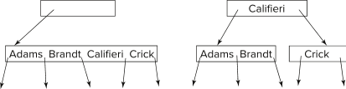
Insertion in B⁺-Trees (Cont.)
Splitting a non-leaf node: when inserting (k,p) into an already full internal node N
Copy N to an in-memory area M with space for n+1 pointers and n keys
Insert (k,p) into M
Copy P₁,K₁, …, K _{⎡n/2⎤-1},P _{⎡n/2⎤} from M back into node N
Copy P_{⎡n/2⎤+1},K _{⎡n/2⎤+1},…,K_{n},P_{n+1} from M into newly allocated node N'
Insert (K _{⎡n/2⎤},N') into parent N
Example
Read pseudocode in book!

Slide 43
Examples of B⁺-Tree Deletion
Before and after deleting “Srinivasan”
Affected nodes
Deleting “Srinivasan” causes merging of under-full leaves

Slide 44
Examples of B⁺-Tree Deletion (Cont.)
Before and after deleting “Singh” and “Wu”
Affected nodes
Leaf containing Singh and Wu became underfull, and borrowed a value Kim from its left sibling
Search-key value in the parent changes as a result

Slide 45
Example of B⁺-tree Deletion (Cont.)
Before and after deletion of “Gold”
Node with Gold and Katz became underfull, and was merged with its sibling
Parent node becomes underfull, and is merged with its sibling
Value separating two nodes (at the parent) is pulled down when merging
Root node then has only one child, and is deleted

Slide 46
Updates on B⁺-Trees: Deletion
Assume record already deleted from file. Let V be the search key value of the record, and Pr be the pointer to the record.
Remove (Pr, V) from the leaf node
If the node has too few entries due to the removal, and the entries in the node and a sibling fit into a single node, then merge siblings:
Insert all the search-key values in the two nodes into a single node (the one on the left), and delete the other node.
Delete the pair (K_{i–1}, P_{i}), where P_{i} is the pointer to the deleted node, from its parent, recursively using the above procedure.

Slide 47
Updates on B⁺-Trees: Deletion
Otherwise, if the node has too few entries due to the removal, but the entries in the node and a sibling do not fit into a single node, then redistribute pointers:
Redistribute the pointers between the node and a sibling such that both have more than the minimum number of entries.
Update the corresponding search-key value in the parent of the node.
The node deletions may cascade upwards till a node which has ⎡n/2⎤ or more pointers is found.
If the root node has only one pointer after deletion, it is deleted and the sole child becomes the root.

Slide 48
Complexity of Updates
Cost (in terms of number of I/O operations) of insertion and deletion of a single entry proportional to height of the tree
With K entries and maximum fanout of n, worst case complexity of insert/delete of an entry is O(log_{⎡n/2⎤}(K))
In practice, number of I/O operations is less:
Internal nodes tend to be in buffer
Splits/merges are rare, most insert/delete operations only affect a leaf node
Average node occupancy depends on insertion order
2/3rds with random, ½ with insertion in sorted order

Slide 49
Non-Unique Search Keys
Alternatives to scheme described earlier
Buckets on separate block (bad idea)
List of tuple pointers with each key
Extra code to handle long lists
Deletion of a tuple can be expensive if there are many duplicates on search key (why?)
Worst case complexity may be linear!
Low space overhead, no extra cost for queries
Make search key unique by adding a record-identifier
Extra storage overhead for keys
Simpler code for insertion/deletion
Widely used
Notes:
49

Slide 50
B⁺-Tree File Organization
B⁺-Tree File Organization:
Leaf nodes in a B⁺-tree file organization store records, instead of pointers
Helps keep data records clustered even when there are insertions/deletions/updates
Leaf nodes are still required to be half full
Since records are larger than pointers, the maximum number of records that can be stored in a leaf node is less than the number of pointers in a nonleaf node.
Insertion and deletion are handled in the same way as insertion and deletion of entries in a B⁺-tree index.

Slide 51
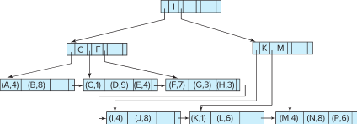
B⁺-Tree File Organization (Cont.)
Example of B+-tree File Organization
Good space utilization important since records use more space than pointers.
To improve space utilization, involve more sibling nodes in redistribution during splits and merges
Involving 2 siblings in redistribution (to avoid split / merge where possible) results in each node having at least entries

Slide 52
Other Issues in Indexing
Record relocation and secondary indices
If a record moves, all secondary indices that store record pointers have to be updated
Node splits in B⁺-tree file organizations become very expensive
Solution: use search key of B⁺-tree file organization instead of record pointer in secondary index
Add record-id if B⁺-tree file organization search key is non-unique
Extra traversal of file organization to locate record
Higher cost for queries, but node splits are cheap
Notes:
52

Slide 53
Indexing Strings
Variable length strings as keys
Variable fanout
Use space utilization as criterion for splitting, not number of pointers
Prefix compression
Key values at internal nodes can be prefixes of full key
Keep enough characters to distinguish entries in the subtrees separated by the key value
E.g., “Silas” and “Silberschatz” can be separated by “Silb”
Keys in leaf node can be compressed by sharing common prefixes

Slide 54
Bulk Loading and Bottom-Up Build
Inserting entries one-at-a-time into a B⁺-tree requires ≥ 1 IO per entry
assuming leaf level does not fit in memory
can be very inefficient for loading a large number of entries at a time (bulk loading)
Efficient alternative 1:
sort entries first (using efficient external-memory sort algorithms discussed later in Section 12.4)
insert in sorted order
insertion will go to existing page (or cause a split)
much improved IO performance, but most leaf nodes half full
Efficient alternative 2: Bottom-up B⁺-tree construction
As before sort entries
And then create tree layer-by-layer, starting with leaf level
details as an exercise
Implemented as part of bulk-load utility by most database systems

Slide 55
B-Tree Index Files
Similar to B+-tree, but B-tree allows search-key values to appear only once; eliminates redundant storage of search keys.
Search keys in nonleaf nodes appear nowhere else in the B-tree; an additional pointer field for each search key in a nonleaf node must be included.
Generalized B-tree leaf node
Nonleaf node – pointers Bi are the bucket or file record pointers.

Slide 56
B-Tree Index Files (Cont.)
Advantages of B-Tree indices:
May use less tree nodes than a corresponding B⁺-Tree.
Sometimes possible to find search-key value before reaching leaf node.
Disadvantages of B-Tree indices:
Only small fraction of all search-key values are found early
Non-leaf nodes are larger, so fan-out is reduced. Thus, B-Trees typically have greater depth than corresponding B⁺-Tree
Insertion and deletion more complicated than in B⁺-Trees
Implementation is harder than B⁺-Trees.
Typically, advantages of B-Trees do not out weigh disadvantages.

Slide 57
B-Tree Index File Example
B-tree (above) and B+-tree (below) on same data

Slide 58
Indexing on Flash
Random I/O cost much lower on flash
20 to 100 microseconds for read/write
Writes are not in-place, and (eventually) require a more expensive erase
Optimum page size therefore much smaller
Bulk-loading still useful since it minimizes page erases
Write-optimized tree structures (discussed later) have been adapted to minimize page writes for flash-optimized search trees

Slide 59
Indexing in Main Memory
Random access in memory
Much cheaper than on disk/flash
But still expensive compared to cache read
Data structures that make best use of cache preferable
Binary search for a key value within a large B⁺-tree node results in many cache misses
B⁺- trees with small nodes that fit in cache line are preferable to reduce cache misses
Key idea: use large node size to optimize disk access, but structure data within a node using a tree with small node size, instead of using an array.

Slide 60
Hashing
Hashing revolves around using mathematical functions, known as hash functions, to calculate direct locations of data records on a disk. But how is it different from Indexing, and why is it an invaluable asset for specific database tasks?
Unlike Indexing, Hashing doesn’t rely on index structures to access data. Instead, it generates unique addresses for data records using hash functions, which take search keys as parameters. This direct calculation of data locations on the disk allows for faster retrieval, making Hashing an ideal choice for large databases.
Types of Hashing:
Static Hashing: In static hashing, a fixed number of buckets is allocated to store data records. While it provides a straightforward approach, it may lead to underutilization or overflow of buckets.
Dynamic Hashing: To address the limitations of static hashing, dynamic hashing adapts the number of buckets dynamically as data grows or shrinks, ensuring efficient space utilization.

Slide 61
Example of Hash Index
hash index on instructor, on attribute ID

Slide 62
Comparison Indexing VS Hashing
: Indexing vs Hashing
Each technique, Indexing, and Hashing, possesses its unique strengths that cater to different use cases in the database world. Let’s compare them against each other.
Data Retrieval Speed
Indexing: With its pre-organized data structures, Indexing offers faster data retrieval, especially for range queries and ordered records.
Hashing: Thanks to its direct calculation of data locations, Hashing outperforms Indexing when searching for specific items, especially in large databases.
Storage Efficiency
Indexing: While Indexes provide optimized search, they come with the cost of additional storage space.
Hashing: Hashing uses a dynamic allocation of buckets, ensuring better storage efficiency, particularly for databases with varying data sizes.

Slide 63
Comparison Indexing VS Hashing
Database Size
Indexing: Indexing works well for small to medium-sized databases where the additional storage overhead is manageable.
Hashing: Hashing shines in large databases, where it scales efficiently and maintains performance even with massive datasets.
Complexity
Indexing: The complexity of Indexing increases with the number of indexes and their size, potentially affecting performance.
Hashing: Hashing offers a simpler and more straightforward method for data retrieval, reducing complexity for certain scenarios.

Slide 64
Static Hashing
A bucket is a unit of storage containing one or more entries (a bucket is typically a disk block).
we obtain the bucket of an entry from its search-key value using a hash function
Hash function h is a function from the set of all search-key values K to the set of all bucket addresses B.
Hash function is used to locate entries for access, insertion as well as deletion.
Entries with different search-key values may be mapped to the same bucket; thus entire bucket has to be searched sequentially to locate an entry.
In a hash index, buckets store entries with pointers to records
In a hash file-organization buckets store records

Slide 65
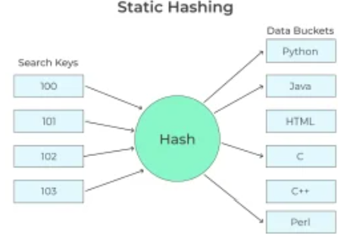
Static hashing
In static hashing, a search key value is provided by the designed Hash Function always computes the same address
For example, if mod (4) hash function is used, then it shall generate only 5 values.
The number of buckets provided remains unchanged at all times
Bucket address = h (K): the address of the desired data item which is used for insertion updating and deletion operations.

Slide 66
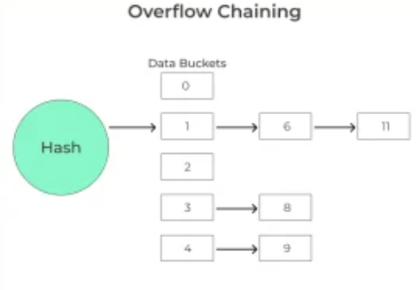
Collision and its resolution
Collision is a condition when there is a fight between multiple data items for the same address
Simply collision arises when a hash function generates an address at which data is already stored
Overflow chaining (closed hashing)
When buckets are full a new bucket is allocated for the same hash result which is then linked after the previous one
For example, if h (k) =3 and if some data is already present in this location, now a new bucket is linked to the existing location 3

Slide 67
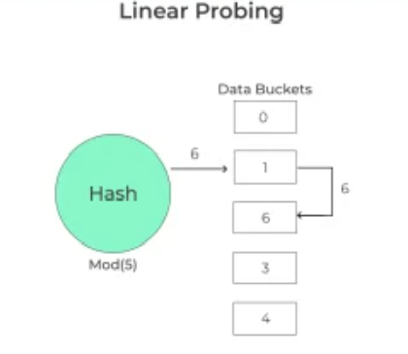
Linear probing (open hashing)
Hash Function is generating a key at which data is already stored then the next free available bucket is allocated
For example, if h (k) =6 and is already occupied now check next possible available bucket that is free

Slide 68
Handling of Bucket Overflows
Bucket overflow can occur because of
Insufficient buckets
Skew in distribution of records. This can occur due to two reasons:
multiple records have same search-key value
chosen hash function produces non-uniform distribution of key values
Although the probability of bucket overflow can be reduced, it cannot be eliminated; it is handled by using overflow buckets.

Slide 69
Handling of Bucket Overflows (Cont.)
Overflow chaining – the overflow buckets of a given bucket are chained together in a linked list.
Above scheme is called closed addressing (also called closed hashing or open hashing depending on the book you use)
An alternative, called open addressing (also called open hashing or closed hashing depending on the book you use) which does not use over- flow buckets, is not suitable for database applications.

Slide 70
Example of Hash File Organization
Hash file organization of instructor file, using dept_name as key (See figure in next slide.)
There are 10 buckets,
The binary representation of the I ^{th} character is assumed to be the integer i.
The hash function returns the sum of the binary representations of the characters modulo 10
E.g. h(Music) = 1 h(History) = 2 h(Physics) = 3 h(Elec. Eng.) = 3

Slide 71
Example of Hash File Organization
Hash file organization of instructor file, using dept_name as key.

Slide 72
Deficiencies of Static Hashing
In static hashing, function h maps search-key values to a fixed set of B of bucket addresses. Databases grow or shrink with time.
If initial number of buckets is too small, and file grows, performance will degrade due to too much overflows.
If space is allocated for anticipated growth, a significant amount of space will be wasted initially (and buckets will be underfull).
If database shrinks, again space will be wasted.
One solution: periodic re-organization of the file with a new hash function
Expensive, disrupts normal operations
Better solution: allow the number of buckets to be modified dynamically.

Slide 73
Dynamic Hashing
Periodic rehashing
If number of entries in a hash table becomes (say) 1.5 times size of hash table,
create new hash table of size (say) 2 times the size of the previous hash table
Rehash all entries to new table
Linear Hashing
Do rehashing in an incremental manner
Extendable Hashing
Tailored to disk based hashing, with buckets shared by multiple hash values
Doubling of # of entries in hash table, without doubling # of buckets

Slide 74
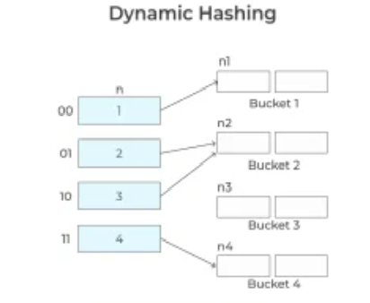
Dynamic hashing (extensible hashing)
The drawback of static hashing is that it does not expand or shrink its size based on the requirement of the database
Dynamic hashing provides a mechanism in which data buckets are added and removed dynamically and on-demand
Generally, Hash Function in dynamic hashing is designed to produce a large number of values such that only a few of them are used at initial stages

Slide 75
Conti…
Organization
The prefix of an entire hash value is taken as a hash index.
Only a portion of the hash value is used for computing bucket addresses.
Every hash index has a depth value to represent how many bits are used for computing a hash function.
These bits can address 2n buckets.
When all these bits are consumed i.e, when all the buckets are full then the depth value is increased linearly and twice the buckets are allocated.

Slide 76
Comparison of Ordered Indexing and Hashing
Cost of periodic re-organization
Relative frequency of insertions and deletions
Is it desirable to optimize average access time at the expense of worst-case access time?
Expected type of queries:
Hashing is generally better at retrieving records having a specified value of the key.
If range queries are common, ordered indices are to be preferred
In practice:
PostgreSQL supports hash indices, but discourages use due to poor performance
Oracle supports static hash organization, but not hash indices
SQLServer supports only B⁺-trees

Slide 77
Multiple-Key Access
Use multiple indices for certain types of queries.
Example:
select ID
from instructor
where dept_name = “Finance” and salary = 80000
Possible strategies for processing query using indices on single attributes:
1. Use index on dept_name to find instructors with department name Finance; test salary = 80000
2. Use index on salary to find instructors with a salary of $80000; test dept_name = “Finance”.
3. Use dept_name index to find pointers to all records pertaining to the “Finance” department. Similarly use index on salary. Take intersection of both sets of pointers obtained.

Slide 78
Indices on Multiple Keys
Composite search keys are search keys containing more than one attribute
E.g., (dept_name, salary)
Lexicographic ordering: (a₁, a₂) < (b₁, b₂) if either
a₁ < b₁, or
a₁=b₁ and a₂ < b₂

Slide 79
Indices on Multiple Attributes
Suppose we have an index on combined search-key
(dept_name, salary).
With the where clause where dept_name = “Finance” and salary = 80000 the index on (dept_name, salary) can be used to fetch only records that satisfy both conditions.
Using separate indices in less efficient — we may fetch many records (or pointers) that satisfy only one of the conditions.
Can also efficiently handle where dept_name = “Finance” and salary < 80000
But cannot efficiently handle where dept_name < “Finance” and balance = 80000
May fetch many records that satisfy the first but not the second condition

Slide 80
Bitmap Indices
Bitmap indices are a special type of index designed for efficient querying on multiple keys
Records in a relation are assumed to be numbered sequentially from, say, 0
Given a number n it must be easy to retrieve record n
Particularly easy if records are of fixed size
Applicable on attributes that take on a relatively small number of distinct values
E.g., gender, country, state, …
E.g., income-level (income broken up into a small number of levels such as 0-9999, 10000-19999, 20000-50000, 50000- infinity)
A bitmap is simply an array of bits

Slide 81
Bitmap Index Structure
In general, Bitmap combines the terms Bit and Map,
where bit represents the smallest amount of data on a computer, which can only hold either 0 or 1
map means transforming and organizing the data according to what value should be assigned to 0 and 1.

Slide 82
Bitmap Indices (Cont.)
In its simplest form a bitmap index on an attribute has a bitmap for each value of the attribute
Bitmap has as many bits as records
In a bitmap for value v, the bit for a record is 1 if the record has the value v for the attribute, and is 0 otherwise
Example

Slide 83
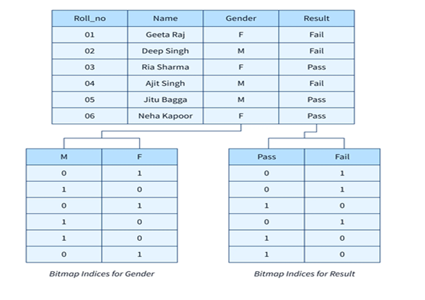
How Bitmap Indexing is Done? we have a Student table where we have 2 columns with low cardinality. Let's consider a problem statement, Query all the students who are female and have passed the exam.
Select Name from Student where Gender =’F’ and Result=’Pass’
Let's look at a table called Student and see how Bitmap is applied to

Slide 84
Bitmap Indices (Cont.)
Bitmap indices are useful for queries on multiple attributes
not particularly useful for single attribute queries
Queries are answered using bitmap operations
Intersection (and)
Union (or)
Each operation takes two bitmaps of the same size and applies the operation on corresponding bits to get the result bitmap
E.g., 100110 AND 110011 = 100010
100110 OR 110011 = 110111 NOT 100110 = 011001
Males with income level L1: 10010 AND 10100 = 10000
Can then retrieve required tuples.
Counting number of matching tuples is even faster

Slide 85
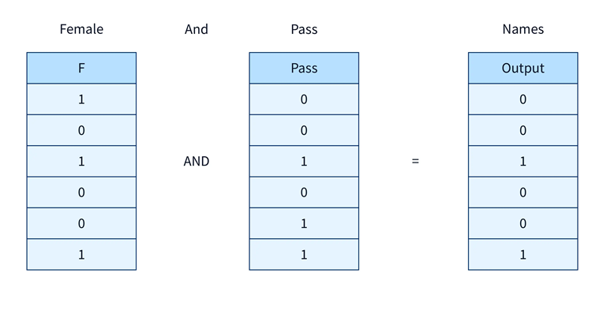
For the query above, the And operation is performed between Gender = F and Result = Pass. All the Gender = F values are mapped as 1(which means true) and M as 0(which means false) whereas, in the Result column same happens with Pass and Fail. Therefore, bimap is the same in its operation, except that logically it operates on bits, making it faster to return the same results. Instead of fetching each row, a logical "And" operation is performed, and the 1(in output under Names shown below) indicates the names that are to be retrieved as output.

Slide 86
Bitmap Indexing in SQL
This syntax can only be used by Oracle because MySQL is unable to support bitmap indexing.
A Bitmap Index is created using the following Syntax for a particular column of a particular table :
Syntax :
The _Index_name_ represents the name that you give to an index along with that to apply the bitmap to a particular column, you must specify the Table name and the exact column name.
CREATE BITMAP INDEX Index_Name -- give new index name here
ON Table_Name (Column_Name);-- give table name and column where you have to apply bitmap
Therefore, in the above example, the Bitmap on the Student table will look like the following :
Query :
CREATE BITMAP INDEX Student_bitmap
ON Student (Gender,Result);
Output:
Index Created

Slide 87
Conti..
Advantages:
Compared to the traditional method, records can be retrieved faster as it fetches the rows in form of bits.
You can combine several bitmap indices to get the desired results.
In addition to being efficient, this method is more effective when the columns have the least number of inserts, updates, and deletions.
Disadvantages:
On tables with few records, it is not recommended to use bitmap as the response time is already less for them.
A new record has to be entered into the table every time, which can be time-consuming and difficult to edit. As a result bitmap indexing is more efficient with static tables.
In the case of record deletion, the sequence of records is disturbed and creates gaps between other records.

Slide 88
Bitmap Indices (Cont.)
Bitmap indices generally very small compared with relation size
E.g., if record is 100 bytes, space for a single bitmap is 1/800 of space used by relation.
If number of distinct attribute values is 8, bitmap is only 1% of relation size

Slide 89
Efficient Implementation of Bitmap Operations
Bitmaps are packed into words; a single word and (a basic CPU instruction) computes and of 32 or 64 bits at once
E.g., 1-million-bit maps can be and-ed with just 31,250 instruction
Counting number of 1s can be done fast by a trick:
Use each byte to index into a precomputed array of 256 elements each storing the count of 1s in the binary representation
Can use pairs of bytes to speed up further at a higher memory cost
Add up the retrieved counts
Bitmaps can be used instead of Tuple-ID lists at leaf levels of B⁺-trees, for values that have a large number of matching records
Worthwhile if > 1/64 of the records have that value, assuming a tuple-id is 64 bits
Above technique merges benefits of bitmap and B⁺-tree indices

