Slide 1
DERIVED OPRATION :JOIN
JOIN means to combine something
JOIN means "to combine two or more tables".
It generates meaningful data by combining multiple relational tables.
hese tables are related using a key and have one-to-one or one-to-many relationships.
SQL Server supports multiple joins and each method has a specific way to retrieve data from multiple tables.
If you want to combine two or more table then SQL JOIN statement is used .it combines rows of that tables in one table and one can retrieve the information by a SELECT statement.
The joining of two or more tables is based on common field between them.

Slide 2
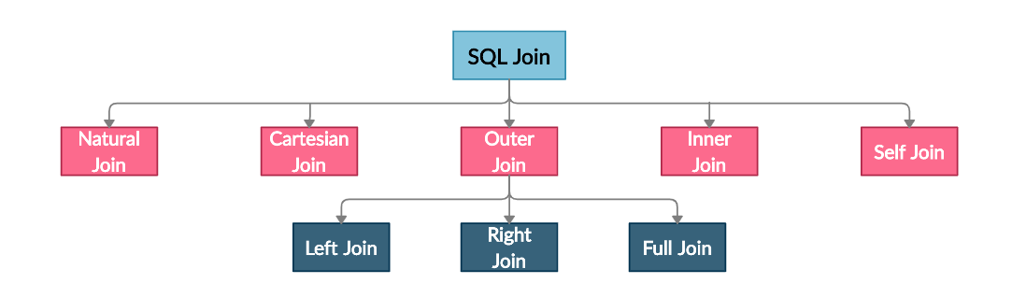
Types of joins

Slide 3
Join
Natural Join
Used to join tables on the basis of a common column
Cartesian Join/Cross join
Returns the cartesian product of tables’ rows
Inner Join
The result table consists of only the common rows
Left Outer Join
The result table contains all the rows from the first table
Right Outer Join
The result table contains all the rows from the second table
Full Outer Join
The result table contains all the rows from both the tables
Self Join
Used to join a table to itself

Slide 4
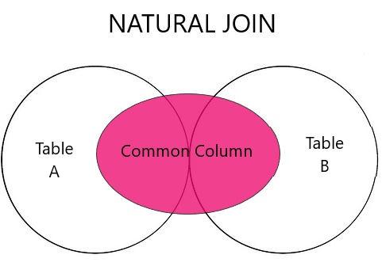
Natural join
A natural join is the set of tuples of all combinations in R and S that are equal on their common attribute names.
The common name and data type in both the tables. columns only appear once in the result of this join name

Slide 5
Syntax :
SELECT *
FROM TABLE1
NATURAL JOIN TABLE2;

Slide 6
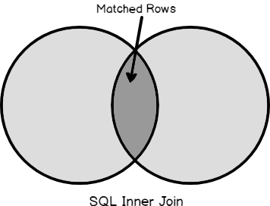
Inner join
inner join includes rows from the tables where the join conditions are satisfied. For example
inner join returns the matching rows from Table A and Table B.

Slide 7
Syntax:
SELECT column1, column2, ... FROM table1 INNER JOIN table2ON table1.column = table2.column;

Slide 8
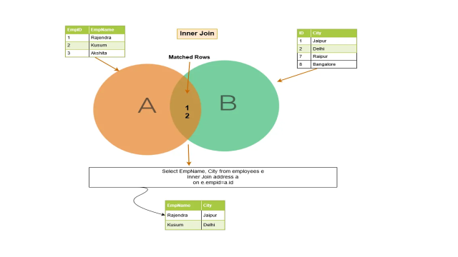
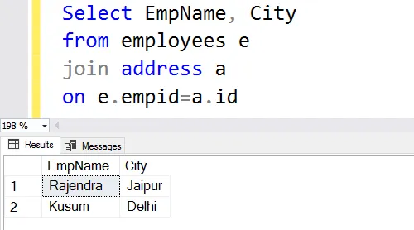
Inner join

Slide 9
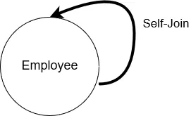
self-join
In a self-join, SQL Server joins the table with itself.
This means the table name appears twice in the from clause.
SELECT columns
FROM table AS alias1
JOIN table AS alias2 ON alias1.column = alias2.column;

Slide 10
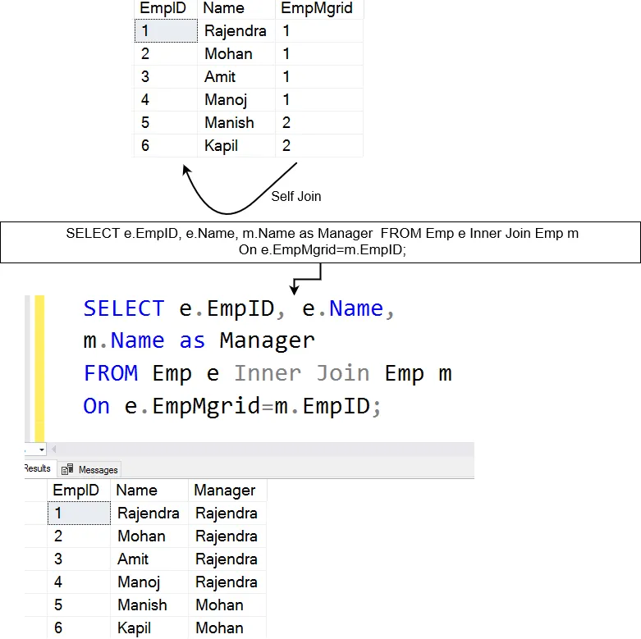
Table [Emp] that has employees as well as their managers’ data

Slide 11
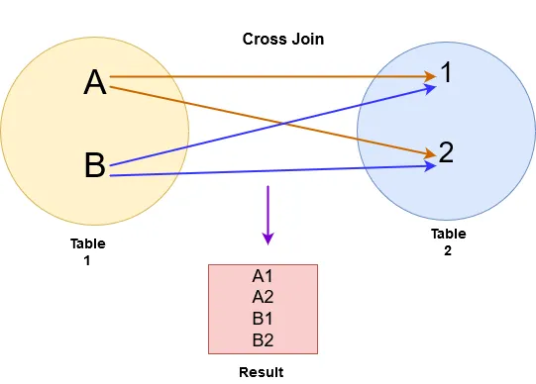
Cross join
In the cross join, SQL Server returns a Cartesian product from both tables.
For example, in the below image, we performed a cross-join for table A and B.

Slide 12
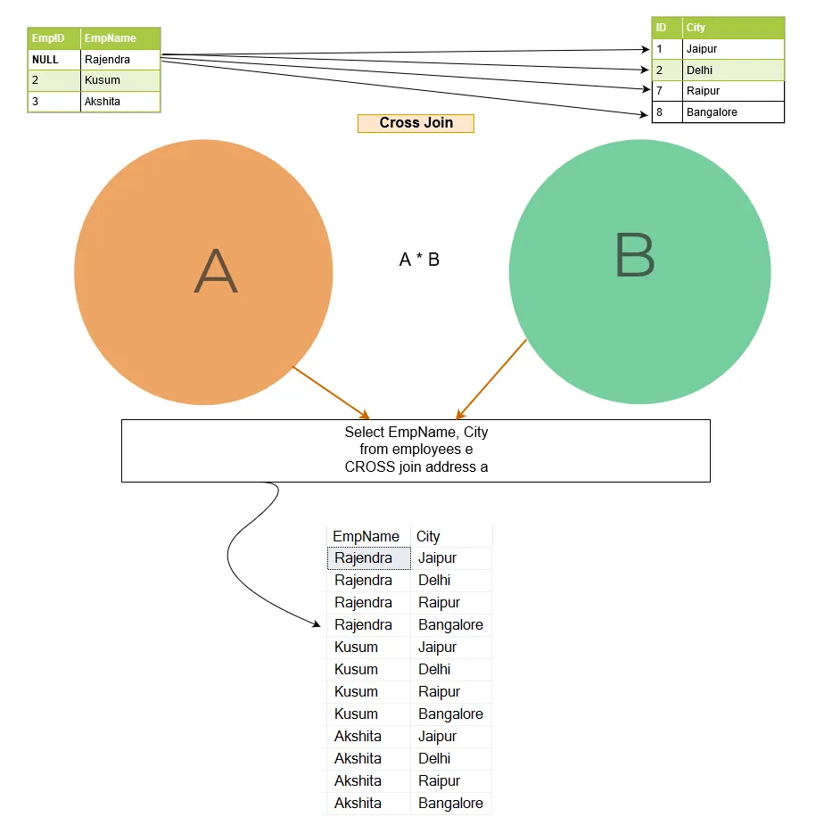
Example
Table [Employee] has three rows for Emp ID 1,2 and 3.
Table [Address] has records for Emp ID 1,2,7 and 8.

Slide 13
Outer join
The inner join returns the matching rows from both of the tables.
In outer join, it not only lists the matching rows, but it also returns the unmatched rows from the other tables.
The unmatched row depends on the left, right or full keywords.

Slide 14
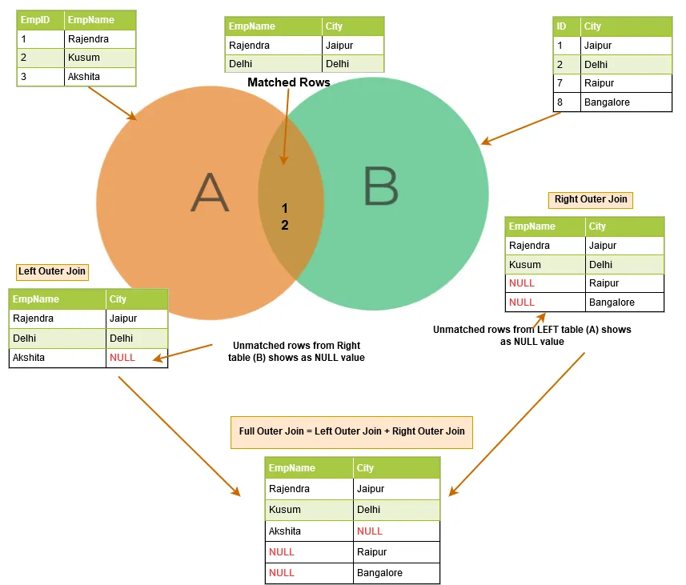

Slide 15
Left outer join
SQL left outer join returns the matching rows of both tables along with the unmatched rows from the left table.
If a record from the left table doesn’t have any matched rows in the right table, it displays the record with NULL values.
Syntax :
SELECT column_name(s) FROM table1 LEFT JOIN Table2 ON Table1.Column_Name=table2.column_name;

Slide 16
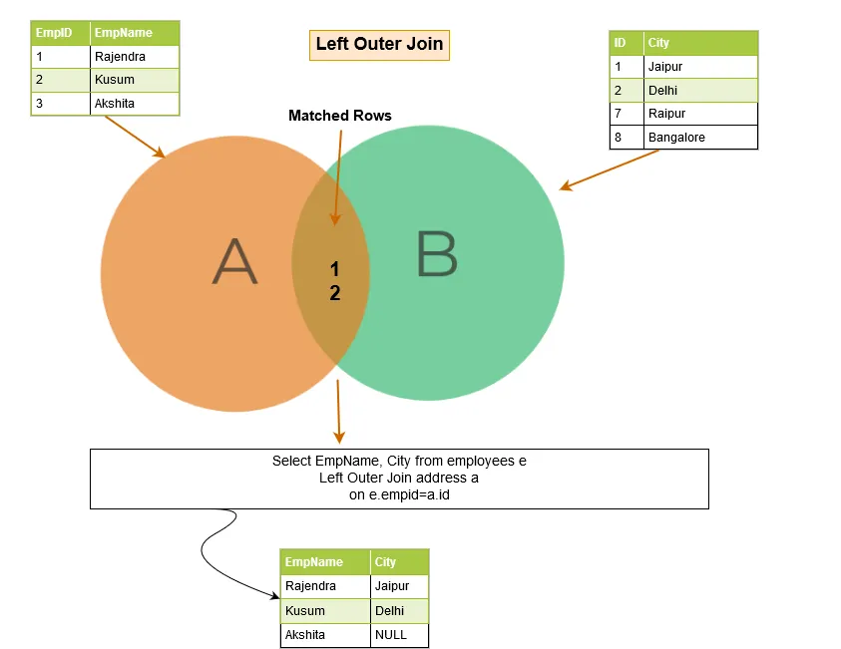
Conti..
Matched rows: Emp ID 1 and 2 exists in both the left and right tables.
Unmatched row: Emp ID 3 doesn’t exist on the right table. Therefore, we have a NULL value in the query output.

Slide 17
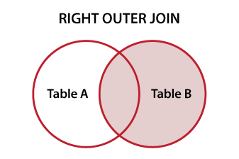
Right outer join
SQL right outer join returns the matching rows of both tables along with the unmatched rows from the right table.
If a record from the right table does not have any matched rows in the left table, it displays the record with NULL values.

Slide 18
Right Outer Join conti..
In given example, we have the following output rows:
Matching rows: Emp ID 1 and 2 exists in both tables; therefore, these rows are matched rows.
Unmatched rows: In the right table, we have additional rows for Emp ID 7 and 8, but these rows are not available in the left table. Therefore, we get NULL value in the right outer join for these rows.
Syntax :
SELECT column_name(s) FROM table1 RIGHT JOIN table2 ON table1.column_name = table2.column_name;

Slide 19
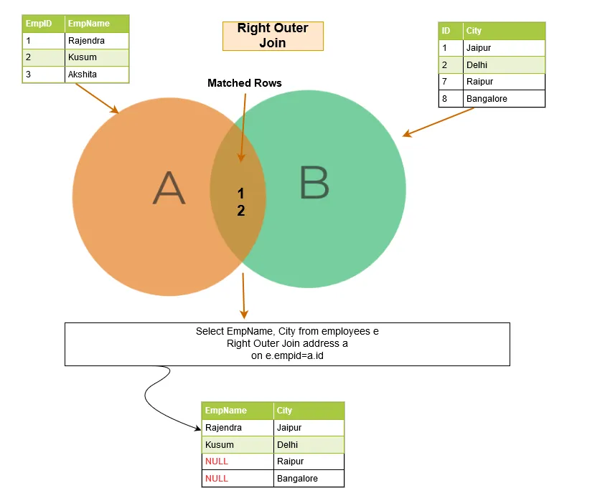
Right Outer conti..

Slide 20
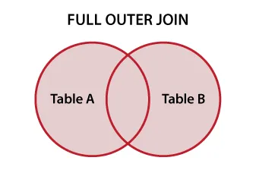
Full outer join
A full outer join returns the following rows in the output:
Matching rows between two tables.
Unmatched rows similar to left outer join: NULL values for unmatched rows from the right table.
Unmatched rows similar to right outer join: Null values for unmatched rows from the left table.
Syntax: SELECT column_name FROM table1 FULL OUTER JOIN table2 ON table1.columnName = table2.columnName WHERE condition;

Slide 21
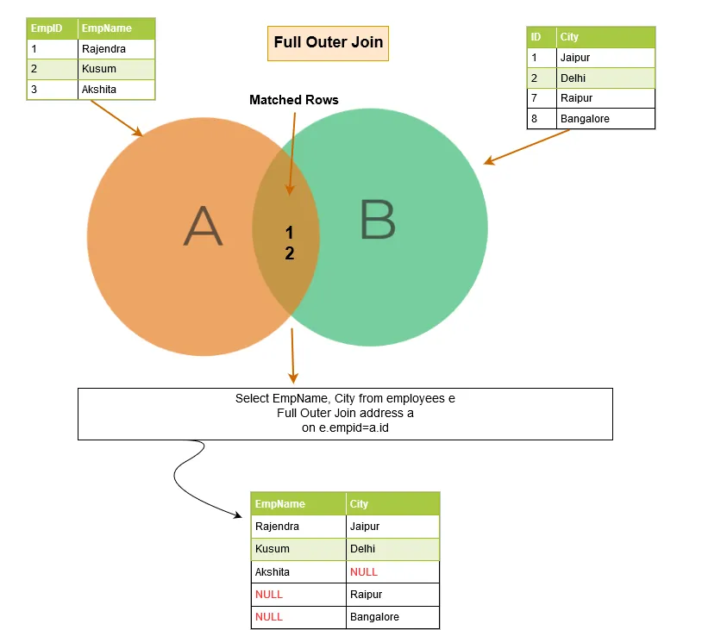
Full Outer Join

