Slide 1
Discrete Mathematics
Sets and Subsets 1.1

Slide 2
Definitions of sets
A set is any well-defined collection of objects
The elements or members of a set are the objects contained in the set
Well-defined means that it is possible to decide if a given object belongs to the collection or not.

Slide 3
Set notation
Enumeration of sets are represented with a list of elements in curly brackets – example: {1, 2, 3}
Set labels are uppercase letters in italics –
example: A, B, C
Element labels are lowercase letters – example: a, b, c
∅ is the label for the empty set, i.e., ∅ = { }

Slide 4
Membership
∈ → “is an element of” (Note that it is shaped like an “E” as in element)
∉ → “is not an element of”
Example:

Slide 5
Specifying sets with their properties:
A set can be represented or defined by the rules classifying whether an object belongs to a collection or not. A = {a | a is a positive even number less than 25} The above notation translates to “the set A is comprised of elements a where a satisfies __the given condition_______.”
A= {…………………..}
The set defined by
P(x), written {x | P(x)}, is just the collection of all objects for which P is sensible and true. {x | P(x)} is read, “the set of all x such that P(x).”

Slide 6
Examples of Common Sets
Write the following set elements:
Z⁺ = {x | x is a positive integer}
N = {x | x is a positive integer or zero}
Z = {x | x is an integer}
R = {x | x is a real number}
The set that has no elements in it is denoted either by { } or the symbol ∅ and is called the empty set.

Slide 7
Subset Notation
⊆ → “is contained in” (Note that it is shaped like a “C” as in contained in)
→ “is not contained in”
“Is not contained in” does not mean that there aren’t some elements that can be in both sets. It just means that not all of the elements of A are in B

Slide 8
Subset Examples
vowels ⊆ alphabet
letters that spell “see” ⊆ letters that spell “yes”
letters that spell “yes” ⊆ letters that spell “easy”
letters that spell “say” ⊆ letters that spell “easy”
positive integers ⊆ integers
odd integers ⊆ integers
integers ⊆ floating point values (real numbers)

Slide 9
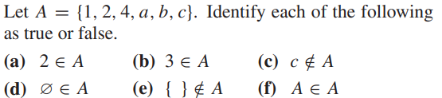
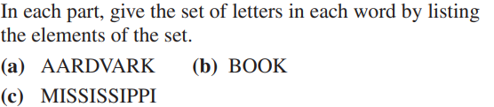
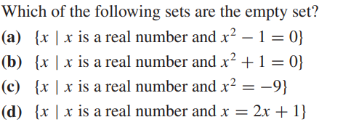
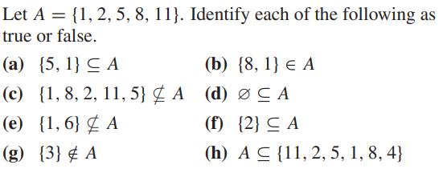
b,c,d,f : False
b,c : Empty set
b,c : False

Slide 10
Venn Diagram Named after British logician John Venn Graphical depiction of the relationship of sets. Does not represent the individual elements of the sets, rather it implies their existence Examples
B
A ⊆ B
A
A
B
or
B
A

Slide 11
More Venn Diagram Examples
a ∈ A, b ∈ B, and c ∈ A and c ∈ B
A
B
c
a
b

Slide 12
Theorems on Sets
A ⊆ B and B ⊆ C implies A ⊆ C
Example:
A = {x | letters that spell “see”} = {e, s}
B = {x | letters that spell “yes”} = {e, s, y}
C = {x | letters that spell “easy”} = {a, e, s, y}

Slide 13
Theorems on Sets (continued)
If A ⊆ B and B ⊆ C, then A ⊆ C.
If A ⊆ B and C ⊆ B, that doesn’t mean we can say anything at all about the relationship between A and C. It could be any of the following three cases:
B
A
C
B
A
C
B
A
C

Slide 14
Theorems on Sets (continued)
If A is any set, then A ⊆ A. That is, every set is a subset of itself.
Since ∅ contains no elements, then every element of ∅ is contained in every set. Therefore, if A is any set, the statement ∅ ⊆ A is always true.
If A ⊆ B and B ⊆ A, then A = B

Slide 15
Universal Set
There must be some all-encompassing group of elements from which the elements of each set are considered to be members of or not.
For example, to create the set of integers, we must take elements from the universal set of all numbers.
It’s desirable for the all-encompassing set to make sense.

Slide 16
Universal Set (continued)
The Universal Set U is the set containing all objects for which the discussion is meaningful. (e.g., examining whether a sock is an integer is a meaningless exercise.)
Any set is a subset of the universal set from which it derives its meaning
In Venn diagrams, the universal set is denoted with a rectangle.
A
U

Slide 17
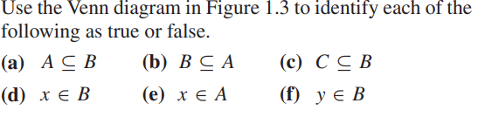
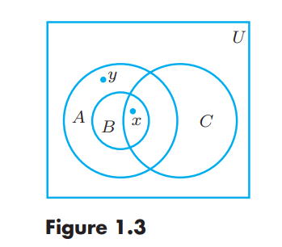

Slide 18
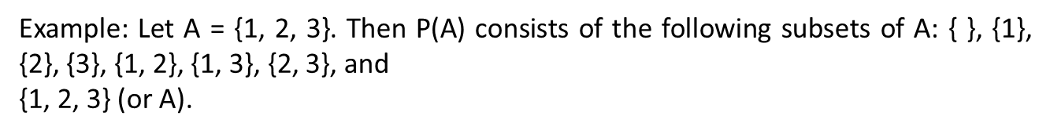
Final set of terms
Finite – A set A is called finite if it has n distinct elements, where n ∈ N.
n is called the cardinality of A and is denoted by |A|, e.g., n = |A|
Infinite – A set that is not finite is called infinite.
The power set of A is the set of all subsets of A including ∅ and is denoted P(A)

Slide 19
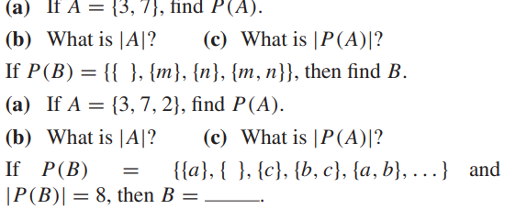
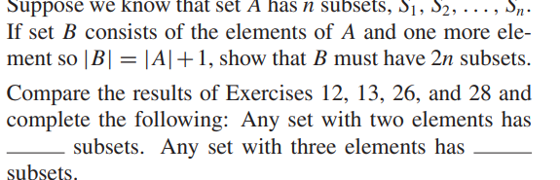
1
2

Slide 20
Partitions
Let S be a nonempty set. A partition of S is a subdivision of S into nonoverlapping, nonempty subsets.
A partition of S is a collection {Ai} of nonempty subsets of S such that:
(i) Each a in S belongs to one of the Ai. (ii) The sets of {Ai} are mutually disjoint; that is, if Aj = Ak then Aj ∩ Ak = ∅ The subsets in a partition are called cells.
EXAMPLE Consider the following collections of subsets of
S = {1, 2, 3,4,5,6,7, 8, 9}:
(i) [{1, 3, 5}, {2, 6}, {4, 8, 9}] (ii) [{1, 3, 5}, {2, 4, 6, 8}, {5, 7, 9}] (iii) [{1, 3, 5}, {2, 4, 6, 8}, {7, 9}] Then
is not a partition of S since 7 in S does not belong to any of the subsets.
is not a partition of S since {1, 3, 5} and {5, 7, 9} are not disjoint.
is a partition of S.

Slide 21
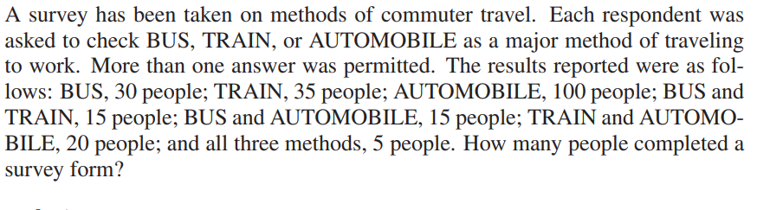

Slide 22
Discrete Mathematics
Operations on Sets 1.2

Slide 23
Operation on Sets
An operation on a set is where two sets are combined to produce a third set.

Slide 24
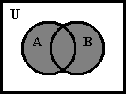
Union
A ∪ B = {x | x ∈ A or x ∈ B}
Example: Let A = {a, b, c, e, f} and B = {b, d, r, s} A ∪ B = {a, b, c, d, e, f, r, s}
Venn diagram

Slide 25
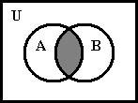
Intersection
A ∩ B = {x | x ∈ A and x ∈ B}
Example: Let A = {a, b, c, e, f}, B = {b, e, f, r, s}, and C = {a, t, u, v}. A ∩ B = {b, e, f} A ∩ C = {a} B ∩ C = { }
Venn diagram

Slide 26
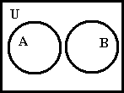
Disjoint Sets
Disjoint sets are sets where the intersection results in the empty set.
Not disjoint
Disjoint

Slide 27
Unions and Intersections Across Multiple Sets
Both intersection and union can be performed on multiple sets
A ∪ B ∪ C = {x | x ∈ A or x ∈ B or x ∈ C}
A ∩ B ∩ C = {x | x ∈ A and x ∈ B and x ∈ C}
Example:
A = {1, 2, 3, 4, 5, 7}, B = {1, 3, 8, 9}, and
C = {1, 3, 6, 8}.
A ∪ B ∪ C = {1, 2, 3, 4, 5, 6, 7, 8, 9}
A ∩ B ∩ C = {1, 3}

Slide 28
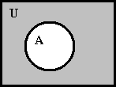
Complement
The complement of A (with respect to the universal set U) ….. all elements of the universal set U that are not a member of A.
Denoted A
Example: If A = {x | x is an integer and x < 4} and U = Z, then A = {x | x is an integer and x > 4}
Venn diagram

Slide 29
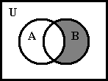
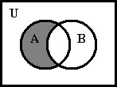
Complement “With Respect to…”
The complement of B with respect to A –> all elements belonging to A, but not to B.
It’s as if U is in the complement is replaced with A.
Denoted as A\B or A – B = {x | x ∈ A and x ∈ B}
Example: Assume A = {a, b, c} and B = {b, c, d, e} A – B = {a}.. Complement of B B – A = {d, e}..Complement of A
Venn diagram
B – A
A – B

Slide 30
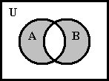
Symmetric difference
Symmetric difference –..> If A and B are two sets, the symmetric difference is the set of elements belonging to A or B, but not both A and B.
Denoted A ⊕ B = {x | (x ∈ A and x ∈ B) or (x ∈ B and x ∈ A)}
A ⊕ B = (A – B) ∪ (B – A)
Venn diagram

Slide 31
Algebraic Properties of Set Operations
Commutative properties A ∪ B = B ∪ A A ∩ B = B ∩ A
Associative properties A ∪ (B ∪ C) = (A ∪ B) ∪ C A ∩ (B ∩ C) = (A ∩ B) ∩ C
Distributive properties A ∩ (B ∪ C) = (A ∩ B) ∪ (A ∩ C) A ∪ (B ∩ C) = (A ∪ B) ∩ (A ∪ C)

Slide 32
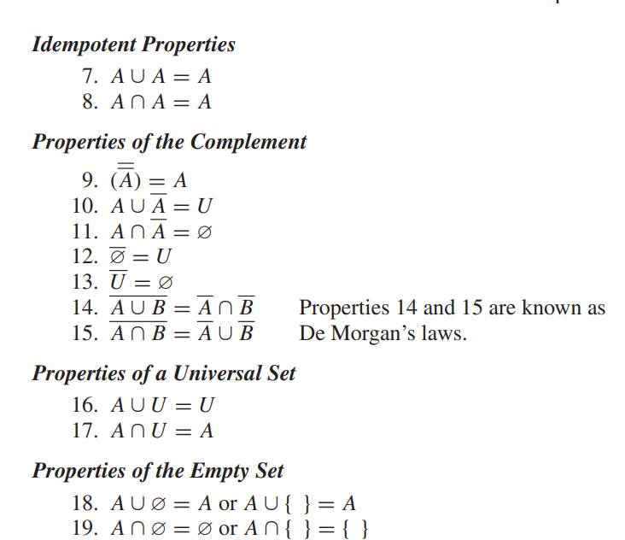
More Algebraic Properties of Set Operations

Slide 33
More Algebraic Properties of Set Operations
Properties of a Universal Set A ∪ U = U A ∩ U = A
Properties of the Empty Set A ∪ ∅ = A or A ∪ { } = A A ∩ ∅ = ∅ or A ∩ { } = { }

Slide 34
The Addition Principle
The Addition Principle associates the cardinality of sets with the cardinality of their union
If A and B are finite sets, then |A ∪ B| = |A| + |B| – |A ∩ B|
Let’s use a Venn diagram to prove this:
The Roman Numerals indicate how many times each segment is included for the expression |A| + |B|
Therefore, we need to remove one |A ∩ B| since it is counted twice.
A ∩ B
1
2
1

Slide 35
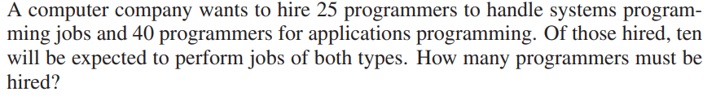
Addition Principle Example: Principle of Inclusion/Exclusion
Let A = {a, b, c, d, e} and B = {c, e, f, h, k, m}
|A| = 5, |B| = 6, and |A ∩ B| = |{c, e}| = 2
|A ∪ B| = |{a, b, c, d, e, f, h, k, m}| ……OR |A ∪ B| = 9 = 5 + 6 – 2
If A ∩ B = ∅, i.e., A and B are disjoint sets, then
the |A ∩ B| term drops out leaving |A| + |B|
Example 1:

Slide 36
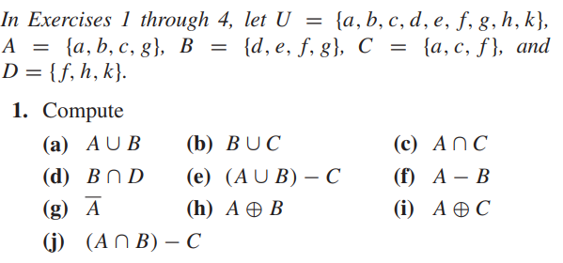
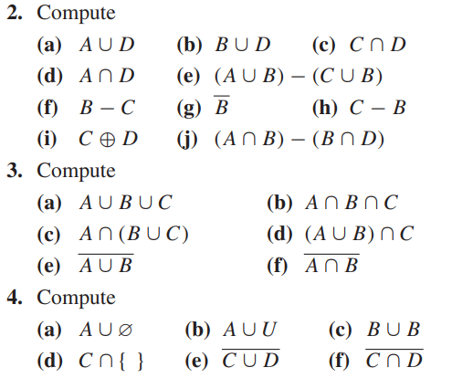
2.

Slide 37
Example 3:
Consider the universal set U = {1, 2, 3, …, 8, 9} and sets A = {1, 2, 5, 6}, B = {2, 5, 7}, C = {1, 3, 5, 7, 9}.
Find: (a) A ∩ B and A ∩ C , (b) A ∪ B and B ∪ C
(c) AC and CC (d) A\B (elements in A not in B) and A\C(elements in A and not in C), (e) A ⊕ B and A ⊕ C
(f) (A ∪ C)\B and (B ⊕ C)\As

Slide 38
Solution:
A ∩ B = {2, 5}, A ∩ C = {1, 5};
(b) A ∪ B = {1, 2, 5, 6, 7}, B ∪ C = {1, 2, 3, 5, 7, 9};
(c) AC = {3, 4, 7, 8, 9}, CC = {2, 4, 6, 8};
(d) A\B = {1, 6}, A\C = {2, 6};
(e) A ⊕ B = {1, 6, 7}, A ⊕ C = {2, 3, 6, 7, 9};
(f) (A ∪ C)\B = {1, 3, 6, 9}, (B ⊕ C)\A = {3, 9}.

