Slide 1


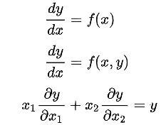

Application of Partial differentiation in engineering (wave equation)
K. J. Somaiya College of Engineering, Mumbai – 400 077
(A Constituent College of Somaiya Vidyavihar University) Dept. of Science and Humanities
F.Y. B. Tech. Semester –I (2022-23)
Applied Mathematics IA-II
Name : Aaryan Sharma Roll no. : 16010123012 Div : C1 Batch : C1_1
Differential equations are mathematical equations that involve one or more unknown functions and their derivatives. Differential equations are used to model and analyze systems that involve change or motion.
Some of the applications of differential equation in engineering are fluid mechanics, heat transfer and material science
The scalar wave equation is :
Where c is a fixed non negative real coefficient

Slide 2
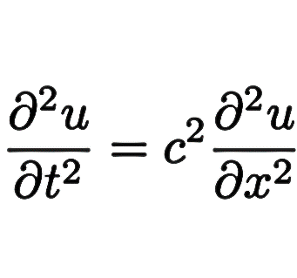
K. J. Somaiya College of Engineering, Mumbai – 400 077
(A Constituent College of Somaiya Vidyavihar University) Dept. of Science and Humanities
F.Y. B. Tech. Semester –I (2022-23)
Applied Mathematics IA-II
The wave equation is a second-order linear partial differential equation that describes the propagation of waves. The wave equation can be used to model a wide variety of phenomena, waves in water, sound waves and electromagnetic waves. It is a hyperbolic partial differential equation.
This equation is typically described as having only one space dimension x, because the only other independent variable is the time t. Nevertheless, the dependent variable u may represent a second space dimension, if, for example, the displacement u takes place in y direction, as in the case of a string that is located in the xy plane.
The wave equation is given as :
Where, x represents the one-space dimension where the displacement, u, takes place at a time, t
References :
https://en.wikipedia.org/wiki/Differential_equation
https://en.wikipedia.org/wiki/Wave_equation
https://resources.system-analysis.cadence.com/blog/msa2022-using-the-finite-difference-method-for-the-wave-equation-in-fluid-dynamics
https://www.youtube.com/watch?v=ub7lok-JQJE&ab_channel=ParthG
The wave equation in the one-dimensional case can be derived from Hooke’s law

