Slide 1
PostgreSQL Disaster Recovery Using pgBackRest
• WAL Archiving, Point-in-Time Recovery & Backup Evaluation
• Case study: StagePass — KJSCE Garba Eve, 12 October
• PG 17.11 • pgBackRest 2.59.3 • Docker Compose lab
Notes:
Welcome the evaluator; state the topic and pinned versions up front.

Slide 2
The problem: one bad DELETE
• 80 bookings left, Garba Eve bookings = 0
• Dashboard goes visibly wrong — real rows, not a mock
• Requirement: restore service, lose (almost) nothing
Notes:
Tell the incident story; switch to /admin screenshot next.

Slide 3
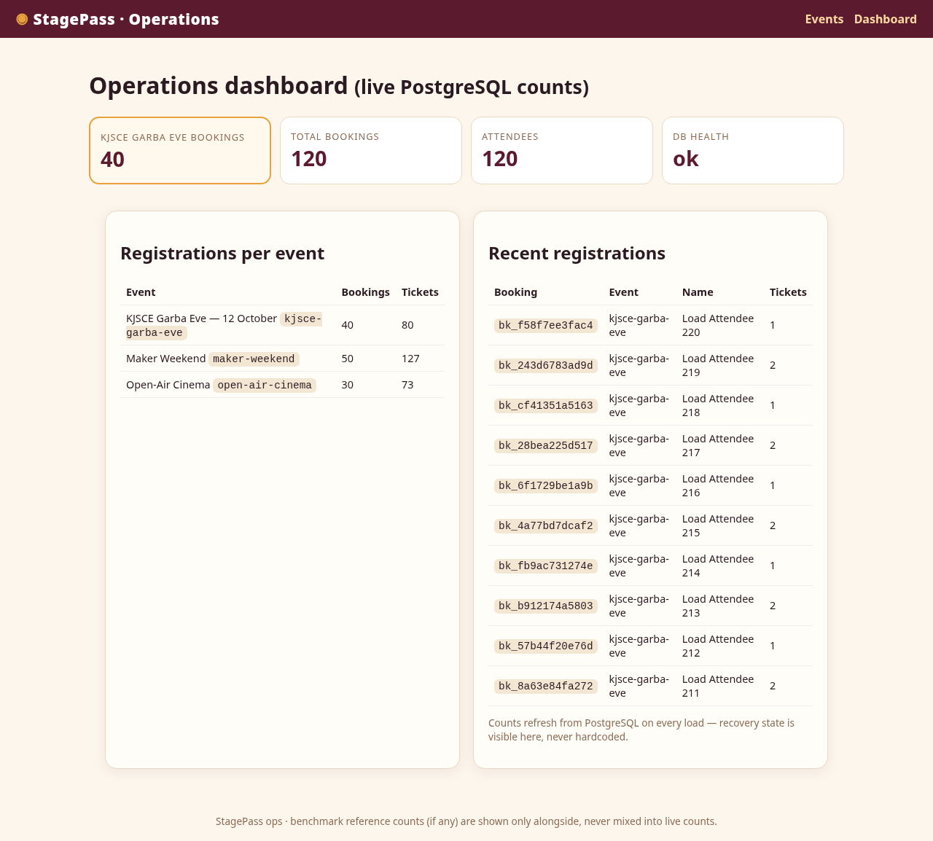
What the evaluator sees
• Live counts from PostgreSQL — incident and recovery are visible here
Notes:
Point at Garba KPI = 40 post-recovery; stress: never hardcoded.

Slide 4
Research question & objectives
• How does pgBackRest + archived WAL improve recoverability vs a snapshot alone — and at what time/storage cost?
• O1 repeatable app + workload + incident • O2 A/B recovery comparison • O3 backup-mode trade-offs
Notes:
Read the question aloud; map each objective to later slides.

Slide 5
Why a snapshot alone is a limited baseline
• Stopped-cluster rsync mirror = consistent files at time T
• No WAL replay by design → post-snapshot transactions unrecoverable
• Honest scope: rsync + WAL could do more — we test snapshot-ONLY
Notes:
Defuse the 'rsync is bad' misreading before showing results.

Slide 6
Architecture: app → DB → WAL → repo → recovery
• app: FastAPI/Jinja2 (request-scoped DB, survives restores)
• db: PG17, archive-push → repo volume (separate from PGDATA)
• backup-tools: guarded rsync + restore ops; PITR target → promote
Notes:
Trace the WAL arrow; explain why repo lives outside PGDATA.

Slide 7
Full / differential / incremental + named PITR
• Full 10.6 s / 4.5 MB → diff 2.5 s / 0.7 MB → incr 3.0 s / 0.6 MB
• Named target: pg_create_restore_point + --type=name (self-documenting)
• Restore waits for proven WAL archival — never assumed
Notes:
Point at sizes: repo-compressed bytes, not raw DB size.

Slide 8
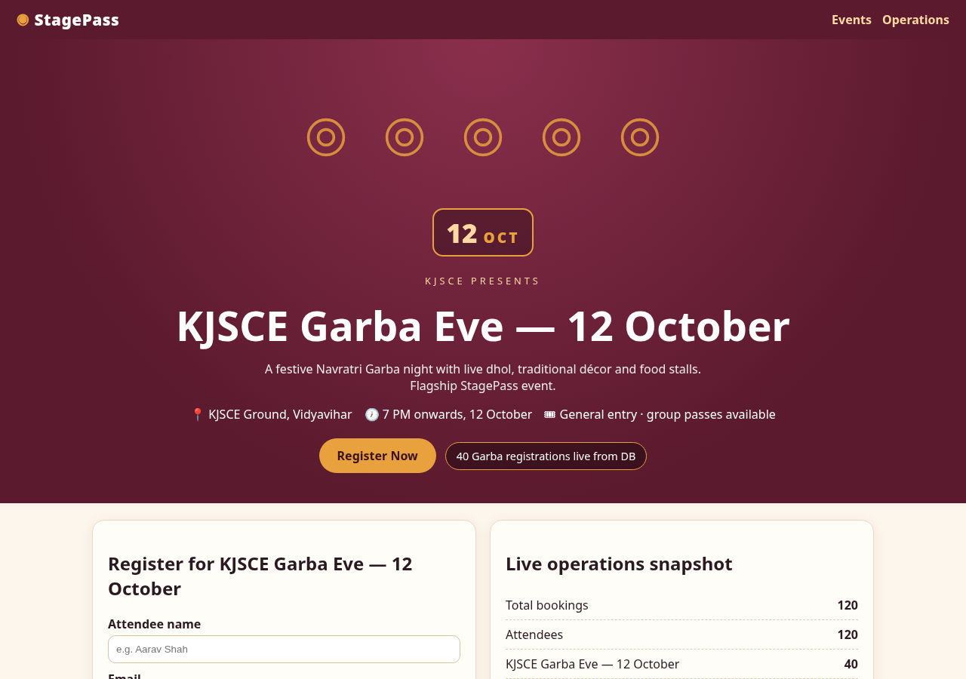
StagePass controls
• Seed 100 (20/50/30) • same 20-HTTP workload in A and B
• Guarded scripts, run IDs, raw CSVs + logs for every claim
Notes:
Show home screenshot; note 12 OCT badge and live pill.

Slide 9
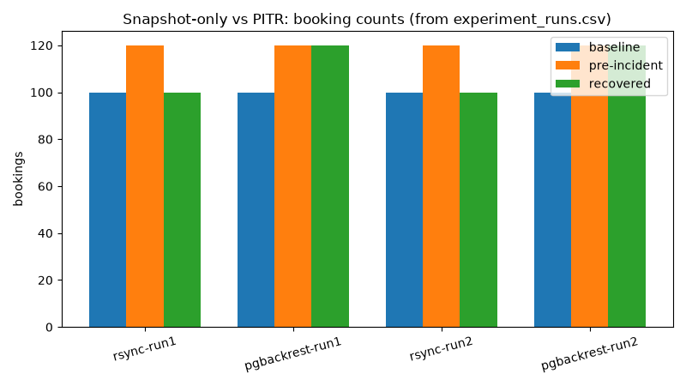
Scenario A: snapshot-only → 100 (20 lost)
• Baseline 100 → pre 120 → incident 80 → recovered 100
• The 20 post-snapshot registrations are gone — by design
• Reproduced twice (run1, run2)
Notes:
Read the recovered row of experiment_runs.csv; show chart next.

Slide 10
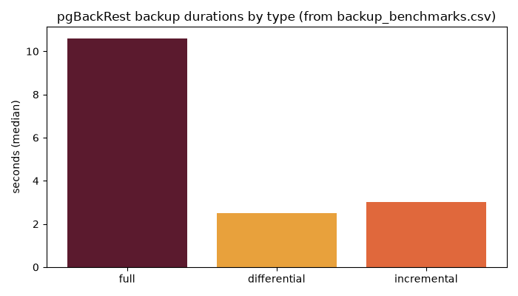
Scenario B: PITR → 120 (0 lost)
• Named target after 20 regs, before DELETE → replay archived WAL
• Recovered 120/40, 20/20 IDs, log-confirmed target (×2 runs)
• pg_dump contrast: 0.3 s but no WAL replay by itself
Notes:
Show db recovery log excerpt; refresh /admin live if demoing.

Slide 11
Evaluation, limits, conclusion
• RTO: ~11–15 s vs ~18–21 s — seconds apart; recoverability: 20 txns apart
• Limits: laptop-local repo, single bench trial, target discards later data
• Answer: PITR turns 'state at backup time' into 'state at chosen target'
Notes:
Close with the one-sentence answer; invite questions on RPO.

Slide 12
References & closing
• pgbackrest.org user guide + command reference; postgresql.org backup/WAL/pg_dump docs
• All accessed 2026-10-12 • claim map: docs/SOURCES.md
• Reproduce: make up && make seed && make test && make demo-rsync && make demo-pgbackrest
Notes:
Thank evaluator; offer live re-run of either scenario.

