Slide 1
IBM University Engagement Project Submission
“Exploring the Power of Agentic AI with IBM Granite and IBM Bob”

Slide 2

Project Tile – Thali & Pulse — AI-Powered Nutrition Agent
Domain of Project – Healthcare / Agentic AI
Student Name | Recent Passport Photo | Email ID | Mobile number [WhatsApp]
AARYAN THAKUR |  | taaryan918@gmail.com | 9317410269

Slide 3
Problem Statement -
Problem Statement: Thali & Pulse — AI Nutrition Agent
The Challenge
Good nutrition is the foundation of health, but individuals often struggle with diet planning, portion control, and tracking nutritional intake. Most nutrition apps push generic international diets (quinoa, kale) that ignore what's actually affordable and available in an Indian household — leaving budget- conscious users with advice they can't realistically follow.
The Objective
Build an AI-powered Nutrition Agent that delivers personalized, budget-aware dietary guidance rooted in everyday Indian food. The solution should:
Personalized Diet Plans – Recommend meals based on age, health goals, city, and monthly food budget (₹)
Food Data RAG Retrieval Fetch accurate nutrition data (calories, macros, cost) for Indian foods (dal, roti, sabzi, poha, etc.) from a trusted knowledge base
Diet Tracking & Feedback – Allow users to log meals via text and get instant nutritional analysis
Budget-Constrained Planning – Every meal plan respects the user's stated monthly budget, not just their calorie target
Multi-Agent System –
Nutrition Knowledge Agent (retrieves food data via RAG)
Diet Recommendation Agent (builds budget-fit meal plans)
Food Log & Feedback Agent (analyzes logged meals)
Health Advisory Agent (preventive health flags)

Slide 4
Proposed Solution -
Proposed Solution: Thali & Pulse Agent
The proposed solution is a multi-agent AI-powered Nutrition Agent, built using IBM Bob, IBM watsonx Orchestrate, and Granite models, that plans a user's daily food intake like a "thali" — balanced, budgeted, and built around what's actually available in their city.
At its core, the solution uses a Retrieval-Augmented Generation (RAG) pipeline to fetch nutrition data for common Indian foods from a curated 26-item knowledge base, embedded using IBM's Slate model and stored in a Milvus vector database, enabling accurate, grounded responses instead of generic AI guesses.
The system consists of four collaborator agents, coordinated by a central orchestrator:
Nutrition Knowledge Agent retrieves and summarizes nutrition data (calories, macros, cost) for Indian foods using RAG.
Diet Recommendation Agent generates a full day's meal plan using regional, seasonal Indian food, constrained to the user's monthly budget.
Health Advisory Agent flags preventive health notes (e.g., high sodium) based on the user's logged intake.
Food Log & Feedback Agent lets users log meals in natural language and returns instant nutritional feedback.
The solution is deployed as a live web application (Next.js frontend, Clerk authentication) connected to the agents running on IBM watsonx Orchestrate, powered by ibm/granite-3-3-8b-instruct for reasoning.
IBM Bob is used to orchestrate agent workflows, while watsonx.ai ensures scalable model deployment, embeddings, and AI governance. Granite models power reasoning, summarization, and personalization.
Overall, this solution delivers an end-to-end, budget-aware nutrition assistant that makes healthy eating realistic and achievable for Indian households — not just personalized, but genuinely affordable.

Slide 5
Technology Used
IBM Bob – Used to design, scaffold, and orchestrate the multi-agent system (Nutrition Knowledge, Diet Recommendation, Food Log & Feedback, Health Advisory agents + Orchestrator).
IBM Granite models – ibm/granite-3-3-8b-instruct for reasoning and meal-plan generation; ibm/granite-3-3-2b-instruct for fast, lightweight responses.
IBM Cloud IAM – Secure token exchange (API key → short-lived access token) for authenticating every request to watsonx.
RAG (Retrieval-Augmented Generation) – Grounds responses in a 26-item Indian food nutrition knowledge base before generating answers, so the agent gives trustworthy, fact-based nutrition advice.
IBM Watsonx.ai - For model deployment, embeddings, and AI governance.
Vector Embeddings – ibm/slate-125m-english-rtrvr for embedding the food knowledge base, enabling accurate semantic retrieval.
Next.js (React) – Frontend framework powering the live web application.

Slide 6
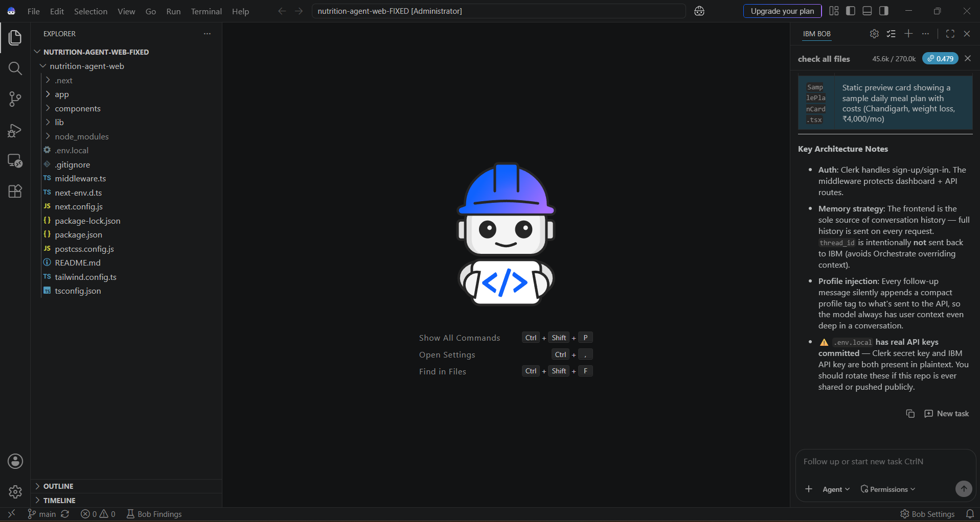
Required Files created using IBM bob -

Slide 7
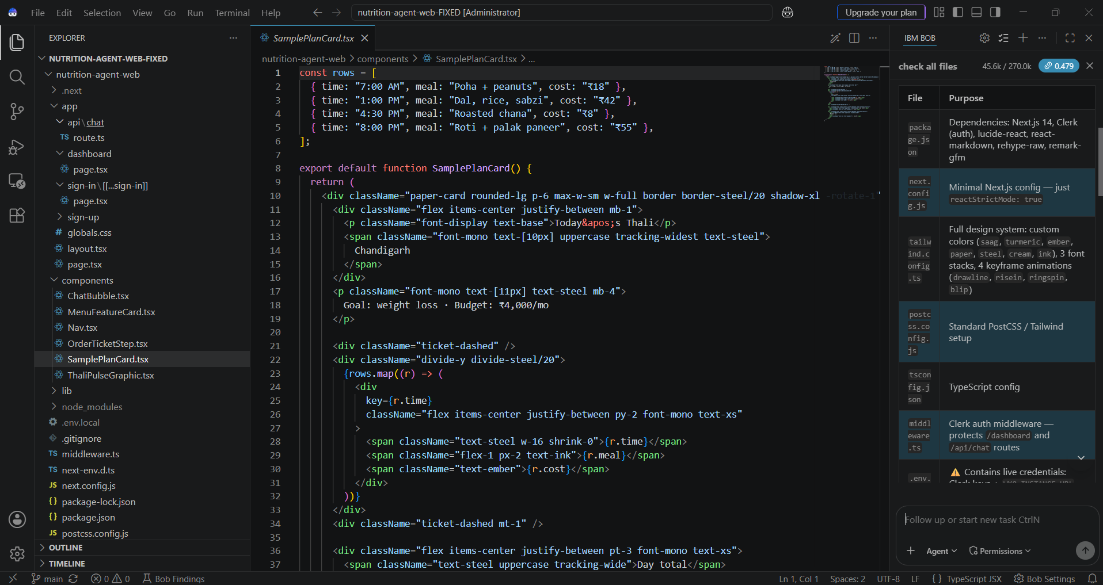
IBM Bob Screenshots:

Slide 8
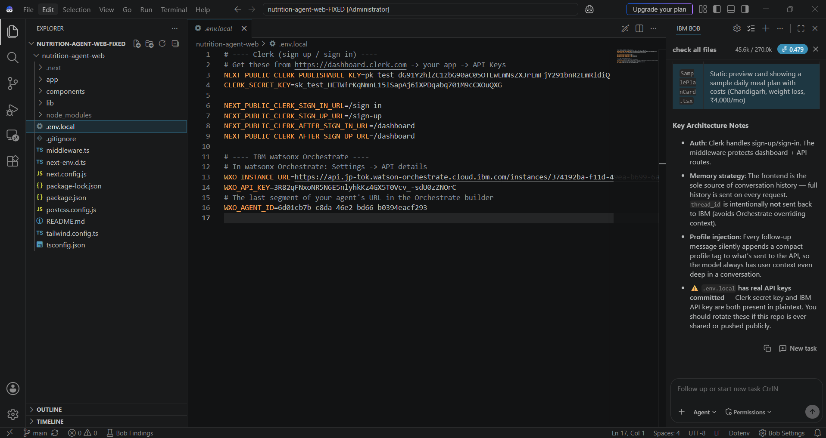



Slide 9
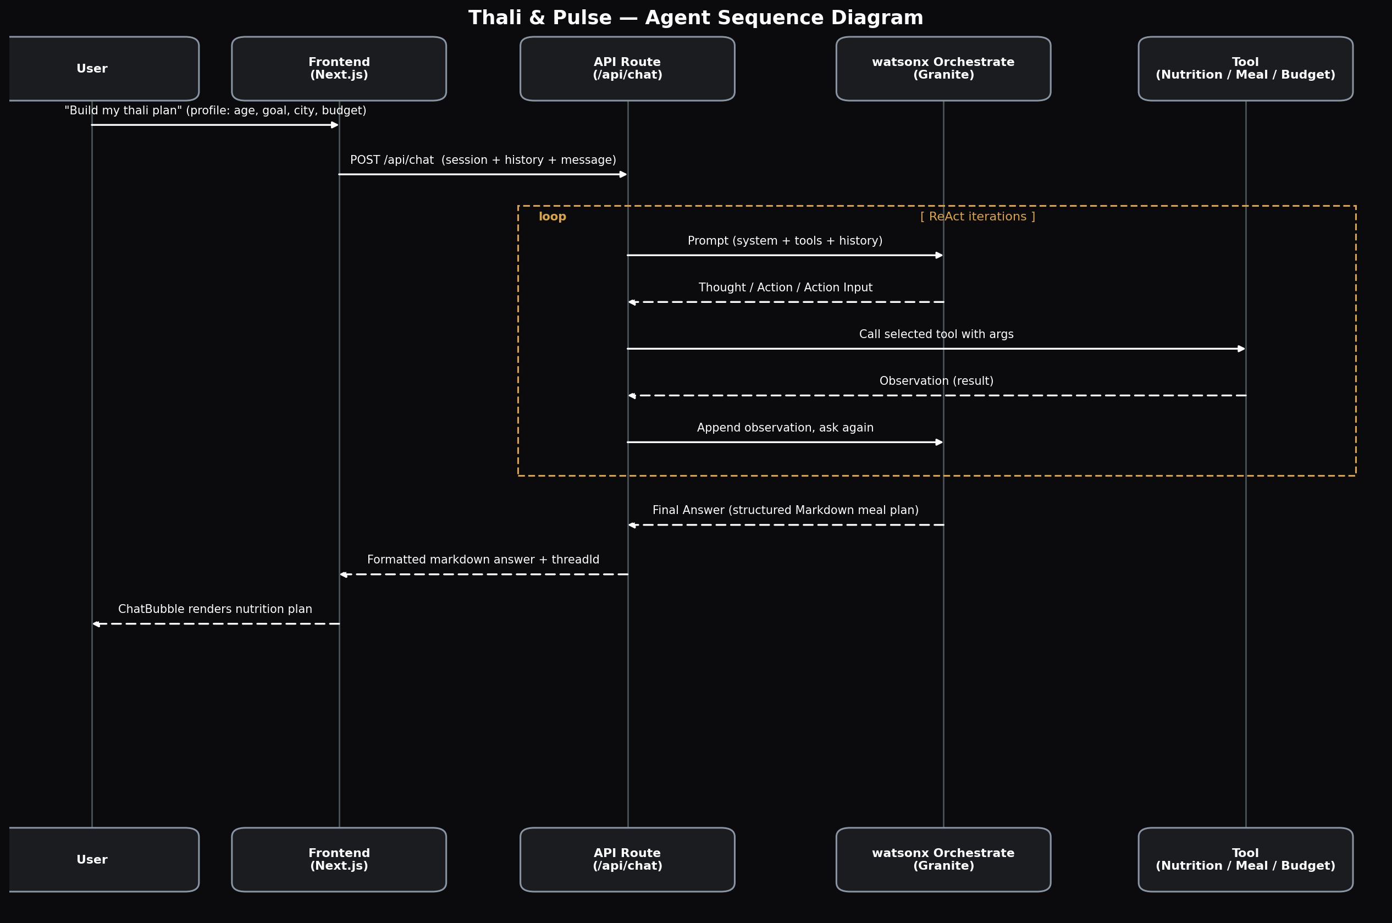
Architecture blueprint for IBM bob:

Slide 10

Role of Agentic AI in the solution
Role of Agentic AI in Thali & Pulse
Agentic AI transforms Thali & Pulse from a simple chatbot into an autonomous, reasoning system that plans, checks, and adapts — not just answers. Built on IBM watsonx Orchestrate and powered by Granite models, the system coordinates five agents working together toward one goal: a meal plan that is both nutritionally sound and affordable.
A central Orchestrator agent routes every user request to the right specialist: the Nutrition Knowledge Agent retrieves grounded food data via RAG, the Diet Recommendation Agent builds a full day's meal plan, the Food Log & Feedback Agent analyzes what the user actually ate, and the Health Advisory Agent flags preventive concerns like high sodium intake.
What makes this agentic — not just automated — is the ReAct reasoning loop: for every request, the agent Thinks about what it needs, takes an Action (calling a tool), Observes the result, and repeats until every constraint is satisfied. A meal plan isn't returned until it's been checked against the user's calorie goal AND their monthly budget.
Agentic AI also brings context awareness (age, city, goal, budget carried across the conversation) and real-time adaptation — a follow-up like "I just had poha and chai" updates the day's plan on the fly, without the user repeating their profile.

Slide 11
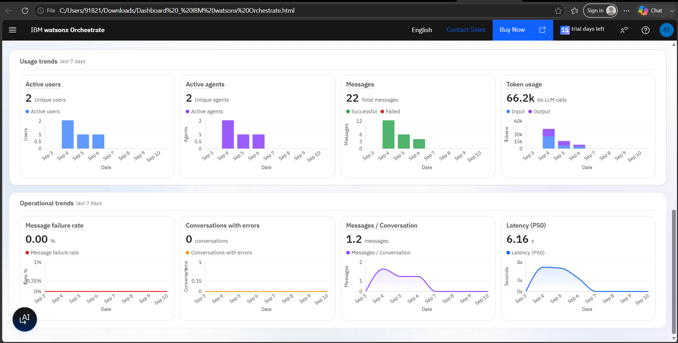
Token Usage
66.2k token are used
·
·
·

Slide 12
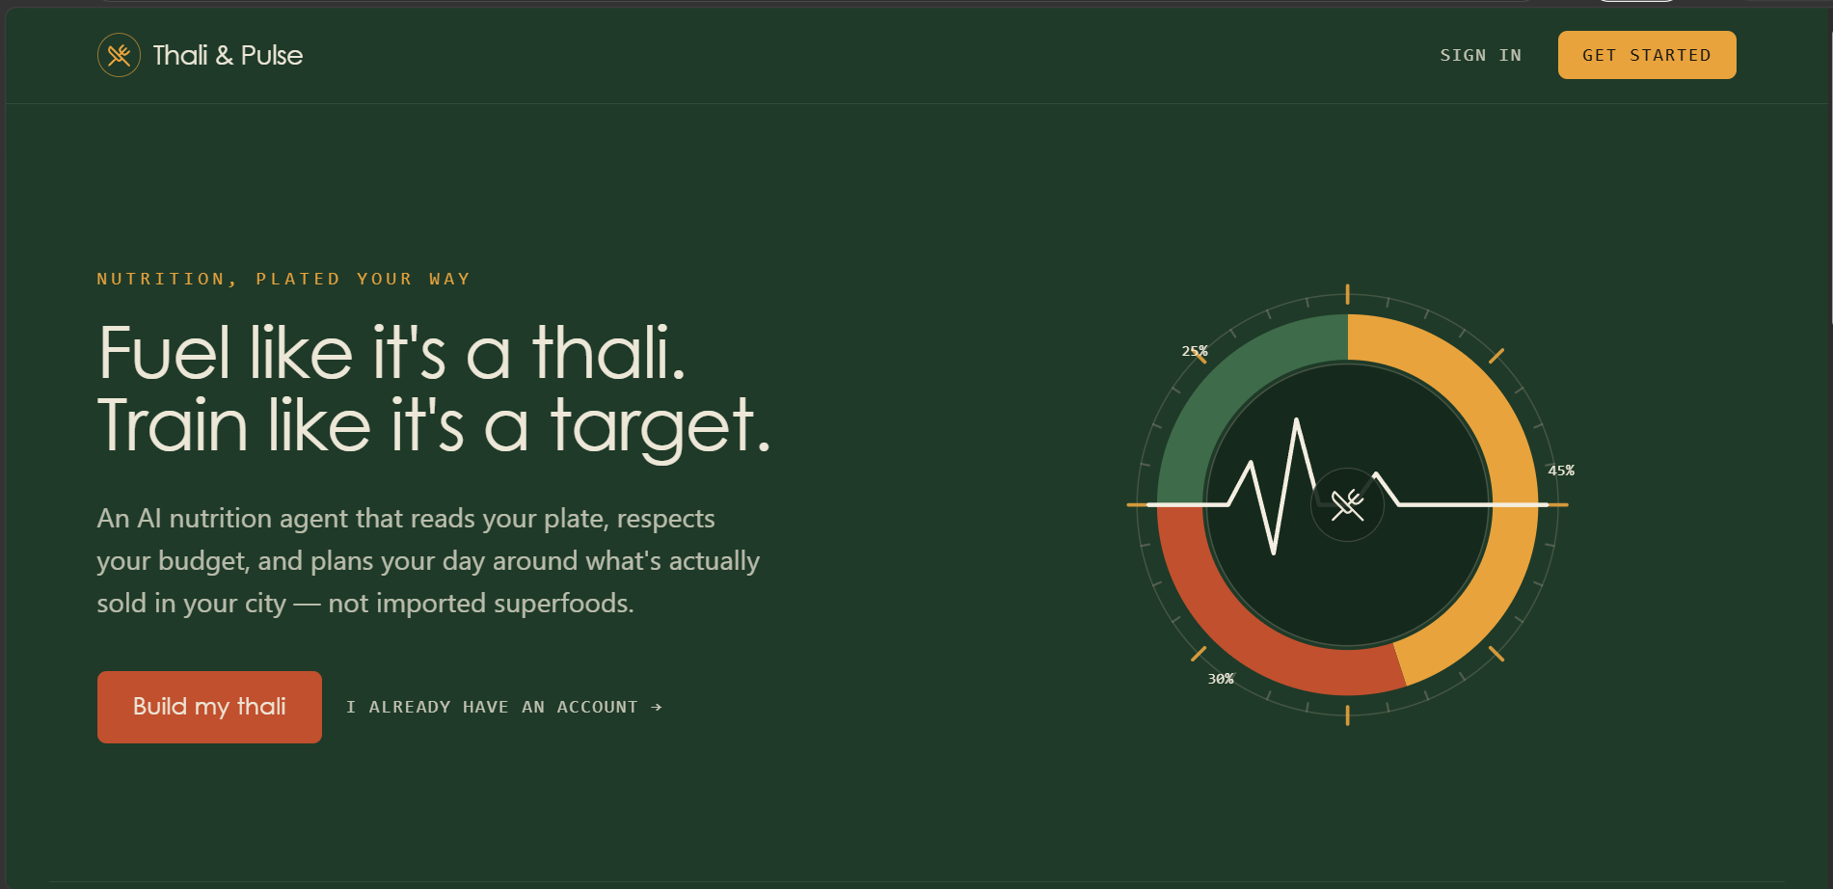
Project Output Screenshot
·
·
·

Slide 13
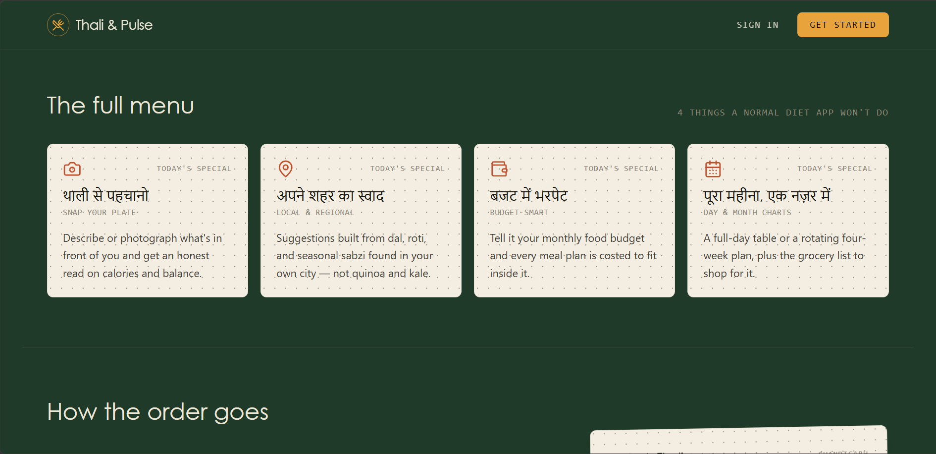
Project Output Screenshot
·
·
·

Slide 14
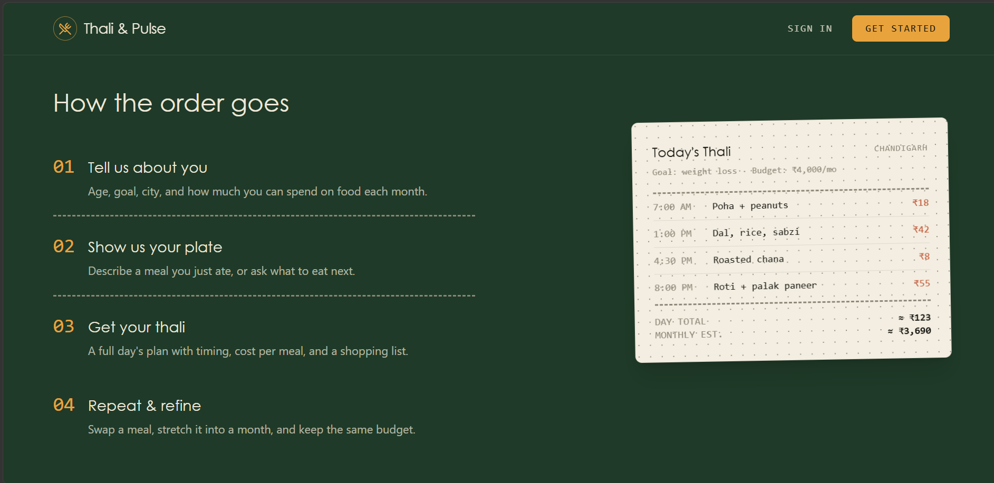
Project Output Screenshot
·
·
·

Slide 15
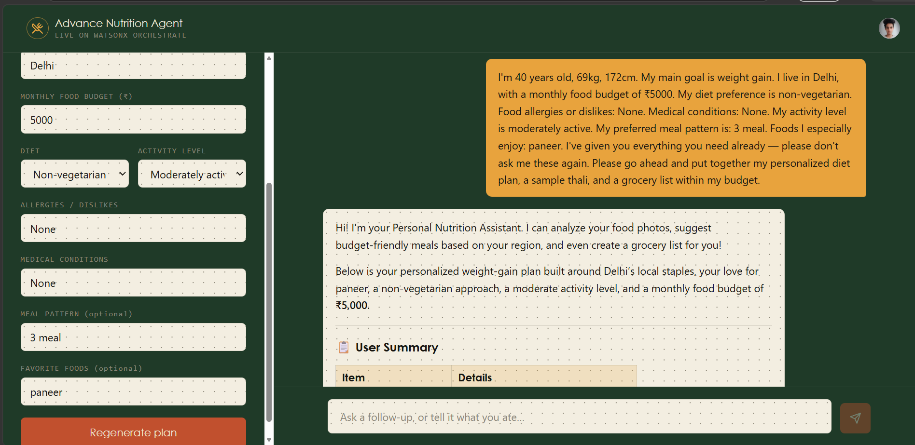
Project Output Screenshot

Slide 16
Novelty and Uniqueness
Thali & Pulse combines Agentic AI, RAG, and budget-conscious personalization into a single system — something no mainstream nutrition app does for Indian users.
Budget-First Planning – Every meal plan respects the user's actual monthly food budget, not just calorie targets, making advice realistic and achievable.
Culturally-Grounded – Built around Indian staples (dal, roti, seasonal sabzi) instead of imported "superfoods" most users can't access or afford.
Self-Verifying Reasoning – A ReAct loop (Thought → Action → Observation) means the agent checks its own plan against both nutrition and budget before responding.
RAG-Grounded Accuracy – Nutrition facts are retrieved from a curated Indian food knowledge base, reducing hallucination and misinformation.
Live, Production-Deployed – A fully working web application (Next.js + Clerk + watsonx Orchestrate), not just a prototype or notebook demo.
Scalable & Enterprise-Ready – Built on IBM watsonx Orchestrate with Granite models, ensuring reliability and a clear path to production scale.
This makes Thali & Pulse a smart, budget-aware digital nutritionist — not another diet app repackaged with AI.

Slide 17
Git Hub Link
· Please create public github repository (Enable Add README button while creating repository) with format –
Please test and Paste the working Github URL – https://github.com/Aaryan010101/nutrition-agent-web
Make sure you have Uploaded following three files into your github repository 1) All Agent relevant files of IBM Cloud , 2) yourproblemstatement.pdf file 3) your projectpresntation.pptx file 4)any other files
·
·
·

Slide 18
Future Scope
1. Integration with Wearables & Health Devices
The system can integrate with smartwatches and fitness trackers to collect real-time data such as steps, calories burned, heart rate, and sleep patterns. This would let the Diet Recommendation Agent adjust meal plans dynamically based on actual activity levels — not just self-reported goals.
2. Real-Time Grocery Price Integration
Connecting to live mandi/grocery price APIs would let the Diet Recommendation Agent build meal plans using today's actual prices instead of static estimates, making the budget constraint even more accurate and locally relevant.
3. Automated Grocery Ordering
Integrating with grocery delivery platforms could let users go from meal plan directly to a shopping cart — turning nutrition advice into action with one tap.
·
·
·

Slide 19
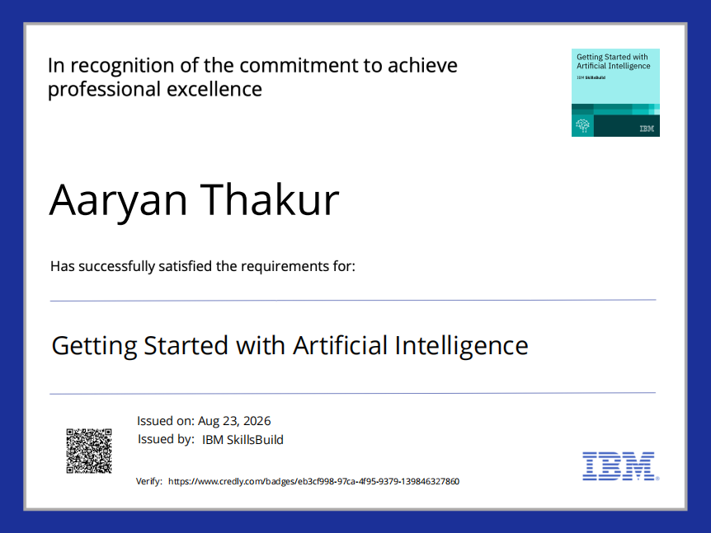
Certificates Earned:

Slide 20
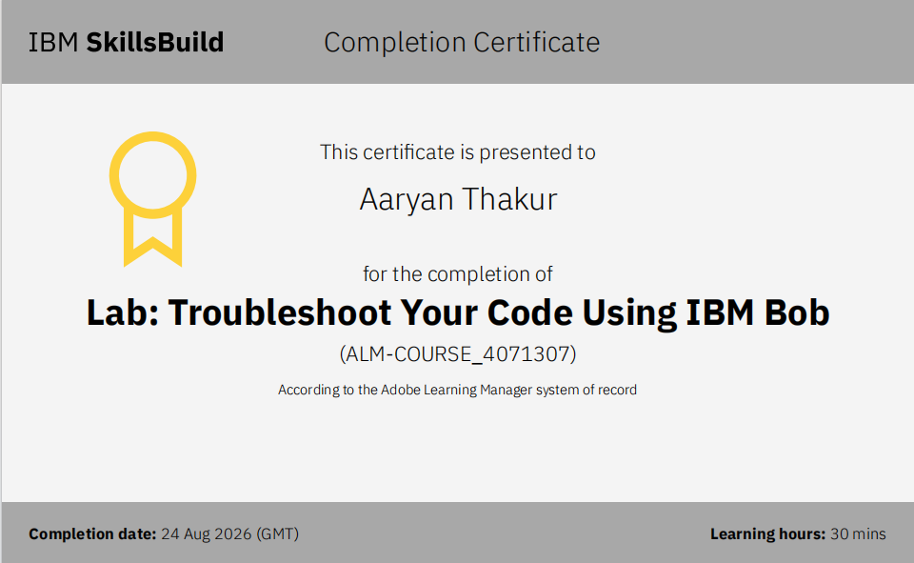
Certificates Earned:​

Slide 21


