Slide 1
Sales & Finance Analytics of AtliQ Hardwares

Slide 2
1.Introduction

Slide 3
AtliQ Hardwares
N & S
PC
P & A
Wi-Fi Extender
USB Flash Drives
Personal Desktop
Personal Laptop
Gaming Laptop
Motherboard
Processors
Graphics Card
Internal HDD
Batteries
Keyboard
Mouse

Slide 4
2.Foundational Steps
ETL ( Extract, Transform, Load )
Data Model Connection
Pivot Table & Power Pivot

Slide 5
3.Key Insights
Top 10 Products
Division Report
Top 5 Countries
New Product Expansion
Quantity Sold Rankings
Customer Net Sales Performance
Market Performance vs Target
P & L by Fiscal Year
P & L by Quarters
P & L for Markets
GM (%) by Quarters

Slide 6
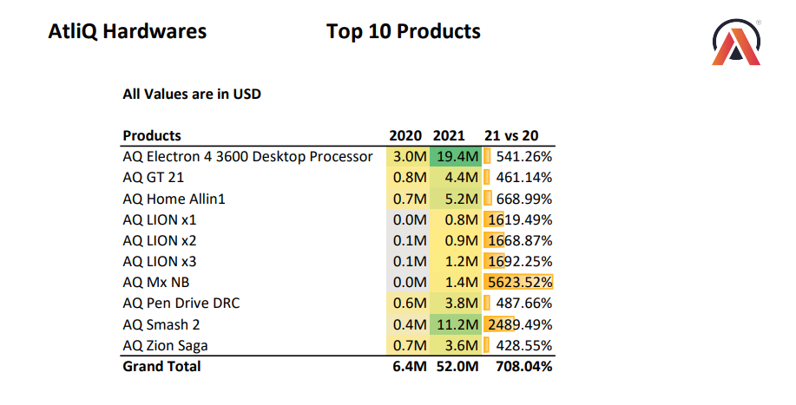
Top 10 Products

Slide 7
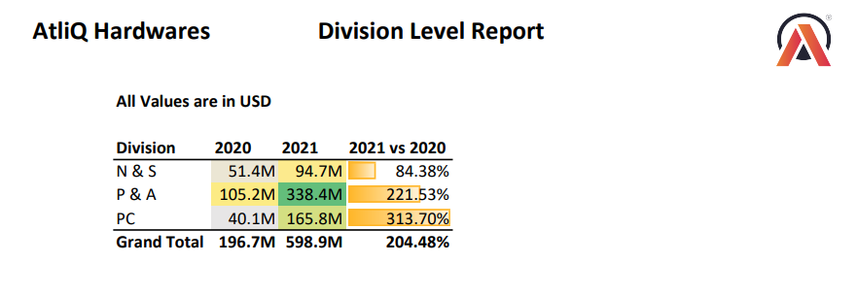
Division Level Report

Slide 8
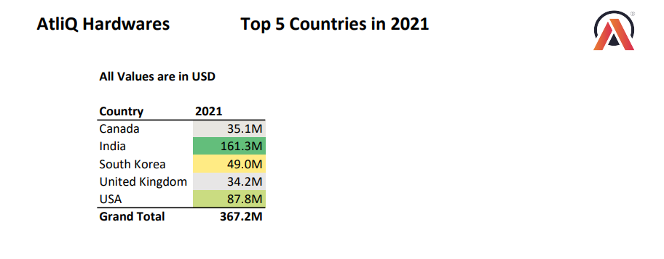
Top 5 Countries

Slide 9
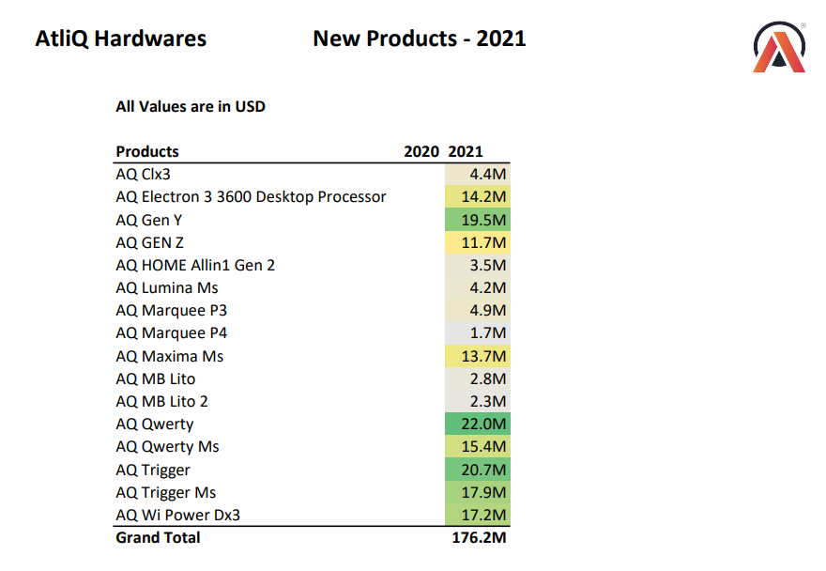
New Product Expansion

Slide 10
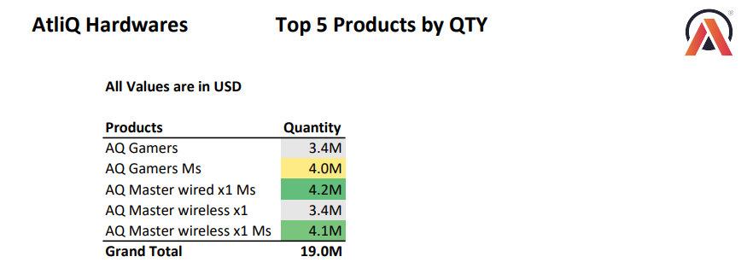
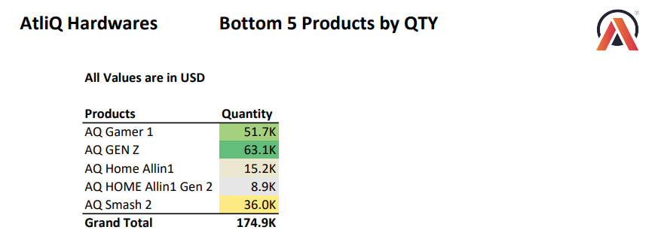
Quantity Sold Rankings

Slide 11
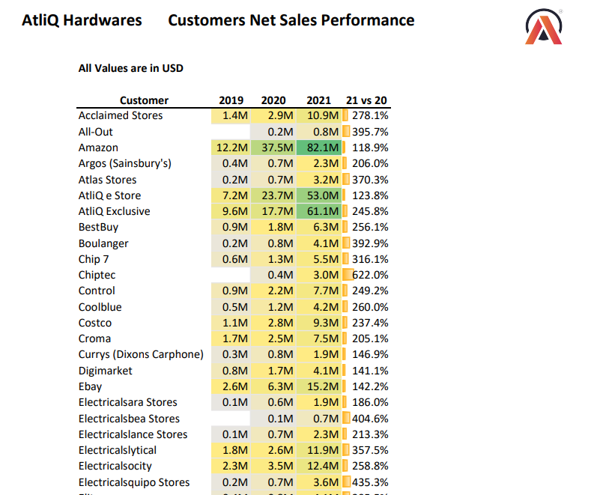
Customer Net Sales Performance

Slide 12
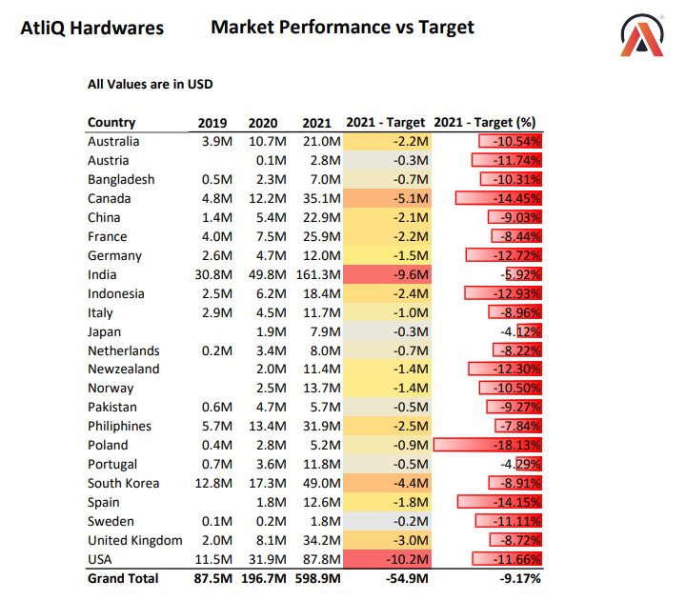
Market Performance vs Target

Slide 13
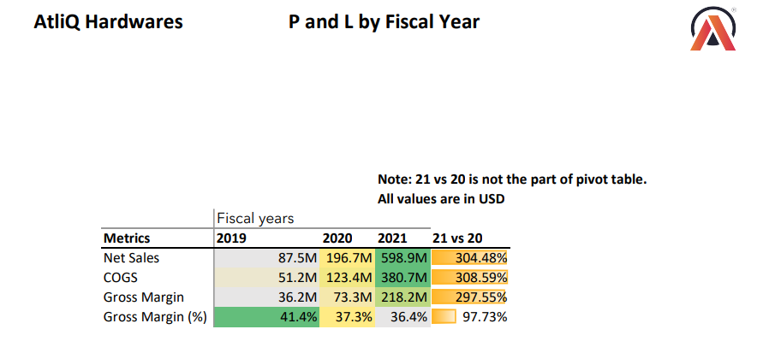
P & L by Fiscal Year

Slide 14
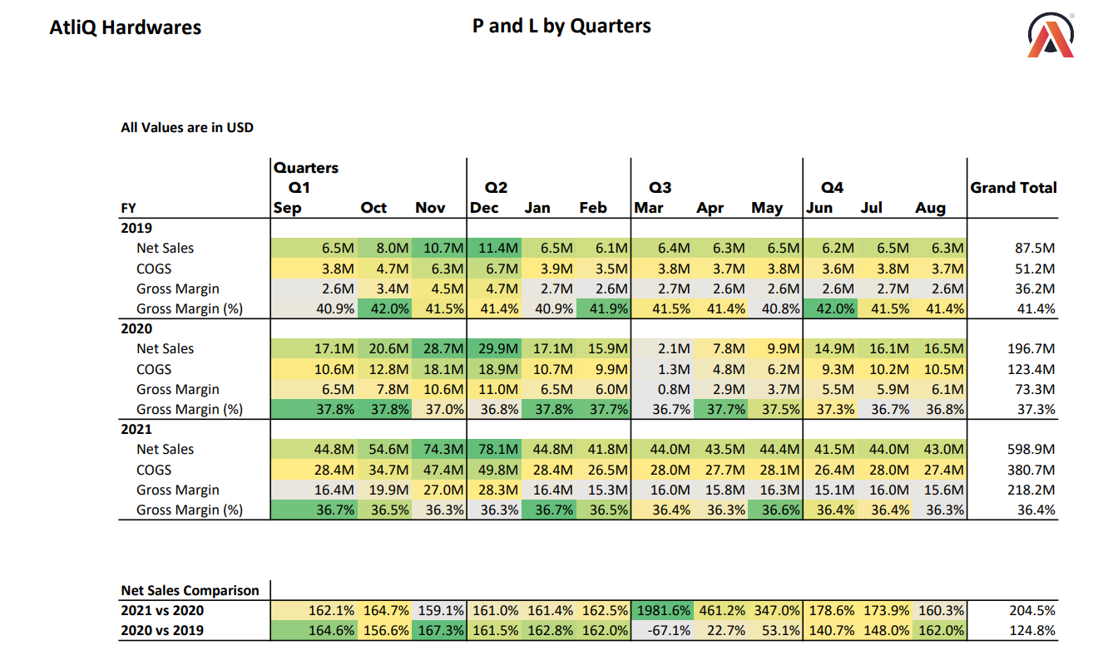
P & L by Quarters

Slide 15
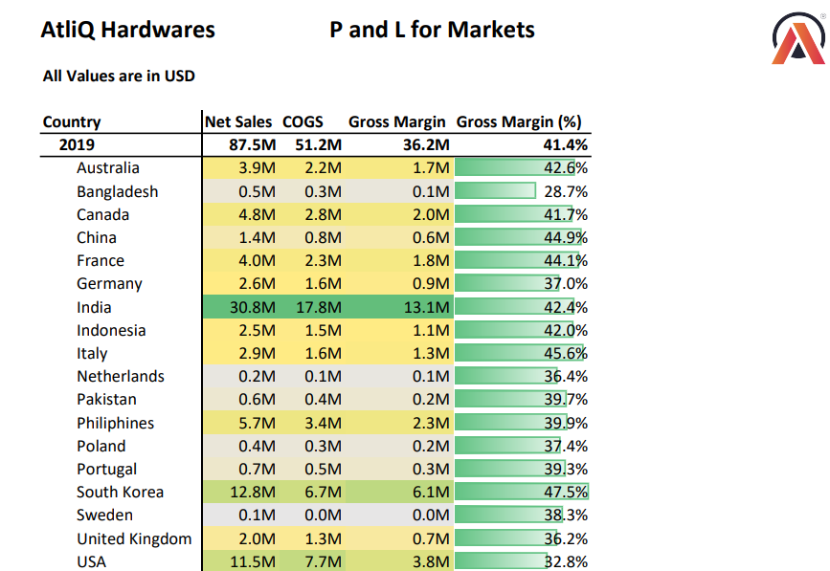
P & L for Markets

Slide 16
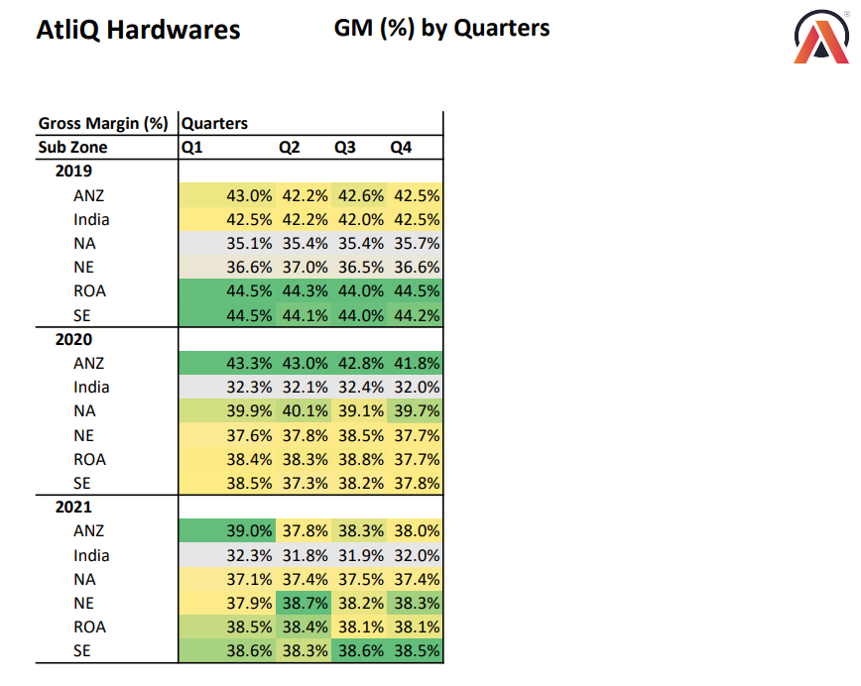
GM (%) by Quarters

Slide 17
Conclusion

Slide 18
Thank You..!!

