Slide 1
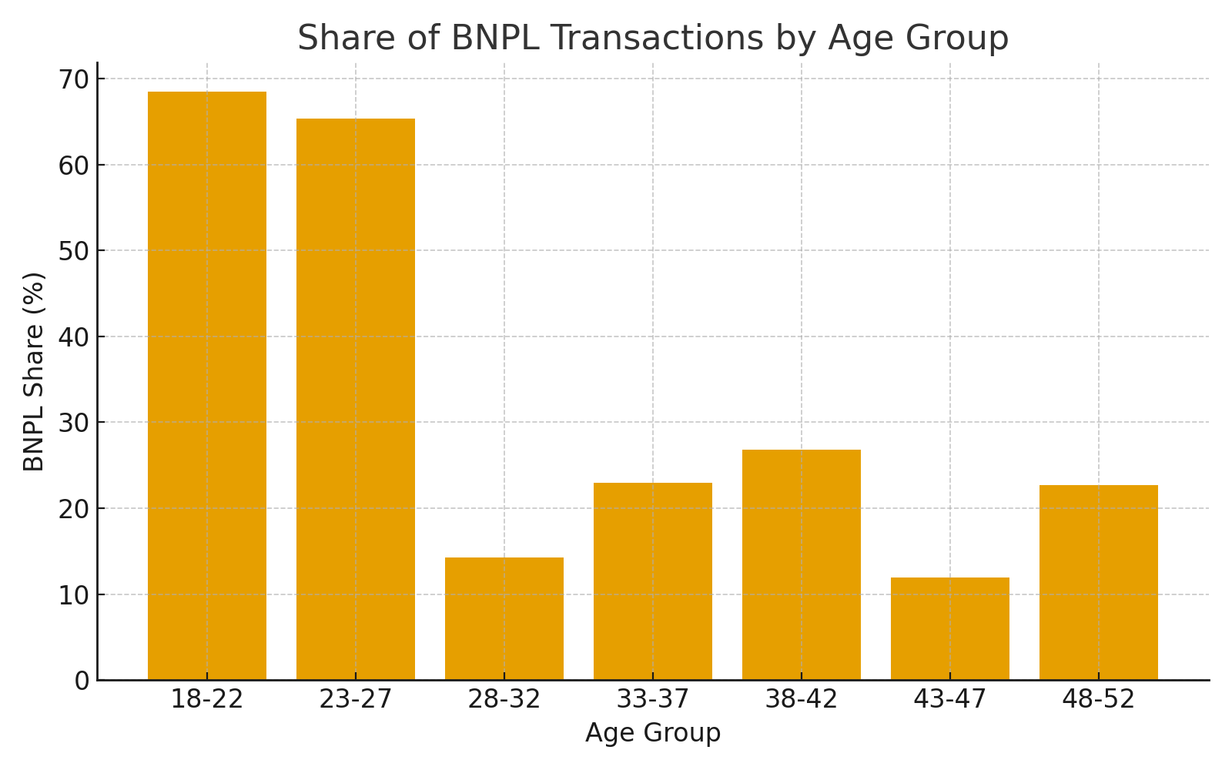
BNPL Adoption by Age Group – Everqlo E-Commerce Insights
Gen Z & Young Millennials (18–27) drive BNPL growth — accounting for over 65% of BNPL transactions.
Younger demographics demonstrate significantly higher BNPL adoption, reflecting digital-native purchasing behavior.
Supporting Insights
• BNPL usage declines steadily after age 30 — indicating older groups still prefer cards or cash.
• 18–27 consumers show a strong preference for BNPL due to flexibility and limited credit history.
• Targeting young consumers with exclusive BNPL offers can enhance digital conversions by 15–20%.
Source: Everqlo BNPL Transaction Data (Ages 18–50) | Visualization by Aaryan Goswami

