Slide 1
Agent Commerce Integrity Layer
American Express - Innovation Labs Hackathon 2026
Aaryan Kandiah (Master of Computing @ NUS)

Slide 2
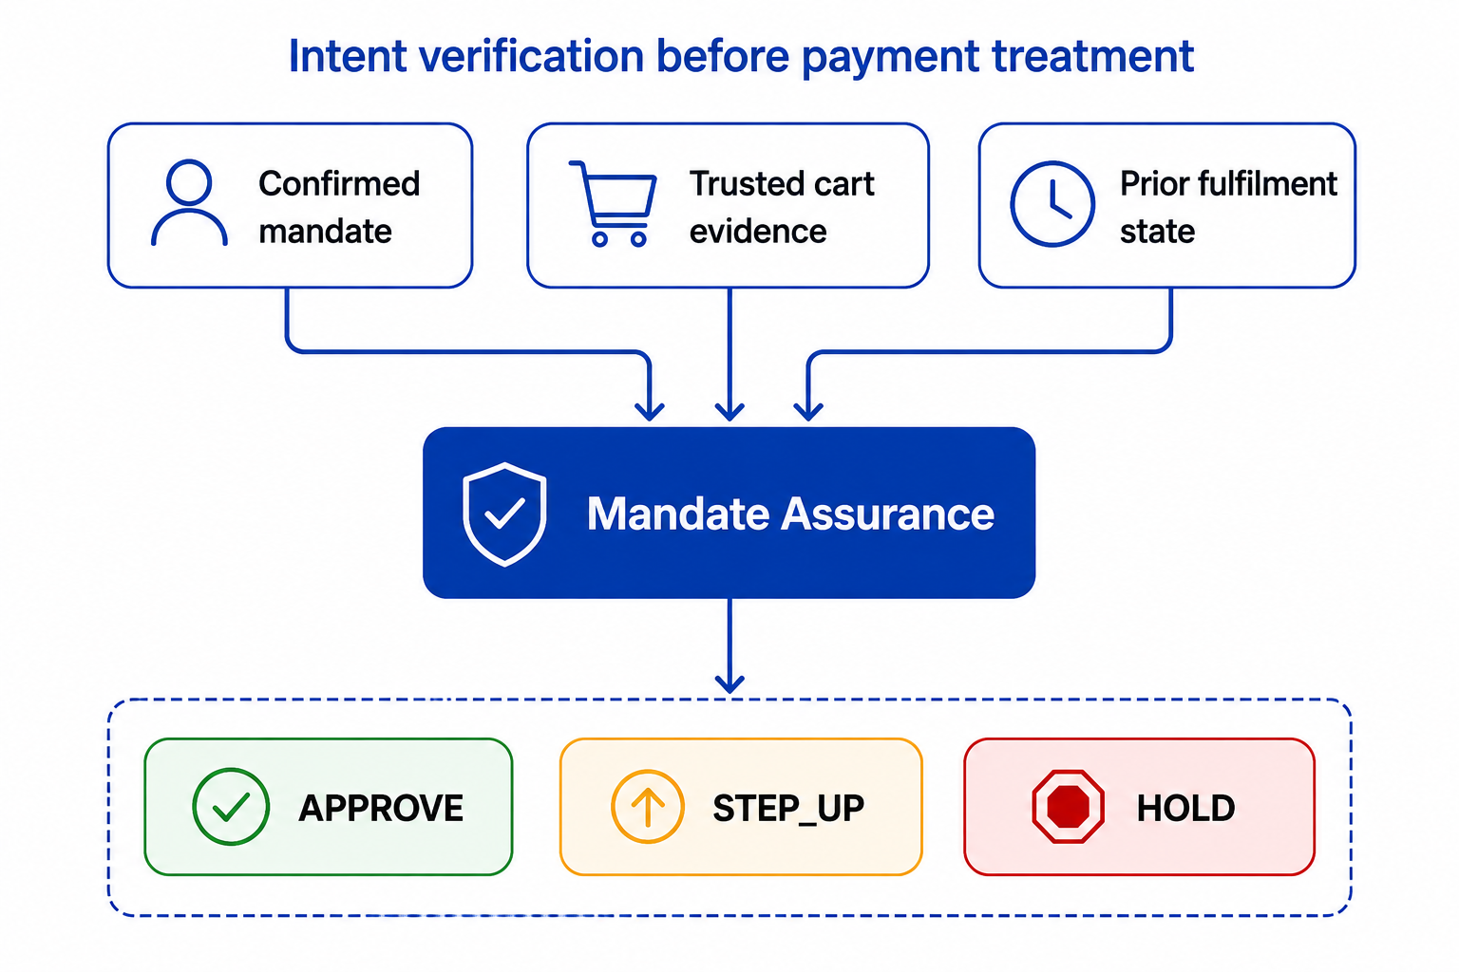
Executive Summary
Verifying whether an agent's final purchase still matches Card Member's confirmed intent before payment treatment.
1. Gap
An authenticated and authorized agent can still produce an unintended outcome; for example, a non-refundable fare, an unwanted add-on, or cumulative spending above the mandate.
2. Solution
Immediately before payment treatment, Mandate Assurance compares the confirmed, versioned mandate and prior fulfillment state with recognized merchant/cart evidence.
3. Decision
Rules and semantic signals feed a versioned policy that returns `APPROVE`, `STEP_UP`, or `HOLD`, together with evidence-backed reasons and an auditable decision record.
4. Value and Boundary
This protects Card Members while keeping valid purchases low-friction. A working end-to-end prototype is implemented; learned models remain promotion-gated and no production-readiness claim is made.

Slide 3
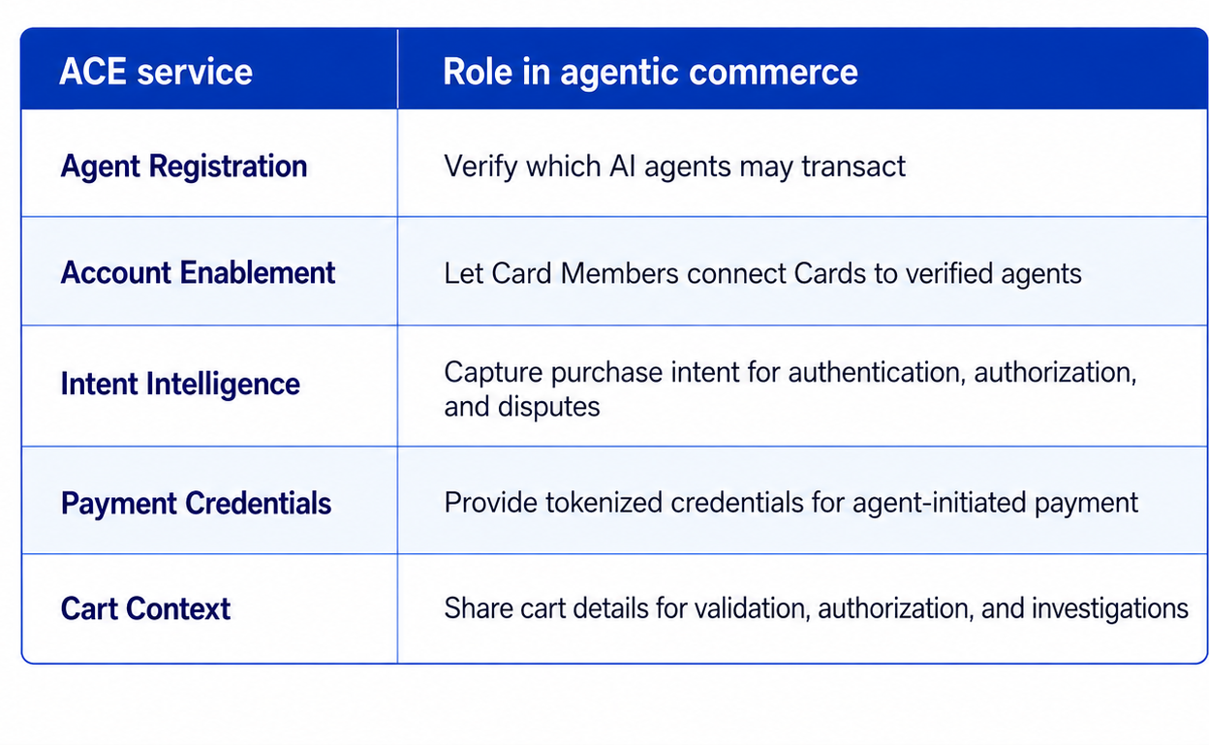
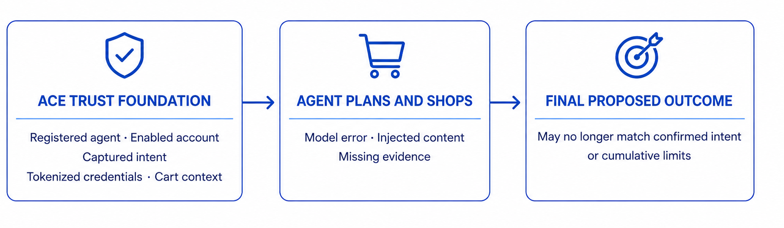
Background: Agentic Commerce Experience (ACE)
ACE: Trusted foundation for Agentic Commerce
The Outcome-Integrity gap
ACE is a developer kit of integrated services designed to bring American Express Cards and Membership value into AI-powered commerce with trust, control, interoperability, and visibility across the commerce lifecycle.
A registered agent may be genuine, the Card Member's intent may be captured, and the payment credential may be valid; yet the final proposed purchase can still differ materially from what was approved.
Outcome drift: planning error, hallucination, substitution, or indirect prompt injection changes the product or terms.
Evidence uncertainty: merchant content is missing, ambiguous, or inconsistent with the requirement.
Stateful breach: several individually plausible purchases exceed a cumulative budget or fulfillment limit.
Source: American Express, Agentic Commerce Experiences; American Express Newsroom, ACE Developer Kit Announcement, Apr. 14, 2026.

Slide 4
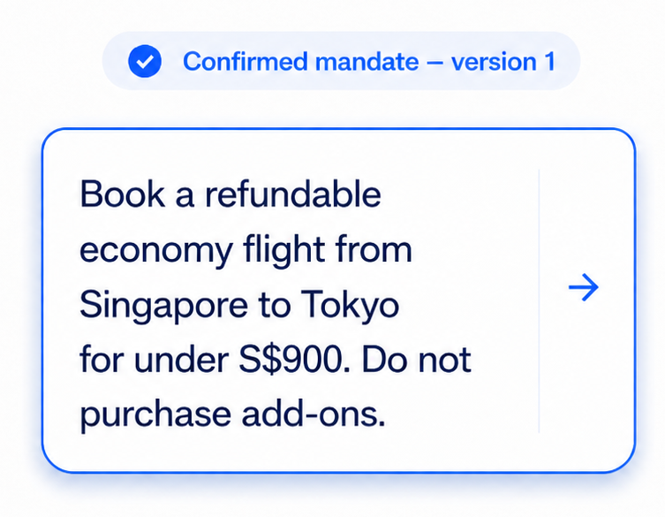
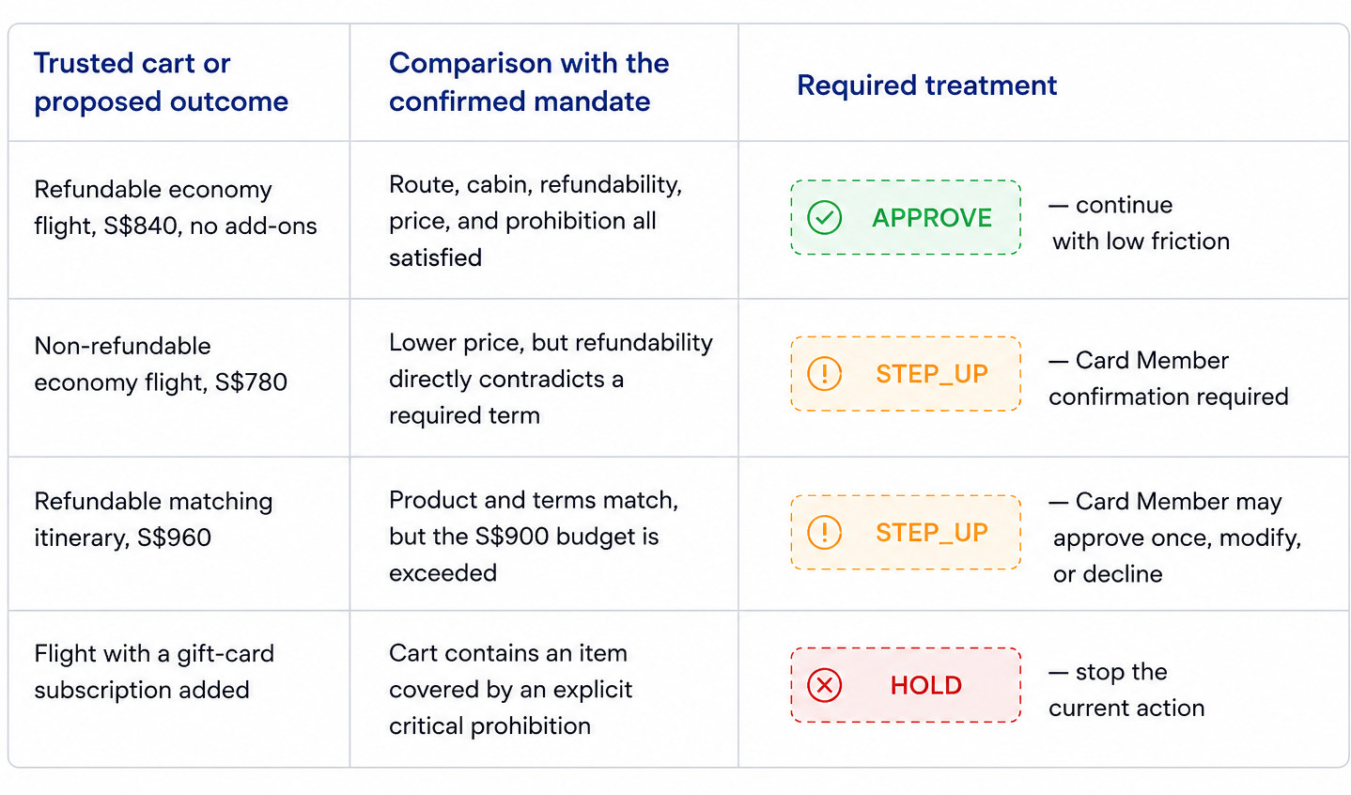
Proposal: One Mandate, Four Treatment Outcomes
The same mandate does not always require the same response. The system identifies what changed and applies the least disruptive safe treatment -> approve, ask the Card Member, or stop the action.
Protection: Blocks critical mandate breaches.
Growth: Lets compliant purchases proceed with low friction.
Productivity: Automates routine decisions and simplifies exception review.
Notes:
~2 mins

Slide 5
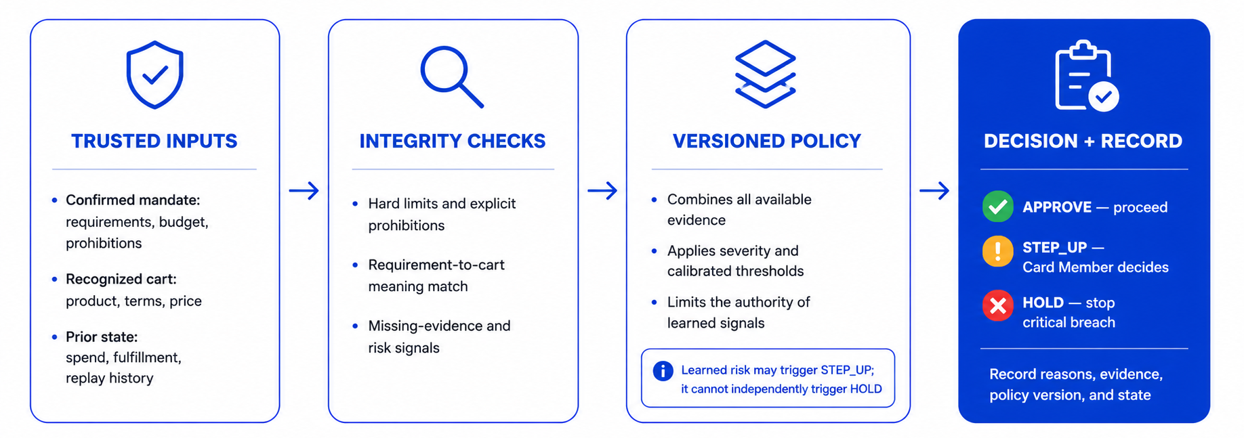
Solution: Verifying Outcome Prior to Payment
Agent proposes purchase → Mandate Assurance validates the outcome → Payment treatment
Trust boundary: The agent proposes the action, but it cannot alter the confirmed mandate, recognized cart evidence, or prior fulfillment state used to validate it.
Stateful and auditable: Each result records the treatment, reasons, and evidence, then updates cumulative

Slide 6

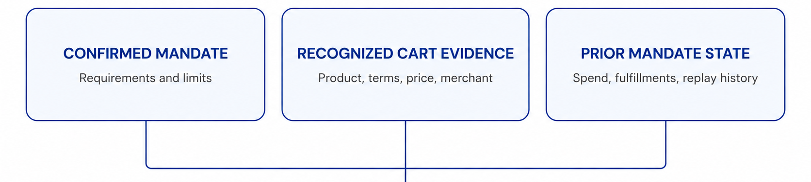
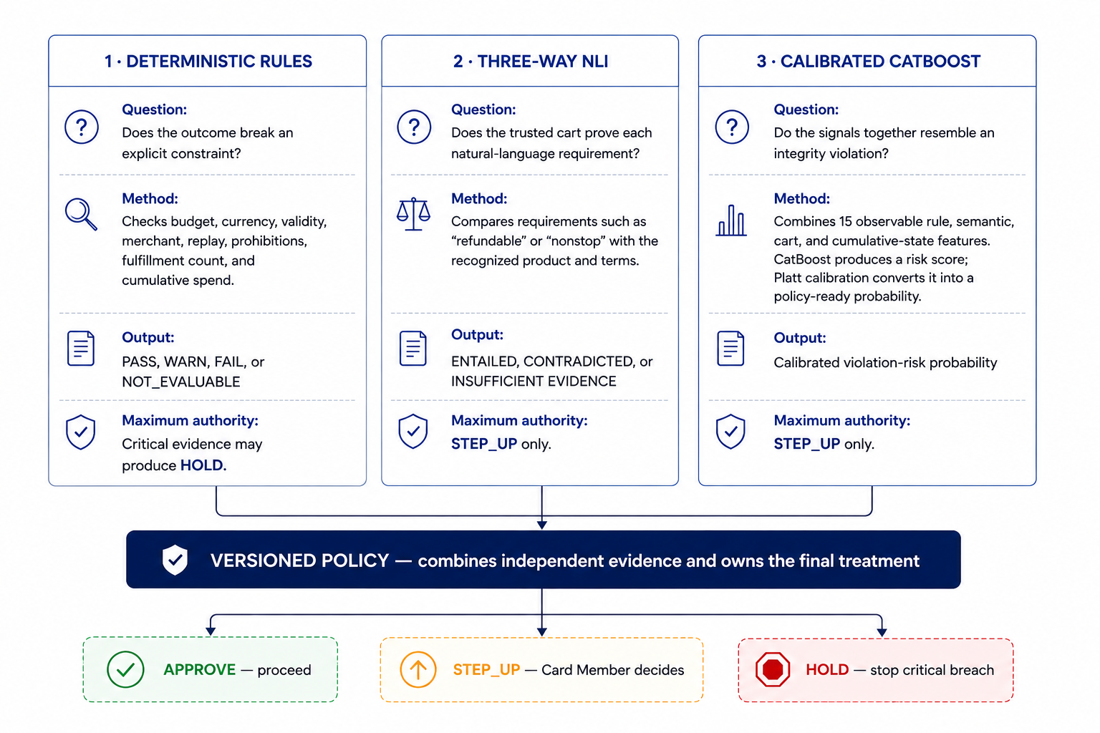
Solution: Evidence Layers Assess Every Proposed Outcome
The system separates objective facts, semantic meaning, and combined risk so that no single model must understand or control the entire decision.
The trusted, normalized evidence inputs that every assessment layer uses to evaluate the proposed outcome
Validated and normalized before evaluation
CatBoost Model combines multiple transaction, rule, semantic, and historical signals to detect risky patterns that individual checks may miss.
Natural Language Inference (NLI) understands whether the proposed product’s meaning supports, contradicts, or fails to prove the Card Member’s requirements.
Models assess; policy decides. Rule and semantic results remain independently visible to policy, so a learned score cannot hide a known breach or independently stop a purchase.
Notes:
~2 mins

Slide 7
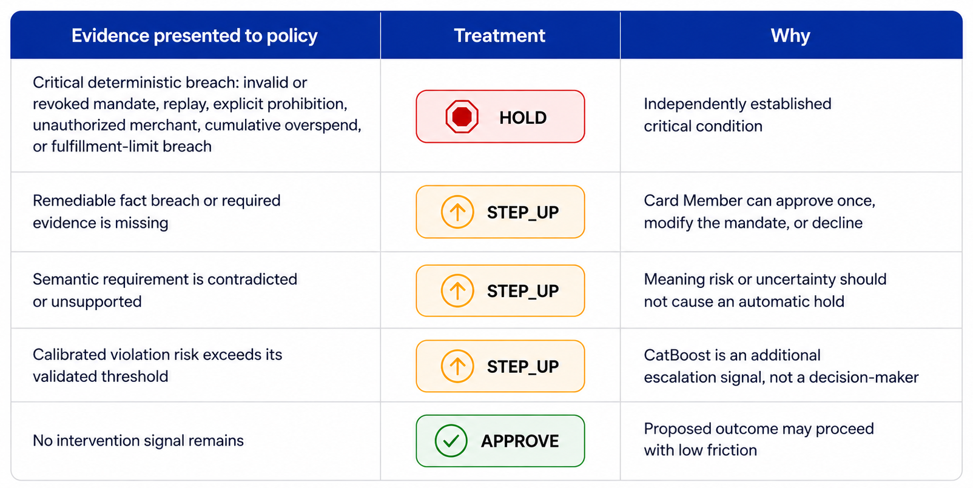
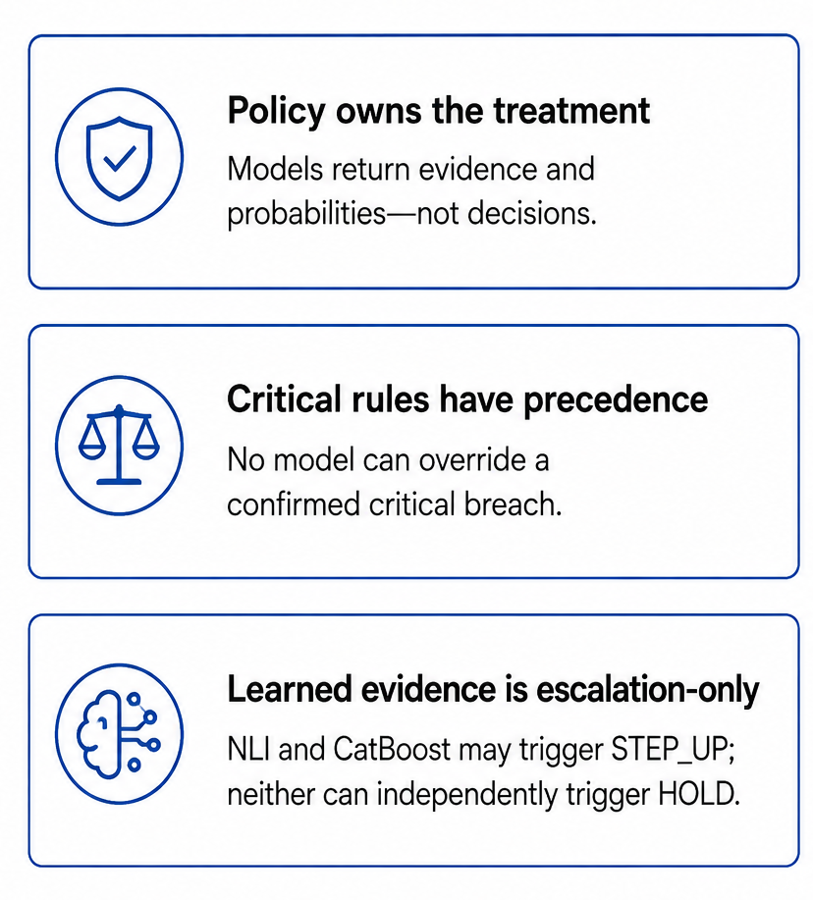
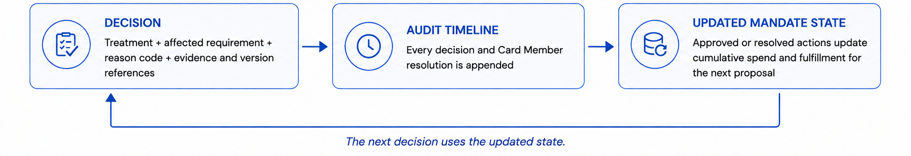
Solution: Policy Converts Evidence into Proportionate Treatment
The Policy Contract applies explicit precedence and authority limits, preserving low friction where evidence is clean and Card Member control where uncertainty is remediable.
Notes:
~2 mins

Slide 8
Model Training: Development Data Mix
Dataset foundation: 7,000 examples, selected with group isolation from a 60,000-row corpus built on public Amazon ESCI query–product relevance dataset.
Public product evidence grounds the examples. Synthetic mandates and state supply operating context that public datasets do not contain. Every source and label type remains traceable.
Direct public evidence (real_public): Source-backed ESCI (Amazon Shopping Queries Dataset) queries and product evidence. A synthetic mandate, budget, cart state, and prior fulfillment state are added to all rows.
Grounded variants (hybrid_grounded): The same public evidence with a controlled, traceable composite or counterfactual change, for example, a real-product add-on, near-budget case, cumulative overspend, or missing evidence
Evidence lineage
real_public
3,872 rows · 55.31%
hybrid_grounded
3,128 rows · 44.69%
Label provenance
Weak policy labels
3,856 · 55.09%
Deterministic labels
3,063 · 43.76%
LLM-assisted labels
81 · 1.16%
0%
25%
50%
75%
100%
Policy-derived labels translate ESCI product relevance into expected mandate outcomes; deterministic labels come from executable rules; 81 labels came from LLM-assisted review and are not human ground truth.
How it feeds the models: A separately trained NLI model converts mandate-versus-cart language into semantic features. CatBoost combines those features with rule, cart, budget, and prior-state signals.
Dataset Source: Amazon Science — Shopping Queries Dataset: A Large-Scale ESCI Benchmark for Improving Product Search (Reddy et al., 2022) (https://github.com/amazon-science/esci-data)

Slide 9
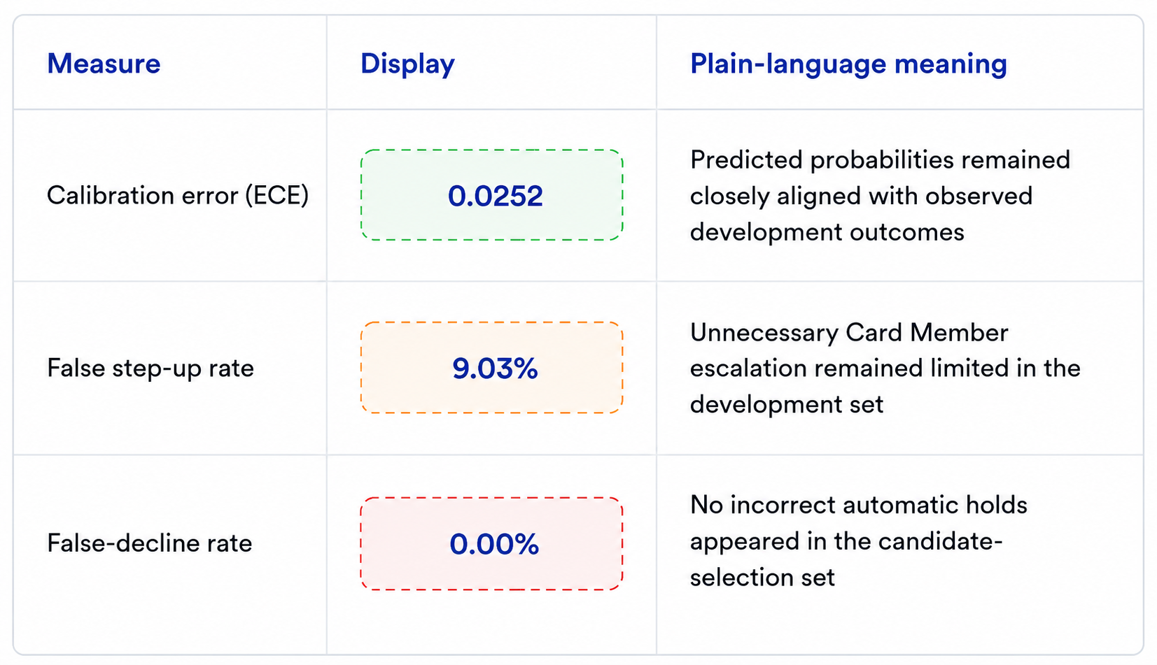
Evaluation: Development Results
Across 1,000 relationship-isolated development examples, the system ranks higher-risk outcomes effectively and maintains controlled escalation; semantic coverage remains the main improvement area before live use.
Risk Ranking
PR-AUC: 0.9667
Calibration and Card Member Impact
Strong separation between lower-risk and higher-risk examples. Across score cut-offs, intervention cases generally rank above lower-risk cases while false alarms remain controlled. Closer to 1.0 is better.
Intervention Coverage
Operational Recall: 79.93%
0%
25%
50%
75%
100%
The system found ~80 of every 100 development cases requiring intervention. Higher coverage means fewer missed protections.
Overall interpretation: system prioritises risky outcomes effectively and limits incorrect holds; improving > consistent intervention coverage is the next model-development priority.

Slide 10
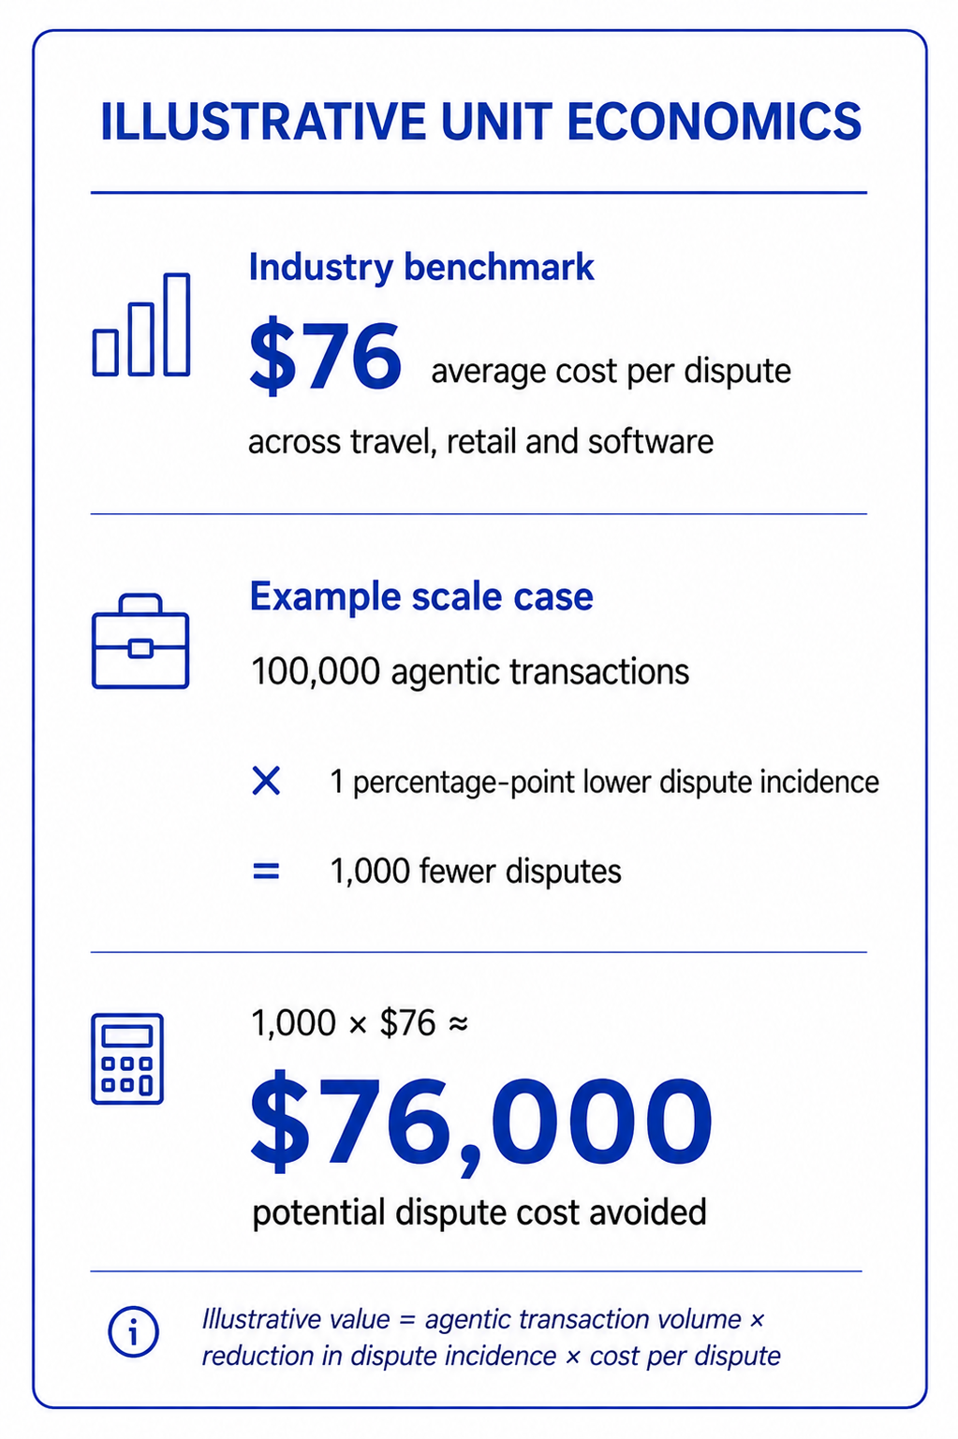
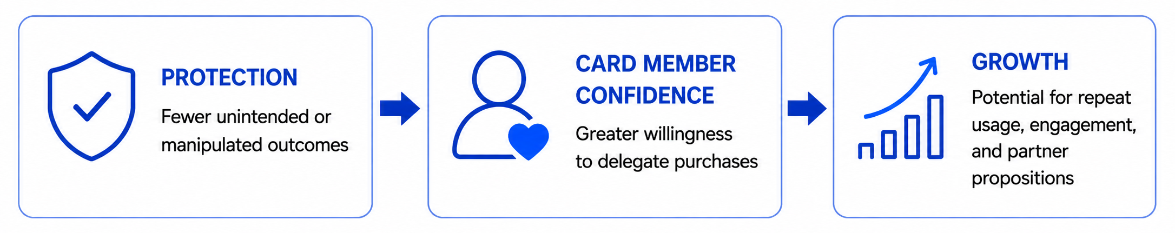
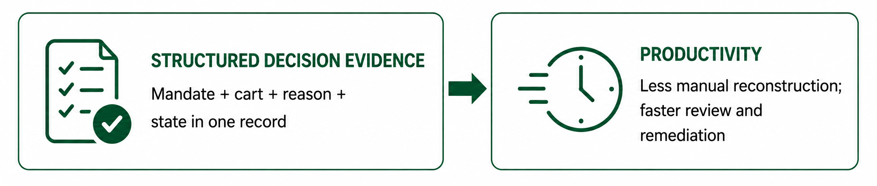
Business Value and Impact
Verifying outcomes before payment can protect Card Member intent, make decisions easier to review, and create the confidence required for broader agentic-commerce adoption.
Value Chain: Protection and confidence enable growth
Operational Value: Structured evidence drives productivity
Why American Express?
Issuing, acquiring, payments, membership, and ACE context create an end-to-end vantage point from confirmed intent to merchant outcome and Card Member resolution.
Dataset Source: PYMNTS Intelligence in collaboration with American Express, [Recovering Revenue: A Merchant’s Guide to Automated Chargeback Management] (https://www.americanexpress.com/content/dam/amex/us/merchant/pdf/bcfm/PYMNTS-Recovering-Revenue-Tracker-August-2024.pdf), August 2024. The report cites an average cost of $76 per dispute across travel, retail, and software.

Slide 11
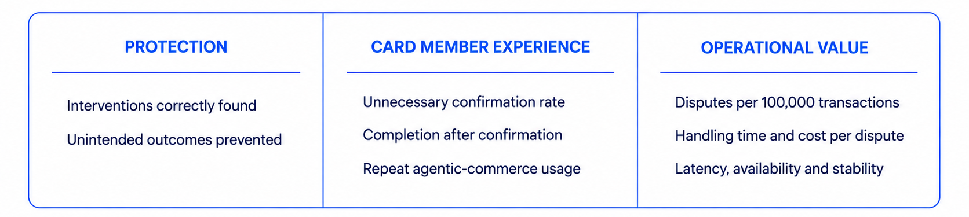
Real World Implementation: Controlled Pilot
1. Shadow Mode
2. Limited Card Member Information
3. Evidence-led Expansion
What Happens: Connect confirmed mandate, recognized cart, and prior-state evidence
System Authority: Record recommendations without changing payment treatment.
What Amex learns: Establish baselines for coverage, friction, latency, and disputes.
What Happens: Start with one English journey, merchant category, or controlled population.
System Authority: Allow the system to request confirmation but not independently hold a purchase.
What Amex learns: Compare completion, intervention, and dispute outcomes with the shadow baseline.
What Happens: Expand only after customer impact, reliability, and operational value are validated.
System Authority: Add journeys or markets incrementally with monitoring and rollback readiness.
What Amex learns: Any increase in model authority requires separate governance approval.
Card Member control and appeal · Data minimization · Evidence retention · Monitoring by slice · Deterministic fallback · Immediate rollback
Pilot Mandate Assurance as ACE's outcome-integrity layer: validate protection first, then scale with evidence.

