Slide 1
AI FOR GOOD · EDUCATION · ACCESSIBILITY
Phloem
AI Learning Companion for learners who understand by listening and speaking.
Aaryan Kandiah
Project: Phloem
Maker: Aaryan Kandiah
Demo: https://db0697e89cd74ce696d44f72edfcc11d.ap-singapore.myide.io/
Core AI: Z.ai GLM-5.1 · OpenAI vision & STT · Google/OpenAI/browser TTS
Notes:
Open with the simplest version of the value: Phloem turns a page into a spoken tutoring loop for people who can't comfortably learn from dense text-first tools.

Slide 2
THE PROBLEM
Many learners understand spoken explanations,
but get blocked by written materials.
01
02
03
04
ESL & EFL
Dyslexia
Young & Low-Literacy
Solo Studiers
Learners studying in a non-native language
Students who face reading difficulty
Learners who need patient guidance
People studying alone without a tutor beside them
Existing tools translate or answer. They rarely facilitate learning.
PHLOEM
Notes:
Frame this as an access problem, not just a tutoring convenience. Reading-heavy AI tools still assume the learner can read the interface and prompt well.

Slide 3
OUR INSIGHT
Use the camera, ears, and voice — not reading fluency.
1
Show or upload a learning page
2
AI extracts topic, text & diagram context
3
Tutor gives spoken Socratic guidance
4
Learner answers aloud
5
Phloem scores a retrieval check & updates progress
Phloem is a voice-first tutor that reads a page, teaches it through guided questions, and tracks whether the learner actually understood.
PHLOEM
Notes:
This slide should make the product feel inevitable: the target user needs less reading, more listening, and a tutor that asks one small question at a time.

Slide 4
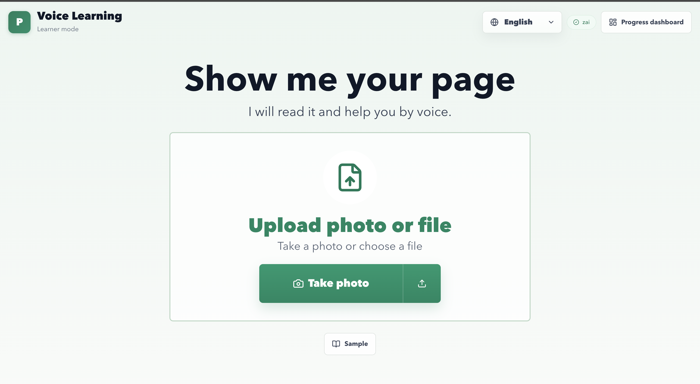
One learner. One page. One spoken question.
01
Start on Voice Learning
02
Click Upload Photo or File
03
"What do plants need for photosynthesis?"
🖼 IMAGE PLACEHOLDER
04
Show spoken tutor answer + speech trace
One-button voice tutor screen
05
Answer follow-up: "Carbon dioxide"
06
Open Progress — concept update appears
One learner, one page, one question, one progress update.
PHLOEM
Notes:
Keep the live demo focused. Don't tour every sidebar. The strongest story is one learner, one page, one spoken question, one progress update.

Slide 5
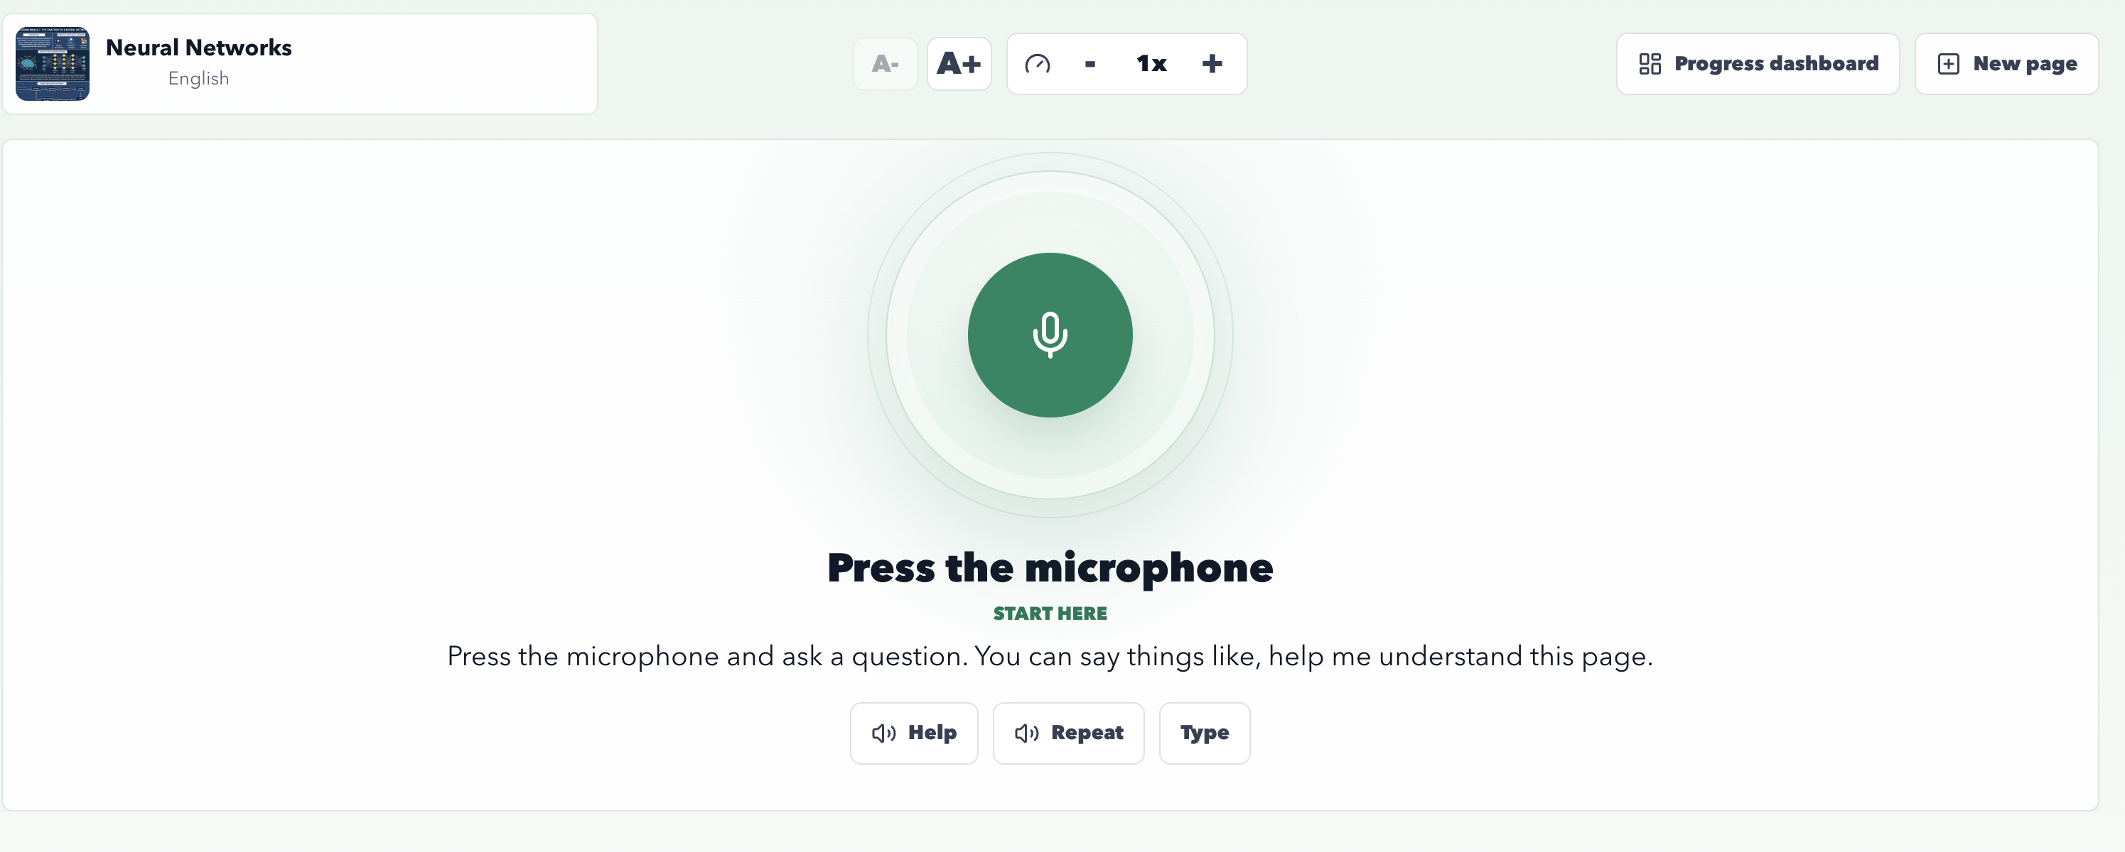
HUMAN-CENTERED DESIGN
Designed around listening — not reading.
✓
One target
Single centered upload or photo capture
✓
One mic
Central microphone affordance — nothing to hunt for
✓
Minimal actions
Help, Repeat, Type, Skip
🖼 IMAGE PLACEHOLDER
✓
Spoken-friendly
Large, readable tutor text
Voice Learning first screen
✓
Learner controls
Tutor voice speed and text size
✓
For caregivers
Progress dashboard available, never in the way
PHLOEM
Notes:
Tie this directly to the judging sheet's human-centered design category. This is not a generic chatbot UI. It is designed around learners who may not want to read a dense interface.

Slide 6
VOICE LEARNING + FULL DASHBOARD
Two modes, one learning loop.
Phloem keeps the learner experience simple without hiding the system's depth.
VOICE LEARNING
For the learner
Default first-run mode
One-page capture flow
Central microphone interaction
Spoken tutor response with speech trace
Minimal escape hatches: Help, Repeat, Type, Skip
PHLOEM
Notes:
Use this slide to show that simplicity for the learner doesn't mean a shallow product. The same tutor lives behind both modes — the difference is how much UI surface is exposed. Voice Learning hides everything but the next action. Full Dashboard surfaces sessions, materials, conversation, progress, and settings for the people who need them.

Slide 7
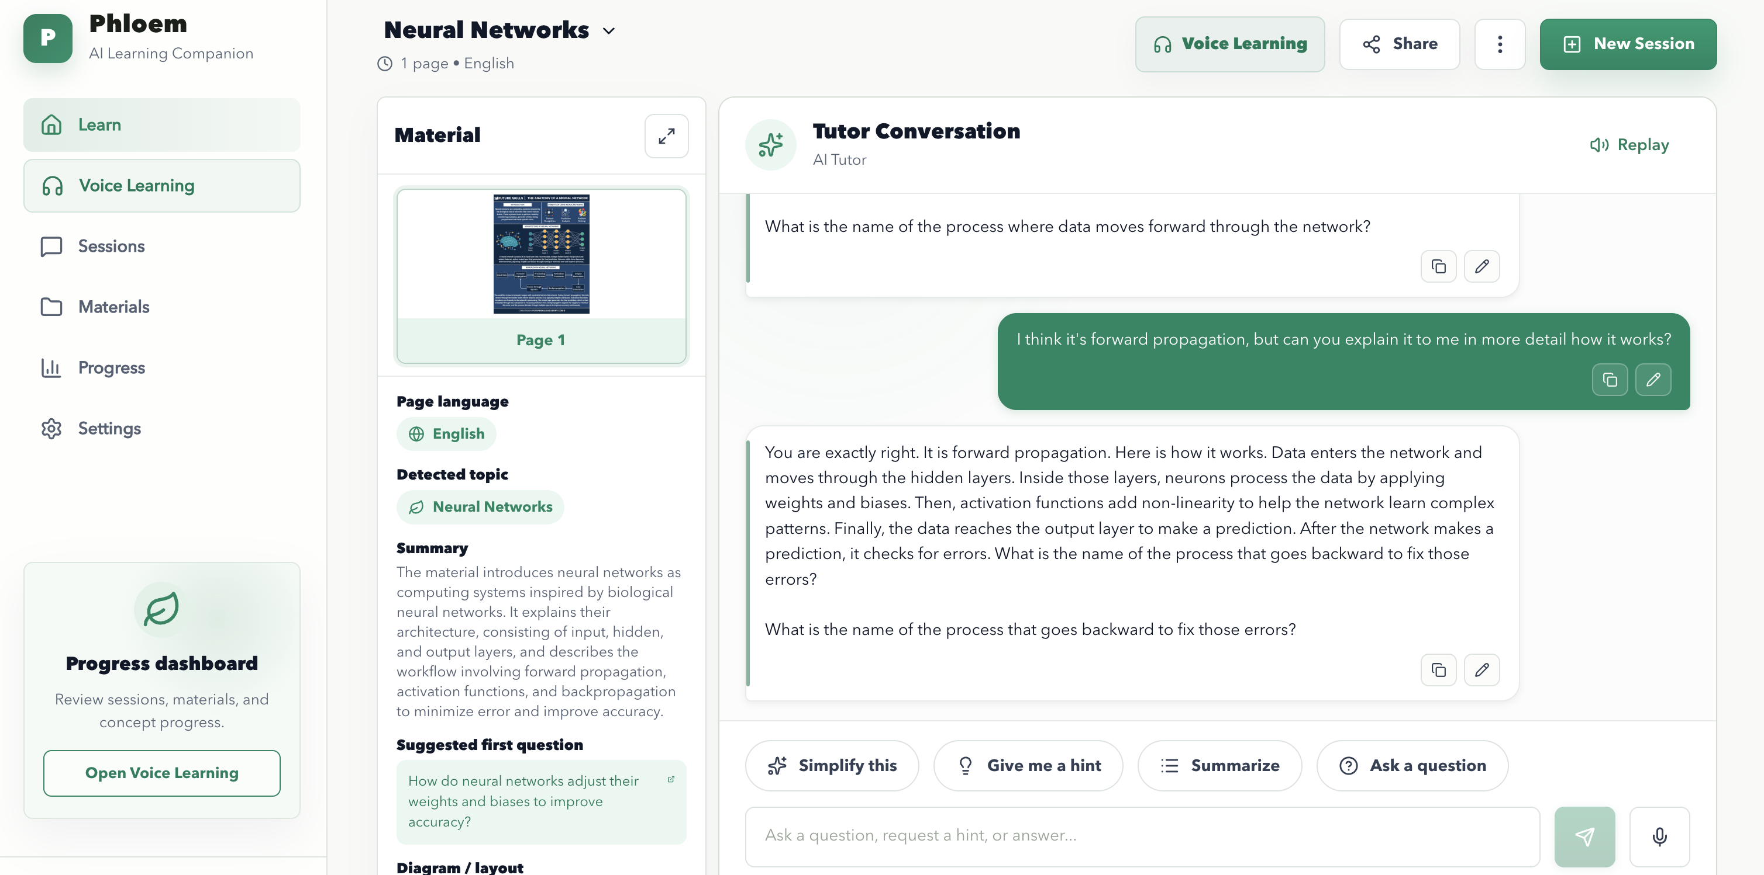
VOICE LEARNING + FULL DASHBOARD
Two modes, one learning loop.
Phloem keeps the learner experience simple without hiding the system's depth.
FULL DASHBOARD
For caregivers & power users
Saved sessions & reloadable history
Materials library with page previews
Conversation panel with copy/edit controls
Concept progress from retrieval checks
Settings: language, voice, speed, TTS usage
Why this matters: the same AI tutor supports accessibility-first learners and the adults or power users who need visibility, review, and control.
PHLOEM
Notes:
Use this slide to show that simplicity for the learner doesn't mean a shallow product. The same tutor lives behind both modes — the difference is how much UI surface is exposed. Voice Learning hides everything but the next action. Full Dashboard surfaces sessions, materials, conversation, progress, and settings for the people who need them.

Slide 8
REAL AI INTERACTION
Real AI calls across every step of the learning loop.
VISION
STT
TUTOR
OpenAI GPT-4o
GPT-4o-transcribe
Z.ai GLM-5.1
Reads images & rendered PDF pages
Turns voice into text
Structured Socratic responses
EVALUATOR
TTS
TURN
Z.ai GLM-5.1
Chirp 3 HD · OpenAI · Browser
Silero VAD + Smart Turn
Scores got-it / needs-practice / confused
Spoken output with fallbacks
Detects when the learner stops talking
Not a scripted chatbot. The AI reads source material, responds to learner turns, evaluates answers, and adapts memory.
PHLOEM
Notes:
The hackathon rubric specifically rewards meaningful real-time AI interaction. Say clearly that this is not a hardcoded Q&A demo: the AI reads source material, responds to learner turns, evaluates answers, and adapts memory.

Slide 9
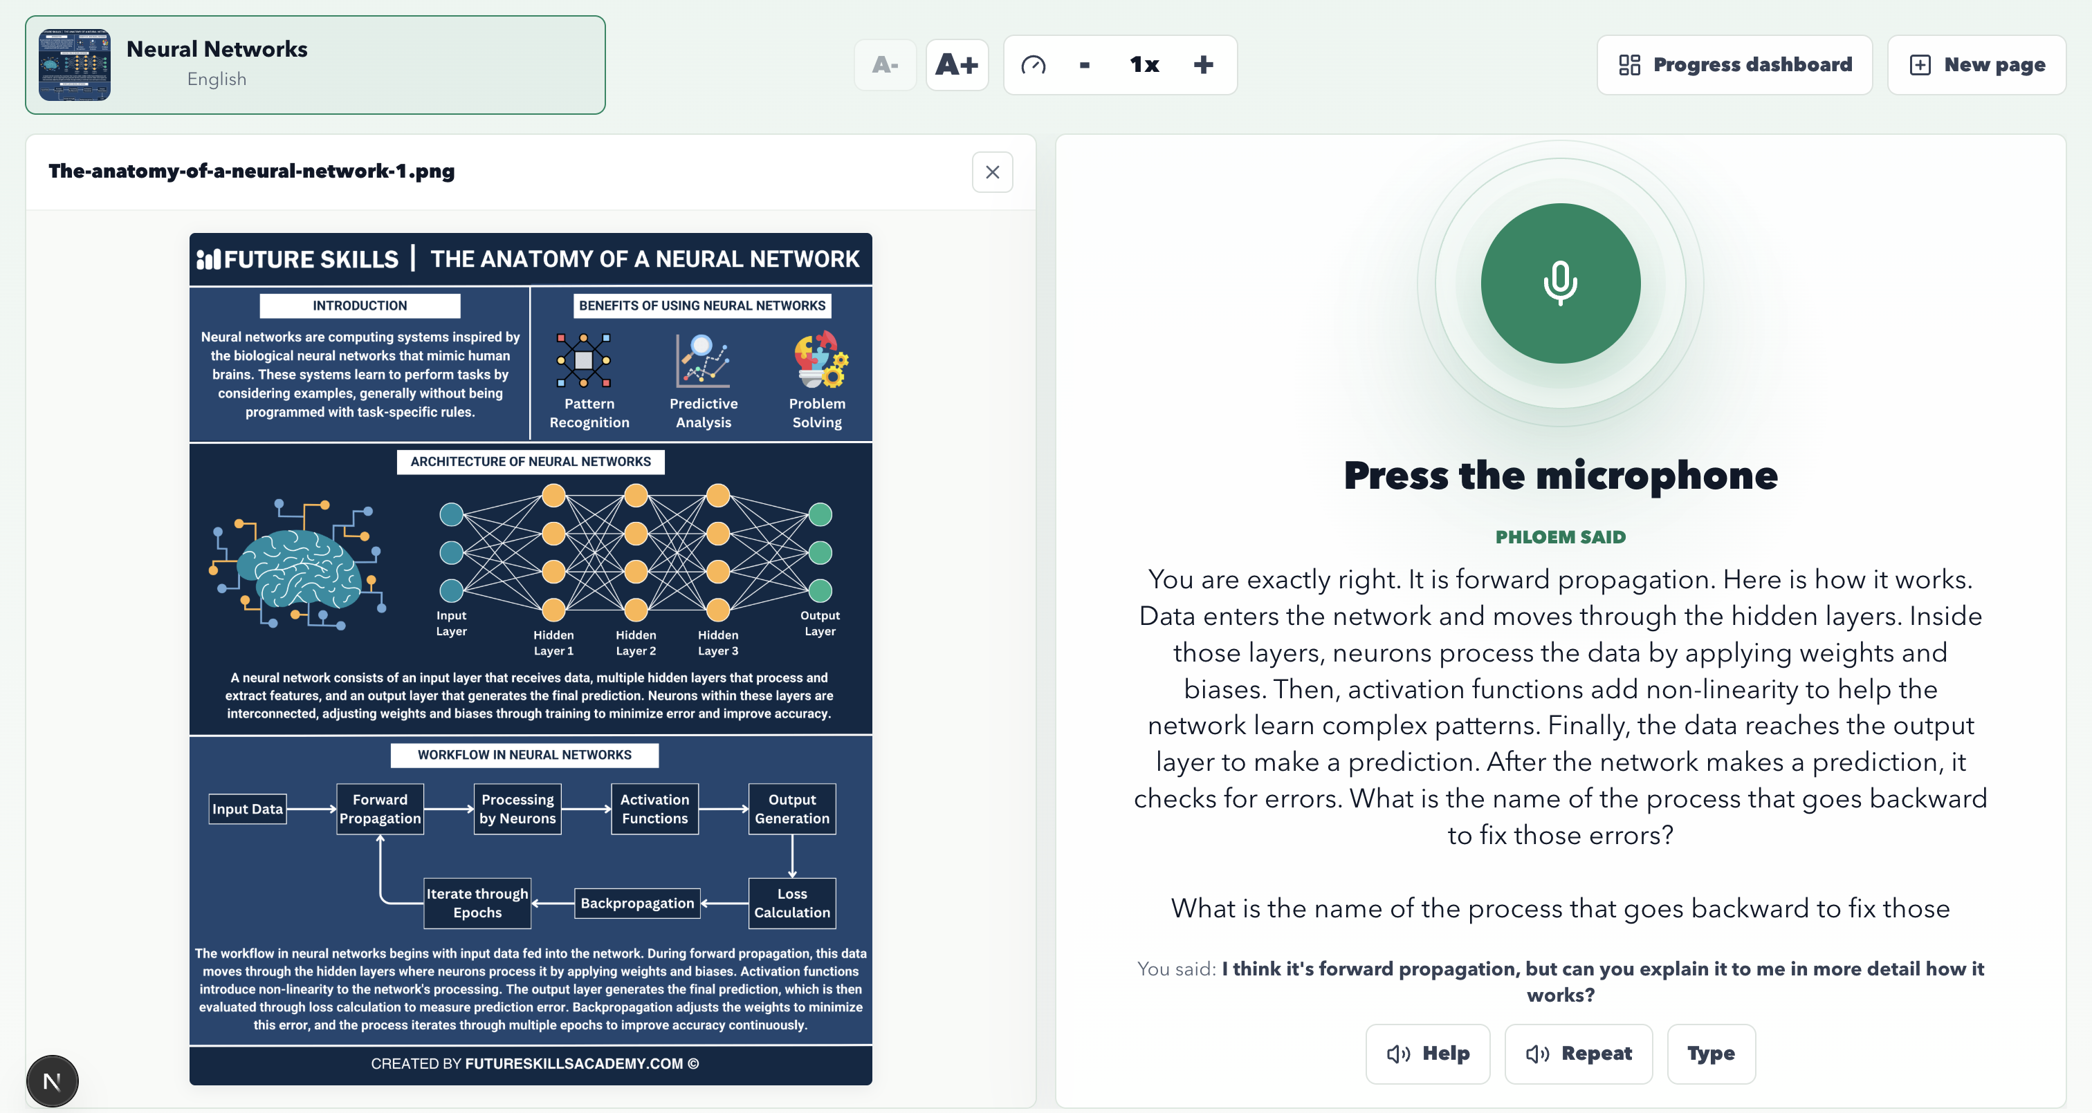
THE SOCRATIC TUTOR LOOP
Teach thinking before revealing answers.
01
Teach thinking before revealing final answers
02
Use short, spoken-friendly sentences
03
Ask exactly one focused follow-up question
🖼 IMAGE PLACEHOLDER
04
Adapt to low, medium, or high understanding
Spoken tutor response with speech trace
05
Honor direct-answer mode only when allowed
06
Treat uploaded material as untrusted context
PHLOEM
Notes:
Show the response and highlight that the tutor does not just dump an answer. It explains the idea in small pieces, then asks a retrieval question.

Slide 10
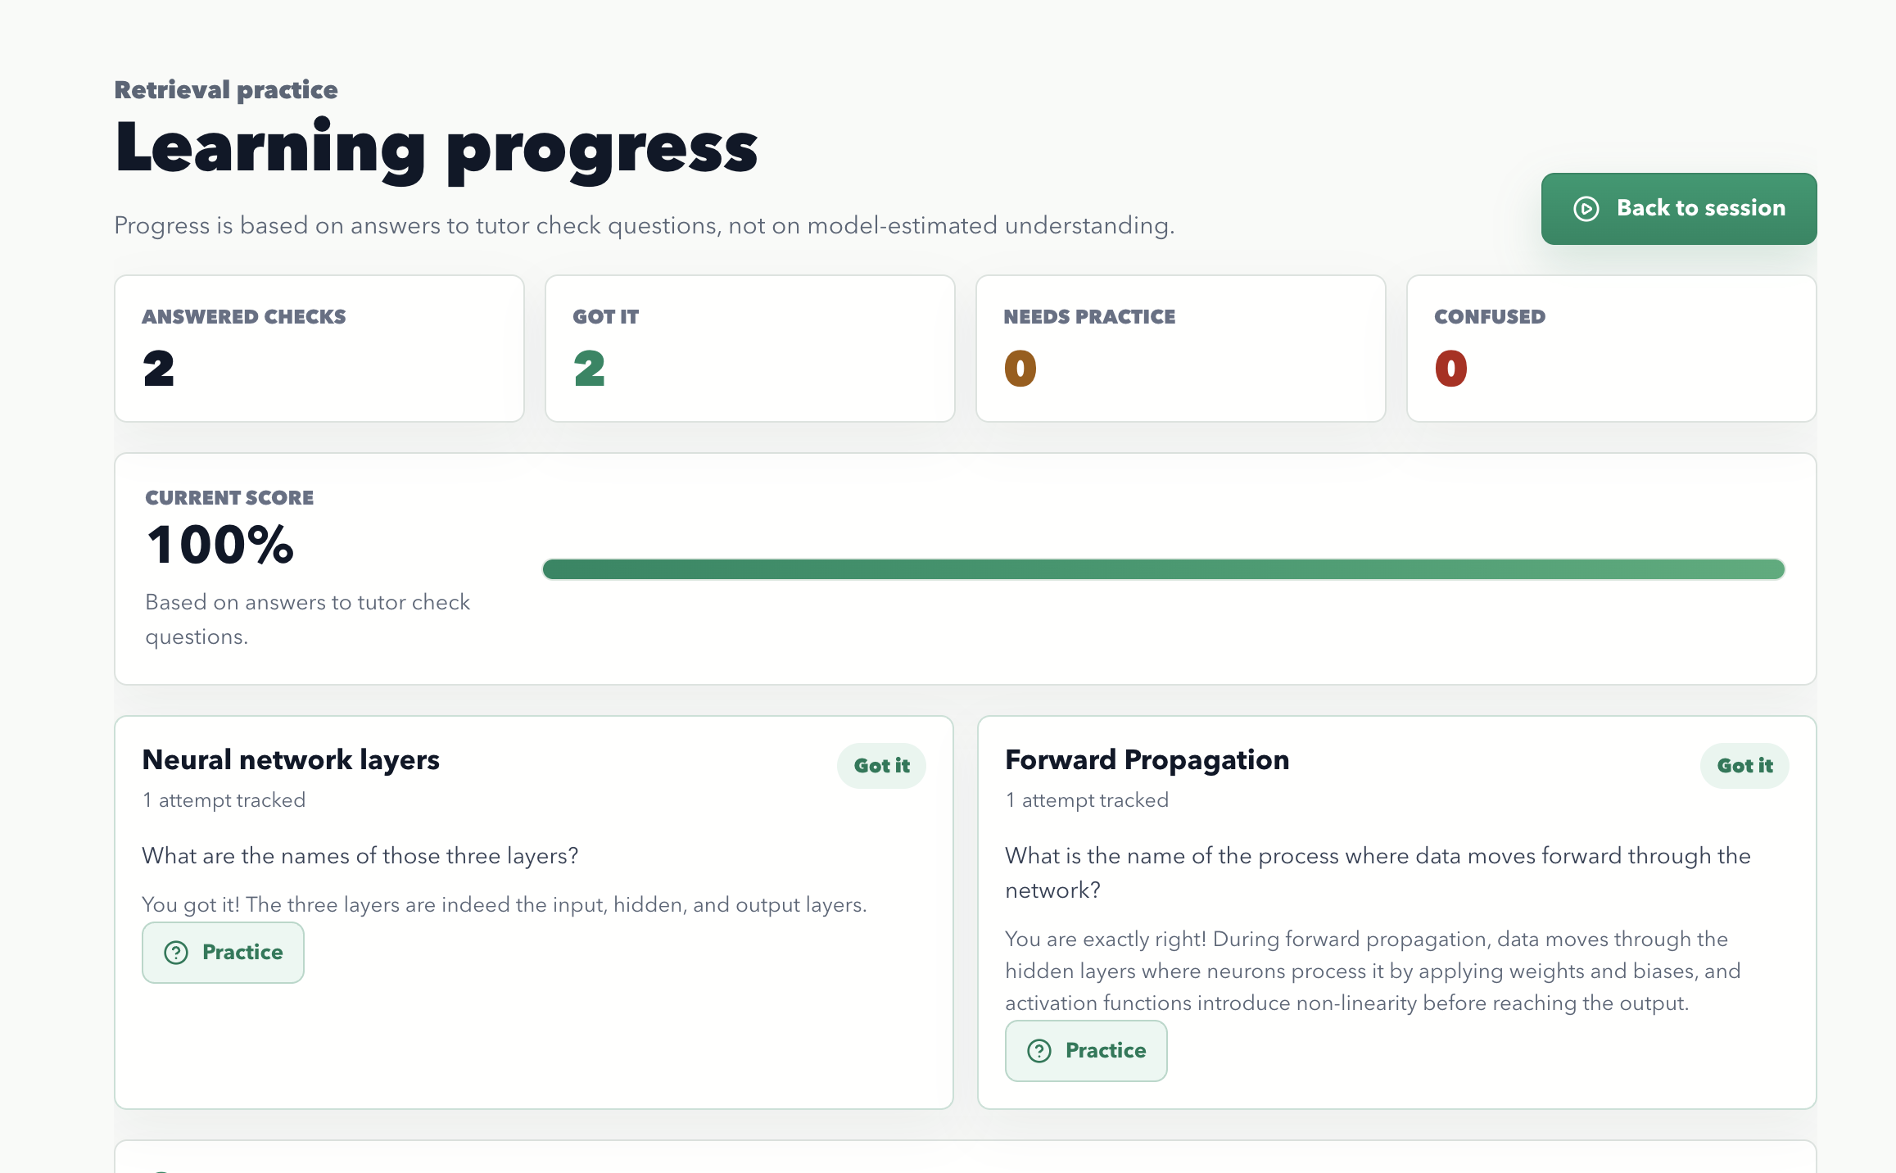
MEASURING UNDERSTANDING
Evidence over vibes.
Phloem separates what the model thinks from what the learner actually demonstrates.
1
Tutor answer creates a check
↓
2
Check appears after speech finishes
↓
3
Learner answers by voice or text
🖼 IMAGE PLACEHOLDER
↓
Active progress check in Voice Learning
4
Evaluator scores the answer
↓
5
Concept mastery updates
PHLOEM
Notes:
This is the learning-effectiveness moment. Judges should understand that progress is based on the learner's answer, not vibes from a chat transcript.

Slide 11
PROGRESS DASHBOARD
A learning record — not just a chat transcript.
Answered
Got-it
CHECKS COUNT
TOTALS
Needs Practice
Confused
🖼 IMAGE PLACEHOLDER
TOTALS
TOTALS
Phloem learning progress dashboard
Score
History
CURRENT MASTERY
RECENT CHECKS
PHLOEM
Notes:
Use this slide to prove the prototype closes the loop. It is not only capture and conversation. It has a learning record that can become spaced review.

Slide 12
TECHNICAL EXECUTION
A functional Next.js + TypeScript app.
API Routes
Vision · tutor · evaluation · STT · TTS · sessions · materials · progress
Validation
Zod across request bodies and model outputs
Resilient parsing
Robust JSON handling for LLM responses
Document ingestion
PDF & DOCX extraction + rendered page images for OCR
Persistence
Supabase: sessions, materials, messages, memory, checks, mastery, TTS usage
Graceful fallbacks
When Supabase, Smart Turn, or paid TTS providers are unavailable
PHLOEM
Notes:
This slide should answer technical-execution concerns. Mention that the demo can run with sample content, but the architecture is wired for real providers and persisted learning history.

Slide 13
CLOSING
Phloem changes the default learning interface.
FROM
TO
reading and prompting
→
showing, listening, speaking, practicing
Phloem helps learners understand the page in front of them — one spoken step at a time.
Thank you.
Notes:
End on impact, not the stack. The stack matters because it makes the learner outcome possible.

