Slide 1
ROAD ACCIDENT VISUALIZATION
By Aaryan

Slide 2
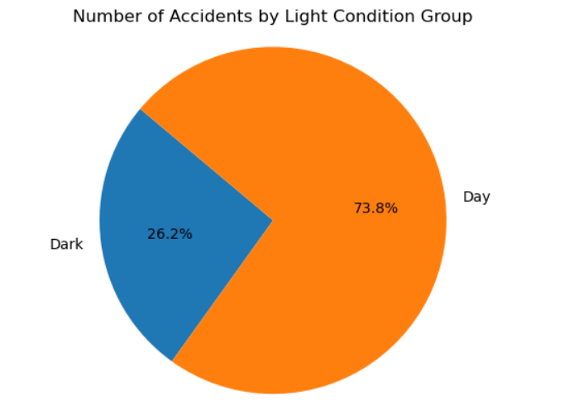
Light Conditions (Pie Chart)

Slide 3
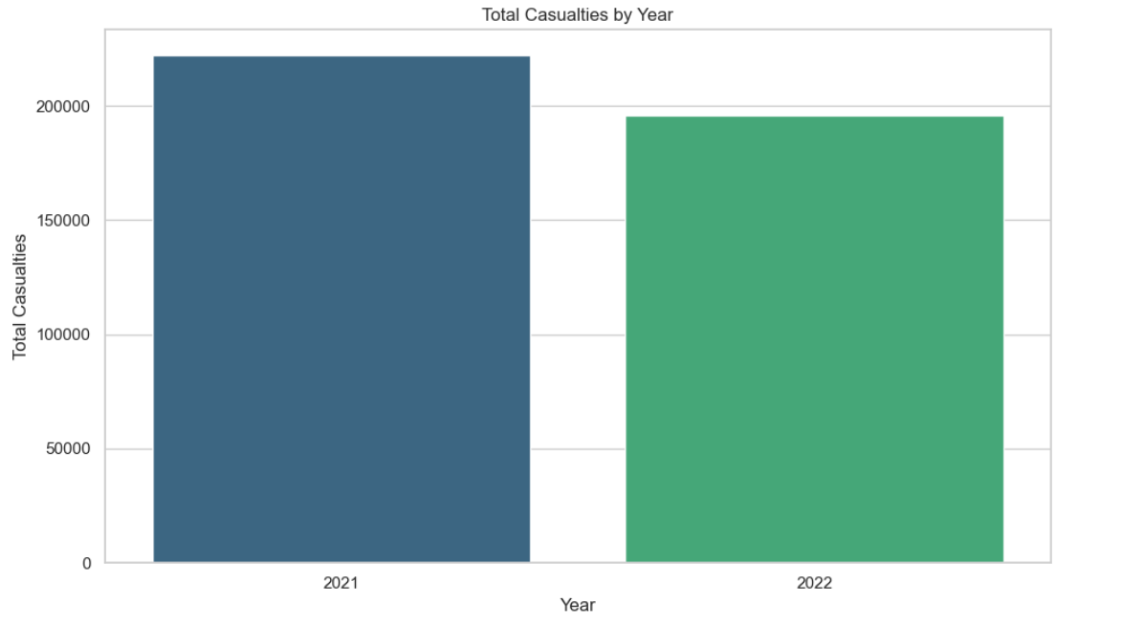
Accident Date (Bar Chart)

Slide 4
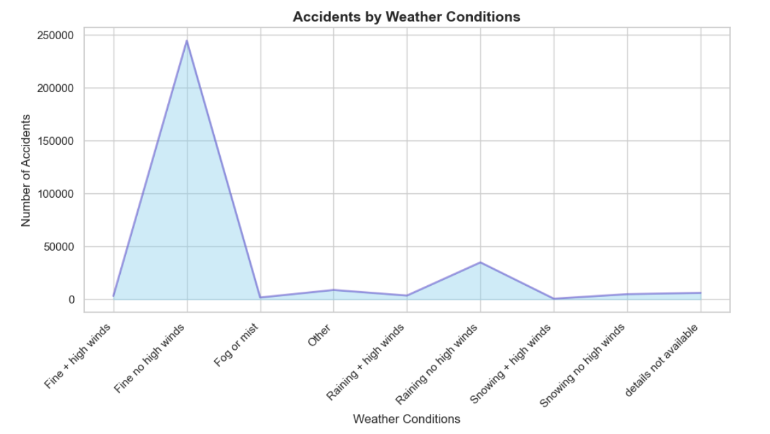
Weather Conditions (Area Chart)

Slide 5
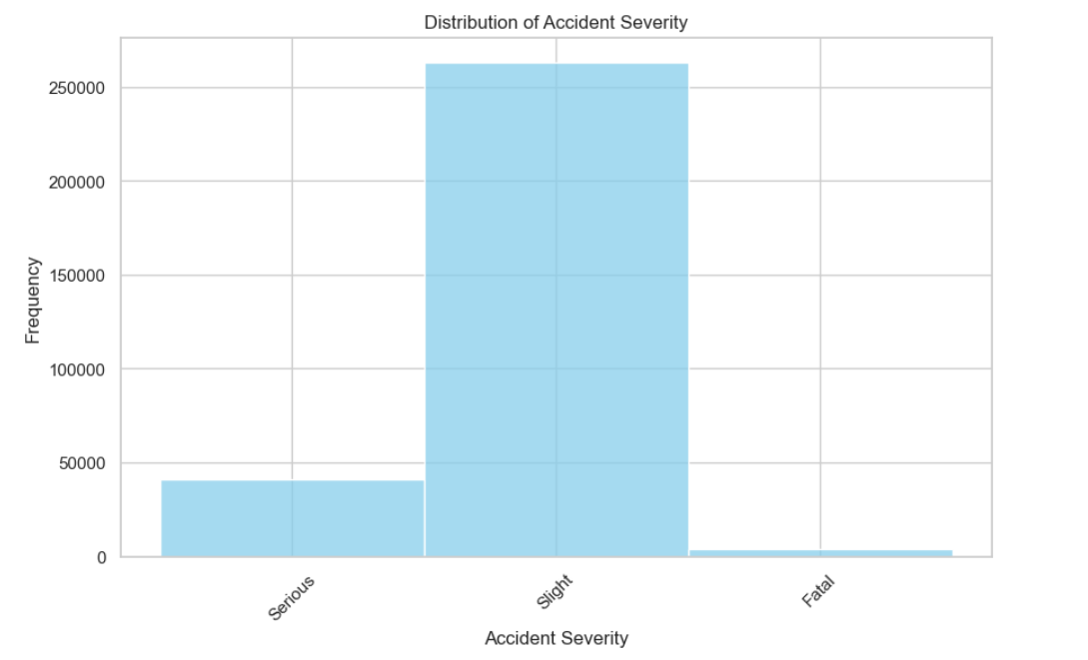
Accident Severity (Histogram)

Slide 6
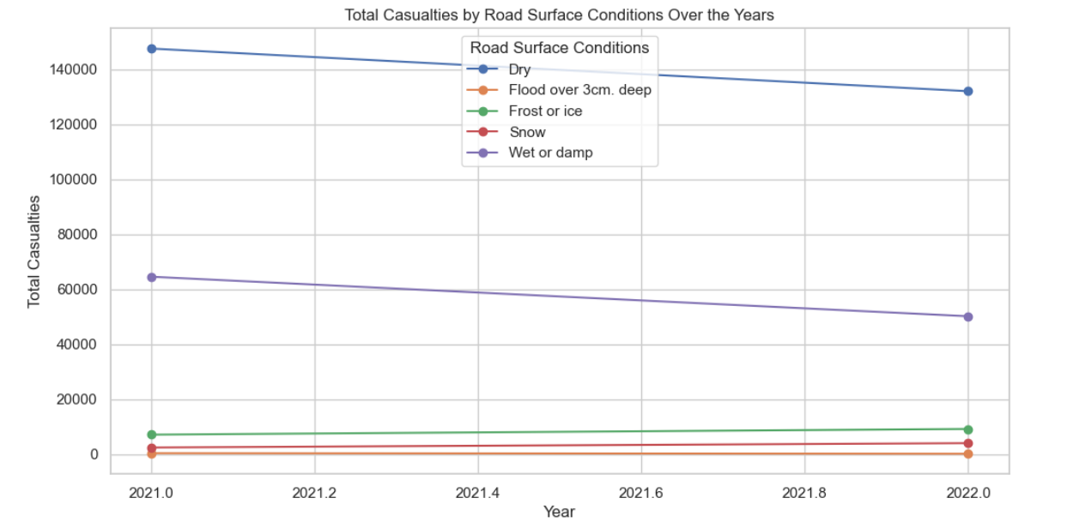
Road Surface Conditions (Line Chart)

Slide 7
THANK YOU

